Slide 1

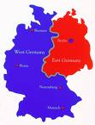
The last four hundred years
Free market
State control
Liberal
Democracy
Totalitarianism
America
Korea
China
Travels
WEST
Travels
EAST
British Empire
Fascism
Britain
Russia
Nazism
Protestantism
Communism
Germany
Martin Luther
1517
Karl Marx
1848
Notes:
1

Slide 2
What happened to the
Jews of Europe?
Notes:
Final Solution: The Fate of the Jews 1933-1949 by David Cesarani, review: 'authoritative and urgent' Medical examination of Jewish refugees in the Netherlands, autumn 1938Medical examination of Jewish refugees in the Netherlands, autumn 1938 CREDIT: THE WIENER LIBRARY, LONDON Sarah Helm 14 FEBRUARY 2016 • 7:00AM
Early in what he calls his “reappraisal” of Adolf Hitler’s Final Solution, David Cesarani details the absurdity of an earlier “solution” to the “Jewish question”. In May 1940, nine months into the war, Hitler still had no concerted plan for ridding Europe of its Jews, particularly the two million Polish Jews who had come under his rule since the invasion of Poland in 1939. When the SS chief, Heinrich Himmler, produced “some thoughts”, including “the large-scale emigration of all Jews to Africa or some colony”, the idea was seized on. The imminent defeat of France meant French colonies would soon become available, including the island of Madagascar, which was to be turned into “an open-air prison… like a parody of the Zionist enterprise in Palestine”. The transfer could start within a month, with millions of Jews sent by ship. Such was the Germans’ confidence that the building of ghettos in Poland was halted, and the SS started learning Swahili. Madagascar, like so many other improvised “solutions”, was a non-starter, not least because 25,000 French still lived there and no Axis ships could reach it through the British-controlled sea lanes. Once France collapsed, Hitler believed, Britain would sue for peace. But Hitler’s “ham-fisted” offers didn’t even warrant a response from Winston Churchill and, Cesarani writes, the Germans were left “to continue to fumble their way towards a solution according to their racial-biological precepts, but under circumstances they could not entirely control”. This detailed presentation of the Madagascar episode gives an early taste of the form Cesarani’s “reappraisal” takes. Over the next 800 pages, he traces a path across a vast mass of material – new and old – demonstrating with urgency and verve how Hitler’s progress towards mass extermination of the Jews was never pre-planned or preordained. This tale of false starts and botches finally leads to the building of the gas chambers; far from being conceived on an industrial scale, they were themselves, at first, “jerry built”. Cesarani challenges the widely held view that the extermination of the Jews was ever Hitler’s first priority. Of course, his “Jew hatred” was never in question. But his plan for a Europe rid entirely of Jews was always secondary to military aims, and had to be adapted to strategic realities. Under the cover of war, mass slaughter first became possible, but still plans were only “hatched”, “brashly conceived” or “dreamt up”. Even as Himmler’s death squads began to kill off Russia’s three million Jews – 8,200 were shot within the first few weeks – it was “a contest of arms rather than a preconceived agenda for the murder of Jews” that provoked the savagery. By killing hungry Jews, scarce food was also preserved for Aryan mouths. Another fallacy challenged here is that the “Holocaust” was implemented by ranks of well-organised Nazis. Much of the work, Cesarani reminds us, was done by collaborators who were recruited hastily and motivated as much by fear or greed as by anti-Semitism. It is no coincidence that Cesarani doesn’t delve into the monstrous horror of Auschwitz until page 520. By this time, he has already reset the received “lopsided” story of the genocide by recounting in extensive detail how a million Jews were slaughtered – both in the Russian killing fields and in the often sidelined death camps of Treblinka, Belzec and Sobibor – before the Auschwitz gas chambers were fully operating. Indeed, so frustrated is Cesarani with public “misconceptions” that he proposes “retiring” the word Holocaust, which has “passed its sell-by date” due to the false picture it summons of industrialised efficiency. Rather, Cesarani says – apologising for the crassness of the term – it was a “cock-up”, a catastrophe that unfolded in the manner it did because the other paths Hitler’s henchmen might have taken to find a “solution” were closed off. Cesarani is not the first person to challenge the view that the Final Solution was scientifically planned and enacted with industrial efficiency. But, to date, his is the most authoritative and urgent voice to present the story this way – all the more urgent, perhaps, because, as he wrote the last chapters, Cesarani knew this would be his last chance to set the record straight. The acclaimed British scholar died in October at the age of just 58. For me, Cesarani’s reappraisal seems utterly convincing, not least because it fits entirely with evidence I uncovered while working on the story of Ravensbrück, the only Nazi camp built for women. Here, testimony often referred to the “chaos” and “insanity”, to the “nonsensical” and “improvised” nature of the day-to-day rule in the camp. For example, when there were not enough doctors to abort unwanted babies, a sudden decision was taken to let the babies be born, in the sure knowledge that they would starve to death, albeit under their already-starved mothers’ eyes. This sort of story occurs again and again across Cesarani’s vast canvas. However, to my mind his canvas is not wide enough; he barely mentions the non-Jewish victims, holding fast to his own preconceived notion that the slaughter of the Jews should be considered by historians as an entirely separate operation to the slaughter of non-Jews. It is not in dispute that only the Jews were singled out by Hitler for total annihilation on the grounds of their race, and that the number of Jewish dead vastly exceeded non-Jewish deaths. But the suffering of “asocials” – homosexuals, gipsies, Jehovah’s Witnesses and hundreds of thousands of so-called “useless mouths” – was no less than that of the Jewish victims. Moreover, the killers at the camps where most of the non-Jews died were from the same SS stable as the killers at the Jewish death camps; and the Führer’s rationale for ordering these murders was in essence the same – to achieve racial purity. One of Cesarani’s most remarkable achievements is to reinvigorate this monstrous narrative. As he shows again and again, the responses of the Allies to the racial war were also marked from the start by misjudgment, denial and errors. Churchill was advised by the military chiefs against a plan to bomb the gas chambers at Auschwitz, and so backed off. Cesarani clearly believes that the chance to bomb the gas chambers could and should have been taken, averting several more hundreds of thousands of deaths. But such a decision would have meant diverting military resources to prevent a humanitarian catastrophe, a change of priorities that – as Churchill discovered – was unthinkable to the military men. Prioritising humanitarian relief still seems a hard choice for world leaders today. Nowhere are the echoes of the past more poignant to us now than in Cesarani’s accounts of the failure of the West to accept Jewish refugees – either on the eve of war, or as the disaster unfolded. At one point, as more and more visa restrictions were imposed on Jewish immigrants, Hitler ridiculed the West for its hypocrisy in attacking his attitude to the Jews. The importance of this “reappraisal”, however, lies first and foremost in Cesarani’s incontestable demonstration of the chaotic and ramshackle way the world’s greatest ever crime against humanity came about. The Final Solution would not have been enacted without Hitler’s coming to power, but from then on it didn’t need a master plan; it unfolded in large part thanks to improvisation and chance, as the world looked elsewhere. This makes it all the more possible that something similar could unfold again.

Slide 3
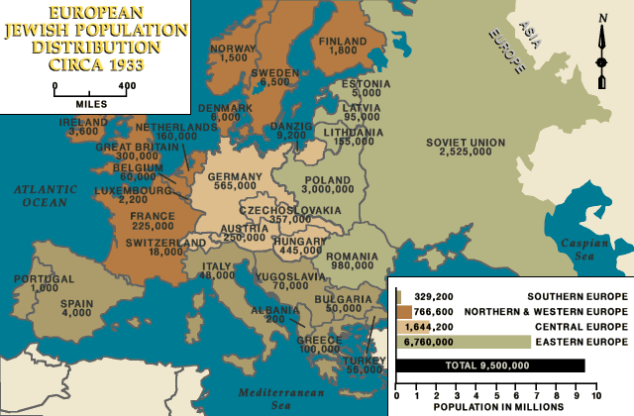
Jews in Europe in 1933
Notes:
A similar bewilderment afflicted Germany at the end of World War I. The first stab-in-the-back story—Dolchstoss in German—happened when the German army returned home in defeat in November 1918. The reason for their surrender was obscure to many Germans: the enemy had never touched German soil, and both at the beginning and the end of the war—at least according to German newspapers—the Kaiser’s forces appeared to be winning. So there was only one possible explanation: Germany had been betrayed by Socialists and (you guessed it) Jews, 1918’s equivalent of the traitorous Sixties counterculture.
Historians have often remembered that right-wing Germans let their Jewish compatriots take the rap for Germany’s defeat and for the shame of Versailles’ punitive peace. They have been less inclined to remember that for most of the war German Jews and gentiles stood proudly together in defense of their country. Jews welcomed the war as a fight for justice, freedom and, most important of all, German culture.
Gertrud Kantorowicz wrote in August 1914, when the conflict broke out, that “the war itself is pure greatness … my being relates to Germany as a life’s breath relates to the body out of which it arises.” Gertrud was the cousin of the historian Ernst Kantorowicz, who earned the Iron Cross on the Western front and after the war joined the Freikorps, the right wing militia that battled Communists and Socialists in the streets of German cities. Both of them were Jews, and proud Germans.
Ernst and Gertrud Kantorowicz were typical of German Jews, Tim Grady demonstrates in his new book A Deadly Legacy: German Jews and the Great War. They were passionate nationalists, as völkisch as you could get. Like other Germans, they celebrated the outbreak of war as a momentous chance for national renewal. The late historian Fritz Stern remarked that the passionate German response to the war went beyond mere patriotism. Many intellectuals, especially, saw the guns of August as a triumphant release from dead-end bourgeois culture, a call to a new nobility and manliness.
In summer 1914, during the first frenzy of battle, even German Zionists declared that there was “no difference” between Jews and other Germans. Martin Buber wrote enthusiastically in August, “Never has the concept of the Volk been such a reality to me than during these last weeks.” The Jewish politician Ludwig Haas remarked that Russia, when it entered the war, had committed “the greatest crime in world history.” Never mind that Germany had in effect set off hostilities by giving a green light to Austria-Hungary’s attack on Serbia. Germans were eager to cast their fatherland as the victim of France, England and, most of all, Russia.
Russia had a deep meaning for Jews worldwide: it was their oppressor, their enemy. And so for many German Jews WWI became a holy war against Russia. The Zionist Jüdische Rundschau proclaimed that Germany was fighting “to free Russia and the world from unprecedented tyranny.” Jewish artists like Max Liebermann drew fierce caricatures of the bloodthirsty, slobbering Russian beast.
German Jews were prominent supporters of the army’s efforts to colonize the East. The territory won from Russia, they argued, properly belonged to Germany. Since the Ostjuden spoke Yiddish, a dialect of German, they were Germany’s racial compatriots.
Not that German Jewish soldiers felt a kinship with Russian Jews: the invaders were often appalled by the squalor of shtetl existence. These were exotic foreigners, alien to German Jewish culture. When refugee Jews from the East began flooding into Germany, Grady remarks, German Jews mostly recoiled from them instead of welcoming them with open arms. Grady quotes Victor Klemperer’s comment about eastern Jews: he did not “belong to these people,” Klemperer wrote: “I thanked my creator that I was German.” In spite of this cultural friction, Eastern Jews mostly welcomed the Germans who had delivered them from Russian rule.
When the Germans marched through Belgium in 1914, the Allies were quick to promote tales of German beastliness: the Belgian baby speared on a Hun’s bayonet was an image guaranteed to rouse indignation. One French journalist claimed that the Kaiser’s troops had cut off the hands of 4,000 children. Faced with such made-up atrocities, German Jews, like other Germans, leaped to the defense of their nation’s soldiers. They also went on the attack, inventing atrocities of their own. The Jewish writer Arnold Zweig published a short story about a Belgian farmer who cuts the throats of three peaceful German soldiers, then butchers them and feeds them to his pigs. In October 1914 the Jewish playwright Ludwig Fulda drafted a petition claiming that Germany had not destroyed “the life and property of a single Belgian citizen”; and he added, “We shall fight this war to the very end as a cultured people to whom the legacy of Goethe, Beethoven and Kant is as sacred as hearth and home.”
Fulda was mistaken in his defense of Germany’s soldiers. Although the German army didn’t cut off hands or shish-kebab babies, they did often murder Belgian prisoners and civilians, as the historian Max Hastings has shown. “How could [German soldiers] expect to be shot at from windows and cellars?” the Kölnische Zeitungasked in 1914, tacitly admitting that Germany had broken the rules of war. Out of self-defense the Kaiser’s troops had to “adopt punitive measures, burn houses, execute civilians,” the newspaper concluded.
In August 1914 the German army was riding high, and Berlin was convinced that the fighting would soon be over. Then came the stumbling block of the Marne in September, which stopped Germany’s advance and turned the war into an excruciating game of attrition. Now Germany was fighting on two fronts, cheated of its fantasy about quickly defeating France. The horrendous specter of trench warfare arose, and with it the desire for new weapons that would deal the enemy a decisive blow.
Grady recounts the well-known story of the German Jew Fritz Haber, the Nobel Prize winner and inventor of chemical weapons. Shortly after the Germans first used Haber’s chlorine gas in defiance of the Geneva Convention in April 1915, Haber’s wife committed suicide; undeterred, he traveled to the eastern front the next day to oversee more gas attacks. Haber’s godson Fritz Stern wrote that Haber was “German in every fibre of his being, in his restless, thorough striving … in his very soul and spirit.”
Unlike African-Americans in the American army, German Jews were integrated into their country’s forces, and anti-Jewish insults were rare. Grady writes that the Bavarian List regiment, “which counted fifty-nine German Jews as well as a young Adolf Hitler, showed few signs of harbouring any form of anti-Semitic spirit.” Rabbis served the religious needs of Germany’s Jewish soldiers and, military circumstances permitting, they were allowed to return home for Jewish holidays. Kaiser Wilhelm had decided that Jews could become officers, and so they did, though the higher-ups were sometimes reluctant to promote them.
But as the war ground relentlessly on, anti-Semitic rumors started circulating among the German people: Jews were shirkers, they were profiting from the war rather than fighting in it. The Wehrmacht gave in to the anti-Semitic canard with the census of November 1916, designed to find out how many Jews were serving at the front. The military insisted, implausibly, that the census had no anti-Semitic intent. Jews, who were fighting and dying for Germany like any other Germans, were disheartened.
Grady writes that Jewish and non-Jewish soldiers fought together on the German front lines with very little tension. But on the home front, the imaginary Jew was culpable for Germany’s loss.
In January 1918, strikes broke out across Germany; workers demanded peace, more food and more democracy. Two prominent Jews, Hugo Haase and Kurt Eisner, were among the leaders of the strikes. Afraid of a revolution like the Bolsheviks’ in Russia, the government quickly arrested the striking workers—and sent many of them to the front. In Berlin, flyers were handed around blaming the Jews for the uprising, though most Jews—and most soldiers—had little sympathy for the strikers. One Jewish newspaper, the Allgemeine Zeitung des Judentums, proclaimed that the strikers had “weaken[ed] the army’s military clout” and added that they were “stabbing the frontline army in the back.” Jewish writers, like other Germans, freely employed the fatal figure of speech.
The last gasp of Germany’s wartime ambition occurred in the spring of 1918. The treaty of Brest-Litovsk had awarded a huge chunk of Russian territory to Germany; the war in the East was over. In the West, German forces under General Ludendorff pushed the British and French armies back thirty-seven miles, but their advance cost half a million casualties. The French counterattacked in the summer, and by September the jig was up. Ludendorff, a broken man, admitted privately that “victory is out of the question,” but the German public still found defeat unimaginable. When news of the armistice broke in November, Joseph Levy, an orthodox Frankfurt cantor who led services in full military uniform, was like most Germans deeply shocked. The fatherland, he lamented, was “lost.” But who had lost it?
The main gift of Grady’s meticulously researched book is its lesson about how poisonous and long-lasting a stab-in-the-back legend can be, and what damage it can do to a country. In 1922 Weimar foreign minister Walter Rathenau, who had put Germany’s economy on a war footing in late 1914, was nicknamed “Gottverfluchte Judensau” (“goddamned Jewish pig”) and killed in the streets. Rathenau had just signed the Treaty of Rapallo with the Soviets, which gave up Germany’s land claims from WWI. A few years later, the idea of Jewish betrayal during and after the war paved the way for a political party that saw Jews as not merely traitors, but a poisonous, subhuman riff-raff.
Stern in his book about the intellectual roots of Nazism, The Politics of Cultural Despair, wrote that “No single idea played so powerful and so pernicious a role in postwar Germany as the notion that an undefeated army had voluntarily laid down its arms in the hope of a just peace. Because of it, Germans were able to feel that the Allies had tricked, not defeated them,” and that sinister elements of German society had aided this betrayal: “socialists, liberals, and Jews.”
The Weimar republic had been “fathered by traitors.” And so when the republic was swept away by the Nazis, Germans swallowed their reservations. They were certain that, whatever Hitler’s shortcomings, at least he would never double-cross them and lead their homeland to ruin.

Slide 4
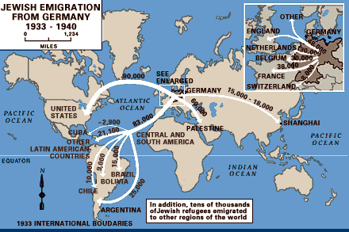
Jewish emigration after Hitler came to power
Notes:
In the 1920s, most German Jews were fully integrated into German society as German citizens. They served in the German army and navy and contributed to every field of German science, business and culture. Conditions for the Jews began to change after the appointment of Adolf Hitler as Chancellor of Germany on 30 January 1933 and the assumption of power by Hitler after the Reichstag fire. From its inception, Hitler's regime moved quickly to introduce anti-Jewish policies. The 500,000 Jews in Germany, who accounted for only 0.76% of the overall population, were singled out by the Nazi propaganda machine as an enemy within who were responsible for Germany's defeat in the First World War and for its subsequent economic difficulties, such as the 1920s hyperinflation and Great Depression. Beginning in 1933, the German government enacted a series of anti-Jewish laws restricting the rights of German Jews to earn a living, to enjoy full citizenship and to educate themselves, including the Law for the Restoration of the Professional Civil Service, which forbade Jews to work in the civil service. The subsequent 1935 Nuremberg Laws stripped German Jews of their citizenship and forbade Jews to marry non-Jewish Germans. The result of these laws was the exclusion of Jews from German social and political life.
After Hitler came to power many Jews left Germany
Kristallnacht, also referred to as the Night of Broken Glass, was a pogrom or series of coordinated attacks against Jews throughout Nazi Germany and parts of Austria on 9–10 November 1938, (Berlin Wall came down 9/11/89 carried out by SA stormtroopers and civilians. German authorities looked on without intervening. The attacks left the streets covered with broken glass from the windows of Jewish-owned stores, buildings, and synagogues. At least 91 Jews were killed in the attacks, and a further 30,000 arrested and incarcerated in concentration camps. Jewish homes, hospitals, and schools were ransacked, as the attackers demolished buildings with sledgehammers. Over 1,000 synagogues were burned (95 in Vienna alone), and over 7,000 Jewish businesses destroyed or damaged.

Slide 5
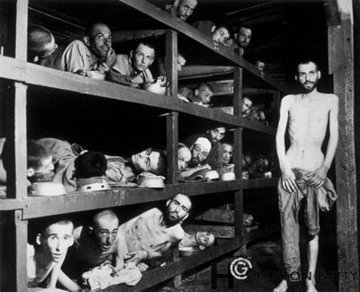
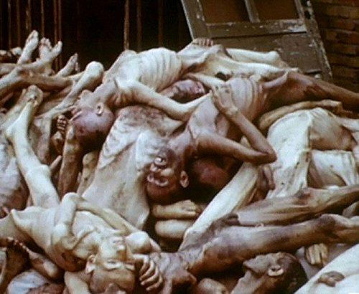
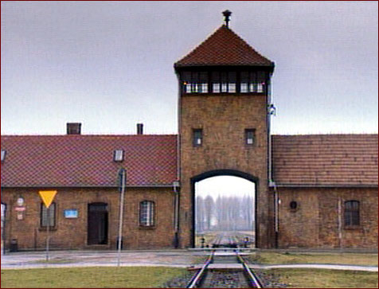
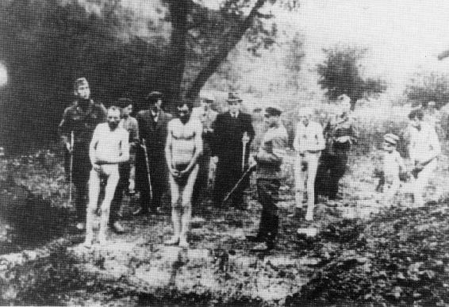
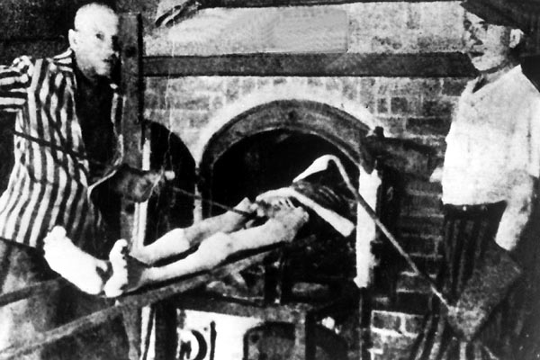
"The Holocaust was a Cain inspired action, one of Hitler’s satanic designs
and plans which should have been prevented by a unified front of all
Christian and Jewish forces.” Sun Myung Moon 1975
Notes:
Churches all silent except Church of England. The Archbishop of Canterbury, Temple, at the behest of the CCJ, made a broadcast to the Hungarian people using the BBC World Service and appealed:
"do your utmost to save from persecution, it may be from massacre, those who are now threatened as a result of German occupation...Help them to hide from their tormentors, help them, if possible, to escape. Do all you can to prevent the extermination of people whose only fault is the race from which they are born or the independence of their minds and constancy of their convictions”

Slide 6
How many perished in the Holocaust?
Country | Jewish pop. Sept. 1939 | Number Jews murdered | Percentage of Jews murdered
Poland | 3,300,000 | 2,800,000 | 85
Soviet Union | 2,100,000 | 1,500,000 | 71
Romania | 850,000 | 425,000 | 50
Hungary | 404,000 | 200,000 | 50
Czechoslovakia | 315,000 | 260,000 | 82
France | 300,000 | 90,000 | 30
Germany | 210,000 | 171,000 | 81
Lithuania | 150,000 | 135,000 | 90
Holland | 150,000 | 90,000 | 60
Others | 522,000 | 313,000 | 60
Total | 8,301,000 | 5,978,000 | 72
Notes:
Source: Cited in Landau, The Nazi Holocaust, Chicago: Ivan R. Dee, 1994. These data originally appeared in Poliakov and Wulf (eds), Das Dritte Reich und die Juden: Documente und Aufsatze (Arani Verlag, GmbH, Berlin, 1955)

Slide 7
Letter found near a dead child at Ravensbruch concentration camp
    O, Lord,
    remember not only the men and women of good will,
    but also those of evil will.
    But do not remember all the suffering
    they have inflicted upon us;
    remember the fruits we have borne thanks to this suffering—
    our comradeship, our loyalty, our humility,
    our courage, our generosity,
    the greatness of heart
    which has grown out of all this;
    and when they come to the judgement,
    let all the fruits that we have borne
    be their forgiveness.
Notes:
Tikkum olam

Slide 8
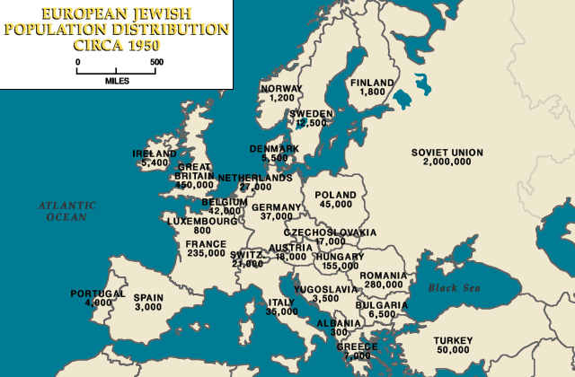
Jews in Europe in 1950
Notes:
After the Holocaust many Jews wanted to go to Israel. They were not welcome and had no desire to go back to their homes which had often been confiscated and the new inhabitants would not give them back.

Slide 9
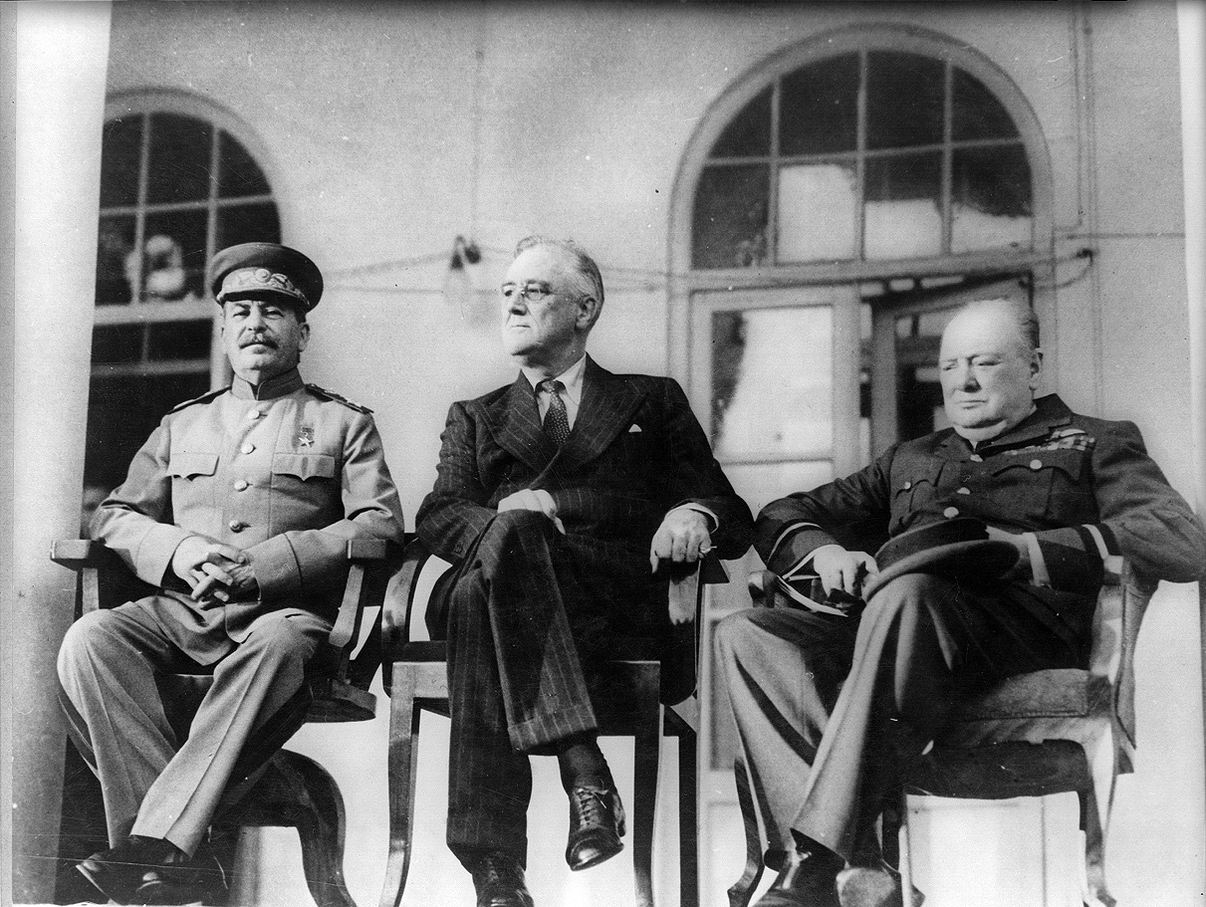
Tehran Conference – Dec 1943
Plan the war
Roosevelt weak
UK & USA disunited
Stalin confident
Soviet Union ‘given’ East Europe
Stalin, Roosevelt and Churchill
Notes:
Churchill and Roosevelt met at Cairo. Churchill wanted to work out a joint approach to Stalin. Roosevelt wanted to deal with Stalin alone. Roosevelt very anti-British empire
Stalin wanted 2nd front
The main objective of the United States and Great Britain was to ensure full cooperation and assistance from the Soviet Union for their war policies. Stalin agreed, but at a price: Roosevelt and Churchill would have to support his reign and the partisans in Yugoslavia, and also allow for the manipulation of the border between Poland and the USSR.
Despite accepting the above arrangements, Stalin dominated the conference, using the Soviet victory at the Battle of Kursk and military might, as well as key positions on the German front, to get his way. Roosevelt attempted to cope with Stalin's onslaught of demands, but was able to do little except appease Stalin. Churchill mostly argued for his Mediterranean plan instead of Operation Overlord, to the annoyance of diplomats and officials. These weaknesses and divisions played into Stalin's hands.
One of Roosevelt and Churchill's main concessions concerned post-war Poland. Stalin wished for an area in the Eastern part of Poland to be added to the USSR, and for the border to be lengthened elsewhere in the country. Roosevelt and Churchill agreed to this demand, and Poland’s borders were declared to lie along the Oder and Neisse rivers and the Curzon line, despite protests of the Polish government-in-exile in London. Churchill and Roosevelt also gave Stalin free rein in his own country, and consented to the USSR setting up puppet communist governments in Poland, Czechoslovakia, the Baltic states, Romania, and other Eastern European countries which would result in a loss of freedom by these countries for the next fifty years and would be the genesis of the Cold War. After the conference it was agreed that military leaders of the three countries would meet together often, for further discussion.
Roosevelt acknowledged that the U.S. had a traditional antipathy towards the British Empire. In One Christmas in Washington,^{[113]} a dinner meeting between Roosevelt and Churchill is described, in which Roosevelt is quoted as saying:
"It's in the American tradition, this distrust, this dislike and even hatred of Britain– the Revolution, you know, and 1812; and India and the Boer War, and all that. There are many kinds of Americans of course, but as a people, as a country, we're opposed to Imperialism—we can't stomach it."

Slide 10
Roosevelt on Stalin
“I just have a hunch that Stalin is not that kind of a man. . . . I think that if I give him everything I possibly can and ask for nothing from him in return, noblesse oblige, he won't try to annex anything and will work with me for a world of democracy and peace.”
President Franklin D. Roosevelt, 1943
Notes:
In 1942, U.S. Ambassador to the Soviet Union William Christian Bullitt, Jr.'s thesis prophesied the "flow of the Red amoeba into Europe". Roosevelt responded to Bullitt, Jr. with a statement summarizing his rationale for war time relations with Stalin

Slide 11
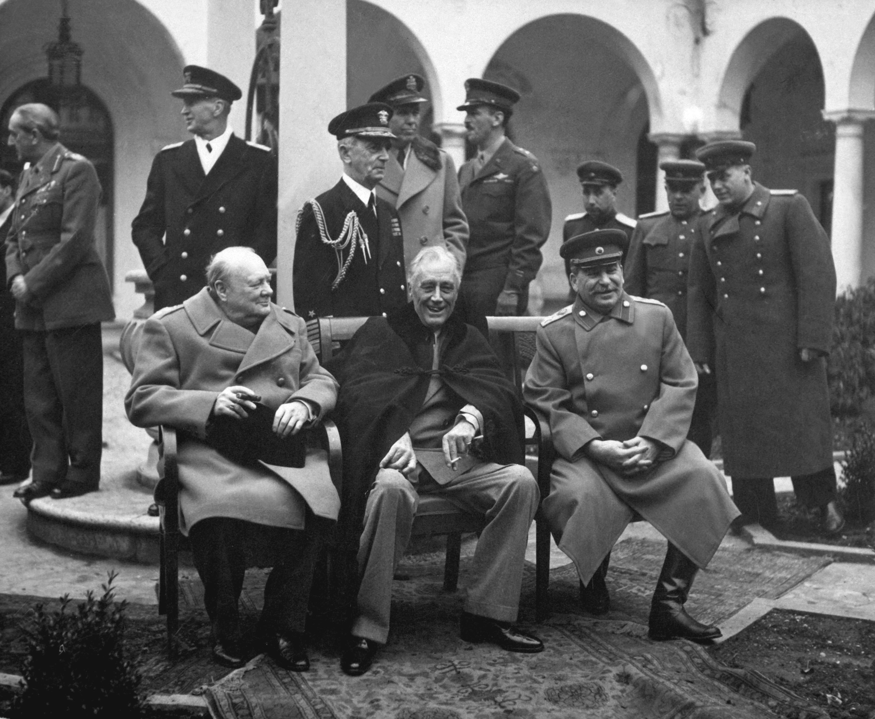
Yalta Conference – Feb 1945
Reorganisation of Europe after the war
Red Army 40 miles
from Berlin
Free democratic elections promised in East Europe
Polish self government to be respected by Soviet Union
Churchill, Roosevelt and Stalin

Slide 12
Churchill on Stalin
“Stalin I’m sure means well to the world and Poland. Stalin has offered the Polish people a free and more broadly based government to bring about an election . . . My hopes lie in a single man, he will not embark on bad adventures.”
Winston Churchill, after Yalta

Slide 13
Second World War ends - 1945
Allies
Axis Powers
USA
USSR
Britain & Empire
France
Germany
Japan
Italy
Military dead 16 million
Civilian dead 45 million
Military dead 8 million
Civilian dead 4 million
Peace
1945
United Nations
Notes:
Soviet Union – Japan: At the Tehran Conference in November 1943, Stalin agreed that the Soviet Union would enter the war against Japan once Nazi Germany was defeated. At the Yalta Conference in February 1945, Stalin agreed to Allied pleas to enter World War II's Pacific Theater within three months of the end of the war in Europe. On July 26, the US, UK and China made the Potsdam Declaration, an ultimatum calling for the Japanese surrender which if ignored would lead to their "prompt and utter destruction". The invasion began on August 8, 1945, precisely three months after the German surrender on May 8 (May 9, 0:43 Moscow time).
The commencement of the invasion fell between the atomic bombings of Hiroshima on August 6 and Nagasaki on August 9. Although Soviet leader Joseph Stalin had not been told much detail of the Western Allies' atomic bomb program by Allied governments, he was nonetheless well aware of its existence and purpose by means of Soviet intelligence sources.[citation needed] However, by virtue of the timing of the agreements at Tehran and Yalta, and the long term buildup of Soviet forces in the Far East since Tehran, it is clear that news of the attacks on the two cities played no major role in the timing of the Soviet invasion; the date of the invasion was foreshadowed by the Yalta agreement, the date of the German surrender, and the fact that on August 3, Marshal Vasilevsky reported to Stalin that, if necessary, he could attack on the morning of August 5. Furthermore, while Stalin could reasonably have concluded that an atomic bombing of Japan was imminent, it does not appear he was overly impressed with the atomic bomb's potential, certainly not so much so as to think it might compel a nation as averse to surrender as Japan into an earlier capitulation.

Slide 14
What were the providential results?
Victory of God’s side over Satan’s side
  Restored three blessings
  Overcame second temptation of Jesus: indemnity condition to restore 2nd blessing
  Messiah could marry and start his mission
  Restoration of God’s sovereignty through democracy on growth stage
  Establishment of the State of Israel
On Satan’s side communism strengthened
Notes:
Spiritual phenomena from end WW2
The indemnity paid by the Nazi persecution of the Jews made possible the restoration of the nation of Israel. Father 18 May 1978

Slide 15
Churchill’s ‘Iron Curtain’ speech March 1946
“An iron curtain has descended across the Continent. Behind that line lie all the capitals of the ancient states of Central and Eastern Europe. . . All these famous cities and the populations around them lie in what I must call the Soviet sphere, and all are subject in one form or another, not only to Soviet influence but to a very high and increasing measure of control from Moscow.”
Notes:
Churchill called a war monger and extremist but proved right. Speech given in Westminster College Fulton, Missouri

Slide 16
The Third World War
1945-
Notes:
Still not over. Finished in the west.

Slide 17
What causes historical events?
Purpose
Free will
Real situation
Historical event
Notes:
People make decisions depending on their circumstances and environment to achieve a purpose -> event. Not deterministic. Not pre-destined.

Slide 18
Internal and external causes
Internal cause -
God’s providence
Historical event
Which is expressed as:
External cause -
Clash of political and economic interests

Slide 19
Third World War
Nature of conflict depends on human responsibility
Military conflict
Cain - Abel
Struggle
Fail
Responsibility
Fulfil
Ideological conflict

Slide 20
What is this ideological conflict?
Abel-type
view of life
Cain-type
view of life
Democracy
Communism
Freedom
Totalitarianism
Religious worldview
Atheism
Dual characteristics
Dialectical materialism
Co-operation & reconciliation
Historical materialism

Slide 21
A new ideology is required
A new ideology to resolve conflict must arise out of the democratic world which is rooted in the Abel-type view of life
This new truth is the essence of the Abel-view of life and the core of democracy
The new truth will conquer the communist ideology and unify the world EDP, 377

Slide 22
What is this ‘new ideology’?
Judeo-Christian liberal democracy
  Yoram Hazony, The Virtue of Nationalism
  F.A. Hayek, Constitution of Liberty
  Michael Oakeshott, On Human Conduct
  Karl Popper, The Open Society and its Enemies

Slide 23
What was the providential cause of the Third World War?
Completion stage restoration of the three blessings
  Anti-type of Christ – Stalin
  Class struggle and proletariat
  World domination/state ownership of economy
Communism is unprincipled flawed imitation of God’s ideal
Overcome Jesus third temptation
Restoration of God’s sovereignty

Slide 24
God’s side and Satan’s side
Adam’s family
Abel side
Cain side
South Korea West Germany | Adam Position | North Korea East Germany
Japan Great Britain | Eve Position | China
USA | Archangel Position | USSR

Slide 25
What were the origins of the third world war?
Bolshevik seizure of power in Russia 1917
Allied intervention in Russian Civil War
Establishment of Third International 1919
  Foment revolution in Europe and world
Molotov-Ribbentrop Pact 1939-41
Wartime Alliance 1941-45
Different visions of post-war Europe
  Democracy vs. one party Communist state
  Free market vs. state control of economy
Notes:
The Communist International (abbreviated as Comintern, also known as the Third International) was an international communist organization founded in Moscow in March 1919. The International intended to fight "by all available means, including armed force, for the overthrow of the international bourgeoisie and for the creation of an international Soviet republic as a transition stage to the complete abolition of the State. The Comintern was founded in these conditions at a congress held in Moscow March 2-6, 1919, against the backdrop of the Russian Civil War. There were 52 delegates present from 34 parties]
As early as 1925, Stalin stated that he viewed international politics as a bipolar world in which the Soviet Union would attract countries gravitating to socialism and capitalist countries would attract states gravitating toward capitalism while the world was in a period of "temporary stabilization of capitalism" preceding its eventual collapse. Several events fueled suspicion and distrust between the western powers and the Soviet Union: the Bolsheviks' challenge to capitalism; the Polish-Soviet War; the 1926 Soviet funding of a British general workers strike causing Britain to break relations with the Soviet Union; Stalin's 1927 declaration that peaceful coexistence with "the capitalist countries . . . is receding into the past”; conspiratorial allegations in the Shakhty show trial of a planned French and British-led coup d'etat; the Great Purge involving a series of campaigns of political repression and persecution in which over half a million Soviets were executed; the Moscow show trials including allegations of British, French, Japanese and German espionage; the controversial death of 6–8 million people in the Ukrainian Soviet Socialist Republic in the 1932–3 Ukrainian famine; western support of the White Army in the Russian Civil War; the US refusal to recognize the Soviet Union until 1933; and the Soviet entry into the Treaty of Rapallo. This outcome rendered Russian–American relations a matter of major long-term concern for leaders in both countries.
Both sides, held very dissimilar ideas regarding the establishment and maintenance of post-war security. The Americans tended to understand security in situational terms, assuming that, if US-style governments and markets were established as widely as possible, countries could resolve their differences peacefully, through international organizations. The key to the US vision of security was a post-war world shaped according to the principles laid out in the 1941 Atlantic Charter — in other words, a liberal international system based on free trade and open markets. This vision would require a rebuilt capitalist Europe, with a healthy Germany at its center, to serve once more as a hub in global affairs.
This would also require US economic and political leadership of the postwar world. Europe needed the USA's assistance if it was to rebuild its domestic production and finance its international trade. The USA was the only world power not economically devastated by the fighting. By the end of the war, it was producing around fifty percent of the world's industrial goods.
Soviet leaders, however, tended to understand security in terms of space. This reasoning was conditioned by Russia's historical experiences, given the frequency with which the country had been invaded over the last 150 years. The Second World War experience was particularly dramatic for the Russians: the Soviet Union suffered unprecedented devastation as a result of the Nazi onslaught, and over 20 million Soviet citizens died during the war; tens of thousands of Soviet cities, towns, and villages were leveled; and 30,100 Soviet factories were destroyed. In order to prevent a similar assault in the future, Stalin was determined to use the Red Army to gain control of Poland, to dominate the Balkans and to destroy utterly Germany's capacity to engage in another war. The problem was that Stalin's strategy risked confrontation with the equally powerful United States, who viewed Stalin's actions as a flagrant violation of the Yalta agreement.

Slide 26
What is communism 1?
Abolition of the third blessing
  “Communism is the abolition of private property.” Communist Manifesto 1848
  State control and ownership of all property
  No free markets; planned economy
Cannot become a true owner
Cannot become Lord of Creation
Cannot inherit God’s creativity

Slide 27
What is communism 2?
Abolition of the second blessing
  “The workers’ state will come to replace the family.”
  “The obligations of parents to their children will wither away gradually until finally society assumes the full responsibility.”
  “Marriage . . . has given way to the free and honest union of men and women who are lovers and comrades.” Alexandra Kollontai, 1920
State takes over law, education, health, welfare and civil society
Notes:
Alexandra Mikhailovna "Shura” (1872 –1952) was a Russian Communist revolutionary, first as a member of the Mensheviks, then from 1914 on as a Bolshevik. In 1923, she was appointed Soviet Ambassador to Norway, becoming the world's first female ambassador. After the Bolshevik revolution in October 1917, Kollontai became People's Commissar for Social Welfare. She was the most prominent woman in the Soviet administration and was best known for founding the Zhenotdel or "Women's Department" in 1919 . This organization worked to improve the conditions of women's lives in the Soviet Union, fighting illiteracy and educating women about the new marriage, education, and working laws put in place by the Revolution. As a foremost champion of women's equality like the other Marxists of her time, she opposed the bourgeois ideology of liberal feminism; though later feminists have claimed her legacy. The Zhenotdel was eventually closed in 1930.
Kollontai raised eyebrows with her unflinching advocacy of free love. However, this does not mean that she advocated casual sexual encounters; indeed, she believed that due to the inequality between men and women that persisted under socialism, such encounters would lead to women being exploited, and being left to raise children alone. Instead she believed that true socialism could not be achieved without a radical change in attitudes to sexuality, so that it might be freed from the oppressive norms that she saw as a continuation of bourgeois ideas about property. It is a myth that she said that "...the satisfaction of one's sexual desires should be as simple as getting a glass of water"; what she actually said, in number 18 of her Theses on Communist Morality in the Sphere of Marital Relations, was that "...sexuality is a human instinct as natural as hunger or thirst."
Kollontai's views on the role of marriage and the family under Communism were arguably more subversive and more influential on today's society than her advocacy of "free love." Kollontai believed that, like the state, the family unit would wither away once the second stage of communism became a reality. She viewed marriage and traditional families as legacies of the oppressive, property-rights-based, egoist past. Under Communism, both men and women would work for, and be supported by, society, not their families. Similarly, their children would be wards of, and reared basically by society.
Kollontai admonished men and women to discard their nostalgia for traditional family life. "The worker-mother must learn not to differentiate between yours and mine; she must remember that there are only our children, the children of Russia’s communist workers." However, she also praised maternal attachment: "Communist society will take upon itself all the duties involved in the education of the child, but the joys of parenthood will not be taken away from those who are capable of appreciating them."^{[19]}

Slide 28
What is communism 3?
Abolition of the first blessing
  “Atheism is a natural and inseparable part of Marxism, of the theory and practice of scientific socialism.” Vladimir Lenin
  “Communism is incompatible with religious faith.” Nikolai Bukharin
  “In our country, the lie has become not just a moral category but a pillar of the State.” Alexander Solzenitsyn
No freedom of speech or religion
Persecution and suppression of religion
Notes:
Think one thing, say another, do a third
The Soviet Union was the first state to have as an ideological objective the elimination of religion and its replacement with atheism as a fundamental ideological goal of the state. Toward that end, the communist regime confiscated church property, ridiculed religion, harassed believers, and propagated atheism in the schools.
Marxism-Leninism has consistently advocated the control, suppression, and, ultimately, the elimination of religious beliefs. Within about a year of the revolution the state expropriated all church property, including the churches themselves, and in the period from 1922 to 1926, 28 Russian Orthodox bishops and more than 1,200 priests were killed (a much greater number was subjected to persecution).[
Marxism-Leninism has consistently advocated for the suppression, and, ultimately, the disappearance of religious beliefs, considering them to be "unscientific" and "superstitious". In the 1920s and 1930s, such organizations as the League of the Militant Godless were active in anti-religious propaganda. Atheism was the norm in schools, communist organizations (such as the Young Pioneer Organization), and the media Most seminaries were closed, and publication of most religious material was prohibited. By 1941 only 500 churches remained open out of about 54,000 in existence prior to World War 1.

Slide 29
What is communist ideology?
Dialectical materialism
  Only matter exists - No God or spirit
  Progress based on dialectical conflict between thesis and anti-thesis
Historical materialism
  Productive forces determine society
  Progress through class struggle
  Violent revolution justified

Slide 30
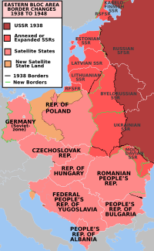
Beginnings of the conflict
Establishment of Eastern
Bloc based on M-R Pact
  States incorporated into
  Soviet Union
  East European countries become satellites
Marshall Plan 1947
  Revive Germany & economies
  Rejected by USSR
Truman Doctrine 1947
  Containment and deterrence
Notes:
Just past 1pm on Wednesday March 12, 1947, President Harry Truman stood before Congress and delivered a speech that Life magazine described as “like a bolt of lightning [that] cut through the confused international atmosphere”.
The speech had been prompted by the decision of the UK to stop providing financial support for Greece. Without funds, Greece would surely become part of the Soviet sphere of influence. Was it America’s role — not one that it had traditionally accepted — to step in financially and militarily to prevent oppression in faraway countries?
Truman determined that, despite strong domestic resistance, it was indeed America’s role. “It must be the policy of the United States to support free people who are resisting attempted subjugation by armed minorities or by outside pressures,” he said, establishing what became known as the Truman Doctrine.
More than half of America’s deployed troops were in EuropeHe sought from Congress, and gained, funds to support Greece and Turkey. The commitment he had really sought and achieved, however, was a far bigger one. America became the protector of a free Europe. From the Truman Doctrine flowed the great funds of the Marshall Plan that propped up European economies. From it flowed the Berlin airlift, 300,000 flights to deliver food and supplies and break the Soviet blockade. And from it flowed the creation of Nato, the pact that guaranteed western freedom.
The announcement of the Truman Doctrine was one of the most important moments in American history and changed that country fundamentally. Modern America — with its military might and its international outlook — is largely the product of its decision to come to our rescue after the war.
Marshall Plan offered to ALL european countries including USSR
After the Marshall Plan, the introduction of a new currency to Western Germany to replace the debased Reichsmark and massive electoral losses for communist parties, On July 20, 1948, President Truman issued the second peacetime military draft in U.S. history.
Truman delivered a speech that called for the allocation of $400 million to intervene in the war and unveiled the Truman Doctrine, which framed the conflict as a contest between free peoples and totalitarian regimes

Slide 31
The war of ideas
Radio Free Europe 1949
Radio Liberty 1951
Voice of America
BBC
Washington Times
CAUSA, VOC
Heritage Foundation
Notes:
RFE was developed out of a belief that the Cold War would eventually be fought by political rather than military means. American policymakers such as George Kennan and John Foster Dulles acknowledged that the Cold War was essentially a war of ideas. The United States, acting through the CIA, funded a long list of projects to counter the Communist appeal among intellectuals in Europe and the developing world.
On February 21, 1981, RFE/RL's headquarters in Munich was struck by a massive bomb, causing $2 million in damage. Several employees were injured, but there were no fatalities. Stasi files opened after 1989 indicated that the bombing was carried out by a group of international terrorists under the direction of Ilich Ramirez Sanchez, the arch-terrorist known by the alias Carlos the Jackal, and paid for by Nicolae Ceauşescu, president of Romania.
Funding for RFE/RL increased during the Reagan Administration. President Ronald Reagan, a fervent opponent of Communism, urged the radios to be more critical of the communist regimes. This presented a challenge to RFE/RL's broadcast strategy, which had been very cautious since the controversy over its alleged role in the Hungarian Revolution.
During the Mikhail Gorbachev era in the Soviet Union, the radios worked hand in hand with Glasnost and benefited significantly from the Soviet regime's new openness. Gorbachev stopped the practice of jamming the radios' broadcasts, and dissident politicians and officials could be freely interviewed by the radios for the first time without fearing persecution or imprisonment. By 1990 Radio Liberty had become the most listened-to Western radio station broadcasting to the Soviet Union. Its coverage of the 1991 August coup enriched sparse domestic coverage of the event and drew in a wide audience from throughout the region. The broadcasts allowed Gorbachev and Boris Yeltsin to stay in touch with the Russian people during this turbulent period. Boris Yeltsin later expressed his gratitude through a presidential decree allowing Radio Liberty to open a permanent bureau in Moscow.
With the arrival of the Reagan administration, the Heritage Foundation and other conservative foreign policy think tanks saw a political opportunity to significantly expand Carter's Afghanistan policy into a more global "doctrine," including U.S. support to anti-communist resistance movements in Soviet-allied nations in Africa, Asia and Latin America. According to the book Rollback, "it was the Heritage Foundation that translated theory into concrete policy. Heritage targeted nine nations for rollback: Afghanistan, Angola, Cambodia, Ethiopia, Iran, Laos, Libya, Nicaragua and Vietnam.”
Along with the broadcasts of the British Broadcasting Corporation and the Voice of America to Eastern Europe,^{[99]} a major propaganda effort begun in 1949 was Radio Free Europe/Radio Liberty, dedicated to bringing about the peaceful demise of the Communist system in the Eastern Bloc.^{[100]} Radio Free Europe attempted to achieve these goals by serving as a surrogate home radio station, an alternative to the controlled and party-dominated domestic press.^{[100]} Radio Free Europe was a product of some of the most prominent architects of America's early Cold War strategy, especially those who believed that the Cold War would eventually be fought by political rather than military means, such as George F. Kennan.^{[101]}
American policymakers, including Kennan and John Foster Dulles, acknowledged that the Cold War was in its essence a war of ideas.^{[101]} The United States, acting through the CIA, funded a long list of projects to counter the Communist appeal among intellectuals in Europe and the developing world.

Slide 32
Communist expansion
Berlin blockade and airlift June ‘48- May ’49
  Division of Germany
Establishment of NATO April 1949
  12 countries North America and Western Europe
China becomes communist 1949
  North Korea becomes communist 1945-49
  South Korea holds elections
  Korean War 1950-53
Notes:
The Berlin Blockade (24 June 1948 – 12 May 1949) was one of the first major international crises of the Cold War and the first resulting in casualties. in June 1948, the Soviet Union cut off surface road access to Berlin, initiating the Berlin Blockade, which cut off all non-Soviet food, water and other supplies for the citizens of the non-Soviet sectors of Berlin. Because Berlin was located within the Soviet-occupied zone of Germany, the only available methods of supplying the city were three limited air corridors. By February 1948, because of massive post-war military cuts, the entire United States army had been reduced to 552,000 men. Military forces in non-Soviet Berlin sectors totaled only 8,973 Americans, 7,606 British and 6,100 French. Soviet military forces in the Soviet sector that surrounded Berlin totaled one and a half million men. The two United States regiments in Berlin would have provided little resistance against a Soviet attack. Therefore, a massive aerial supply campaign was initiated by the United States, Britain, France and other countries, the success of which caused the Soviets to lift their blockade in May 1949.
During the multinational occupation of post-World War II Germany, the Soviet Union blocked the Western Allies' railway and road access to the sectors of Berlin under Allied control. Their aim was to force the western powers to allow the Soviet zone to start supplying Berlin with food and fuel, thereby giving the Soviets practical control over the entire city.
In response, the Western Allies organized the Berlin Airlift to carry supplies to the people in West Berlin. The United Kingdom's Royal Air Force and the recently formed United States Air Force, flew over 200,000 flights in one year that provided 13,000 tons of daily necessities such as fuel and food to the Berliners. By the spring of 1949, the effort was clearly succeeding, and by April, the airlift was delivering more cargo than had previously flowed into the city by rail.
The success of the Berlin Airlift brought humiliation to the Soviets who had refused to believe it could make a difference. The blockade was lifted in May 1949 and resulted in the creation of two separate German states
North Korea refused to participate in a United Nations–supervised election held in the south in 1948, which led to the creation of separate Korean governments for the two occupation zones.

Slide 33
Continuing conflict
  Warsaw Pact established 1955
  Start of Vietnam War 1955-75
Hungarian independence uprising 1956
Cuban Revolution 1959
Competition by proxy in Third World
Sino-Soviet split 1956
Berlin Crisis and Wall 1961
Cuban Missile Crisis 1962

Slide 34
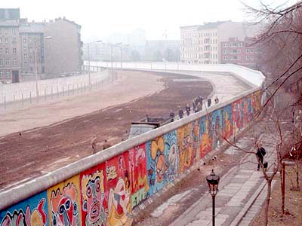
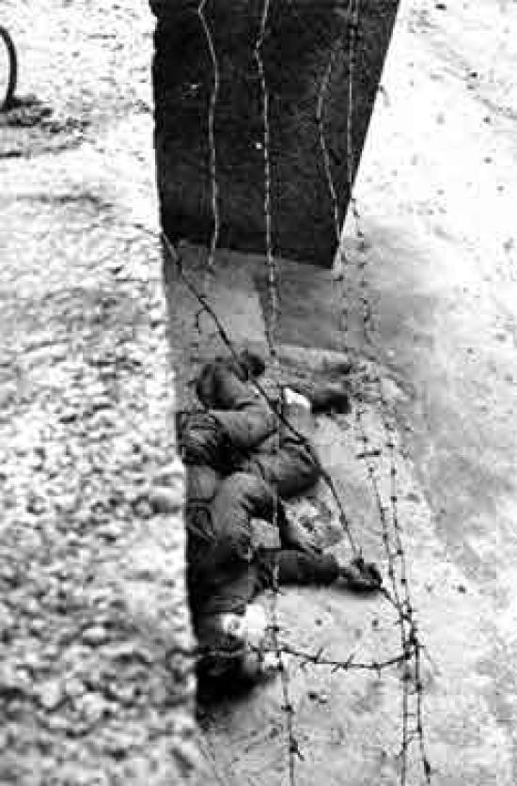
Berlin Wall scenes
Berlin Wall
Peter Fechter August 1962

Slide 35
Communist expansion
Prague Spring and Soviet invasion of Czechoslovakia 1968
Brezhnev Doctrine
  Right to invade a socialist state to stop it adopting capitalism
Soviet support for Arab nations against Israel
Notes:
The Prague Spring was a period of political liberalization in Czechoslovakia during the era of its domination by the Soviet Union after World War II. It began on 5 January 1968, when reformist Slovak Alexander Dubček came to power, and continued until 21 August when the Soviet Union and members of its Warsaw Pact allies (except Romania) invaded the country to halt the reforms.
The Brezhnev Doctrine was a Soviet Union foreign policy
"When forces that are hostile to socialism try to turn the development of some socialist country towards capitalism, it becomes not only a problem of the country concerned, but a common problem and concern of all socialist countries." This doctrine was announced to retroactively justify the Soviet invasion of Czechoslovakia in August 1968 that ended the Prague Spring, along with earlier Soviet military interventions, such as the invasion of Hungary in 1956. These interventions were meant to put an end to democratic liberalization efforts and uprisings that had the potential to compromise Soviet hegemony inside the Eastern bloc, which was considered by the Soviets to be an essential defensive and strategic buffer in case hostilities with NATO were to break out.

Slide 36
Détente and Peaceful Co-existence
Chinese – American relations
  President Nixon visits China 1972
  Sino-Soviet split deepens
Notes:
The US continued to spend heavily on supporting friendly Third World regimes in Asia. Conflicts in peripheral regions and client states—most prominently in Vietnam—continued. Johnson stationed 575,000 troops in Southeast Asia to defeat the National Front for the Liberation of South Vietnam (NLF) and their North Vietnamese allies in the Vietnam War, but his costly policy weakened the US economy and, by 1975, ultimately culminated in what most of the world saw as a humiliating defeat of the world's most powerful superpower at the hands of one of the world's poorest nations.^{[19]}

Slide 37
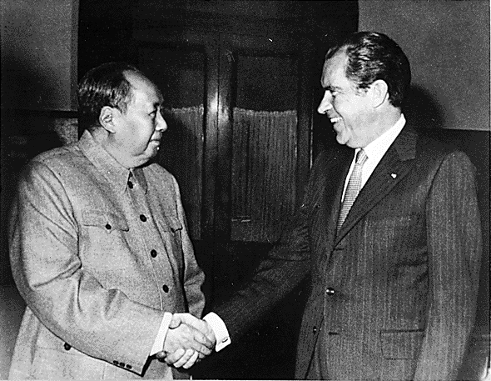
Mao Zedong and Richard Nixon 1972

Slide 38
Détente and Peaceful Co-existence
Chinese – American relations
  President Nixon visits China 1972
  Sino-Soviet split deepens
American – Soviet Relations
  Nixon visits Moscow 1972
  Anti-Ballistic Missile Treaty 1972
  Strategic Arms Limitation Talks 1974
  Helsinki Accords 1975
American defeated in Vietnam 1975
Notes:
The visit ushered in a new era of Sino-American relations. Fearing the possibility of a Sino-American alliance, the Soviet Union yielded to American pressure for détente.
The US continued to spend heavily on supporting friendly Third World regimes in Asia. Conflicts in peripheral regions and client states—most prominently in Vietnam—continued. Johnson stationed 575,000 troops in Southeast Asia to defeat the National Front for the Liberation of South Vietnam (NLF) and their North Vietnamese allies in the Vietnam War, but his costly policy weakened the US economy and, by 1975, ultimately culminated in what most of the world saw as a humiliating defeat of the world's most powerful superpower at the hands of one of the world's poorest nations.

Slide 39
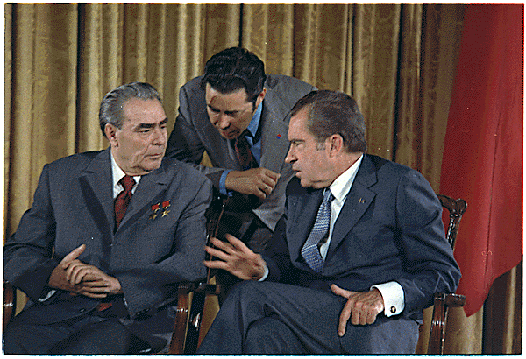
Leonid Brezhnev and Richard Nixon

Slide 40
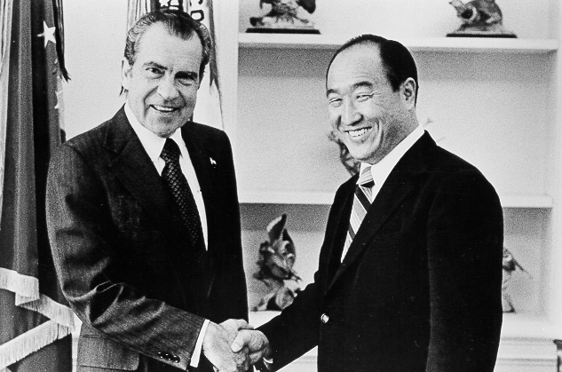
President Nixon and Rev. Moon

Slide 41
Renewed conflict
Soviet invasion of Afghanistan 1979
Solidarity in Poland 1980-81
Thatcher (‘79) and Reagan (‘81) elected
  Falklands conflict 1982
Arms build up by USA
  ‘Stars Wars’, B-1 bomber etc.
  Invasion of Grenada 1983
  Reagan Doctrine
  Support for Contras in Nicaragua
  Support for Mujihadeen in Afghanistan
Notes:
During December 1979, approximately 75,000 Soviet troops invaded Afghanistan in order to support the Marxist government formed by ex-Prime-minister Nur Muhammad Taraki, assassinated that September by one of his party rivals.^{[180]} As a result, US President Jimmy Carter withdrew the SALT II treaty from the Senate, imposed embargoes on grain and technology shipments to the USSR, demanded a significant increase in military spending, and further announced that the United States would boycott the 1980 Moscow Summer Olympics. He described the Soviet intervention in Afghanistan as "the most serious threat to the peace since the Second World War.
Grenada first time country went communist had been returned to democracy

Slide 42
The war against communism
“The Reagan Doctrine proclaimed that the truce with communism was over. The West would henceforth regard no area of the world as destined to forego its liberty simply because the Soviets claimed it to be within their sphere of influence. We would fight a battle of ideas against communism, and we would give material support to those who fought to recover their nations from tyranny.”
Margaret Thatcher, December 1997

Slide 43
Final years
Gorbachev elected 1985
  Perestroika
  Glasnost
Gorbachev – Reagan talks 1985-87
End of Cold War
  Withdrawal from Afghanistan 1989
  End of the Angolan conflict 1989
  Fall of Berlin Wall and revolutions in East Europe 1989
End of Soviet Union 1991

Slide 44
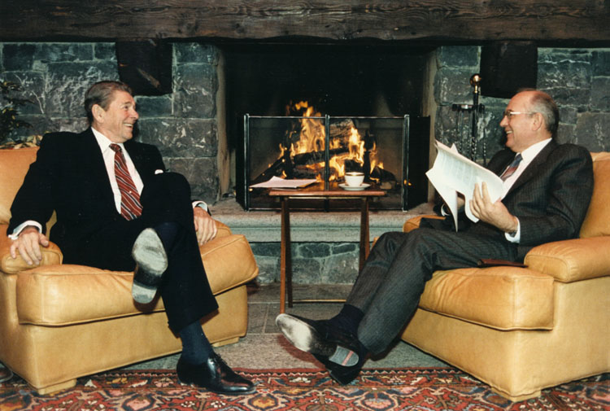
Reagan and Gorbachev

Slide 45
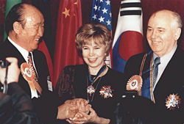
Rev. Moon with Mr and Mrs Gorbachev
Notes:
In 1990, Reverend Moon organized a major meeting of government and media figures in Moscow. During this conference, Reverend and Mrs. Moon met with Soviet President Mikhail Gorbachev. Through several interviews, televised and in print, they gave a message of hope to the Soviet people, urging them to turn toward God.

Slide 46
Third World War in the West over
USA
West Europe
Turkey
USSR
East Europe
Peace

Slide 47
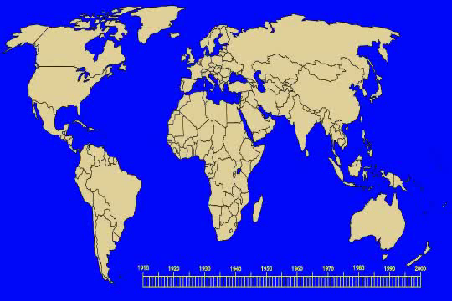
The rise and decline of Communism

Slide 48
What was the human cost of communism?
20-60 million in the Soviet Union
65 million in the People's Republic of China
1 million in Vietnam
2 million in North Korea
2 million in Cambodia
1 million in communist Eastern Europe
150,000 in Latin America
1.7 million in Africa
1.5 million in Afghanistan
Stéphane Courtois (ed) The Black Book of Communism: Crimes, Terror, Repression. Harvard University, 1999

Slide 49
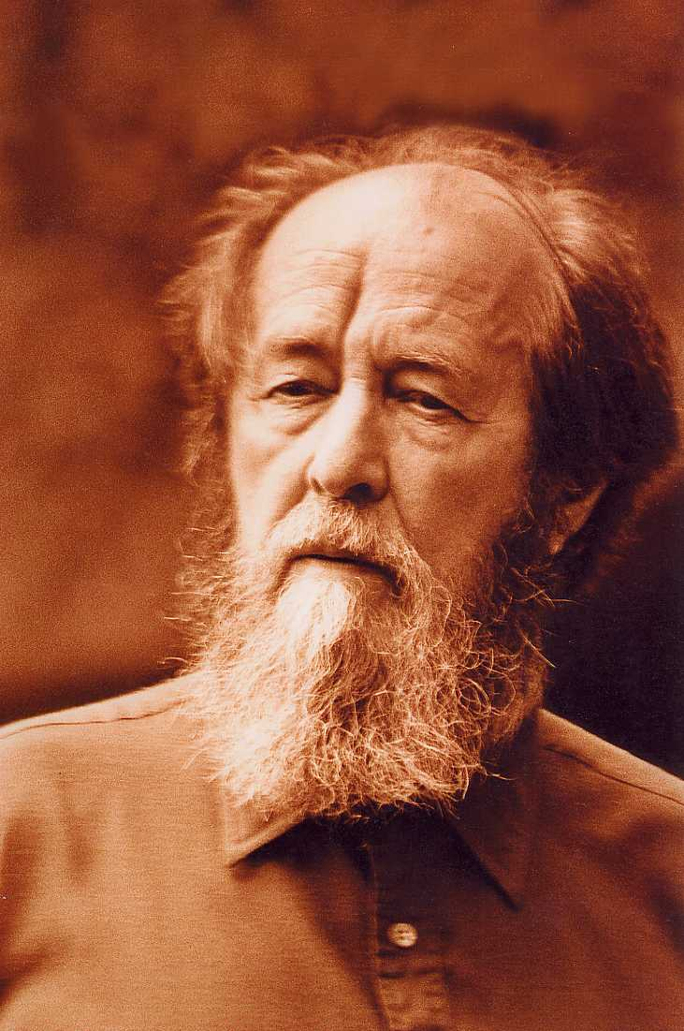
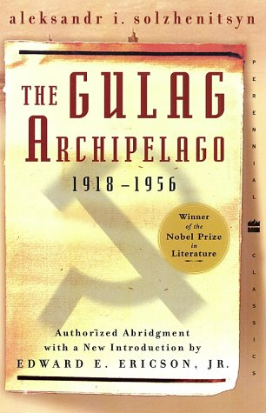
Alexander Solzhenitsyn
Notes:
Aleksandr Isayevich[a] Solzhenitsyn 11 December 1918 – 3 August 2008) was a Russian novelist, historian, and short story writer. He was an outspoken critic of the Soviet Union and communism and helped to raise global awareness of its Gulag forced labor camp system. He was allowed to publish only one work in the Soviet Union, One Day in the Life of Ivan Denisovich (1962), in the periodical Novy Mir. After this he had to publish in the West, most notably Cancer Ward (1968), August 1914 (1971), and The Gulag Archipelago (1973). Solzhenitsyn was awarded the 1970 Nobel Prize in Literature "for the ethical force with which he has pursued the indispensable traditions of Russian literature".[6] Solzhenitsyn was afraid to go to Stockholm to receive his award for fear that he would not be allowed to reenter. He was eventually expelled from the Soviet Union in 1974, but returned to Russia in 1994 after the state's dissolution.

Slide 50

A portrait of everyday Russian life during the repression of the Stalin years, analyzing the regime's effect on people's personal lives as they struggled to survive in the middle of the fear, mistrust, betrayal, and compromise of the world in which they lived.

Slide 51
Results of the end of the war
Peaceful restoration of Cain and Abel on the worldwide level
Restoration of the third blessing possible
  Privatisation, free market
World wide expansion of democracy

Slide 52
How did we contribute to the fall of communism?
VOC
CAUSA
Washington Times
Star Wars
Rallies
CARP
PWPA
http://www.reverendsunmyungmoon.org/works_communism.html

Slide 53
Third World War in the East
USA
Japan
S. Korea
USSR
China
N. Korea
Ideological War
‘Cold War’

Slide 54
God’s side and Satan’s side
Abel side
Cain side
Israel | First Israel | Iran, Syria, Hamas, ISIS
Christian world | Second Israel | China
South Korea | Third Israel | North Korea
Notes:
Cain and Abel relative. Which closest to God’s will and Abel-type view of life

Slide 55
God’s side and Satan’s side
Abel side
Cain side
Judaism | First Israel | Islamism
Christianity | Second Israel | Communism
Unificationism | Third Israel | Juche

Slide 56
Three religions, three nations
Judaism, is in an elder brother's position. Christianity, is in the position of the second brother. The Unification Church, is in the position of the youngest brother. Israel, the United States and Korea, the nations where these three religions are based must be brothers. Because these three nations have a common destiny representing God's side, the Communist bloc as Satan's representative is trying to isolate and destroy them at the U.N.
Sun Myung Moon, Washington Monument, 1976

Slide 57
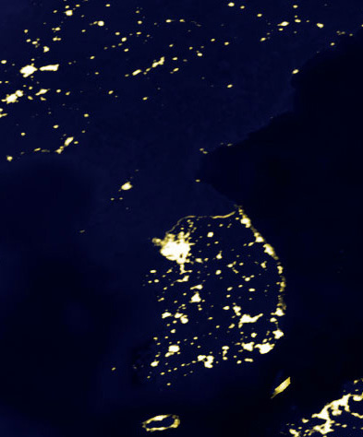
What is North Korea like?
Communist one party state
  Planned economy
  Most militarised nation in the world
  Nuclear state
  Worst human rights
  Religious persecution
North
South
Korea at night
Notes:
Multiple international human rights organizations, including Amnesty International and Human Rights Watch, accuse North Korea of having one of the worst human rights records of any nation. North Koreans have been referred to as "some of the world's most brutalized people" by Human Rights Watch, due to the severe restrictions placed on their political and economic freedoms.
North Korean defectors have testified to the existence of prisons and concentration camps with an estimated 150,000 to 200,000 inmates (about 0.85% of the population), and have reported torture, starvation, rape, murder, medical experimentation, forced labour, and forced abortions. Convicted political prisoners and their families are sent to these camps, where they are prohibited from marrying, required to grow their own food, and cut off from external communication (which was previously allowed)

Slide 58
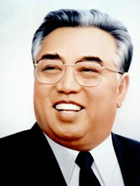
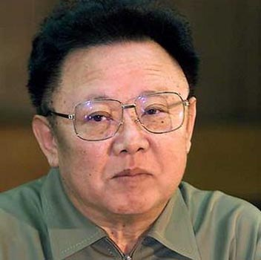
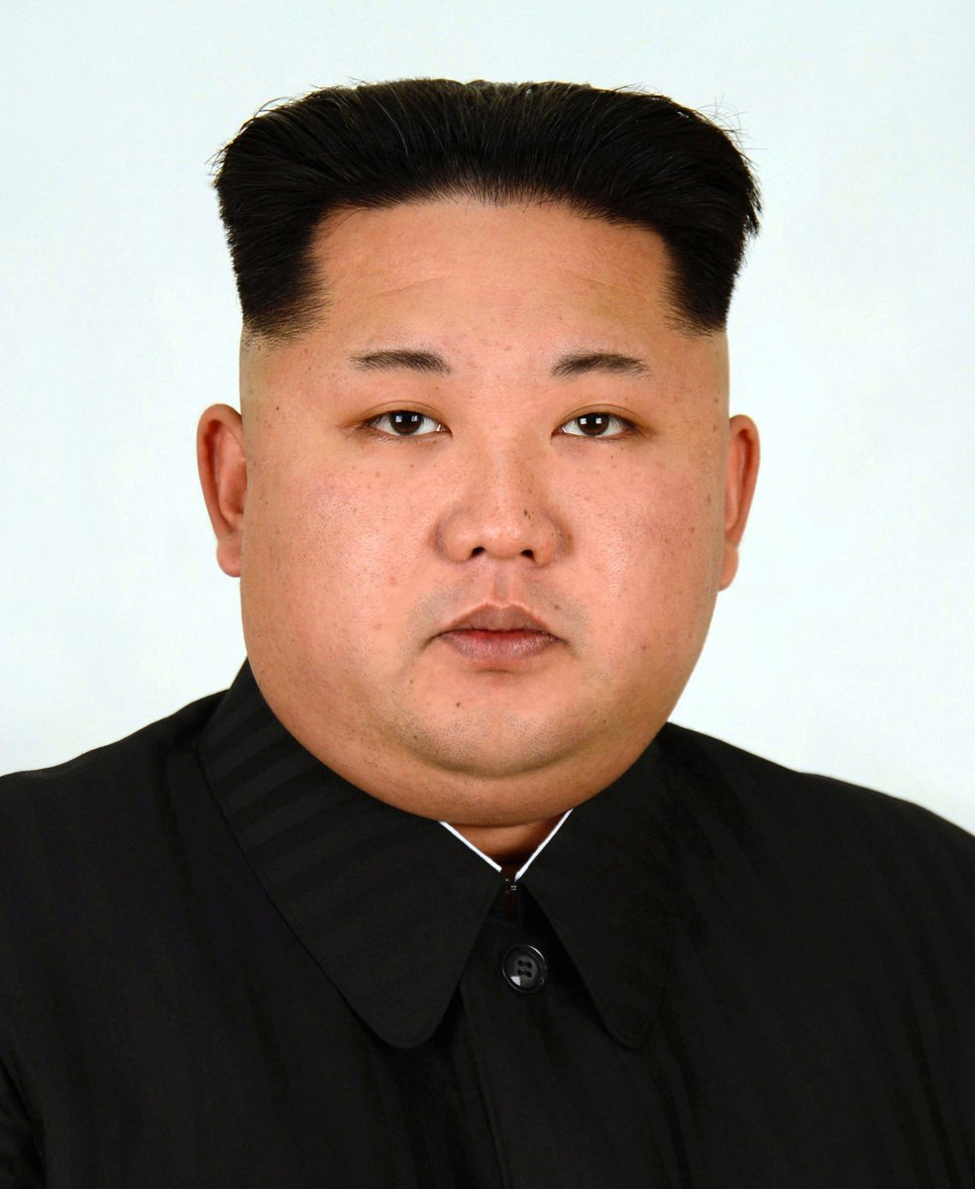
What is North Korea like?
Communist one party state
Hereditary dynasty
  Kim Il Sung – “Great Leader” is the ‘Eternal President’
  Kim Jong Il – “Dear Leader”
  Kim Jong Un – “Brilliant Comrade”
Notes:
Kim Il Sung was raised in a Presbyterian family; his maternal grandfather was a Protestant minister, his father had gone to a missionary school and was an elder in the Presbyterian Church, and both his parents were reportedly very active in the religious community. Kim was an accomplished church organist

Slide 59
What is North Korea like?
Communist one party state
Hereditary dynasty
Personality cult
  “Adore Kim Jong Il with all your heart”
Divine ruler
  “Do not believe in God. Believe in the Great Man.”
Ruling ideology of Juche
  Juche calendar began 1912
Notes:
The Juche Idea is the official state ideology of North Korea (Democratic People's Republic of Korea). It teaches that "man is the master of everything and decides everything," and that the Korean people are the masters of Korea's revolution. Juche is a component of North Korea's political system. Juche literally means "main body" or "subject"; it has also been translated in North Korean sources as "independent stand" and the "spirit of self-reliance".
In 1972, Juche replaced Marxism-Leninism in the revised North Korean constitution as the official state ideology, this being a response to the Sino-Soviet split. Juche was nonetheless defined as a creative application of Marxism-Leninism. Kim Il-sung also explained that Juche was not original to North Korea and that in formulating it he only laid stress on a programmatic orientation that is inherent to all Marxist-Leninist states.
"independence in politics" (chaju)
"self-sustenance in the economy" (charip)
"self-defense in national defense" (chawi).

Slide 60
Third World War
Nature of conflict depends on human responsibility
Military conflict
Cain – Abel
struggle
Fail
Responsibility
Fulfil
Ideological conflict

Slide 61
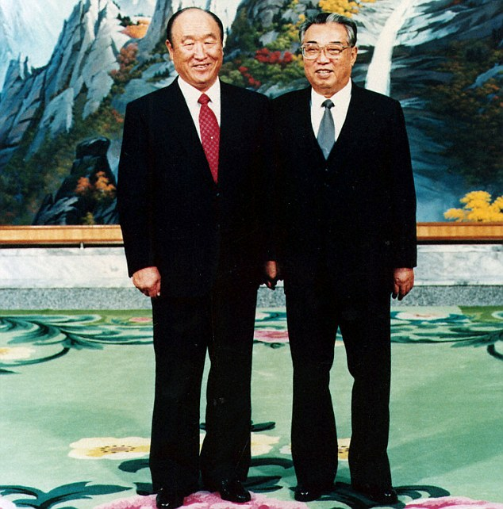
Rev Moon and President Kim
Notes:
December 1991

Slide 62
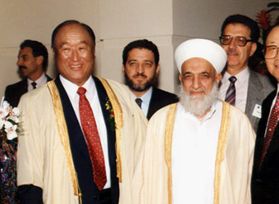
Rev Moon and Grand Mufti of Syria
Notes:
Grand Mufti of Syria 1990

