Slide 1
The foundation to receive the Lord of the Second Advent
God’s 2000 years providence has prepared a democratic social and legal environment which will protect Christ at the Second Advent. EDP, 282
An environment where people are free to realise the three great blessings
  Personal freedom
  Social and political freedom
  Economic freedom

Slide 2
Attitude to freedom
No freedom of religion
  Tsarist Russia banned or restricted all expressions of Christianity other than Russian Orthodoxy, the privileged state church.
  An ideological amalgam of xenophobia, nationalism, and Orthodox triumphalism served as the justification for the wide array of measures taken by the Russian state against non-Orthodox Christians—and other faiths as well.
No right to freedom of speech, association publication, ideas or movement

Slide 3
Attitude to law
Russian thought is rarely associated with philosophy of law. The intellectuals of pre-revolutionary Russia are known rather for their uncompromising critique of legalism, passing sometimes into a genuine ‘legal nihilism’. Indeed, both right-wing and left-wing Russian thinkers – the Slavophiles and Dostoevskii on the one hand, the populists and anarchists (from Bakunin to Tolstoi) on the other – saw modern rational law as an instrument of egoistic bourgeois individualism, destroying the values of communal collectivism still preserved among the Russian peasantry. This attitude found expression not only in different forms of programmatic anti-capitalism but also in a tendency to discredit civil rights and political liberty as a mere mask for capitalist exploitation. Capitalist development and the juridicization of social bonds it involved were perceived as something peculiar to the West, coming to Russia from without and as such not worthy of acceptance. Law and legal rights were criticized in Russia from many quarters and for various reasons: in defence of an idealized autocracy or in defence of true freedom, on behalf of the Russian soul or on behalf of universal progress towards socialism, in the name of Christ or in the name of Marx. In this manner right-wing and left-wing Russian intellectuals supported one another in creating a peculiar tradition of the censure of law. Russian philosophy of law, Andrzej Walicki,
Notes:
For second advent need a legal framework.
However, it would be wrong to draw from these facts a conclusion of an inherent hostility between the ‘Russian mind’ and the ‘spirit of law’. The ‘juridical world-view’ of the Enlightenment was well represented in imperial Russia. The modernizing Russian autocrats – Peter the Great and Catherine the Great – believed firmly in the power of rational legislation and won admiration from among leading European thinkers (Leibniz, Voltaire, Diderot) fir setting a good example for Western monarchs. The first radical critic of Russian autocracy, Aleksandr Radishchev (1749–1802), was in turn a theorist of natural law, a firm believer in inalienable human rights, and an enthusiastic worshipper of the American constitution. Under the reign of Alexander I (1801–25), who himself thought seriously about the introduction of constitutional rule in Russia, admiration for law was very strong among Russia’s intellectual elite. Radischchev’s disciples, Ivan Pnin and Vasilii Popugaev, inspired also by the Scottish Enlightenment, advocated the idea of a ‘civil society’ with a developed system of private law and legally safeguarded human rights. Nikita Murav’ev and Pavel Pestel, ideological leaders of the two trends within the Decembrist movement (named so after the abortive uprising of December l825), expressed their ideas in the form of detailed constitutional projects. A common feature of these projects, otherwise very different, was a pronounced juridical rationalism, sharply contrasting with all variants of a sceptical attitude towards law. https://www.rep.routledge.com/articles/thematic/russian-philosophy-of-law/v-1/sections/boris-chicherin-and-vladimir-solovev

Slide 4
Attitude to property
Land granted by the Crown to nobles who had to serve the state
1762 - no longer had to serve the state
1785 - land transformed from possession to property
Serfs still tied to the land
  1649 serfs given to estates. In 1658, flight was made a criminal offence. Russian landowners eventually gained almost unlimited ownership over Russian serfs. The landowner could transfer the serf without land to another landowner while keeping the serf's personal property and family; however, the landowner had no right to kill the serf
Abolition of serfdom 1861 serfs couldn’t own property
Huge inequality
Lack of respect for institution of private property
Notes:
Emperor Alexander I (r. 1801–1825) wanted to reform the system but moved cautiously, liberating serfs in Estonia, Livonia (both 1816) and Courland (1817) only. New laws allowed all classes (except the serfs) to own land, a privilege previously confined to the nobility.[3] Emperor Alexander II abolished serfdom in the emancipation reform of 1861, a few years later than Austria and other German states. Scholars have proposed multiple overlapping reasons to account for the abolition, including fear of a large-scale revolt by the serfs, the government's financial needs, changing cultural sensibilities, and the military's need for soldiers.[4]

Slide 5
The system of private property is the most important guaranty of freedom, not only for those who own property, but scarcely less for those who do not. F.A. Hayek

Slide 6
Three are inter-related
No private property
  No security of livelihood
  Afraid to express dissenting view and upset power
No rule of law
  Arbitrary arrest and punishment
  No private property
  Afraid to express dissenting view and upset power
No freedom of religion
  No creativity
No possibility of the messiah being able to do his mission

Slide 7
20th Century
Religious-Philosophical Renaissance
1905 revolution
Vekhi (1909) Berdyayev, Lossky, Frank, Kistyakovsky, Struve, Bulgakov
1917
  February revolution
  Re-establishment patriarchate
  October coup
Totalitarian communism – Possessor mentality
Dissidents – Non Possessor mentality
Notes:
The Russian Religious-Philosophical Renaissance was created by lay intellectuals who found rationalism, positivism and Marxism inadequate as explanations of the world or guides to life. They were deeply engaged in finding solutions to the problems of their time, which they saw as moral or spiritual/cultural in nature. Some were already devout Christians; others became so later on. Collectively known as the God-seekers, they propounded their ideas in numerous publications and in the Religious-Philosophical Societies of St Petersburg and Moscow. The meetings of these societies attracted capacity audiences and helped disassociate religion from reaction. Branches were founded in Kiev and Vladimir. The founding members were mainly Symbolist writers and idealist philosophers. Both groups sought a new understanding of Christianity, but the Symbolists emphasized psychological and literary/aesthetic issues and the idealists focused on ethics, epistemology and political and social reform. The Revolution of 1905 was a watershed for all of them. The hitherto apolitical Symbolists perceived it as the start of the apocalypse and championed anarchistic political doctrines. The idealists continued to champion reform. After the revolution, some of them called for a new religious intelligentsia that respected culture and the creation of wealth, spiritual/cultural and material. Both groups began to talk about national identity and destiny. The Bolshevik Revolution signalled the end of the Religious-Philosophical Renaissance. In 1922–3, over 160 non-Marxist intellectuals were forced into exile, where they continued their work. Inside Russia private religious-philosophic study circles carried on illegally.
The Religious-Philosophical Renaissance had a profound impact on Russian thought and culture. It inspired attempts to ground metaphysics and political doctrines in Christianity, demands for church reform, visions of a new culture, sophiology, religious existentialism and new interpretations of Orthodox ritual and dogma. Its proponents made people aware of the needs of the ‘inner man’, the soul or the psyche, and the importance of art and myth. Symbolism became the dominant aesthetic, shaping literature, poetry, painting and theatre. Theorists of Symbolism tried to make it the basis of a new cosmological worldview. The Religious-Philosophical Renaissance was rediscovered by Soviet intellectuals in the 1960s, nourished the dissident movement from then on, and is extensively discussed in Russia today.

Slide 8
Providential analysis?
980-1380 400 years (slavery/patriarchs?) (Kievan Rus)
988 (conversion of Vladimir) - 1380 (Kulikovo Pole)
1380-1502 120 years (united?)
(Muscovy)
1380 (Sergius Radonezh) 1502 (Council division Nil and Joseph)
1503-1917 400 years (divided?)
(Petrine Russia)
1917-1988 70 years (Papal captivity?)
(Communism)
1989-2129 140 years (return, confusion?)

Slide 9
Who is chosen?
What qualifications should the person possess to merit such a calling? First, the central figure must be born into the chosen people. Next, even among the chosen people, he must come from an ancestral line with many good accomplishments. Among the descendants of this outstanding lineage, he must be endowed with the requisite character. Among those with the requisite character, he must develop the necessary qualities during his early life. Finally, among those who have acquired these qualities, God selects first the individual who lives in a time and place most fitting to His need.

Slide 10
Chosen people
God predestines those whom He foreknows; then He calls upon him to fulfil the purpose of the providence. Calling the person is God’s responsibility, but that alone does not entitle the person to be justified before God and given glory. Only when the person completes his responsibility after being called by God is he justified and then glorified. God’s predestination concerning an individual’s glorification is thus contingent upon the completion of his portion of responsibility.

Slide 11
The foundation to receive the Lord of the Second Advent
God’s 2000 years providence has prepared a democratic social and legal environment which will protect Christ at the Second Advent. EDP, 282
An environment where people are free to realise the three great blessings
  Personal freedom
  Social and political freedom
  Economic freedom

Slide 12
Attitude to freedom
No freedom of religion
  Tsarist Russia banned or restricted all expressions of Christianity other than Russian Orthodoxy, the privileged state church.
  An ideological amalgam of xenophobia, nationalism, and Orthodox triumphalism served as the justification for the wide array of measures taken by the Russian state against non-Orthodox Christians—and other faiths as well.
No right to freedom of speech, association publication, ideas or movement

Slide 13
Attitude to law
Russian thought is rarely associated with philosophy of law. The intellectuals of pre-revolutionary Russia are known rather for their uncompromising critique of legalism, passing sometimes into a genuine ‘legal nihilism’. Indeed, both right-wing and left-wing Russian thinkers – the Slavophiles and Dostoevskii on the one hand, the populists and anarchists (from Bakunin to Tolstoi) on the other – saw modern rational law as an instrument of egoistic bourgeois individualism, destroying the values of communal collectivism still preserved among the Russian peasantry. This attitude found expression not only in different forms of programmatic anti-capitalism but also in a tendency to discredit civil rights and political liberty as a mere mask for capitalist exploitation. Capitalist development and the juridicization of social bonds it involved were perceived as something peculiar to the West, coming to Russia from without and as such not worthy of acceptance. Law and legal rights were criticized in Russia from many quarters and for various reasons: in defence of an idealized autocracy or in defence of true freedom, on behalf of the Russian soul or on behalf of universal progress towards socialism, in the name of Christ or in the name of Marx. In this manner right-wing and left-wing Russian intellectuals supported one another in creating a peculiar tradition of the censure of law. Russian philosophy of law, Andrzej Walicki,
Notes:
For second advent need a legal framework.
However, it would be wrong to draw from these facts a conclusion of an inherent hostility between the ‘Russian mind’ and the ‘spirit of law’. The ‘juridical world-view’ of the Enlightenment was well represented in imperial Russia. The modernizing Russian autocrats – Peter the Great and Catherine the Great – believed firmly in the power of rational legislation and won admiration from among leading European thinkers (Leibniz, Voltaire, Diderot) fir setting a good example for Western monarchs. The first radical critic of Russian autocracy, Aleksandr Radishchev (1749–1802), was in turn a theorist of natural law, a firm believer in inalienable human rights, and an enthusiastic worshipper of the American constitution. Under the reign of Alexander I (1801–25), who himself thought seriously about the introduction of constitutional rule in Russia, admiration for law was very strong among Russia’s intellectual elite. Radischchev’s disciples, Ivan Pnin and Vasilii Popugaev, inspired also by the Scottish Enlightenment, advocated the idea of a ‘civil society’ with a developed system of private law and legally safeguarded human rights. Nikita Murav’ev and Pavel Pestel, ideological leaders of the two trends within the Decembrist movement (named so after the abortive uprising of December l825), expressed their ideas in the form of detailed constitutional projects. A common feature of these projects, otherwise very different, was a pronounced juridical rationalism, sharply contrasting with all variants of a sceptical attitude towards law. https://www.rep.routledge.com/articles/thematic/russian-philosophy-of-law/v-1/sections/boris-chicherin-and-vladimir-solovev

Slide 14
Attitude to property
Land granted by the Crown to nobles who had to serve the state
1762 - no longer had to serve the state
1785 - land transformed from possession to property
Serfs still tied to the land
  1649 serfs given to estates. In 1658, flight was made a criminal offence. Russian landowners eventually gained almost unlimited ownership over Russian serfs. The landowner could transfer the serf without land to another landowner while keeping the serf's personal property and family; however, the landowner had no right to kill the serf
Abolition of serfdom 1861. Serfs couldn’t own property
Huge inequality
Lack of respect for institution of private property
Notes:
Emperor Alexander I (r. 1801–1825) wanted to reform the system but moved cautiously, liberating serfs in Estonia, Livonia (both 1816) and Courland (1817) only. New laws allowed all classes (except the serfs) to own land, a privilege previously confined to the nobility.[3] Emperor Alexander II abolished serfdom in the emancipation reform of 1861, a few years later than Austria and other German states. Scholars have proposed multiple overlapping reasons to account for the abolition, including fear of a large-scale revolt by the serfs, the government's financial needs, changing cultural sensibilities, and the military's need for soldiers.[4]

Slide 15
Why private property?
The system of private property is the most important guaranty of freedom, not only for those who own property, but scarcely less for those who do not. F.A. Hayek
True owner and Lord of Creation

Slide 16
Three are inter-related
No private property
  No security of livelihood
  Afraid to express dissenting view and upset power
No rule of law
  Arbitrary arrest and punishment
  Property not protected
  Afraid to express dissenting view and upset power
No freedom of religion
  No creativity
No possibility of the messiah being able to do his mission

Slide 17
The world wars in the providence of restoration

Slide 18
What causes historical events?
Purpose
Free will
Real situation
Historical event
Notes:
People make decisions depending on their circumstances and environment to achieve a purpose -> event. Not deterministic. Not pre-destined.

Slide 19
Internal and external causes
Internal cause -
God’s providence
Historical event
Which is expressed as:
External cause -
Clash of political and economic interests

Slide 20
What are the providential causes of the world wars?
Satan’s attempt to preserve sovereignty
  Dictatorship
  Totalitarianism
  Authoritarianism
  Cult personality
  Sexual abuse
  Bullying
  Organised criminality
  Injustice
  Discrimination
  Nationalisation
Notes:
Satan’s sovereignty – oppressive dictatorships

Slide 21
What are the providential causes of the world wars?
Satan’s attempt to preserve sovereignty
2. Indemnity condition to restore God’s
sovereignty
  Restoring Satan’s invasion of the Enlightenment in Germany and Russia
  Establishing foundation to receive the messiah
  Cain and Abel restoration through 3 stages
  Abel world prevails over the Cain world
Notes:
Satan’s sovereignty – oppressive dictatorships

Slide 22
What is the meaning of restoration through indemnity?
When someone has lost his original position or state, he must make some condition to be restored to it. The making of such conditions of restitution is called indemnity. For example, to recover lost reputation, position or health, one must make the necessary effort or pay the due price. Suppose two people who once loved each other come to be on bad terms; they must make some condition of reconciliation before the love they previously enjoyed can be revived.
When a person has failed to meet a condition of lesser indemnity, he must make another indemnity condition to return to the original state, this time at a price greater than the first.
For anyone to be restored to the original position or state from which he fell, he must make an indemnity condition by reversing the course of his mistake.

Slide 23
What are the providential causes of the world wars?
3. Worldwide indemnity condition to restore the three blessings
  Satanic imitations of the three blessings
    Individual champion of Satan’s causes
    Multiplication of Satanic children
    Conquest of the world under Satanic domination
4. Overcome on the world level the three
temptations of Jesus
    WW 1 – 1st blessing -- 1st temptation
    WW 2 – 2nd blessing -- 2nd temptation
    WW 3 – 3rd blessing -- 3rd temptation

Slide 24
Who is on God’s and who is on Satan’s side?
God’s side | Satan’s side
Support God’s providence | Oppose God’s providence
Abel view of life | Cain view of life
Support Christianity | Oppose Christianity
Attacked | Aggressor
Notes:
Those who support God’s providence
Moses and the slave driver
Israelites and the Canaanites
Jesus and Judaism
Abel view of life – Christian democracy and religious freedom. Cain – humanism, atheism
Christianity is the central religion for God’s providence

Slide 25
The First World War
1914-1918
Notes:
World War I was a military conflict centered on Europe that began in the summer of 1914. The fighting ended in late 1918. This conflict involved all of the world's great powers, assembled in two opposing alliances: the Allies (centred around the Triple Entente) and the Central Powers. More than 70 million military personnel, including 60 million Europeans, were mobilized in one of the largest wars in history. More than 9 million combatants were killed, due largely to great technological advances in firepower without corresponding ones in mobility. It was the second deadliest conflict in history.

Slide 26
How did World War I start?
Archduke Ferdinand, heir to Hapsburg throne, assassinated by Serbian nationalists 28th June 1914
Notes:
Following Russia’s defeat of Turkey in 1878 Ottoman’s weakened and withdraw from Balkans. New nations created at Congress of Berlin by Bismark. Lots of dissatisfaction especially by Russia.
The Balkan Wars were two conflicts that took in 1912 and 1913 The Ottoman Empire lost nearly all of its holdings in Europe. Austria-Hungary, although not a combatant, was weakened as a much enlarged Serbia pushed for union of the South Slavic peoples. The war set the stage for the Balkan crisis of 1914 and thus was a "prelude to the First World War.
AH and Russia both wanted to expand into Balkans. AH looking for a pretext.
Assassination the excuse. Serbia refused to cooperate to bring perpetrators to justice.
Russia also interested in Balkans. Protector of Slavs.
AH shouldn’t have invaded Serbia
Britain had a treaty to protect neutral Belgium. When Germany invaded Belgium GB declared war on Germany

Slide 27
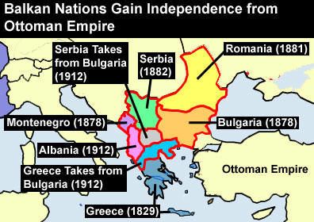

Slide 28
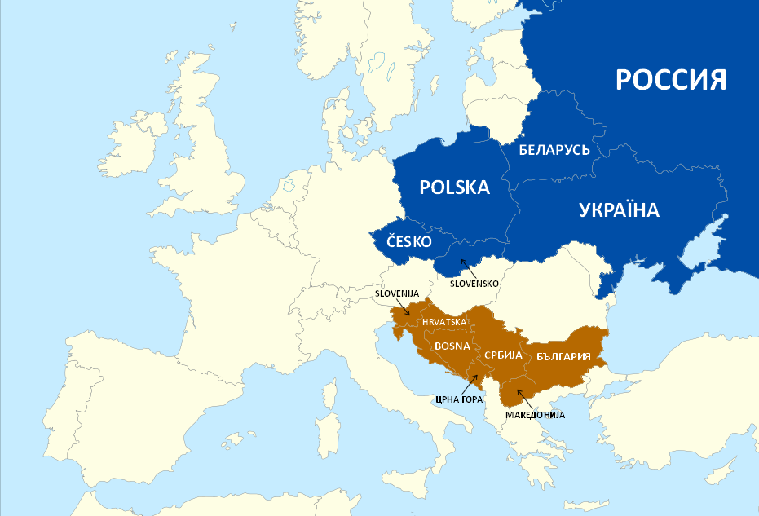
Slavic nations

Slide 29
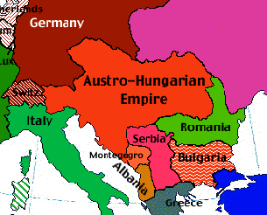
Russian Empire
Turkey

Slide 30
How did World War I start?
Archduke Ferdinand, heir to Hapsburg throne, assassinated by Serbian nationalists 28th June 1914
Austria-Hungary declares war on Serbia 28th July
Russian mobilisation 30th July
Germany declares war on Russia 1st August
Germany and Ottoman Empire sign treaty 2nd August
Germany declares war on France 3rd August
Britain declares war on Germany 4th August
Austria-Hungary declares war on Russia 6th August
Notes:
Following Russia’s defeat of Turkey in 1878 Ottoman’s weakened and withdraw from Balkans. New nations created at Congress of Berlin by Bismarck. Lots of dissatisfaction especially by Russia.
The Balkan Wars were two conflicts that took in 1912 and 1913 The Ottoman Empire lost nearly all of its holdings in Europe. Austria-Hungary, although not a combatant, was weakened as a much enlarged Serbia pushed for union of the South Slavic peoples. The war set the stage for the Balkan crisis of 1914 and thus was a "prelude to the First World War.
AH and Russia both wanted to expand into Balkans. AH looking for a pretext.
Assassination the excuse. Serbia refused to cooperate to bring perpetrators to justice.
Russia also interested in Balkans. Protector of Slavs.
AH shouldn’t have invaded Serbia
Prussia dominated Germany wanting to fight Slavs. Looking for a pretext to attack Russia. Prussia had the big army
Britain had a treaty to protect neutral Belgium. When Germany invaded Belgium GB declared war on Germany

Slide 31
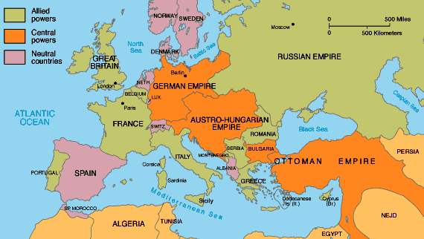
Where is all this happening?

Slide 32
What was behind this?
Shifting balance of power
  Germany vs. France - 1870
  German expansionism - 'place in the sun’
  Ottoman Empire weakening
  Austria-Hungary desire for expansion into Balkans
  Russia growing economically and modernizing
Growth of nationalism e.g Serbia
Changing alliances of support
  Germany, Austria-Hungary, Italy
  France, Russia, Great Britain
Imperial rivalry and arms race
  Colonies, power, raw materials and trade
Notes:
1866 – Prussia defeated west German principlaties and forced unification of Germany dominated by Prussia.
1870 – Germany defeated France and annexed Alsac- Lorraine. France wanted it back.
In the 19th century, the major European powers had gone to great lengths to maintain a balance of power throughout Europe, resulting by 1900 in a complex network of political and military alliances throughout the continent. These had started in 1815, with the Holy Alliance between Prussia, Russia, and Austria. Then, in October 1873, German Chancellor Bismarck negotiated the League of the Three Emperors (German: Dreikaiserbund) between the monarchs of Austria–Hungary, Russia and Germany. This agreement failed because Austria–Hungary and Russia could not agree over Balkan policy, leaving Germany and Austria–Hungary in an alliance formed in 1879, called the Dual Alliance. This was seen as a method of countering Russian influence in the Balkans as the Ottoman Empire continued to weaken. In 1882, this alliance was expanded to include Italy in what became the Triple Alliance.
After 1870, European conflict was averted largely due to a carefully planned network of treaties between the German Empire and the remainder of Europe orchestrated by Chancellor Bismarck. He especially worked to hold Russia at Germany's side to avoid a two-front war with France and Russia. With the ascension of Wilhelm II as German Emperor (Kaiser), Bismarck's system of alliances was gradually de-emphasized. For example, the Kaiser refused to renew the Reinsurance Treaty with Russia in 1890. Two years later the Franco-Russian Alliance was signed to counteract the force of the Triple Alliance. In 1904, the United Kingdom sealed an alliance with France, the Entente cordiale and in 1907, the United Kingdom and Russia signed the Anglo-Russian Convention. This system of interlocking bilateral agreements formed the Triple Entente.
From the time of the Balkan Wars, which had increased the size of Serbia, it had been the opinion of leading Austrian officials, (most notably the Foreign Minister), Count Leopold von Berchtold, that Austria would have to wage a "preventive war" to greatly weaken or destroy Serbia as a state in order to preserve the dual monarchy which held extensive Serb-populated Balkan territories. Between January 1913 and January 1914, Conrad advocated a preventive war against Serbia twenty four times.
In November 1912 Russia, humiliated by its inability to support Serbia during the Bosnian crisis of 1908 or the First Balkan War, announced a major reconstruction of its military.
Wilhelm II called British balance of power principles “idiocy,” but agreed that Haldane’s statement was a “desirable clarification” of British policy. His opinion was that Austria should attack Serbia that December, and if “Russia supports the Serbs, which she evidently does…then war would be unavoidable for us, too,” and that would be better than going to war after Russia completed the massive modernization and expansion of their army that they had just begun. Moltke agreed. In his professional military opinion “a war is unavoidable and the sooner the better”. Moltke “wanted to launch an immediate attack”.
Both Wilhelm II and the Army leadership agreed that if a war were necessary it were best launched soon. Admiral Tirpitz, however, asked for a “postponement of the great fight for one and a half years” because the Navy was not ready for a general war that included Britain as an opponent. He insisted that the completion of the construction of the U-boat base at Heligoland and the widening of the Kiel Canal were the Navy’s prerequisites for war
French president Poincaré was more interested in the idea of French expansion in the Middle East than a war of revenge to regain Alsace-Lorraine. Had the Reich been interested in improved relations with France before August 1914, the opportunity was available, but the leadership of the Reich lacked such interests, and preferred a policy of war to destroy France.
German-Austrian treaty (1879) or Dual Alliance Italy joining Germany and Austria in 1882 Franco-Russian Alliance (1894) The "Entente Cordiale" between Britain and France (1904) which left the northern coast of France undefended, and the separate "entente" between Britain and Russia (1907) forming the Triple Entente
Rivalries for not just colonies, but colonial trade and trade routes developed between the emerging economic powers and the incumbent great powers. Although still argued differently according to historical perspectives on the path to war, this rivalry was illustrated in the Berlin-Baghdad Railway, which would have given German industry access to Iraqi oil, and German trade a southern port in the Persian Gulf. A history of this railroad in the context of World War I has arrived to describe the German interests in countering the British Empire at a global level, and Turkey's interest in countering their Russian rivals at a regional level. As stated by a contemporary 'man on the ground' at the time, Jastrow wrote "It was felt in England that if, as Napoleon is said to have remarked, Antwerp in the hands of a great continental power was a pistol leveled at the English coast, Bagdad and the Persian Gulf in the hands of Germany (or any other strong power) would be a 42-centimetre gun pointed at India.
fear that "windows of opportunity for victorious wars" were closing, "the arms race did precipitate the First World War". Some historians see the German naval build-up as the principal cause of deteriorating Anglo-German relations. Germany built up navy as a way to divert finances from Prussian army and Berlin. Navy improved economy of western Germany. But it was foolish as meant Germany facing 3 way fight. Russia, France and UK. Shiflen plan not developed for 3 way fight.
The Franco-Prussian War was initiated by Napoleon III of France, who was alarmed at the rapid growth in population and unity among the German people and eventually chose to declare war in the face of potential loss of French international prestige. This period marked a relative decline in the strength of France, which continued into the 20th century. The war ended with a Prussian victory, and Germany unified soon after. Alsace-Lorraine, a border territory, was transferred from France to Germany. The resulting disruption in the balance of power led France to seek alliances with Russia and the United Kingdom.

Slide 33
German perspective
Professor Fritz Fischer, Grasp for World Power’ (1961) and War of Illusions (1969) argued that:
There was a 'will to war' amongst the leaders of Germany – plans, policies etc.
The German government wanted events to slide into war in 1914 – eager for war with Russia
The German government had a plan of expansion very similar to that of Nazi Germany in the 1930s
This was as a result of social and economic factors inside Germany - the attitude of Germans - as much as it was the result of any fears about foreign policy or the international scene.

Slide 34
What were the providential causes?

Slide 35
Providential causes of WW 1
Restore the 3 blessings on the formation stage: Satanic imitation of the 3 blessings:
  Anti-type of Adam – Kaiser Wilhelm II
  Pan-Germanism
  World domination
Notes:
After 40 days Jesus tempted. 40 days to restore 400 years lost because JB failure. If UK occupied Korea maybe no WW necessary???
Wilhelmine Germany is that from 1897 it was run as a "functioning monarchy" with power concentrated in the hands of one man (thought by many who knew him to be mad) and that, as a result, "the Kaiser, the royal family, the Kaiser's circle of friends, the [imperial entourage and the court form[ed] the heart of this system on which the very highest officials of the Reich and state bureaucracy (as well as the leaders of the army and the navy) were psychologically dependent." the period 1888-1890 was dominated by the conflict with the 'all-powerful" Bismarck; the years 1890-1897 were ones of transition from an "improvised" to "an institutionalised personal rule" (the latter phrase borrowed from the German constitutional historian, Huber); the period 1897 -1908 represented Bulow's promised "personal rule in the good sense" (i.e. with the cooperation of a sycophantic Chancellor), a period which may well have extended till 1914. Almost all the controversial legislation of the Wilhelmine period, according to Rohl, can be traced back to the Kaiser's own initiative. best examples of the Kaiser's personal rule, according to Rohl, were "the social and socialist policies, the gigantic fleet-building programme and the Prussian canal policy." The building of the fleet was, of course, to have tremendous consequences driving Great Britain into the arms of Russia and France and thus helping Germany lose the First World War. by 1902 Maximilian Harden was writing in Die Zukunft that "the Kaiser (was) his own Reich Chancellor" and that "all the important decisions of the past twelve years [had] been taken by him." The situation was such that no high-ranking minister, army or naval officer, courtier or civil servant would risk disagreeing with the Kaiser in case he dismissed them- negative personal rule”. Wilhelm did not even like ministers to submit their own resignations--that showed too much independence- although a frosty glance, a curt dismissal, a lack of conversation or an imperial contradiction might all be motives for resignation none the less. In the end courtiers, diplomats, civil servants and officers all became sycophants. Certainly, he always remained immature, with one courtier complaining in 1908: "he is a child and will always remain one." He was also an egomaniac with a complete over-estimation of his own abilities which he loved to talk about. Unfortunately these did not include a sense of reality, for he saw things only as he wished. Thus the French and English were once described in a racial diatribe as " not Whites at all but Blacks" while Jesus of Nazareth, he claimed, "had never been a Jew." Nor did he have any sense of proportion or moderation, always calling for revenge on enemies who had to die or be punished, since he hated all sorts of groups and classes, not to mention individuals such as his parents. His sense of humour, perhaps not surprisingly therefore, included hitting, beating, stabbing or otherwise humiliating colleagues and servants. As far as his sex life was concerned, he had innumerable affairs with prostitutes before ascending the throne in 1888, after which time he became more interested in men, particularly- soldiers. He had a withered left arm and was later to suffer deafness in the right ear. The most important fact, however, was that he suffered from growths and discharges in the inner ear near the brain, a condition which drove him al most mad. Lord Salisbury thought him "not quite normal", Sir Edward Grey, "not quite sane". Other European dignitaries thought him "mentally ill" or having "a screw loose." Leading German princes and statesmen felt the same, with Bismarck explaining that he had only wanted to remain in office after 1888 because he knew of Wilhelm's "abnormal mental condition", something which even Eulenburg was shocked and frightened by. Indeed, on one occasion Eulenburg recorded: "Pale, ranting wildly, looking restlessly about him and piling lie upon lie, he made such a terrible impression on me that I still cannot get over it."
Such Hitler-like rages made Eulenburg predict an imperial nervous breakdown, something, however, that never occurred. Still, there were occasions when rumours spread that the Kaiser would have to be committed--again, something which never actually took place. Fits of rage, unfortunately, were not the only characteristic that the Kaiser shared with Hitler. Full-blooded anti-Semitism was another and Rohl makes it perfectly clear that Wilhelm II had nothing to learn in this respect from the Fuhrer. If, like Hitler, he had Jewish friends as a youth, he later turned on the Jews as Germany's most deadly enemy, informing Sir Edward Grey, for example, in 1907 that "They want stamping out." He also believed in a international conspiracy of Jewish capitalists and communists - the Golden International, blaming the First World War, Germany's defeat and his own - abdication on an international} conspiracy of Jewish freemasons, so that in exile in Holland his anti-Semitism reached fever pitch. In 1919 he wrote to General von Mackensen: "Let no German.... rest until these parasites have been destroyed and exterminated." He called for an international, Russian-style pogrom against them condemning them as a "nuisance" that humanity must in some way destroy. Then in his own hand, he added: " I believe the best would be gas." It was altogether natural, therefore, that, before he died in June 1941, he welcomed Hitler's victories as confirmation of the fighting qualities of the troops of 1914-1918. He boasted: " The hand of God is creating a new World and working miracles....We are becoming a U.S. of Europe under German leadership, a united European Continent, nobody ever hoped to see.....The Jews are being (sic) thrust out of their nefarious positions in all countries, whom they have driven to hostility for centuries.” Rohl also believes that, like Hitler, the Kaiser was responsible for starting a world war. His analysis of the December 1912 War Council makes clear that the people who counted were the Kaiser's naval and military friends and that the civilian leaders--the Chancellor and the Foreign Secretary-- took second place. As a result, the 1913 Army Bill was pushed through, naval plans for war against Britain were prepared, stockpiling of gold and fodder was approved and the course set for war in 1914 when the Kiel Canal would be ready - as Tirpitz demanded. Moltke, of course, wanted war straight away. Rohl makes clear that, despite early doubts, the Kaiser gave unconditional support to Austria during the First Balkan War and was ready to unleash a world war to defend Austria- Hungary's position in the Balkans. In short the "blank cheque" of 1914 was ready for delivery as soon as the other preparations were completed. Rohl doesn't say so in his book, but I know from seminar discussions with him, that he suspects that Berlin may even have been behind Franz Ferdinand's assassination at Sarajevo in 1914.
Pan-Germanism (German: Pangermanismus or Alldeutsche Bewegung) was a political movement of the 19th century aiming for unity of the German-speaking populations of Europe, identified as Volksdeutsche ("ethnic Germans").

Slide 36
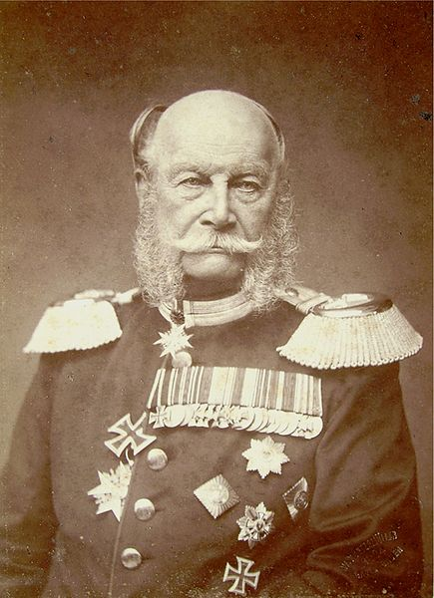
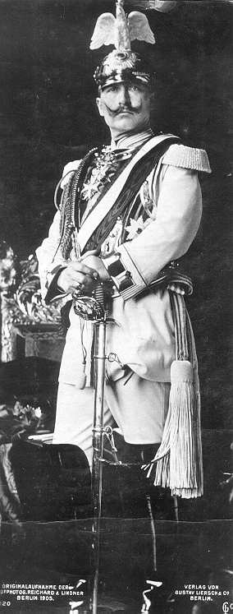
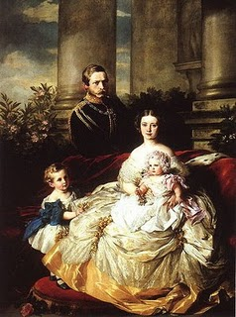
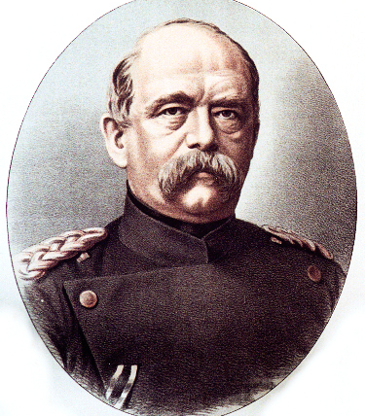
Wilhelm I
Frederick and Victoria
Bismarck
Wilhelm II

Slide 37
Providential causes of WW 1
Restore the 3 blessings on the formation stage: Satanic imitation of the 3 blessings:
  Anti-type of Adam – Kaiser Wilhelm II
  Pan-Germanism
  World domination
Overcome 1st temptation of Jesus
  Foundation for birth of the messiah
Restoration of God’s sovereignty through expansion of democracy and Christianity
Notes:
After 40 days Jesus tempted. 40 days to restore 400 years lost because JB failure. If UK occupied Korea maybe no WW necessary???
Wilhelmine Germany is that from 1897 it was run as a "functioning monarchy" with power concentrated in the hands of one man (thought by many who knew him to be mad) and that, as a result, "the Kaiser, the royal family, the Kaiser's circle of friends, the [imperial entourage and the court form[ed] the heart of this system on which the very highest officials of the Reich and state bureaucracy (as well as the leaders of the army and the navy) were psychologically dependent." the period 1888-1890 was dominated by the conflict with the 'all-powerful" Bismarck; the years 1890-1897 were ones of transition from an "improvised" to "an institutionalised personal rule" (the latter phrase borrowed from the German constitutional historian, Huber); the period 1897 -1908 represented Bulow's promised "personal rule in the good sense" (i.e. with the cooperation of a sycophantic Chancellor), a period which may well have extended till 1914. Almost all the controversial legislation of the Wilhelmine period, according to Rohl, can be traced back to the Kaiser's own initiative. best examples of the Kaiser's personal rule, according to Rohl, were "the social and socialist policies, the gigantic fleet-building programme and the Prussian canal policy." The building of the fleet was, of course, to have tremendous consequences driving Great Britain into the arms of Russia and France and thus helping Germany lose the First World War. by 1902 Maximilian Harden was writing in Die Zukunft that "the Kaiser (was) his own Reich Chancellor" and that "all the important decisions of the past twelve years [had] been taken by him." The situation was such that no high-ranking minister, army or naval officer, courtier or civil servant would risk disagreeing with the Kaiser in case he dismissed them- negative personal rule”. Wilhelm did not even like ministers to submit their own resignations--that showed too much independence- although a frosty glance, a curt dismissal, a lack of conversation or an imperial contradiction might all be motives for resignation none the less. In the end courtiers, diplomats, civil servants and officers all became sycophants. Certainly, he always remained immature, with one courtier complaining in 1908: "he is a child and will always remain one." He was also an egomaniac with a complete over-estimation of his own abilities which he loved to talk about. Unfortunately these did not include a sense of reality, for he saw things only as he wished. Thus the French and English were once described in a racial diatribe as " not Whites at all but Blacks" while Jesus of Nazareth, he claimed, "had never been a Jew." Nor did he have any sense of proportion or moderation, always calling for revenge on enemies who had to die or be punished, since he hated all sorts of groups and classes, not to mention individuals such as his parents. His sense of humour, perhaps not surprisingly therefore, included hitting, beating, stabbing or otherwise humiliating colleagues and servants. As far as his sex life was concerned, he had innumerable affairs with prostitutes before ascending the throne in 1888, after which time he became more interested in men, particularly- soldiers. He had a withered left arm and was later to suffer deafness in the right ear. The most important fact, however, was that he suffered from growths and discharges in the inner ear near the brain, a condition which drove him al most mad. Lord Salisbury thought him "not quite normal", Sir Edward Grey, "not quite sane". Other European dignitaries thought him "mentally ill" or having "a screw loose." Leading German princes and statesmen felt the same, with Bismarck explaining that he had only wanted to remain in office after 1888 because he knew of Wilhelm's "abnormal mental condition", something which even Eulenburg was shocked and frightened by. Indeed, on one occasion Eulenburg recorded: "Pale, ranting wildly, looking restlessly about him and piling lie upon lie, he made such a terrible impression on me that I still cannot get over it."
Such Hitler-like rages made Eulenburg predict an imperial nervous breakdown, something, however, that never occurred. Still, there were occasions when rumours spread that the Kaiser would have to be committed--again, something which never actually took place. Fits of rage, unfortunately, were not the only characteristic that the Kaiser shared with Hitler. Full-blooded anti-Semitism was another and Rohl makes it perfectly clear that Wilhelm II had nothing to learn in this respect from the Fuhrer. If, like Hitler, he had Jewish friends as a youth, he later turned on the Jews as Germany's most deadly enemy, informing Sir Edward Grey, for example, in 1907 that "They want stamping out." He also believed in a international conspiracy of Jewish capitalists and communists - the Golden International, blaming the First World War, Germany's defeat and his own - abdication on an international} conspiracy of Jewish freemasons, so that in exile in Holland his anti-Semitism reached fever pitch. In 1919 he wrote to General von Mackensen: "Let no German.... rest until these parasites have been destroyed and exterminated." He called for an international, Russian-style pogrom against them condemning them as a "nuisance" that humanity must in some way destroy. Then in his own hand, he added: " I believe the best would be gas." It was altogether natural, therefore, that, before he died in June 1941, he welcomed Hitler's victories as confirmation of the fighting qualities of the troops of 1914-1918. He boasted: " The hand of God is creating a new World and working miracles....We are becoming a U.S. of Europe under German leadership, a united European Continent, nobody ever hoped to see.....The Jews are being (sic) thrust out of their nefarious positions in all countries, whom they have driven to hostility for centuries.” Rohl also believes that, like Hitler, the Kaiser was responsible for starting a world war. His analysis of the December 1912 War Council makes clear that the people who counted were the Kaiser's naval and military friends and that the civilian leaders--the Chancellor and the Foreign Secretary-- took second place. As a result, the 1913 Army Bill was pushed through, naval plans for war against Britain were prepared, stockpiling of gold and fodder was approved and the course set for war in 1914 when the Kiel Canal would be ready - as Tirpitz demanded. Moltke, of course, wanted war straight away. Rohl makes clear that, despite early doubts, the Kaiser gave unconditional support to Austria during the First Balkan War and was ready to unleash a world war to defend Austria- Hungary's position in the Balkans. In short the "blank cheque" of 1914 was ready for delivery as soon as the other preparations were completed. Rohl doesn't say so in his book, but I know from seminar discussions with him, that he suspects that Berlin may even have been behind Franz Ferdinand's assassination at Sarajevo in 1914.
Pan-Germanism (German: Pangermanismus or Alldeutsche Bewegung) was a political movement of the 19th century aiming for unity of the German-speaking populations of Europe, identified as Volksdeutsche ("ethnic Germans").

Slide 38
Who’s who in World War I?
Adam’s Family
Abel Side
Cain Side
Russia | Adam Position | Germany
Great Britain and Empire | Eve Position | Austria-Hungary
France | Archangel Position | Ottoman Empire
Notes:
By 1917, the Russian economy finally neared collapse under the strain of the war effort. While the equipment of the Russian armies actually improved due to the expansion of the war industry, the food shortages in the major urban centres brought about civil unrest, which led to the abdication of the Tsar and the February Revolution. The large war casualties also created disaffection and mutinous attitudes in the army, which was fueled by Bolshevik agitators and the Russian Provisional Government’s new liberalization policies towards the army (stripping officers of their mandate by giving wide sweeping powers to "soldier committees", the abolition of the death penalty). On 29 November 1917, the Communist Bolsheviks took power under their leader Vladimir Lenin. Lenin’s new Bolshevik government tried to end the war but the Germans demanded enormous concessions. Finally, in March 1918, the Treaty of Brest-Litovsk was signed and the Eastern Front ceased to be a war zone.

Slide 39
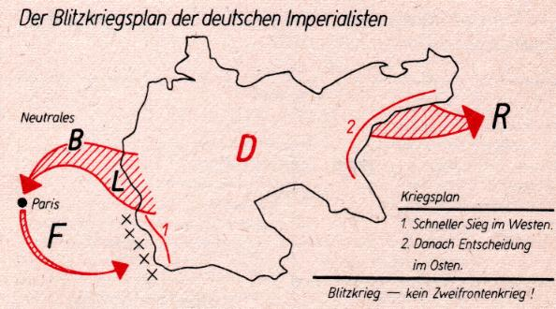
The Schlieffen plan
Notes:
Attack through neutral Belgium and Luxembourg. Avoided Maginot line. Attack French army from behind. Failed: Belgium resistance, British BEF, French held Germans at Marne, Russians mobilised in 10 days instead of 6 weeks. So Germany had to fight on 2 fronts.
1917 Germany made peace with Russia. Troops sent to western front for major attack 1918. Held by French and British. US entered war – raised morale of west and undermined morale of Germans who realised could never defeat US – fresh, powerful. 100 days Germans pushed back. Economic collapse. Germans surrendered.

Slide 40
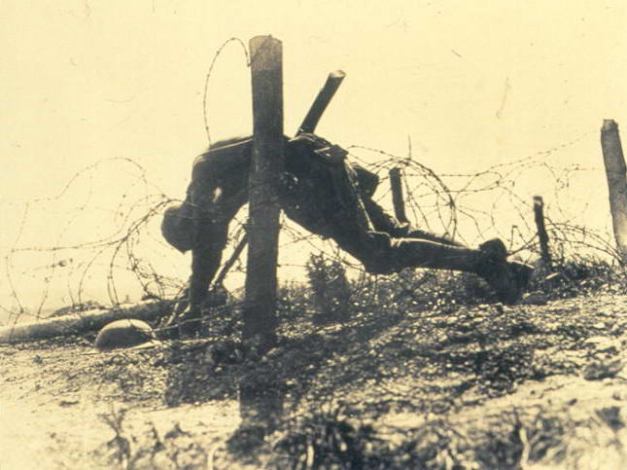
Notes:
First World War 8.5 m total died military, 15m total
37.5 m total casualties

Slide 41
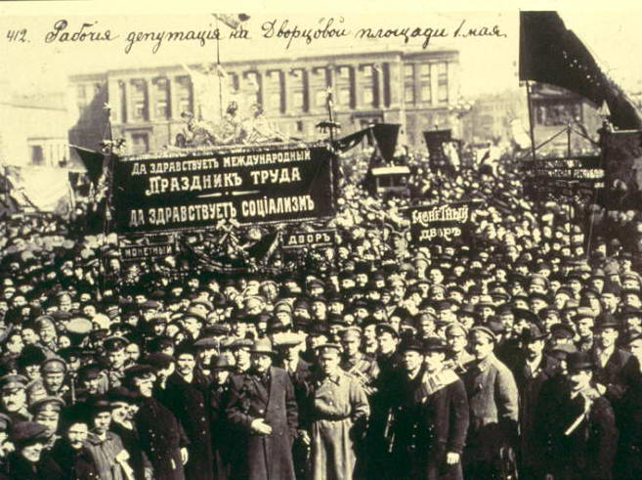

Slide 42
Who’s who in World War I?
Adam’s Family
Abel Side
Cain Side
Russia | Adam Position | Germany
Great Britain and Empire | Eve Position | Austria-Hungary
France | Archangel Position | Ottoman Empire
1917
Revolution
Notes:
By 1917, the Russian economy finally neared collapse under the strain of the war effort. While the equipment of the Russian armies actually improved due to the expansion of the war industry, the food shortages in the major urban centres brought about civil unrest, which led to the abdication of the Tsar and the February Revolution. The large war casualties also created disaffection and mutinous attitudes in the army, which was fueled by Bolshevik agitators and the Russian Provisional Government’s new liberalization policies towards the army (stripping officers of their mandate by giving wide sweeping powers to "soldier committees", the abolition of the death penalty). On 29 November 1917, the Communist Bolsheviks took power under their leader Vladimir Lenin. Lenin’s new Bolshevik government tried to end the war but the Germans demanded enormous concessions. Finally, in March 1918, the Treaty of Brest-Litovsk was signed and the Eastern Front ceased to be a war zone.

Slide 43
America joins the war 1917
Adam’s Family
Abel Side
Cain Side
April 1917 USA | Adam Position | Germany
Great Britain and Empire | Eve Position | Austria-Hungary
France | Archangel Position | Ottoman Empire
Notes:
The United States was a formal participant in World War One from April 6, 1917 until the war's end in 1918. Up to that point, the US had remained neutral, though the US had been an important supplier to The United Kingdom and other Allied powers. During the war, the US mobilized over 4,000,000 military personnel and suffered over 300,000 casualties, including over 110,000 deaths. The war saw a dramatic expansion of the US government in an effort to harness the war effort and a significant increase in the size of the US military.
The United States originally pursued a policy of non-intervention, avoiding conflict while trying to broker a peace. When a German U-boat sank the British liner Lusitania in 1915, with 128 Americans aboard, U.S. President Woodrow Wilson vowed, "America is too proud to fight" and demanded an end to attacks on passenger ships. Germany complied. Wilson unsuccessfully tried to mediate a settlement. He repeatedly warned the U.S. would not tolerate unrestricted submarine warfare, in violation of international law and U.S. ideas of human rights.
In January 1917, after the Navy pressured the Kaiser, Germany resumed unrestricted submarine warfare. Britain's secret Royal Navy cryptanalytic group had broken the German diplomatic code. They intercepted a proposal from Berlin (the Zimmermann Telegram) to Mexico to join the war as Germany's ally against the United States, should the U.S. join. The proposal suggested that if the U.S. were to enter the war then Mexico should declare war against the United States and enlist Japan as an ally. This would prevent the United States from joining the Allies and deploying troops to Europe, and would give Germany more time for their unrestricted submarine warfare program to strangle Britain's vital war supplies. In return, the Germans would promise Mexico support in reclaiming the territories of Texas, New Mexico, and Arizona that Mexico lost during the Mexican-American War 70 years earlier. Crucial to U.S. participation was the sweeping domestic propaganda campaign executed by the Committee on Public Information, overseen by George Creel. The campaign consisted of tens of thousands of government-selected community leaders giving brief carefully scripted pro-war speeches at thousands of public gatherings. Along with other branches of government and private vigilante groups like the American Protective League, it also included the general repression and harassment of people either opposed to American entry into the war or of German heritage.

Slide 44
First World War ends - 1918
Allies
Central Powers
USA/Russia
Britain & Empire
France
Germany
Austria-Hungary
Ottoman Empire
Military casualties
Dead 5.5 million
Wounded 12.8 million
Missing 4.1 million
Military casualties
Dead 4.3 million
Wounded 8.4 million
Missing 3.6 million
Armistice Day
11am 11th November 1918
Notes:
Wilson gave very idealistic speech was widely disseminated as an instrument of propaganda to encourage the Allies to victory. Copies were also dropped behind German lines, to encourage the Central Powers to surrender in the expectation of a just settlement. Indeed, a note sent to Wilson by Prince Maximilian of Baden, the German imperial chancellor, in October 1918 requested an immediate armistice and peace negotiations on the basis of the Fourteen Points.
The speech was made without prior coordination or consultation with Wilson's counterparts in Europe. As the only public statement of war aims, it became the basis for the terms of the German surrender at the end of the First World War, as negotiated at the Paris Peace Conference in 1919 and documented in the Treaty of Versailles.
Opposition to the Fourteen Points among British and French leaders became clear after hostilities ceased: the British were against freedom of the seas; the French demanded war reparations. Wilson was forced to compromise on many of his ideals to ensure that his most important point, the establishment of the League of Nations, was accepted. In the end, the Treaty of Versailles went against many of the principles of the Fourteen Points, both in detail and in spirit. Rather than Wilson's proposed "peace without victory,” the treaty sought harsh punishment of Germany both financially and territorially. The resulting bitterness in Germany together with U.S. loans, laid the seeds for the rise of Nazism in the 1930s which resulted, in part, from the economic depression of the 1920s in Germany (which the Versailles Treaty helped create). The United States Senate refused to consent to the ratification of the Treaty of Versailles, making it invalid in the U.S. and effectively hamstringing the nascent League of Nations envisioned by Wilson.

Slide 45
Woodrow Wilson’s 14 Points
“Peace without victory”
Free trade and freedom of the seas
Self-determination of colonies
No reparations
Armaments reductions
League of Nations
Germany agreed to peace upon this basis
BUT Wilson didn’t consult Allies

Slide 46
What happened at Versailles?
Germany and allies held responsible for the war: ‘War Guilt Clause’
Reparations for the damage and loss of life (£217 billion in 2010 money)
Rhineland occupied by Allies
Military restrictions on Germany
Germany lost territory and colonies
Germany felt humiliated, ‘stab in the back’
  Civilian government and “the Jews”
Notes:
Germans expected to be a a peace conference treated as equals. But allies dictatred terms.
didn’t feel war just their fault. The compulsory signing was especially bitter because Germans of all political persuasion “had rushed to arms in 1914 in the sincere conviction that they were fighting a war of self-defense.”
Felt hadn’t lost as army still in France and no big defeat. Stab in the back by government , jews, capitalists, communists
Expected to be part of negotiations but excluded
Reparations normal but excessive. Reparations after 1870 war etc.
France's chief interest was security. France had lost some 1.5 million military personnel and an estimated 400,000 civilians and had suffered great devastation during the war. Like Belgium, which had been similarly affected, France needed reparations to restore its prosperity and reparations also tended to be seen as a means of weakening any future German threat. Clemenceau particularly wished to regain the rich and industrial land of Alsace-Lorraine, which had been stripped from France by Germany in the Franco-Prussian War of 1871.
On 29 April the German delegation under the leadership of the Foreign Minister Ulrich Graf von Brockdorff-Rantzau arrived in Versailles. On 7 May when faced with the conditions dictated by the victors, including the so-called "War Guilt Clause", von Brockdorff-Rantzau replied to Clemenceau, Wilson and Lloyd George: "We know the full brunt of hate that confronts us here. You demand from us to confess we were the only guilty party of war; such a confession in my mouth would be a lie. Because Germany was not allowed to take part in the negotiations, the German government issued a protest against what it considered to be unfair demands, and a "violation of honour” and soon afterwards, withdrew from the proceedings of the Treaty of Versailles.
Conservatives, nationalists and ex-military leaders condemned the peace and democratic Weimar politicians, socialists, communists, and Jews were viewed by them with suspicion, due to their supposed extra-national loyalties. It was rumoured that the Jews had not supported the war and had played a role in selling out Germany to its enemies. Those who seemed to benefit from a weakened Germany, and the newly formed Weimar Republic, were regarded as having "stabbed Germany in the back" on the home front, by either opposing German nationalism, instigating unrest and strikes in the critical military industries or profiteering. hese theories were given credence by the fact that when Germany surrendered in November 1918, its armies were still on French and Belgian territory. Furthermore, on the Eastern Front, Germany had already won the war against Russia and concluded the Treaty of Brest-Litovsk. In the West, Germany had seemed to have come close to winning the war with the Spring Offensive earlier in 1918. Its failure was blamed on strikes in the arms industry at a critical moment of the offensive, leaving soldiers with an inadequate supply of materiel. The strikes were regarded by nationalists as having been instigated by traitors, with the Jews taking most of the blame.
More Jews proportionally than their fellow citizens made the supreme sacrifice for what they thought was their Fatherland. That sacrifice was invisible to Hitler, the German High Command, and, increasingly, the German public. On the contrary, in October 1916, the German High Command ordered a Judenzählung, a “Jew census,” to demonstrate that Jews were less patriotic than what at the time were considered their “fellow Germans.” The findings demonstrated the opposite. Approximately eighty percent of the Jews in the German army served in the front-lines. Over 100,000 Jews served out of a total German Jewish population of 550,000; 12,000 died in battle; 30,000 were decorated for bravery. Jews disproportionately-represented in all categories.

Slide 47
Different reactions
"We know the full brunt of hate that confronts us here. You demand from us to confess we were the only guilty party of war; such a confession in my mouth would be a lie.”
German Foreign Minister Ulrich von Brockdorff-Rantzau
"This is not Peace. It is an Armistice for twenty years.”
French Field Marshall Ferdinand Foch
The USA refused to ratify the treaty and did not join the League of Nations
Notes:
Count von Brockdorff-Rantzau led the German delegation which arrived at Versailles on April 29, and was kept waiting for several days. When the first session began on May 7, French newspapers suggested that this was because it was the anniversary of the sinking of the RMS Lusitania. After Georges Clemenceau had accused Germany of being responsible for the war, Brockdorff-Rantzau said that the issue was to reach a lasting peace but admitting that the power of German arms was broken, he nevertheless declared that admission of sole German responsibility for the war would be a lie. He stated that the policy of revenge, as well as the policy of expansion, in disregard of the fight of peoples to determine their own affairs contributed to the sickness of Europe, which reached its crisis in the World War. Russian mobilisation took the possibility of curing the disease out of the hands of statesmen and placed the decision into the hand of military force. Whilst he admitted wrongs carried out by the former leaders of Germany, he argued that these and other wrongs committed by other nations should be considered by an objective commission with access to all the archives. The German delegation was then granted seven days to respond to the 440 articles.
In this capacity, Count von Brockdorff-Rantzau attended the signing of the Treaty of Versailles (1919). He had set out to negotiate a peace based on President Woodrow Wilson's Fourteen Points and a request for the union of Austria with Germany. In practice, he found himself trying to defend Germany against the accusation of sole war guilt; he attacked the atrocities of the Allied blockade on Germany following the armistice on November 11th, and even made the prediction (which was later borne out), that such a treaty would be impossible to fulfill, and cause continual discontent amongst the German people.
Clemenceau had failed to achieve all of the demands of the French people, and he was voted out of office in the elections of January 1920. French Field Marshal Ferdinand Foch, who felt the restrictions on Germany were too lenient, declared (quite accurately), "This is not Peace. It is an Armistice for twenty years.” The French delegation wanted to break Germnay up into parts so it could never try to dominate the continent again. I.e. leave France to dominate as it had done for centuries.
Wilson's friend Edward Mandell House, present at the negotiations, wrote in his diary on 29 June 1919:
I am leaving Paris, after eight fateful months, with conflicting emotions. Looking at the conference in retrospect, there is much to approve and yet much to regret. It is easy to say what should have been done, but more difficult to have found a way of doing it. To those who are saying that the treaty is bad and should never have been made and that it will involve Europe in infinite difficulties in its enforcement, I feel like admitting it. But I would also say in reply that empires cannot be shattered, and new states raised upon their ruins without disturbance. To create new boundaries is to create new troubles. The one follows the other. While I should have preferred a different peace, I doubt very much whether it could have been made, for the ingredients required for such a peace as I would have were lacking at Paris.[

Slide 48
What were the providential results of the First World War?
Indemnity condition to restore 3 blessings
Overcame first temptation of Jesus
  Rejected the temptation to submit to the Kaiser and German domination of Europe
God’s side made indemnity condition for birth of the Lord of the Second Advent
Victory of Abel over Cain
  Democracy over authoritarianism

Slide 49
Some other results
Establishment of the League of Nations
Break up of the Austro-Hungarian Empire
  Balkan problems, nationalism
Break up of the Ottoman Empire
  Problems in Middle East
Establishment of a Jewish homeland
Russian revolution
  Spread of communism
Notes:
One major issue after the dissolution of Austria-Hungary was that the self-determination principle proposed by President Woodrow Wilson failed to achieve its goal. While some problems had been solved, a whole new set of issues emerged at the same time as a consequence of the treaties of Trianon and Saint Germain.
Former lands of Austria-Hungary were divided up arbitrarily after the war in order to suit the ambitions of the victorious powers, and large groups of national minorities remained trapped in other countries. For example, a significant portion of Hungarians and Germans ended up under foreign rule. Hungary was held responsible for the war and stripped of two thirds of its territory and inhabitants; while Austria, which had been an equal partner in the Austro-Hungarian government, received Burgenland (formally part of Hungary), while losing the part of Tyrol that makes up Trentino-Alto Adige/Südtirol. German-speaking areas of Bohemia (so-called Sudetenland) remained part of it inside Czechoslovakia. In addition, Yugoslavia (originally the Kingdom of Serbs, Croats, and Slovenes) was home of five major ethnic groups (Serbs, Croats, Macedons, Montenegrins, and the Slovenes), and was created after the war.

Slide 50
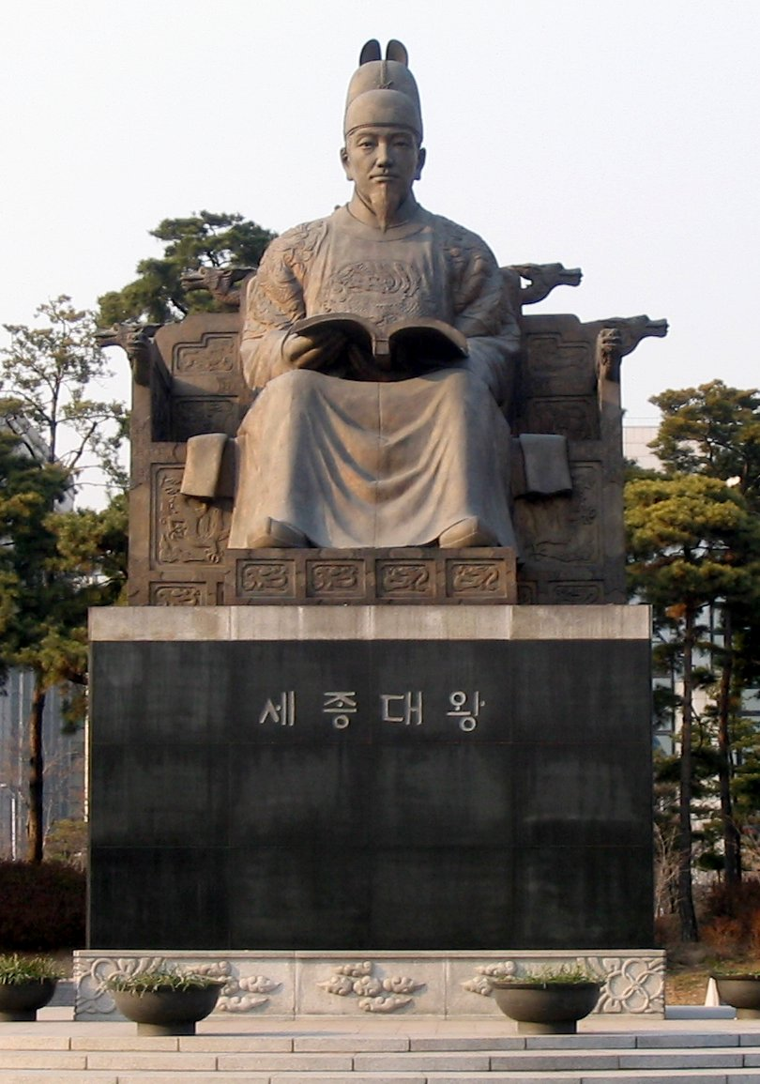
Some recent Korean history
5000 year history
Chosun dynasty established 1392
King Sejong the Great
  Hangul alphabet
  Neo-Confucianism
  Cultural and technological advances
  Agricultural innovations
  Calendar reform
  Polygamy abolished
  1/3 population slaves
King Sejong the Great
(1418-50)
Notes:
Parallel to Reformations in Europe – Huss
Sejong's ascension to the throne was different from those of most other kings. The eldest son, Yangnyeong, viewing himself as lacking in the requisite skills for kingship, believed that Sejong was destined to become king. Together with the second son, Grand Prince Hyoryeong, he believed it was their duty to place Sejong as king. So they acted extremely rudely in the court, and soon were banished from Seoul. This plot of the two princes ultimately brought Sejong to the throne. The eldest prince became a wandering traveler and lived in the mountains. The second son traveled to a Buddhist temple, where he became a monk.
King Sejong the Great profoundly impacted Korean history with his introduction of hangul, the native phonetic alphabet system for the Korean language.^{[11]}
Before the creation of Hangul, only members of the highest class were literate (hanja was typically used to write Korean by using adapted Chinese characters while Hanmun was sometimes used to write court documents in classical Chinese). One would have to learn the quite complex hanja characters in order to read and write Korean. Further, despite modifications to the Chinese characters, hanja could prove cumbersome when transcribing the Korean language due to considerable differences in grammar and sentence order.^{[12]}
King Sejong presided over the introduction of the 28 letter Korean alphabet, with the explicit goal being that Koreans from all classes would read and write. He also attempted to establish a cultural identity for his people through its unique script. First published in 1446, anyone could learn Hangul in a matter of days. Persons unfamiliar with Hangul can typically pronounce Korean script accurately after only a few hours study.
Each hangul letter is based on a simplified diagram of the patterns made by the mouth, tongue and teeth when making the sound related to the character. Morphemes are built by writing the characters in syllabic blocks. The blocks of letters are then strung together linearly.
1415 Jan Huss killed.
Jews created first phonetic alphabet.
Old Korea was a polygamous society where a man could keep as many concubines as he could support. However, from the 15th century, Korean law clearly stipulated that every man was allowed only one wife (remarrying after a spouse’s death was nearly obligatory for men and nearly prohibited for women).
The strict line between the wife and concubines was maintained thoroughly. In most cases, only people whose income and social standing were well above average could afford to take even one concubine. However, sons born by a concubine faced serious discrimination in their careers.
Contrary to what you might have read, such sons could enter the officialdom, but their promotion opportunities were limited. Within the household, concubines were under the complete control of the wife.
Hence, for centuries no decent woman of good upbringing would consider becoming a concubine. It was the way of the gisaeng (Korean courtesans) who wanted to quit their profession, or for girls from seriously impoverished peasant families, or for young and pretty female serfs. The name for concubine (cheop in Korean) had negative and humiliating connotations.
However, in the 1920s a new type of polygamous marriage appeared. This was a marriage between a “modern” (that is, Western-educated and, usually, affluent) man and a “modern” woman who also came from a privileged background.
Such union was based on mutual love, and often were the product of a long romantic affair. Nonetheless, the bride knew that the happy groom kept maintaining another woman as well.
But why couldn’t men just marry the women they loved, and nobody else one might ask? The reason was that it was impossible. In the 1910s and 1920s men of elite families (and we are talking here about the elite) married in their teens, perhaps when they were merely 13 or 14 years old.
Of course, nobody bothered to show them their would-be wives: the meeting at their wedding ceremony could easily be the first direct encounter of the spouses. The marriage was arranged by parents and family whose considerations were largely of a political or a financial nature.
Then, as new times demanded, the teenage boy was shipped away, to study the “new knowledge” in some Western-style school, perhaps even in Japan. His young wife, who might be pregnant by that time, stayed at home, to serve her parents-in-law as an obedient Confucian wife should.
Meanwhile, overseas the young man could meet other women. It was tacitly assumed that sleeping around was OK for a privileged young man as long as appearances were kept up and the targets of his desire were women of “low orders,” preferably those who were seen as “loose” by definition (gisaeng or, for a less affluent philanderer, waitresses in cafes etc.).
However, some people fell in love with “new women,” educated girls who could be found in cities, and also discovered the then novel idea of a romantic love union. Of course, young, bright, modern girls easily outclassed the boring and semi-literate traditional women who were left behind.
Well, and if such romance began, what should be done? Many Korean males just divorced their boring old wives (these “old wives” were usually in their 20s) and married the “new women,” with varying degree of marital success.
Such a divorce was very common, and sometimes it seems that majority of prominent Korean artists and writers of the era had such experience ― including the founder of the modern Korean literature Yi Kwang-su. To us this decision might sound natural and a good thing to do, but I am not so sure whether it was indeed the case.
First of all, usually parents were deadly against divorce. Second, the fate of the abandoned wife and her children could be very sad. In those days the women had almost no way of earning a living, and the children of a divorcee would be stigmatized forever.
In some cases the need to choose pushed people to extremes. Kim U-jin, the founder of modern Korean theater, faced the same choice between a traditional wife and his lover Yun Sim-dok, the most famous singer of the era. Finally, he and Yun chose suicide.
However, some people tried to have best of both worlds. They married the “new woman,” but still maintained the first wife as a legal spouse. Needless to say, unlike the concubines of the past years, the new wife lived in a separate household.
But what to call such women? The old “concubine,” with all its negative connotations, was seen as rude and inappropriate. Hence, a new term, “second wife,” was coined in the 1920s. This was quite new: in old Korea, as has been said, man by definition could have only one wife.
To some extent, the “second wife” was a nice euphemism, since no legal regulations envisioned the existence of such relationships. For more traditional-minded Koreans, that is, for a vast majority of people, the “second wife” was merely another concubine, and her college degree did not matter.
Educated circles, especially women’s circles, also looked upon such arrangements with great disdain since the idea of sharing the man with somebody else ran against the grain of the notion of romantic love as the sole basis for marriage, and this idea was commonly accepted among the first generation of the Western-style Korean intellectuals. Indeed, somebody said that “love in Korea began in 1919.”

Slide 51
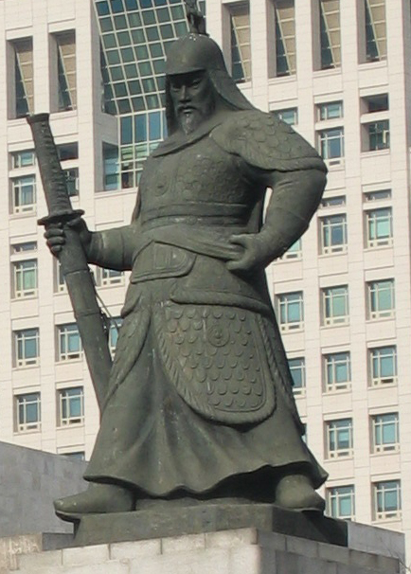
Invasions and threats
Japanese invasions 1592-98
  Admiral Yi Sun-sin and turtle ships supported by Chinese Ming Dynasty defeated them
Manchu invasions 1627/36
  Korea under Qing suzerainty
  - paid tribute
  200 years of peace and isolation “Hermit Kingdom”
  Hostile to foreign trade and contact including missionaries
Admiral Yi Sun-sin
Notes:
Fought 23 sea battles and never defeated.
The turtle ships designed by Yi held eleven cannons on each side of the ship, with two each at the stern and the bow. The ship's figurehead was in the shape of a dragon. The figurehead itself held up to four cannons, and emitted a smokescreen that, in combination with its fierce appearance, was meant to be used as psychological warfare. The sides of the turtle ship were dotted with smaller holes from which arrows, guns, and mortars could be fired. The roof was covered with planks and spikes. The purpose of the spikes was to prevent the ship from being boarded by the enemy. The larger Japanese ships' sides were higher than the turtle ships' and thus, the spikes prevented boarders from jumping down onto the roof without risking impalement. There were two masts that held two large sails. The turtle ship was also steered and powered by twenty oars, which were pulled by two men during fair conditions and five in combat situations.

Slide 52
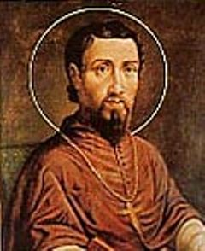
Coming of Catholic Christianity
1603 Korean envoy to China brought some Catholic texts
1758 Christianity outlawed
1840 French missionaries
1856 French bishop appointed
January 1866 Russian ships off coast
February Catholics propose alliance
  France, Britain, Korea
Rejected by Korean court
  7 French priests martyred
Bishop Siméon-François Berneaux
Notes:
The practice of Christianity in Korea revolves around two of its largest branches, Protestantism and Catholicism, accounting for 8.6 million and 5.1 million members respectively. Roman Catholicism was first introduced during the late Joseon Dynasty period. In 1603, Yi Gwang-jeong, Korean diplomat, returned from Beijing carrying a world atlas and several theological books written by Matteo Ricci, a Jesuit missionary to China. He began disseminating the information in the books and the first seeds of Christianity were sown. In 1758 King Yeongjo of Joseon officially outlawed Catholicism as an evil practice. Roman Catholicism was again introduced in 1785 by Yi Sung-hun. Korean Christians were subject to persecution and hardship but this has not deterred believers.
Many were martyred, especially during the Catholic Persecution of 1801 and later, the most famous of whom was Andrew Kim Taegon, who was beheaded in 1846 at the age of 25 for his practice of a foreign religion. The Joseon Dynasty saw the new religion as a subversive influence and persecuted its earliest followers in Korea, culminating in the Catholic Persecution of 1866, in which 8,000 Catholics across the country were killed, including 9 French missionaries.
In January, 1866 Russian ships appeared on the east coast of Korea demanding trading and residency rights in what seemed an echo of the demands made on China by other western powers. Korean Christians, with connections at court, saw in this an opportunity to advance their cause and suggested an alliance between France and Korea to repel the Russian advances, suggesting further that this alliance could be negotiated through Bishop Berneux. The Heungseon Daewongun seemed open to this idea, though it is uncertain whether this was ruse to bring the head of the Korean Catholic Church out into the open. Berneux was summoned to the capital, but upon his arrival in February 1866, he was seized and executed. A roundup then began of the other French Catholic priests and Korean converts.
Several factors contributed to the Heungseon Daewongun‘s decision to crack down on the Catholics. Perhaps the most obvious was the lesson provided by China, which had apparently reaped nothing but hardship and humiliation from its dealing with the western powers, seen most recently in its disastrous defeat during the Second Opium War. No doubt also fresh in the Heungseon Daewongun‘s mind was the example of the Taiping Rebellion in China, which had been infused with Christian doctrines. 1865 had seen poor harvests in Korea as well as social unrest, which may have contributed to a heightened sensitivity to the foreign creed. The crackdown may also have been related to attempts to combat factional cliques at court, where Christianity had made some inroads.
Korea should have established trinity with UK and France. This would have protected Korea from Russia and also from Japan. Christianity could then have developed along with the gradual introduction of liberal democracy.
During the early 17th century, Christian literature written in Chinese was imported from China to Korea. On one of these occasions, around 1777, Christian literature obtained from Jesuits in China led educated Korean Christians to study.[3] Although no Koreans were converted to Catholicism by these books until the last quarter of the eighteenth century, the ideas of the Catholic priests espoused in them were debated and denounced as heterodox as early as 1724.[4]A home Church began. When a Chinese priest managed to enter secretly a dozen years later, he found 4,000 Catholics, none of whom had ever seen a priest.[3] The dynamic Catholic communities were led almost entirely by educated lay people of the aristocratic classes, as they were the only ones who could read the books that were written in Hanja.(Chinese letters in Korean)
The Christian community sent a delegation on foot to Beijing, 750 miles away, to ask the Bishop of Beijing to send them bishops and priests. Eventually, two Chinese priests were sent, but their ministry was short-lived, and another forty years passed before the Paris Foreign Mission Society began its work in Korea with the arrival of Father Maubant in 1836. Paul Chong Hasang, Augustine Yu Chin-gil and Charles Cho Shin-chol had made several visits to Beijing in order to find ways of introducing missionaries into Korea. Since the persecution of 1801, there had been no priest to care for the Christian community. Serious dangers awaited the missionaries who dared to enter Korea. The bishops and priests who confronted this danger, as well as the lay Christians who aided and sheltered them, were in constant threat of losing their lives.[5]Saint Laurent-Marie-Joseph Imbert, M.E.P.Bishop Laurent Imbert and ten other French missionaries were the first Paris Foreign Mission Society priests to enter Korea and to embrace a different culture. During the daytime, they kept in hiding, but at night they travelled about on foot attending to the spiritual needs of the faithful and administering the sacraments. The first Korean priest, Andrew Kim Taegon, succeeded in entering Korea as a missionary. However, thirteen months after his ordination he was put to death by the sword in 1846 at the age of 26.[5]The Catholics gathering in one place with no distinction on the basis of class were perceived to undermine 'hierarchical Confuciansim', the ideology which held the State together. The new learning was seen to be subversive of the establishment and this gave rise to systematic suppression and persecution. The suffering the believers endured is well known through official documents which detail trials and the sentences. There were four major persecutions - the last one in 1866, at which time there were only 20,000 Catholics in Korea. 10,000 had died. Those figures give a sense of the enormous sacrifice of the early Korean Catholics. (Other Christian denominations did not enter Korea until sometime later).[2] The vast majority of the martyrs were simple lay people, including men and women, married and single, old and young.More than 10,000 martyrs died in persecutions which extended over more than one hundred years. Of all these martyrs, seventy-nine were beatified in 1925. They had died in the persecutions of 1839 (Ki-hae persecution), 1846 (Pyong-o persecution) and 1866 (Pyong-in persecution). In addition, twenty-four martyrs were beatified in 1968. All together, 103 martyrs were canonized by Pope John Paul II on May 6, 1984.[5] In a break with tradition, the ceremony did not take place in Rome, but in Seoul. Their feast day is September 20. Currently, Korea has the 4th largest number of saints in the Catholic world.

Slide 53
Persecution of Korean Catholics
1801 Sinyo persecution
  Letter written by a Korean
1815 Unhae persecution
1827 Chonghae persecution
1839 Ki-hae persecution
  French clergy executed
1846 Pyong-o persecution
  First Korean priest executed
1866-71 Pyong-in persecution
  8 000 Korean Catholics executed
  Half membership killed
Bishop Siméon-François Berneaux
tortured, beheaded March 1866
Notes:
During the early 17th century, Christian literature written in Chinese was imported from China to Korea. On one of these occasions, around 1777, Christian literature obtained from Jesuits in China led educated Korean Christians to study. Although no Koreans were converted to Catholicism by these books until the last quarter of the eighteenth century, the ideas of the Catholic priests espoused in them were debated and denounced as heterodox as early as 1724.[4]A home Church began. When a Chinese priest managed to enter secretly a dozen years later, he found 4,000 Catholics, none of whom had ever seen a priest. The dynamic Catholic communities were led almost entirely by educated lay people of the aristocratic classes, as they were the only ones who could read the books that were written in Hanja.(Chinese letters in Korean)
The Christian community sent a delegation on foot to Beijing, 750 miles away, to ask the Bishop of Beijing to send them bishops and priests. Eventually, two Chinese priests were sent, but their ministry was short-lived, and another forty years passed before the Paris Foreign Mission Society began its work in Korea with the arrival of Father Maubant in 1836. Paul Chong Hasang, Augustine Yu Chin-gil and Charles Cho Shin-chol had made several visits to Beijing in order to find ways of introducing missionaries into Korea. Since the persecution of 1801, there had been no priest to care for the Christian community. Serious dangers awaited the missionaries who dared to enter Korea. The bishops and priests who confronted this danger, as well as the lay Christians who aided and sheltered them, were in constant threat of losing their lives. Saint Laurent-Marie-Joseph Imbert, M.E.P. Bishop Laurent Imbert and ten other French missionaries were the first Paris Foreign Mission Society priests to enter Korea and to embrace a different culture. During the daytime, they kept in hiding, but at night they travelled about on foot attending to the spiritual needs of the faithful and administering the sacraments. The first Korean priest, Andrew Kim Taegon, succeeded in entering Korea as a missionary. However, thirteen months after his ordination he was put to death by the sword in 1846 at the age of 26.
The Catholics gathering in one place with no distinction on the basis of class were perceived to undermine 'hierarchical Confuciansim', the ideology which held the State together. The new learning was seen to be subversive of the establishment and this gave rise to systematic suppression and persecution. The suffering the believers endured is well known through official documents which detail trials and the sentences. There were four major persecutions - the last one in 1866, at which time there were only 20,000 Catholics in Korea. 10,000 had died. Those figures give a sense of the enormous sacrifice of the early Korean Catholics. (Other Christian denominations did not enter Korea until sometime later).[2] The vast majority of the martyrs were simple lay people, including men and women, married and single, old and young. More than 10,000 martyrs died in persecutions which extended over more than one hundred years. Of all these martyrs, seventy-nine were beatified in 1925. They had died in the persecutions of 1839 (Ki-hae persecution), 1846 (Pyong-o persecution) and 1866 (Pyong-in persecution). In addition, twenty-four martyrs were beatified in 1968. All together, 103 martyrs were canonized by Pope John Paul II on May 6, 1984.[5] In a break with tradition, the ceremony did not take place in Rome, but in Seoul. Their feast day is September 20. Currently, Korea has the 4th largest number of saints in the Catholic world.

Slide 54
Why was Catholicism rejected?
Undermines traditional Confucian social order
  Equality
  Rejection of ancestor worship
  Lack of absolute respect for father and king
  Gender equality, desegregation of men and women
Concerns about Korean sovereignty
  Opium War
  Russian advances
  Catholicism seen as aligned to foreigners
Internal political problems
  Finances, corruption
  Peasant rebellions
Notes:
The Christian community sent a delegation on foot to Beijing, 750 miles away, to ask the Bishop of Beijing to send them bishops and priests. Eventually, two Chinese priests were sent, but their ministry was short-lived, and another forty years passed before the Paris Foreign Mission Society began its work in Korea with the arrival of Father Maubant in 1836. Paul Chong Hasang, Augustine Yu Chin-gil and Charles Cho Shin-chol had made several visits to Beijing in order to find ways of introducing missionaries into Korea. Since the persecution of 1801, there had been no priest to care for the Christian community. Serious dangers awaited the missionaries who dared to enter Korea. The bishops and priests who confronted this danger, as well as the lay Christians who aided and sheltered them, were in constant threat of losing their lives.[5]Saint Laurent-Marie-Joseph Imbert, M.E.P.Bishop Laurent Imbert and ten other French missionaries were the first Paris Foreign Mission Society priests to enter Korea and to embrace a different culture. During the daytime, they kept in hiding, but at night they travelled about on foot attending to the spiritual needs of the faithful and administering the sacraments. The first Korean priest, Andrew Kim Taegon, succeeded in entering Korea as a missionary. However, thirteen months after his ordination he was put to death by the sword in 1846 at the age of 26.[5]

Slide 55
What if . . .?
The True Mother would have come out of the Christian realm. Perhaps she would have been a British woman. It could be-why not? Once the worldwide foundation had been accomplished, I would have picked the True Mother on the world level. Imagine if the royal princess of England had become the True Mother. I am only interested in one thing-how to restore the world.
It is because our movement was rejected by Korean Christianity that our boundaries became so limited. If we had been supported, the Korean movement would have immediately become insignificant because the movement would have become worldwide and universal, with no boundaries. Let's say that the True Mother had come from Great Britain, the source of the English-speaking culture. The U.S. is in the position of son to Great Britain. It would have been very rapid and easy for America to humble itself to Britain.
Britain as ‘Eve’ nation
‘Gave birth’ to
  1st Israel – Israel 1948
  2nd Israel – USA
  3rd Israel – Korea
Many colonies - > Empire
  Spread Christianity
  Technology
British Commonwealth
  Liberal democracies
Father said he should have married English princess
  Queen head of 16 countries
  Queen head of Church

