Slide 1
What does a foundation to receive the messiah look like?
Foundation of faith
  Spiritual community
  Life of prayer, study and worship
Foundation of substance
  Freedom of thought and speech
  Rule of law
Foundation to receive the messiah
  Spiritual community who can respond to the messiah and be able to protect him
Notes:
Long before the Beit HaMikdash was built, two brothers lived and farmed on that same site. One was married and had a large family, while the other was single. They lived in close proximity to each other, and each worked his land, growing wheat. When harvest time arrived, each was blessed with a bountiful crop and piled up his grain for long-term storage.
The unmarried brother, observing his good fortune, thought to himself that God had blessed him with more than he needed, whereas his brother, who was father to a large family, could surely use more. He arose in the middle of the night and secretly took from his grain and put it in his brother’s pile.
Similarly, the married brother thought to himself that he was blessed to have children who would care for him in his old age, while his brother must depend on what he saved. He, too, arose in the middle of the night and quietly transferred grain from his pile to his brother’s.
In the morning, each wondered why there was no noticeable decrease in his own pile, and so they repeated the transfer the next night. These nocturnal activities continued, until one night the brothers bumped into each other. In that instant, in the dark of night, the glow of brotherly love lit up the mountain sky; they each understood what the other had been doing and they fell into a warm embrace. According to the legend, when God saw that display of brotherly love, He selected the site for His Temple.

Slide 2
The foundation to receive the Lord of the Second Advent
God’s 2000 years providence has prepared a democratic social and legal environment which will protect Christ at the Second Advent. EDP, 282

Slide 3
Hellenism – Hebraism
Only by Cain-type Hellenism submitting to Abel-type Hebraism could Satan be separated from the prevailing spirit of the age. Then the foundation of substance necessary for receiving Christ at the Second Advent could be established worldwide. EDP, 350
  Movements to restore original human nature
  Both are good and necessary
  Both need to be integrated with Hebraism in subject position

Slide 4
The Enlightenment in Russia
Byzantine inheritance
  Church - State
St Sergius of Radonezh (1314-92)
  Sobornost – Unity-in-Freedom
Split between Possessors and non-Possessors (1503)
  Ideology of the Possessors dominant
Great schism – Old Believers (1666)
  Church greatly weakened
When changes happen in Russia there is a sharp break or fracture

Slide 5
Old Russia - Nicholas Zernov
"Thus Russian culture from that period bears the marks of the exclusive influence of the Possessor's mentality. It became excessively ritualistic, stagnant intellectually, and too ready to sacrifice an individual for the sake of the community. The cost of strong communal sense was paid in the evasion of personal responsibility, in the failure to breed men of moral courage, and in the rarity of outstanding personalities. Any man who wanted to think for himself was in danger of departing from the traditional pattern, and therefore was suspected and discouraged by others. Everyone who dared to raise his voice in protest against accepted custom was ostracised. Cruelty and crime, if committed, not by the individual, but by the collective body, were excused. The Tsars, the heads of the community, were treated, Oriental fashion, as persons responsible only to God for their conduct; their actions were not judged by the standards of the ordinary man.”
Notes:
Nicolas Michaelovich Zernov (9 October 1898 [O.S. 21 September] - 25 August 1980)^{[1]} (Cyrillic: Николай Михайлович Зернов) was a Christian Russian émigré who settled in Britain, and taught theology at Oxford University. He wrote many books about the Orthodox Church, and about Christianity in Russia, of which the best known is The Russian Religious Renaissance of the Twentieth Century (1963). He worked continuously for the unity of Christians, and from 1935 to 1947 was secretary of the ecumenical Fellowship of Saint Alban and Saint Sergius, which he helped to found in 1928.

Slide 6
The centuries of the Tartar yoke had left a deep trace on Russian mentality. They encouraged the growth of passive resignation before the supreme power, and readiness to submit unconditionally to the rule of the autocrat. It was not by chance that Russian legend crowned the Moscow Tsars with the insignia of the Babylonian despots. Russia was not only a Christian family; she was also an Oriental monarchy which required from its people blind obedience to the sovereign. Russia was deplorably lacking in legal notions. Her people had little sense of their rights and obligations; their adherence to the family ideal exposed them to the danger of domestic tyranny and arbitrary oppression. Her people aspired to holiness, but were inclined to disregard more prosaic but nevertheless all-important virtues of honesty, sobriety and truthfulness. These shortcomings led to the clumsiness of the administration, the inferiority of the army organisation, the pitiful neglect of the proper organisation of industry, and a low standard of production. But the main social defect was the reduction of the free peasantry to serfdom.”

Slide 7
Peter the Great (1682-1725)
Childhood trauma
  Mother’s family murdered in front of him
Peter hostile to Russian church & culture
Travelled to Europe. Admired west & imported ideas and technology to modernize Russia
Replaced theocracy by state absolutism
  Family by bureaucratic and militaristic state
Destroyed unity of Russian people
  Moved capital to St Petersburg
Used Church for ideological uniformity
  Patriarch Adrian died 1700 didn't replace
  Became department of State – Lutheran model
  1721 Holy Governing Synod presided by secular Procurator
Hellenism dominating Hebraism
Notes:
Tsar Alexis married twice
Miloslavskaia=Alexis=Nayshkina
9 children Peter
Sophia(daughter became Regent)
Ivan Peter
Oldest son Theodor died young. Next Ivan slow witted. Peter vigorous. struggle between factions. First N won then M -> N family murdered in front of Peter. Peter estranged from court & Russian church & culture. Admired west -> traveled & imported ideas. Liked Lutheran Church. wore military uniform instead of sacred vestments. mocked religious tradition
Broke theocratic tradition and replaced with western state absolutism
Reforms were necessary. Muscovy was too closed, introverted, suffocating and totalitarian. No spiritual freedom. Peter did it clumsily and with mixed motivation. Russia needed air and light from the west for its cultural development
[Western forms imbued with new content and force of which Orthodoxy was the wellspring for the depth of literature and music of Dostoyevsky, Tolstoy & Tsaikovsky. Russians didn't merely imitate. Transformed and deepened what received but still without West, Russian culture not develop. Best Russian culture synthesis of East and West]
Peter destroyed unity of Russian people. attacked Orthodox ritual of life & tried to replace with Prussian efficiency. Replaced family ideal of Tsar & people by bureaucratic & militaristic state. introduced alien form of govt. Gulf appeared between upper classes & people. enslaved peasants & paralysed church.
Problem not so much western ideas as way in which they were introduced.
succeeded throne.
When Pat asked him to show mercy declared Bishops no authority over military. —> distinction secular & ecclesiastical. destroyed harmony
When Patriarch Adrian died 1700 didn't replace. Remembered Nikon and didn't want anyone to be able to challenge authority as autocrat. Issued Spiritual Regulation to regulate Church. He was Lutheran. Not afraid of power of Church. A consequence of possessors ideology was their complete subservience to Tsar. He used that to destroy Church. Couldn't accept that Church had moral right to judge him as Philip did Ivan IV. Didn't want Church to be the conscience of the nation representing a higher truth and a higher law, a transcendental universal judge.
1721 established Holy Governing Synod presided by secular Procurator. Members picked. Swore allegiance to Tsar.
Church became department of State. "Department of the Orthodox Confession" Didn't resist. Priests had to inform on parishioners. Used Church for ideological uniformity. Priest had to force people in or inform. The purpose of the Church was given by the State. State responsible for everything. Apportioned care of soul to Church.
Peter killed own son —> no successor—> Germans took over

Slide 8
Russian enlightenment
Elizabeth continued westernization
  Enlightened absolutism
Catherine Great
  Enlightened despot
  Corresponded with Voltaire
  Expanded Russia. Division of Poland
Church lost position as chief source of cultural life
  Parish schools established to indoctrinate populace
Spiritual confusion
  Development of sects Khlysts: flagellants, mystics; Dukhobars
Aristocracy turned to French Enlightenment
  Atheism and materialism
Notes:
Elizabeth confiscated monastic lands.
Under Catherine Great 1764 much land—> State control. Protesters imprisoned. Atheist made procurator of synod
Church more and more under state control yet demanded allegiance to it. Insincere. Old Believers persecuted.
Attempted to eradicate/convert Muslims of Kazan 1613-1762
Development of sects Khlysts: flagellants, mystics; Spiritual Xty (Dukhobars)
Church lost position as chief source of cultural life. Aristocracy turned to French Enlightenment & Voltairism.
No theology or tradition of rebellion or resistance. Not even the most mild.
Under Nicholas even more dominated by secular procurator. New Church regulations for governing. Not canon law. Lay bureaucrats controlled every aspect of church including sermons. Priest who stepped out of line sent to prison. Pobedonostoev most notorious. Church serve political ideology of the State.
Parish schools established to indoctrinate populace -> keep in place

Slide 9
Culture
Muscovy – closed. Ossified.
Western forms imbued with new content and force of which Orthodoxy was the wellspring for the depth of literature, art and music of Pushkin, Dostoyevsky, Tolstoy, Chekhov, Rachmaninov, Tchaikovsky, Stravinsky.
  Synthesis of Hebraism and Hellenism
  Recovery of non-possessor tradition (starets)
  Happening outside the church
Russians didn't merely imitate. Transformed and deepened what received
Without the west, Russian culture not develop.
Best Russian culture synthesis of East and West

Slide 10
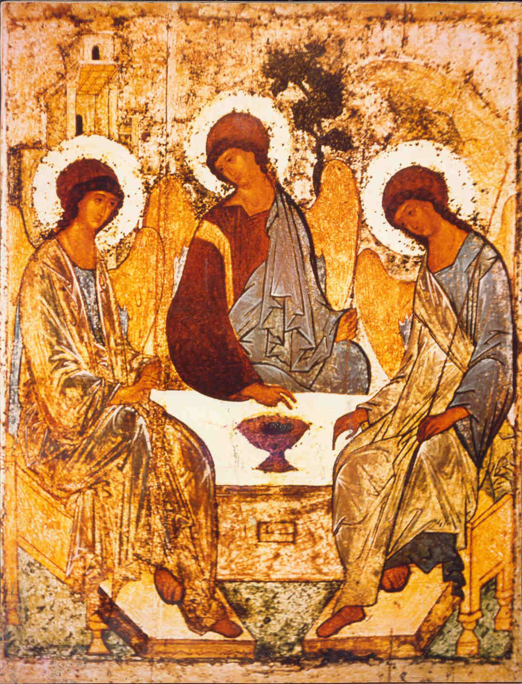
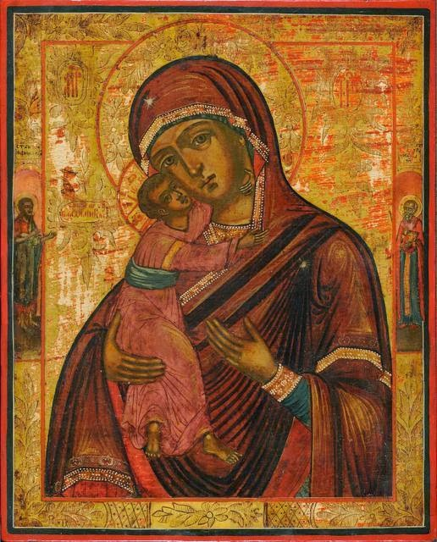
Russian icons
The Holy Trinity, Andrei Rublev, 1411
The Virgin of Vladimir

Slide 11
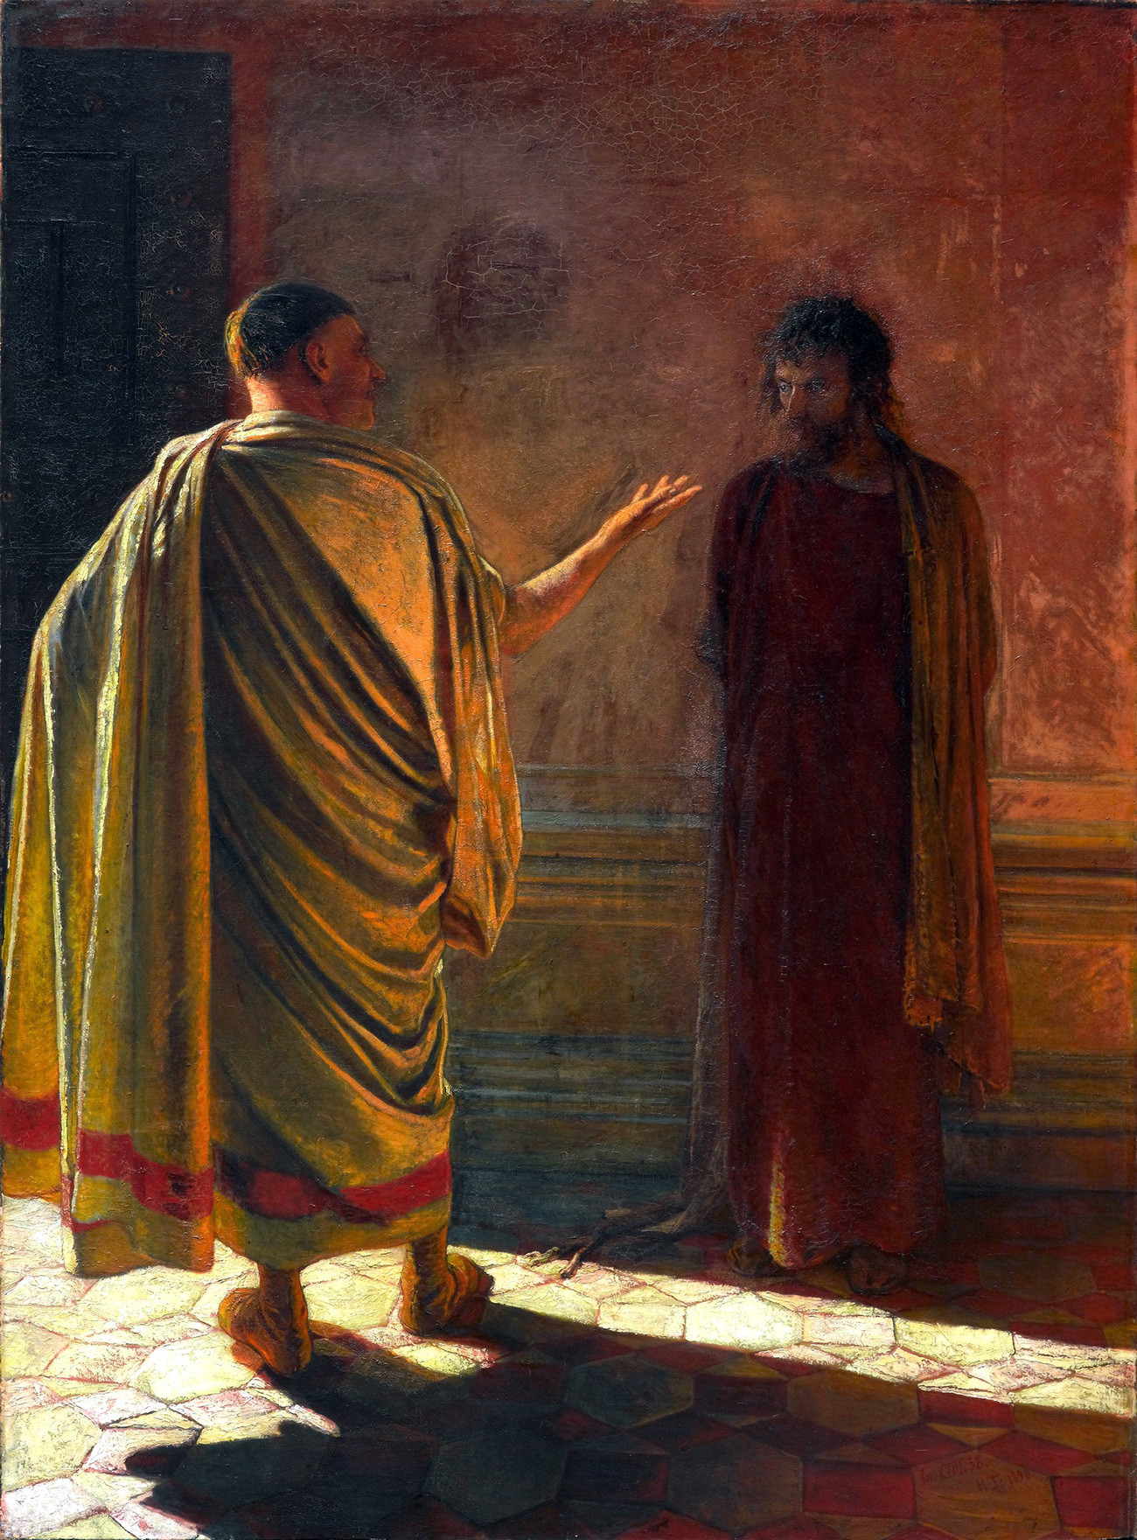
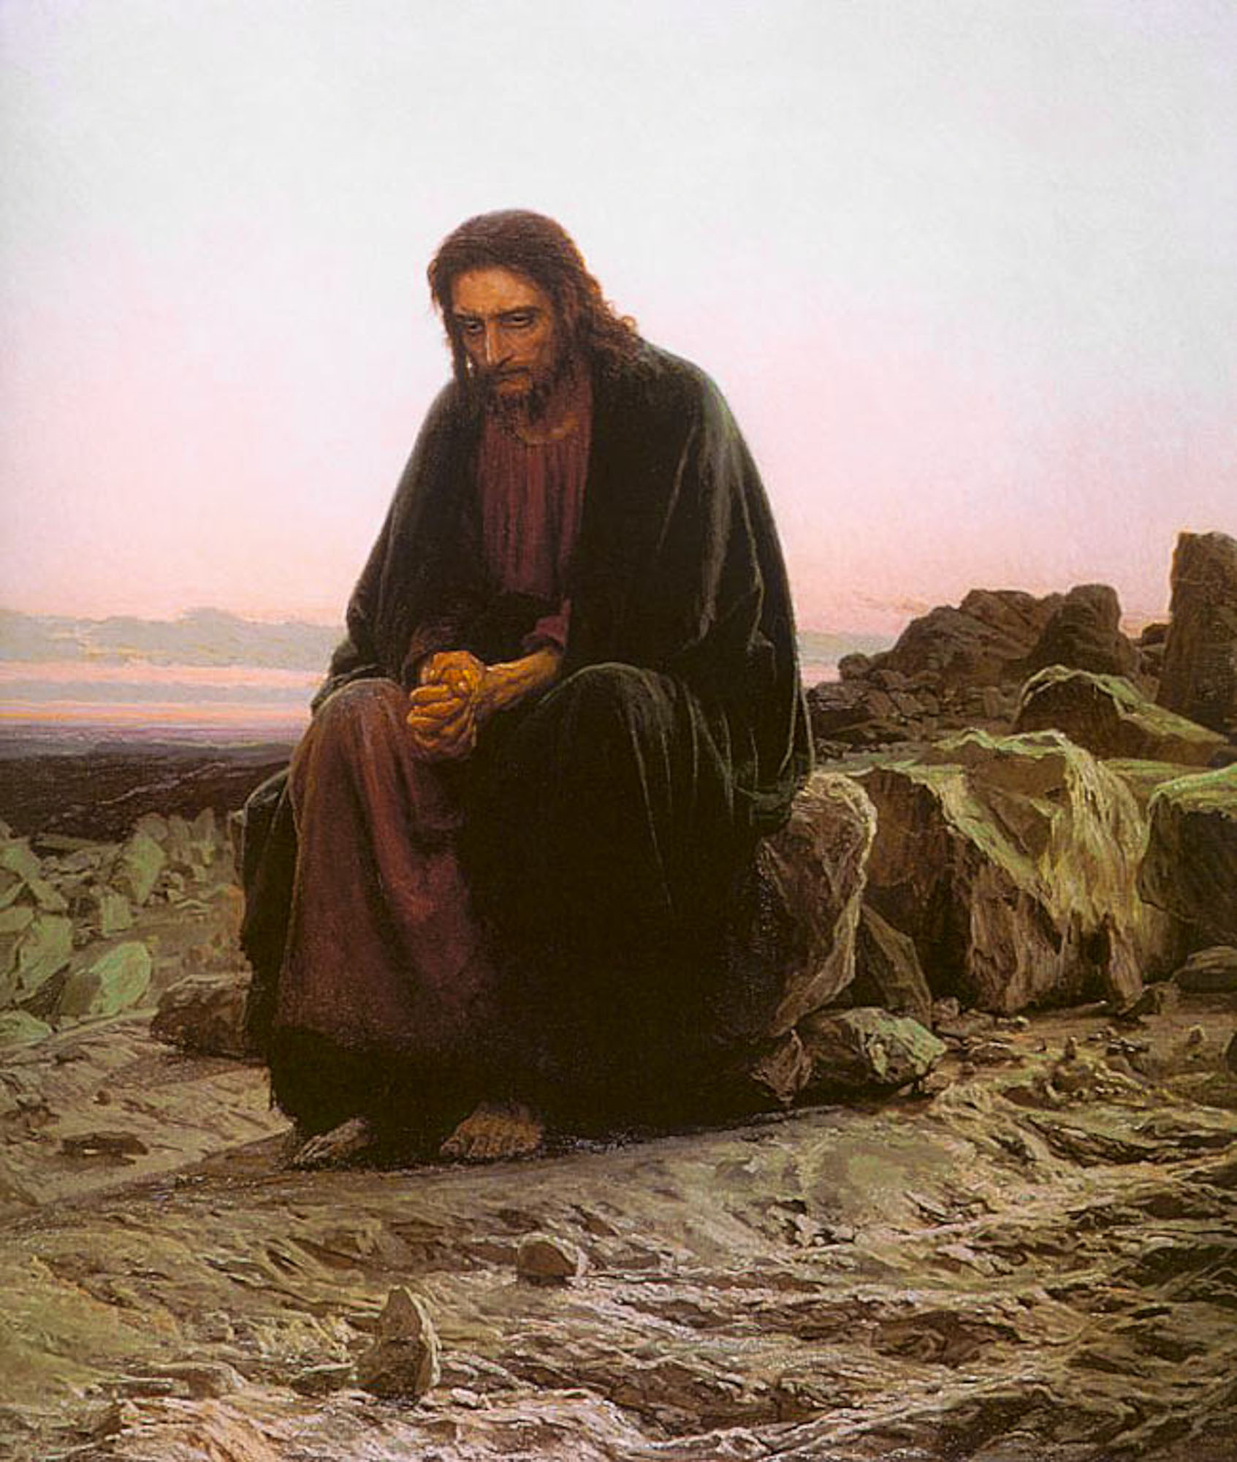
Later Russian art
Nikolay Ge. What is Truth? 1890
Ivan Kramskoy. Christ in the Wilderness. 1872

Slide 12
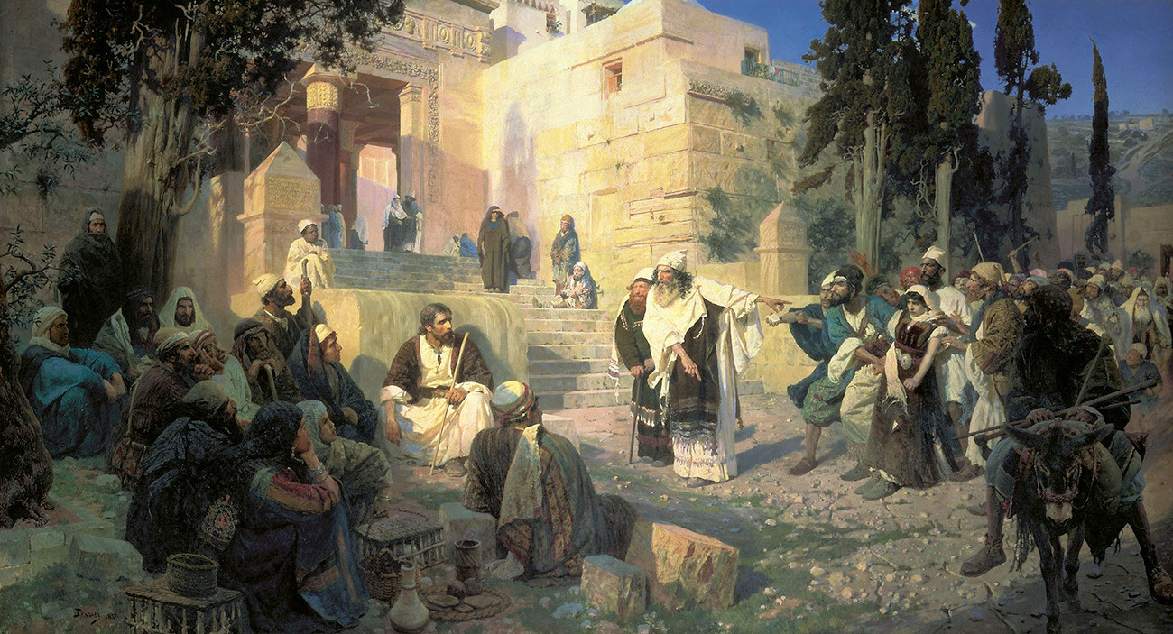
Vasily Polenov. Christ and the Adulteress (Who is without Sin?), 1888

Slide 13
19th century
French revolution and Napoleon
  Germany – counter enlightenment, romanticism, Bismarck
  Russia – re-introduction of western ideas
Decembrists 1815
Stankovich Circle 1830s
  Akaskov, Samarin, Katkov, Granovsky, Herzen, Khomiakov, Radishchev

Slide 14
Chaadaev
Chaadaev, (1793-1856)
  Is Russia East or West?
  Follow Peter's path or return to Muscovy?
  What did God think about Russia?
  ”Love of one's native land is a beautiful thing but there is something still more beautiful, and that is love of truth."
  "I have a profound conviction that we have a vocation to solve a great many of the problems of social order, to bring about the fulfilment of a great many ideas which have taken their rise in societies of the past and to give an answer to questions of great importance with which mankind is concerned.”
Split 1840s
  Slavophiles and Westernisers

Slide 15
Basis for the split
Split between Westernisers and Slavophiles over Peter's reforms.
  Westernisers accepted them entirely and saw future in the western path. Confused their ideal for Russia with Western Europe in own day
  Slavophiles regarded Peter as betrayal of Russia and saw special type of culture springing out of spiritual soil of Orthodoxy. Influenced by Hegel and applied to Russian history.
Neither had a clear view. Both distorted. Neither could see good and bad of the other. Lack of balance.

Slide 16
Slavophiles
Russia is different (not anti-western)
Confused ideal of Russia, ideal utopia of perfect order of society with historical past.
3 basic principles of Russia: Orthodoxy, autocracy, nationhood
Khomiakov (1804-60) – sobornost: unity-in-freedom pursuing the truth
Ivan Kireevsky, Aksakov, Samarin
Aksakov
Pan-Slavism
Soil bound school
Dostoyevsky, Solovyov
Notes:
Khomyakov, Kireyevsky and Samarin, the main Slavophile philosophers, created their own philosophical doctrine. The Slavophiles believed that the true East Orthodox faith borrowed by Rus predetermined the Russian nation’s special historical mission. East Orthodoxy was marked by Sobornost, the term for organic unity and integration and the salient feature of Russian society’s life. The innermost foundations of the Russian soul were formed by Orthodoxy and traditional peasant communes.
The Slavophiles idealized the Russian nation’s patriarchal nature and the principles of traditionalism and perceived it in the spirit of conservative romanticism. At the same time, they called on intellectuals to merge with the people and to study their way of life, culture and language.
Slavophile concepts were reflected in the philosophical doctrines advanced by Vladimir Solovyov, Nikolai Berdyayev, Sergei Bulgakov, Lev Karsavin and Pavel Florensky in the late 19th century and the early 20th century.
Split between W and S over Peter's reforms.
• W accepted them entirely and saw future in the western path. Confused their ideal for Russia with Western Europe in own day
• S regarded Peter as betrayal of Russia and saw special type of culture springing out of spiritual soil of Orthodoxy. Influenced by Hegel and applied to Russian history.
Neither had a clear view. Both distorted. Neither could see good and bad. Lack of balance.
Great Debate 1840's
Slavophils
Classical S not anti-western. Kh called Western Europe land of miracles. Merely thought that Russia different. Confused ideal of Russia, ideal utopia of perfect order of society with historical past. The S loved freedom but there was no freedom in Muscovite Russia.
Organic conception of life and history and society. Linked to the soil. Family basis of society. Society should be constructed on familial relationships.
3 basic principles of Russia: Orthodoxy, autocracy, nationhood
Khomiakov (1804-60) First Russian theologian. Guards officer. Brilliant debater. Wrote little. Developed notion of sobornost. unity-in-freedom pursuing ht truth.
2 different spiritual types: Iranian and Kushite.
Iranian seeks freedom and spirituality and tries to establish complete freedom in the world, free community of faith and reason—> Orthodox Church. Iranian—> Jewish—> Russia
Kushite tres to escape responsibility of freedom—> realm of necessity and materiality—> fragmentation, disunity of will, reason, faith, subordination to external authority. Kushite —> Egypt—> Roman —> Catholicism. Fragmentation of western Europe, Protestantism, science etc.
Pursuit of wholeness, community integral
Ivan Kireevsky. distinguished west from Russia.
3 main elements of west absent from Russia: Roman Catholic Church, ancient Roman culture, political government originating in violent conquest.
West triumph of formal reason—> fragmentation, rational abstraction
Orhtodoxy striving after truth by inward raising of consciousness towards integrality of the heart, instead of external and lifeless unity striving towards something living and inward.
Russian culture is only the highest degree of Western culture.
Aksakov In the west they kill soul and replace them with perfecting of political forms and establishment of good order by police action. Conscience replaced by law, regulations instead of inward impulse. At foundations of Russian state spontaneity, freedom, peace.
Not historical but ideal types. Spiritual history.
Samarin
Pan-Slavism
Pogodin, Prof History at Moscow. One of chief upholders of Official Nationality
Danilevsky (1822-85) Theory of cultural types. Each self contained. Each cultural type could excel in one area. rel, cult, soc, or economic. Only Slavs had potentiality to excel in all directions —> create balanced civilization
Soil-Bound School
Russians should know own country and return of upper classes to soil. Bridge division come from Peter.
Freedom
Grigorev (1822-64)
Dostoyevsky
compassion for suffering—> Penkovsky Circle. Sentenced. In prison recognized human nature. Wrong fro an individual to make up social ideal and impose on others. Constructing an ideal of one's own is self-deification. Return to Christian ideal of the people. Church. Spiritual brotherhood even though external social inequality. Didn't idealize Russia but recognized special mission. 2 valuable features of Russian character:
1. unusual ability to absorb spirit and ideas of others
2. recognition of own sinfulness, thirst for purification
Image of Xt in Russian soul which would be recognized by others and draw them into voluntary unity.
Wanted replacement of externally imposed law by innerly accepted truth.
Dostoyevsky
Solovyov
Vekhi

Slide 17
Westernisers - 1840s
Russia was European and should follow and imitate it
Herzen, Granovsky, Ogarov, Kavelin, Belinsky, Turgenev
Split in 1840s
Liberal
  Annenkov, Granovsky, Chicherin, Kavelin – religious
Revolutionary
  Ogaryov, Belinsky, Herzen, Botkin – atheists
Anarchism
  Bakunin, Kropotkin, Nechayev, Tolstoy,
Marxism
  Plekhanov, Lenin, Trotsky, Bukharin, Stalin
  Mensheviks, Bolsheviks
Notes:
The Westernizers were a group of 19th century Russian intellectuals who opposed feudalism and the Slavophiles in the 1840s. Writer Alexander Herzen described their ideological disputes, held at Moscow’s literary salons, in his book My Past and Thoughts. Alexander Herzen, Timofei Granovsky, Nikolai Ogaryov, Vasily Botkin, Nikolai Ketcher, Yevgeny Korsh, Konstantin Kavelin and some others comprised the Moscow Westernizers group. Belinsky, who lived in St. Petersburg, maintained close ties with the group.
Writer Ivan Turgenev was also a Westernizer. Representatives of the movement rejected feudalism and serfdom in the economy, political life and culture, and demanded Western-style socio-economic reforms. The Westernizers deemed it possible to establish a bourgeois democratic system by peaceful means. They believed that education and propaganda could forge Russian public opinion and force the Tsar to launch bourgeois reforms. Also, they had a high opinion of Peter the Great’s reforms.
The Westernizers called for overcoming Russia’s socio-economic backwardness on the basis of progressive European experience, rather than promoting unique elements of national culture. They prioritized the common aspects of Russian-Western historical and cultural destinies, rather than mutual disagreements.
Asserted Russia was European and should follow and imitate it.
Conservatism:
Katkov (1818-87).
K.P. Pobedonostsev (1827-1907) Lawyer. MU. Procurator of Holy Synod. Very influential. Devout. Moscow Collection.
Church: gathering of Xns who are organically bound together by unity of belief into a God-establish union.
State: society organised into a civic union.
State should be on guard form sectional interests. Monarchy best.
Law: external regulation, commandment —moral consciousness. Law guard people's freedom, respond to sense of justice in people soul. few laws better. Custom more important than written law. Laws should be simple and comprehensible. Disliked French rev. —> swept custom away and organic society. Things should develop spontaneously out of custom and not plan or principle.
Sceptical about democracy. Party seize power and use for own selfish ends.
Tikhomirv (1852-1923)
Progressive:
S. Yu. Witte (1849-1915)
Stolypin ((1862-1911)
Liberalism
Kavelin (1818-85)
Chicherin (1828-1904). Classical liberal. Freedom—> law. distinction state and society. Argued for freedom within law, no state interference in religion, autonomous universities. Independent courts.
Granovsky (1813-55)
Later splitting parties:
Octobrists, Cadets, Progressive Party
Zemstovo movement
Peter Struve,
Cadets, (constitutional democratic party) main party of liberal intelligentsia
Milyukov (1859-1943)
Socialism
Bakunin
Belinsky (1811-48). literary critic.
Herzen (1812-70)
Emigrated. Published The Bell. Lived in London. Russian socialism
Herzen etc.
Church could not & did not engage in debate. Intellectually dead. Couldn't deal with atheism, Marxism. Didn't enter the debate/ideological struggle
Rejected Khomiakov, Dostoyevsky, Soloviev, Tolstoy etc.

Slide 18
20th Century
Religious-Philosophical Renaissance
1905 revolution
Vekhi (1909) Berdyayev, Lossky, Frank, Kistyakovsky, Struve, Bulgakov
1917
  February revolution
  Re-establishment patriarchate
  October coup
Totalitarian communism – Possessor mentality
Dissidents – Non Possessor mentality
Notes:
The Russian Religious-Philosophical Renaissance was created by lay intellectuals who found rationalism, positivism and Marxism inadequate as explanations of the world or guides to life. They were deeply engaged in finding solutions to the problems of their time, which they saw as moral or spiritual/cultural in nature. Some were already devout Christians; others became so later on. Collectively known as the God-seekers, they propounded their ideas in numerous publications and in the Religious-Philosophical Societies of St Petersburg and Moscow. The meetings of these societies attracted capacity audiences and helped disassociate religion from reaction. Branches were founded in Kiev and Vladimir. The founding members were mainly Symbolist writers and idealist philosophers. Both groups sought a new understanding of Christianity, but the Symbolists emphasized psychological and literary/aesthetic issues and the idealists focused on ethics, epistemology and political and social reform. The Revolution of 1905 was a watershed for all of them. The hitherto apolitical Symbolists perceived it as the start of the apocalypse and championed anarchistic political doctrines. The idealists continued to champion reform. After the revolution, some of them called for a new religious intelligentsia that respected culture and the creation of wealth, spiritual/cultural and material. Both groups began to talk about national identity and destiny. The Bolshevik Revolution signalled the end of the Religious-Philosophical Renaissance. In 1922–3, over 160 non-Marxist intellectuals were forced into exile, where they continued their work. Inside Russia private religious-philosophic study circles carried on illegally.
The Religious-Philosophical Renaissance had a profound impact on Russian thought and culture. It inspired attempts to ground metaphysics and political doctrines in Christianity, demands for church reform, visions of a new culture, sophiology, religious existentialism and new interpretations of Orthodox ritual and dogma. Its proponents made people aware of the needs of the ‘inner man’, the soul or the psyche, and the importance of art and myth. Symbolism became the dominant aesthetic, shaping literature, poetry, painting and theatre. Theorists of Symbolism tried to make it the basis of a new cosmological worldview. The Religious-Philosophical Renaissance was rediscovered by Soviet intellectuals in the 1960s, nourished the dissident movement from then on, and is extensively discussed in Russia today.

Slide 19
Providential analysis?
980-1380 400 years (slavery/patriarchs?) (Kievan Rus)
988 (conversion of Vladimir) - 1380 (Kulikovo Pole)
1380-1502 120 years (united?)
(Muscovy)
1380 (Sergius Radonezh) 1502 (Council division Nil and Joseph)
1503-1917 400 years (divided?)
(Petrine Russia)
1917-1988 70 years (Papal captivity?)
(Communism)
1989-2129 140 years (return, confusion?)

