Slide 1
What does a foundation to receive the messiah look like?
Foundation of faith
  Spiritual community
  Life of prayer, study and worship
Foundation of substance
  Freedom of thought and speech
  Rule of law
Foundation to receive the messiah
  Spiritual community who can respond to the messiah and be able to protect him
Notes:
Long before the Beit HaMikdash was built, two brothers lived and farmed on that same site. One was married and had a large family, while the other was single. They lived in close proximity to each other, and each worked his land, growing wheat. When harvest time arrived, each was blessed with a bountiful crop and piled up his grain for long-term storage.
The unmarried brother, observing his good fortune, thought to himself that God had blessed him with more than he needed, whereas his brother, who was father to a large family, could surely use more. He arose in the middle of the night and secretly took from his grain and put it in his brother’s pile.
Similarly, the married brother thought to himself that he was blessed to have children who would care for him in his old age, while his brother must depend on what he saved. He, too, arose in the middle of the night and quietly transferred grain from his pile to his brother’s.
In the morning, each wondered why there was no noticeable decrease in his own pile, and so they repeated the transfer the next night. These nocturnal activities continued, until one night the brothers bumped into each other. In that instant, in the dark of night, the glow of brotherly love lit up the mountain sky; they each understood what the other had been doing and they fell into a warm embrace. According to the legend, when God saw that display of brotherly love, He selected the site for His Temple.

Slide 2
The foundation to receive the Lord of the Second Advent
God’s 2000 years providence has prepared a democratic social and legal environment which will protect Christ at the Second Advent. EDP, 282

Slide 3
Only by Cain-type Hellenism submitting to Abel-type Hebraism could Satan be separated from the prevailing spirit of the age. Then the foundation of substance necessary for receiving Christ at the Second Advent could be established worldwide. EDP, 350
  Movements to restore original human nature
  Both are good and necessary
  Both need to be integrated with Hebraism in subject position

Slide 4
A recap
Medieval synthesis
  Islam, Judaism, European Christianity
  Successful movements of renewal
  Corrupted
Renaissance
  Spiritual values informed cultural and scientific change
  Church would not reform or be reformed
“Reformation”
  Division of Europe
  Cultural vandalism
  Wars
  Rise of nationalism
Enlightenment
  All Christian Europe should make a foundation for messiah

Slide 5
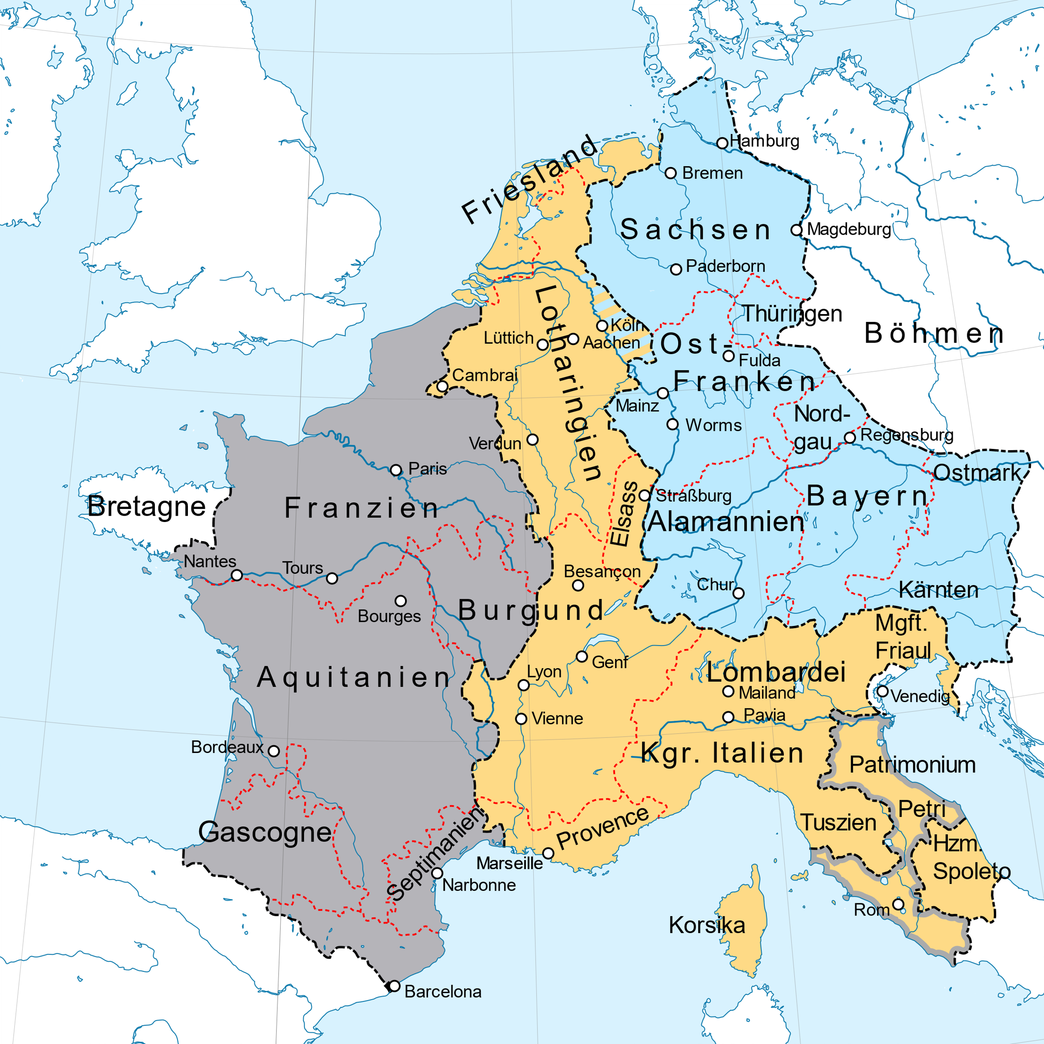
The Carolingians
Carolingian dynasty
  Replaced Merovingians with support of the papacy
  Efficient and effective civil service
    Charlemagne
    Louis the Pious (814-840)
    Charles the Bald, Louis the German against Lothair I
  Viking invasions
    Decentralisation
  Positions came to be inherited
    Feudalism
  Weak kings
    What to do?
    Nobles claimed monarchy elective
Treaty Verdun 843

Slide 6
Divisions of the Franks
Henry Fowler – 919 King East Franks
  Saxon dynasty – founder German state
  Otto the Great made Holy Roman Emperor 962
Hugh Capet – 987 King of the Franks
  Elected at Reims – wanted his son crowned
  Beginning modern France
  Weak decentralised state
    Powerful nobles – Normans, Plantagenets, Hautevilles, Ramnulfids
  Gradual establishment of royal authority
    Primogeniture
    Support of the church – crusades
  No male heirs – 1328 – Hundred Years War
House of Valois
  Consolidation of France and centralised state

Slide 7
Estates General
Legislative and consultative assembly
  Clergy, nobility, commoners
First met 1302
  Support Philip IV in conflict with Pope Boniface VIII
No power in its own right
  Not required to approve taxation or legislation
Met intermittently
  Only once after 1614 until 1789

Slide 8
Religion in France
Roman Catholicism official religion
  Extermination Cathars – 1209-1350
  St. Bartholomew's Day massacre – 1572
    5-30 000 Huguenots killed
  Edict Nantes – 1598
Jean Bodin (1530-1596)
  Colloquium
  Divine right of kings
Descartes (1596-1650)
  ‘I think therefore I am’
  Proofs for existence of God
  Books banned by the church
Monarchy and church corrupt and inefficient
  Rational critique of tradition
Rationalism
Truth from
Reason
Dogmatism
Universalism
Notes:
Jean Bodin, (1530-1596) who was renowned for his powerful intellect and breadth of knowledge and was truly a renaissance man: “His works on political and legal thought set him apart as one of the most brilliant minds of the period. Although he is perhaps less known for his writing on religious questions of his day, his Colloquium remains a unique contribution to religious dialogue. It circulated in its Latin manuscript form, but it was not published until the nineteenth century. Marion L. Kuntz offers the first English translation of this masterpiece. Structured as a conversation between a Catholic, a Jew, a Lutheran, a Calvinist, a Muslim, a skeptic, and a philosophical naturalist, the Colloquium encourages religious tolerance and poses challenging questions for anyone interested in the nature of religious and philosophical thought. Bodin also came up with idea of divine right of kings. The Six Books of the Commonwealth represents the sum total of legal and political thought of the French Renaissance. His Method for the Easy Comprehension of History is at the pinnacle of early-modern, European humanism's Ars historica. Finally, his work Colloquium of the Seven about Secrets of the Sublime, …”
René Descartes (/deɪˈkɑːrt/ or UK: /ˈdeɪkɑːrt/; French: [ʁəne dekaʁt] (About this soundlisten); Latinized: Renatus Cartesius;[b][15] 31 March 1596 – 11 February 1650[16][17][18]:58) was a French philosopher, mathematician, and scientist who invented analytical geometry, linking the previously separate fields of geometry and algebra. He spent a large portion of his working life in the Dutch Republic, initially serving the Dutch States Army of Maurice of Nassau, Prince of Orange and the Stadtholder of the United Provinces. One of the most notable intellectual figures of the Dutch Golden Age,[19] Descartes is also widely regarded as one of the founders of modern philosophy.
Many elements of Descartes's philosophy have precedents in late Aristotelianism, the revived Stoicism of the 16th century, or in earlier philosophers like Augustine. In his natural philosophy, he differed from the schools on two major points: first, he rejected the splitting of corporeal substance into matter and form; second, he rejected any appeal to final ends, divine or natural, in explaining natural phenomena.[20] In his theology, he insists on the absolute freedom of God's act of creation. Refusing to accept the authority of previous philosophers, Descartes frequently set his views apart from the philosophers who preceded him. In the opening section of the Passions of the Soul, an early modern treatise on emotions, Descartes goes so far as to assert that he will write on this topic "as if no one had written on these matters before." His best known philosophical statement is "cogito, ergo sum" ("I think, therefore I am"; French: Je pense, donc je suis), found in Discourse on the Method (1637; in French and Latin) and Principles of Philosophy (1644, in Latin).[21]
Voltaire - mocked religion
Rousseau - totalitarian democracy
Encyclopedists - atheistic materialists
Robspeare - idealist dictator
Napoleaon
Disputative
Revolutionary Enlightenment, more dominant in France, was represented by the thought of Denis Diderot (1713–1784), Baron d'Holbach (1723–1789), Jean le Rond d'Alembert (1717–1783) and Claude Adrien Helvétius (1715–1771)
Saint Simon: he advocated a form of state technocratic socialism, an arrangement where industrial chiefs should control society. In place of the church, he felt the direction of society should fall to the men of science. Men who are fitted to organize society for productive labour are entitled to rule it.
Universalism - one size fits all

Slide 9
Divine right of kings
Rulers legitimised their power and authority through the doctrine of ‘divine right’. They claimed that political power was a divine responsibility, a gift given to rulers by God.
The Catholic church supported the notion of divine right by including it in church doctrine. Because the power of kings and emperors came from God, it was beyond challenge. To engage in rebellion or disloyalty against one’s king was to disobey the will of God.
The French king Louis XIV (1638-1715), was a significant exponent of this belief. A devoutly religious leader, Louis worked to expand and strengthen the doctrine of divine right in France.
What if one rejects God and hence divine right as the source of legitimate political authority?

Slide 10
Philosophes
The philosophes raised objections against the decadent lifestyles of leading Church representatives, as well as the Church’s persistence in collecting exorbitant taxes and tithes from the commoners to fund outlandish salaries for bishops and other Church officials. What the philosophes found most appalling, however, was the control that the Church held over impressionable commoners by instilling in them a fear of eternal damnation. The philosophes may have had mixed feelings about the common people, but they had very strong feelings against the Church. As a result, they provoked the Church by challenging doctrines such as the existence of miracles and divine revelation, often disproving specific tenets with simple science. The Church, in turn, hated the philosophes and all they stood for.

Slide 11
Philosophes
Philosophes
  Intellectuals of the 18th-century French Enlightenment
  Salons, coffee shops
  Rousseau, Voltaire, Montesquieu, Secondat
  Contributed to Diderot's Encyclopédie
  Critical eye and looked for weaknesses and failures to be improved
  Confident that human society could be improved through rational thought
  Influenced by deism, Locke, Newton
  Very anti-clerical and anti-religious
  Destructive and atheistic
French Enlightenment developed outside the church
  1764 – suppression of the Jesuits

Slide 12
The philosophes were not revolutionaries or radical democrats. They had no wish to destroy the authority of kings and governments or to dismantle or level social hierarchies. Nevertheless, they did not believe that political power emanated from God. In their view, the role of governments was to guard the nation, protect the people and secure their individual rights.
Concerned social and political reform

Slide 13
Quotes Voltaire
“It is dangerous to be right in matters on which the established authorities are wrong.”
“I have never made but one prayer to God, a very short one: Oh Lord, make my enemies ridiculous. And God granted it.”
“Cherish those who seek the truth but beware of those who find it.”
“Judge a man by his questions rather than by his answers.”
“The right to free speech is more important than the content of the speech.”
Beware of the words "internal security," for they are the eternal cry of the oppressor.
“It is forbidden to kill; therefore all murderers are punished unless they kill in large numbers and to the sound of trumpets.”
“Now, now my good man, this is no time to be making enemies."
(Voltaire on his deathbed in response to a priest asking him that he renounce Satan.)

Slide 14
Some leading philosophes
Voltaire (1694 – 1778)
  Candide
  Mocked religion
Rousseau (1712-1788)
  Social Contract, Emile
  ‘Democratic totalitarianism’
Saint Simon (1760–1825)
  State technocratic socialism
Revolution (1789)
  Louis called estates general
  Atheistic, bloody, dictatorship
  Napoleon crowned emperor by the pope
  Revolutionary and Napoleonic wars (1792-1815)

Slide 15
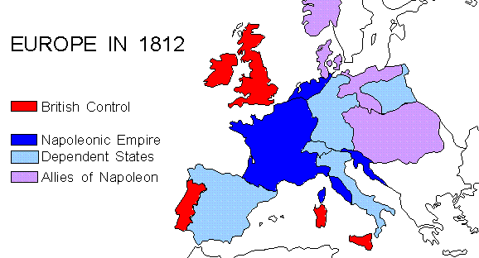
Napoleonic Empire
Russia
Prussia
Confed.
of the
Rhine
French
Empire
Austria
Ottoman
Empire
Portugal
Spain
Notes:
Rise of Napoleon 1795-1805
At the time of the French Revolution, Napoleon was a lowly army cadet. The revolution opened the army to promotion on the basis of talent - in the old regime, you became an officer through noble birth, patronage or by bribing officials. As a military genius with ruthless ambition, Napoleon rose rapidly in the revolutionary armies. France was being attacked on all sides as the kings of Europe feared the revolution would spread, and that its ideas of liberty and equality would appeal to their own subjects. It was a time of great opportunity for an ambitious young army officer.
1795 - appointed commander of French revolutionary forces in Italy
1797 - appointed to command French forces for invasion of England
1798 - sailed down the Mediterranean to invade Egypt.
1799 - followed by British Admiral Nelson, who defeated the French fleet at the battle of the Nile - ending hopes of extending the French Empire in the Middle East and blocking British trade with India. Napoleon returned to Paris. Things were going badly for the French, and he led a military coup which overthrew the weak government (the "Directory"), replacing it with a military junta called the Consuls.
1802 - after successfully beating off the hostile coalition led by Britain, the Consuls made a temporary peace.
1803 - to raise money for another war everyone expected, Napoleon sold the French colony of Louisiana in north America - a huge area from New Orleans up the Mississippi to the Canadian border. The USA bought it for $3 million (the "Louisiana Purchase"), borrowing the money from British and Dutch bankers!
With his war chest full, Napoleon planned to invade England. He massed a "Grand Armée" camped on the hills above Boulogne, and set about building a flotilla of barges by which they could invade England. This set off panic reaction across the Channel, with enormous resources poured into strengthening defences against invasion - the Royal Military Canal around Romney Marsh, the ring of coastal gun turrets called Martello Towers, and huge fortifications on the hills either side of Dover harbour.
1804 - elected "Consul for life", then crowned himself as "Emperor of France" in Paris, in the presence of the Pope.
1805 - British Admiral Nelson defeats combined French and Spanish fleets in the battle of Trafalgar.
1805 - Napoleon was forced to abandon plans to invade England (he realised he could not stop the British fleet attacking his troop-carrying barges as they crossed the Straits of Dover).
Meanwhile he had already marched his army eastwards, and defeated the Russians and Austrians at the battle of Austerlitz.
1806 - With opposition to the east greatly weakened, Napoleon united most of the small German states into the "Confederation of the Rhine" under his control. He destroyed the Prussian army at the battle of Jena, and took over Prussia's Polish territories.
To undermine the British war effort, he started the "Continental System": his Customs Officers were ordered to stop British goods being landed in France or anywhere in Europe under French control. He hoped this embargo would ruin British trade and industry, which provided the wealth that enabled Britain to keep a powerful navy and large armies.
1807 - He made peace with Britain's other potential coalition ally, Russia. Napoleon agreed to allow Russia a "sphere of influence" round its borders. He established a Duchy of Warsaw to keep most of Poland under French control.
1808 - He invaded Spain and Portugal, setting up his brother as King of Spain.
1809 - A British expeditionary army into Spain was beaten at Corunna, and almost driven into the sea. Reorganised under the Duke of Wellington, the British fought through the peninsula until 1814, helped by fierce resistance by Spanish peasants who waged a guerrilla war that tied up French forces.
1810 - Napoleon was at the height of his powers. His main enemy Britain was almost isolated: France had made peace with Britain's main former coalition allies: Russia, Austria and Prussia, having weakened them in decisive land battles. The French Empire ruled over 10 million of Europe's 175 million inhabitants. Only Britain's continued sea power stopped France taking over the distant Spanish and Dutch colonies in America, India and the Far East to create an even bigger world empire.
1812 - Napoleon decided to invade Russia. They had stopped boycotting British goods, and Napoleon suspected they were going to re-join the coalition with Britain. He led the Grand Army from Poland, beating the Russians at the battle of Borodino at the gates of Moscow. But the Russians beat him with a "scorched earth" policy, destroying everything so there was no food or shelter for the French army. Napoleon was forced to retreat from Moscow. In the cruel Russian winter, only 100,000 men out of 600,000 made it back to France.
1813 - Encouraged by the French catastrophe, Prussia and Austria switched sides, allied with Britain who financed them to declare war on France. Napoleon won several early battles, but the enlarged coalition routed him in the "battle of Nations" at Leipzig. Together they invaded France, and French public opinion turned against Napoleon and his endless wars.
The Napoleonic Wars were a series of wars declared against Napoleon's French Empire by opposing coalitions that ran from 1803 to 1815. As a continuation of the wars sparked by the French Revolution of 1789, they revolutionised European armies and played out on an unprecedented scale, mainly due to the application of modern mass conscription. French power rose quickly as Napoleon's armies conquered much of Europe but collapsed rapidly after France's disastrous invasion of Russia in 1812. Napoleon's empire ultimately suffered complete military defeat resulting in the restoration of the Bourbon monarchy in France. The wars resulted in the dissolution of the Holy Roman Empire and sowed the seeds of nascent nationalism in Germany and Italy that would lead to the two nations' individual consolidation later in the century. Meanwhile, the global Spanish Empire began to unravel as French occupation of Spain weakened Spain's hold over its colonies, providing an opening for nationalist revolutions in Spanish America. As a direct result of the Napoleonic wars, the British Empire became the foremost world power for the next century thus beginning Pax Britannica.
The Napoleonic Wars brought great changes both to Europe and the Americas. Napoleon had succeeded in bringing most of Western Europe under one rule—a feat that had not been accomplished since the days of the Roman Empire (although Charlemagne had nearly done so around 800 CE). However, France's constant warfare with the combined forces of the other major powers of Europe for over two decades finally took its toll. By the end of the Napoleonic Wars, France no longer held the role of the dominant power in Europe, as it had since the times of Louis XIV. In its place, the United Kingdom emerged as by far the most powerful country in the world and the Royal Navy gained unquestioned naval superiority across the globe. This, coupled with Britain's large and powerful industrial economy, made it perhaps the first truly global superpower and ushered in the Pax Britannica that lasted for the next 100 years.
In most European countries, subjugation in the French Empire bought with it many products of the French Revolution including democracy, due process in courts, abolition of privileges, etc. The increasing prosperity of the middle classes with rising commerce and industry meant that restored European monarchs found it difficult to restore pre-revolutionary absolutism, their basic laws—an enduring legacy of the Napoleonic Code.
Another concept emerged – that of a unified Europe. After his defeat, Napoleon deplored the fact that his dream of a free and peaceful "European association" remained unaccomplished. Such a European association would share the same principles of government, system of measurement, currency and Civil Code. Some one-and-a-half centuries later, and after another major conflagration (the Second World War), several of these ideals re-emerged in the form of the European Union.

Slide 16
France
No unity of Hebraism and Hellenism
Expanded to continental Europe
Totalitarian democracy
German Counter-Enlightenment Communism, Europeanism
Notes:
"Counter-Enlightenment" is a term used to refer to a movement that arose in the late-eighteenth and early-nineteenth centuries in opposition to the eighteenth century Enlightenment. The term is usually associated with Isaiah Berlin, who is often credited with coining it, perhaps taking up a passing remark of the German philosopher Friedrich Nietzsche, who used the term Gegenaufklärung at the end of the nineteenth century. It has not been widely used since. The first known use of the term 'counter-enlightenment' in English was in 1949. Berlin published widely about the Enlightenment and its enemies and did much to popularise the concept of a Counter-Enlightenment movement that he characterised as relativist, anti-rationalist, vitalist and organic and which he associated most closely with German Romanticism. Some recent scholarship has challenged this view for focusing too narrowly on Germany and stopping abruptly in the early nineteenth century, thereby ignoring the Enlightenment's many subsequent critics, particularly in the twentieth century

Slide 17
German Enlightenment 1650-1800
Spener (1635-1705)
  Pietism
Leibnitz (1646–1716)
  Monodology - spiritual atoms
  Universe a manifestation of a perfect God
Kant (1724-1804)
  Synthesised rationalism and empiricism
  Transcendental idealism
Goethe (1749–1832)
  Young Werther Sturm und Drang
Hamann (1730-1788) , Herder (1744-1803)
  Romanticism - emotion over reason - reaction to French view
  Pluralism instead of universalism
Emotional
Mystical
Irrationalism
Notes:
Pietism (from the word piety) was a movement within Lutheranism, lasting from the late 17th century to the mid-18th century and later. It proved to be very influential throughout Protestantism and Anabaptism, inspiring Anglican priest John Wesley and Alexander Mack to begin the Brethren movement. The Pietist movement combined the Lutheranism of the time with the Reformed emphasis on individual piety and living a vigorous Christian life. Though pietism shares an emphasis on personal behavior with the Puritan movement, and the two are often confused, there are important differences, particularly in the concept of the role of religion in government. The main difference between the new Pietistic Lutheran school and the orthodox Lutherans arose from the Pietists' conception of Christianity as chiefly consisting in a change of heart and consequent holiness of life. Orthodox Lutherans rejected this viewpoint as a gross simplification, stressing the need for the church and for sound theological underpinnings. As forerunners of the Pietists in the strict sense, certain voices had been heard bewailing the shortcomings of the Church and advocating a revival of practical and devout Christianity. Amongst them were Christian mystic Jakob Böhme. Spener founded Halle University
Leibniz proposed the idea that everything in the universe consisted of monads, which he conceived of essentially as “spiritual atoms” that constitute our perception of the world but lack physical dimension. Unlike many figures in the French and English Enlightenment, Leibniz was very religious and in fact saw monads as reflections of a structured, harmonious universe—the work of a perfect God. Leibniz’s deep religious faith and affinity for tradition kept him conservative in his approach to his work, permeated his writings, and paved the way for the mysticism of the rest of the German Enlightenment. Leibniz a Platonist and not a Christian. Rarely went to church although involved in Prot-Cath reunion.
Kant’s work with skepticism perfectly sums up the German Enlightenment’s mistrust of empiricism. The Critique suggests that we all are born with our own ideas and perceptions of the world and, as such, can never know what is “real” and what is “our perception.” In other words, reality is in the eyes of the beholder. However, because nothing really exists separate from its existence in the eyes of the observer, then perceptions and observations in the world cannot be trusted. As a result, empirical evidence cannot be trusted either. By thus stating that only a select few universal truths in the world were valid, Kant effectively disagreed with the premise of the entire French Enlightenment. Kant’s transcendental idealism was a modest philosophical doctrine about the difference between appearances and things in themselves, which claimed that the objects of human cognition are appearances and not things in themselves. Fichte, Schelling, and Hegel radicalized this view, transforming Kant’s transcendental idealism into absolute idealism, which holds that things in themselves are a contradiction in terms, because a thing must be an object of our consciousness if it is to be an object at all. The German idealists attempted to derive all the different parts of philosophy from a single, first principle. This first principle came to be known as the absolute, because the absolute, or unconditional, must precede all the principles which are conditioned by the difference between one principle and another.
Goethe’s novel The Sorrows of Young Werther (1774), about a young boy who falls for an unattainable girl and eventually kills himself out of despair, had an unimaginable impact on German youth at the time. It is primarily for that work that Goethe is considered the most prominent figure in Germany's Sturm und Drang (“storm and stress”) movement, a roughly twenty-year period from the 1760s to 1780s in which young German intellectuals, inspired by Rousseau’s emphasis on emotion, revolted against optimism and reason and plunged into darker, more anarchic themes.
Sturm und Drang literally "Storm and Urge", although usually translated as "Storm and Stress” is the name of a movement in German literature and music taking place from the late 1760s through the early 1780s, in which individual subjectivity and, in particular, extremes of emotion were given free expression in reaction to the perceived constraints of rationalism imposed by the Enlightenment and associated aesthetic movements. The philosopher Johann Georg Hamann is considered to be the ideologue of Sturm und Drang, and Johann Wolfgang von Goethe was a notable proponent of the movement; though he and Friedrich Schiller ended their period of association with it by initiating what would become Weimar Classicism.
Goethe released numerous essays, poems, and critiques over the following thirty years, then unveiled the literary masterpiece that would solidify his place in history. The first part of the epic verse drama Faust was published in 1808, the second in 1832. The work—a retelling of the German legend of a man who promises his soul to the devil in exchange for knowledge and power (previously told in Christopher Marlowe’s 1604 Dr. Faustus)—was massively successful. Goethe, however, died the same year that the second part was published.
Romanticism movement that arose primarily in late eighteenth and early nineteenth century Germany against the rationalism, universalism and empiricism commonly associated with the Enlightenment.
Counter-Enlightenment thought did not really 'take off' until the Germans 'rebelled against the dead hand of France in the realms of culture, art and philosophy, and avenged themselves by launching the great counter-attack against the Enlightenment.' This reaction was led by the Konigsberg Pietist philosopher J. G. Hamann, (1730-1788) 'the most passionate, consistent, extreme and implacable enemy of the Enlightenment', according to Berlin. This German reaction to the imperialistic universalism of the French Enlightenment and Revolution, which had been forced on them first by the Francophile Frederick II of Prussia, then by the armies of Revolutionary France, and finally by Napoleon, was crucial to the epochal shift of consciousness that occurred in Europe at this time, leading eventually to Romanticism. According to Berlin, the surprising and unintended consequence of this revolt against the Enlightenment has been pluralism, which owes more to the Enlightenment's enemies than it does to its proponents, most of whom were monists whose political, intellectual and ideological offspring have often been terror and totalitarianism.
Twentieth-century interpretations of Hegel were mostly shaped by British Idealism, logical positivism, Marxism, and Fascism. The Italian Fascist Giovanni Gentile, according to Benedetto Croce, "...holds the honor of having been the most rigorous neo-Hegelian in the entire history of Western philosophy and the dishonor of having been the official philosopher of Fascism in Italy."

Slide 18
Later German philosophy
Fichte (1762-1814)
  Idealism, nationalism, authoritarianism
Hegel (1770-1831)
  Dialectical idealism
  French atheism Left-wing Hegelians
  Satan invades Cain view
Feuerbach (1804-1872)
  Atheism, materialism Marx, Freud
Marx (1818-1883) Engels (1820-1895)
  Dialectical materialism, historical materialism, scientific atheism
Nietzsche (1844-1900)
  Rejected Christianity as slave morality
  ‘Death of God’
Idealism
Communism
Fascism
Nazism
Anti-Semitism
Notes:
Johann Gottlieb Fichte (May 19, 1762 – January 27, 1814 was a German philosopher. He was one of the founding figures of the philosophical movement known as German idealism, a movement that developed from the theoretical and ethical writings of Immanuel Kant. Fichte is often perceived as a figure whose philosophy forms a bridge between the ideas of Kant and the German Idealist Hegel. Recently, philosophers and scholars have begun to appreciate Fichte as an important philosopher in his own right due to his original insights into the nature of self-consciousness or self-awareness. Like Descartes and Kant before him, he was motivated by the problem of subjectivity and consciousness. Fichte also wrote political philosophy and is considered one of the fathers of German nationalism. In 1805, Fichte was appointed to a professorship. The disaster at Jena in 1806, in which Napoleon completely crushed the Prussian army, drove him to Königsberg for a time, but he returned to Berlin in 1807 and continued his literary activity.
The deplorable situation of Germany stirred him to the depths and led him to deliver the famous Addresses to the German Nation (1808) which guided the uprising against Napoleon. Fichte made important contributions to political nationalism in Germany. In his Addresses to the German Nation (1808), a series of speeches delivered in Berlin under French occupation, he urged the German peoples to "have character and be German"--entailed in his idea of Germaness was anti-semitism, since he argued that "making Jews free German citizens would hurt the German nation”. Historian Robert Nisbet thought him to be "the true author of National Socialism”.
Jewish liberal philosopher Isaiah Berlin listed Fichte, along with his fellow German idealist G.W.F. Hegel, French materialist and utilitarian philosophe Claude Adrien Helvétius, Swiss collectivist philosophe Jean-Jacques Rousseau, French utopian socialist Henri de Saint-Simon, and Savoyard conservative Joseph de Maistre as thinkers who constituted the ideological basis for modern authoritarianism, in his book Freedom and Its Betrayal: Six Enemies of Human Liberty.
Georg Wilhelm Friedrich Hegel ( (August 27, 1770 – November 14, 1831) was a German philosopher, one of the creators of German Idealism. His historicist and idealist account of reality as a whole revolutionized European philosophy and was an important precursor to Continental philosophy and Marxism.
Hegel developed a comprehensive philosophical framework, or "system", of Absolute idealism to account in an integrated and developmental way for the relation of mind and nature, the subject and object of knowledge, and psychology, the state, history, art, religion and philosophy. In particular, he developed the concept that mind or spirit manifested itself in a set of contradictions and oppositions that it ultimately integrated and united, without eliminating either pole or reducing one to the other. Examples of such contradictions include those between nature and freedom, and between immanence and transcendence.
Those who maintain that God created man in God’s image and likeness have got it the wrong way around, according to some thinkers. According to them, the truth is that man has created God in man’s image and likeness. Ludwig Feuerbach (1804-1872) says the following: “Such are a man’s thoughts and dispositions, such is his God;” “Consciousness of God is self-consciousness, knowledge of God is self-knowledge;” and “All attributes of the divine nature are attributes of the human nature.” Thus, for Feuerbach, God is a human creation, and each person thinks of God as a being who personifies her own thoughts, interests, and values. Because human thoughts, interests, and values can differ, there may be as many different conceptions of God as there are believers in God. For Feuerbach then, “consciousness of God is the self-consciousness of man.” However, Feuerbach says that we are not aware that our consciousness of God is really a kind of consciousness of ourselves. In fact, our ignorance of this matter “is fundamental to the peculiar nature of religion.”
For Sigmund Freud (1856-1939) God is also a projection of the human mind, and represents a supreme parent or father figure. Children think that their parents are all-knowing and all-powerful, but later find that they are not. The need for an all-knowing and all-powerful figure which a parent once fulfilled now is fulfilled by the concept of God as father.
Nietzsche : "God is dead" never meant that Nietzsche believed in an actual God who first existed and then died in a literal sense. It may be more appropriate to consider the statement as Nietzsche's way of saying that the conventional "God" of 19th century middle class Christianity is no longer a viable or believable source of any received wisdom. Nietzsche recognizes the crisis which the death of God represents for existing moral considerations, because "When one gives up the Christian faith, one pulls the right to Christian morality out from under one's feet. This morality is by no means self-evident... By breaking one main concept out of Christianity, the faith in God, one breaks the whole: nothing necessary remains in one's hands.” This is why in "The Madman", a work which primarily addresses atheists, the problem is to retain any system of values in the absence of a divine order. The death of God is a way of saying that humans are no longer able to believe in any such cosmic order since they themselves no longer recognize it. The death of God will lead, Nietzsche says, not only to the rejection of a belief of cosmic or physical order but also to a rejection of absolute values themselves — to the rejection of belief in an objective and universal moral law, binding upon all individuals. In this manner, the loss of an absolute basis for morality leads to nihilism. This nihilism is what Nietzsche worked to find a solution for by re-evaluating the foundations of human values. This meant, to Nietzsche, looking for foundations that went deeper than Christian values. He would find a basis in the "will to power" that he described as "the essence of reality."

Slide 19
Germany
No foundation to receive the messiah
Rise of nationalism, fascism, Nazism
World War 1 and 2

Slide 20
Maturation of politics, economy
and ideology (1789-1918)
Cain-type view
Renaissance | Enlightenment | Communism
Reformation | Second Reformation | Liberal Democracy
Abel-type view
Reformation and Renaissance
Conflict between religion and philosophies
Maturing of political structure, economy,
Agricultural & industrial revolution

Slide 21
Ideas have consequences
Cain view of life
French rationalism
German idealism
Materialism, atheism
Totalitarian
Democracy
Abel view of life
British empiricism
Spiritual revival
Liberal
Democracy
Notes:
France, German enlightenments invaded by Satan. British one not
Democracy is Britain grew out of the church. Parliament met in Chapter House of Westminster Abbey for centuries before moving to Palace of Westminster. Peace basis of English political life. Keeping the King’s Peace. Justice of the Peace. Breaking the peace. Very Biblical.

Slide 22
Summary
The foundation to receive the messiah should have been established by all Christian countries
“Satan invaded” the Judeo-Christian foundation in France, Germany, Russia, Italy which led to the establishment of dictatorship, fascism, communism, terror, death camps etc.
These failures had to be restored and Satan’s sovereignty overthrown
This was the reason behind the Napoleonic wars, 1st, 2nd and 3rd world wars

