Slide 1
The foundation to receive the Lord of the Second Advent
God’s 2000 years providence has prepared a democratic social and legal environment which will protect Christ at the Second Advent. EDP, 282

Slide 2
English reformation
England a Catholic nation
Henry VIII
  Change of leadership of the church
  Structure and theology remain Catholic
  Church in England becomes Church of England
Edward VI
  Structure remains Catholic
  Theology and practices become protestant
  Controversy between catholic and protestant wings
Mary I
  Returned church to Papal authority and doctrine
  283 protestants burned
  800 protestants went into exile

Slide 3
The Elizabethan settlement
Elizabeth I
  Anglican
    Catholic in structure
    Protestant in theology
    Act of Supremacy 1559 – Monarch the ‘supreme governor’
    Act of Uniformity 1559 – opposed by Catholics
      Book of Common Prayer
      “I have no desire to make windows into men's souls.”
Catholic subversion and rebellions
  Pope declared Elizabeth a heretic and excommunicated her
  The Pope declared she was not Queen of England – 1570
    Her subjects were told not to obey her
  Major plots to overthrow her – 1558, 1569, 1571, 1583, 1586
  Spanish Armada 1588

Slide 4
Rise of the puritans
Protestant exiles return
  Demand further reform
    Abolish the episcopate, vestments, official prayer books, English edition of the Bible
  Separatists
    Independent congregations worship in according to conscience
    Cambridge university graduates
    Thought church unreformable from within
    Ministers to be elected by congregation
    Imprisoned – 1593 fled to Holland
    2 executed for sedition not heresy
    Banished from the country
  James VI and I – 1603
    King James Bible
    “No Bishop, no King”
    Further migration to Holland

Slide 5
Settlement of the New World
Gunpowder Plot – 1605
  English Catholics attempt to blow up King and Parliament
Jamestown – 1607
  First English settlement
  Tobacco
  First slaves – 1619
Mayflower – 1620
  Separatists
  London Company
  Permission granted by James I
Disputes on the way as no patent
  Who is in charge?
  Legitimate authority
Notes:
The Jamestown^{[a]} settlement in the Colony of Virginia was the first permanent English settlement in the Americas. It was located on the northeast bank of the James (Powhatan) River about 2.5 mi (4 km) southwest of the center of modern Williamsburg.^{[1]} It was established by the Virginia Company of London as "James Fort" on May 4, 1607 O.S. (May 14, 1607 N.S.),^{[2]} and was considered permanent after a brief abandonment in 1610. It followed several failed attempts, including the Lost Colony of Roanoke, established in 1585 on Roanoke Island, later part of North Carolina. Jamestown served as the colonial capital from 1616 until 1699.
Colonial Jamestown About 1614
Despite the dispatch of more settlers and supplies, including the 1608 arrival of eight Polish^{[3][4]} and German colonists^{[5][6][7][8]} and the first two European women,^{[5][6]} more than 80 percent of the colonists died in 1609–10, mostly from starvation and disease.^{[9]} In mid-1610, the survivors abandoned Jamestown, though they returned after meeting a resupply convoy in the James River.
In August 1619, the first recorded slaves from Africa to British North America arrived in what is now Old Point Comfort near the Jamestown colony, on a British privateer ship flying a Dutch flag. The approximately 20 Africans from the present-day Angola had been removed by the British crew from a Portuguese slave ship, the "São João Bautista".^{[10][11]} They most likely worked in the tobacco fields as slaves under a system of race-based indentured servitude.^{[12]} The modern conception of slavery in the colonial United States was formalized in 1640 (the John Punch hearing) and was fully entrenched in Virginia by 1660.^{[13]}

Slide 6
Mayflower Compact
In the name of God, Amen. We, the loyal subjects of our Sovereign Lord King James, having undertaken, for the Glory of God and advancement of the Christian Faith and Honour of our King and Country, a Voyage to plant the First Colony in the Northern Parts of Virginia, do solemnly and mutually in the presence of God and one of another, Covenant and Combine ourselves together into a Civil Body Politic; and to enact, constitute such just and equal Laws, as shall be thought most convenient for the general good of the Colony, to which we promise all due submission and obedience. In witness we have subscribed our names at Cape Cod, the 11th of November, in the year of the reign of our Sovereign Lord King James, of England, France and Ireland the eighteenth, and of Scotland. Anno Domini 1620.

Slide 7
Further political developments
1621 – Parliament asserted its right to control its own elections and that its privileges are of right and not grace;
The declaration by the Commons that their privileges were not the gift of the Crown, but the natural birthright of Englishmen, that they could discuss matters of public interest and that they had the right to liberty of speech
1628 – Petition of Right
  No man could be taxed without consent
  No subject imprisoned without just cause

Slide 8
What happened next?
European wars of religion
The Reformation split Germany
  Conflict between Catholics and Protestants
  Peace of Augsburg 1555
    Princes could choose Roman Catholicism or Lutheranism for their subjects
Division of Europe
  Thirty Years War 1618-1648
  Catholicism and Protestantism
  Austro-Spanish Habsburgs and French Bourbons
  Most destructive war in European history
Notes:
The European wars of religion were a series of wars waged in Europe from ca. 1524 to 1648, following the onset of the Protestant Reformation in Western and Northern Europe. Although sometimes unconnected, all of these wars were strongly influenced by the religious change of the period, and the conflict and rivalry that it produced. Spanish Armada 1588
The Thirty Years' War (1618–1648) was fought primarily in what is now Germany, and at various points involved most countries in Europe. It was one of the most destructive conflicts in European history.
The origins of the conflict and goals of the participants were complex, and no single cause can accurately be described as the main reason for the fighting. Initially, the war was fought largely as a religious conflict between Protestants and Catholics in the Holy Roman Empire, although disputes over the internal politics and balance of power within the Empire played a significant part. Gradually, the war developed into a more general conflict involving most of the European powers.
The male population of the German states was reduced by almost half. The population of the Czech lands declined by a third due to war, disease, famine and the expulsion of Protestant Czechs
The Swedish armies alone may have destroyed up to 2,000 castles, 18,000 villages and 1,500 towns in Germany, one-third of all German towns
One result of the war was the division of Germany into many territories — all of which, despite their membership in the Empire, won de facto sovereignty. This limited the power of the Holy Roman Empire and decentralized German power.
Treaty of Westphalia allowed the rulers of the Imperial States to independently decide their religious worship. Protestants and Catholics were redefined as equal before the law, and Calvinism was given legal recognition. Also, each of the 400 or so princes of the Holy Roman Empire were given equal authority to that of the Emperor, de-centralizing the government and effectively ending the power of the Holy Roman Empire.

Slide 9
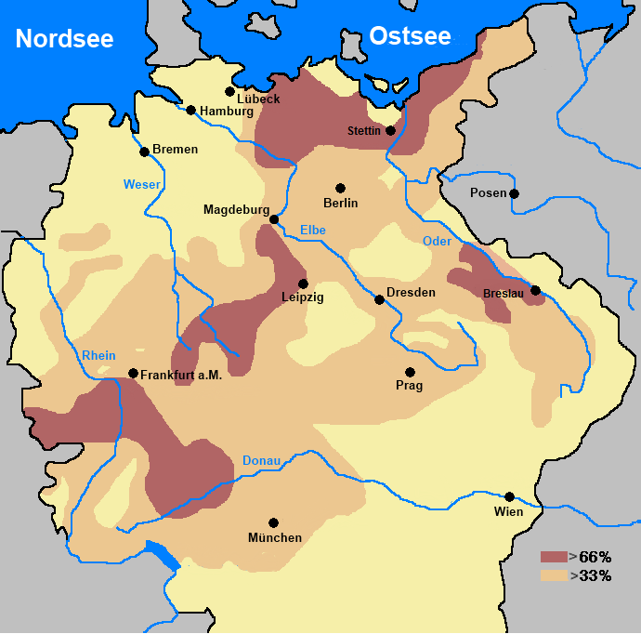
Consequences of war
Population decline
  8 million killed
  Male population in Germany – 50%
  Czech – 30%
  Fighting, disease, starvation
Destruction
  Swedish armies 2000 castles, 18000 villages 1500 towns in Germany
Social dislocation
Financial problems
Population decline in Germany
Notes:
The origins of the conflict and goals of the participants were complex, and no single cause can accurately be described as the main reason for the fighting. Initially, the war was fought largely as a religious conflict between Protestants and Catholics in the Holy Roman Empire, although disputes over the internal politics and balance of power within the Empire played a significant part. Gradually, the war developed into a more general conflict involving most of the European powers.
The male population of the German states was reduced by almost half. The population of the Czech lands declined by a third due to war, disease, famine and the expulsion of Protestant Czechs
The Swedish armies alone may have destroyed up to 2,000 castles, 18,000 villages and 1,500 towns in Germany, one-third of all German towns
One result of the war was the division of Germany into many territories — all of which, despite their membership in the Empire, won de facto sovereignty. This limited the power of the Holy Roman Empire and decentralized German power.
Treaty of Westphalia allowed the rulers of the Imperial States to independently decide their religious worship. Protestants and Catholics were redefined as equal before the law, and Calvinism was given legal recognition. Also, each of the 400 or so princes of the Holy Roman Empire were given equal authority to that of the Emperor, de-centralizing the government and effectively ending the power of the Holy Roman Empire.

Slide 10
Treaty of Westphalia 1648
End of Habsburg attempt to control Holy Roman Empire – absolutist state
New political order
  Sovereign states
  Non-interference in domestic affairs
  Inviolability of borders
Fragmentation of Germany
Equality of Catholics and Protestants

Slide 11
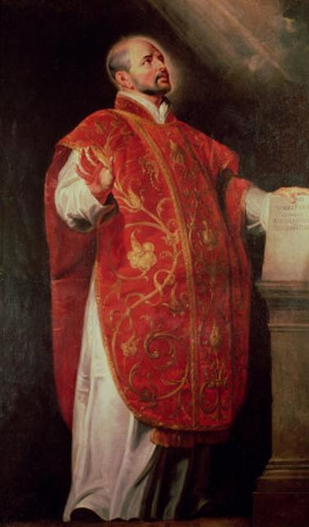
Counter/Catholic Reformation
Council of Trent 1545-63
Church restructuring
New religious orders
  Jesuits
Missionary work
Spiritual movements
Forcible conversion of Protestants
Spanish Inquisition
Heresy trials
Gregorian calendar
Ignatius Loyola
1491-1556
Notes:
The Counter-Reformation (also the Catholic Revival or Catholic Reformation) denotes the period of Catholic revival beginning with the Council of Trent (1545–1563) and ending at the close of the Thirty Years' War, 1648 as a response to the Protestant Reformation. The Counter-Reformation was a comprehensive effort, composed of four major elements:
Ecclesiastical or structural reconfiguration
Religious orders
Spiritual movements
Political dimensions
Such reforms included the foundation of seminaries for the proper training of priests in the spiritual life and the theological traditions of the Church, the reform of religious life by returning orders to their spiritual foundations, and new spiritual movements focusing on the devotional life and a personal relationship with Christ, including the Spanish mystics and the French school of spirituality. It also involved political activities that included the Roman Inquisition.
However, in this movement to strengthen the authority of the Catholic Church, it has been argued that it also inadvertently helped set the stage for the Scientific Revolution, which would eventually present a more fundamental challenge to that authority.
RC retrenched. Saint Ignatius of Loyola, 1491-1556. Founder of Jesuits – direct service to the Pope. Complied ‘Spiritual Exercises’ . Fought against the Protestant Reformation. Key companion – Francis Xavier (went to Japan)

Slide 12

Allegri Miserere
Notes:
Miserere (full title: Miserere mei, Deus, Latin for "Have mercy on me, O God") is a setting of Psalm 51 (50) by Italian composer Gregorio Allegri. It was composed during the reign of Pope Urban VIII, probably during the 1630s, for use in the Sistine Chapel during matins, as part of the exclusive Tenebrae service on Holy Wednesday and Good Friday of Holy Week.

Slide 13
Period of religious and ideological conflict - 1648-1789
Cain-type view
Renaissance | Enlightenment
Reformation | Second Reformation
Cain-type world is to
submit to the Abel-type
World to establish the
worldwide foundation
of substance.
EDP, 353
Abel-type view
Reformation and Renaissance
Freedom of thought led to conflict between religion and philosophies

Slide 14
What led to the Enlightenment?
Continuation of providence to establish foundation to receive the messiah
Religious wars
  Scepticism about religion
  Alternatives to religious authority
  Rational basis to ethics and science as source of knowledge
Rationalism and Empiricism
  Breakdown of medieval synthesis
  Questioning of values, traditions, doctrines
  Rejection of revelation as sole authority
Some streams of Enlightenment ‘invaded by Satan by becoming materialistic and atheistic’
  England, Scotland, France, Germany, Russia
Notes:
God and religion pushed a little to the edge. Pendulum swung too far

