Slide 1
Tracing God’s providence:
From the renaissance to the second advent
The last 600 years
If the function of the conscience were absent in fallen
people, God’s providence of restoration would be
impossible. EDP. 36

Slide 2
What does a foundation to receive the messiah look like?
Foundation of faith
  Spiritual community
  Life of prayer, study and worship
Foundation of substance
  Freedom of thought and speech
  Rule of law
Foundation to receive the messiah
  Spiritual community who can respond to the messiah and be able to protect him
Notes:
Long before the Beit HaMikdash was built, two brothers lived and farmed on that same site. One was married and had a large family, while the other was single. They lived in close proximity to each other, and each worked his land, growing wheat. When harvest time arrived, each was blessed with a bountiful crop and piled up his grain for long-term storage.
The unmarried brother, observing his good fortune, thought to himself that God had blessed him with more than he needed, whereas his brother, who was father to a large family, could surely use more. He arose in the middle of the night and secretly took from his grain and put it in his brother’s pile.
Similarly, the married brother thought to himself that he was blessed to have children who would care for him in his old age, while his brother must depend on what he saved. He, too, arose in the middle of the night and quietly transferred grain from his pile to his brother’s.
In the morning, each wondered why there was no noticeable decrease in his own pile, and so they repeated the transfer the next night. These nocturnal activities continued, until one night the brothers bumped into each other. In that instant, in the dark of night, the glow of brotherly love lit up the mountain sky; they each understood what the other had been doing and they fell into a warm embrace. According to the legend, when God saw that display of brotherly love, He selected the site for His Temple.

Slide 3
The foundation to receive the messiah in Jesus’ time
Foundation of faith
  Spiritual community – Jewish people
  Temple – sacrificial system
  Synagogues – study of scriptures
Foundation of substance
  Religious pluralism
  Many spiritual groups
  Rule of law

Slide 4
The foundation to receive the Lord of the Second Advent
God’s 2000 years providence has prepared a democratic social and legal environment which will protect Christ at the Second Advent. EDP, 282

Slide 5
Abraham’s family

Slide 6
Abraham’s family
Hagar
Abraham
Sarah
Ishmael
Isaac
Sarah said to Abraham, ‘Cast out this slave woman with her son; for the son of this slave woman shall not be the heir with my son Isaac.’ Genesis 21:10

Slide 7
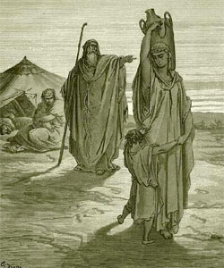
What promises did God make to Ishmael?
“I will bless [Ishmael] and make him fruitful and he shall be the father of 12 princes and I will make him a great nation. But I will establish my covenant with Isaac.”
Genesis 17:20-21
Abraham sending Hagar
and Ishmael away
Notes:
Beneath the surface of Chayei Sarah is another story, with three important clues waiting in the text.
The first occurs when Abraham’s servant is returning with the woman who is to become Isaac’s wife. As Rebecca sees Isaac in the distance, we are told that he is “coming from the way of Be’er-lahai-ro’i” (Gen. 24:62) to meditate in the field. Where is Be’er-lahai-ro’i and what is its significance?
The second is the final stage of Abraham’s life. For chapter after chapter we read of the love and faithfulness Abraham and Sarah had for one another. Then Sarah’s life draws to a close. Abraham mourns and weeps for her and buys a cave in which she is buried. We might then expect to read that Abraham lived out the rest of his years alone before being placed beside “Sarah his wife” in the Cave of Machpelah.
Unexpectedly, however, once Isaac is married, Abraham marries a woman named Keturah and has six children with her. We are told nothing else about this woman, and the significance of the episode is unclear. But the Torah does not include mere incidental details. So what is the significance of Abraham’s second marriage and how is it related to the rest of the story?
The third clue is revealed in the Torah’s description of Abraham’s death – the surprising presence of Ishmael at Abraham’s funeral. The sages pieced together these three puzzling details to form an enthralling story.
First, they point out that Be’er-lahai-ro’i, the place from which Isaac was coming, is mentioned once before, inGenesis (16:14): It is the spot where Hagar, pregnant and fleeing from Sarah, encountered an angel who told her to return. It is indeed she who gives the place its name, meaning “the well of the Living One who sees me”. The Midrash says that Isaac was there looking for Hagar, because he said, “Shall I be married while my father lives alone? I will go and return Hagar to him.”
This also explains the second question: who was Keturah? The sages tell us she was Hagar. Hagar was also called Keturah because “her acts gave forth fragrance like incense (ketoret).” This together with the Midrash we saw, also answers the third question, and helps complete the challenging narrative of the expulsion of Hagar and Ishmael. Hagar did not end her days as an outcast and Ishmael and Abraham did not remain estranged. Hagar returned, at Isaac’s prompting and with Abraham’s consent, to become the wife of her former master, and Ishmael and Abraham were ultimately reconciled.
In that Midrash in Pirkei deRabbi Eliezer, the name of Ishmael’s second wife, Fatimah, is highly significant. In the Koran, Fatimah is the daughter of Mohammad. Pirkei deRabbi Eliezer is making an explicit, and positive, reference to Islam. The hidden story of Chayei Sarah has immense consequence for our time. Jews and Muslims both trace their descent from Abraham – Jews through Isaac, Muslims through Ishmael.
The fact that both sons stood together at their father’s funeral tells us that they too were reunited.
Beneath the surface of the narrative in Chayei Sarah, the sages read the clues and pieced together a moving story of reconciliation between Abraham and Hagar on the one hand, Isaac and Ishmael on the other.
Yes, there was conflict and separation; but that was the beginning, not the end. Between Judaism and Islam there can be friendship and mutual respect. Abraham loved both his sons, and was laid to rest by both. There is hope for the future in this story of the past.
On the surface, the story of Isaac and Ishmael is about sibling rivalry and the displacement of the elder by the younger. Beneath the surface, however, the sages heard a counter-narrative telling the opposite story: the birth of Isaac does not displace Ishmael. To be sure, he will have a different destiny. But he too is a beloved son of Abraham, blessed by his father and by God. He becomes a great nation. God stays with him to ensure that his children flourish and become ‘twelve rulers’. Abraham and Isaac both make a journey of reconciliation. The two half-brothers stand together at their father’s grave. There is no hostility between them. Their futures diverge, but they do not compete for God’s affection, which encompasses them both. This reading becomes all the more powerful when, in the Midrash, it is extended to the relationship between Judaism and Islam.
This is the first indication of what will, in the next few chapters, emerge as a systemic feature of the biblical text. In each narrative of apparent choice-and-rejection, there is a counter-narrative that subverts the surface story and presents a more nuanced, generous picture of divine (and, by implication, human) sympathy. It is never blatant. It never unequivocally announces itself. But it is unmistakably there in the text…
The surface narrative is itself revolutionary. It asserts that the hierarchy of the ancient world – where the elder is destined to rule, the younger to serve – was about to be overthrown. The counter-narrative is more radical still, because it hints at the most radical of monotheism’s truths: that God may choose, but God does not reject. The logic of scarcity – of alpha males and chosen sons – has no place in a world made by a God whose ‘tender mercies are on all His works’ (Psalm 145:9).

Slide 8
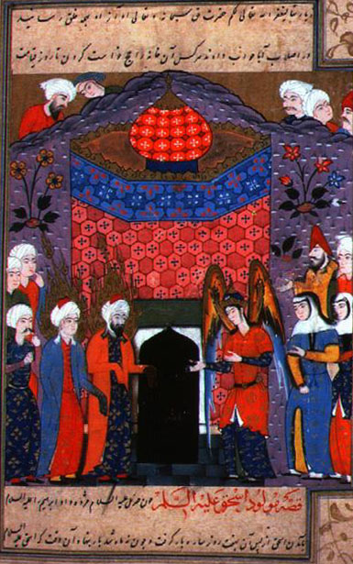
Building the Ka’aba
Abraham and Ishmael built the Ka’aba, the first house for the worship of God
‘As Abraham raised the foundations of the shrine, together with Ishmael (they prayed): “Our Lord, accept this from us. You are the Hearer, the Omniscient.”’
  Qu’ran 2:127
Ishmael and Abraham pray
after building the Ka’aba
Notes:
According to Islamic tradition, the Stone fell from Heaven to show Adam and Eve where to build an altar and offer a sacrifice to God. The Altar became the first temple on Earth. Muslims believe that the stone was originally pure and dazzling white, but has since turned black because of the sins it has absorbed over the years.[7] Islamic tradition holds that Adam's altar and the stone were lost in the process of Noah's Flood and forgotten. It was Abraham who found the Black Stone at the original site of Adam's altar when the Archangel Gabriel revealed it to him.[8] Abraham ordered his son—and the ancestor of Muhammad--Ishmael to build a new temple in which to imbed the Stone. This new temple is the Kaaba in Mecca.

Slide 9
Abraham’s descendants
Hagar
Abraham
Sarah
Ishmael
Isaac
Arab nation
Jewish people
Jesus
Muhammad
Islam
Judaism
Christianity
Notes:
Keturah: (Gen. Rabbah 61:4) This is Hagar. She was called Keturah because her deeds were as beautiful as incense (קְטֹרֶת), and because she tied (קָטְרָה, the Aramaic for“tied”) her “opening” (a euphemism), for she was not sexually intimate with any man from the day she separated from Abraham (Tanchuma 8, Genesis Rabbah 61:4).
¹ Abraham took another wife, whose name was Keturah. ² She bore him Zimran, Jokshan, Medan, Midian, Ishbak, and Shuah. ³ Jokshan begot Sheba and Dedan. The descendants of Dedan were the Asshurim, the Letushim, and the Leummim. ⁴ The descendants of Midian were Ephah, Epher, Enoch, Abida, and Eldaah. All these were descendants of Keturah. ⁵ Abraham willed all that he owned to Isaac; ⁶ but to Abraham’s sons by concubines Abraham gave gifts while he was still living, and he sent them away from his son Isaac eastward, to the land of the East.^{[1]}

Slide 10
More sons
Abraham took another wife, whose name was Keturah. She bore him Zimran, Jokshan, Medan, Midian, Ishbak, and Shuah. Abraham willed all that he owned to Isaac; but to Abraham’s sons by concubines Abraham gave gifts while he was still living, and he sent them away from his son Isaac eastward, to the land of the East. Genesis 25:1-6
Who was Keturah?
  Hagar? – kept sexual purity
  Sarah (Shem); Keturah (Japeth); Hagar (Ham)
Indian religions? Sanskrit? Brahmins? Aryans?
Notes:
Abraham married three wives – Sarah, a daughter of Shem; Keturah, a daughter of Japheth; and Hagar, a daughter of Ham. (ibid., chpt. 8)

Slide 11
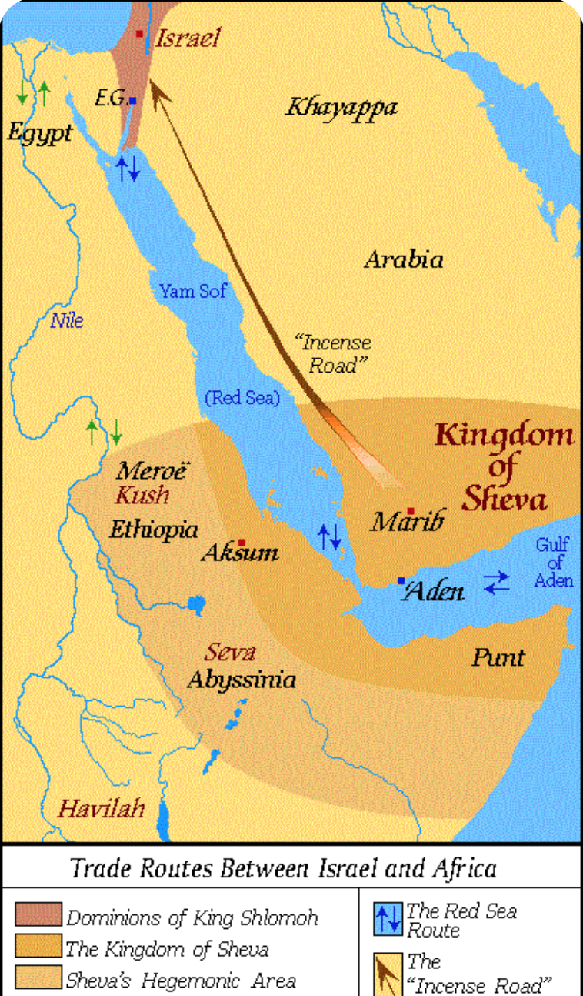
God’s providence in Africa
And when the Queen of Sheba heard of the fame of Solomon concerning the name of the LORD, she came to prove him with hard questions. And she came to Jerusalem with a very great train, with camels that bore spices, and very much gold, and precious stones: and when she was come to Solomon, she communed with him of all that was in her heart. And King Solomon gave to the Queen of Sheba all her desire, whatsoever she asked, beside that which Solomon gave her of his royal bounty. So she turned and went to her own country, she and her servants. I Kings 10:1-13
Notes:
And when the Queen of Sheba heard of the fame of Solomon concerning the name of the LORD, she came to prove him with hard questions. And she came to Jerusalem with a very great train, with camels that bore spices, and very much gold, and precious stones: and when she was come to Solomon, she communed with him of all that was in her heart. And King Solomon gave unto the Queen of Sheba all her desire, whatsoever she asked, beside that which Solomon gave her of his royal bounty. So she turned and went to her own country, she and her servants.(I Kings 10 v.1-13)

Slide 12
Jews in Ethiopia
According to Ethiopian scripture Kebra Nagast Solomon and Sheba had a son – Menelik
  Solomon asked him to be his heir
  Ark of the Covenant
  Solomonic dynasty
  Haile Selassie: “By the Conquering Lion of the Tribe of Judah, His Imperial Majesty Haile Selassie I, King of Kings, Lord of Lords, Elect of God” – 1974 overthrown
Tribe of Dan migrated during time of Rehaboam
During reign King Mannaseh Ark taken to Egypt and then Ethiopia (800 BCE)
Notes:
According to the medieval age of Ethiopian book of the Kebra Nagast, translated into Geʽez in 1321 CE,[3] [4][5] this man's name was Bäynä Ləḥkəm (from Arabic: ابن الحكيم‎, Ibn Al-Hakim, "Son of the Wise."[6]). He was conceived when his father Solomon tricked his visiting mother, the Queen of Sheba, into sleeping with him. His mother raised him as a Jew in Ethiopia and he only traveled to Jerusalem to meet his father for the first time when he was in his twenties. While his father begged Menelik to stay and rule over Israel, Menelik told him that he wanted to return to Ethiopia. So, Solomon sent many Israelites with him, to aid him in ruling according to biblical standards, and they, aggrieved at being exiled forever, King Solomon gave his Ark of the Covenant to his son as a gift for being his son and being king of Ethiopia. Menelik then became king of Ethiopia, upon the death of his mother.
The Solomonic Dynasty’s legendary origins come from an Ethiopian myth called the Kebre Negast. According to the story, Queen Makeda, who took the Ethiopian throne in the 10th century, B.C., travelled to Jerusalem to learn to be a good ruler from King Solomon, who was famous worldwide for his wisdom and capabilities as a ruler. King Solomon agreed to take Makeda as his student and taught her how to be a good queen. Queen Makeda was so impressed with Solomon that she converted to Judaism and provided Solomon with many gifts. Before Makeda returned home, the two had a son together. Solomon had a dream in which God said that his and Makeda’s son would be the head of a new order. In response, he sent Makeda home but told her to send their son back to Jerusalem when he came of age to be taught Jewish lore and law. Makeda did as she was told and sent Menilek I, their son, to Jerusalem to be taught by Solomon, who offered to make him the prince of Jerusalem. However, Menilek declined and instead returned to Ethiopia, anointed by his father and God to be the king of Ethiopia.
The Kebre Negast exemplifies the importance of Judaism, and subsequently, of Christianity to the Ethiopian people, serving as a source of Ethiopian national pride and providing a justification for the idea of Ethiopians as a chosen people of God. More importantly to the Solomonic Dynasty however, it provided the grounds for the “restored Solomonic” Empire, so named because of its renewed fervor for the connection of King Solomon to Ethiopian royalty, which began under Emperor Yekuno Amlak (r. 1270-1285) and was ruled and justified by Christianity until the late twentieth century. The Muslim city of Yifat was conquered by Ethiopia in 1270, under Yekuno Amlak, which caused officials in Cairo to use their influence to prevent a new bishop from being sent to Ethiopia. This action crippled the Ethiopian Church as well as the power of the emperor. By the time that Amda Siyon (r. 1314-1344) took the throne in 1314, Sabradin of Yifat led a united Muslim front made up of people angered by Christian rule, destroying churches in Ethiopia and forcing Christians to convert to Islam. Siyon responded with a savage attack that resulted in the defeat of Yifat. Furthermore, Siyon’s victory caused the frontier of Christian power in Africa to expand past the Awash valley.

Slide 13
Christianity, Islam and Ethiopia
Philip encounters an Ethiopian official reading Isaiah
  Philip began with that very passage of Scripture and told him the good news about Jesus Acts 8:35
  Baptized
  Ethiopian Orthodox Church
330 Christianity official religion
Muslims sent by Muhammad to take refuge in Ethiopia
Only Christian African country to resist Islam
Did Ethiopian Jews or Christians send missionaries to the rest of Africa?
Notes:
26 Now an angel of the Lord said to Philip, “Go south to the road—the desert road—that goes down from Jerusalem to Gaza.” 27 So he started out, and on his way he met an Ethiopian[a] eunuch, an important official in charge of all the treasury of the Kandake (which means “queen of the Ethiopians”). This man had gone to Jerusalem to worship, 28 and on his way home was sitting in his chariot reading the Book of Isaiah the prophet. 29 The Spirit told Philip, “Go to that chariot and stay near it.”
30 Then Philip ran up to the chariot and heard the man reading Isaiah the prophet. “Do you understand what you are reading?” Philip asked.
31 “How can I,” he said, “unless someone explains it to me?” So he invited Philip to come up and sit with him.
32 This is the passage of Scripture the eunuch was reading:
“He was led like a sheep to the slaughter,
and as a lamb before its shearer is silent,
so he did not open his mouth.
33 In his humiliation he was deprived of justice.
Who can speak of his descendants?
For his life was taken from the earth.”[b]
34 The eunuch asked Philip, “Tell me, please, who is the prophet talking about, himself or someone else?” 35 Then Philip began with that very passage of Scripture and told him the good news about Jesus.
36 As they traveled along the road, they came to some water and the eunuch said, “Look, here is water. What can stand in the way of my being baptized?” [37] [c] 38 And he gave orders to stop the chariot. Then both Philip and the eunuch went down into the water and Philip baptized him. 39 When they came up out of the water, the Spirit of the Lord suddenly took Philip away, and the eunuch did not see him again, but went on his way rejoicing.

Slide 14
Original nature
of human being
Internal aspect
External aspect
Hebraism
Hellenism
Movements to restore original human nature
Both are good and necessary
Both need to be integrated with Hebraism in subject position
Only by Cain-type Hellenism submitting to Abel-type Hebraism could Satan be separated from the prevailing spirit of the age. Then the foundation of substance necessary for receiving Christ at the Second Advent could be established worldwide. EDP, 350

Slide 15
Hebraism and Hellenism
Israel
Spiritual culture, Abel
Listening
Free will
Theist
Divine laws
Revelation, faith
Worshipping community
Modest dress
Sexually conservative
Greece
Material culture, Cain
Seeing
Fate
Humanist
Human laws
Reason, science
Political community
Exercise in nude
Sexually liberal
Notes:
The trends of Hebraism and Hellenism had formed long ago and had encountered each other several times in the course of prior history. From 2000 B.C., the Minoan civilization flourished on the island of Crete, succeeded by the Mycenaean civilization on the Greek mainland. By the eleventh century, these civilizations had created a Cain-type Hellenic civilization, whose guiding ideology was humanism. Around the same time in the Near East, the Abel-type Hebraic civilization was born, with Jewish monotheism as its guiding ideology. This was the period of the united kingdom. Had the kings of Israel in that period laid the foundation for the Messiah and received him, this flourishing Hebraic civilization could have assimilated the waning Hellenic civilization to form one worldwide civilization. However, when the kings failed to fulfill the Will of God, this dispensation was not accomplished. Instead, after the Jews were taken into exile in Babylon, they returned only to be put under subjection to the Greeks in 333 B.C. and then to Rome in 63 B.C. Thus, during the centuries leading up to and including Jesus' time, Hebraism was placed under the dominion of Hellenism.
Gk need to separate from Satan especially sexual stuff
“How does luck work? Luck, or heavenly fate, always follows th eheartistic current. Like the black current: if you follow it, you know where you will go. If there is heavenly luck, that means the heartistic current is being followed, and you're in luck. “ SMM 1990
Oedipus was born to King Laius and Queen Jocasta. In the most well-known version of the myth, Laius wished to thwart a prophecy, which said that his child would grow up to murder his father and marry his mother. Thus, he fastened the infant's feet together with a large pin and left him to die on a mountainside. The baby was found on Kithairon by shepherds and raised by King Polybus and Queen Merope in the city of Corinth. Oedipus learned from the oracle at Delphi of the prophecy, but believing he was fated to murder Polybus and marry Merope, he left Corinth. Heading to Thebes, Oedipus met an older man in a chariot coming the other way on a narrow road. The two quarreled over who should give way, which resulted in Oedipus killing the stranger and continuing on to Thebes. He found that the king of the city (Laius) had been recently killed and that the city was at the mercy of the Sphinx. Oedipus answered the monster's riddle correctly, defeating it and winning the throne of the dead king and the hand in marriage of the king's widow, his mother, Jocasta.
Oedipus and Jocasta had two sons (Eteocles and Polynices) and two daughters (Antigone and Ismene). In his search to determine who killed Laius (and thus end a plague on Thebes), Oedipus discovered it was he who had killed the late king (his father). Jocasta, upon realizing that she had married her own son and Laius's murderer, hanged herself. Oedipus then seized two pins from her dress and blinded himself with them. Oedipus was driven into exile, accompanied by Antigone and Ismene. After years of wandering, he arrived in Athens, where he found refuge in a grove of trees called Colonus. By this time, warring factions in Thebes wished him to return to that city, believing that his body would bring it luck. However, Oedipus died at Colonus, and the presence of his grave there was said to bring good fortune to Athens.

Slide 16
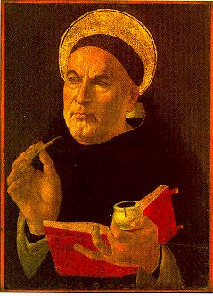
Thomas Aquinas (1225-1274)
Philosopher, theologian, monk
Combined Aristotle and Christian thought
Medieval synthesis
Basis of Western Christianity
Notes:
Summa theological

Slide 17
Reforming movements
Cluny 10th century
Carthusians 1084
Cistercians 1098
Augustinians 1244
Carmelites 12th century
  Contemplation: prayer, community, service
Franciscans 1209
Dominicans 1216
  Preaching and teaching
Notes:
Monastic orders
Cluny - ~William of Aquitaine (919) source of most reform movements. The Cluniac Reforms (also called Clunian Reforms) were a series of changes within medieval monasticism of West focused on restoring the traditional monastic life, encouraging art, and caring for the poor. The movement is named for the Abbey of Cluny in Burgundy, where it started within the Benedictine order. The reforms were largely carried out by Saint Odo (c. 878 – 942) and spread throughout France (Burgundy, Provence, Auvergne, Poitou), into England, and through much of Italy and Spain Reformed Benedictines (Benedictines founded Benedict of Nursia in 529) at Monte Cassino
Cistercians (1098), Augustinians, Carthusians (1082), Carmelites (1156), Dominicans (1216) St Dominic, Spaniard (1170-1221) - Dominicans - Order of Preachers. Inquisition
Franciscans (1223) St Francis of Assisi (1182-1226) Minor Brethren
Bernard of Clairvaux, O.Cist (1090 – August 20, 1153) was a French abbot and the primary builder of the reforming Cistercian monastic order. 350 monasteries in lifetime
Hildegard of Bingen, (1098 – 17 September 1179), also known as Saint Hildegard and Sibyl of the Rhine, was a German Benedictine abbess, writer, composer, philosopher, Christian mystic, visionary, and polymath.[1] She is considered to be the founder of scientific natural history in Germany.[2]Hildegard was elected magistra by her fellow nuns in 1136; she founded the monasteries of Rupertsberg in 1150 and Eibingen in 1165. One of her works as a composer, the Ordo Virtutum, is an early example of liturgical drama and arguably the oldest surviving morality play.[3] She wrote theological, botanical, and medicinal texts, as well as letters, liturgical songs, and poems, while supervising miniature illuminations in the Rupertsberg manuscript of her first work, Scivias.[4] She is also noted for the invention of a constructed language known as Lingua Ignota.Although the history of her formal consideration is complicated, she has been recognized as a saint by branches of the Roman Catholic Church for centuries. On 7 October 2012, Pope Benedict XVI named her a Doctor of the Church.
Others called heretics;
Waldensians
Lollards - followers John Wycliffe
Hussites - John Huss
Scholars:
St Aquinas (1225-74)
John Scotus (1266-1308)
William Ockham (1280-1349)

Slide 18
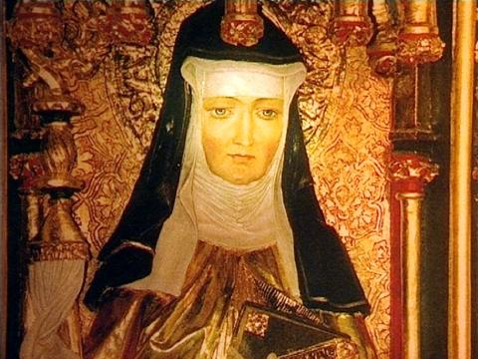
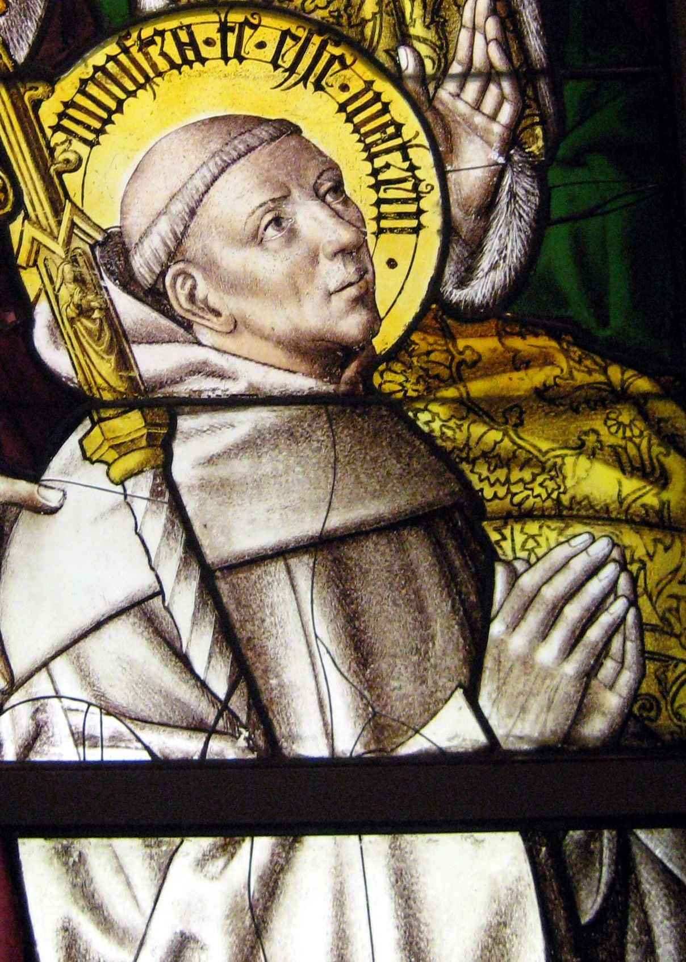
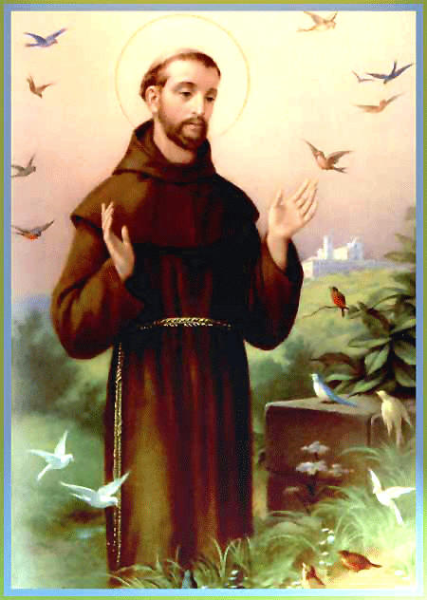
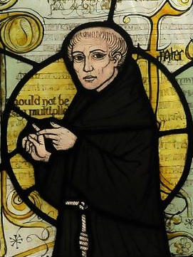
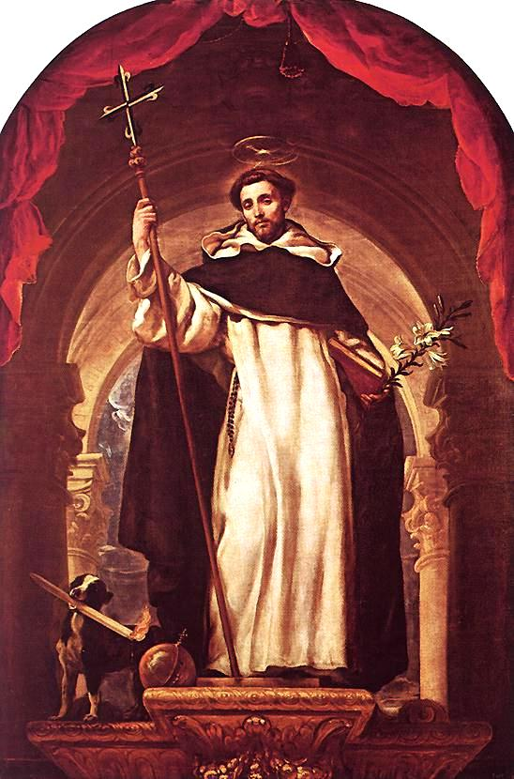
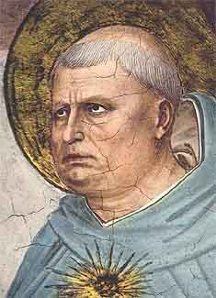
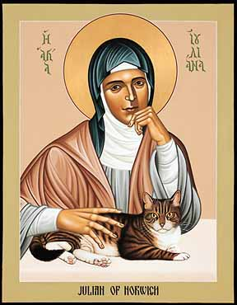
Who were the reformers?
Bernard
of Clairvaux
St Francis
of Assisi
Saint Hildegard
William Ockham
Thomas Aquinas
St Dominic
Julian of Norwich
Notes:
Monastic orders
Cluny - ~William of Aquitaine (919) source of most reform movements. The Cluniac Reforms (also called Clunian Reforms) were a series of changes within medieval monasticism of West focused on restoring the traditional monastic life, encouraging art, and caring for the poor. The movement is named for the Abbey of Cluny in Burgundy, where it started within the Benedictine order. The reforms were largely carried out by Saint Odo (c. 878 – 942) and spread throughout France (Burgundy, Provence, Auvergne, Poitou), into England, and through much of Italy and Spain Reformed Benedictines (Benedictines founded Benedict of Nursia in 529) at Monte Cassino
Cistercians (1098), Augustinians, Carthusians (1082), Carmelites (1156), Dominicans (1216) St Dominic, Spaniard (1170-1221) - Dominicans - Order of Preachers. Inquisition
Franciscans (1223) St Francis of Assisi (1182-1226) Minor Brethren
Bernard of Clairvaux, O.Cist (1090 – August 20, 1153) was a French abbot and the primary builder of the reforming Cistercian monastic order. 350 monasteries in lifetime
Hildegard of Bingen, (1098 – 17 September 1179), also known as Saint Hildegard and Sibyl of the Rhine, was a German Benedictine abbess, writer, composer, philosopher, Christian mystic, visionary, and polymath.[1] She is considered to be the founder of scientific natural history in Germany.[2]Hildegard was elected magistra by her fellow nuns in 1136; she founded the monasteries of Rupertsberg in 1150 and Eibingen in 1165. One of her works as a composer, the Ordo Virtutum, is an early example of liturgical drama and arguably the oldest surviving morality play.[3] She wrote theological, botanical, and medicinal texts, as well as letters, liturgical songs, and poems, while supervising miniature illuminations in the Rupertsberg manuscript of her first work, Scivias.[4] She is also noted for the invention of a constructed language known as Lingua Ignota.Although the history of her formal consideration is complicated, she has been recognized as a saint by branches of the Roman Catholic Church for centuries. On 7 October 2012, Pope Benedict XVI named her a Doctor of the Church.
Others called heretics;
Waldensians
Lollards - followers John Wycliffe
Hussites - John Huss
Scholars:
St Aquinas (1225-74)
John Scotus (1266-1308)
William Ockham (1280-1349)

Slide 19
European Christianity
Synthesis of Hebraism and Hellenism
Foundation to receive the messiah

Slide 20
Church – state relations?
After crowning and blessing the emperor, the pope was to obey him as one of his subjects in temporal matters. The emperor, in turn, was to lift up and further the spiritual work of the papacy in his realm. EDP 258

Slide 21
Conflict papacy and king
Pope Boniface VIII retracts all privileges granted to kings of France. 1302
  Demands Philippe comes before council in Rome
  "God has placed us over the Kings and Kingdoms.”
Philippe responds
  "Your venerable conceitedness may know, that we are nobody's vassal in temporal matters"
  Summons the pope to a council to answer charges of sodomy, simony, sorcery, and heresy
Pope responds:
  ”It is necessary to salvation that every human creature be subject to the Roman pontiff."
French noble goes to forcibly take pope to France
  Boniface shocked and dies
Notes:
Pope Boniface VIII issued the bull Salvator Mundi, retracting all privileges granted to the French king by previous popes, and a few weeks later issued charges against the king, summoning him before a council to Rome. In a bold assertion of Papal sovereignty, Boniface declared that "God has placed us over the Kings and Kingdoms."
In response, Philippe wrote "Your venerable conceitedness may know, that we are nobody's vassal in temporal matters," and called for a meeting of the Estates General, a council of the lords of France, who supported his position. The King of France issued charges of sodomy, simony, sorcery, and heresy against the pope and summoned him before the council. The pope's response was the strongest affirmation to date of papal sovereignty. In Unam Sanctam (November 18, 1302), he decreed that "it is necessary to salvation that every human creature be subject to the Roman pontiff." He was preparing a bull that would excommunicate the King of France and put the interdict over France, and to depose the entire clergy of France, when in September of 1303, William Nogaret, the strongest critic of the Papacy in the French inner circle, led a delegation to Rome, with intentionally loose orders by the king to bring the pope, if necessary by force, before a council to rule on the charges brought against him. Nogaret coordinated with the cardinals of the Colonna family, long standing rivals against whom the pope had even preached a crusade earlier in his Papacy. In 1303 French and Italian troops attacked the pope in Anagni, his home town, and arrested him. He was freed three days later by the population of Anagni. However, Boniface VIII, then 68 years of age, was deeply shattered by this attack on his own person and died a few weeks later.
Pope Cement V 1305-1314 decided to move to Avignon
Move of the Roman Curia from Rome to Avignon in 1305. Following the impasse during the previous conclave and to escape from the infighting of the powerful families that had produced earlier Popes, such as the Colonna and the Orsini, the Roman Church looked for a safer place and found it in Avignon, under the influence of the French king. During its time in Avignon the Papacy adopted many features of the Royal court: the life-style of its cardinals was more reminiscent of princes than clerics; more and more French cardinals, often relatives of the ruling pope, took key positions; and the proximity of French troops was a constant reminder of where secular power lay, with the memory of Boniface VIII still fresh.
The Great Schism of Western Christianity or Papal Schism (also known as the Western Schism) was a split within the Roman Catholic Church from 1378 to 1417. After Gregory XI died, the Romans rioted to ensure the election of a Roman for pope. The cardinals, fearing the crowds, elected a Neapolitan when no viable Roman candidates presented themselves. Pope Urban VI, born Bartolomeo Prignano, the Archbishop of Bari, was elected in 1378. Urban had been a respected administrator in the papal chancery at Avignon, but as pope he proved suspicious, overbearing, and prone to violent outbursts of temper. The cardinals who had elected him soon regretted their decision: the majority removed themselves from Rome to Anagni, where they elected Robert of Geneva as a rival pope on September 20 of the same year. Robert took the name Pope Clement VII and reestablished a papal court in Avignon. The second election threw the Church into turmoil. There had been antipopes--rival claimants to the papacy--before, but most of them had been appointed by various rival factions; in this case, a single group of leaders of the Church had created both the pope and the anti-pope.
Council Pisa 1409 deposed "Benedict XIII and Gregory XII” - "are recognised as schismatics, the approvers and makers of schism, notorious heretics, guilty of perjury and violation of solemn promises, and openly scandalising the universal Church. elected another -> votes were unanimously cast in the favour of Cardinal Peter Philarghi, who took the name of Pope Alexander V. other Popes refused to stand down.
Finally, the Council of Constance in 1414, advised by the theologian Jean Gerson, secured the resignations of John XXIII and the successor in Rome of Urban VI, Pope Gregory XII (who had abdicated in 1415, but not before formally empowering the Council of Constance to elect the new pope, thus ensuring the legitimacy of the Roman line), and excommunicated the claimant who refused to step down, Avignon Pope Benedict XIII. The Council then elected Pope Martin V, essentially ending the schism. Nonetheless, the Kingdom of Aragon did not recognize Martin V and continued to recognize Benedict XIII. A follower of Benedict XIII subsequently elected Antipope Benedict XIV (Bernard Garnier) and three followers simultaneously elected Antipope Clement VIII, but the Western Schism was by then practically over. (Clement VIII resigned in 1429 and apparently recognized Martin V.)
Wycliffe 1329-84) denied transubstantiation, criticised wealth of church and indulgences. Peasants revolt
Huss (1373-1415) opposed indulgences, images. Burned at Council of Constance.

Slide 22
Papal captivity
Clement V moves papacy to Avignon 1305
  Escape in fighting of families in Rome over papacy
  Adopted features of the royal court and lifestyle
  Political, centralising, money grabbing, luxury
  7 popes
Gregory XI moved back to Rome 1376
  Reformer
  Condemned William Wycliffe
  Appointed Frenchmen over Italian provinces resentment
  Pressure from St Catherine of Sienna
  Died following year
Notes:
Pope Cement V 1305-1314 decided to move to Avignon
Move of the Roman Curia from Rome to Avignon in 1305. Following the impasse during the previous conclave and to escape from the infighting of the powerful families that had produced earlier Popes, such as the Colonna and the Orsini, the Roman Church looked for a safer place and found it in Avignon, under the influence of the French king. During its time in Avignon the Papacy adopted many features of the Royal court: the life-style of its cardinals was more reminiscent of princes than clerics; more and more French cardinals, often relatives of the ruling pope, took key positions; and the proximity of French troops was a constant reminder of where secular power lay, with the memory of Boniface VIII still fresh.
The Great Schism of Western Christianity or Papal Schism (also known as the Western Schism) was a split within the Roman Catholic Church from 1378 to 1417. After Gregory XI died, the Romans rioted to ensure the election of a Roman for pope. The cardinals, fearing the crowds, elected a Neapolitan when no viable Roman candidates presented themselves. Pope Urban VI, born Bartolomeo Prignano, the Archbishop of Bari, was elected in 1378. Urban had been a respected administrator in the papal chancery at Avignon, but as pope he proved suspicious, overbearing, and prone to violent outbursts of temper. The cardinals who had elected him soon regretted their decision: the majority removed themselves from Rome to Anagni, where they elected Robert of Geneva as a rival pope on September 20 of the same year. Robert took the name Pope Clement VII and reestablished a papal court in Avignon. The second election threw the Church into turmoil. There had been antipopes--rival claimants to the papacy--before, but most of them had been appointed by various rival factions; in this case, a single group of leaders of the Church had created both the pope and the anti-pope.
Council Pisa 1409 deposed "Benedict XIII and Gregory XII” - "are recognised as schismatics, the approvers and makers of schism, notorious heretics, guilty of perjury and violation of solemn promises, and openly scandalising the universal Church. elected another -> votes were unanimously cast in the favour of Cardinal Peter Philarghi, who took the name of Pope Alexander V. other Popes refused to stand down.
Finally, the Council of Constance in 1414, advised by the theologian Jean Gerson, secured the resignations of John XXIII and the successor in Rome of Urban VI, Pope Gregory XII (who had abdicated in 1415, but not before formally empowering the Council of Constance to elect the new pope, thus ensuring the legitimacy of the Roman line), and excommunicated the claimant who refused to step down, Avignon Pope Benedict XIII. The Council then elected Pope Martin V, essentially ending the schism. Nonetheless, the Kingdom of Aragon did not recognize Martin V and continued to recognize Benedict XIII. A follower of Benedict XIII subsequently elected Antipope Benedict XIV (Bernard Garnier) and three followers simultaneously elected Antipope Clement VIII, but the Western Schism was by then practically over. (Clement VIII resigned in 1429 and apparently recognized Martin V.)

Slide 23
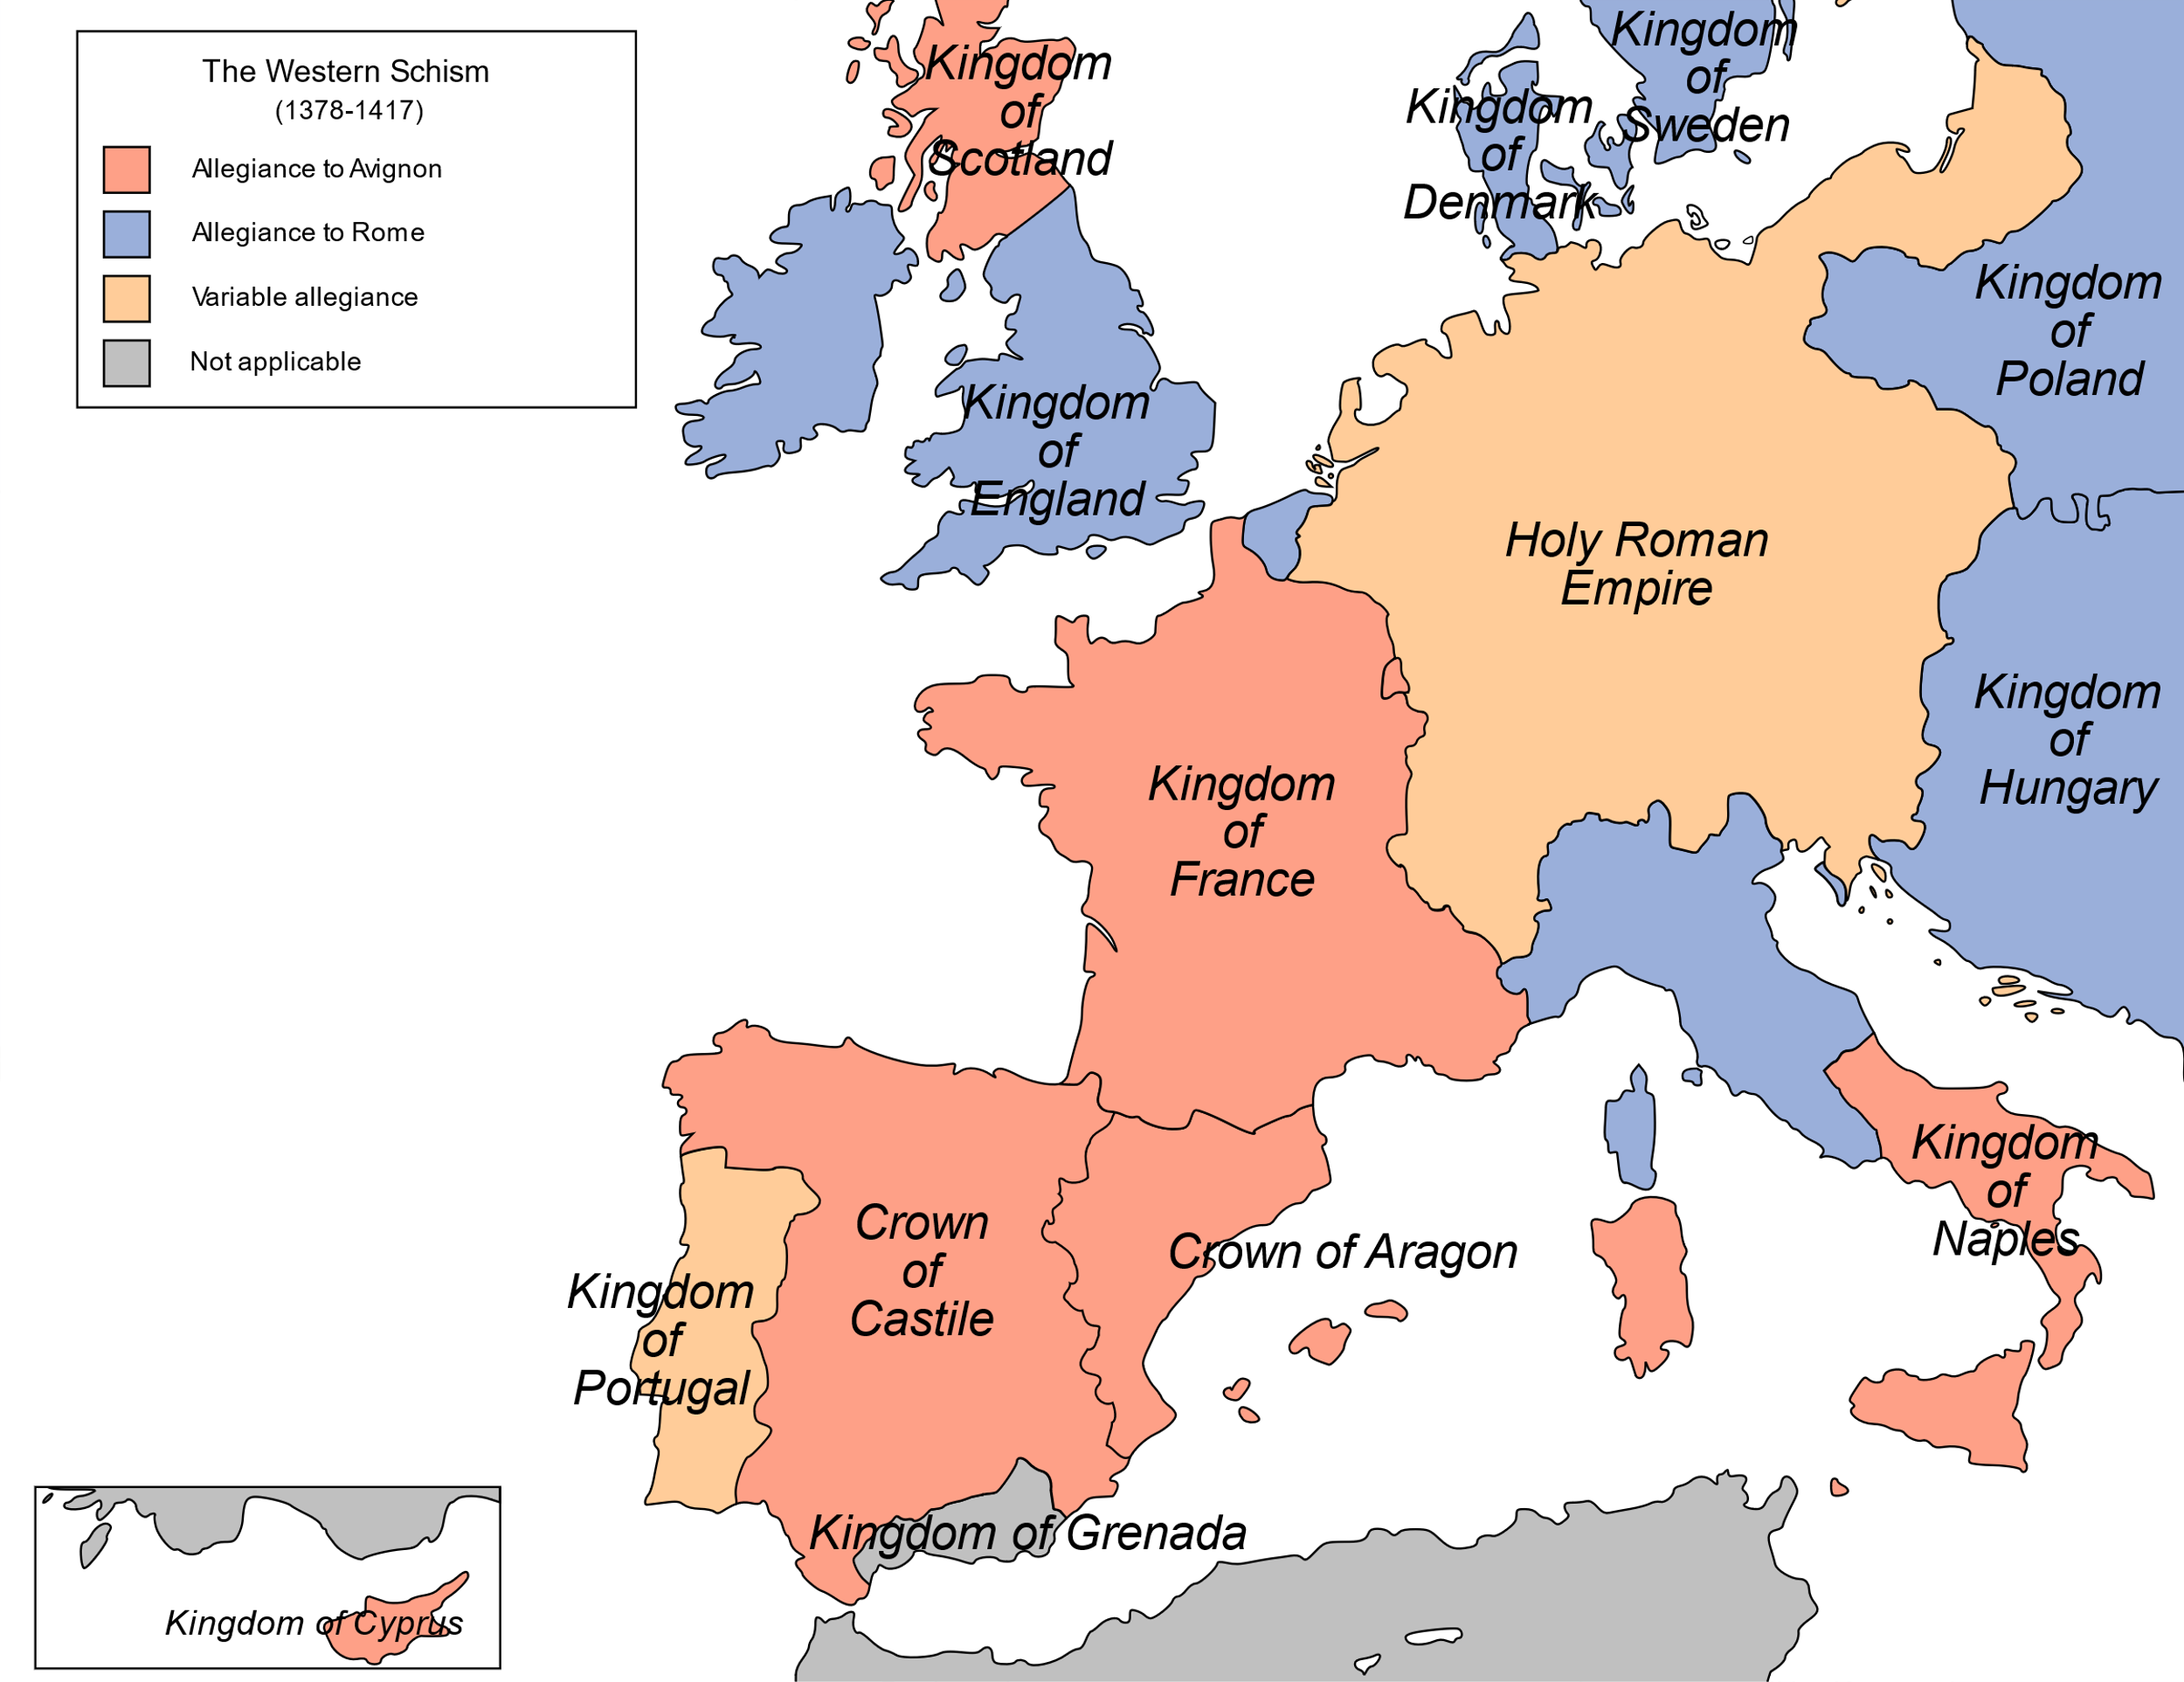
Western or Papal schism
Roman cardinals elected Urban VI
  Upset cardinals
Cardinals elected a rival pope – Clement VII
  Returned to Avignon
  Crisis of legitimacy. Split Europe
Council Pisa 1409
  2 popes ‘deposed’ 3rd elected
Council Constance 1415
  2 popes resigned. 1 didn’t
  Martin V elected
Notes:
After Gregory XI died in the Vatican palace on 27 March 1378,[5] the Romans put into operation a plan to ensure the election of a Roman pope. The pope and his Curia were back in Rome after seventy years in Avignon, and the Romans were prepared to do everything in their power to keep them there. They intended to use intimidation and violence (impressio et metus) as their weapons.[6] On April 8, 1378 the cardinals elected a Neapolitan when no viable Roman candidate presented himself. Urban VI, born Bartolomeo Prignano, the archbishop of Bari, was elected. Urban had been a respected administrator in the papal chancery at Avignon, but as pope he proved suspicious, reformist, and prone to violent outbursts of temper.[7] Many of the cardinals who had elected him soon regretted their decision: the majority removed themselves from Rome to Anagni, where, even though Urban was still reigning, they elected Robert of Geneva as a rival pope on September 20 of the same year, claiming that the election of Urban was invalid because it had been done for fear of the rioting Roman crowds.[8] Elected pope at Fondi on 20 September 1378 by the cardinals in Anagni, unable to maintain himself in Italy, Robert took the name Clement VII and reestablished a papal court in Avignon, where he became dependent on the French court.[11] Clement had the immediate support of Queen Joanna I of Naples and of several of the Italian barons. Charles V of France, who seems to have been sounded out beforehand on the choice of the Roman pontiff, soon became his warmest protector. Clement eventually succeeded in winning to his cause Castile, Aragon, Navarre, a great part of the Latin East, Flanders and Scotland.[12]
The pair of elections threw the Church into turmoil. There had been rival antipope claimants to the papacy before, but most of them had been appointed by various rival factions; in this case, a single group of leaders of the Church had created both the pope and the antipope.[13]
In 1377, while serving as papal legate in upper Italy (1376–1378), in order to put down a rebellion in the Papal States,[7] known as the War of the Eight Saints, Clement VII personally commanded troops to reduce the small city of Cesena in the territory of Forlì. there he authorized the massacre of 3,000–8,000 civilians, an atrocity even by the rules of war at the time, which earned him the nickname butcher of Cesena.[8]
Sustained by such national and factional rivalries throughout Catholic Christianity, the schism continued after the deaths of both Urban VI in 1389 and Clement VII in 1394. Boniface IX, who was crowned at Rome in 1389, and Benedict XIII, who reigned in Avignon from 1394, maintained their rival courts. When Pope Boniface died in 1404, the eight cardinals of the Roman conclave offered to refrain from electing a new pope if Benedict would resign; but when Benedict's legates refused on his behalf, the Roman party then proceeded to elect Pope Innocent VII.
In the intense partisanship characteristic of the Middle Ages, the schism engendered a fanatical hatred noted by Johan Huizinga:[14] when the town of Bruges went over to the "obedience" of Avignon, a great number of people left to follow their trade in a city of Urbanist allegiance; in the 1382 Battle of Roosebeke, the oriflamme, which might only be unfurled in a holy cause, was taken up against the Flemings, because they were Urbanists and thus viewed by the French as schismatics.[citation needed]
Efforts were made to end the Schism through force or diplomacy. The French crown even tried to coerce Benedict XIII, whom it supported, into resigning. None of these remedies worked. The suggestion that a church council should resolve the Schism, first made in 1378, was not adopted at first, because canon law required that a pope call a council.[citation needed] Eventually theologians like Pierre d'Ailly and Jean Gerson, as well as canon lawyers like Francesco Zabarella, adopted arguments that equity permitted the Church to act for its own welfare in defiance of the letter of the law.
Eventually the cardinals of both factions secured an agreement that Benedict and Pope Gregory XII (successor to Innocent VII) would meet at Savona. They balked at the last moment, and both groups of cardinals abandoned their preferred leaders. A church council was held at Pisa in 1409 under the auspices of the cardinals to try solving the dispute. At the fifteenth session, 5 June 1409, the Council of Pisa attempted to depose both Pope and antipope as schismatical, heretical, perjured and scandalous,[15] but it then added to the problem by electing a second antipope, Alexander V. He reigned briefly from June 26, 1409, to his death in 1410, when he was succeeded by antipope John XXIII, who won some but not universal support.

Slide 24
Reform movements
William Wycliffe (1320-1384)
  Oxford professor theology
  ‘The Bible is the only valid source of doctrine and the only pertinent measure of legitimacy.’
Lollards
  Church doesn’t need temporal wealth
  Church officials should interfere in secular matters
  Universal priesthood
Peasant’s revolt (1381)
  John Ball a Lollard
Jan Huss – (1369-1415)
  Executed at Council of Constance
  Hussite Wars in Bohemia 1419-34
Notes:
was an English scholastic philosopher, theologian, biblical translator, reformer, priest, and a seminary professor at the University of Oxford. He became an influential dissident within the Roman Catholic priesthood during the 14th century and is considered an important predecessor to Protestantism.
Wycliffe questioned the privileged status of the clergy which had bolstered their powerful role in England and the luxury and pomp of local parishes and their ceremonies.[3] Wycliffe advocated translation of the Bible into the common vernacular. Wycliffe’s involvement in such translation is disputed; however, according to tradition, Wycliffe is said to have completed a translation directly from the Vulgate into Middle English – a version now known as Wycliffe's Bible. It is probable that he personally translated the Gospels of Matthew, Mark, Luke, and John; and it is possible he translated the entire New Testament, while his associates translated the Old Testament. Wycliffe's Bible appears to have been completed by 1384, additional updated versions being done by Wycliffe's assistant John Purvey and others in 1388 and 1395. More recently, historians of the Wycliffite movement have determined that Wycliffe had, at most, a minor role in the actual translations.[4]
Wycliffe's later followers, derogatorily called Lollards by their orthodox contemporaries in the 15th and 16th centuries, adopted many of the beliefs attributed to Wycliffe such as theological virtues, predestination, iconoclasm, and the notion of caesaropapism, while questioning the veneration of saints, the sacraments, requiem masses, transubstantiation, monasticism, and the legitimacy of the Papacy.
Like the Paulicians and Waldensians, the Lollard movement is sometimes regarded as a precursor to the Protestant Reformation. Wycliffe was accordingly characterised as the "evening star" of scholasticism and as the morning star or stella matutina of the English Reformation.[5] An epithet first accorded to the theologian by the 16th century historian and controversialist John Bale in his Illustrium maioris britanniae scriptorum (Wesel, 1548).[6] Wycliffe’s writings in Latin greatly influenced the philosophy and teaching of the Czech reformer Jan Hus (c. 1369–1415), whose execution in 1415 sparked a revolt and led to the Hussite Wars of 1419–1434.
n 1374 his name appears second, after a bishop, on a commission which the English Government sent to Bruges to discuss with the representatives of Gregory XI a number of points in dispute between the king and the pope.[19] He was no longer satisfied with his chair as the means of propagating his ideas, and soon after his return from Bruges he began to express them in tracts and longer works. In a book concerned with the government of God and the Ten Commandments, he attacked the temporal rule of the clergy, the collection of annates, indulgences, and simony.
He entered the politics of the day with his great work De civili dominio ("On Civil Dominion"). This called for the royal divestment of all church property.[20] His ideas on lordship and church wealth caused his first official condemnation in 1377 by Pope Gregory XI, who censured 19 articles. Wycliffe argued that the Church had fallen into sin and that it ought therefore to give up all its property and that the clergy should live in complete poverty. The tendency of the high offices of state to be held by clerics was resented by many of the nobles. John of Gaunt most likely had his own reasons for opposing the wealth and power of the clergy.
Conflict with the Church[edit]
Wycliffe was summoned before William Courtenay, Bishop of London, on 19 February 1377. The exact charges are not known, as the matter did not get as far as a definite examination. Lechler suggests that Wycliffe was targeted by John of Gaunt's opponents among the nobles and church hierarchy.[21] Gaunt, the Earl Marshal Henry Percy, and a number of other supporters accompanied Wycliffe. A crowd gathered at the church, and at the entrance, party animosities began to show, especially in an angry exchange between the bishop and Wycliffe's protectors.[19] Gaunt declared that he would humble the pride of the English clergy and their partisans, hinting at the intent to secularise the possessions of the Church. The assembly broke up and Gaunt and his partisans departed with their protégé.[22]
Most of the English clergy were irritated by this encounter, and attacks upon Wycliffe began. The second and third books of his work dealing with civil government carry a sharp polemic. On 22 May 1377 Pope Gregory XI sent five copies of a bull against Wycliffe, dispatching one to the Archbishop of Canterbury, and the others to the Bishop of London, King Edward III, the Chancellor, and the university; among the enclosures were 18 theses of his, which were denounced as erroneous and dangerous to Church and State. Stephen Lahey suggests that Gregory's action against Wycliffe was an attempt to put pressure on King Edward to make peace with France.[20] Edward III died on 21 June 1377, and the bull against Wycliffe did not reach England before December. Wycliffe was asked to give the king's council his opinion on whether it was lawful to withhold traditional payments to Rome, and he responded that it was.[23]

Slide 25

The Three Blessings
God’s Work Through History
Notes:
Lack of freedom

Slide 26
Late medieval society
Original mind repressed and free development blocked by
  Feudalism - social stratification
    Little social or economic freedom
    Little social mobility
  Church - secularisation and corruption
    Ritualistic, dogmatic, simony, loss of spiritual authority
    No religious freedom
Path of restoration of original nature blocked
  Impulse of heart to realise 3 blessings irrepressible
  Breakdown barriers
Notes:
Pope Alexander VI (1 January 1431 – 18 August 1503) Borgia family. 4 children by mistress. Nepotism. Because Alexander needed funds to carry out his various schemes, he began a series of confiscations, of which one of the victims was his own secretary. The process was a simple one: any cardinal, nobleman or official who was known to be rich would be accused of some offence; imprisonment and perhaps murder followed at once, and then the confiscation of his property. The least opposition to the Borgia was punished with death.
Girolamo Savonarola (21 September 1452, Ferrara, Emilia-Romagna – 23 May 1498, Florence) was an Italian Dominican priest and leader of Florence from 1494 until his execution in 1498. He was known for his book burning, destruction of what he considered immoral art, and hostility to the Renaissance. He vehemently preached against the moral corruption of much of the clergy at the time, and his main opponent was Rodrigo Borgia, who was Pope Alexander VI from 1492, through Savonarola's death, to 1503).
Social strat - people do job brn to do. No social mobility. Can’t move.
Let us begin by looking back at medieval society and examining what influences it exerted upon the original nature of the people of that age which led them to embark upon the Renaissance and the Protestant Reformation. In the late Middle Ages, man's original mind was repressed, its free development blocked by the social environment of feudalism and the secularization and corruption of the Roman church. Faith is the path each person must walk in search of God. Faith should be nurtured through a direct vertical relationship between God and each individual. Yet in that age, the papacy and the clergy, with their rituals and dogmas, constrained the people's devotional life. Moreover, the rigid social stratification of feudalism did not allow for religious freedom. Meanwhile, religious offices were bought and sold. Bishops and priests often exploited their offices to lead lives of luxury and decadence. As a consequence, the papacy lost its sanctity and became no different than other institutions of worldly power. It lost the ability to guide the spiritual lives of the people. In this way, the social environment of the late Middle Ages blocked the path through which the original nature of the people could be restored. Fettered by such circumstances, medieval Europeans were prompted by the impulses of their innermost hearts to break down their social environment to open the way for the restoration of their original nature.

Slide 27


Slide 28


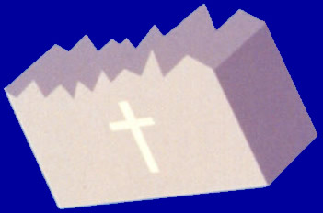
Three Blessings
Renaissance
God’s Work
Reformation
Religious freedom
Rule of law
Property ownership
Only by Cain-type Hellenism submitting to Abel-type Hebraism could Satan be separated from the prevailing spirit of the age. Then the foundation of substance necessary for receiving Christ at the Second Advent could be established worldwide. EDP, 351
Notes:
Fredom of original mind. Like grass cracking concrete
Freedom to become perfect through fuliflling own responsibility
Freedom to make mistakes, to learn, to grow
Medieveal church - don’t have freedom to make mistake
Individual truth body -> develop individuality. Reject conformism
God created physical environment first
Restoration external first and then internal. FofF which is external and symbolic then FofS which is internal an substantial
So for FforM first ext then int
As people pursued the recovery of the internal and external aspects of their original nature, the thought of the age branched out into two movements to recover the heritage of the past, which we distinguish in relative terms as Abel-type and Cain-type.
Had the popes and emperors who were responsible for restoring the foundation of faith in the Carolingian period not become faithless, the foundation for the Second Advent of the Messiah would have been established at that time. Hebraism would have completely assimilated Hellenism to form one worldwide civilization. Instead, their faithlessness and immorality allowed Satan to corrupt the guiding medieval ideology, which was founded upon Hebraism. As a consequence, God had to conduct a new dispensation for the separation of Satan. Just as God had divided fallen Adam into Cain and Abel to separate Satan, God divided the prevailing ideology of the Middle Ages into two trends of thought: the movements to revive Cain-type Hellenism and Abel-type Hebraism. These bore fruit in the Renaissance and the Reformation, respectively.

Slide 29
What was the impetus behind the Renaissance?
We are created to attain perfection by fulfilling our given responsibility of our own free will, without God's direct assistance. We are then to attain oneness with God and acquire true autonomy. Therefore, it is the calling of our original nature to pursue freedom and autonomy. A person of perfect character understands the Will of God and puts it into practice through his own insight and reason, without the need to rely on revelations from God. Hence, it is only natural that we pursue reason and understanding. We also are endowed with the God-given right to master the natural world, to tame and cultivate it in order to create a pleasant living environment, by investigating the hidden laws of nature through science. Hence, we value the natural world, pursue science, and esteem the practical life. EDP, 351
Notes:
Renasiaane was an expression of SS pursuit of HS aspect of human nature

Slide 30
Where did it start and why?
Florence - Italian city-state, 14th century
  Loved freedom to be creative and pursue beauty, truth, goodness
    Good governance – exited from feudalism and based on merchants and commerce
    Medici patronage
  Greek scholars and texts after the conquest of Constantinople in 1453 by Ottoman Turks
    Imitating Greek and Roman thought and culture
  Driving force behind modern world
Notes:
There is a general, but not unchallenged, consensus that the Renaissance began in Florence, Tuscany in the 14th century. Various theories have been proposed to account for its origins and characteristics, focusing on a variety of factors including the social and civic peculiarities of Florence at the time; its political structure; the patronage of its dominant family, the Medici;[5] and the migration of Greek scholars and texts to Italy following the Fall of Constantinople at the hands of the Ottoman Turks.
Historian and political philosopher Quentin Skinner points out that Otto of Freising (c. 1114 - 1158) , a German bishop visiting north Italy during the 12th century, noticed a widespread new form of political and social organisation, observing that Italy appeared to have exited from Feudalism so that its society was based on merchants and commerce. Linked to this was anti-monarchical thinking, represented in the famous early Renaissance fresco cycle Allegory of Good and Bad Government in Siena by Ambrogio Lorenzetti (painted 1338–1340) whose strong message is about the virtues of fairness, justice, republicanism and good administration. Holding both Church and Empire at bay, these city republics were devoted to notions of liberty. Skinner reports that there were many defences of liberty such as Matteo Palmieri’s (1406–1475) celebration of Florentine genius not only in art, sculpture and architecture, but “the remarkable efflorescence of moral, social and political philosophy that occurred in Florence at the same time”.[34]

Slide 31
The intellectual basis of the Renaissance was its version of humanism, derived from the concept of Roman humanitas and the rediscovery of classical Greek philosophy, such as that of Protagoras, who said that "man is the measure of all things". This new thinking became manifest in art, architecture, politics, science and literature.
  Perspective and natural reality in art
  Vernacular literature
  Educational reform,
  Banking, accounting

Slide 32
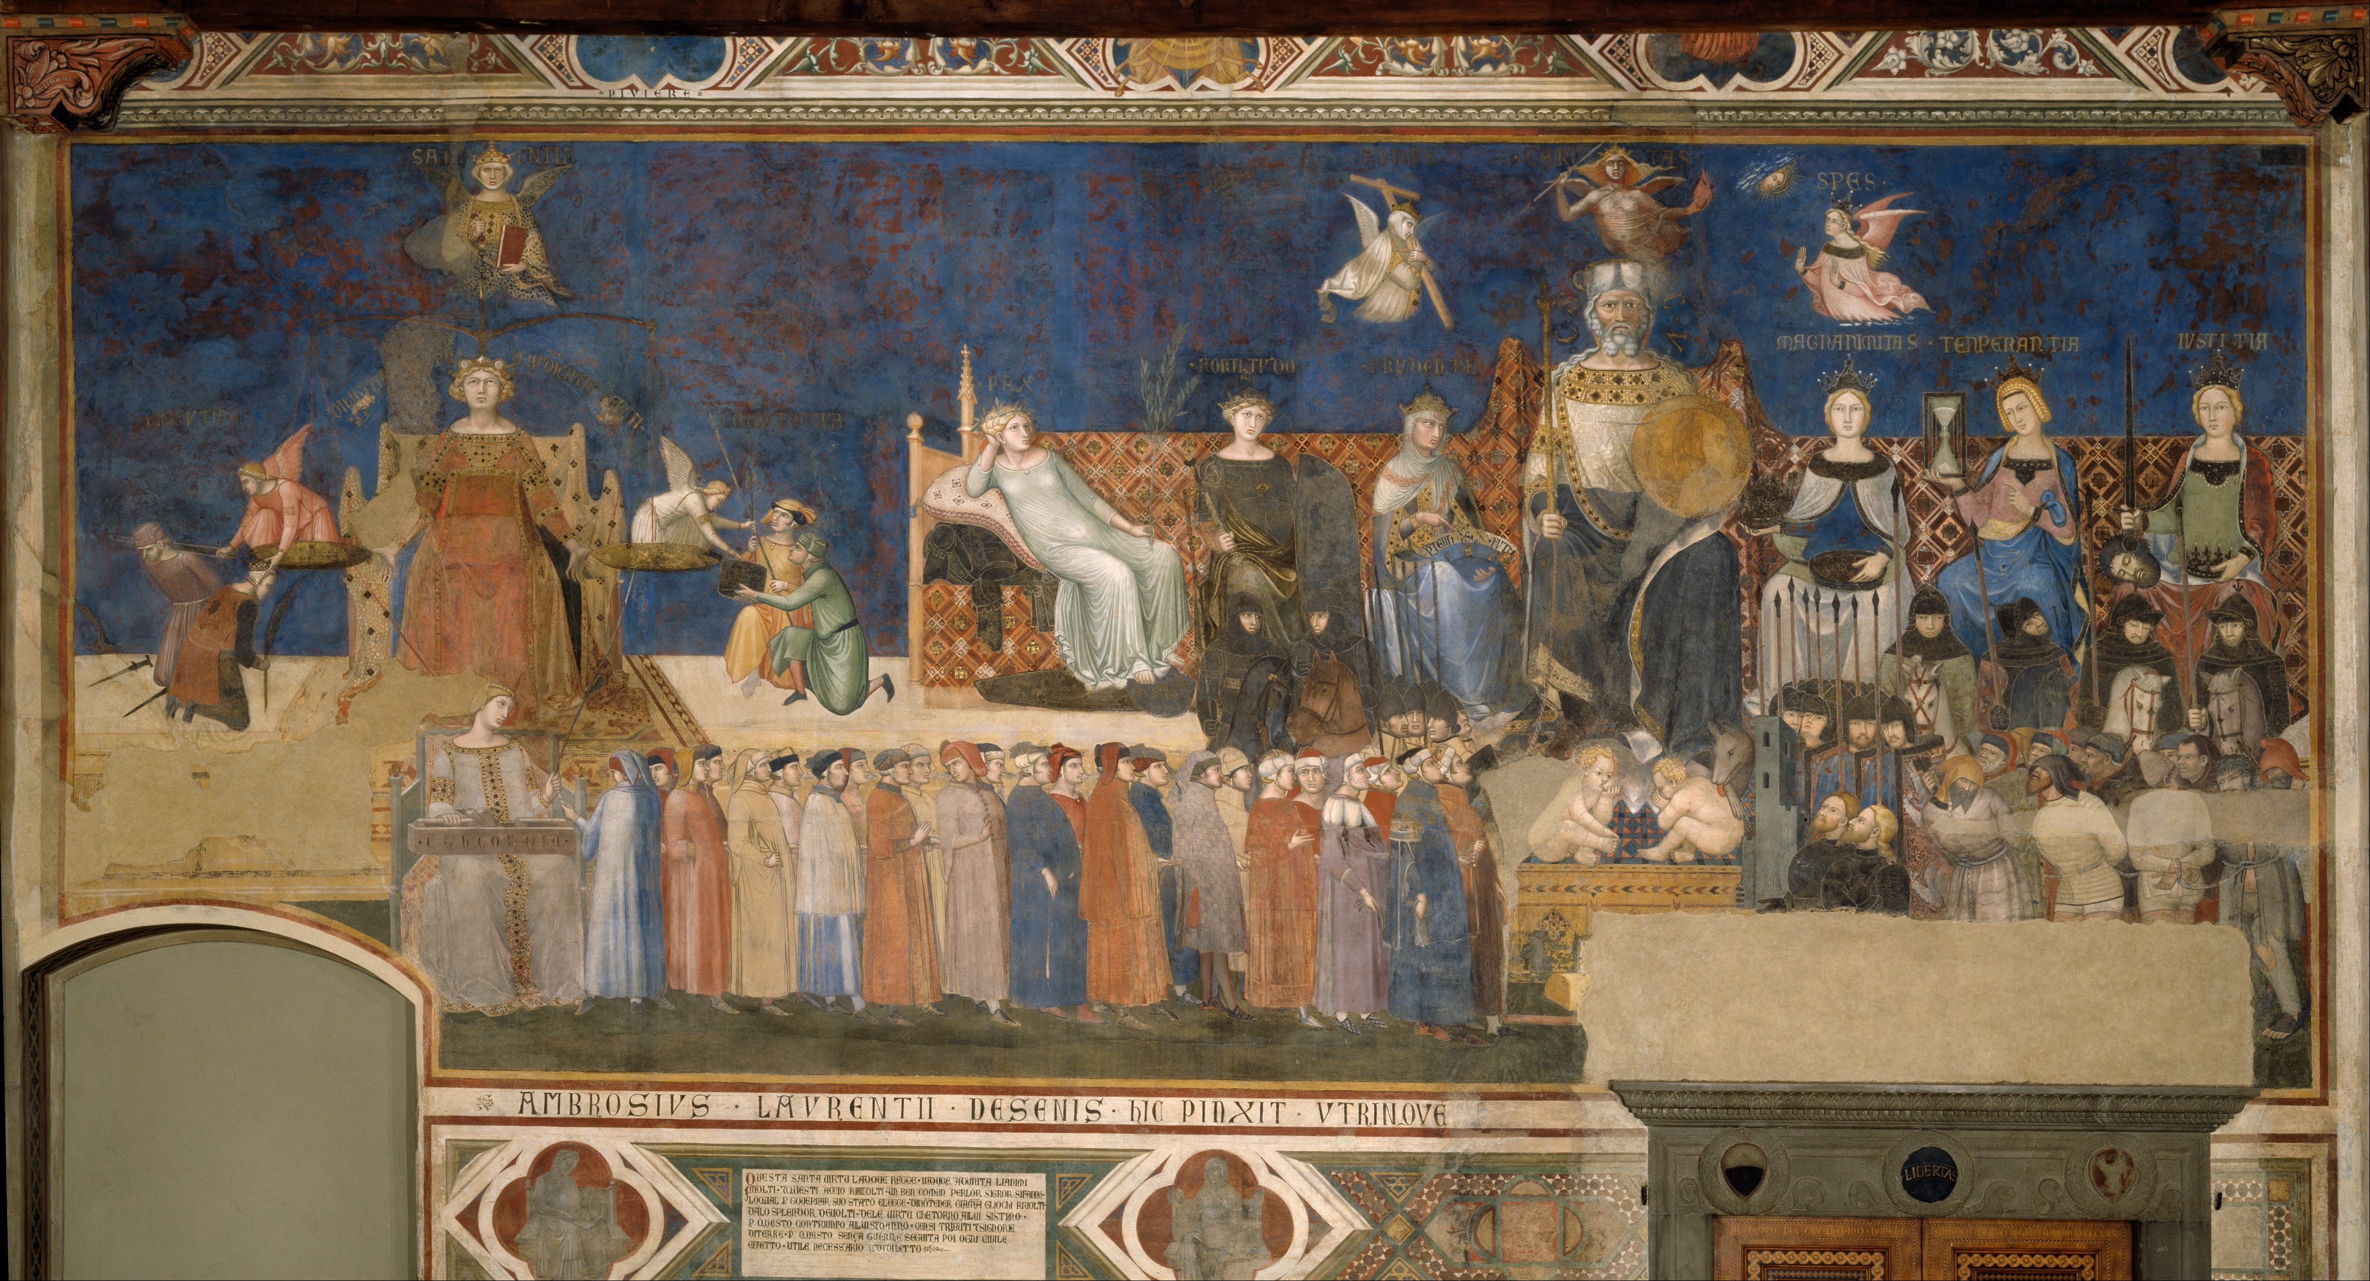
Allegory of Good and Bad Government
Ambrogio Lorenzetti (painted 1338–1340)
Virtues of fairness, justice, republicanism and good administration
Notes:
whose strong message is about the virtues of fairness, justice, republicanism and good administration.

Slide 33
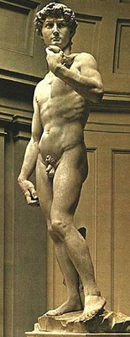
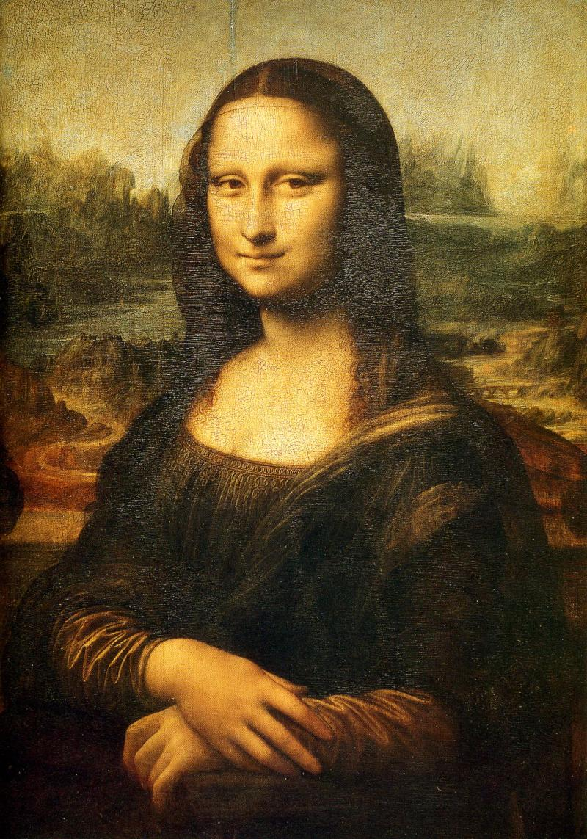
How was this expressed in art and science?
Michelangelo
1475-1564
“David”
Renaissance humanists
did not reject Christianity;
many of the Renaissance's
greatest works were
devoted to it, and the
Church patronized
Renaissance art
Leonardo da Vinci
1452-1519
“Mona Lisa”
Notes:
Started 14c Italy
Immitated Gk and Rm
Transformed medieval way of life -> ploitics, economics, religion
Construction of modern worl
Michelangelo 1475-1564
Painter, sculptor, architect, poet, engineer
Copernicus 1473-1543, Astronomer – formualted the first heliocentric model of the solar system – had been considered by Greek, Indian and Islamic scholars before
Perhaps the most significant development of the era was not a specific discovery, but rather a process for discovery, the scientific method.[53] This revolutionary new way of learning about the world focused on empirical evidence, the importance of mathematics, and discarding the Aristotelian "final cause" in favor of a mechanical philosophy. Early and influential proponents of these ideas included Copernicus and Galileo.

Slide 34
Nicolaus Copernicus (1473-1543)
Roman Catholic canon, mathematician, astronomer
"All the spheres revolve about the sun as their mid-point, and therefore the sun is the centre of the universe.”
"Moreover, since the sun remains stationary, whatever appears as a motion of the sun is really due rather to the motion of the earth.”
"To know the mighty works of God, all this must be a pleasing and acceptable mode of worship to the Most High."
Notes:
Nicolaus Copernicus (/koʊˈpɜːrnɪkəs, kə-/;[2][3][4] Polish: Mikołaj Kopernik;[b] German: Niclas Koppernigk, modern: Nikolaus Kopernikus; 19 February 1473 – 24 May 1543) was a Renaissance-era mathematician, astronomer, and Catholic canon who formulated a model of the universe that placed the Sun rather than Earth at its center. In all likelihood, Copernicus developed his model independently of Aristarchus of Samos, an ancient Greek astronomer who had formulated such a model some eighteen centuries earlier.[5][c][d]

Slide 35
Johannes Kepler (1571-1630)
Laws of planetary motion
“The chief aim of all investigations of the external world should be to discover the rational order and harmony which has been imposed on it by God and which He revealed to us in the language of mathematics.”
“I am merely thinking God’s thoughts after him.”
“I wanted to become a theologian. For a long time I was restless. Now, however, behold how through my effort God is being celebrated in astronomy.”
Notes:
The orbit of a planet is an ellipse with the Sun at one of the two foci.
A line segment joining a planet and the Sun sweeps out equal areas during equal intervals of time.
The square of a planet's orbital period is proportional to the cube of the length of the semi-major axis of its orbit.

Slide 36
Galileo Galilei (1564 -1642)
Laws of nature are mathematical
Science of dynamics
“I do not feel obliged to believe that that same God who has endowed us with senses, reason, and intellect has intended to forgo their use and by some other means to give us knowledge which we can attain by them.”
“Mathematics is the language in which God wrote the universe.”
“In disputes about natural phenomena one must begin not with the authority of Scriptural passage but with sensory experience and necessary demonstrations.”

Slide 37
Galileo’s clash with the church
“The inertia of the human mind and its resistance to innovation are most clearly demonstrated not, as one might expect, by the ignorant mass – which is easily swayed once its imagination is caught – but by professionals with a vested interest in tradition and in the monopoly of learning. Innovation is a twofold threat to academic mediocrities: it endangers their oracular authority, and it evokes the deeper fear that their whole laboriously constructed edifice might collapse.” Arthur Koestler, The Sleepwalkers
Notes:
“The personality of Galileo, as it emerges from works of popular science, has ever less relation to historic fact than Canon Koppernigk's. In his particular case, however, this is not caused by benevolent indifference towards the individual as distinct from his achievement, but by more partisan motives. In works with a theological bias, he appears as the nigger in the woodpile; in rationalist mythography, as the Maid of Orleans of Science, the St. George who slew the dragon of the Inquisition. It is, therefore, hardly surprising that the fame of this outstanding genius rests mostly on discoveries he never made, and of feats he never performed. Contrary to statements in even recent outlines of science, Galileo did not invent the telescope; nor the microscope; nor the thermometer; nor the pendulum clock. He did not discover the law of inertia; nor the parallelogramm of forces or motions; nor the sun spots. He made no contribution to theoretical astronomy; he did not throw down weights from the leaning tower of Pisa, and did not prove the truth of the Copernican system. He was not tortured by the Inquisition, did not languish in its dungeons, did not say 'eppur si muove';16 and he was not a martyr of science. What he did was to found the modern science of dynamics, which makes him rank among the men who shaped human destiny.” Koestler

