Slide 1
Consequences
Now let us count the consequences. Isaac, old and blind, felt betrayed by Jacob. He “trembled violently” when he realised what had happened, saying to Esau, “Your brother came deceitfully.” Esau likewise felt betrayed and experienced such violent hatred towards Jacob that he vowed to kill him. Rebecca was forced to send Jacob into exile, thus depriving herself of the company of the son she loved for more than two decades. As for Jacob, the consequences of the deceit lasted a lifetime, resulting in strife between his wives and even between his children. “Few and evil have been the days of my life” (Gen. 47:9), he said to Pharaoh as an old man. So many lives scarred by one act which was not even necessary in the first place – Isaac did in fact give Jacob “the blessing of Abraham” without any deception, knowing him to be Jacob not Esau. Jonathan Sacks

Slide 2
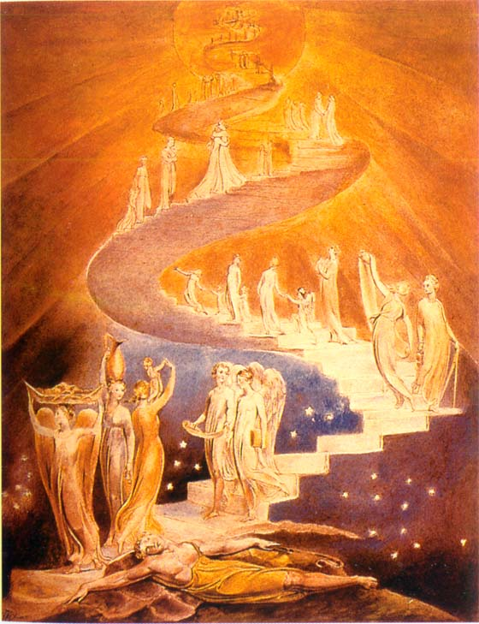
Jacob’s ladder
“I am the Lord . . . I will give you and your descendants the land on which you are lying. Your descendants will be like the dust of the earth. All peoples on earth will be blessed through you and your offspring. I will bring you back to this land.”
Genesis 28: 13-15
Jacob’s ladder
Notes:
Jacob’s prayer is very different. He does not initiate it. His thoughts are elsewhere – on Esau from whom he is escaping, and on Laban to whom he is travelling. Into this troubled mind comes a vision of God and the angels and a stairway connecting earth and heaven. He has done nothing to prepare for it. It is unexpected. Jacob literally “encounters” God as we can sometimes encounter a familiar face among a crowd of strangers. This is a meeting brought about by God, not man. That is why Jacob’s prayer could not be made the basis of a regular obligation. None of us knows when the presence of God will suddenly intrude into our lives.
There is an element of the religious life that is beyond conscious control. It comes out of nowhere, when we are least expecting it. If Abraham represents our journey towards God, and Isaac our dialogue with God, Jacob signifies God’s encounter with us – unplanned, unscheduled, unexpected; the vision, the voice, the call we can never know in advance but which leaves us transformed. As for Jacob so for us, it feels as if we are waking from a sleep and realising as if for the first time that “God was in this place and I did not know it.” The place has not changed, but we have. Such an experience can never be made the subject of an obligation. It is not something we do. It is something that happens to us. Vayfiga bamakom means that, thinking of other things, we find that we have walked into the presence of God.
Such experiences take place, literally or metaphorically, at night. They happen when we are alone, afraid, vulnerable, close to despair. It is then that, when we least expect it, we can find our lives flooded by the radiance of the divine. Suddenly, with a certainty that is unmistakable, we know that we are not alone, that God is there and has been all along but that we were too preoccupied by our own concerns to notice Him. That is how Jacob found God – not by his own efforts, like Abraham; not through continuous dialogue, like Isaac; but in the midst of fear and isolation. Jacob, in flight, trips and falls – and finds he has fallen into the waiting arms of God. No one who has had this experience, ever forgets it. “Now I know that You were with me all the time but I was looking elsewhere.”
That was Jacob’s prayer. There are times when we speak and times when we are spoken to. Prayer is not always predictable, a matter of fixed times and daily obligation. It is also an openness, a vulnerability. God can take us by surprise, waking us from our sleep, catching us as we fall.
Jacob left Beersheba and set out for Harran. 11 When he reached a certain place, he stopped for the night because the sun had set. Taking one of the stones there, he put it under his head and lay down to sleep. 12 He had a dream in which he saw a stairway resting on the earth, with its top reaching to heaven, and the angels of God were ascending and descending on it. 13 There above it[c] stood the Lord, and he said: ‘I am the Lord, the God of your father Abraham and the God of Isaac. I will give you and your descendants the land on which you are lying. 14 Your descendants will be like the dust of the earth, and you will spread out to the west and to the east, to the north and to the south. All peoples on earth will be blessed through you and your offspring.[d] 15 I am with you and will watch over you wherever you go, and I will bring you back to this land. I will not leave you until I have done what I have promised you.’
16 When Jacob awoke from his sleep, he thought, ‘Surely the Lord is in this place, and I was not aware of it.’ 17 He was afraid and said, ‘How awesome is this place! This is none other than the house of God; this is the gate of heaven.’
18 Early the next morning Jacob took the stone he had placed under his head and set it up as a pillar and poured oil on top of it. 19 He called that place Bethel,[e] though the city used to be called Luz.
20 Then Jacob made a vow, saying, ‘If God will be with me and will watch over me on this journey I am taking and will give me food to eat and clothes to wear 21 so that I return safely to my father’s household, then the Lord[f] will be my God 22 and[g] this stone that I have set up as a pillar will be God’s house, and of all that you give me I will give you a tenth.’

Slide 3
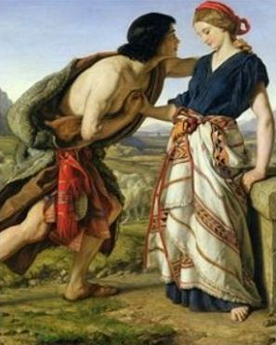
Jacob arrives in Haran
When Jacob saw Rachel daughter of his uncle Laban, and Laban’s sheep, he went over and rolled the stone away from the mouth of the well and watered his uncle’s sheep. Then Jacob kissed Rachel and began to weep aloud.
Genesis 29:10-11
Jacob meets Rachel at the well

Slide 4
Jacob gets married
Now Laban had two daughters; the name of the elder was Leah, and the name of the younger was Rachel. Leah’s eyes were lovely (sensitive), and Rachel was graceful and beautiful. Jacob loved Rachel; so he said, ‘I will serve you seven years for your younger daughter Rachel.’ So Jacob served seven years for Rachel, and they seemed to him but a few days because of the love he had for her. Then Jacob said to Laban, ‘Give me my wife that I may go in to her, for my time is completed.’ So Laban gathered together all the people of the place, and made a feast. But in the evening he took his daughter Leah and brought her to Jacob; and he went in to her. Genesis 29:18-21
  Leah – inner beauty and sensitivity, fertile
  Rachel – outwardly beautiful but hard and barren
Notes:
There was a plan for Esau to marry Leah and Jacob to marry Rachel but Leah didn’t want to marry Esau
Jacob Meets Rachel
29 Then Jacob went on his journey, and came to the land of the people of the east. ² As he looked, he saw a well in the field and three flocks of sheep lying there beside it; for out of that well the flocks were watered. The stone on the well’s mouth was large, ³ and when all the flocks were gathered there, the shepherds would roll the stone from the mouth of the well, and water the sheep, and put the stone back in its place on the mouth of the well.
⁴ Jacob said to them, ‘My brothers, where do you come from?’ They said, ‘We are from Haran.’ ⁵ He said to them, ‘Do you know Laban son of Nahor?’ They said, ‘We do.’ ⁶ He said to them, ‘Is it well with him?’ ‘Yes,’ they replied, ‘and here is his daughter Rachel, coming with the sheep.’ ⁷ He said, ‘Look, it is still broad daylight; it is not time for the animals to be gathered together. Water the sheep, and go, pasture them.’ ⁸ But they said, ‘We cannot until all the flocks are gathered together, and the stone is rolled from the mouth of the well; then we water the sheep.’
⁹ While he was still speaking with them, Rachel came with her father’s sheep; for she kept them. ¹⁰ Now when Jacob saw Rachel, the daughter of his mother’s brother Laban, and the sheep of his mother’s brother Laban, Jacob went up and rolled the stone from the well’s mouth, and watered the flock of his mother’s brother Laban. ¹¹ Then Jacob kissed Rachel, and wept aloud. ¹² And Jacob told Rachel that he was her father’s kinsman, and that he was Rebekah’s son; and she ran and told her father.
¹³ When Laban heard the news about his sister’s son Jacob, he ran to meet him; he embraced him and kissed him, and brought him to his house. Jacob^{[a]} told Laban all these things, ¹⁴ and Laban said to him, ‘Surely you are my bone and my flesh!’ And he stayed with him for a month.
Jacob Marries Laban’s Daughters
¹⁵ Then Laban said to Jacob, ‘Because you are my kinsman, should you therefore serve me for nothing? Tell me, what shall your wages be?’ ¹⁶ Now Laban had two daughters; the name of the elder was Leah, and the name of the younger was Rachel. ¹⁷ Leah’s eyes were lovely,^{[b]} and Rachel was graceful and beautiful. ¹⁸ Jacob loved Rachel; so he said, ‘I will serve you seven years for your younger daughter Rachel.’ ¹⁹ Laban said, ‘It is better that I give her to you than that I should give her to any other man; stay with me.’ ²⁰ So Jacob served seven years for Rachel, and they seemed to him but a few days because of the love he had for her.
²¹ Then Jacob said to Laban, ‘Give me my wife that I may go in to her, for my time is completed.’ ²² So Laban gathered together all the people of the place, and made a feast. ²³ But in the evening he took his daughter Leah and brought her to Jacob; and he went in to her. ²⁴ (Laban gave his maid Zilpah to his daughter Leah to be her maid.) ²⁵ When morning came, it was Leah! And Jacob said to Laban, ‘What is this you have done to me? Did I not serve with you for Rachel? Why then have you deceived me?’ ²⁶ Laban said, ‘This is not done in our country—giving the younger before the firstborn. ²⁷ Complete the week of this one, and we will give you the other also in return for serving me for another seven years.’ ²⁸ Jacob did so, and completed her week; then Laban gave him his daughter Rachel as a wife. ²⁹ (Laban gave his maid Bilhah to his daughter Rachel to be her maid.) ³⁰ So Jacob went in to Rachel also, and he loved Rachel more than Leah. He served Laban^{[c]}for another seven years.
³¹ When the Lord saw that Leah was unloved, he opened her womb; but Rachel was barren. ³

Slide 5
Jacob’s wives
When morning came, it was Leah! And Jacob said to Laban, ‘What is this you have done to me? Did I not serve with you for Rachel? Why then have you deceived me?’ Laban said, ‘This is not done in our country—giving the younger before the firstborn. Complete the week of this one, and we will give you the other also in return for serving me for another seven years.’
Father and older daughter deceived Jacob
  Jacob was being reminded that how he treated his father and older brother was wrong
  If he had not stolen Esau’s blessing Jacob would have married at the right time and had only one wife
  So Jacob went in to Rachel also, and he loved Rachel more than Leah. Genesis 29:30
Notes:
Jacob accusing Laban of deception which is exactly what he himself had practiced!!!
Abraham – 1 wife
Isaac – 1 wife
Monogamy was the tradition and teaching of Abraham and family from Genesis Adam and Eve
20 So Jacob served seven years for Rachel, and they seemed to him but a few days because of the love he had for her.
Jacob, who had with the help of his mother outwitted his brother Esau (see the story of this deception at Bible Men and Women: Jacob ) was now outwitted by someone even wilier than himself. Moreover, he had been fooled with the same trick: he had pretended to be his brother Esau, and now he had been fooled when Leah pretended to be her sister Rachel. Who says the Bible has no sense of humour? It was a terrible start to their marriage: his new wife Leah had colluded with her father to deceive him. This soured their relationship from the start.
But there was not much that could be done. During the night he had taken Leah's virginity, and in tribal society this meant she was his wife, like it or not. But he never forgave her for what she had done - she is usually described as 'unloved' in the English translation of the story, but the original Hebrew word is better translated as 'hated’.
Clear from this that Jacob’s deception of Esau was wrong

Slide 6
Why did Jacob have two wives?
Arranges to marry Rachel
Married to Leah
Jacob, “Why did you deceive me?”
Laban, “It is not the done thing in our place to give the younger before the elder”
What goes around comes around
10 times Laban cheated Jacob out of his wages
Notes:
Jacob, in flight from Esau’s anger, has travelled to the house of Laban. Arriving, he meets Laban’s younger daughter Rachel and falls in love with her. Laban proposes a deal: work for me for seven years and I will give her to you in marriage. Jacob does so, but on the wedding night Laban substitutes Leah for Rachel. The next morning, when Jacob discovers the deception, he protests, “Why did you deceive me?” Laban pointedly replies, “It is not the done thing in our place to give the younger before the elder” (a reference, intended or otherwise, to Jacob’s deception of Isaac, a case of the younger taking the blessing of the elder, Esau). Laban agrees, however, that in return for a further seven years’ labour, Jacob may marry Rachel. He will not have to wait until the seven years are complete, but he must, however, wait for seven days until Leah’s wedding celebration is complete (an early example of a custom we still keep: the week of sheva berakhot). The seven days pass. Jacob marries Rachel. We then read the following:
He also [gam] married Rachel, and he also [gam] loved Rachel . . . (29:30)
The implication at this point is clear. The repeated word gam, “also,” leads us to believe that the two sisters are equal in Jacob’s eyes. The story of the deception has – or so we must suppose on the basis of what we have so far heard – a happy ending after all. Jacob has married both. He loves them both. The sibling rivalry that is so pronounced a theme of Bereishith (Cain and Abel, Isaac and Ishmael, Jacob and Esau) seems to be reaching a positive resolution. It is possible to love two siblings equally. The next word sends our expectation crashing to the ground:
…more than Leah (29:30)
This is an ungrammatical construction. The words “also” and “more than” do not belong together in the same sentence. Either one loves X and also Y, or one loves X more than Y, but not both. The effect – like a sudden discord in the middle of a Mozart symphony – is strident and shocking. Jacob does not love the two sisters equally. He may love them both, but his passion is for Rachel. The next verse contains an even sharper discord:
God saw that Leah was hated [senuah]. . .
This is a phrase that cannot be understood literally. The previous verse has just said that Leah was not hated but loved. The commentators and translators wrestled with this difficulty. Ramban (on his second interpretation) and Radak read the word senuah not as “hated” but as “[relatively] unloved.” Yet though the text is semantically strange, is it psychologically lucid. Leah knew that Jacob’s heart was elsewhere. She may have been loved but she felt the lesser love as a rejection. The words “God saw” mean that God felt her sense of humiliation. Laban’s deception had human consequences, and they were tragic. Leah weeps inwardly for the husband she acquired as a result of her father’s wiles, whose love is for someone else.
Only now, perhaps, do we understand the significance of the Torah’s first mention of Leah:
Now Laban had two daughters; the name of the older was Leah, and the name of the younger was Rachel. The eyes of Leah were weak (rakot), but Rachel was lovely in form, and beautiful.
The word rakot could mean many things: beautiful (Targum, Rashbam), weak (Ibn Ezra), or sensitive (Netziv suggests that Leah was unable to go out with the flocks because the bright sunlight hurt her eyes). The ambiguity is deliberate. Only rarely and sparingly does the Torah give us physical descriptions of its characters, and always for a reason that will eventually be disclosed (so, for example, we hear in 2 Samuel 14 about Absolom’s hair; four chapters later we discover why: it became caught in a tree, which led to his death).
The meaning of the phrase “Leah’s eyes were rakot,” is (as Rashi, Radak and various midrashic traditions explain) “Leah was easily moved to tears.” She was emotionally vulnerable. She had none of the resilience that might have carried her through her husband’s attachment to her younger sister. She was thin-skinned, sensitive, attuned to nuance, easily hurt. She knew she was Jacob’s lesser love, and it caused her pain.
The subtlety with which all this is conveyed is remarkable. The Torah has sketched Leah’s portrait in a few deft strokes, each of which we will only hear if we are listening carefully. Nor has this been done for the sake of description. Rather, it has set the scene for the drama that is about to unfold – and once again we find it done with the utmost brevity and delicacy. In fact, unless we are paying the closest attention we will not notice it at all.
What follows next is, on the face of it, a simple account of the birth of four children. Beneath the surface, however, these verses are as eloquent as any in the entire Torah:
God saw that Leah was hated, and He opened her womb. Rachel remained barren. Leah became pregnant and gave birth to a son. She named him Reuben, saying: “God has seen (ra’ah) my troubles. Now my husband will love me.” She became pregnant again and had a son. “God has heard (shama) that I was unloved,” she said, “and has given me also this son.” She named the child Shimon. She became pregnant again and had a son. “Now my husband will become attached (lavah) to me,” she said, “because I have given him three sons.” Therefore he named the child Levi. She became pregnant again and had a son. She said, “This time let me praise (odeh) God,” and she named the child Judah (Yehudah). She then stopped having children.
Read superficially, these verses are no more than a genealogy, a list of births, of the kind of which there are many in Bereishith. As soon as our ear is attuned to Leah’s plight, however, we listen more carefully, and what we hear is heart-breaking.
Leah is pleading for attention. Each of the names of her first three children is a cry to her husband Jacob – to see, to listen, to be attached, to notice her, to love. Significantly, it is she, not Jacob, who names three of the children (The exception is Levi. The commentators who emphasise the plain sense of the text, Rashbam and Radak, assume that the “he” who names Levi is Jacob. Rashi, whose commentary goes deeper, says, on the basis of midrashic tradition, that it was an angel. Rashi has understood that a key fact about the four births is the absence of Jacob).
Sadly, the lack of relationship between Jacob and Leah at the birth of her children is carried through in the years to come. Jacob’s relationship with Reuben, Shimon and Levi breaks down completely (with Reuben after the episode of Bilhah’s couch, with Shimon and Levi after the incident with Shechem). On his death-bed he curses them instead of blessing them. Yet it is from Levi that Israel’s spiritual leaders will eventually come (Moses, Aaron, Miriam, and eventually the cohanim and levi’im), and from Judah will come its kings (David and his descendants).
It is not only Leah’s cry that Jacob does not hear. He fails equally to respond to Rachel’s distress when she sees her sister having children while she has none:
When Rachel saw that she was not bearing Jacob any children, she became jealous of her sister. So she said to Jacob, “Give me children, or I will die.” Jacob became angry with her and said, “Am I in the place of G-d? It is He who has kept you from having children.”
The sages noticed a parallel between Jacob’s words here, and Joseph’s at the end of Bereishith when the brothers fear that, now that their father is dead, Joseph will take revenge. Joseph comforts them, saying, “Do not be afraid. Am I in the place of God?” Joseph uses the same words his father had said before he was born, but to opposite effect: to bring comfort. Using this contrast to maximal effect, the sages said about Jacob’s reply to Rachel:
Said the Holy One, blessed be He [to Jacob]: “Is that the way to answer a woman in distress? By your life, your children will one day stand before her son [Joseph, who will answer them, Am I in the place of G-d?].”
What is going on in this intense and sometimes tragic drama between Leah and Jacob? Jacob is unlike the other patriarchs. If the word that comes to mind in relation to Abraham is chessed, kindness, and to Isaac pachad, fear, the idea that characterises Jacob is struggle.
Already in the womb he struggles with his brother. He competes with him for the birthright and the blessing. The defining scene in his life is his wrestling match at night with an unnamed adversary. Both his names – Jacob, “he who grasps by the heel,” and Israel, “he who struggles with G-d and man and prevails” – convey a sense of conflict.
While Abraham and Isaac represent modes of being, Jacob stands for becoming. The gifts he has, he has fought for. None has come naturally. Jacob is the supreme figure of persistence. He is the man who said to the angel, “I will not let you go until you bless me.” More than Abraham and Isaac, Jacob is the person who wrestles with life and refuses to let go.
The Torah describes him as an ish tam, sometimes translated as “a simple man” but better understood (according to R. Samson Raphael Hirsch) as “a single-minded man.” The prophet Micah associated him with truth – “You give truth to Jacob, kindness to Abraham.” 15 Jacob’s life embodies the fact that truth must be fought for with single-minded determination. It rarely comes without a struggle and the pain of experience. What is the truth at stake in Jacob’s life?
There are many, but one is a truth about love. One of the most striking facts about the Jacob narrative is the frequency with which the word “love” appears. It figures once in the story of Abraham (Ber. 22: 2) 16, twice in the life of Isaac (24: 6717, 25: 2818, though there are also three references to Isaac’s love of a particular kind of food: 27:4, 9, 14) 19, but seven times in the case of Jacob (29: 18, 20, 30, 3220; 37: 3, 421; 44: 2022). Jacob loves more than any other figure in Bereishith.
But through painful experience, Jacob must learn a truth about love. There are times when love not only unites but also divides. It did so in his childhood, when Isaac loved Esau and Rebekah loved Jacob. It did so again when he married two sisters. It did so a third time when he loved Rachel’s child Joseph more than his other sons. What Jacob learned – and what we learn, reading his story – is that love is not enough. We must also heed those who feel unloved. Without that, there will be conflict and tragedy. That requires a specific capacity – the ability to listen, in Jacob’s case, to the unspoken tears of Leah and her feeling of rejection, made explicit in the names she gave her sons.
I began by pointing out that the Torah was a text intended to be read aloud and listened to. It is the single greatest expression of faith in a G-d we cannot see, but only hear. Judaism is supremely a religion of the ear, unlike all other ancient civilizations, which were cultures of the eye. This is more than a metaphysical fact. It is a moral one as well. In Judaism the highest spiritual gift is the ability to listen – not only to the voice of G-d, but also to the cry of other people, the sigh of the poor, the weak, the lonely, the neglected and, yes, sometimes the un- or less-loved. That is one of the meanings of the great command Shema Yisrael, “Listen, O Israel.” Jacob’s other name, we recall, was Israel.
Jacob wrestles with this throughout his life. It is not that he has a moral failing. To the contrary, he is the most tenacious of all the patriarchs – and the only one all of whose children become part of the covenant. It is rather that every virtue has a corresponding danger. Those who are courageous are often unaware of the fears of ordinary people. Those of penetrating intellect are often dismissive of lesser minds. Those who, like Jacob, have an unusual capacity to love must fight against the danger of failing to honour the feelings of those they do not love with equal passion. The antidote is the ability to listen. That is what Jacob learns in the course of his life – and why he, above all, is the role model for the Jewish people – the nation commanded to listen.
How beautiful it is that this message – one of the deepest and most subtle in the Torah – is conveyed in a series of passages whose meaning does not lie on the surface of the text, but discloses itself only to those who listen to what is going on beneath the words: the unspoken cry, the implicit appeal, the unheard tears, the unarticulated pain. Those who wish to learn to listen to G-d must learn to listen to other people – to the kol demamah dakah, “the still, small voice” of those who need our love.

Slide 7
How did Jacob change?
“He felt sorry for what he had done to his elder brother. He thought it was understandable for Esau to want to kill him when he had taken away the blessing by cheating; and he was sympathetic with his brother.”
Sun Myung Moon, Jacob’s course and our life of faith, 27 May 1973

Slide 8
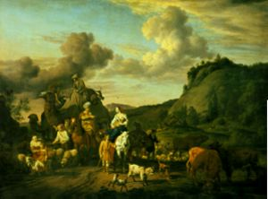
Jacob matures
21 years in Haran with Uncle Laban
Three Blessings
Man of character
  Deceived 10 times
Establishes family with twelve sons
Acquires wealth
Jacob leaving Laban
Rachel steals Laban’s idols
Notes:
Jacob was tricked many times by Laban. But he didn’t get angry and try to kill him or run away. Instead he endured and developed a deep character. He also married Rachel and Leah and with their maids as concubines had 12 sons and 1 daughter. He also worked very hard and was a good husbandman so that despite Laban’s trickery he became wealthy.
Jacob had twelve sons to restore through indemnity in his generation (horizontally) the indemnity conditions
accumulated (vertically) through the twelve generations from Noah to Jacob which had been lost to Satan. EDP 228
He felt sorry for what he had done to his elder brother. He thought it was understandable for Esau to want to kill him when he had taken away the birthright by cheating; and he was sympathetic with his brother. SMM 1973
You know also that when Jacob was well on, his way, Laban caught up with him and quarreled with him over the idol which he had stolen. If Leah, in sympathy with her father, had told him the truth about the idol, Jacobs 21-year course would have come to nothing. But Leah deceived her father, Laban. What is interesting here is that Leah cheated her father, and Jacob also cheated his father. If Leah and Jacob had both deceived their fathers for their own benefit, it would have been wrong. However, they did this for God and His people, and we know that this is a necessary condition in the course of restoration. Leah was strictly on the side of Jacob. If Leah had cheated her own father, this would mean that she had become completely one with Jacob. In terms of becoming a God's side family, we can define Jacob's family as one which history had never before seen. Leah was one with Jacob without becoming one with her father, Laban, and this made it possible for Jacob to remain the owner of all his possessions. SMM 1973
Sacks: Jacob, in flight from Esau’s anger, has travelled to the house of Laban. Arriving, he meets Laban’s younger daughter Rachel and falls in love with her. Laban proposes a deal: work for me for seven years and I will give her to you in marriage. Jacob does so, but on the wedding night Laban substitutes Leah for Rachel. The next morning, when Jacob discovers the deception, he protests, “Why did you deceive me?” Laban pointedly replies, “It is not the done thing in our place to give the younger before the elder” (a reference, intended or otherwise, to Jacob’s deception of Isaac, a case of the younger taking the blessing of the elder, Esau). Laban agrees, however, that in return for a further seven years’ labour, Jacob may marry Rachel. He will not have to wait until the seven years are complete, but he must, however, wait for seven days until Leah’s wedding celebration is complete (an early example of a custom we still keep: the week of sheva berakhot). The seven days pass. Jacob marries Rachel. We then read the following:
It seems that Rachel in particular was still angry at her father for what he had done to her. Before they set out, she took the small figurines that represented the spirits of ancestors and the protective deities of her father's family (the teraphim), telling no-one at all what she was doing. See Bible Archaeology: Ancient Religions for information about ancient religious beliefs and practices.
This was not a random act of malice, for years ago on what should have been her wedding night, Laban had stolen Rachel's happiness. Now she stole something that was precious to him - pay-back for a life-time of bullying.
But her act had wider significance than this, because the teraphim were a form of title deed, and the person who possessed them could claim the tribe's wealth. BIBLE WOMEN: RACHEL: Ancient clay statuette, possibly of Asherah and similar to the terephim stolen by Rachel Ownership of the household deities was the prerogative of the head of the family, and by taking them Rachel secured this position for her husband.
aban searched the tents of Jacob, Leah, and the two maids to find the teraphim- each woman in a polygamous marriage had her own separate tent.
For interesting images of tents used by nomadic herders like Jacob and Rachel, see Bible Architecture: Housing.
Nomadic tents
'The front section of the tent was used for work. It was the public area, open to visitors. The men of the family lived there. The second or rear part of the tent was private. A dividing curtain separated it from the front area. It was here that the women, children and babies lived and slept.'
Nomadic Tents
Laban found nothing. Then he went into Rachel's tent, where the teraphim were hidden. What he did not know was that Rachel had hidden them in the saddle-bags of her camel. She greeted her father respectfully but did not rise from where she was sitting. She explained demurely that she could not do so, since she was menstruating.
'Let not my lord be angry that I cannot rise before you, for the way of women is upon me.'
This meant that the cloth on which she was sitting was ritually unclean, and could not be touched by anyone. Most ancient tribes had customs that allowed menstruating women to withdraw from physical contact with the tribe while they had their periods, and women welcomed this time of rest from their usual tasks.
Rachel's manner towards her father was so sweet and yielding that Laban did not argue or tell her to move, and the upshot was that he left her tent empty-handed. She had used the laws of ritual cleanliness to her own advantage. The irony was that it was a lie. She was already pregnant with a son.
Since Laban could not find the teraphim, he had to back down. The two men made a face-saving covenant, and early the next morning Laban said good-bye to them all, and left.
http://www.womeninthebible.net/1.4.Rachel.htm

Slide 9
Parts company with Laban
Jacob was angry and took Laban to task. ‘What is my crime?’ he asked Laban. ‘How have I wronged you that you hunt me down?
I worked for you fourteen years for your two daughters and six years for your flocks, and you changed my wages ten times. If the God of my father, the God of Abraham and the Fear of Isaac, had not been with me, you would surely have sent me away empty-handed. But God has seen my hardship and the toil of my hands, and last night he rebuked you.’
Laban answered Jacob, ‘The women are my daughters, the children are my children, and the flocks are my flocks. All you see is mine.
Genesis 31
Notes:
Laban begins by seeming like a friend. He offers Jacob refuge when he is in flight from Esau, who has vowed to kill him. Yet it turns out that his behaviour is less generous than self-interested and calculating. Jacob works for him for seven years for Rachel. Then on the wedding night Laban substitutes Leah for Rachel, so that to marry Rachel, Jacob has to work another seven years. When Joseph is born to Rachel, Jacob tries to leave. Laban protests. Jacob works another six years, and then realizes that the situation is untenable. Laban’s sons are accusing him of getting rich at Laban’s expense. Jacob senses that Laban himself is becoming hostile. Rachel and Leah agree, saying, “He treats us like strangers! He has sold us and spent the money!”3
Jacob realizes that there is nothing he can do or say that will persuade Laban to let him leave. He has no choice but to escape. Laban then pursues him, and were it not for G‑d’s warning the night before he catches up with him, there is little doubt that he would have forced Jacob to return and live out the rest of his life as his unpaid laborer. As he says to Jacob the next day: “The daughters are my daughters! The sons are my sons! The flocks are my flocks! All that you see is mine!”4 It turns out that everything he had ostensibly given Jacob, in his own mind he had not given at all.
Laban treats Jacob as his property, his slave. He is a non-person. In his eyes Jacob has no rights, no independent existence. He has given Jacob his daughters in marriage, but still claims that they and their children belong to him, not Jacob. He has given Jacob an agreement as to the animals that will be his as his wages, yet he still insists that “the flocks are my flocks.”
What arouses his anger, his rage, is that Jacob maintains his dignity and independence. Faced with an impossible existence as his father-in-law’s slave, Jacob always finds a way of carrying on. Yes, he has been cheated of his beloved Rachel, but he works so that he can marry her too. Yes, he has been forced to work for nothing, but he uses his superior knowledge of animal husbandry to propose a deal which will allow him to build flocks of his own that will allow him to maintain what is now a large family. Jacob refuses to be defeated. Hemmed in on all sides, he finds a way out. That is Jacob’s greatness. His methods are not those he would have chosen in other circumstances. He has to outwit an extremely cunning adversary. But Jacob refuses to be defeated, or crushed and demoralized. In a seemingly impossible situation, Jacob retains his dignity, independence and freedom. Jacob is no man’s slave.
Laban is, in effect, the first anti-Semite. In age after age, Jews sought refuge from those, like Esau, who sought to kill them. The nations who gave them refuge seemed at first to be benefactors. But they demanded a price. They saw in Jews people who would make them rich. Wherever Jews went, they brought prosperity to their hosts. Yet they refused to be mere chattels. They refused to be owned. They had their own identity and way of life; they insisted on the basic human right to be free. The host society then eventually turned against them. They claimed that Jews were exploiting them, rather than what was in fact the case, that they were exploiting the Jews. And when Jews succeeded, they accused them of theft: “The flocks are my flocks! All that you see is mine!” They forgot that Jews had contributed massively to national prosperity. The fact that Jews had salvaged some self-respect, some independence, that they too had prospered, made them not just envious but angry. That was when it became dangerous to be a Jew.
Laban was the first to display this syndrome, but not the last. It happened again in Egypt after the death of Joseph. It happened under the Greeks and Romans, the Christian and Muslim empires of the Middle Ages, the European nations of the nineteenth and early twentieth centuries, and after the Russian Revolution.
In her fascinating book World on Fire, Amy Chua argues that ethnic hatred will always be directed by the host society against any conspicuously successful minority. All three conditions must be present: [1] The hated group must be a minority, or people will fear to attack it. [2] It must be successful, or people will not envy it, merely feel contempt for it. [3] It must be conspicuous, or people will not notice it. Jews tended to fit all three. That is why they were hated.
And it began with Jacob during his stay with Laban. He was a minority, outnumbered by Laban’s family. He was successful, and it was conspicuous: you could see it by looking at his flocks.
What the sages are saying in the Haggadah now becomes clear. Pharaoh was a one-time enemy of the Jews, but Laban exists, in one form or another, in age after age. The syndrome still exists today. As Amy Chua notes, Israel in the context of the Middle East is a conspicuously successful minority. It is a small country, a minority; it is successful, and it is conspicuously so. Somehow, in a tiny country with few natural resources, it has outshone its neighbours. The result is envy that becomes anger that becomes hate. Where did it begin? With Laban.
Put this way, we begin to see Jacob in a new light. Jacob stands for minorities and small nations everywhere. Jacob is the refusal to let large powers crush the few, the weak, the refugee. Jacob refuses to define himself as a slave, someone else’s property. He maintains his inner dignity and freedom. He contributes to other people’s prosperity, but he defeats every attempt to be exploited. Jacob is the voice that says: I too am human. I too have rights. I too am free.
If Laban is the eternal paradigm of hatred of conspicuously successful minorities, then Jacob is the eternal paradigm of the human capacity to survive the hatred of others. In this strange way Jacob becomes the voice of hope in the conversation of humankind, the living proof that hate never wins the final victory; freedom does.

Slide 10
Jacob goes to meet Esau
Jacob sent messengers before him to his brother
Esau . . . [saying] “I [Jacob] have sent to tell my
lord, in order that I may find favour in your sight.”
Genesis 32: 3
And the messengers returned to Jacob, saying, “We came to your brother Esau, and he is coming to meet you, and four hundred men with him.” Then Jacob was greatly afraid and distressed.
Genesis 32: 6-7
Notes:
Jacob was ‘afraid’ (vayyira) and ‘distressed’ (vayezer) (32:8). Why are both of these recorded? The answer given in the name of Rabbi Judah bar Rabbi Illai is that Jacob was afraid that he might be killed by Esau and he was distressed that he might kill Esau. Both scenarios are disturbing: harm to the self by the other and fear of harm by the self to the other.
Jacob, father of the Jewish people, experienced not only the physical fear of defeat but the moral distress of victory. Only those who are capable of feeling both, can defend their bodies without endangering their souls.
Jacob came up with a plan. He made a large present of cattle, sheep and camels for Esau, divided them up and sent them to him, one gift of animals after another.
Esau must have wondered if perhaps his brother had changed.
Now Jacob was on his way home to meet his brother, Esau. He could have gone somewhere else to enjoy his wealth if he did not think of God's will. He could have said, "Esau is Esau, and I am I; what have I to do with his life?" But his mind was so occupied by God's will that he wanted to meet his brother and reconcile the past and soothe his heart until his resentment vanished. SMM 1973

Slide 11
Jacob’s strategy
Jacob divided possessions in two and sent gifts to Esau
“They belong to your servant Jacob; they are a present sent to my lord Esau; and moreover he is behind us.” Genesis 32:18
“I may appease him with the present that goes before me, and afterwards I shall see his face; perhaps he will accept me.” Genesis 32:20
Notes:
he took a present for his brother Esau, ¹⁴ two hundred female goats and twenty male goats, two hundred ewes and twenty rams, ¹⁵ thirty milking camels and their calves, forty cows and ten bulls, twenty female donkeys and ten male donkeys.

Slide 12
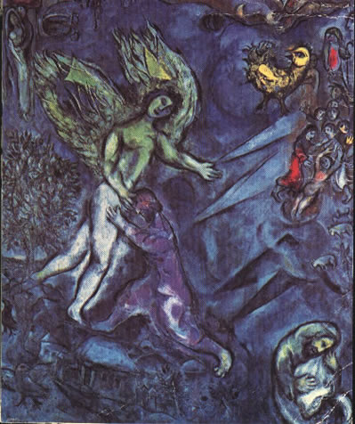
Victory over the angel
A man wrestled with Jacob until daybreak. When the man saw that he did not prevail against him, he struck him on the hip socket. Then he said, ‘Let me go, for the day is breaking.’ But Jacob said, ‘I will not let you go, unless you bless me.’ So he said to him, ‘What is your name?’ And he said, ‘Jacob.’ “Your name shall no longer be called Jacob, but Israel, for you have striven with God and with men, and have prevailed.” Genesis 32:28
The Ford of Jabbok
Notes:
There’s one biblical passage that’s deeply helpful. It’s the famous, enigmatic story in Genesis 32 in which, at night, Jacob wrestles with an unknown, unnamed adversary: “Jacob was left alone, and a man wrestled with him till daybreak”. It was this passage that gave the Jewish people their name, Israel, meaning, “One who struggles with God and with man and prevails”. The key phrase is when Jacob says to the stranger, “I will not let you go until you bless me”. Within every crisis lies the possibility of blessing. Events that at the time were the most painful, are also those that in retrospect we see most made us grow.
Crisis forces us to make difficult but necessary decisions. It makes us ask, “Who am I and what really matters to me?” It plunges us from the surface to the depths, where we discover strengths we didn’t know we had, and a clarity of purpose we had hitherto lacked. So you have to say to every crisis, “I will not let you go until you bless me”.
The struggle isn’t easy. Though Jacob was undefeated, he “limped”. Battles leave scars. Yet God is with us even when He seems to be against us. For if we refuse to let go of Him, He refuses to let go of us, giving us the strength to survive and emerge stronger, wiser, blessed.
The oldest question in religion is: “Why do bad things happen to good people?” But there are two ways of asking this question. The first is, “Why has God done this to me?” Never ask this question, because we will never know the answer. God cares for us, but He also cares for everyone and everything. We think of now; God thinks of eternity. We could never see the universe from God’s point of view. So we will never find the answer to the question: “Why me?”
But there is another way of asking the question. “Given that this has happened, what does God want me to learn from it? How is He challenging me to grow? How is He calling on me to respond?” Asking it this way involves looking forward, not back. “Why did God do this?” is the wrong question. The right one is: “How shall I live my life differently because this has happened?”
That is how to deal with crisis. Wrestle with it, refusing to let it go until it blesses you, until you emerge stronger, better or wiser than you were before. To be a Jew is not to accept defeat. That is the meaning of faith.
Jacob great survivor. Went through many stressful situations but resilient. With brother, parents, Laban, 2 wives, Rachel dying, losing Joseph etc.
Wrestling with the angel – victorious. The angel had defeated Adam but Jacob defeated the angel. Hip put out of joint.
Wrestling with spirit world. Won the respect of the angel. Like studying and passing exams to be qualified and win respect.
Jacob wrestling with and overcoming fears. Wanted to escape or run away. Cos overcame fears then was serene. If felt afraid Esau would have noticed and not respected.
Limping – had scars.
Not letting angel go till blessed him – determined to bring something good out of suffering. Person of character.
Jacob
Chagall, Ford of Jabbok
Jacob was the first fallen man to make indemnity condition to restore dominion over the angel
Israel - he set the pattern for victory over Satan. Subjugated Satan.
Striven with God (F of F) and man (F of S)
for Jacob to complete the restoration of
Canaan at the family level-that is, return to Canaan with his family and wealth and
there restore the foundation to receive the Messiah-he had to triumph in a fight at the
risk of his life with an angel, representing Satan. Jacob was desperate to overcome this
trial as he wrestled with the angel at the ford of Jabbok. He triumphed and received
the name “Israel.”4 In this trial, it was God who tested Jacob by putting the angel in
the position of Satan. God’s purpose in doing this was not to make Jacob miserable,
but to help him secure the position of Abel and complete the restoration of his family
by winning the qualification to rule the angel. Furthermore, through the angel playing
the leading role in the trial, the way was opened for the angelic world to be restored.
Yet Jacob has no control over Esau, only over himself. To alleviate fear and distress he can only alter his own attitude, expectations and behaviour. This is a painful process. To understand, to come to terms with, and impact on the core of our being is challenging to say the least. This is the challenge that Jacob wrestles with at the centre of one of the most stunning, powerful and enigmatic passages that follows: “Jacob was left alone. And a man wrested with him until the break of dawn (32:25).”The midrash understands this to be an encounter with the angel Michael aimed at showing Jacob that he should trust in God. Zornberg builds on the traditional readings with a distinctly modern vocabulary. For her, this moment constitutes a ‘therapeutic encounter’ with Israel, Jacob’s own shadow-self. In his journey to wholeness he must wrestle with his inner demons; he must delve inwards to better understand his own psyche. This encounter changes Jacob. He is given a new name, Israel, ‘he who struggles with God’ and by seeing “God face to face” (32:31) comes closer to understanding himself. The pain and power of this experience is mapped symbolically onto Jacob’s injured thigh.

Slide 13
Commentary by Jonathan Sacks
Jacob says to the stranger, “I will not let you go until you bless me”. Within every crisis lies the possibility of blessing. Events that at the time were the most painful, are also those that in retrospect we see most made us grow.
Crisis forces us to make difficult but necessary decisions. It makes us ask, “Who am I and what really matters to me?” It plunges us from the surface to the depths, where we discover strengths we didn’t know we had, and a clarity of purpose we had hitherto lacked. So you have to say to every crisis, “I will not let you go until you bless me”.
The struggle isn’t easy. Though Jacob was undefeated, he “limped”. Battles leave scars. Yet God is with us even when He seems to be against us. For if we refuse to let go of Him, He refuses to let go of us, giving us the strength to survive and emerge stronger, wiser, blessed.
Notes:
There’s one biblical passage that’s deeply helpful. It’s the famous, enigmatic story in Genesis 32 in which, at night, Jacob wrestles with an unknown, unnamed adversary: “Jacob was left alone, and a man wrestled with him till daybreak”. It was this passage that gave the Jewish people their name, Israel, meaning, “One who struggles with God and with man and prevails”. The key phrase is when Jacob says to the stranger, “I will not let you go until you bless me”. Within every crisis lies the possibility of blessing. Events that at the time were the most painful, are also those that in retrospect we see most made us grow.
Crisis forces us to make difficult but necessary decisions. It makes us ask, “Who am I and what really matters to me?” It plunges us from the surface to the depths, where we discover strengths we didn’t know we had, and a clarity of purpose we had hitherto lacked. So you have to say to every crisis, “I will not let you go until you bless me”.
The struggle isn’t easy. Though Jacob was undefeated, he “limped”. Battles leave scars. Yet God is with us even when He seems to be against us. For if we refuse to let go of Him, He refuses to let go of us, giving us the strength to survive and emerge stronger, wiser, blessed.
The oldest question in religion is: “Why do bad things happen to good people?” But there are two ways of asking this question. The first is, “Why has God done this to me?” Never ask this question, because we will never know the answer. God cares for us, but He also cares for everyone and everything. We think of now; God thinks of eternity. We could never see the universe from God’s point of view. So we will never find the answer to the question: “Why me?”
But there is another way of asking the question. “Given that this has happened, what does God want me to learn from it? How is He challenging me to grow? How is He calling on me to respond?” Asking it this way involves looking forward, not back. “Why did God do this?” is the wrong question. The right one is: “How shall I live my life differently because this has happened?”
That is how to deal with crisis. Wrestle with it, refusing to let it go until it blesses you, until you emerge stronger, better or wiser than you were before. To be a Jew is not to accept defeat. That is the meaning of faith.

Slide 14
The oldest question in religion is: “Why do bad things happen to good people?” But there are two ways of asking this question. The first is, “Why has God done this to me?” Never ask this question, because we will never know the answer. God cares for us, but He also cares for everyone and everything. We think of now; God thinks of eternity. We could never see the universe from God’s point of view. So we will never find the answer to the question: “Why me?”
But there is another way of asking the question. “Given that this has happened, what does God want me to learn from it? How is He challenging me to grow? How is He calling on me to respond?” Asking it this way involves looking forward, not back. “Why did God do this?” is the wrong question. The right one is: “How shall I live my life differently because this has happened?”
That is how to deal with crisis. Wrestle with it, refusing to let it go until it blesses you, until you emerge stronger, better or wiser than you were before. Not to accept defeat is the meaning of faith.

Slide 15
Jacob’s choice
After defeating the angel, he was ready to face his brother Esau. He could have gone somewhere else to enjoy his hard-earned wealth if he did not think of God’s will. He could have said, ‘Esau is Esau, and I am I; so what do I have to do with his life?’ But his mind was so occupied by God’s will that he wanted to meet his brother and reconcile the past and soothe his heart until his resentment vanished.
Sun Myung Moon, Jacob’s course and our life of faith, 27.5.73
Notes:
How then are we to understand what, first the stranger, then God, said to Jacob? Not as a statement, but as a request, a challenge, an invitation. Read it not as, “You will no longer be called Jacob but Israel.” Instead read it as, “Let your name no longer be Jacob but Israel,” meaning, “Act in such a way that this is what people call you.” Be a prince. Be royalty. Be upright. Be yourself. Don’t long to be someone else. This would turn out to be a challenge not just then but many times in the Jewish future.

Slide 16
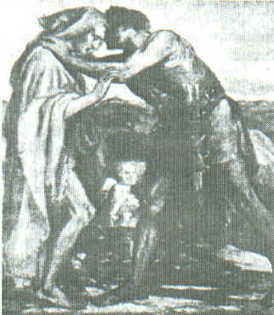
Jacob and Esau embrace
Jacob went on bowing himself to the ground seven times, until he came near to his brother.
But Esau ran to meet him, and embraced him, and fell on his neck and kissed him, and they wept.
Genesis 33:3-4
Jacob and Esau reconciled
Notes:
Jacob really humbled himself

Slide 17
Their conversation
Esau: “What do you mean by all this company which I met?”
Jacob: “To find favour in the sight of my lord.”
Esau: “I have enough, my brother; keep what you have for yourself.”
Jacob: “I pray you, if I have found favour in your sight, then accept my present from my hand; for truly to see your face is like seeing the face of God, with such favour you have received me. Accept, I pray you, my gift that is brought to you, because God has dealt graciously with me, and because I have enough.”
Genesis 33:8-11
Notes:
and it is a mark of Jacob’s greatness that he recognized it and made amends to Esau. Sacks

Slide 18
Jacob restores his mistake
He realises he was not a good younger brother
He understands that he was wrong to steal Esau’s blessing and hurt his older brother
So at the risk of his life he returns the blessing he stole
  He gives Esau gifts
  He bows down to his older brother 7 times
He becomes a good younger brother
  He becomes loveable
  He becomes worthy of respect

Slide 19
Jacob repents so that Esau can forgive him
Admits he committed a crime
  That he was wrong to steal Esau’s blessing
Accepts responsibility for what he did.
  Doesn’t give extenuating circumstances
Shows grief and acknowledges the harm done
Puts things right
Notes:
The perpetrator agrees the abuse happened.
The perpetrator accepts responsibility for the abuse.
The perpetrator shows grief and acknowledges the harm done.

Slide 20
Restoring the foundation of substance
For Jacob and Esau to fulfil the indemnity condition to remove the fallen nature, Esau needed to love Jacob, respect him as his mediator to God, obediently submit to Jacob’s directions, and finally, multiply goodness by inheriting goodness from the bearer of God’s blessing. EDP 183

Slide 21
Lasting foundation
Jacob established the pattern for the natural and voluntary subjugation of Satan by winning Esau’s heart and respect
It is the pattern followed later by Joseph, Moses, Jesus and Sun Myung Moon
Abraham’s family established the heavenly tradition
“God of Abraham, Isaac and Jacob” Three Great Kingships
Jacob achieved what neither Abraham nor Isaac accomplished: all his children stayed within the faith.
Jacob became a leader
Notes:
that he eventually achieved what neither Abraham nor Isaac accomplished: all his children stayed within the faith.

Slide 22
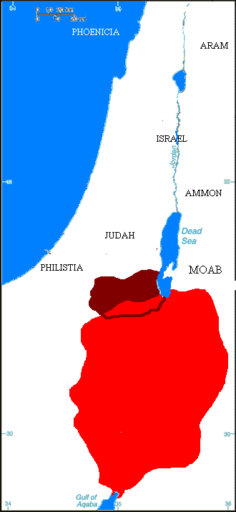
What happened next?
Jacob and Esau go separate ways
Meet up to bury Isaac
Jacob becomes ancestor of Hebrews
Esau becomes ancestor of Edomites
They were enemies
Eventually Edomites converted to Judaism
Edom

Slide 23
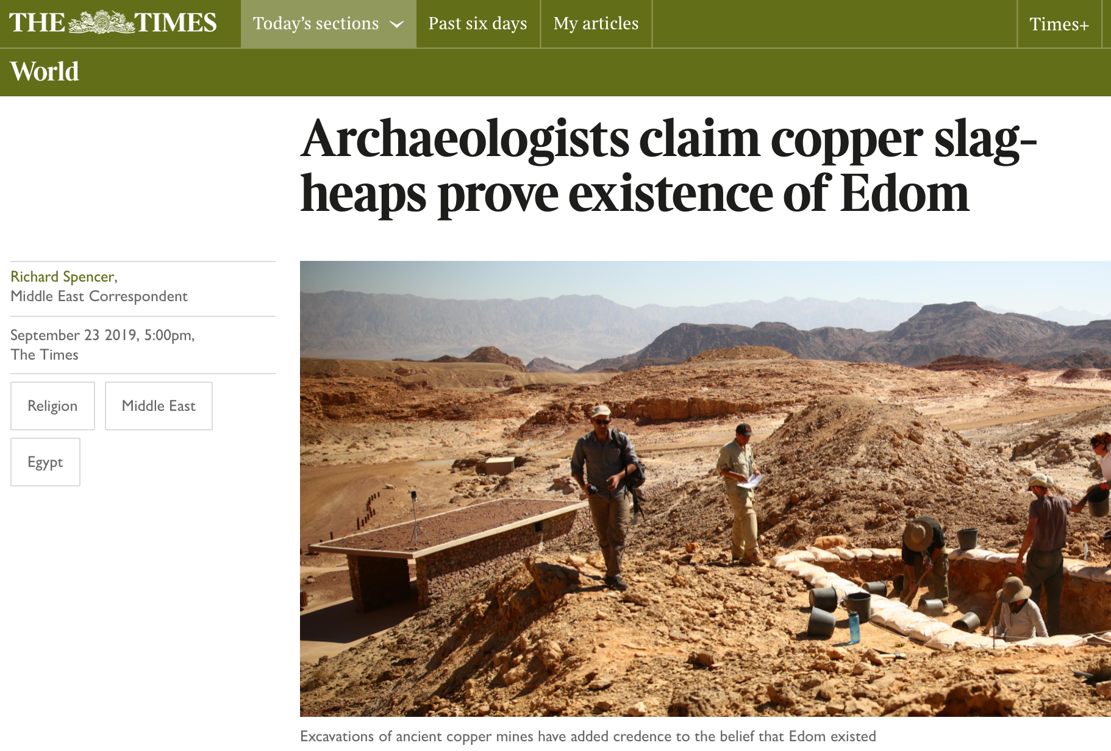

Slide 24
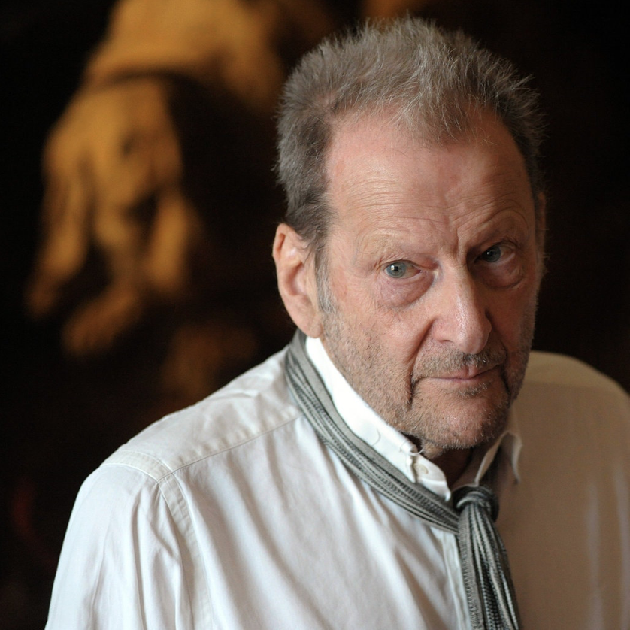
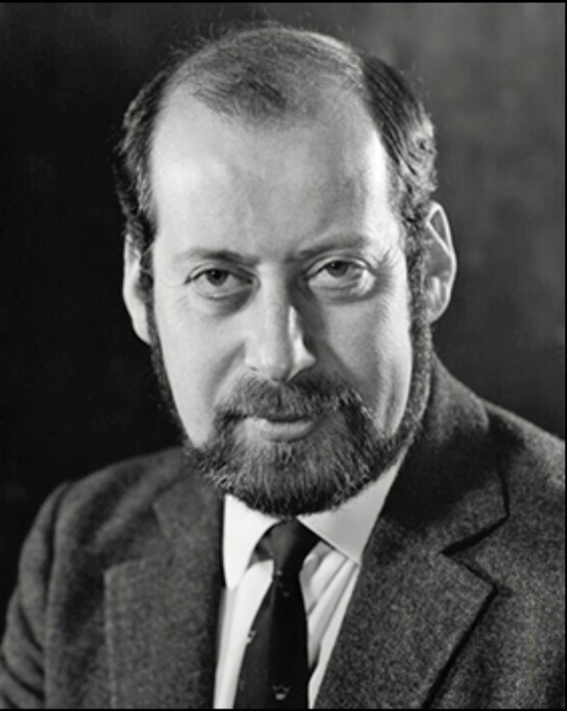
A tale of two brothers
Lucian Freud, whose 1995 painting Benefits Supervisor Sleeping set a world record price for a work by a living artist when it was sold last month for $33.6 million is said not to have spoken to his brother Clement, 84, in more than 50 years. Last week he was quoted as saying they would not exchange another word.
"Why on earth would I want to speak to him or see him again?" he said.
"Family is not important to me," he added. "It doesn't bother me in the slightest."
The origins of the rift between the pair, who are grandsons of Sigmund Freud, the psychoanalyst, are clouded in mystery.
Lucian Freud OM (1922-2011)
Sir Clement Freud (1924–2009)
Notes:
Lucian Michael Freud, OM CH[1] (/frɔɪd/; 8 December 1922 – 20 July 2011) was a British painter and draughtsman, specialising in figurative art, and is known as one of the foremost 20th-century portraitists. He was born in Berlin, the son of Jewish architect Ernst L. Freud and the grandson of Sigmund Freud. Freud got his first name "Lucian" from his mother in memory of the ancient writer Lucian of Samosata. His family moved to England in 1933 to escape the rise of Nazism. From 1942–43 he attended Goldsmiths College, London. He served at sea with the British Merchant Navy during the Second World War.
His early career as a painter was influenced by surrealism, but by the early 1950s his often stark and alienated paintings tended towards realism.[2] Freud was an intensely private and guarded man, and his paintings, completed over a 60-year career, are mostly of friends and family. They are generally sombre and thickly impastoed, often set in unsettling interiors and urban landscapes. The works are noted for their psychological penetration and often discomforting examination of the relationship between artist and model. Freud worked from life studies, and was known for asking for extended and punishing sittings from his models.
Sir Clement Raphael Freud (24 April 1924 – 15 April 2009)[1][2][3] was a British broadcaster, writer, politician and chef.
The grandson of Sigmund Freud and brother of Lucian Freud, he moved to the United Kingdom from Germany as a child and later worked as a prominent chef and food writer before becoming known to a wider audience as a television and radio personality. He was elected as a Liberal Member of Parliament in 1973, retaining his seat until 1987, when he received a knighthood.

Slide 25
7c. Restoring the relationship between Adam and the Archangel
Joseph and his brothers

Slide 26
Jacob’s family
Leah
Jacob
Rachel
Zilpah
Bilhah
Asher
Gad
8
Joseph
Benjamin
7
Simeon
11
12
2
Reuben
Levi
Dan
Napthali
1
3
5
6
Judah
4
Issachar
9
Zebulun
Dinah
10

