Slide 1
5. Restoring the Archangel-Eve-Adam relationship

Slide 2
What is restoration?
Restoration occurs when you find yourself in a similar position to Adam, Eve, the archangel, Cain or Abel etc.
And you have to face the same temptation to make the same mistake that they did and continue the pattern of fallen history
But you choose not to do so and instead of acting out of your fallen nature you act according to your original nature and follow your conscience. You break the cycle of abuse and pattern of fallen history

Slide 3
What needs to be restored?
Relationship between Archangel and Eve
  Men have inherited the archangelic nature to want to control and possess and have sexual relationship with women for their own pleasure and gratification. Lust, not love
    Droit du seigneur – ‘lord’s right’
    Sexual harassment and worse
  Women have inherited the tendency to be seduced by powerful men and to seduce

Slide 4
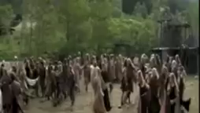

Slide 5
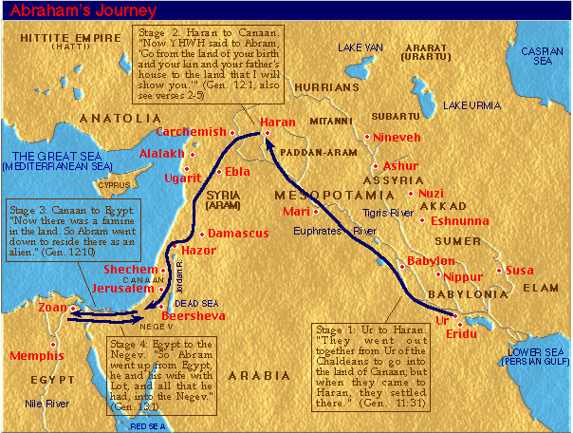
Abram’s journey
Notes:
Went with Terah to haran. Then after Terah died moved to Canaan

Slide 6
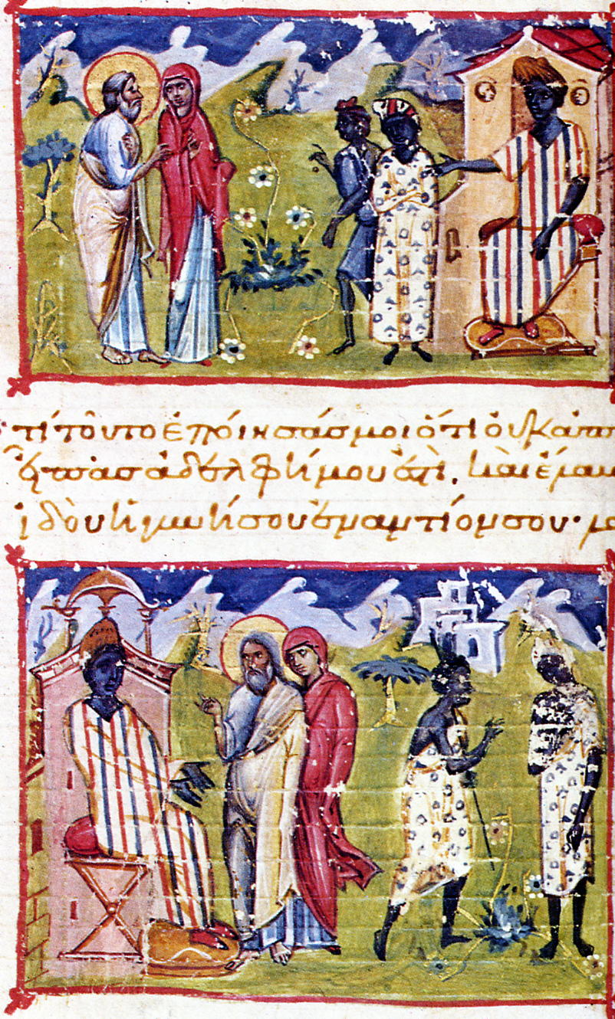
Abram, Sarah and Pharaoh
Now there was a famine in the land and so Abram went down to Egypt to stay there. When he was about to enter Egypt, he said to Sarai his wife, “I know that you are a woman beautiful in appearance, and when the Egyptians see you, they will say, ‘This is his wife.’ Then they will kill me, but they will let you live. Say you are my sister, that it may go well with me because of you, and that my life may be spared for your sake.” When Abram entered Egypt, the Egyptians saw that the woman was very beautiful. And when the princes of Pharaoh saw her, they praised her to Pharaoh. And the woman was taken into Pharaoh's house. And for her sake he dealt well with Abram.
Notes:
When a famine struck the land, Abram went down toward Egypt to live as an immigrant since the famine was so severe in the land. ¹¹ Just before he arrived in Egypt, he said to his wife Sarai, “I know you are a good-looking woman. ¹² When the Egyptians see you, they will say, ‘This is his wife,’ and they will kill me but let you live. ¹³ So tell them you are my sister so that they will treat me well for your sake, and I will survive because of you.”
¹⁴ When Abram entered Egypt, the Egyptians saw how beautiful his wife was. ¹⁵ When Pharaoh’s princes saw her, they praised her to Pharaoh; and the woman was taken into Pharaoh’s household. ¹⁶ Things went well for Abram because of her: he acquired flocks, cattle, male donkeys, men servants, women servants, female donkeys, and camels. ¹⁷ Then the Lord struck Pharaoh and his household with severe plagues because of Abram’s wife Sarai. ¹⁸ So Pharaoh summoned Abram and said, “What’s this you’ve done to me? Why didn’t you tell me she was your wife? ¹⁹ Why did you say, ‘She’s my sister,’ so that I made her my wife? Now, here’s your wife. Take her and go!” ²⁰ Pharaoh gave his men orders concerning Abram, and they expelled him with his wife and everything he had.

Slide 7
What is going on here?
Satan
Eve
Adam
Humanity
Creation
Notes:
Before the fall Adam and Eve were like brother and sister. Eve was more attracted to Lucifer who appeared sophisticated.

Slide 8
What is going on here?
Pharaoh
Sarah
Abraham
Lot, Hagar
Wealth
Notes:
Before the fall Adam and Eve were like brother and sister. Eve was more attracted to Lucifer who appeared sophisticated.

Slide 9
Sarah and Hagar
Sarai, Abram’s wife, hadn’t yet produced a child. She had an Egyptian maid named Hagar. Sarai said to Abram, “God has not seen fit to let me have a child. Sleep with my maid. Maybe I can get a family from her.” Abram agreed to do what Sarai said.
So Sarai, Abram’s wife, took her Egyptian maid Hagar and gave her to her husband Abram as a wife. Abram had been living ten years in Canaan when this took place. He slept with Hagar and she got pregnant. When Hagar learned she was pregnant, she looked down on her mistress.
Sarai told Abram, “It’s all your fault that I’m suffering this abuse. I put my maid in bed with you and the minute she knows she’s pregnant, she treats me like I’m nothing. May God decide which of us is right.”
“You decide,” said Abram. “Your maid is your business.”
Sarai was abusive to Hagar and Hagar ran away.

Slide 10
‘Listen to your wife’
Abraham was a hundred years old when his son Isaac was born. The baby grew and was weaned. Abraham threw a big party on the day Isaac was weaned.
One day Sarah saw the son that Hagar the Egyptian had borne to Abraham, poking fun at her son Isaac. She told Abraham, “Get rid of this slave woman and her son. No child of this slave is going to share inheritance with my son Isaac!”
The matter gave great pain to Abraham—after all, Ishmael was his son. But God spoke to Abraham, “Don’t feel badly about the boy and your maid. Do whatever Sarah tells you. Your descendants will come through Isaac. Regarding your maid’s son, be assured that I’ll also develop a great nation from him—he’s your son, too.”

Slide 11
Ishmael and Isaac
“The angel of the LORD found Hagar near a spring in the desert; it was the spring that is beside the road to Shur. . . . the well was called Beer Lahai Roi. Genesis 16:7,14
Isaac was living in the Negev. He had just come back from a visit to Beer Lahai Roi. Genesis 24:62
  Isaac had gone there to bring Hagar to Abraham so he could marry her
Abraham proceeded and took a wife whose name was Keturah. And she bore him sons . . . And while he was still alive he sent them away eastwards. Genesis 25:1
  This is Hagar but she is called Keturah because her deeds were so beautiful and after leaving Abraham she had no relationships with other men. (Rashi)
Abraham died . . . And his sons Isaac and Ishmael buried him. Genesis 25:8,9
  Ishmael repented and let Isaac walk ahead of him out of respect even though Ishmael was older (Rashi)
Notes:
In Genesis 21:1, we learn that Abraham remarried three years after the death of Sarah. Once his son Isaac was married off, Abraham, at age 140, married Keturah, who bore him six children.
But who exactly was Keturah and why did Abraham marry her? What pushed him to have six more children so late in life?
Rashi tells us that Keturah was one and the same as Hagar, whom Abraham had married more than 50 years prior (when he was 85 years of age), and who bore his firstborn, Ishmael.1
So why the name change? To teach us that she was pure and good like ketoret, the incense that was offered to G‑d on the altar in the Holy Temple.
You might recall that Hagar had been chased out of Abraham’s home when her son was misbehaving. For many years, she was away from Abraham and his influence.2 Yet during all their years apart, she never cohabited with another man and remained faithful and true to the ethics that Abraham taught.3 Hence, this was another reason for the name change: in Aramaic, keturah means “bound,” and Hagar remained connected to Abraham throughout all those years.4
But if Abraham had intended to remarry Hagar after Sarah died, why did he wait until Isaac married three years later?
Interestingly, Isaac was the matchmaker.5 Soon after his mother’s passing, he traveled to Hagar and brought her back to Abraham’s home. He obviously had positive feelings towards his stepmother and considered her worthy of remarrying his father after his own mother passed away.
Yet, Abraham chose to wait until Isaac was married before he himself remarried. From here the sages learn that one whose wife passes away and who has older children should ideally first see to it that his children are settled before he gets remarried.6
This still doesn’t explain why Abraham chose to get married and have children at age 140. Even in those days, 140 was old (Abraham passed away at 175 and is considered to have lived until a ripe, old age)!
Yet to Abraham, it was important to have many children. Why?
According to the Talmud, one very simple reason for having many children is that you don’t know which one will give you nachat.7 Obviously, Abraham had nachat and spiritual continuity through Isaac, so this most probably wasn’t his worry. So what other reason might he have had for remarrying and siring more children?
Simple. The first mitzvah that G‑d ever gave to mankind was to Adam and Eve immediately after their creation: “Be fruitful and multiply!” He repeated those same words to Noah and his family after the decimation of the Flood: Go have babies!
Overpopulation is not a worry for G‑d; it’s His desire that the world be full of human beings who are decent and good. The world is big enough for us all.
There is no greater act of service we can do than bestowing life onto another human being. The gift of life is truly the greatest gift of all. So while Abraham had already created a nation through Isaac, he still felt obligated to gift life to others.8
An idea that the Lubavitcher Rebbe spoke passionately about many times, especially during the ’80s, was bringing many children into the world. He saw this as a Divine endeavor and a source of tremendous blessing for the parents, the community and the world.
After World War II, the Ponevezher Rav, Rabbi Yosef Shlomo Kahneman, used to visit Miami annually to raise funds for his yeshivah. Rabbi Berel Wein, who was a congregational rabbi in Miami during that period, related this story:
One day, the Ponevezher Rav called me and asked me to arrange a meeting in my home with the younger couples affiliated with my congregation. I told him that I would do so, but I cautioned him that I did not think that he would raise much money from them. He gently told me that he was not going to speak to them about donations at all.
At that meeting, which was very well-attended, the Ponevezher Rav rose and said to them: “My beloved children, the souls of a million and a half Jewish children murdered in the Holocaust are floating in the air above us. Your task is to give those souls bodies to live in.”
On a personal note, I’m the oldest of 12 children, and both my parents come from large families, so I have over 200 first cousins! I can confidently say that big families are pure blessing. I pray that my wife and I should continue to be blessed with the incredible gift of bringing children into this world.
The Talmud says: “The son of David (Moshiach) will not arrive until all the souls in the treasury in heaven [which is referred to as guf] are brought into this world.”9
I’ll leave you with this final thought: You will never regret the kids you have, but too many people regret the ones they didn’t bring into this beautiful world.
1.
Based on the tradition of Rabbi Yehuda in Midrash Rabbah 61: 4. This is cited in the Zohar 132b as well.
2.
Abraham remarried her either 37 years or 27 years after she was chased out of his home (depending on two opinions regarding the age of Ishmael when he and his mother were banished from Abraham’s home).
3.
According to some opinions, she had returned to paganism when she moved back to her homeland, but not long after that she repented and returned to monotheism and the ways of Abraham.
4.
Rashbam (Rashi’s grandson) and others (like the Ibn Ezra) say that according to the simple meaning of the text, Keturah isn’t Hagar, but rather a different woman whom Abraham chose to marry. The Midrash Yalkut Shimoni (Job, Remez 904) has a fascinating take on the three wives of Abraham: “Sarah was the daughter of Shem, Keturah was the daughter of Japheth, and Hagar was the daughter of Ham.” In other words, Abraham married (and had children) from the three families of Noah.
5.
Rashi on Genesis 24:62.
6.
Yefei Toar and Rabbeinu Bechayei on Genesis 24:67.
7.
Talmud, Yevamot 62b.
8.
Another possible reason that Abraham remarried Hagar, based on the principle that the patriarchs kept the entire Torah before Sinai, was to fulfill the mitzvah of remarrying one’s divorcee as long as she didn’t marry someone else in the meantime, which as mentioned previously was a non-issue here due to Hagar’s celibacy over the many years they were separated. Not all opinions agree that this is a biblical mitzvah, but the Sefer HaChinuch, mitzvah 580, and the Tashbetz, part 3, section 9, opine that remarrying one’s divorcee is a biblical commandment. Rabbi Shmuel Vital (son of the famous Rabbi Chaim Vital) writes in B’er Mayim Chaim, ch. 80: There is no greater mitzvah than remarrying one’s ex-wife.
9.
Yevamot 62a.

Slide 12
6a. Restoring the Parent - Child relationship
A brief review of filial piety

Slide 13
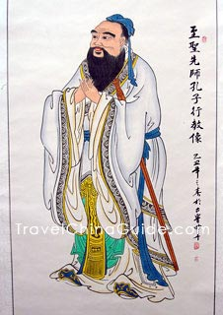
Confucius and filial piety
Chinese philosopher, scholar and social reformer
551 BC – 479 BC
Very little understanding of God
Focused on ethics and relationships in the family

Slide 14
What is filial piety?
Filial piety means to be good to one's parents; to take care of one's parents; to engage in good conduct not just towards parents but also outside the home so as to bring a good name to one's parents and ancestors; to perform the duties of one's job well so as to obtain the material means to support parents as well as carry out sacrifices to the ancestors; not be rebellious; show love, respect and support; display courtesy; ensure male heirs, uphold fraternity among brothers; wisely advise one's parents, including dissuading them from moral unrighteousness; display sorrow for their sickness and death; and carry out sacrifices after their death.

Slide 15
How does Father understand filial piety?
What is the centre and the foundation of the universe? I reached the realm of mystery and prayed to God and asked this question. And God answered, “it is the relationship between a father and his children”, in other words the father-son relationship. People who do not understand might think we are talking about relationship of our fathers and mothers, sons and daughters, but we mean the relationship of God and man. True Father (19-160)
But ordinary people think it is about their own parents. They think it is about their own father and mother, centring on moral principles. It is wrong. When we look at it from a solid point of view, the conclusion is that the place where God and man becomes one centring on the deep heart of the father-son relationship is the centre of the universe. True Father (48-209)
Notes:
Love God as devoutly as love parents

Slide 16
7b. Restoring the Parent - Child relationship
Noah’s family

Slide 17
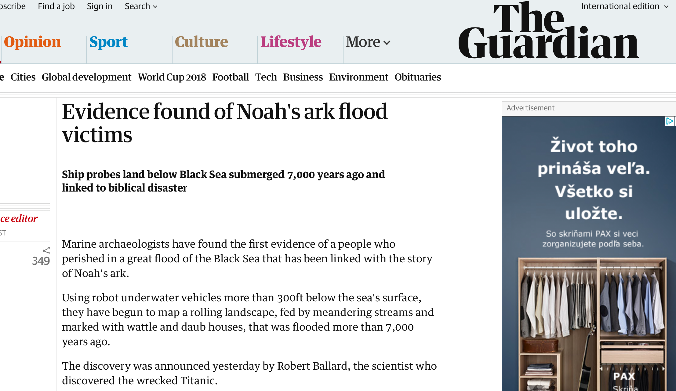
Did the flood happen?
Notes:
ictims
Ship probes land below Black Sea submerged 7,000 years ago and linked to biblical disaster
Tim Radford, science editor
Thu 14 Sep 2000 02.19 BSTFirst published on Thu 14 Sep 2000 02.19 BST
Shares
349
Marine archaeologists have found the first evidence of a people who perished in a great flood of the Black Sea that has been linked with the story of Noah's ark.
Using robot underwater vehicles more than 300ft below the sea's surface, they have begun to map a rolling landscape, fed by meandering streams and marked with wattle and daub houses, that was flooded more than 7,000 years ago.
The discovery was announced yesterday by Robert Ballard, the scientist who discovered the wrecked Titanic.
The Black Sea was once a freshwater lake, well below sea level. About 7,000 years ago, according to geological evidence, the rising Mediterranean sea pushed a channel through what is now the Bosphorus, and then seawater poured in at about 200 times the volume of Niagara Falls. The Black Sea would have widened at the rate of a mile a day, submerging the original shoreline under hundreds of feet of salty water.
Advertisement
Nearly 100,000 square miles were inundated. Sea shells on the beaches of the modern Black Sea are of marine origin, but deep below the surface there are layers of shells of freshwater molluscs, mute witnesses to the shoreline of the ancient lake.
There are many myths concerning a great flood in the region. There was a first mention in the Epic of Gilgamesh, the Babylonian work. The Romans and Greeks had the legend of Deucalion and Pyrrha, who saved their children and animals by floating away in a giant box. The Hebrew book of Genesis most famously tells the story of Noah, who found grace in the eyes of the Lord, when all around him were wicked. Noah was warned of a forthcoming flood, and built a huge "ark" to hold his family and all the animals in pairs. Noah survived when all perished. Tradition has it that his ark came to rest on the slopes of Mount Ararat in Turkey.
Dr Ballard began exploring the Black Sea in the Hull registered ship Northern Horizon, and used side-scanning sonar to look for interesting shapes on the seabed over a 200-sq-mile area, 12 miles off the Turkish coast, near Sinop.
The instruments detected "targets" worth a closer look, so video cameras mounted on underwater robot submarines were put to use. "We found two ancient ships last night," said Dr Ballard speaking by phone from his research vessel yesterday. "What we were trying to do in our wildest dreams - which is exactly what happened - was find a structure that was evidence, not a sunken ship, not trash and not geology, but characteristic of human habitation."
They found it. Above an area submerged too deeply for human divers, the sonar instruments revealed details of the landscape. On September 9 they sent robot scouts down to objects which looked like beams and branches, debris that might have been the stiffening for wattle and daub homes.
They found a rectangular area up to 12ft by 25 ft, over which an ancient mud and wooden house had collapsed, and they found tools of highly polished stone, together with fragments of ceramics.
"What we are looking at is a culture that is definitely thousands of years old," said Fred Hiebert, an archaeologist at the University of Pennsylvania, who was also on the ship. "The flood is an event that is geologically known, and for us to find a structure in 150 metres of water means that these people were definitely living there before it flooded, so it is pre-Greek. It is a different world and it deserves a great deal of attention and years of study to help us truly identify who these people were."
Dr Ballard is perhaps oceanography's answer to Indiana Jones. As a marine scientist in the US, two decades ago, he took part in the dramatic discovery of communities of strange creatures living in submarine volcanic vents two miles below the ocean surface. He also found the submerged liner Titanic, and tracked the wreck of the German battleship, Bismarck, and the fleet which the US navy lost off Guadalcanal in the Pacific.
He formed his own exploration institute in Mystic, Connecticut, before going on to lead National Geographic expeditions to probe the mud of the Mediterranean and the Black Sea for lost treasures - and now a lost world.
But he does not claim to have found the landscape of Noah. " We really cannot say in any way, shape or form that this is the biblical flood. All we can say is that there has been a major flood, that people were living here when it happened. We prefer to stick with the facts -and who knows where those facts will lead us."

Slide 18
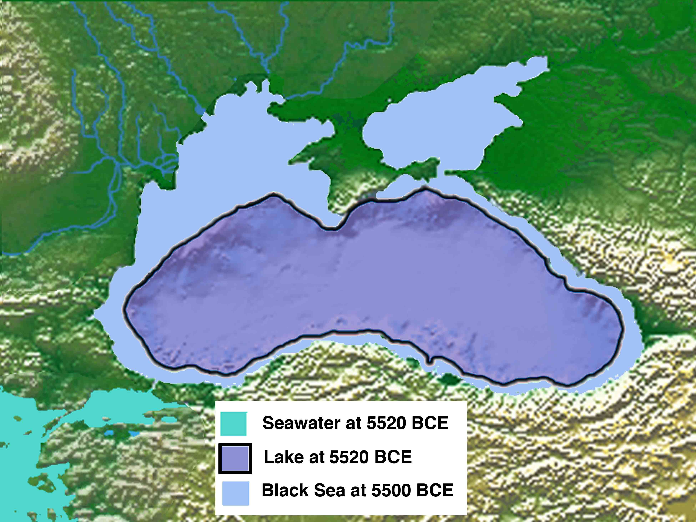

Slide 19
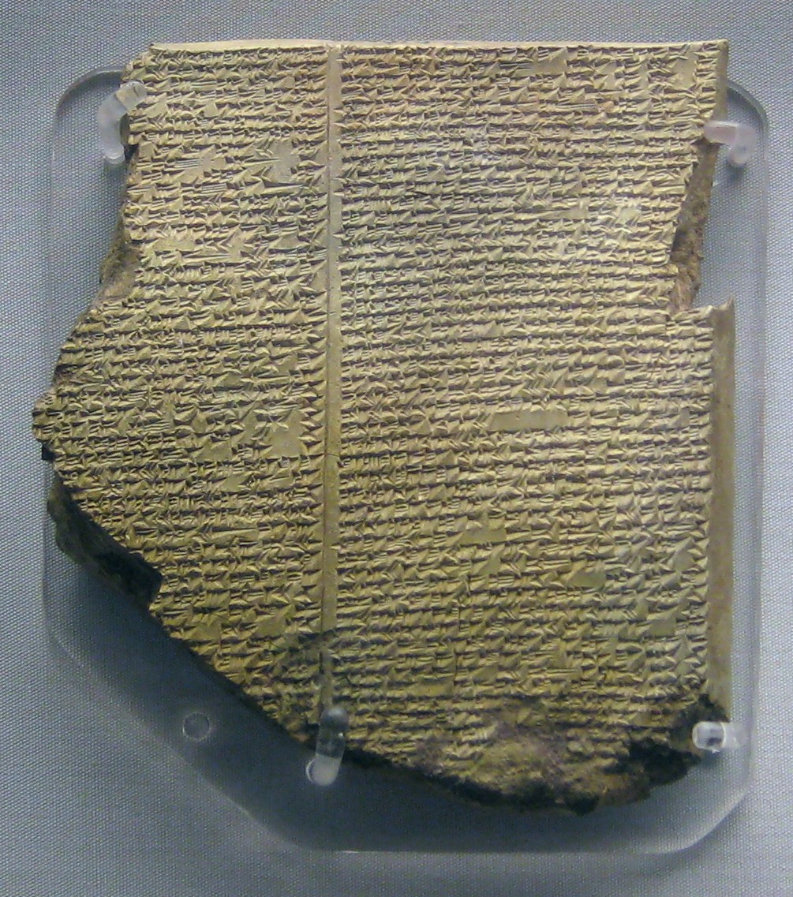
Gilgamesh epic
Oldest surviving literature
2100 BC
Mesopotamia
Cuneiform
Akkadian language
Why did the gods do it?
They regretted creating people and decide to drown them. One god has pity and betrays their secret to king who tricks people into building the boat for him
Notes:
The story Utnapishtim tells Gilgamesh: The gods had grown to regret having created the human race. They decided to erase the human slate and start over, and a flood seemed like a good way to do that. They plan afterward to create a new, improved human race. One god, however, betrays their secret — Ea, the cleverest of them, went to the palace of Utnapishtim and whispered through the flimsy woven-reed wall not only the destruction the gods have planned, but also a way that the king could save himself and his family.
Ea told the king that he has a choice between clinging to his possessions and saving his life. Since Utnapishtim, of course, wanted to live, the god told him how to build a huge boat that would survive the flood, big enough to contain animals and seeds to replenish the Earth after all other life has been destroyed. Ea also instructed him how to get his subjects to help him build the boat without their asking pesky questions about it, such as, “Why do you need a boat so big that it won’t actually fit in the river?” He must say that the god Enlil had grown to hate him, so for the good of the city he must leave.
So the people of the city all pitched in to get the boat finished ASAP, and then they celebrated a great festival to send off the king and his household. (Utnapishtim, having been instructed in deception by the god Ea, disobeyed the god in one matter: in addition to storing the seed of all living things in the boat, he also managed to sneak aboard all his gold and silver.) After the people got good and drunk on their feasting, everyone pulled together to push this gigantic boat into the Euphrates. Then the king and his family climbed aboard and a craftsman sealed them in. And then came the great deluge.
Utnapishtim and his wife were given the gift of immortality — a gift that, eventually, they would have been glad to return.
Seven days of terrible storms ensued — so dark and fierce that it frightened the gods themselves. Utnapishtim and his household were safely sealed inside their boat. A good thing, too, because every living thing except those on the boat perished in the ensuing flood. After seven days, the storm abated and Utnapishtim sent out a dove to see if it could find a place to alight. But the waters had not yet receded far enough to expose the land, so the bird returned. Later, he tried again with a swallow, but got the same result. Finally, he sent out a raven, which did not return — the water was going down and bare land had reappeared.
After his boat lodged at the top of a tall mountain and the flood waters went down, Utnapishtim let his animals loose and sacrificed a sheep in thanksgiving for his survival. The fragrance of his sacrifice attracted the attention of the gods, who had grown hungry since they killed off all the worshipers who used to sacrifice to them as well as all the animals needed for burnt offerings. The gods were glad that someone survived to offer them sacrifice — all except Enlil, who grew very angry, realizing that if someone had survived the flood it could only be because Ea had warned him.
Ea deflected attention from himself by accusing Enlil of using overkill to deal with the human problem — why did he have to destroy everyone? Why couldn’t he be satisfied with sending plagues and famines, or ravenous wolves and lions, to keep mortals in check?
Enlil responded to this remonstration by relenting in his anger and conferring immortality on the flood’s survivors, Utnapishtim and his wife. Then he sent them to a remote spot to live, which is where Gilgamesh finds them, centuries later.

Slide 20
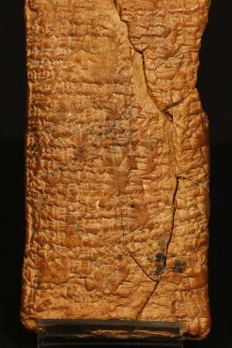
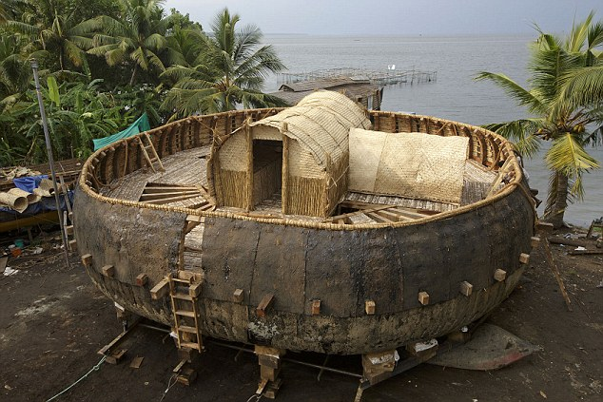
Ark tablet
Approx. 1900 BC, found in Iraq 1940s, Deciphered British Museum 2008
Notes:
The Ark Tablet, like many documents of its period, is designed to fit comfortably in the reader’s hand; it is much the same size and weight as a contemporary mobile phone.
The tablet was written during the Old Babylonian period, broadly 1900–1700BC. The document was not dated by the scribe, but from the shape and appearance of the tablet itself, the character and composition of the cuneiform and the grammatical forms and usages, we can be sure that this is the period in which it was written. It was composed in Semitic Babylonian (Akkadian) in a literary style. The hand is neat and that of a fully trained cuneiform scribe. The text has been written out very ably without error and for a specific purpose; it is certainly not a school practice tablet from a beginner, or anything of that kind. It measures 11.5cm by 6cm and contains exactly 60 lines.
The front (or obverse) is in fine condition and virtually everything can be read. The back (or reverse) is damaged in the middle of most lines, with the result that not everything there can be read now, although much of substantial importance can be deciphered; some parts are simply missing altogether and other parts are very badly worn.
The most remarkable feature provided by the Ark Tablet is that the lifeboat built by Atra-hasıs – the Noah-like hero who receives his instructions from the god Enki – was definitely, unambiguously round. “Draw out the boat that you will make,” he is instructed, “on a circular plan.”
Confronting the fact comes, initially, as a shock. For every­one knows what Noah’s Ark, the real Ark, looks like: a squat wooden affair with prow and stern and a little house in the middle, not to mention a gangplank and several windows. No respectable child’s nursery at one time was without one, with its chewed pairs of animals.
The tenacity of the conventional Western vision of the Ark is remarkable, and remains, at least to me, inexplicable, for where did it come from in the first place? The only “evidence” that artists or toymakers had before them was the description in the Old Testament where Noah’s Ark is altogether a different proposition. (Indeed, the key words in the description of the Ark are used nowhere else in the Bible, and no one knows what language they are written in.)
As I stared into space with the tablet precariously poised over the desk, the idea of a round ark began to make sense. A truly round boat would be a coracle, and they certainly had coracles in ancient Mesopotamia; a coracle is exceptionally buoyant and would never sink, and if it happened to be difficult to steer or stop from going around and round that would not matter, because all it had to do was keep its contents safe and dry until the waters receded.
A Twenties photograph of Iraqi coracle-builders
Coracles, in their unassuming way, have played a crucial and long-running role in man’s relationship with rivers. They belong, like dugout canoes and rafts, to the most practical stratum of invention: natural resources giving rise to simple solutions that can hardly be improved upon. The reed coracle is effectively a large basket, sealed with bitumen to prevent waterlogging. Its construction is somehow natural to riverine communities; coracles from India and Iraq, Tibet and Wales are close cousins. These traditional craft remained in use, unchanged, on the rivers of Mesopotamia into the first half of the last century.
Before the arrival of the Ark Tablet, hard facts for the boatbuilder were sparse. We have had to wait until now for the statistics of shape, size and dimensions, as well as everything to do with the matter of waterproofing. The information that has now become available could be turned into a printed set of specifications sufficient for any would-be ark-builder today.
Enki tells Atra-hasıs in a very practical way how to get his boat started; he is to draw out a plan of the round boat on the ground. The simplest way to do this would have been with a peg and a long string. The stage is thus set for building the world’s largest coracle, with a base area of 38,750sq ft, and a diameter of, near enough, 230ft. It works out to be the size of a Babylonian “field”, what we would call an acre. The walls, at about 20ft, would effectively inhibit an upright male giraffe from looking over at us.
Atra-hasıs’s coracle was to be made of rope, coiled into a gigantic basket. This rope was made of palm fibre, and vast quantities of it were going to be needed. Coiling the rope and weaving between the rows eventually produces a giant round floppy basket, which is then stiffened with a set of J-shaped wooden ribs. Stanchions, mentioned in lines 15-16, were a crucial element in the Ark’s construction and an innovation in response to Atra-hasıs’s special requirements, for they allow the introduction of an upper deck.
These stanchions could be placed in diverse arrangements; set flat on the interlocked square ends of the ribs, they would facilitate subdivision of the lower floor space into suitable areas for bulky or fatally incompatible animals. One striking peculiarity of Atra-hasıs’s reports is that he doesn’t mention either the deck or the roof explicitly, but within the specifications both deck and roof are implicit. (In line 45 Atra-hasıs goes up to the roof to pray.)
The next stage is crucial: the application of bitumen for waterproofing, inside and out, a job to be taken very seriously considering the load and the likely weather conditions. Fortunately, bitumen bubbled out of the Mesopotamian ground in an unending, benevolent supply. Atra-hasıs devotes 20 of his 60 lines to precise details about waterproofing his boat. It is just one of the many remarkable aspects of the Ark Tablet that we are thereby given the most complete account of caulking a boat to have come down to us from antiquity.
Johan Huibers' full-scale model of Noah's Ark was built according to the instructions given in the Bible (EPA/Ed Oudenaarden)
Boat-building notwithstanding, one cannot help but worry about the various Noahs, Babylonian and otherwise, and all their animals: the thought of rounding them up, marching them up the gangplank and ensuring good behaviour all round for a voyage of unknown length…
At first sight, the very broken lines 51–52 of the Ark Tablet looked unpromising. The surface, if not completely lost, is badly abraded in this part of the tablet. I needed, then, to bring every sophisticated technique of decipherment into play: polishing the magnifying glass, holding it steady, repeatedly moving the tablet under the light to get the slightest shadow of a worn-out wedge or two. Eventually the sign traces in line 51 could be seen to be “and the wild animal[s of the st]ep[pe]”.
What gave me the biggest shock in 44 years of grappling with cuneiform tablets was, however, what came next. My best shot at the first two signs beginning line 52 came up with “sa” and “na”, both incompletely preserved. On looking unhopefully for words beginning “sana” in the Chicago Assyrian Dictionary, I found the following entry and nearly fell off my chair as a result of the words: “sana (or sanâ) adv. Two each, two by two.”
This is a very rare word among all our texts – when the dictionary was published there had only been two occurrences. To me, it is the world’s most beautiful dictionary definition.
For the first time we learn that the Babylonian animals, like those of Noah, went in two by two, a completely unsuspected Babylonian tradition that draws us ever closer to the familiar narrative of the Bible. (Another interesting matter: the Babylonian flood story in cuneiform is 1,000 years older than the Book of Genesis in Hebrew, but reading the two accounts together demonstrates their close, literary relationship. No firm explanation of how this might have really come about has previously been offered, but study of the circumstances in which the Judaeans exiled to Babylon by Nebuchadnezzar II found themselves answers many crucial questions.)
There is a further consideration raised by these two lines in the Ark Tablet: they only mention wild animals. I imagine domestic livestock might well be taken for granted, especially if some of the animals were going to be part of their own food chain.
Today the question of Noah’s animals is no longer a preoccupation of scientific inquiry, but there was a time when serious scholars, especially the great polymath Athanasius Kircher (c1601–80), thought a good deal about them, just when knowledge of natural history was on the increase.
Kircher’s Ark taxonomy ran to only about 50 pairs of animals, leaving him to conclude that space inside was not such a difficulty. He developed the explanation that Noah had rescued all the animals that then existed, and that the subsequent profusion of different species in the world resulted from postdiluvian adaptation, or interbreeding among the Ark species; so that giraffes, for example, were produced after the Flood by camel and leopard parents.
The relationship between Enki and Atra-hasıs is conventionally portrayed as that between master and servant. If Atra-hasıs was not a king but a private citizen, this does raise the question of the grounds on which these “proto-Noahs” were selected to fulfil their great task. It is not evident that either was an obvious choice as, say, a famous boatbuilder. There is some indication of temple connections, but nothing to indicate that the hero was actually a member of the priesthood. Perhaps the selection was on the grounds that what was needed was a fine, upright individual who would listen to divine orders and carry them out to the full whatever his private misgivings, but we are not told.
In each case the right man seems to have been offered the job. All the stories agree that the boat, whatever its shape, was successfully built, and that human and animal life was safely preserved so that the world could go on. A story that recommends foresight and planning in order to ensure that outcome has lost none of its resonance.

Slide 21
In Genesis why did God ‘do it’?
The Lord saw that humanity had become thoroughly evil on the earth and that every idea their minds thought up was always completely evil. The Lord regretted making human beings on the earth, and he was heartbroken.
In God’s sight, the earth had become corrupt and was filled with violence. God saw that the earth was corrupt, because all creatures behaved corruptly on the earth.
God said to Noah, “The end has come for all creatures, since they have filled the earth with violence.” Genesis 6:5-7; 11-13
Notes:
People hurt -> angry -> violence. Why people get hurt? What gets hurt? Heart. How? Love gone wrong

Slide 22
Noah’s family = Adam’s family
Adam
Eve
8 members
Cain
Abel
Seth
1600 years
10 generations
Noah
Naamah
8 members
Japeth
Shem
Ham
Notes:
For example, Noah was 500 years old when Japheth, the first of his sons, was born (Genesis 5:32). Yet Noah’s second son, Shem, had his first son two years after the Flood, when he was 100 (Genesis 11:10).2 This means that Shem was 98 years old when the Flood came, and it also means that Shem was born when Noah was 502 years old. So for Noah to begin having children at 500 means that Japheth was indeed the older brother, as per Genesis 10:21, being born when Noah was 500. Ham is mentioned as the youngest of Noah (Genesis 9:24).
Shem is often listed first (e.g., Genesis 6:10, 7:13) due to importance much as Abraham is listed first; yet Shem was not the oldest. From the lineage of Shem and Abraham came Christ.
Naamah - name Noah’s wife
The Persian historian Muhammad ibn Jarir al-Tabari (c. 915) recounts that Japheth's wife was Arbasisah, daughter of Marazil, son of al-Darmasil, son of Mehujael, son of Enoch, son of Cain; that Ham's wife was Naḥlab, daughter of Marib, another son of al-Darmasil; and that Shem's wife was Ṣalib, daughter of Batawil, another son of Mehujael. He says Noah's wife was Amzurah, daughter of Barakil, another son of Mehujael.
10 generations. 10 represents unity. 10 gens to get unity with God’s will. After 10 gens world should be a good place for God to be able to start working again. However by time of Noah world very sinful. Satan invaded. Therefore start all over again to restore.
40 days flood judgement to restore 1600 years invaded by Satan

Slide 23
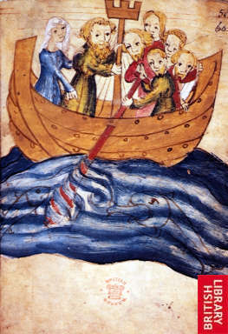
Restoring the foundation of faith
Noah was a righteous man, blameless among the people of his time, and he walked faithfully with God. Genesis 6:9
  Judge people according to their era
Built the Ark
120 years preaching
Time period - 40 days flood
Noah’s family to purify themselves and separate from Satan
God said, “You [Noah] shall come into the ark, you, your sons, your wife, and your sons’ wives.” Genesis 6:18
Noah told his family not to have sexual relations during flood judgment
Notes:
Abraham was not a conventional leader. He did not rule a nation. There was as yet no nation for him to lead. But he was the role model of leadership as Judaism understands it. He took responsibility. He acted; he didn’t wait for others to act. Of Noah, the Torah says, “he walked with God” (Gen. 6:9). But to Abraham, God says, “Walk before Me,” (Gen. 17:1), meaning: be a leader. Walk ahead. Take personal responsibility. Take moral responsibility. Take collective responsibility.
Righteous but not a leader.
Noah preserved his virtue by separating himself from his environment. Stayed sane
When bad things are happening in society, when corruption, violence and injustice prevail it is our duty to register a protest even if it is unlikely to have any effect. That is what moral integrity demands. Silence may be taken as consent. Prophetic voice. Speak to people even if they won’t listen.
Talmud says 120 years of preaching while building the ark. But people didn’t listen. God wanted to save others. Noah had dream. Sensed flood coming. God often warns about disasters but people usually ignore
Noah’s family represented Adam’s family
Purpose of the flood to eliminate sinful humanity.
10 – unity – 10 generations to bring humanity back into unity with his will. Each gen 4 PF.
Restore number 40 (10 times 4)(10 generations of 4 position foundation which were lost to Satan)
Went in as men and women - living separate quarters. No conjugal relations.
Noah didn’t argue with God about flood.
History of Love
Based on the teachings of the Lubavitcher Rebbe
Courtesy of MeaningfulLife.com
Man, by nature, is a selfish creature. Even in his relationships with others he tends to focus primarily on himself or, at most, on his self-colored perception of his fellow. "Love" is the endeavor to transcend this intrinsic selfishness and truly relate to one's fellow, to be sensitive to and devoted to his/her needs as an individual distinct of oneself and one's own stake in the relationship.
And yet, when the Torah speaks of the mitzvah (Divine commandment) to "Love your fellow as yourself" it does so in the context of man's duty to influence, and even change, the behavior and nature of his fellow man. In Leviticus 19 (verses 18-19), the Torah commands:
Do not hate your brother in your heart; repeatedly rebuke your fellow, and do not attribute sin to him. Do not take revenge, or harbor hatred toward your people, and love your fellow as yourself; I am G-d.
As the commentaries explain, there are two possible reactions a person can have toward a fellow who has wronged him, or whom he sees behaving in a morally deficient manner: 1) he can despise him in his heart, regarding him as a "sinner," and perhaps even persecute him for his "sins"; 2) he can rebuke him in the effort to convince him of the folly of his ways and seek to influence him to change them. The path of love, says the Torah, is not to to "hate your brother in your heart" but to "repeatedly rebuke" him and seek to better him.
Obviously, the desire to influence is consistent with the idea of love. No one would stand by as a loved one suffers hunger or is threatened by violence; no less so, if one sees someone he loves suffering from spiritual malnutrition or moral blindness, he will make every effort to reach out to him, to enlighten him, to offer guidance and assistance. But this aspect of loving behavior carries an inherent paradox. On the one hand, the endeavor to influence and change implies a departure from self and concern with the well-being of the other. On the other hand, it implies a seemingly selfish view of the other: a rejection of the other as he is and a desire to impose one's own perception of what is good for him upon him.
Four Biblical Prototypes
An exploration of the history of humanity, as recounted in the Torah, reveals four figures who personified four different points of reference on the relationship between self and fellow.
Each of these individuals was considered the most righteous of his generation. Thus, their lives can be seen to reflect four stages in the spiritual development of humanity -- four stages in the movement from an instinctive selfhood toward the complete abnegation of self and self-interest in relating to others. Our examination of this process will also shed light on the acceptance/non-acceptance dilemma inherent in the love relationship.
The first of these four outstanding individuals was Enoch, a great-great-great-great-grandson of Adam, who was born in the year 622 from creation (3139 BCE). By his time, humanity had abandoned the One G-d of their fathers and had succumbed to idolatry and pagan perversity. Only Enoch still "walked with G-d."
But Enoch's righteousness was wholly selfish: he was preoccupied only with the refinement and perfection of his own spiritual self. The Midrash even relates that, for many years, he disassociated himself from his corrupt generation and secluded himself in a cave.
Not only did Enoch fail to have a lasting impact on his society, but he was ultimately in danger of being influenced by their corrupt behavior. This is why Enoch died at the "tender young age" of 365 (compared with the 800 and 900-year life spans of his contemporaries): "G-d took him to Himself" before his time, lest the only righteous man of the generation also be lost.
For such is the relationship of an individual with his environment: there is no sustained equilibrium. Where there is contact there is a flow, in one direction or the other; one either influences his society or is influenced by it.
The 120-Year Failure
Several generations later we encounter another righteous man in a corrupt generation: Noah, builder of the ark and regenerator of humanity after the Flood.
In Noah, we find the first stirrings of a departure from self to improve and rehabilitate one's fallen fellow. In the year 1536 from creation (2225 BCE) G-d told Noah that "the end of all flesh has come before me, for the earth is filled with violence" and that He therefore intends to "bring a deluge of water upon the earth, to destroy all flesh" and start anew with Noah and his family. Noah is instructed to build an ark so that they may survive the Flood. Our sages relate that Noah worked on the ark's construction a full one hundred and twenty years; all this time, he called out to his generation to mend its ways and avoid catastrophe.
However, the Zohar criticizes Noah for the fact that, despite his efforts, he did not pray for the salvation of his generation, unlike Abraham and Moses who pleaded with G-d to spare the wicked. This implies that, ultimately, it did not matter to Noah what became of them. Had he truly cared, he would not have sufficed with doing his best to bring them to repent but would have implored the Almighty to repeal His decree of destruction -- just as one who is personally threatened would never say, "Well, I did my best to save myself," and leave it at that, but would beseech G-d to help him.
In other words, Noah's involvement with others was limited to his sense of what he ought to do for them, as opposed to a true concern for their well-being. His "self" had sufficiently broadened to include the imperative to act for the sake of another, recognizing that the lack of a "social conscience" is a defect in one's own character; but he fell short of transcending the self to care for others beyond the consideration of his own righteousness.
This also explains a curious aspect of Noah's efforts to reach out to his generation. When the Flood came, Noah and his family entered the ark -- alone. His 120-year campaign yielded not a single baal teshuvah (repentant)! Perhaps public relations was never Noah's strong point, but how are we to explain the fact that, in all this time, he failed to win over a single individual?
But in order to influence others, one's motives must be pure; in the words of our sages, "Words that come from the heart enter the heart." Deep down, a person will always sense whether you truly have his interests at heart, or you're filling a need of your own by seeking to change him. If your work to enlighten your fellow stems from a desire to "do the right thing" -- to observe the mitzvot to "love your fellow as yourself" and "rebuke your fellow" -- but without really caring about the result, your call will be met with scant response. The echo of personal motive, be it the most laudable of personal motives, will be sensed, if only subconsciously, by the object of your efforts, and will ultimately put him off.

Slide 24
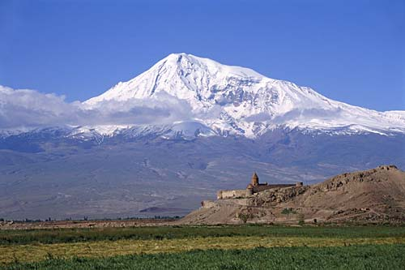
Covenant with Noah
God said to Noah, “Go forth from the ark, you and your wife, and your sons and your sons’ wives with you.”
Genesis 8:15
Noah built an altar to the Lord and offered burnt offerings on the altar.
And God blessed Noah and his sons, and said to them, “Be fruitful and multiply, and fill the earth.”
Genesis 8:20, 9:1
Mount Ararat
Notes:
Noah: The First Covenant in Tanakh
Of the many profound lessons that Parashat Noah teaches us about relationships, I’d like to focus on the one we learn from the covenant, the berit, that God makes with Noah in the wake of the flood. A covenant is, fundamentally, a record of the terms of a relationship. Reading the terms of a covenant can teach us about the components and terms of that relationship. This is the first covenant that appears in Tanakh and its function is self-restraint in the name of sustaining and preserving relationship. This covenant presents a model: Any successful set of relationships is predicated on knowing one’s weaknesses and putting systems in place to deal with one’s own limitations.
As the Great Flood’s waters recede, and Noah, his household, and all of the animals emerge from the ark, God makes a covenant with humanity. What does this covenant mean and why is it necessary for Noah’s return to the world? In order to explore these essential questions, we first need to focus our attention on one particular moment that precedes the covenant’s establishment. Simultaneous with the emergence from the ark, “God said to Himself, I will no longer curse the earth on account of humanity for the inclination of a person’s heart is evil from their youth. And I will no longer smite all that lives as I have done. For as long as the earth exists, sowing and reaping, cold and heat, summer and winter, night and day will never cease” (Genesis 8:21-22). It seems that God promises Himself that He will not bring another flood on the earth!
In order to understand the covenant itself, we need to understand this prefatory statement. I would like to draw your attention to four salient components of these verses: the manner of speech, the object of the statement, its content, and the challenge that the statement presents.
1) First let’s turn our attention to how God speaks. The language that the verse uses to describe God’s speech is “to His heart,” like an internal monologue.
You care about Israel, peoplehood, and vibrant, ethical Jewish communities. We do too.
JOIN OUR EMAIL LIST FOR MORE HARTMAN IDEAS
2) Second, the objects of God’s statement are the earth and “all living.” God’s speech is directed to Nature. Granted, people are included in “all living,” but God is not speaking regarding humanity specifically.
3) Thirdly, the content of God’s speech is made up of a number of different components: the earth will no longer be cursed, God will no longer kill His creatures, and the laws of nature will not be abrogated, neither the cycle of the seasons, nor the pattern of day and night. One aspect sticks out—this is a shift from the past. In the past God could or would alter the course of nature; this is a decision regarding the future that is discontinuous with the past.
4) Lastly, humanity is not the main object of God’s statement, but humanity provides the major challenge to God’s ability to execute and keep His word. Humanity, due to the evil embedded in its heart, is likely to act in a way that invites cursing and destruction. Nevertheless, God commits not to curse or destroy the earth. God’s resolution is not contingent on humanity’s actions.
In the continuation of the parashah, we see the more famous covenant that God makes with humanity and the world. These second set of verses have similar content, but an entirely different presentation. Let’s examine these two sets of verses:
God said to Himself:
I will no longer curse the earth on account of humanity for the inclination of a person’s heart is evil from their youth. And I will no longer smite all that lives as I have done. For as long as the earth exists, sowing and reaping, cold and heat, summer and winter, night and day will never cease.
God said to Noah and to his sons with him:
I now establish My covenant with you and your offspring after you, and with every living thing that is with you—birds, cattle, and every wild beast as well—all that have come out of the ark, every living thing on earth. I will maintain My covenant with you:
No longer shall all flesh be cut off by the waters of a flood, and no longer shall there be a flood to destroy the earth.
This is the sign of the covenant that I set between Me and you, and every living creature with you, for all ages to come. I have set My bow in the clouds, and it shall serve as a sign of the covenant between Me and the earth.
Let’s compare these two sets of verses, using the four components that we identified: the manner of speech, the object of the statement, its content, and the challenge that the statement presents:
1) Firstly, one of the most striking differences between these two sets of verses is that it transitions from God’s speaking to Himself, “to His heart,” a personal promise that God expresses only to Himself, to a statement that is properly described as a covenant, a berit, that is pronounced in public: “God said to Noah and to his sons with him: I now establish My covenant…” (Genesis 9:8-9)—this is the covenant with people, “My covenant with you.”
2) Secondly, the object of the statement shifts as well. God’s original statement to Himself was about the earth, the forces of nature, of which “all living things” are a part. However, regarding God’s speech in the covenant, the object is humanity. Humanity is no longer conceived of as an impediment to the promise, but as the partner in the covenant. Even though this second iteration does include all animals “every living thing that is with you—birds, cattle, and every wild beast as well—all that have come out of the ark” (v. 10) the emphasis is very much on humanity.
They are the ones who are specified in the covenant, they are the addressees of God’s words, generations of them: “I now establish My covenant with you and your offspring after you” (vv. 8-9).
3) Thirdly, the content of the covenant, like in God’s initial statement, is a unidirectional promise that God will not bring another flood on people and the rest of the living creatures—“I will maintain My covenant with you: No longer shall all flesh be cut off by the waters of a flood, and no longer shall there be a flood to destroy the earth” (v. 11). In God’s soliloquy in chapter 8 and in God’s outward promise in chapter 9, there is no condition attached, there is no demand that needs to be fulfilled in order for the covenant to be kept, just a simple, one-sided promise.
4) Lastly, as I mentioned, a final element is worthy of our attention: The potential challenge to the fulfillment of the blessing. Humanity with its heart inclined to evil is the primary obstacle to God’s statement, God’s promise to Himself in chapter 8. It appears, however, that unlike God’s statement in chapter 8, in the covenant described in chapter 9 no potential obstacle is presented. To the contrary, there is a guarantee in the form of a sign, “I have set My bow in the clouds, and it shall serve as a sign of the covenant between Me and the earth.” (v. 13). However, a closer examination points us to the presence of a more subtle threat to the covenant instead.
The Sifrei, the Tannaitic Midrash on Sefer Bemidbar, turns our attention to God’s promise that “there will never be another flood.” This phrase, while perhaps intended to be comforting, actually reminds us of a painful past, of the way that God behaved towards us before preventing this type of reaction by means of a covenant:
Sifrei Bemidbar, Parashat Korah, 116
You say, “There will never be another flood” what does “another” come to teach us? That there had been.
The obstacle to the covenant is the past. History testifies to what could happen if the covenant is not kept—a flood. The past itself, the way life looked before the establishment of this covenant, is the central threat and challenge to it. Thus, the major transition from God’s statement to Himself to God’s covenant with the world is a shift in blame. When God speaks to Himself, God blames humanity for being inclined towards evil. On the other hand, when God constructs the covenant, He acknowledges His extreme reaction to evil. God complains to Himself about humanity’s nature, and God makes promises to Humanity about God’s own behavior.
The role of the rainbow, the need for a sign, emerges from here. A close reading of the verses shows that the rainbow is, in fact, a sign that God makes for Himself. The rainbow reminds God of the covenant that He made with humanity: “I will remember My covenant… When the bow is in the clouds, I will see it and remember the everlasting covenant between God and all living creatures, all flesh that is on earth” (9:14-16). The rainbow is a sign that God shows to Himself. It’s necessary, ostensibly, because the God of the covenant of Parashat Noah recognizes His own character traits in the rainbow and is reminded of them when the rainbow is present. These characteristics, as they are presented to us, the biblical readers, include disappointment and sadness that could theoretically result in an extreme act of destruction, in a flood.
Therefore, the content of the covenant is based on a deep understanding of these character traits and it functions as a recognition of them and as a resolution taken to allow the relationship to continue, to enable the continuation of a life together. God, as it were, limits Himself and says, “that the waters shall never again become a flood to destroy all flesh” (9:15), for the sake of maintaining His connection to, and with, humanity. The shift from God’s statement to Himself to God’s covenant with the world and with humanity, from chapter 8 to chapter 9, is an instructive process, one that moves from an internal monologue to a dialogue. [1] Perhaps every connection we make with someone else demands that we connect with ourselves first. God is demonstrating the way in which an internal conversation and reflection can become the foundation of communication between partners, and the basis for creating a lasting bond.
God’s relationship with the world is not simple or easy and God has reason to feel resentment and mistrust. The Torah says explicitly, “God regretted that He had made man on earth, and His heart was saddened” (6:6). Parashat Noah teaches us very pointedly about a bond that is full of feelings of sadness, disappointment, and even regret. This type of bond has a risk attached—these feelings are likely to bring about a devastating storm. This parashah emphasizes the way in which this kind of fraught relationship can be given new life when there are some boundaries on behavior set in place. The restriction isn’t on the cause of the disappointment or sadness, but on the person who is frustrated and furious. When this angry and hurt person chooses to manage their behavior at the times that those feelings come to the surface, they are consciously choosing not to break out in a destructive rage, knowing that if they do the relationship dissolves and the covenant is severed.
Perhaps every relationship needs this kind of covenant, one where an individual is aware of one’s own weaknesses and recognizes them. The content of the covenant is a statement regarding control over the potential destructive storm, a covenant that is a guarantee that the individual will set up boundaries to stop these potential storms. An individual needs to commit themselves, to bind themselves, to make strict, inviolable rules regarding their own behavior, no matter how frustrated or even justified their position, for the sake of lasting relationships.
In Parashat Noah, God shows us that being in relationship with other people requires deep knowledge of ourselves and our own weaknesses, and a strong commitment to controlling our own impulses and our own behavior. God does not try to change the nature of humanity, to change the “inclination of man to good.” Instead, God talks to Himself, talks to humanity, puts restrictions on Himself, and becomes able, thereby, to be bound to us.

Slide 25
What needs to be restored?
The relationship between parents and children
  Parents need to love respect and take care of their children
  Children need to honour their parents

Slide 26
Overcoming fallen nature
Noah
For Ham to stand in the position of Abel,
as one who had succeeded in making
the symbolic offering, he had to become
inseparably one in heart with his father
Noah. EDP, 203
One in
heart
Ham
Japeth, Shem
Abel
Cain
Indemnity condition
to remove fallen nature
Notes:
Noah had made the foundation of faith. TO be able to stand in the position of Abel Ham had to inherit Noah’s foundation by demonstrating unity of heart with him.

Slide 27
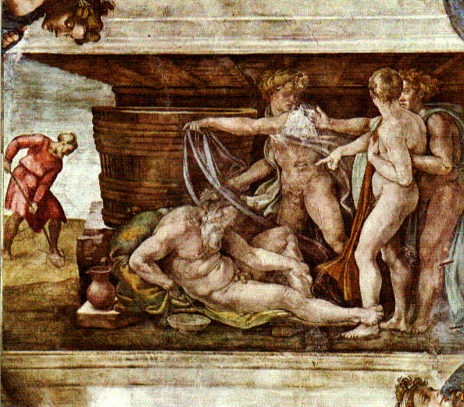
The incident in the tent
Noah plants a vineyard
He makes wine, becomes drunk and lies naked in his tent
Ham sees Noah naked
He tells Shem and Japeth to cover Noah
Noah wakes up and curses Ham’s son Canaan
Notes:
Noah descent.

Slide 28
Test of Ham’s unity with Noah
Noah
Felt
ashamed
Rebuked
Japeth
Ham
Shem
Stirred up &
multiplied sin
Abel
Felt ashamed
covered Noah
Notes:
Why was this all a problem? After the fall Adam and Eve felt ashamed that they were naked. Feeling of shame due to sexual fall. Indicates impurity. When Ham felt ashamed of Noah being naked showed that he was impure. Why did he have this feeling? What sin had he committed so that Satan could invade his inner life?
Why could Satan invade Ham and thus Noah’s family? Qur’an and Jewish Talmud says that Noah told his sons and daughters-in law that for 40 days they should have no sexual relations. Ham and his wife had sexual relations:
“After the sacrifice was completed God blessed Noah and his sons. He made them to be the rulers of the world as Adam had been, and he gave them a command, saying, “Be fruitful and multiply upon the earth,” for during their sojourn in the ark, the two sexes, of men and animals alike, had lived apart from each other. This law of conduct had been violated by none in the ark except by Ham, by the dog, and by the raven.” (Ginsberg)
If Ham had kept his purity for the 40 days he would not have felt ashamed at seeing Noah naked. This ‘fall’ was the condition for Satan to invade Ham’s feelings so that he felt ashamed when he saw Noah naked. So if one has wrong feelings, look back and see if one made some bad condition and clear it up before one makes a mistake.
Other ancient commentators suggested that Ham was guilty of more than what the Bible says. The 2nd century Targum Onqelos has Ham gossiping about his father's drunken disgrace "in the street" (a reading which has a basis in the original Hebrew), so that being held up to public mockery was what had angered Noah; as the Cave of Treasures (4th century) puts it, "Ham laughed at his father's shame and did not cover it, but laughed about it and mocked."^{[16]}

Slide 29
Why was it a sin to feel ashamed?
Satan needs an object partner to exist and act
  Sin – condition for Satan to invade
Before the fall Adam and Eve were naked and unashamed – innocent
  After the Flood Noah’s family should have separated from Satan and been innocent
Feeling ashamed showed still of Satan’s lineage
Ham felt ashamed covered Noah
could not restore position of a good son
Notes:
Why was it such a sin to feel ashamed of nakedness? To understand these matters, let us first recall what constitutes sin. Satan cannot manifest his powers - including the power to exist and act - unless he first secures an object partner with whom he can make a common base and engage in a reciprocal relationship of give and take. Whenever a person makes a condition for Satan to invade, it means that he has allowed himself to become Satan's object partner, thereby empowering Satan to act. This constitutes sin.
We can thus understand that when Noah's sons felt ashamed of their father's nakedness and covered his body, it was tantamount to acknowledging that they, like Adam's family after the Fall, had formed a shameful bond of kinship with Satan and were thus unworthy to come before God. Satan, like the raven hovering over the water, was looking for a condition to invade Noah's family. He attacked the family by taking Noah's sons as his object partners when they in effect acknowledged that they were of his lineage.
When Ham felt ashamed of his father's nakedness and acted to cover it up, he made a condition for Satan to enter; hence his feeling and act constituted a sin. Consequently, Ham could not restore through indemnity the position of Abel from which to make the substantial offering. Since he could not establish the foundation of substance, the providence of restoration in Noah's family ended in failure.
Satan could invade and Ham didn’t inherit Noah’s foundation of faith. Therefore shame a sin. Should have had compassion for Noah.
We owe to anthropologists like Ruth Benedict[4] the distinction between shame cultures and guilt cultures. Shame is a social phenomenon. It is what we feel when our wrongdoing is exposed to others. It may even be something we feel when we merely imagine other people knowing or seeing what we have done. Shame is the feeling of being found out, and our first instinct is to hide. That is what Adam and Eve did in the garden of Eden after they had eaten the forbidden fruit. They were ashamed of their nakedness and they hid.
Guilt is a personal phenomenon. It has nothing to do with what others might say if they knew what we have done, and everything to do with what we say to ourselves. Guilt is the voice of conscience, and it is inescapable. You may be able to avoid shame by hiding or not being found out, but you cannot avoid guilt. Guilt is self-knowledge.
There is another difference, which explains why Judaism is overwhelmingly a guilt rather than a shame culture. Shame attaches to the person. Guilt attaches to the act. It is almost impossible to remove shame once you have been publicly disgraced. It is like an indelible stain on your skin. Shakespeare has Lady Macbeth say, after her crime, “Will these hands ne’er be clean?” In shame cultures, wrongdoers tend either to go into exile, where no one knows their past, or to commit suicide. Playwrights have them die.
Guilt makes a clear distinction between the act of wrongdoing and the person of the wrongdoer. The act was wrong, but the agent remains, in principle, intact. That is why guilt can be removed, “atoned for,” by confession, remorse and restitution. “Hate not the sinner but the sin,” is the basic axiom of a guilt culture.

Slide 30
Why did Ham feel ashamed?
  Ham, like Adam’s family, had formed a shameful bond of kinship with Satan. EDP, 205
  Ham committed a sinful act which reaffirmed the Fall. EDP, 89
  Talmud says that Ham and his wife had sexual relations during period of the flood
  Ham projected his feeling of shame onto Noah
  Ham accused Noah of his own sin
  So what happened?
Notes:
We can thus understand that when Noah's sons felt ashamed of their father's nakedness and covered his body, it was tantamount to acknowledging that they, like Adam's family after the Fall, had formed a shameful bond of kinship with Satan and were thus unworthy to come before God.
Why was this all a problem? After the fall Adam and Eve felt ashamed that they were naked. Feeling of shame due to sexual fall. Indicates impurity. When Ham felt ashamed of Noah being naked showed that he was impure. Why did he have this feeling? What sin had he committed so that Satan could invade his inner life?
Why could Satan invade Ham and thus Noah’s family? Qur’an and Jewish Talmud says that Noah told his sons and daughters-in law that for 40 days they should have no sexual relations. Ham and his wife had sexual relations:
“After the sacrifice was completed God blessed Noah and his sons. He made them to be the rulers of the world as Adam had been, and he gave them a command, saying, “Be fruitful and multiply upon the earth,” for during their sojourn in the ark, the two sexes, of men and animals alike, had lived apart from each other. This law of conduct had been violated by none in the ark except by Ham, by the dog, and by the raven.” (Ginsberg)
If Ham had kept his purity for the 40 days he would not have felt ashamed at seeing Noah naked. This ‘fall’ was the condition for Satan to invade Ham’s feelings so that he felt ashamed when he saw Noah naked. So if one has wrong feelings, look back and see if one made some bad condition and clear it up before one makes a mistake.

Slide 31
Why did Noah curse Canaan?
According to Midrash Ham’s wife was pregnant before the flood by a Nefilim or fallen angel (Shamchazel) or son of a ruler – ‘men of renown’
This was Canaan or Sichon
Ham thought he was his son
Maybe Ham’s wife seduced him so Ham would think Canaan was his son?
Notes:
Sichon was brother of Og:
I, Og King of Bashan, have undertaken to commit my life experiences to writing, in an attempt to ensure that my legacy does not get lost and that my place in history is not forgotten.
I have lived a long life, and it is difficult to remember all that I have experienced. I am forever indebted to the Jewish people for being so diligent in their note-taking and for making sure that history is not forgotten. My story can be pieced together from accounts recorded in their texts, both in the written Torah, as well as in the collection of teachings known as the Midrash.
I affirm that the information contained herein is correct and true to the best of my memory.
Written Torah Account
The Torah is quite brief in its depiction of me. There’s a section in the book of Numbers that describes the war that I waged with the Jews (and my ultimate demise):
Og, the king of Bashan, came out toward them with all his people, to wage war at Edrei. The L‑rd said to Moses, “Do not fear him, for I have delivered him, his people and his land into your hand. You shall do to him as you did to Sichon the king of the Emorites who dwelt in Cheshbon.” They smote him, his sons and all his people, until there was no survivor, and they took possession of his land.1
Not too flattering a biography, is it? I’m pretty grateful for the book of Deuteronomy, which adds a little more insight into my character and personal life.
For only Og, king of Bashan, was left from the remnant of the Rephaim. His bedstead was a bedstead of iron; is it not in Rabbah of the children of Ammon? Nine cubits was its length, and four cubits its breadth, according to the cubit of a man.2
Yes, it is true, I’m originally from the tribe of Rephaim. We were known to be giants in our time, and people were pretty afraid of us.3 But, alas, the Ammonites got the better of us. I was the only survivor from my entire family.4 The Ammonites took my custom-made bed and put it on display in their capital city, Rabbah, as an everlasting testament to their victory over my people.5
I was quite large, even from a very young age. People tell me that my crib had to be made from iron, because a wooden crib would break every time I lay down in it.6 In those days we used to make beds about a third longer than the person sleeping in them, so with a bed of 9 cubits long (approx. 4.5 meters), I must have measured in at about 6 cubits tall (a respectable 3 meters).7 Others are a fair bit more generous in estimating my height, as they assume that the carpenter used my own arm lengths in measuring my bed, and not the standard cubit measure.8 And as you might have guessed, my arm is a little longer than the average reader’s.
Well, that’s it as far as the written Torah records go. I really feature only as one of the Jewish conquests on their way to Canaan, and my story ends upon my defeat. The Midrash, however, is far more generous in its recording of history, and it documents my interactions with the Jews from the very beginning.
Pre-Flood Days
Like I mentioned earlier, I come from the family of Rephaim, who were known to be giants. We giants have existed since way back, from the pre-Flood days. We were known back then as the Nephilim, and have been described as “mighty men” and “men of renown.”9
Although my entire family, along with the rest of humanity, was wiped out by the Flood, I managed to save myself and have my life spared.10 Noah and I cut a little deal: I promised Noah that I’d be his slave for life, and he agreed to let me hitch a ride on the ark. We added a little plank of wood onto the back of his boat, and I held on throughout the Flood.11 G‑d was extra kind and arranged that the water immediately surrounding the ark was cool, despite the rest of the floodwaters being boiling hot.12 Noah was pretty kind, too, and he used to feed me through a trapdoor that he made in the side of the ark.
Although this part of my life doesn’t feature explicitly in the Torah, some people have pointed out some neat hints to it.
When summing up the damage caused by the Flood, the Torah says, “Only Noah and those with him in the ark survived.”13 If you take the Hebrew words אך נח, “only Noah,” and add up their numerical value, you get 79. I’ll bet you can guess what other word has the numerical value of 79. You got it. It’s my name, Og (עוג).14 As well, I’m referred to in the Torah as being the “remnant of the Rephaim,” which alludes to me being the only one of my family who survived the Flood.15
Fugitive from War
Things calmed down for a while after all the Flood drama, and I pretty much fell off the scene. That was, of course, until the Great War, which the Rephaim managed to get stuck in the middle of.16
In short, Chedorlaomer and his cronies were fed up with their subordinates not paying their dues and taxes, and they wanted to show them once and for all who was boss.17 On their way down south they decided to practice their battle tactics on my people and a couple of neighboring nations,18 and once again I was lucky to escape with my life.19
Who do you think I ran to for help? To Abraham, of course. You see, Abraham’s nephew Lot was living in Sodom at the time, one of the cities under siege by Chedorlaomer.20 Abraham was not the kind of guy who would let his family be captured and sit by idly, and I knew he would fight until the end.
Here’s something I never thought I’d admit: My intentions were not entirely pure, and I did have other motives in mind as well. Let’s just say that Abraham’s wife, Sarah, was one of a kind, and if Abraham were to die in battle, I just might have been lucky . . .21
Looking for hints to this part of my story in the Torah? “The fugitive came and told Abram the Hebrew.”22 The fugitive is me. After all, I’ve been pretty lucky so far. I’m the only one outside of Noah’s family who survived the Flood, and I did manage to escape Chedorlaomer and his army.23
For those of you wondering where I received my name Og, well, it wasn’t by chance. When I arrived at Abraham’s place to deliver the news, he was the in middle of baking matzah for Passover. In Hebrew, matzah is called עוגות מצות (ugot matzot). Out of gratitude to Abraham, I adopted this as my name, so now everyone just calls me Og.24
Well, my plans failed, and Abraham came home unscathed. G‑d was most unimpressed with my devilish plans, and cursed me for trying to lay hands on his precious Abraham. “You tried arranging the death of Abraham,” He said. “I promise you, your demise will come in the hands of his descendants.”25 Naturally, my relationship with Abraham has been pretty sketchy since then, and I’ve grown wary of the Hebrews.
Isaac’s Party
The next time I crossed paths with Abraham was at a party he threw, celebrating his son Isaac’s growing up. The Torah calls that party a “great feast.”26 You know why? Because all of the great people of the time showed up, myself included.27
The word on the street in those times was that Abraham would never have children. They used to call him the “barren mule,” and we assumed that his family line would have no continuation.28 When news came around that Isaac was born, I was pretty skeptical, so I decided to go see for myself.
Let me tell you something. Isaac was the puniest little thing that I have ever seen. I mean, seriously, I could have crushed him with my little pinky. Apparently G‑d wasn’t too fond of my thinking, and He took the opportunity to remind me again of what was ultimately in store for me. “Remember My promise,” He said. “This little kid’s descendants are going to get the better of you one day.”29
War Against Moses
Well, G‑d’s promise came to fruition in the end. The next documented episode in my life is the war I had with the Jews on their way to Canaan, where I was humiliatingly crushed.
There’s one point, though, that I think I ought to make, and that is that Moses was not terribly confident going into this battle. He was scared, really scared. And rightfully so, I might say. I was quite a war veteran by then, and had plenty of experience behind me. Add to that my abnormal height and strength, and I made for quite a formidable opponent.30 As well, Moses was worried that G‑d was on my side, as I was the one who ultimately saved Lot’s life.31
But G‑d dispelled Moses’ fears pretty quickly, and made it clear what the outcome of this battle would be: “The L‑rd said to Moses, ‘Do not fear him, for I have delivered him, his people and his land into your hand.’”32
And so Moses took me on. It was a humiliating defeat for me, and the Torah does not spare any of the embarrassing details: “They smote him, his sons and all his people, until there was no survivor, and they took possession of his land.”33
Deuteronomy’s account is even worse:
There was not a town that we did not take from them, sixty cities, all the territory of Argov, the kingdom of Og in Bashan. All these cities were fortified with high walls, double doors and bolts, in addition to a great many unwalled cities. We utterly destroyed them as we did to Sichon, king of Cheshbon, utterly destroying every city, the men, the women and the young children.34
I guess I should never have messed with Abraham in the first place. Although, I must admit, I did not see this coming at all. G‑d really outdid Himself this time.
The worst part of this whole story was the way I died. I had thought up a brilliant plan:
The camp of the Jews was around 3 parsah by 3 parsah (13 km by 13 km). I knew of a mountain that was around the same size. I would pick up the mountain and drop it on the Jews. Simple, right?
Well, it would have been, if not for G‑d and His miracles.
While the mountain was perched on my head ready to be dropped on the Jews, trillions of tiny little ants came and ate away at the bottom of it, making a huge hole all the way through. The rest of the mountain slipped down over my shoulders, leaving my head sticking out of the top. I was literally stuck with a mountain around my neck. Not a terribly comfortable position to be in.
It gets worse.
As I was trying to pull the mountain off of my head, my teeth miraculously grew, and locked the mountain in place. Stuck between a rock and a hard place?
At that point it was pretty much game over. Moses himself came along with a battle axe and started hacking away at my ankles, which was the highest he could reach even while jumping. It didn’t take long till he got the better of me, and, with the mountain tight around my neck, I toppled to my death.35
The lesson that I wish to leave you all with is this: The Jews may seem like a small nation, especially in contrast to their opponents, but there is something special about them. They’re not intimidated by their surroundings, and they go about their business proudly.36
G‑d was right when He warned me about Isaac: “This little kid’s descendants are going to get the better of you one day.” Get the better of me they did.

Slide 32
What lessons can be learned from Noah’s family?
Ham should have been grateful to his father for saving the life of the family
Ham should have had compassion for his father after all he had done
Ham should have overcome his shameful feelings and treated his father with respect
Have compassion for your parents
Don’t be angry with your children
If you make a bad condition, indemnify it quickly or Satan can use it to invade something important
Notes:
karate kid 2

Slide 33
What kind of a leader was Noah?
Noah was a good man who was not a leader. Was he, after the Flood haunted by guilt? Did he think of the lives he might have saved if only he had spoken out?
The Bible sets a high standard for the moral life. It is not enough to be righteous if that means turning our backs on a society that is guilty of wrongdoing. We must take a stand. We must protest. We must register dissent even if the probability of changing minds is small. That is because the moral life is a life we share with others. We are, in some sense, responsible for the society of which we are a part. It is not enough to be good. We must encourage others to be good. There are times when each of us must lead. Jonathan Sacks
Notes:
The praise accorded to Noah is unparalleled in Tanach. He was, says the Torah, “a righteous man, perfect in his generations; Noah walked with God.” No such praise is given to Abraham or Moses or any of the Prophets. The only person in the Bible who comes close is Job, described as “blameless and upright (tam ve- yashar); he feared God and shunned evil” ( Job 1:1). Noah is in fact the only individual that the Tanach describes as righteous (tzaddik).
Yet the Noah we see at the end of his life is not the person we saw at the beginning. After the Flood:
Noah, a man of the soil, proceeded to plant a vineyard. When he drank some of its wine, he became drunk and lay uncovered inside his tent. Ham, the father of Canaan, saw his father naked and told his two brothers outside. But Shem and Japheth took a garment and laid it across their shoulders; then they walked in backward and covered their father’s naked body. Their faces were turned the other way so that they would not see their father naked. (Gen. 9:20-23)
The man of God has become a man of the soil. The upright man has become a drunkard. The man clothed in virtue now lies naked. The man who saved his family from the Flood is now so undignified that two of his sons are ashamed to look at him. This is a tale of decline. Why?
Noah is the classic case of someone who is righteous, but who is not a leader. In a disastrous age, when all has been corrupted, when the world is filled with violence, when even God Himself – in the most poignant line in the whole Torah – “regretted that He had made man on earth, and was pained to His very core,” Noah alone justifies God’s faith in humanity, the faith that led Him to create humankind in the first place. That is an
Righteousness is not Leadership 1 Noach 5781
immense achievement, and nothing should detract from it. Noah is, after all, the man through whom God makes a covenant with all humanity. Noah is to humanity what Abraham is to the Jewish people.
Noah was a good man in a bad age. But his influence on the life of his contemporaries was, apparently, non-existent. That is implicit in God’s statement, “You alone have I found righteous in this whole
generation” (Gen. 7:1). It is implicit also in the fact that only Noah and his family, together with the animals, were saved. It is reasonable to assume that these two facts – Noah's righteousness and his lack of influence on his contemporaries – are intimately related. Noah preserved his virtue by separating himself from his environment. That is how, in a world gone mad, he stayed sane.
The famous debate among the Sages as to whether the phrase “perfect in his generations” (Gen. 6:9) is praise or criticism may well be related to this. Some said that “perfect in his generations” means that he was perfect only relative to the low standard then prevailing. Had he lived in the generation of Abraham, they said, he would have been insignificant. Others said the opposite: if in a wicked generation Noah was righteous, how much greater he would have been in a generation with role models like Abraham.
The argument, it seems to me, turns on whether Noah’s isolation was part of his character, or whether it was merely the necessary tactic in that time and place. If he were naturally a loner, he would not have gained by the presence of heroes like Abraham. He would have been impervious to influence, whether for good or bad. If he was not a loner by nature but merely by circumstance, then in another age he would have sought out kindred spirits and become greater still.
Yet what exactly was Noah supposed to do? How could he
have been an influence for good in a society bent on evil? Was he
really meant to speak in an age when no one would listen?
Sometimes people do not listen even to the voice of God Himself. We had an example of this just two chapters earlier, when God warned Cain of the danger of his violent feelings toward Abel – “'Why are you so furious? Why are you depressed? ... sin is crouching at the door. It lusts after you, but you can dominate it” (Gen. 4:6-7). Yet Cain did not listen, and instead went on to murder his brother. If God speaks and people do not listen, how can we criticise Noah for not speaking when all the evidence suggests that they would not have listened to him anyway?
The Talmud raises this very question in a different context, in another lawless age: the years leading to the Babylonian conquest and the destruction of the First Temple, another lawless age:
R. Aha b. R. Hanina said: Never did a favourable word go forth from the mouth of the Holy One, blessed be He, of which He retracted for evil, except the following, where it is written, “And the Lord said unto him: Go through the midst of the city, through the midst of Jerusalem, and set a mark upon the foreheads of the men that sigh and cry for all the abominations that are being done in the midst thereof” (Ezek. 9:4).
The Holy One, blessed be He, said to Gabriel, “Go and set a mark of ink on the foreheads of the righteous, that the destroying angels may have no power over them; and a mark of blood upon the foreheads of the wicked, that the destroying angels may have power over them.” Said the Attribute of
Righteousness is not Leadership 2 Noach 5781
Was Noah’s isolation part of his character, or was it merely the necessary tactic in that time and place.
Justice before the Holy One, blessed be He, “Sovereign of the Universe! How are these different from those?”
“Those are completely righteous men, while these are completely wicked,” He replied. “Sovereign of the Universe!” said Justice, “They had the power to protest but did not.”
Said God, “Had they protested, they would not have heeded them.”
“Sovereign of the Universe!” said Justice, “This was revealed to You, but was it revealed to them?” (Shabbat 55a)
According to this passage, even the righteous in Jerusalem were punished at the time of the destruction of the Temple because they did not protest the actions of their contemporaries. God objects to the claim of Justice: Why punish them for their failure to protest when it was clear that had they done so, no one would have listened? Justice replies: This may be clear to you or to the angels - meaning, this may be clear in hindsight – but at the time, no human could have been sure that their words would have no impact. Justice asks: How can you be sure you will fail if you never try?
The Talmud notes that God reluctantly agreed with Justice. Hence the strong principle: when bad things are happening in society, when corruption, violence and injustice prevail, it is our duty to register a protest, even if it seems likely that it will have no effect. Why? Because that is what moral integrity demands. Silence may be taken as acceptance. And besides, we can never be sure that no one will listen. Morality demands that we ignore probability and focus on possibility. Perhaps someone will take notice and change their ways - and that “perhaps” is enough.
This idea did not suddenly appear for the first time in the Talmud. It is stated explicitly in the book of Ezekiel. This is what God says to the Prophet:
“Son of man, I am sending you to the Israelites, to a rebellious nation that has rebelled against Me; they and their ancestors have been in revolt against Me to this very day. The people to whom I am sending you are obstinate and stubborn. Say to them, ‘This is what the Sovereign Lord says.’ And whether they listen or fail to listen—for they are a rebellious people—they will know that a Prophet has been among them.” (Ezek. 2:3-5)
God is telling the Prophet to speak, regardless of whether “Morality demands that we people will listen. ignore probability and focus
So, one way of reading the story of Noah is as an example
of lack of leadership. Noah was righteous but not a leader. He
was a good man who had no influence on his environment. There are, to be sure, other ways of reading the story, but this seems to me the most straightforward. If so, then Noah is the third case in a series of failures of responsibility. As we saw last week, Adam and Eve failed to take personal responsibility for their actions (“It wasn’t me”). Cain refused to take moral responsibility (“Am I my brother’s keeper?”). Noah failed the test of collective responsibility.
This way of interpreting the story, if correct, entails a strong conclusion. We know that Judaism involves collective responsibility, for it teaches Kol Yisrael arevim ze bazeh (“All Israel are responsible for one
Righteousness is not Leadership 3 Noach 5781
on possibility.”
another” Shavuot 39a). But it may be that simply being human also involves collective responsibility. Not only are Jews responsible for one another. So are we all, regardless of our faith or religious affiliations. So, at any rate, Maimonides argued, though Nahmanides disagreed.1
The Hassidim had a simple way of making this point. They called Noah a tzaddik im peltz, “a righteous man in a fur coat.” There are essentially two ways of keeping warm on a cold night. You can wear a thick coat, or you can light a fire. Wear a coat and you warm only yourself. Light a fire and you can warm others too. We are supposed to light a fire.
Noah was a good man who was not a leader. Was he, after the Flood, haunted by guilt? Did he think of the lives he might have saved if only he had spoken out, whether to his contemporaries or to God? We cannot be sure. The text is suggestive but not conclusive.
It seems, though, that the Torah sets a high standard for the moral life. It is not enough to be righteous if that means turning our backs on a society that is guilty of wrongdoing. We must take a stand. We must protest. We must register dissent even if the probability of changing minds is small. That is because the moral life is a life we share with others. We are, in some sense, responsible for the society of which we are a part. It is not enough to be good. We must encourage others to be good. There are times when each of us must lead.
1. Do you see Noah as “perfect” because he managed to maintain this despite his contemporaries, or was he only “righteous” relative to the people that surrounded him?
2. Why is it so difficult to take a stand on something we believe in when we are uncertain of the response?
3. Is it possible to live in an Ark, or in complete isolation from society, and still be a moral person?

Slide 34
What is shame?
Shame is what we feel when our wrong-doing is exposed to others. It may even be something we feel when we merely imagine other people knowing or seeing what we have done. Shame is the feeling of being found out, and our first instinct is to hide.
How do other people see me? Keeping “face”. Family ‘honour’
Notes:
“…Chae-myung (”face saving”) [in Korea] often took precedence over rationality, practicality and truth.
In this face-sensitive society, speaking clearly and candidly became taboo. Speech became indirect and vague. Direct criticism, especially of superiors, was prohibited, and there were serious sanctions for breaking the ban. When something disruptive happened between individuals or groups, one of the institutionalized ways of “repairing” the damage was for a mutual agreement to opton kosuro haja, which means “pretend it never happened.”
…Despite evolutionary changes in Korean culture since the end of the Choson dynasty, Koreans continuously engage in chae-myung in all of their personal and business relationships. Foreigners in Korea must do the same. Face saving, in fact, remains Korea’s “cultural lubricant,” without which things cannot and will not run smoothly.
As it happens, Korea also has a “shame culture” which makes saving face one of the most important elements of proper, moral behavior.
In its Confucian context shame is regarded as the root of morality, and in shame cultures morality is driven externally. People in shame cultures try to avoid causing emotional pain to others and being subjected to such pain themselves – pain that is caused by being looked down on others, by being embarrassed, by being disgraced in the eyes of others. Shame-centred people do not try to “be good” as to avoid committing a sin that endangers their soul; they try to behave as is required by their social status and station to avoid losing their reputation….
Historically, the greatest sources of shame (changpi) in Korea were failing to live up to the expectations of the father, the family, the kin, and one’s circle of friends and associates and not being treated as one’s status demanded.
In contrast to both Korea and Japan, the United States and other Christianized countries have “guilt cultures.” The primary sanction of the Christian religion is guilt feelings, and the more influence Christianity has on people the more guilty they feel about what they do – or think. Because these guilt feelings are internalized, people who have “sinned” can suffer on their own and in silence to the point that they go crazy – something that is rare in shame cultures.
While Christianity peddles guilt and Confucianism purveys shame, there is a fundamental difference in the effect of the two sanctions. Shame-centered people can get by with all kinds of “immoral conduct and not suffer any pangs of shame as long as it doesn’t become known to others. In shame cultures it is not doing that is shameful so much as getting caught. Among the many things that people in shame cultures can “morally” do, that are considered immoral in Christianized guilt cultures, is treat people as inferiors, take financial advantage of people, conceal the truth, use devious tactics, and – for men anyway – engage in premarital and extramarital sex.”
(extracts from Understanding the Korean Mind, by Lafayette De Mente)

Slide 35
What is guilt?
Guilt is a personal phenomenon. It has nothing to do with what others might say if they knew what we have done, and everything to do with what we say to ourselves. Guilt is the voice of conscience, and it is inescapable. You may be able to avoid shame by hiding or not being found out, but you cannot avoid guilt. Guilt is self-knowledge.
How does God, my conscience see me? Honesty and transparency

Slide 36
Shame attaches to the person. Guilt attaches to the act. It is almost impossible to remove shame once you have been publicly disgraced. It is like an indelible stain on your skin.
But we are not condemned to live endlessly with the mistakes and errors of our past. That is the great difference between a guilt culture and a shame culture.
He who conceals his sins does not prosper, but whoever confesses and renounces them finds mercy. Proverbs 28:13
“Be not ashamed of mistakes and thus make them crimes.” Confucius
Notes:
The psychology of shame is quite different to that of guilt. We can discharge guilt by achieving forgiveness –Shame cannot be removed by forgiveness. The victim of our crime may have forgiven us, but we still feel defiled by the knowledge that our name has been disgraced, our reputation harmed, our standing damaged. We still feel the stigma, the dishonour, the degradation. We are not condemned to live endlessly with the mistakes and errors of our past. That is the great difference between a guilt culture and a shame culture.

Slide 37
6c. Restoring the parent - child relationship
Abraham and Isaac
Notes:
The stories told in Bereishit chapters 21 and 22 – the sending away of Ishmael and the binding of Isaac – are among the hardest to understand in the whole of Tanakh. Both involve actions that strike us as almost unbearably harsh. But the difficulties they present go deeper even than that.
Recall that Abraham was chosen “so that he would instruct his children and his household after him to keep the way of the Lord by doing what is right and just.” He was chosen to be a father. The first two letters of his name, Av, mean just that. Avram means “a mighty father.” Avraham, says the Torah, means “a father of many nations.”
Abraham was chosen to be a parental role model. But how can a man who banished his son Ishmael, sending him off with his mother Hagar into the desert, where they nearly died, be thought of as an exemplary father? And how could a man who was willing to sacrifice his son Isaac be a model for future generations?
These are not questions about Abraham. They are questions about the will of God. For it was not Abraham who wanted to send Ishmael away. To the contrary, it “distressed Abraham greatly,” because Ishmael was his son (Gen. 21:11). It was God who told him to listen to Sarah and send the child away.
Nor was it Abraham who wanted to sacrifice Isaac. It was God who told him to do so, referring to Isaac as “your son, your only one, the one you love” (Gen. 22:2). Abraham was acting on both occasions against his emotions, his paternal instincts. What is the Torah telling us about the nature of fatherhood? It seems very difficult indeed to draw a positive message from these events.
There is an even deeper problem, and it is hinted at in the words God spoke to Abraham in summoning him to the binding of his son: “Take your son, your only son, the one you love—Isaac—and go [lekh lekha] to the region of Moriah. Sacrifice him there as a burnt offering on a mountain I will show you.” These words inevitably remind us of God’s first summons: “Go forth [lekh lekha] from your land, your birthplace and your father’s house” (Gen. 12:1). These are the only two places in which this phrase occurs in the Torah. Abraham’s last trial echoed his first.
But note that the first trial meant that Abraham had to abandon his father, thereby looking as if he were neglecting his duties as a son.[1] So, whether as a father to his sons or as a son to his father, Abraham was commanded to act in ways that seem the exact opposite of what we would expect and how we should behave.
This is too strange to be accidental. There is a mystery here to be decoded.
The barrier to our understanding of these events lies in the sheer abyss of time between then and now. Abraham, as the pioneer of a new kind of faith and way of life, was instituting a new form of relationship between the generations. Essentially, what we are seeing in these events is the birth of the individual.
In ancient times, and in antiquity in Greece and Rome, the basic social unit was not the individual but the family. Religious rituals were performed around the fire in the family hearth, with the father serving as priest, offering sacrifices, libations and incantations to the spirits of dead ancestors. The power of the father was absolute. Wives and children had no rights and no independent legal personalities. They were mere property and could be killed by the head of the household at will. Each family had its own gods, and the father was the sole intermediary with the ancestral spirits, whom he would one day join. There were no individuals in the modern sense. There were only families, under the absolute rule of its male head.
The Torah was a radical break with this entire mindset. The anthropologist Mary Douglas points out that the Torah was unique in the ancient world in making no provision for sacrifices to dead ancestors, and forbidding the attempt to communicate with the spirits of the dead.[2]
Monotheism was more than simply the belief in one God. Because each human was in His image, and because each could be in direct relationship with Him, the individual was suddenly given significance – not just fathers but also mothers, and not just parents but also children. No longer were they fused into a single unit, with a single controlling will. They were each to become persons in their own right, with their own identity and integrity.[3]
Such changes do not happen overnight, and they do not happen without wrenching dislocations. That is what is happening at both ends of the Abraham story. At the beginning of his mission, Abraham was told to separate himself from his father, and towards the end he was told to separate himself, in different ways, from each of his two sons. These painful episodes represent the agonising birth-pangs of a new way of thinking about humanity.
First separate, then connect. That seems to be the Jewish way. That is how God created the universe, by first separating domains – day and night, upper and lower waters, sea and dry land – then allowing them to be filled. And that is how we create real personal relationships. By separating and leaving space for the other. Parents should not seek to control children. Spouses should not seek to control one another. It is the carefully calibrated distance between us in which relationship allows each party to grow.
In his recent book on sporting heroes, The Greatest, Matthew Syed notes how important the encouragement of parents is to the making of champions, but he adds:
Letting go – that is the essential paradox of parenthood. You care, you nurture, you sacrifice, and then you watch as the little ones fly into the great unknown, often shouting recriminations as they depart. You will experience the stomach clenching pain of separation, but you do so with a smile and a hug, aware that the desire to protect and love must never morph into the tyranny of mollycoddling.[4]
It is this drama of separation that Abraham symbolically enacts in his relationship both to his father and to his two sons. In this world-transforming moment of the birth of the individual, God is teaching him the delicate art of making space, without which no true individuality can grow.
In the lovely words of Irish poet John O’Donohue our challenge is: “To bless the space between us.”[5]

Slide 38
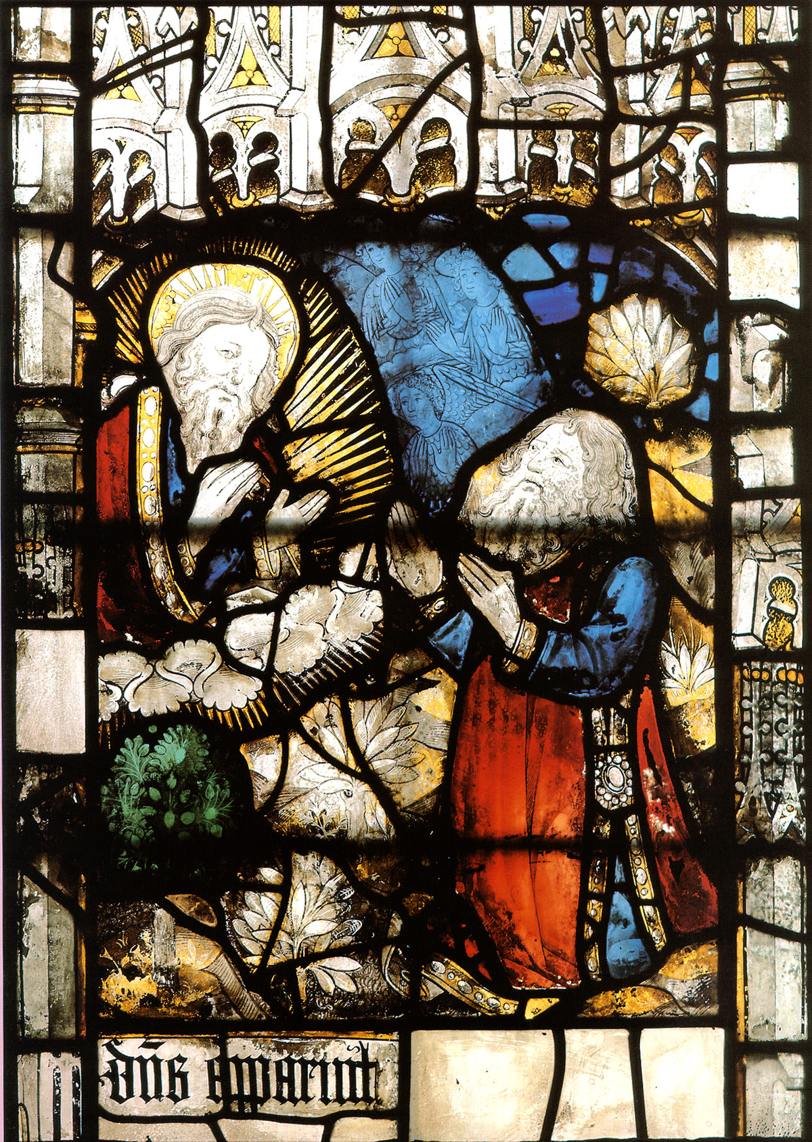
Abram’s faith in God
“Look toward heaven, and number the stars, if you are able to number them.” Then he said to him, “So shall your offspring be.” And he believed the Lord, and he counted it to him as righteousness.
Genesis15:5-6
Notes:
What is faith? The art of holding on to things your reason has once accepted in spite of your changing moods.
Faith and reason verses emotion and imagination
Work out your salvation with fear and trembling for it is God who worketh in you

Slide 39
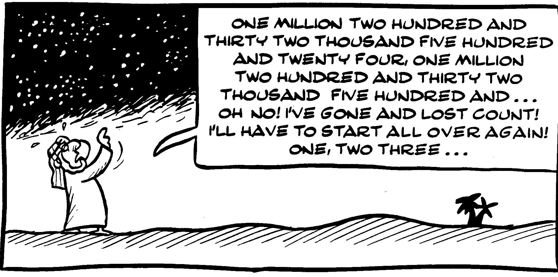

Slide 40
Abram’s faith in God
“Look toward heaven, and number the stars, if you are able to number them.” Then he said to him, “So shall your offspring be.” And he believed the Lord, and he counted it to him as righteousness.
Genesis15:5-6
“I am the Lord who brought you out from Ur of the Chaldeans to give you this land to possess.” But he said, “O Lord God, how am I to know that I shall possess it?”
Genesis 15:7-8
Notes:
What is faith? The art of holding on to things your reason has once accepted in spite of your changing moods.
Faith wavered
Faith and reason verses emotion and imagination
Work out your salvation with fear and trembling for it is God who worketh in you

Slide 41
Restoring the foundation of faith
God
Heifer
Completion
Growth
Formation
Offering
Ram & goat
Dove & pigeon
Abram
What did the offerings represent?
Previous symbolic offerings
Generations: Adam, Noah, Abram
Central person
Notes:
After fall restored Abraham in position of unfallen Adam and so could restore of faith
Abraham, now in the position of Adam, was supposed to restore, all at once, the long providence which God had conducted through the three providential generations of Adam (formation), Noah (growth) and Abraham (completion). Through one offering, he could restore all the defiled conditions containing the number three.
Abraham's offering was also to make a symbolic indemnity condition as restitution for their failures in making the substantial offering. In other words, the purpose of Abraham's symbolic offering of the three types of objects for the condition was to restore in his generation (horizontally) all the indemnity conditions which had accumulated in the course of the providence (vertically) through the three generations of Adam, Noah and Abraham.
Then God told Abraham that he would possess the land of Canaan. “But he said, ‘O Lord God, how am I to know that I shall possess it?” Abraham did not have absolute faith. And so God told him to make an offering to lay a foundation of faith. However Abraham fell asleep and the offering was invaded by Satan. So instead of occupying the land as previously promised his descendants had to live in a foreign land for 400 years first to indemnify Abraham’s mistake.
“Your descendants will be… enslaved and mistreated four hundred years.” Genesis 15:13

Slide 42
Making the offering
And he brought him all these, cut them in half, and laid each half over against the other. But he did not cut the birds in half. And when birds of prey came down on the carcasses, Abram drove them away.
As the sun was going down, a deep sleep fell on Abram. And behold, dreadful and great darkness fell upon him. Then the Lord said to Abram, “Know for certain that your offspring will be sojourners in a land that is not theirs and will be servants there, and they will be afflicted for four hundred years.”
Genesis 15:10-13
Notes:
God's work of salvation aims to restore the sovereignty of goodness by first dividing good from evil and then destroying evil and uplifting the good. God had Abraham cut the sacrifices in two before offering them, with the intention of doing the symbolic work of dividing good from evil,
The sacrifices were to be divided, first, to restore the situation in Adam's family in which Abel and Cain were divided into a representative of good and a representative of evil. Second, it was to restore the situation of having divided good from evil during the forty days of Noah's flood. Third, it was to make the symbolic condition to separate a realm of good sovereignty out of the universe ruled by Satan. Fourth, it was to make the condition to sanctify the offering by draining out the blood of death, which had entered fallen humanity when they were bound in blood-ties to Satan.
First, not dividing the offering has the significance of not dividing Abel from Cain. Without being divided, the offering could not be acceptable to God because it did not provide Him with an Abel-type object partner which He could take. Consequently, the mistakes Cain and Abel had made in their sacrifices were not restored. Second, not dividing the offering was tantamount to repeating the failure of the providence in Noah's time, when good and evil remained undivided despite the flood. Like the failure of Noah's family, Abraham's failure to divide the offering also deprived God of His good object partner. Thus, it repeated the mistake which made the dispensation of the flood a failure. Third, not dividing the offering meant there was no symbolic condition to separate a realm of God's good sovereignty out of the universe under Satan's dominion. Fourth, because the blood of death was not drained out of it, not dividing the offering meant it could not be a sanctified offering acceptable to God. In other words, when Abraham offered the birds without first dividing them, it meant that he offered what had not been wrested from Satan's possession. His mistake had the effect of acknowledging Satan's claim of possession over them.
The dove, symbolizing the formation stage, remained in Satan's possession. Consequently, Satan also claimed the ram, symbolizing the growth stage, and the heifer, symbolizing the completion stage, both of which were to be fulfilled based upon the formation stage. Since it had the effect of handing over the entire symbolic offering to Satan, not dividing the birds constituted a sin.

Slide 43
Why the heavy ‘punishment’?
Satan claimed 400 year period Noah Abraham
Satan
God
Condition
Curse
Blessing
Condition decides ownership
Greater indemnity
Lesser indemnity
Notes:
Abraham's mistake in making the symbolic offering caused the offering to be defiled. All the conditions God intended to restore through it were lost. As a consequence, Abraham's descendants had to suffer oppression and slavery for four hundred years in the land of Egypt. Let us investigate the reason for this.
God called upon Abraham and commanded him to make the symbolic offering at the completion of a four-hundred-year period for the separation of Satan. This period had been set up to restore through indemnity the ten generations from Adam to Noah and the forty-day period of the flood judgment, lost to Satan due to Ham's sin. It was also the indemnity period necessary to establish Abraham as the father of faith when he completed the symbolic offering. When Abraham's mistake in the symbolic offering allowed Satan to claim the offering as his, that four-hundred-year period was also lost to Satan. To re-create on the national level the situation before Abraham's failure in the symbolic offering, which was itself parallel to when Noah was called upon to build the ark, God set up another four-hundred-year period for the separation of Satan. During this period, the Israelites were slaves in Egypt. By enduring through this period, the Israelites were to restore - this time on the national level - the situations of Noah and Abraham at the outset of their missions as the fathers of faith, thereupon also laying the foundation for Moses to begin his mission. Hence, this period of slavery was both the time when the Israelites were being punished for Abraham's mistake and the time when they were laying the foundation to cut off ties to Satan and commence God's new providence.

Slide 44
What is restoration?
Restoration occurs when you find yourself in a similar position to Adam, Eve, the archangel, Cain or Abel etc.
And you have to face the same temptation to make the same mistake that they did and continue the pattern of fallen history
But you choose not to do so and instead of acting out of your fallen nature you act according to your original nature and follow your conscience. You break the cycle of abuse and pattern of fallen history

Slide 45
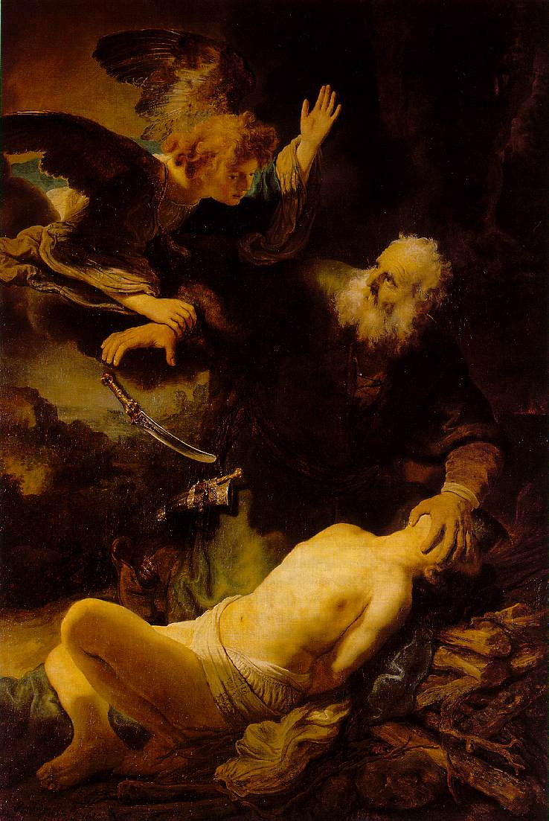
Restoring the parent-child relationship
After these things God tested Abraham and said to him, “Abraham!” And he said, “Here am I.” He said, “Take your son, your only son Isaac, whom you love, and offer him as a burnt offering. So Abraham rose early in the morning . . .”
Genesis 22:1-2
The Binding of Isaac
Notes:
The stories told in Bereishit chapters 21 and 22 – the sending away of Ishmael and the binding of Isaac – are among the hardest to understand in the whole of Tanakh. Both involve actions that strike us as almost unbearably harsh. But the difficulties they present go deeper even than that.
Recall that Abraham was chosen “so that he would instruct his children and his household after him to keep the way of the Lord by doing what is right and just.” He was chosen to be a father. The first two letters of his name, Av, mean just that. Avram means “a mighty father.” Avraham, says the Torah, means “a father of many nations.”
Abraham was chosen to be a parental role model. But how can a man who banished his son Ishmael, sending him off with his mother Hagar into the desert, where they nearly died, be thought of as an exemplary father? And how could a man who was willing to sacrifice his son Isaac be a model for future generations?
These are not questions about Abraham. They are questions about the will of God. For it was not Abraham who wanted to send Ishmael away. To the contrary, it “distressed Abraham greatly,” because Ishmael was his son (Gen. 21:11). It was God who told him to listen to Sarah and send the child away.
Nor was it Abraham who wanted to sacrifice Isaac. It was God who told him to do so, referring to Isaac as “your son, your only one, the one you love” (Gen. 22:2). Abraham was acting on both occasions against his emotions, his paternal instincts. What is the Torah telling us about the nature of fatherhood? It seems very difficult indeed to draw a positive message from these events.
There is an even deeper problem, and it is hinted at in the words God spoke to Abraham in summoning him to the binding of his son: “Take your son, your only son, the one you love—Isaac—and go [lekh lekha] to the region of Moriah. Sacrifice him there as a burnt offering on a mountain I will show you.” These words inevitably remind us of God’s first summons: “Go forth [lekh lekha] from your land, your birthplace and your father’s house” (Gen. 12:1). These are the only two places in which this phrase occurs in the Torah. Abraham’s last trial echoed his first.
But note that the first trial meant that Abraham had to abandon his father, thereby looking as if he were neglecting his duties as a son.[1] So, whether as a father to his sons or as a son to his father, Abraham was commanded to act in ways that seem the exact opposite of what we would expect and how we should behave.
This is too strange to be accidental. There is a mystery here to be decoded.
The barrier to our understanding of these events lies in the sheer abyss of time between then and now. Abraham, as the pioneer of a new kind of faith and way of life, was instituting a new form of relationship between the generations. Essentially, what we are seeing in these events is the birth of the individual.
In ancient times, and in antiquity in Greece and Rome, the basic social unit was not the individual but the family. Religious rituals were performed around the fire in the family hearth, with the father serving as priest, offering sacrifices, libations and incantations to the spirits of dead ancestors. The power of the father was absolute. Wives and children had no rights and no independent legal personalities. They were mere property and could be killed by the head of the household at will. Each family had its own gods, and the father was the sole intermediary with the ancestral spirits, whom he would one day join. There were no individuals in the modern sense. There were only families, under the absolute rule of its male head.
The Torah was a radical break with this entire mindset. The anthropologist Mary Douglas points out that the Torah was unique in the ancient world in making no provision for sacrifices to dead ancestors, and forbidding the attempt to communicate with the spirits of the dead.[2]
Monotheism was more than simply the belief in one God. Because each human was in His image, and because each could be in direct relationship with Him, the individual was suddenly given significance – not just fathers but also mothers, and not just parents but also children. No longer were they fused into a single unit, with a single controlling will. They were each to become persons in their own right, with their own identity and integrity.[3]
Such changes do not happen overnight, and they do not happen without wrenching dislocations. That is what is happening at both ends of the Abraham story. At the beginning of his mission, Abraham was told to separate himself from his father, and towards the end he was told to separate himself, in different ways, from each of his two sons. These painful episodes represent the agonising birth-pangs of a new way of thinking about humanity.
First separate, then connect. That seems to be the Jewish way. That is how God created the universe, by first separating domains – day and night, upper and lower waters, sea and dry land – then allowing them to be filled. And that is how we create real personal relationships. By separating and leaving space for the other. Parents should not seek to control children. Spouses should not seek to control one another. It is the carefully calibrated distance between us in which relationship allows each party to grow.
In his recent book on sporting heroes, The Greatest, Matthew Syed notes how important the encouragement of parents is to the making of champions, but he adds:
Letting go – that is the essential paradox of parenthood. You care, you nurture, you sacrifice, and then you watch as the little ones fly into the great unknown, often shouting recriminations as they depart. You will experience the stomach clenching pain of separation, but you do so with a smile and a hug, aware that the desire to protect and love must never morph into the tyranny of mollycoddling.[4]
It is this drama of separation that Abraham symbolically enacts in his relationship both to his father and to his two sons. In this world-transforming moment of the birth of the individual, God is teaching him the delicate art of making space, without which no true individuality can grow.
In the lovely words of Irish poet John O’Donohue our challenge is: “To bless the space between us.”[5]

Slide 46
Why did God test Abraham?
Test and miracle same word in Hebrew
Test – do what is impossible. Break barriers. Break habits of thinking
Abraham had passed 9 tests
Sacrificing Isaac contrary to everything
Why did God ask him to do it?
Why did he do it?
Why did Isaac go along with it?
The core of one’s being lies not in the self but in commitment to the Creator
Notes:
The Test
By Tzvi Freeman
Why did G-d test Abraham? Why does He test us? Why does an all-knowing G-d need to test anybody? Shouldn't He know what is in our hearts without testing us?
A test is any situation that demands more from you than you think you have. In a test, if you would use your rational mind you would say, "This is impossible. This is not what I bargained for. I don't have to do this because it is not within my skill set. It is beyond who I am."
You don't pass a test with understanding, with reason. You pass a test with rock solid faith and blind perseverance.
Tests are closely related to miracles. In fact, in Hebrew they are practically the same word.
A miracle is when G-d breaks out of his standard pattern of natural law and demonstrates unlimited powers. A test is when G-d invites you to do the same. That is why people who pass tests cause miracles to happen -- G-d is mirroring them.
There are different kinds of tests. All of them break barriers. Some tests take a person past old habits that bridle him. Others pull out of him new strength, a tenacity, a deep confidence in his purpose and the inherent goodness within the world.
The ultimate test is that which takes a person beyond the ultimate barrier: The barrier between creation and Creator. Such was the test Abraham passed when he was asked to offer up his son Isaac.
Abraham had passed many tests before -- nine in total. As a young man, he had chosen certain death in a fiery furnace over worship of the evil demagogue, King Nimrod, and was miraculously saved. Throughout his life, he had never questioned G-d's justice, despite his many tribulations. Except for once, when he demanded justice for the inhabitants of Sodom and Gemorrah -- and that itself was how he passed another test.
But the test of offering Isaac was a class in itself. Because this test made absolutely no sense.
Throw yourself in a fiery furnace rather than worship a megalomaniac who thinks he is a god -- you've made a statement and you've got it out there. The same with all the other tests -- they were ways to promote a cause, to publicize to the world the faith of Abraham. And as such, there always lurked a doubt that perhaps, just perhaps all this was tied to Abraham's ego. Because what could be a greater accomplishment than being the founder of the faith of Abraham?
Turn the whole world on its head and you'll be the most significant man in history. Isn't that worth fire and high water, and even death itself?
But the Akedah ("Binding" of Isaac) didn't fit that profile. The Akedah flew in the face of everything Abraham ever stood for: that G-d is good and kind, that He keeps His promises and has a destiny for His world. All this is out the window when G-d says, "Abraham! Remember that son I promised you, for which you waited for so long? The one about whom I promised he is destined to carry on all that you began so that it will continue until eternity? Remember how I told you to listen to Sarah against your own judgment and send Ishmael away so that this other son could flourish? The son who you have fostered with your wisdom and trained for his destiny these many years? The son of your old age, that you love more than any father has ever loved a son?
"Take him to the land of Moriah and raise him up for a burnt offering on one of the mountains I will show you there."
No explanation. No consolation. No excuses. Just do it. Turn around and destroy everything you have built until this day so that there will never be a chance to rebuild.
A mindless act.
So why did he do it?
Abraham was a man with a mission. A mission for which he sacrificed everything, a mission more important to him than his own life.
For many years he had agonized over the fact that there was no heir to this mission, that his work of bringing the beliefs and ethics of monotheism to a pagan world would cease with his passing from the world. Then came the divine promise: miraculously, at the age of one hundred, he will have a son, out of whom will stem the people of Israel. “You shall call his name Isaac,” said G‑d, “and I shall establish My covenant with him for an everlasting covenant, and with his descendants after him.”
And then G‑d told him to destroy it all.
When Abraham bound Isaac upon the altar, it was not in the service of any calling or cause. In fact, it ran contrary to everything he believed in and taught, to everything for which he had sacrificed his life, to everything G‑d Himself had told him. He could see no reason, no purpose for his act. Every element of his self cried out against it—his material self, his spiritual self, his transcendent and altruistic self. But he did it. Why? Because G‑d had told him to.
Abraham was the pioneer of self-sacrifice.
For Abraham bequeathed to his descendants the essence of Jewishness: that at the core of one’s very being lies not the self but one’s commitment to the Creator. And that, ultimately, one’s every choice and act is an expression of that “spark of divinity” within.
10 tests
1. He is thrown into a fiery furnace.
2. G‑d tells him to leave his homeland to be a stranger in the land of Canaan.
3. Immediately after his arrival in the Promised Land, he encounters a famine.
4. The Egyptians capture his beloved wife, Sarah, and bring her to Pharaoh.
5. He faces incredible odds in the battle of the four and five kings.
6. He is told by G‑d that his children will be strangers in a strange land.13
7. G‑d tells him to circumcise himself at an advanced age.
8. The king of Gerar captures Sarah, intending to take her for himself.
9. G‑d tells him to send away Hagar and her son, Ishmael.
10. Abraham is told by G‑d to sacrifice his dear son Isaac upon an altar.

Slide 47
But . . .
Abraham was chosen to be a role model
  “For I have chosen him so that he will instruct his children and his household after him to keep the way of the Lord by doing what is right and just.”
Kierkegaard, - “teleological suspension of the ethical”
  Willingness to let the I-Thou love of God overrule the universal principles that bind humans to one another.
This is the logic of the religious fanatic, the inquisitor, the suicide bomber
God does not ask us to be unethical
  How does the story function in Christianity?
Another way of looking at it . . .
  Restoration and change of lineage as the prism
  Restoring what? What is change lineage?
Notes:
It is the hardest passage of all, one that seems to defy understanding. Abraham and Sarah have waited years for a child. G-d has promised them repeatedly that they would have many descendants, as many as the stars of the sky, the dust of the earth, the grains of sand on the sea shore. They wait. No child comes.
Sarah in despair suggests that Abraham should have a child by her handmaid Hagar. He does. Ishmael is born. Yet G-d tells Abraham, This is not the one. By now Sarah is old, post-menopausal, unable by natural means to have a child. Angels come and again promise a child. Sarah laughs. But a year later Isaac is born. Sarah’s joy is almost heartbreaking.
Sarah said, “G-d has brought me laughter, and everyone who hears about this will laugh with me.” \ And she added, “Who would have said to Abraham that Sarah would nurse children? Yet I have borne him a son in his old age.” [Gen. 21: 6-7]
Then come the fateful words:
Then G-d said, “Take your son, your only son, Isaac, whom you love, and go to the region of Moriah. Sacrifice him there as a burnt offering on one of the mountains I will tell you about.” [Gen. 22: 2]
The rest of the story is familiar. Abraham takes Isaac. Together they journey for three days to the mountain. Abraham builds an altar, gathers wood, binds his son and lifts the knife. At that moment:
The angel of the Lord called out to him from heaven, “Abraham! Abraham!”
“Here I am,” he replied.
“Do not lay a hand on the boy,” he said. “Do not do anything to him. Now I know that you fear G-d, because you have not withheld from me your son, your only son.” [Gen. 22: 11-12]
The trial is over. It is the climax of Abraham’s life, the supreme test of faith, a key moment in Jewish memory and self-definition.
But it is deeply troubling. Why did G-d so nearly take away what He had given? Why did he put these two aged parents – Abraham and Sarah – through so appalling a test? Why did Abraham, who had earlier challenged G-d on the fate of Sodom, saying, “Shall the Judge of all the earth not do justly?” not protest against this cruel act against an innocent child?
The standard interpretation, given by all the commentators, classical and modern, is that Abraham demonstrates his total love of G-d by being willing to sacrifice the most precious thing in his life, the son for whom he has been waiting for so many years.
The Christian theologian Soren Kierkegaard wrote a powerful book about it, Fear and Trembling,[1] in which he coined such ideas as the “teleological suspension of the ethical” – the love of G-d may lead us to do things that would otherwise be considered morally wrong – and “faith in the absurd” – Abraham trusted G-d to make the impossible possible. He believed he would lose Isaac but still keep him. For Kierkegaard, faith transcends reason.
Rabbi Joseph Soloveitchik saw the binding as demonstrating that we must not expect always to be victorious. Sometimes we must experience defeat. “G-d tells man to withdraw from whatever man desires the most.”[2]
All these interpretations are surely correct. They are part of our tradition. I want, however, to offer a quite different reading, for one reason. Throughout Tenakh, the gravest sin is child sacrifice. The Torah and the prophets consistently regard it with horror. It is what pagans do. This is Jeremiah on the subject:
They have built the high places of Baal to burn their sons in the fire as offerings to Baal—something I did not command or mention, nor did it enter my mind. [Jeremiah 19: 5]
And this is Micah:
Shall I offer my firstborn for my transgression,
the fruit of my body for the sin of my soul? [Micah 6: 7]
It is what Mesha, King of Moab, does to get the gods to grant him victory over the Israelites:
When the king of Moab saw that the battle had gone against him, he took with him seven hundred swordsmen to break through to the king of Edom, but they failed. Then he took his firstborn son, who was to succeed him as king, and offered him as a sacrifice on the city wall. The fury against Israel was great; they withdrew and returned to their own land. [2 Kings 3: 26-27]
How can the Torah regard as Abraham’s supreme achievement that he was willing to do what the worst of idolaters do? The fact that Abraham was willing to sacrifice his son would seem to make him – in terms of Tenakh considered as a whole – no better than Baal or Molech worshippers or the pagan king of Moab. This cannot be the only possible interpretation.
II
There is an alternative way of looking at the trial. To do so we must consider an overriding theme of the Torah as a whole. Let us assemble the evidence.
First principle: G-d owns the land of Israel. That is why He can command the return of property to its original owners in the Jubilee year:
The land must not be sold permanently, because the land is mine and you are but aliens and my tenants. [Lev 25: 23]
Second principle: G-d owns the children of Israel, since He redeemed them from slavery. That is what the Israelites mean when they sing, at the Red Sea
until your people pass by, O LORD, until the people you acquired [am zu kanita] pass by.
Therefore they cannot be turned into permanent slaves:
Because the Israelites are my servants, whom I brought out of Egypt, they must not be sold as slaves. [Lev 25: 42]
Third principle: G-d is the ultimate owner of all that exists. That is why we must make a blessing over anything we enjoy:
Rav Judah said in the name of Samuel: To enjoy anything of this world without first reciting a blessing is like making personal use of things consecrated to heaven, since it says, “The earth is the Lord’s and the fullness thereof.” R. Levi contrasted two texts. It is written, “The earth is the Lord’s and the fullness thereof,” and it is also written, “The heavens are the heavens of the Lord, but the earth hath He given to the children of men!” – There is no contradiction: in the one case it is before a blessing has been said, in the other, after a blessing has been said. [Berakhot 35a]
All things belong to G-d, and we must acknowledge this before we make use of anything. That is what a blessing is: acknowledging that all we enjoy is from G-d.
This is the jurisprudential basis of the whole of Jewish law. G-d rules by right, not by might. G-d created the universe. Therefore G-d is the ultimate owner of the universe. The legal term for this is “eminent domain.” Therefore G-d has the right to prescribe the conditions under which we may benefit from the universe. It is to establish this legal fact – not to tell us about the physics and cosmology of the Big Bang – that the Torah begins with the story of Creation.
This carries a special depth and resonance for the Jewish people since in their case G-d is not just – as He is for all humankind – Creator and sustainer of the universe. He is also, for Jews, the G-d of history, who redeemed them from slavery and gave them a land that originally belonged to someone else, the “seven nations.” G-d is sovereign of the universe, but in a special sense He is Israel’s only ultimate king, and the sole source of their laws. That is the significance of the book of Exodus.
The key narratives of the Torah are there to teach us that G-d is the ultimate owner of all.
III
In the ancient world, up to and including the Roman empire, children were considered the legal property of their parents. They had no rights. They were not legal personalities in themselves. Under the Roman principle of patria potestas, a father could do whatever he wished with his child, including putting him to death. Infanticide was well known in antiquity. (It has even been defended in our time by the Harvard philosopher Peter Singer in the case of severely handicapped children). That, for example is how the story of Oedipus begins, with his father Laius leaving him to die.
It is this principle that underlies the entire practice of child sacrifice, which was widespread throughout the pagan world. The Torah is horrified by child sacrifice, which it sees as the worst of all sins. It therefore seeks to establish, in the case of children, what it establishes in the case of the universe as a whole, the land of Israel, and the people of Israel. We do not own our children. G-d does. We are merely their guardians on G-d’s behalf.
Only the most dramatic event could establish an idea so revolutionary and unprecedented – even unintelligible – in the ancient world. That is what the story of the binding of Isaac is about. Isaac belongs to neither Abraham nor Sarah. Isaac belongs to G-d. All children belong to G-d. Parents do not own their children. The relationship of parent to child is one of guardianship only. G-d does not want Abraham to sacrifice his child. G-d wants him to renounce ownership in his child. That is what the angel means when it calls to Abraham, telling him to stop, “You have not withheld from Me your son, your only son.”
The binding of Isaac is a polemic against, and a rejection of, the principle of patria potestas, the idea universal to all pagan cultures that children are the property of their parents.
IV
Seen in this light, the binding of Isaac is now consistent with the other foundational narratives of the Torah, namely the creation of the universe and the liberation of the Israelites from slavery in Egypt. The rest of the narrative also makes sense. G-d had to show Abraham and Sarah that their child was not naturally theirs, because his birth was not natural at all. It took place after Sarah could no longer conceive. The story of the first Jewish child establishes a principle that applies to all Jewish children. G-d creates legal space between parent and child, because only when that space exists do children have the room to grow as independent individuals.
The Torah ultimately seeks to abolish all relationships of dominance and submission. That is why it dislikes slavery and makes it, within Israel, a temporary condition rather than a permanent fate. That is why it seeks to protect children from parents who are overbearing or worse.
Abraham, we argued in last week’s study, was chosen to be the role model for all time of what it is to be a parent. We now see that the binding of Isaac is the consummation of that story. A parent is one who knows he or she does not own their child.
Why did God choose Abram? He knew he would teach his children. Abram means ‘father’. Why did God need to “test” Abraham, given that He knows the human heart better than we know it ourselves? Maimonides answers that God did not need Abraham to prove his love for Him. Rather the test was meant to establish for all time how far the fear and love of God must go.
The story is about the awe and love of God. Kierkegaard wrote a book about it, Fear and Trembling, and made the point that ethics is universal. It consists of general rules. But the love of God is particular. It is an I-Thou personal relationship. What Abraham underwent during the trial was, says Kierkegaard, a “teleological suspension of the ethical,” that is, a willingness to let the I-Thou love of God overrule the universal principles that bind humans to one another.
There are four problems with the conventional reading:
1. We know from Tanakh and independent evidence that the willingness to offer up your child as a sacrifice was not rare in the ancient world. It was commonplace. Tanakh mentions that Mesha king of Moab did so. So did Jepthah, the least admirable leader in the book of Judges. Two of Tanakh’s most wicked kings, Ahaz and Manasseh, introduced the practice into Judah, for which they were condemned. There is archeological evidence – the bones of thousands of young children –– that child sacrifice was widespread in Carthage and other Phoenician sites. It was a pagan practice.
2. Child sacrifice is regarded with horror throughout Tanakh. Micah asks rhetorically, “Shall I give my firstborn for my sin, the fruit of my body for the sin of my soul?” and replies, “He has shown you, O man, what is good. And what does the Lord require of you? To act justly and to love mercy and to walk humbly with your God.” How could Abraham serve as a role model if what he was prepared to do is what his descendants were commanded not to do?
3. Specifically, Abraham was chosen to be a role model as a father. God says of him, “For I have chosen him so that he will instruct his children and his household after him to keep the way of the Lord by doing what is right and just.” How could he serve as a model father if he was willing to sacrifice his child? To the contrary, he should have said to God: “If you want me to prove to You how much I love You, then take me as a sacrifice, not my child.”
4. As Jews – indeed as humans – we must reject Kierkegaard’s principle of the “teleological suspension of the ethical.” This is an idea that gives carte blanche to a religious fanatic to commit crimes in the name of God. It is the logic of the Inquisition and the suicide bomber. It is not the logic of Judaism rightly understood. God does not ask us to be unethical. We may not always understand ethics from God’s perspective but we believe that “He is the Rock, His works are perfect; all His ways are just” (Deut. 32: 4).

