Slide 1
4. Abraham, the idols and the burning palace

Slide 2
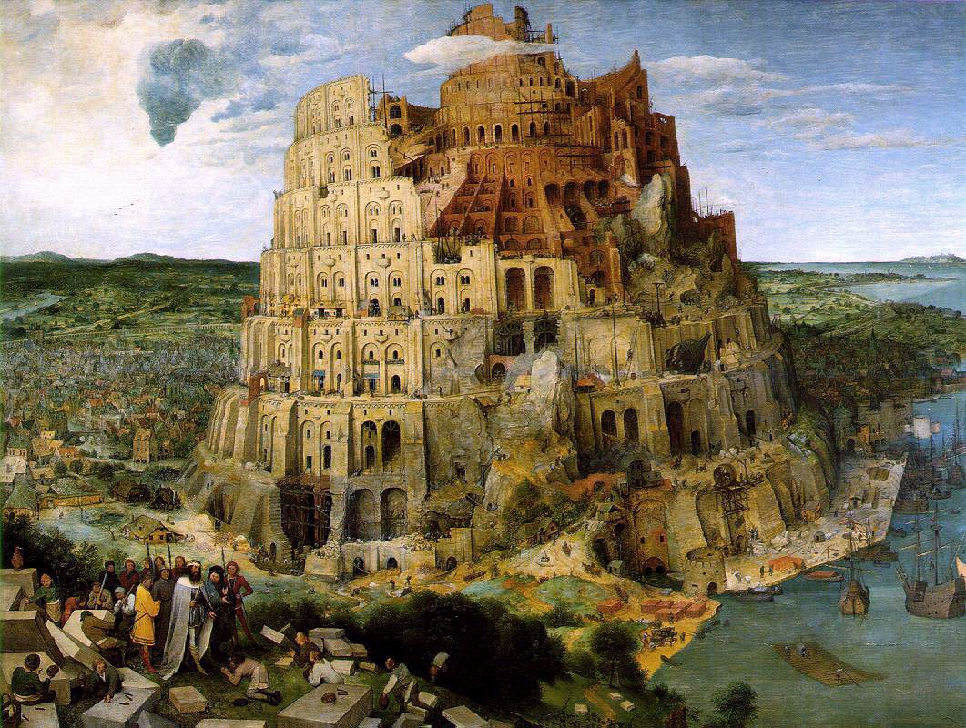
What was Abram’s world?
Abram came from Ur
Ur was ruled by Nimrod
  Dictator with a personality cult
  Name means ‘let us revolt’
  Built the Tower of Babel
Abram’s father was called Terah. He was an idol maker
Tower of Babel
Notes:
Nimrod, ‘a mighty hunter before the Lord’. Hunted people and Ensnared them leading them to rebel against God.
Nimrod the prototype for dictators such as Hitler and Stalin and Kim Il Sung. Planned economy.
Babel is the opposite, and we now have important historical evidence as to exactly what was meant by the sentence, “The entire land had one language and a common speech.” This may not refer to primal humanity before the division of languages. In fact in the previous chapter the Torah has already stated, “From these the maritime peoples spread out into their lands in their clans within their nations, each with its own language” (Gen. 10: 50. The Talmud Yerushalmi, Megillah 1: 11, 71b, records a dispute between R. Eliezer and R. Johanan, one of whom holds that the division of humanity into seventy languages occurred before the Flood).
The reference seems to be to the imperial practice of the neo-Assyrians, of imposing their own language on the peoples they conquered. One inscription of the time records that Ashurbanipal II “made the totality of all peoples speak one speech.” A cylinder inscription of Sargon II says, “Populations of the four quarters of the world with strange tongues and incompatible speech . . . whom I had taken as booty at the command of Ashur my lord by the might of my sceptre, I caused to accept a single voice.” The neo-Assyrians asserted their supremacy by insisting that their language was the only one to be used by the nations and populations they had defeated. On this reading, Babel is a critique of imperialism.
There is even a hint of this in the parallelism of language between the builders of Babel and the Egyptian Pharaoh who enslaved the Israelites. In Babel they said, “Come, [hava] let us build ourselves a city and a tower . . . lest [pen] we be scattered over the face of the earth” (Gen. 11: 4). In Egypt Pharaoh said, “Come, [hava] let us deal wisely with them, lest [pen] they increase so much . . .” (Ex. 1: 10). The repeated “Come, let us … lest” is too pronounced to be accidental. Babel, like Egypt, represents an empire that subjugates entire populations, riding roughshod over their identities and freedoms.
If this is so, we will have to re-read the entire Babel story in a way that makes it much more convincing. The sequence is this: Genesis 10 describes the division of humanity into seventy nations and seventy languages. Genesis 11 tells of how one imperial power conquered smaller nations and imposed their language and culture on them, thus directly contravening God’s wish that humans should respect the integrity of each nation and each individual. When at the end of the Babel story God “confuses the language” of the builders, He is not creating a new state of affairs but restoring the old. Interpreted thus, the story of Babel is a critique of the power of the collective when it crushes individuality

Slide 3
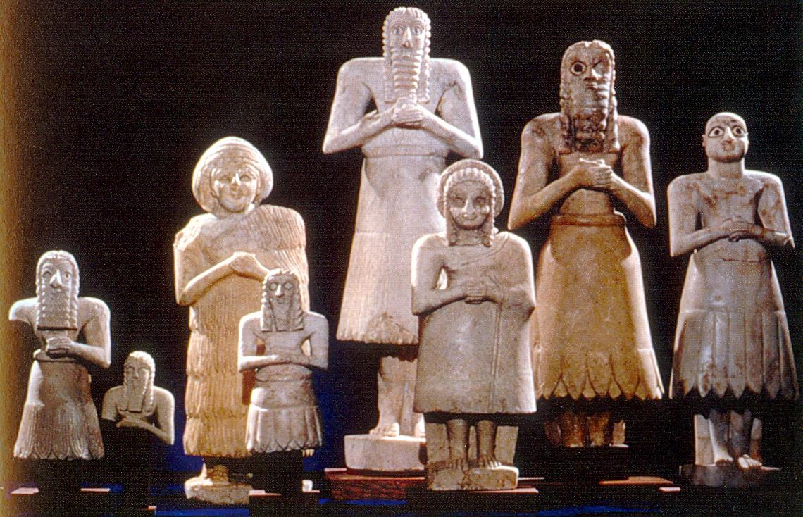
What is an idol?
A man made object worshipped as if it were a god
That which is of ultimate value to you
Worship power
“Their land is full of idols; they worship the work of their own hands, that which their own fingers have made.” Isaiah 2:8
Sumerian idols
Notes:
Idol worship – worship of self. Totem. Some religions. Nationalism.
Can religion survive, even flourish, in a secular age? The answer is an emphatic yes. The question is how.
Religions can react to change by denial. You see the signs in houses of worship where they sing the same songs and listen to the same sermons. Outside the world revolves regardless, and inside the congregation gets older and fewer.
The second option is to steal the clothes of secular society and pretend they were religious all along. The world has become political? So will we. The world celebrates sexual freedoms? So will we. The world worships the self? So will we. Eventually the world notices that religion, instead of leading society, is following it. It loses credibility.
The third option is resistance — the religiosity that opposes modernity as the work of Satan. This is fundamentalism, and it fails because it cannot handle complexity, difference and freedom.
What should religion do in a secular age? It should be a counter-voice, challenging the conventional wisdom and confronting idolatry. Every age has its idols. What are ours?
One is politics. We fall out of love with the government of the day and into the lap of a new party that promises to solve our problems without pain. We elect it. It discovers that you can’t solve deep social problems without pain, and it either chooses not to solve them or to take the path of pain. Either way, we fall out of love with it and the cycle continues. This is the triumph of hope over experience and it happens every five or ten years.
The next comes from economics. People believe the market will solve problems. We then see banks pursuing short-term gain at the long-term cost of customers and the economy. Next we put our faith in regulation, forgetting that more ingenuity will be spent on evading the rules than on applying them. The third comes from the belief that we can do without morality, especially in matters of sex. This was the magical thinking of the 1960s. We can count the cost today: children growing up without fathers, new forms of child poverty and a threefold rise in drug, alcohol and eating disorders.
Idol worship and magical thinking happen when we believe some institution or person will bend the world to our desires, making problems vanish without effort on our part. The idol can be liberal democracy, the consumer society, science, medicine or genetic engineering.
Religious faith says all these things can be a blessing or a curse, depending on whether they are used with humility, restraint, concern for the common good and care for long-term consequences.
Humility involves the recognition that there is something greater than us to whom we are accountable. Restraint means that not everything we can do we should do. Concern for the common good means recognising that others, not just us, are in the image and likeness of God. Care for long-term consequences means believing in something that will last longer than we will.
Religion is not myth or magic. It is the recognition of how small we are in the scheme of things, and how great is our responsibility to others. It is the still, small voice reminding us that there is no achievement without sacrifice, no freedom without self-restraint. Those who worship the idols of the age perish with the age, while the worship of eternity lives on.

Slide 4
What are the idols of the modern world?
Twitter – fake grief and anger
Instagram – fake envy
Tinder – fake love
Leader
Nation
Concepts
Political correctness
Image
Power
Money
Position
Cars
Computer
Celebrities
Religion
Notes:
Question:
Why is Judaism so intolerant of idolatry? I don't mean massive temples with human sacrifices. What about a civilized idolater, in the privacy of his own home. With a job, a family, a mortgage, donates to the World Hunger Fund and Greenpeace — and instead of one G‑d, he just happens to have two or three or even several dozen, all lined up on the dashboard of his car. Why does Judaism make a cardinal sin of it, demanding total eradication of idolatry in every corner the world? As long as it doesn't hurt anyone else, what's so terrible?
Answer:
There are many ways to answer this, but let's take a historical perspective. Historians agree that our current standard of ethics stems from the Jewish ethic. Yes, the Greeks gave us the natural sciences, philosophy and art; the Romans gave us governmental structure and engineering; from the Persians we have poetry and astronomy; from the Chinese, paper, printing, gunpowder, acupuncture and more philosophy, and so on. But the historical fact is that all those cultures (and all the other unmentioned cultures) sustained and even glorified attitudes and behaviors that today we universally find abhorrent. Today, if you dispose of your unwanted infants, practice pederasty, set humans to kill each other for sport, ignore the rights of those lower than you on the social ladder and refuse to acknowledge any social responsibility to the poor and the unhealthy, and can't wait to run to war against the nation next door, you are a barbarian. You may have made a wonderful citizen of Athens or Rome, but today, no club will take you.
Where did those values come from? There's only one source historians can point to: Torah. And the same for universal education and the ideal of world peace.
Now, this gives any scholar a meaty problem to solve. History is generally seen as something of a wild and diverse forest, where one thing grows from another. Seeds fall and sprout. Trees branch out and flourish, then fall and nurture mushrooms off their rotting wood. All the vegetation and creatures of the forest share the same air, water and soil and no creature exists alone. So, too, one civilization arises out of the mud, branches out, and falls to become the breeding ground of the next. Ideas move about, in perpetual metamorphosis as they pass through the filters of variant cultures. Whatever is, was — and will eventually pass.
All except for the Jews. Entirely out of context, with an ethic that had every nation calling them crazy and absurd, ever-radical, always out of step. Definitely not part of this forest. And in the end, their ethic wins.
There's got to be some explanation. First of all, where did they get these weird ideas? And telling me that the Almighty G‑d snatched them out of slavery and dictated it all to them doesn't work. It's true, but it's not enough. Because human beings can only hear that which they know already. There had to be something there from before.
The classic answer is that once there was a man named Abraham, from Ur of the Chaldees — the original seat of civilization. He came up with this standard through his own maverick genius. Of course, being ingenious, brave and dissident wasn't enough. His task also demanded the tenacity and conviction to raise up a generation that would carry on this idea, swimming upstream against all odds of the dominant society. And then, over many ages, this ethic proved itself as the most effective backbone of a sustainable society.
Now, tell me, does any rational scholar really believe such a scenario?
In fact, the version supported by the Talmud and described in detail by the Rambam (Maimonides) is far more believable:
The ethic that Abraham presented to the world had been there from the beginning. Humankind had originally known that each person bore the Divine image. That life was with purpose. That the world was the work of a supernal entity that desired we take care of it and judged us accordingly. Even in Abraham's time, there endured lone individuals who preached this to their disciples, as a tradition from Adam, through Methuselah and Noah.
But we're talking about human beings. Precisely due to that Divine spark within, the human is also the wild and crazy creature that seeks out the most bizarre approach to life, ready and capable to do anything. So, human society in general abandoned the original standard of Adam for "that which feels good." Law became no more than a way for a king to govern his people. Ethics became no more than the custom that felt most comfortable to the most people. The only measure of the value of a human life was the degree of power a human held. And the natural world was understood as a worthless place, not worth any investment beyond that which produced food and power over others.
Abraham didn't have to begin from scratch with humanity. He only had to rescue that original ethic. But he also re-discovered — and this he did do on his own — the base that made that ethic sustainable: Monotheism. More specifically: monotheistic providence. Simply put: Every adult and child must know there is a single Creator of all things, who cares about what you are doing with His world.
Why are monotheism and providence so essential? Again, back to history, according to the traditional Jewish sources:
Abraham's predecessors had also known of the one G‑d, creator of heaven and earth. But they understood G‑d as far too sublime and transcendent to be occupied with this mundane world and its creatures. They began to chip away at His providence, asserting that lesser powers, of His appointment, had been granted a share of dominion. They went so far as to build temples where they focused their minds upon the dynamics of these forces, attaining spiritual heights and mystic power. Eventually, wisdom gave way to charlatanism, as priests told the masses that a certain star or god or goddess had spoken to them, commanding them to serve him or her in a certain fashion. Rulers found that a good mix of secret knowledge and convenient mythology could be an instrument of power over the populace; that by controlling the flow of knowledge they were able to hold the people in awe and obedience.
This is where Abraham dissented. He saw through the established order with its hierarchy of knowledge and power, and reasoned it to be the source of all evil. And he saw to the root of it: As long as G‑d was "up there" and everything else was seen as lying on a descending plane further and further removed from His domain, this evil would continue.
Within such a paradigm, human life loses its essential value. You as an individual no longer count. All that matters is how high you are up on the scale. Not only human rights, but also the advance of technology is hindered — by the need of the ruling class to keep the masses working. All progress is to further empower the powerful. Public health, welfare and education are absurdities. So Abraham challenged that hierarchy. He taught each person to call upon the name of the One G‑d of the heavens and the earth, who judges the deeds of all men equally, from the highest king to the most lowly serf. By putting the original G‑d back into the world, Abraham recreated the "person" — a human who is of value just by being there.
Within the old paradigm, ethics have no base to stand on. If you don't like what one god demands of you, you go find another god more to your taste. Or you work around these gods, tricking or bribing them, as they themselves are wont to do with one another. After all, none of them is supreme, none is all-powerful. Therefore, anything could be justified. So Abraham smashed the idols. Once there is only one G‑d, who supervises all things, morality is no longer relative. All ethics are determined not by the flux of social convenience, but by His intransient standard.
Without Abraham's base to ethics, society has no stability. Any institution could be shaken to the ground by changing circumstance and the whims of human desire. In Ancient Greece, the institution of marriage bordered on collapse due to their gender-preference, while in Rome, the family unit was gradually dismantled by promiscuity. The institutions that should have nurtured human spirituality in many societies became corrupted into bloody orgies and worship of the senses. In many instances, such as in the Far East, poverty was allowed to grow to unmanageable proportions while a select few amassed an immense concentration of power—all due to the void of a sense of social responsibility. In our day and age, with the origin of species attributed to the mystical gods of chance and natural law, the most horrid crimes against humanity were committed and the very biosphere is now threatened. Only once the building blocks of society stand upon the solid ground of the One Who Created Everything in the First Place, can a sustainable society develop.
Truth be told, Abraham's message also began to perish with time. It wasn't until monotheistic providence transcended the realm of ideas and became the real-life experience of a people that it was truly able to stick. And that is just what happened at Mount Sinai, when Abraham's descendants came face-to-face with marching orders directly from Above. The concept of a "mitzvah" entered the world — something you do because G‑d wants it done. And that basis has proven eternally resilient.
As for the rest of the nations, as the Rambam writes, they were also commanded at Mount Sinai — to keep the seven mitzvahs of Adam and Noah, which include the prohibition against polytheism.
Today, we are witnessing the most dramatic results of Abraham's strategy in action: Our progress in the last 500 years, to the point of the current empowerment of the consumer with technology and information, only became possible through the rise of this ethic. In a polytheistic world, this could never have occurred. It was only once the people of Europe began actually reading the Bible and discussing what it had to say to them, that the concepts of human rights, social responsibility, the value of life, and eventually the ideal of world peace took a front seat in civilization's progress. And it is only such a world that could have developed public education and health care, old age pension, telephones, fax machines, personal computers, the Internet, environmental design and nuclear disarmament.
We are too much a part of the flow to recognize this; the blanket of darkness that endures, fighting to its last breath, preoccupies our minds. But if we could travel back in time and describe to the Jew of past ages the world we have today — a world that values life, world peace, individual rights, freedom of expression, literacy, knowledge and compassion for those who have less — that Jew would undoubtedly respond, wide-eyed, "You mean, it is the days of Moshiach?"
-- A time that began when a young boy in Sumeria took a hammer and smashed the idols in his father's house.1
FOOTNOTES
1.
Further Reading: The Jewish version of history is scattered throughout the Talmud, but the comprehensive overview is in the opening of Maimonides' Laws of Idolatry. This is essential reading. So is the Lubavitcher Rebbe's talk that illuminates that overview, presented in Likutei Sichot, volume 20, pp 13-24. Most of this essay is based on those two sources.
For an enlightening account of the Jewish impact on history, three popular books are: Rabbi Dr. Jonathan Sacks' A Letter in the Scroll, Paul Johnson's A History of the Jews, and Thomas Cahill's The Gifts of the Jews. An engaging audio tape on the topic is Ken Spiro's World Perfect.

Slide 5
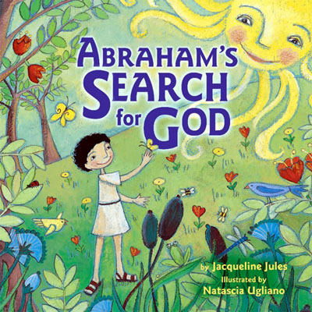
Why could God choose Abram?
Abram discovers God
Abram’s belief in God was
based on reason:
There must be a First Cause
There must be an unchanging
reality behind the changing
world of phenomena
Notes:
"When night outspread over him he say a star and said, 'This is my Lord.' But when it set he said, 'I love not the setters.' When he saw the moon rising, he said, 'This is my Lord.' But when it set he said, 'If my Lord does not guide me I shall surely be of the people gone astray.' When he say the sun rising, he said, 'This is my Lord; this is greater.' But when it set he said, 'O my people, surely I quit that which you associate, I have turned my face to Him Who originated the heavens and the earth; a man of pure faith, I am not of the idolaters.'" (6:76-79)
How did Abraham discover God?
Abraham was the son of Terah an idol maker. He lived in Ur one of the first cities in human history. Now the ruler of Ur was a man called Nimrod. He was the archetype of all the dictators who ever lived. He thought he was god and there was a huge personality cult associated with him. People used to have statues of him in their homes and would worship him thinking that all good things in their city came from him. One night Nimrod had a frightening dream. He dreamt that a man would be born who would teach people about the True God and expose him was a fake. Nimrod woke up trembling with anger. He was outraged at the idea that there was a being greater than him. He decided to build a tower to attack heaven where he had heard this God lived and kill him. To do this he forced his subjects to the Tower of Babel from which his archers could shoot arrows into the clouds where God lived.
Meanwhile, Terah and his wife had a son who they called Abram. Now, Abram was a very clever little boy who was always asking questions. Why this and why that and why the other. He was really quite a little philosopher. One day he realised that he hadn’t always been alive. He must have come from somewhere. So he asked his Mum and Dad where he came from. They explained that they had given birth to him. When Abram understood the significance of this, that his parents had created him, he immediately bowed down to them and started worshipping them. Every day he would bow to his parents as if they were gods. After a while though, it occurred to him that his parents hadn’t made themselves either. So he asked them where they came from. They said that Grandma and Grandpa had given birth to him. So he left off worshipping his parents and went round to his grandparents house and started bowing to them. Soon he realised that they hadn’t made themselves either and asked them who had created them. They replied that they too had parents but they had died and were buried in the local cemetery. So Abram set off for the cemetery, found the graves, and started bowing down to worship them and all his ancestors. One day a nearby grave was dug up and he saw that all that was left of the person were white bones and he realised that the body had decayed and become part of the earth. So he started to worship ‘mother earth’ which had given him his body. One cold day he realised that without the sun there would be no life and so he became a sun worshipper. But the sun set every evening in the west and rose every morning in the east. It too was changing. But Abram realised that behind everything that was changing there must be an unchanging reality. There must be an invisible first cause that created the universe and everything in it. He decided he was going to worship and pray to the invisible God who created the heavens and the earth.
Bereshith or Genesis Rabbah: (60-61)
Terah, the father of Abraham and Haran, was a dealer in images as well as a worshiper of them. Once when he was away he gave Abraham his stock of graven images to sell in his absence. In the course of the day an elderly man came to make a purchase. Abraham asked him his age, and the man gave it as between fifty and sixty years. Abraham taunted him with want of sound sense in calling the work of another man's hand, produced perhaps in a few hours, his god; the man laid the words of Abraham to heart and gave up idol-worship. Again, a woman came with a handful of fine flour to offer to Terah's idols, which were now in charge of Abraham. He took a stick and broke all the images except the largest one, in the hand of which he placed the stick which had worked this wholesale destruction. When his father returned and saw the havoc committed on his "gods" and property he demanded an explanation from his son whom he had left in charge. Abraham mockingly explained that when an offering of fine flour was brought to these divinities they quarreled with one another as to who should be the recipient, when at last the biggest of them, being angry at the altercation, took up a stick to chastise the offenders, and in so doing broke them all up. Terah, so far from being satisfied with this explanation, understood it as a piece of mockery, and when he learned also of the customers whom Abraham had lost him during his management he became very incensed, and drove Abraham out of his house and handed him over to Nimrod. Nimrod suggested to Abraham that, since he had refused to worship his father's idols because of their want of power, he should worship fire, which is very powerful. Abraham pointed out that water has power over fire. "Well," said Nimrod, "let us declare water god." "But," replied Abraham, "the clouds absorb the water; and even they are dispersed by the wind." "Then let us declare the wind our god." "Bear in mind," continued Abraham, "that man is stronger than wind, and can resist it and stand against it."
Nimrod, becoming weary of arguing with Abraham, decided to cast him before his god--fire--and challenged Abraham's deliverance by the God of Abraham, but God saved him out of the fiery furnace. Haran, too, was challenged to declare his god, but halted between two opinions, and delayed his answer until he saw the result of Abraham's fate. When he saw the latter saved he declared himself on the side of Abraham's God, thinking that he too, having now become an adherent of that God, would be saved by the same miracle. But since his faith was not real, but depended on a miracle, he perished in the fire, into which, like Abraham, he was cast by Nimrod. This is hinted in the words (Gen. xi. 28): "And Haran died before his father Terah in the land of his nativity, in Ur of the Chaldees."

Slide 6
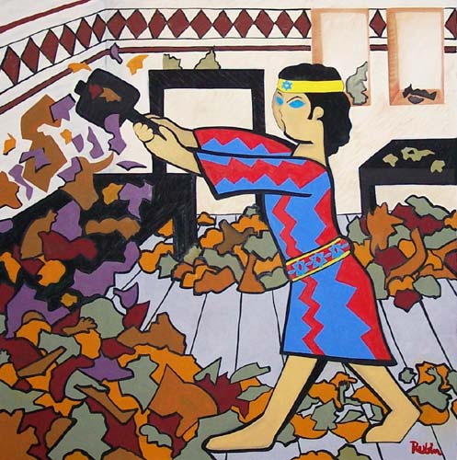
Abram changes his lineage
Abram discovers God
Abram and the idols
Notes:
Parents
Change of ID
Change of lineage
Risk of life
Idol – something not God but worship as if it were God
Qur’an 37
Surely Ibrahim belonged to the first group (who followed Nuh's way),
84 when he came to his Rabb with a pure heart.
85 Behold, he said to his father and to his people: "What are these that you worship?
86 Would you serve false gods instead of Allah?
87 What is your idea about the Rabb of the worlds?"
88 Then he looked at the stars one time
89 and said "I am feeling sick."
90 So his people left him behind and went away to their national fair.
91 He sneaked into the temple of their gods and addressed them: "Why don't you eat from these offerings before you?
92 What is the matter with you that you don't even speak?"
93 Then he fell upon them, smiting them with his right hand.
94 The people came running to the scene.
95 "Would you worship that which you have carved with your own hands," he said,
96 "when Allah is the One Who created you and that which you have made?"
97 They said to one another: "Prepare for him a furnace and throw him into the blazing flames."
98 Thus did they scheme against him: but We humiliated them in their scheme.
Abram was a very helpful boy at home even though his questions sometimes drove his parents mad. One day his father, Terah, said to him, “Abram, tomorrow is market day but I have an important meeting to go to at the palace. So would you take the idols to the market and run the stall for me tomorrow please.”
“Of course,” said Abram, “I’d be happy to.”
So next day Abram took the wagon out of the garage and loaded it up with the idols his father had made and set off for the market. When he arrived he set up his stall, carefully displaying all the idols with their price tags.
Soon an elderly woman came up to him and said, “I want to buy one of your gods Abram. How much are they?”
“Why?” asked Abram, “what happened to the gods you bought before?”
“Someone broke into my house last week and stole them,” said the woman.
“Well, they weren’t very powerful were they if someone could steal them.”
“No” said the woman, “that’s why I want to buy yours. I am sure they are much stronger.”
“How old are you, old woman?” asked Abram who could sometimes not be as polite as he ought to be.
“Eighty-five years old last month,” she replied proudly.
“Well, my Dad made these gods in his workshop last month. You are much older than they are so they ought to bow down and worship you.”
“You’re right Abram,” she said, “So who do you worship then?”
“I worship the invisible God who created the heavens and the earth,” he replied.
“I think I am going to worship him too,” she said and became Abram’s first disciple.
At the end of the day Abram packed up his stall, loaded up the wagon and went home. When he arrived Terah was eagerly waiting for him.
“How did you get on?” he asked, “Did you sell out?”
“No, Dad. I didn’t sell a single idol.”
“What!” exclaimed Terah, “What happened? Weren’t there any customers? Was someone else selling them for less?”
“No Dad,” Abram replied and he told his father what had happened.
Terah slapped his forehead and said, “You’re a useless salesman. Of course no one would buy anything from you if that was your sales patter. Next time you can stay at home and I’ll go to the market.”
The following month Terah called Abram and said to him, “Look Abram, tomorrow is market day again. I’ll take the idols to sell but I want you to remain at home and look after the gods in the temple.”
The next day, after waving good bye to his father, Abram went into the temple to see the gods. He went up to the largest one at the front of the temple and in a loud voice said to him, “If you are really god, tell me what your message is and I will tell it to the world.” The idol though said nothing.
“OK,” said Abram, “Perhaps you are hungry. I’ll go into the kitchen and make you some lunch and then we can sit down and talk.” So Abram went out and prepared lunch for the idol. He came back in, placed the food at the foot of the idol and waited for him to eat. When he didn’t Abram said, “Alright then, I expect you want to eat in peace so I’ll leave you and come back in an hour.”
An hour later Abram went back to the temple and found that the food was still untouched. So he spoke to the idol saying, “You are not a god. You have no power. You cannot speak and have no message. You are just carved stone and the rest of you are just wood.”
Then he went to his father’s workshop and picked up an axe. Returning to the temple he walked around smashing and chopping up all the small idols. Then he carefully placed the axe in the hands of the largest idol and walked out.
At the end of the day Terah came home. He was tired but happy as he had sold out. He went straight to the temple to offer the money to the gods and thank them for their help. But when he opened the door, he was greeted by a scene of destruction.
“Abram! Abram!” he shouted, “What happened? I left you to look after the gods. Did some vandals break in and destroy them?”
“No,” said Abram, “I did exactly what you said. The largest idol complained that he was hungry so I made him a delicious meal. Look you can still see it at his feet. Then I left him to enjoy it in peace. Soon I heard the other smaller gods asking him to share the food with them. But he refused and told them to shut up. But they wouldn’t so he beat them all up. And look. There is the evidence. The axe is in his hands.”
“What are you talking about?” exclaimed Terah, “They are just pieces of stone and wood. They have no power. They cannot speak or move.”
“Exactly,” said Abram, “So why do you worship them?”
Terah was stunned. “So who do you worship then son?”
“I worship the invisible God who created the heavens and the earth. I talk to him and he talks back to me. I can feel his presence around me everyday.”
“You had better come and see Nimrod with me,” said Terah, “He will want to hear about this.”
So off they went to visit Nimrod in the palace. When Terah appeared in front of Nimrod he bowed to the ground but Abram stood upright and looked him in the eyes. Nimrod and all his courtiers were shocked.
“How dare you stand there and stare at me,” shouted Nimrod. “Why don’t you bow down and worship your god like everyone else?”
“I only bow down and worship the invisible God who created the heavens and the earth. He is your creator too and one day he will judge you for your evil deeds,” said Abram boldly.
Nimrod was enraged and he remembered the dream he had had about just such a boy. He said to Abram, “If you don’t bow down and worship me I will have you put to death.”
“I am not afraid of you,” said Abram. “I believe in God. He is my creator, the one whom I love and worship. He is more real to me than this world, more real than this palace and more real than you. If you kill me I will still be with him.”
Nimrod had Abram seized and thrown into a burning furnace. But the flames didn’t touch him and he emerged unscathed. Nimrod decided the best thing to do was to expel Abram and never allow him to return. At this point Terah decided perhaps it was time for the whole family to leave. So they packed up all their belongings and set off for Haran where they could be safe and Abram could carry on telling people about the invisible God who created the heavens and the earth and with whom one talk and whose loving presence and power one could feel.
This is how Abraham changed his lineage from that of the son of an idol maker to a son of God. At the risk of his life he refused to worship Nimrod and the idols of his day. Instead he declared that his identity came from his relationship with God.
_
(Freely adapted from the stories in the Talmud and Qur'an)

Slide 7
Abram changed his lineage
Where is the change of blood lineage done? On the individual level, man has to go beyond the boundary of life and death. The individual has to go through life and death situations for the sake of God and the future dignity of man.
(True Father, 1970)
Notes:
Life and death situations. Challenging situations. Extreme situations. How did Abraham change his lineage and be qualified.

Slide 8
Inner-directedness: the courage to be different
Abraham’s entire life was governed by an inner voice, the voice of God. He did not behave the way he did because that is how people had always acted, nor did he conform to the customs of his age. He had the courage to “be on one side while all the rest of the world was on the other.” Jonathan Sacks
Notes:
It is one of the most important words in Judaism, and also one of the least understood. Its two most famous occurrences are in last week’s parsha and this week’s: “Hear O Israel, the Lord our God, the Lord is one,” and “It shall come to pass if you surely listen to My commandments which I am commanding you today, to love the Lord your God and to serve Him with all your heart and all your soul” – the openings of the first and second paragraphs of the Shema. It also appears in the first line of the parsha: “It shall come to pass, if you listen to these laws.”
The word, of course, is shema. I have argued elsewhere that it is fundamentally untranslatable into English since it means so many things: to hear, to listen, to pay attention, to understand, to internalise, to respond, to obey. It is one of the motif-words of the book of Devarim, where it appears no less than 92 times – more than in any other book of the Torah. Time and again in the last month of his life Moses told the people, Shema: listen, heed, pay attention. Hear what I am saying. Hear what God is saying. Listen to what he wants from us. If you would only listen … Judaism is a religion of listening. This is one of its most original contributions to civilisation.
The twin foundations on which Western culture was built were ancient Greece and ancient Israel. They could not have been more different. Greece was a profoundly visual culture. Its greatest achievements had to do with the eye, with seeing. It produced some of the greatest art, sculpture and architecture the world has ever seen. Its most characteristic group events – theatrical performances and the Olympic games – were spectacles: performances that were watched. Plato thought of knowledge as a kind of depth vision, seeing beneath the surface to the true form of things.
This idea – that knowing is seeing – remains the dominant metaphor in the West even today. We speak of insight, foresight and hindsight. We offer an observation. We adopt a perspective. We illustrate. We illuminate. We shed light on an issue. When we understand something, we say, “I see.”[1]
Judaism offered a radical alternative. It is faith in a God we cannot see, a God who cannot be represented visually. The very act of making a graven image – a visual symbol – is a form of idolatry. As Moses reminded the people in last week’s parsha, when the Israelites had a direct encounter with God at Mount Sinai, “You heard the sound of words, but saw no image; there was only a voice.” (Deut. 4:12). God communicates in sounds, not sights. He speaks. He commands. He calls. That is why the supreme religious act is Shema. When God speaks, we listen. When He commands, we try to obey.
Rabbi David Cohen (1887–1972), known as the Nazirite, a disciple of Rav Kook and the father of R. Shear-Yashuv Cohen, chief rabbi of Haifa, pointed out that in the Babylonian Talmud all the metaphors of understanding are based not on seeing but on hearing. Ta shema, “come and hear.” Ka mashma lan, “It teaches us this.” Shema mina, “Infer from this.” Lo shemiyah lei, “He did not agree.” A traditional teaching is called shamaytta, “that which was heard.” And so on.[2] All of these are variations on the word shema.[3]
This may seem like a small difference, but it is in fact a huge one. For the Greeks, the ideal form of knowledge involved detachment. There is the one who sees, the subject, and there is that which is seen, the object, and they belong to two different realms. A person who looks at a painting or a sculpture or a play in a theatre or the Olympic games is not himself part of the art or the drama or the athletic competition. He or she is a spectator, not a participant.
Speaking and listening are not forms of detachment. They are forms of engagement. They create a relationship. The Hebrew word for knowledge, da’at, implies involvement, closeness, intimacy. “And Adam knew Eve his wife and she conceived and gave birth” (Gen. 4:1). That is knowing in the Hebrew sense, not the Greek. We can enter into a relationship with God, even though He is infinite and we are finite, because we are linked by words. In revelation, God speaks to us. In prayer, we speak to God. If you want to understand any relationship, between husband and wife, or parent and child, or employer and employee, pay close attention to how they speak and listen to one another. Ignore everything else.
The Greeks taught us the forms of knowledge that come from observing and inferring, namely science and philosophy. The first scientists and the first philosophers came from Greece from the sixth to the fourth centuries BCE.
But not everything can be understood by seeing and appearances alone. There is a powerful story about this told in the first book of Samuel. Saul, Israel’s first king, looked the part. He was tall. “From his shoulders and upward he was higher than any of the people,” (1 Sam. 9:2, 10:23). He was the image of a king. But morally, temperamentally, he was not a leader at all; he was a follower.
God then told Samuel to anoint another king in his place, and told him it would be one of the children of Yishai. Samuel went to Yishai and was struck by the appearance of one of his sons, Eliav. He thought he must be the one God meant. But God said to him, “Do not be impressed by his appearance or his height, for I have rejected him. God does not see as people do. People look at the outward appearance, but the Lord looks at the heart” (1 Sam. 16:7).
Jews and Judaism taught that we cannot see God, but we can hear Him and He hears us. It is through the word – speaking and listening – that we can have an intimate relationship with God as our parent, our partner, our sovereign, the One who loves us and whom we love. We cannot demonstrate God scientifically. We cannot prove God logically. These are Greek, not Jewish, modes of thought. I believe that from a Jewish perspective, trying to prove the existence of God logically or scientifically is a mistaken enterprise.[4] God is not an object but a subject. The Jewish mode is to relate to God in intimacy and love, as well as awe and reverence.
One fascinating modern example came from a Jew who, for much of his life, was estranged from Judaism, namely Sigmund Freud. He called psychoanalysis the “speaking cure”, but it is better described as the “listening cure.”[5] It is based on the fact that active listening is in itself therapeutic. It was only after the spread of psychoanalysis, especially in America, that the phrase “I hear you” came into the English language as a way of communicating empathy.[6]
There is something profoundly spiritual about listening. It is the most effective form of conflict resolution I know. Many things can create conflict, but what sustains it is the feeling on the part of at least one of the parties that they have not been heard. They have not been listened to. We have not “heard their pain”. There has been a failure of empathy. That is why the use of force – or for that matter, boycotts – to resolve conflict is so profoundly self-defeating. It may suppress it for a while, but it will return, often more intense than before. Job, who has suffered unjustly, is unmoved by the arguments of his comforters. It is not that he insists on being right: what he wants is to be heard. Not by accident does justice presuppose the rule of audi alteram partem, “Hear the other side.”
Listening lies at the very heart of relationship. It means that we are open to the other, that we respect him or her, that their perceptions and feelings matter to us. We give them permission to be honest, even if this means making ourselves vulnerable in so doing. A good parent listens to their child. A good employer listens to his or her workers. A good company listens to its customers or clients. A good leader listens to those he or she leads. Listening does not mean agreeing but it does mean caring. Listening is the climate in which love and respect grow.
In Judaism we believe that our relationship with God is an ongoing tutorial in our relationships with other people. How can we expect God to listen to us if we fail to listen to our spouse, our children, or those affected by our work? And how can we expect to encounter God if we have not learned to listen. On Mount Horeb, God taught Elijah that He was not in the whirlwind, the earthquake or the fire but in the kol demamah dakah, the “still, small voice”[7] that I define as a voice you can only hear if you are listening.
Crowds are moved by great speakers, but lives are changed by great listeners. Whether between us and God or us and other people, listening is the prelude to love.

Slide 9
Abraham the ancestor of faith
Abraham was determined that no matter what kind of ordeals and difficulties he might face, he would overcome them hundreds and thousands of times. The heart of Abraham and the heart of God, who was desperately looking for a reciprocal object, came together in unity. God was able to proudly give Abraham His blessings, which included the garden of the absolute ideal for which God longed. This is how Abraham was put in the blessed position of being the ancestor of faith before Heaven.
Sun Myung Moon, Let Us Understand God. Who Wanted to Be Proud, 8 February 1959
Notes:
Abraham initiated the quest for God. He was a creative religious personality – the father of all those who set out on a journey of the spirit to an unknown destination, armed only with the trust that those who seek, find. Abraham sought God before God sought him.

Slide 10
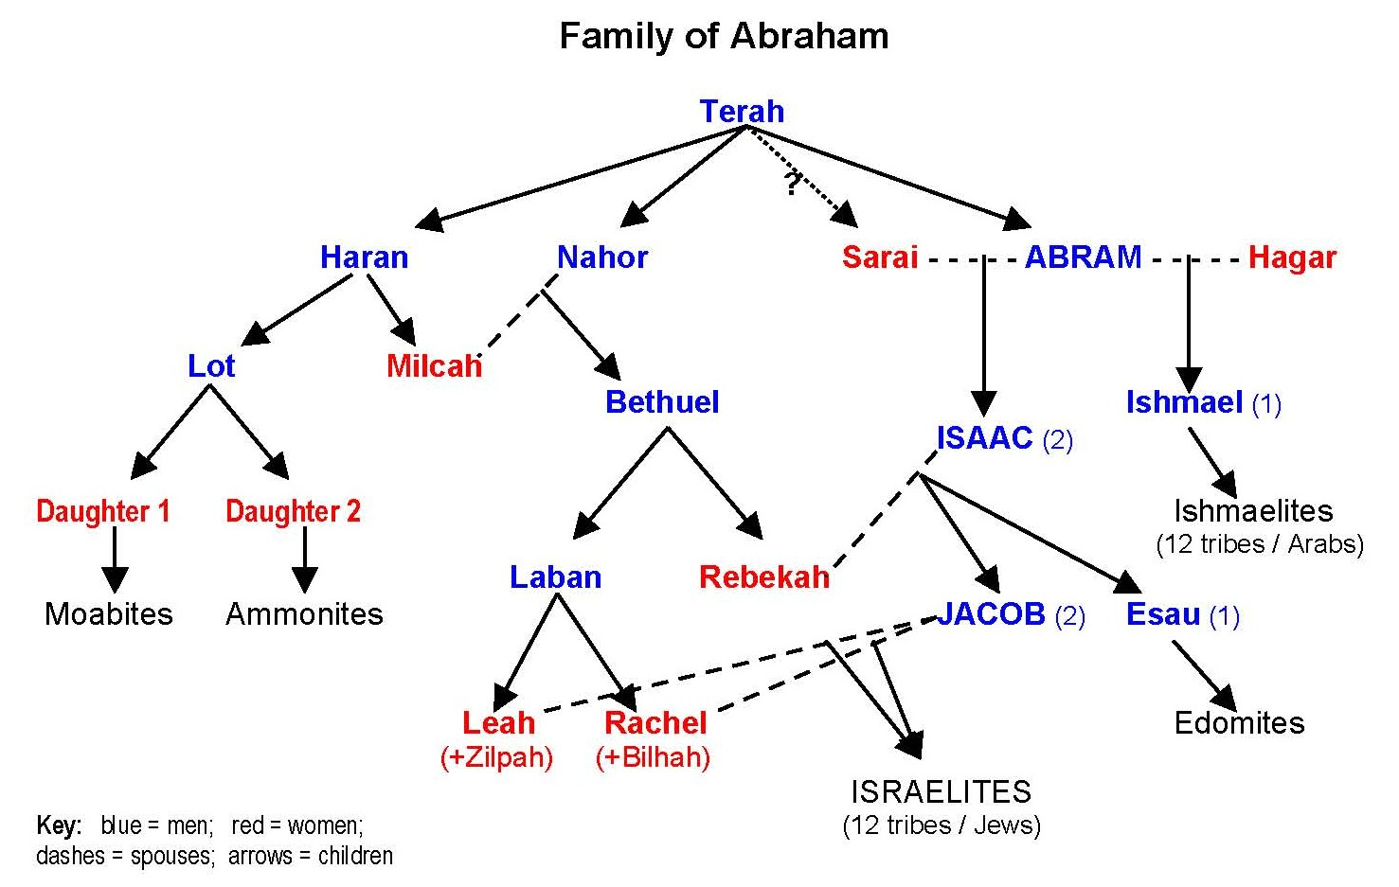
Terah’s family move to Haran
Notes:
Terah is the father of both Abraham and Sarah, by different wives. That is why Sarah was Abraham’s half-sister (Gen. 20:12). Thus, Isaac had only one grandfather. Gen. 20:13: “Moreover, she is indeed my sister, my father’s daughter, though not my mother’s daughter; and she became my wife.” (Note that Abraham said this to appease Abimelech. It was actually only figuratively true in his case, since Sarah was the daughter of Abraham’s brother. So they had the same paternal grandfather, who people often referred to as “father.”)
This puts Terah in the same position as Zechariah, who was the father of both Jesus and also Jesus’ would-be bride, John the Baptist’s sister. The reason behind this providence in Jesus’ family was to make Jesus and his wife the second Adam and Eve. Adam and Eve were also brother and sisters, with only one father—God.
According to the Principle, Abraham and Sarah were supposed to “restore the positions of Adam’s family” (p. 209) in the incident when they went down to Egypt and posed as brother and sister (Gen. 12:10-20). This, it is said, would have created a ‘model course’ for Jesus. So it is significant that God set up Abraham’s family to have one grandfather-figure, Terah, in the same way that Jesus’ family was later set up to have one grandfather-figure, Zechariah.

Slide 11
What is Abram’s place in God’s providence?
Now the Lord said to Abram, “Go from your country and your kindred and your father’s house to the land that I will show you. And I will make of you a great nation, and I will bless you and make your name great, so that you will be a blessing. I will bless those who bless you, and him who dishonours you I will curse, and in you all the families of the earth shall be blessed.”
Genesis12:1-3
More than half the world’s population are descended from Abraham
Notes:
Don’t be defined by past.
75 years old left Haran
Speak about patriarchs with respect
When God says to Abraham, – Leave your land, your birthplace and your father’s house and go to the land which I will show you, that is the birth of a concept of time as a journey. Time as a way of travelling towards a destination. Time as a narrative that has a beginning, middle and an end. That is a revolutionary concept of time born in Judaism and a very important one indeed. Linear time is a Jewish idea. Ancients only had cyclical time – repetitive. No progress.
Marx said that human beings are determined by the play of economic forces, by class differences, by who owns land. Therefore God said to Abraham:– Leave the land. Spinoza said that human beings are determined by the circumstances of their birth, by what today we would call genetic instincts and therefore God said to Abraham: Leave the place of your birth. Freud said that human beings are determined by our early childhood experiences and therefore God said to Abraham: Leave your father’s house.
That, I think, is actually at least a little fragment of the truth because God was telling Abraham to leave behind all the things that determine our future. That seem to suggest that we have no choice in what we become, that are deterministic. And He is saying to Abraham: Leave that world and embark on a journey of radical freedom.

Slide 12
Change of lineage = change of identity
Now the Lord said to Abram, “Go from your country and your kindred and your father’s house to the land that I will show you.” Genesis 12:1
Leaving behind all the traditional sources of identity
“Go by yourself.” Only a person willing to stand alone, singular and unique can worship the God who is alone, singular and unique. Only one able to leave behind the natural sources of identity can encounter God who stands above and beyond nature. A journey into the unknown is one of the greatest possible expressions of freedom. God wanted Abraham and his children to be a living example of what it is to serve the God of freedom, in freedom, for the sake of freedom.
Notes:
There is, however, a fourth interpretation: “Go by yourself.” Only a person willing to stand alone, singular and unique can worship the G-d who is alone, singular and unique. Only one able to leave behind the natural sources of identity can encounter G-d who stands above and beyond nature. A journey into the unknown is one of the greatest possible expressions of freedom. G-d wanted Abraham and his children to be a living example of what it is to serve the G-d of freedom, in freedom, for the sake of freedom.
75 years old left Haran And I will make of you a great nation, and I will bless you and make your name great, so that you will be a blessing. I will bless those who bless you, and him who dishonours you I will curse, and in you all the families of the earth shall be blessed.”
Change of lineage= change of identity.
identity not coming from the country– from his nationality
identity not coming from kindred – circumstances of his birth or social class
identity not coming from his physical lineage– his genetic inheritance
When God says to Abraham, – Leave your land, your birthplace and your father’s house and go to the land which I will show you, that is the birth of a concept of time as a journey. Time as a way of travelling towards a destination. Time as a narrative that has a beginning, middle and an end. That is a revolutionary concept of time born in Judaism and a very important one indeed. Linear time is a Jewish idea. Ancients only had cyclical time – repetitive. No progress.
Marx said that human beings are determined by the play of economic forces, by class differences, by who owns land. Therefore God said to Abraham:– Leave the land. Spinoza said that human beings are determined by the circumstances of their birth, by what today we would call genetic instincts and therefore God said to Abraham: Leave the place of your birth. Freud said that human beings are determined by our early childhood experiences and therefore God said to Abraham: Leave your father’s house.
That, I think, is actually at least a little fragment of the truth because God was telling Abraham to leave behind all the things that determine our future. That seem to suggest that we have no choice in what we become, that are deterministic. And He is saying to Abraham: Leave that world and embark on a journey of radical freedom.
Blessing: The Hebrew word בָּרוּךְ (blessed) conveys the idea of being strengthened, of our weakness being compensated for with G-d’s strength. The field of meaning of its root (ברך) is “to kneel, bless, praise, salute.”
One of the nouns which derives from this root is the Hebrew word for “knee” (בֶּרֶך), which is one of the weakest parts of the body; i.e. the English idiom for fear-stricken “weak in the knees.” You can see even in English the relationship between the two words “knee” and “kneel.” In our weakness, we kneel before G-d and He provides His strength (lit. blessing). Thus a blessing from G-d is empowerment to be able to do what is not within our natural capabilities. Some of the contexts in which blessing occurs include the end of a worship service, when we are sent back out into the pagan world – often the priestly blessing (Numbers 6:24-26): Blessings are also a traditional part of a Jewish wedding, for without G-d’s help, how much more difficult marriage would be! The marriage contract has three partners: the husband, the wife, and the L-rd. As Ecclesiastes reminds us, “A cord of three strands is not easily broken.”

Slide 13
Change of lineage = change of identity
Now the Lord said to Abram, “Go from your country and your kindred and your father’s house to the land that I will show you.” Genesis 12:1
‘Go from your country’
  Your identity does not depend on your nationality
’Go from your kindred’
  Your identity does not depend on the circumstances of your birth, your social class
‘Go from your father’s house’
  Your identity does not depend on your genetic inheritance
Notes:
There is, however, a fourth interpretation: “Go by yourself.” Only a person willing to stand alone, singular and unique can worship the G-d who is alone, singular and unique. Only one able to leave behind the natural sources of identity can encounter G-d who stands above and beyond nature. A journey into the unknown is one of the greatest possible expressions of freedom. G-d wanted Abraham and his children to be a living example of what it is to serve the G-d of freedom, in freedom, for the sake of freedom.
75 years old left Haran And I will make of you a great nation, and I will bless you and make your name great, so that you will be a blessing. I will bless those who bless you, and him who dishonours you I will curse, and in you all the families of the earth shall be blessed.”
Change of lineage= change of identity.
identity not coming from the country– from his nationality
identity not coming from kindred – circumstances of his birth or social class
identity not coming from his physical lineage– his genetic inheritance
When God says to Abraham, – Leave your land, your birthplace and your father’s house and go to the land which I will show you, that is the birth of a concept of time as a journey. Time as a way of travelling towards a destination. Time as a narrative that has a beginning, middle and an end. That is a revolutionary concept of time born in Judaism and a very important one indeed. Linear time is a Jewish idea. Ancients only had cyclical time – repetitive. No progress.
Marx said that human beings are determined by the play of economic forces, by class differences, by who owns land. Therefore God said to Abraham:– Leave the land. Spinoza said that human beings are determined by the circumstances of their birth, by what today we would call genetic instincts and therefore God said to Abraham: Leave the place of your birth. Freud said that human beings are determined by our early childhood experiences and therefore God said to Abraham: Leave your father’s house.
That, I think, is actually at least a little fragment of the truth because God was telling Abraham to leave behind all the things that determine our future. That seem to suggest that we have no choice in what we become, that are deterministic. And He is saying to Abraham: Leave that world and embark on a journey of radical freedom.
Blessing: The Hebrew word בָּרוּךְ (blessed) conveys the idea of being strengthened, of our weakness being compensated for with G-d’s strength. The field of meaning of its root (ברך) is “to kneel, bless, praise, salute.”
One of the nouns which derives from this root is the Hebrew word for “knee” (בֶּרֶך), which is one of the weakest parts of the body; i.e. the English idiom for fear-stricken “weak in the knees.” You can see even in English the relationship between the two words “knee” and “kneel.” In our weakness, we kneel before G-d and He provides His strength (lit. blessing). Thus a blessing from G-d is empowerment to be able to do what is not within our natural capabilities. Some of the contexts in which blessing occurs include the end of a worship service, when we are sent back out into the pagan world – often the priestly blessing (Numbers 6:24-26): Blessings are also a traditional part of a Jewish wedding, for without G-d’s help, how much more difficult marriage would be! The marriage contract has three partners: the husband, the wife, and the L-rd. As Ecclesiastes reminds us, “A cord of three strands is not easily broken.”

Slide 14
Why did God choose Abraham?
“I’ve chosen him as the one to train his children and future family to observe God’s way of life, live kindly and generously and fairly, so that God can complete in Abraham what he promised him.” Genesis 18:19
The name Abram means ‘father’
Abraham means ‘father of many nations’
What Darwin saw as the urge to reproduce, what Richard Dawkins calls “the selfish gene”, is in the Bible high religious art, full of drama and beauty. Abraham the father, and Sarah the mother, are our enduring role models of parenthood as God’s gift and our highest vocation. Jonathan Sacks
Notes:
The most influential man who ever lived, does not appear on any list I have seen of the hundred most influential men who ever lived. He ruled no empire, commanded no army, engaged in no spectacular acts of heroism on the battlefield, performed no miracles, proclaimed no prophecy, led no vast throng of followers, and had no disciples other than his own child. Yet today more than half of the 6 billion people alive on the face of the planet identify themselves as his heirs.

Slide 15
The burning palace
A man was travelling from place to place when he saw a palace in flames. He wondered: "Is it possible that the palace has no owner?" The owner of the palace looked out and said, "I am the owner of the palace." So Abram our father said, "Is it possible that the world lacks a ruler?" God looked out and said to him, "I am the ruler, the Sovereign of the universe.”
Midrash Rabbah Bereishit 39:1
Notes:
How did the Jewish faith come into existence?
The Midrash describes the birth of Judaism with the following cryptic parable:
"And G‑d said to Abraham: 'Go from your land, your birthplace, and your father's house...'" (Genesis12:2) -- To what may this be compared? To a man who was traveling from place to place when he saw a palace in flames. He wondered: "Is it possible that the palace has no owner?" The owner of the palace looked out and said, "I am the owner of the palace." So Abraham our father said, "Is it possible that the world lacks a ruler?" G‑d looked out and said to him, "I am the ruler, the Sovereign of the universe."
Abraham's bewilderment is clear. This sensitive human being gazes at a brilliantly structured universe, a splendid piece of art. He is overwhelmed by the grandeur of a sunset and by the miracle of childbirth; he marvels at the roaring ocean waves and at the silent, steady beat of the human heart. The world is indeed a palace.
But the palace is in flames. The world is full of bloodshed, injustice and strife. Thugs, abusers, rapists, kidnappers and killers are continuously demolishing the palace, turning our world into an ugly tragic battlefield of untold pain and horror.
What happened to the owner of the palace? Abraham cries. Why does G‑d allow man to destroy His world? Why does He permit such a beautiful palace to go up in flames? Could G‑d have made a world only to abandon it? Would anyone build a palace and then desert it?
The Midrash records G‑d's reply: "The owner of the palace looked out and said: 'I am the owner of the palace.' G‑d looked out and said to Abraham: 'I am the ruler, the Sovereign of the universe.’”
Rather than thinking about revelation as something which originates “out there”, the great Hassidic masters turned the focus inwards and spoke of the heart as the seat of revelation. R. Zadok Hakohen of Lublin (Tzidkat HaTzadik 261) writes that the burning palace (birah doleket) which gives birth to the faith of Avraham is the burning of his very own heart. Faith in God (as well as the Torah) is produced by the encounter with God which transpires in the heart and not necessarily through history or nature “out there”. R. Ya’akov Leiner of Radzyn goes even further than R. Zadok when he writes that if one was to be conscious of the mystery of one’s own spirit which rests in the heart, that would be tantamount to knowledge of God. (Beit Ya’akov, Mishpatim no.4).

Slide 16
Three ways to see the world
There is evil and no God
There is God and evil is an illusion
There is God and there is evil
  Abram asks God, "Where are you?" God replies, "I am here, where are you?" Man asks God, "Why did You abandon the world?" God asks man, "Why did you abandon Me?”
Experience of evil and suffering starting point for Moses, Buddha, Jesus, Muhammad, Father
Notes:
Abraham sees a palace. That means that he sees the world has order. Therefore, it has a Creator. But the palace is in flames! – which means the world is full of disorder. It is full of evil, violence, injustice. Now nobody builds a building and then goes away and deserts it. Therefore, if there is a fire there must be somebody in charge to put it out. The building must have an owner. Where is he? And that is Abraham’s question. Where is God in this world?
That is the question that gives Abraham no peace. Here is the starting point of faith. In the Biblical tradition, faith does not begin with an answer. It begins with a question. It doesn’t begin in harmony. It begins in dissonance. Here it is: if God created the world then God created man. Why then does God allow man to destroy the world? How can we reconcile the order of the world with the disorder of human society? Can God have made the world only to desert it? That is Abraham’s question.– Can it be the world has no one in charge, no owner? That is his question.
I now want to outline to you the two logical possibilities which are the only possible answers to that question. Here they are – and these have been the two defining possibilities throughout most of human culture. There are two ways of seeing the world.
Way one – and this one, as you know, prevailed at certain times in the past and certainly prevails today in many quarters. According to this view, there is no God. There are only contending forces: there is chance and there is necessity. There is genetic mutation and natural selection. The strong, the well adapted survive; the weak, the maladapted die. The evolution of the universe is governed by forces which are inexorable and blind. There is no justice because there is no judge. Therefore, there is no question. We can only ever ask ‘How?’: that is, the scientific question. We can never ask the question ‘Why?’ because there is no ‘Why?’ There is no palace. There are only flames. That is the logical possibility: one.
Logical possibility: two. This is the opposite of the first. God exists. Therefore, everything that is, is because He made it. Everything that happens, happens because He willed it. In which case all injustice must be an illusion. We think it is evil because we don’t really understand. When people suffer, either it is they are being punished because they did wrong or, if they are innocent, it is to purge them, to purify them, to teach them sympathy or compassion or serenity. Somehow God organises the souls’ perfection through the bodies’ torments. All evil is good in disguise. If we could only see things through God’s perspective, we would have no question because everything, being from God, is good. There are no flames: there is only the palace.
Those are the two – and only two – logical possibilities. The faith of Abraham begins in a refusal to accept either answer. Because both contain an element of truth and between them there is a contradiction. Either God exists, in which case there is no evil. Or evil exists, in which case there is no God. But supposing both exist? Supposing there are both God and evil? Supposing there are both the palace and the flames?
Now if that is so, then Judaism begins not in the conventional place where faith is thought to begin, namely in wonder that the world is. Judaism begins in the opposite, in the protest against a world that is not as it ought to be. At the very heart of reality, by which I mean reality as we see it, from our point of view, there is a contradiction between order and chaos: the order of creation and the chaos we make.
Now the question is: how we do we resolve that contradiction? And the answer is that that contradiction between the palace and the flames, between the world that is and the world that ought to be, cannot be resolved at the level of thought. It doesn’t exist! You cannot resolve it! Logically, philosophically, in terms of theology or theodicy, you cannot do it! The only way you can resolve that tension is by action; by making the world better than it is.
That is the only way you can lessen the tension between the palace and the flames. When things are as they ought to be, when there is only a palace and no flames – then we have resolved the tension. Then we have reached our destination. But that is not yet. It was not yet for Abraham and it is not yet for us.
In other words, faced with conflicting evidence between order and chaos, between God and evil, it would have been so easy to deny the reality of one or the other. Either we deny God, in which case we have despair: or we deny evil, in which case we have consolation. Judaism refuses the premature and easy options: despair on the one hand; consolation on the other. If either of those logical alternatives were true – either there is no justice or everything in the world is just – then we could live at peace with the world. But to be a Jew is to refuse those easy answers and to live within the tension which sees evil as real and therefore rejects premature consolation, acceptance of the world. And it is also to say that God is real and therefore hope is not an illusion.
If God exists then life has a purpose. If evil exists then we have not yet achieved that purpose. Until then we must travel:– like Abraham and Sarah travelled and as Jews have travelled ever since – to the land which I will show you – which is always just over the horizon which is always not quite yet.
What is haunting about this midrash is not only Abraham’s question but also God’s reply. What He does is that He stands there and He says – I am the Owner of the palace. I am the Ruler of the world. In effect, all He says is: “I am here”. That’s all He says. Abraham asks God, – the world is on fire: where are You? And God replies in the first words He said to Adam and Eve as they were about to leave the Garden – Ayeka? – Where are you?
Abraham says: God, why did you abandon the world? God says to Abraham: Why did you abandon Me?
And there then begins that dialogue between Heaven and Earth which has not ceased in 4,000 years. That dialogue in which God and Man find one another. Whose resolution is not an answer. A solution whose resolution is an action. Because God says to Man: Only you can put out the flames and I will show you how.

Slide 17
Abraham and obedience
“I am God almighty; walk before me and be blameless. And I will make my covenant with you.” Genesis 17
God is looking for people who will take the initiative, listen to their conscience and follow the impulses of their heart or original nature
Moving from following orders and waiting for direction (the attitude of a slave or servant) to responsibility (the attitude of an owner)
What then is obedience?
Notes:
Abraham was not a conventional leader. He did not rule a nation. There was as yet no nation for him to lead. But he was the role model of leadership as Judaism understands it. He took responsibility. He acted; he didn’t wait for others to act. Of Noah, the Torah says, “he walked with God” (Gen. 6:9). But to Abraham, God says, “Walk before Me,” (Gen. 17:1), meaning: be a leader. Walk ahead. Take personal responsibility. Take moral responsibility. Take collective responsibility.

Slide 18
Etymology of ‘obey’
The English word ‘obey’ appeared in the late 13th century and comes from the Old French obeir which is in turn comes from the Latin oboedire which means, “pay attention to, give ear, obey.” Oboedire literally means, “listen to” as it is a combination of the prefix ob meaning "to" as in “towards” and audire “listen or hear” which gives us words such as audience.

Slide 19
Dictionary definition
“to give ear to”, to execute the commands of; to yield submission to; to comply with the orders of; to submit to the authority of; to be ruled by; to yield to the impulse, power, or operation of; to give obedience; to adapt, conform, adjust; to receive and be expected to follow directions or commands; to submit to, surrender to, give way to, succumb to, bow to, give in to, yield to, be ruled by, serve, defer to, cave in to; take orders from and ‘do what you are told’

Slide 20
What changed?
The meaning of the English word ‘obedient’ altered in the late 14th century to "bending or prostration of the body as a gesture of submission or respect" when it became confused with abaisance which is derived from abase. Abase is derived from the 14th century word abaishen which comes from the Old French abaissier which means to "diminish, make lower in value or status; to humble or belittle oneself; cause to feel shame; hurt the pride of."

Slide 21
Obedience in the Bible
Judaism has many commands. You would have thought that a religion with 613 commands had a word that means 'obey'. The whole of Hebrew does not have a word that means 'obey'. What is the verb that the Bible uses instead of 'obey'? Lishmoa, shema. Shema means not 'to obey': it means 'to listen', 'to hear', 'to internalise', 'to understand', 'to respond'. There is no English word that means what the Hebrew word Shema means.
Chief Rabbi Jonathan Sacks

Slide 22
Spirituality of listening
'Shema Yisrael means something like: “Listen. Concentrate. Give the word of God your most focused attention. Strive to understand. Engage all your faculties, intellectual and emotional. Make His will your own. For what He commands you to do is not irrational or arbitrary but for your welfare, the welfare of your people, and ultimately for the benefit of all humanity.” In Judaism faith is a form of listening: to the song creation sings to its Creator, and to the message history delivers to those who strive to understand it. That is what Moses says, time and again in Deuteronomy. Stop looking: listen. Stop speaking: listen. Create a silence in the soul. Still the clamour of instinct, desire, fear, anger. Strive to listen to the still, small voice beneath the noise. Then you will know that the universe is the work of the One beyond the furthest star yet closer to you than you are to yourself – and then you will love the Lord your God with all your heart, all your soul and all your might.'
(Jonathan Sacks)

Slide 23
The conscience knows everything about you, every move you make and every thought you have. It knows these things before your teacher does. It knows them before your parents do. It knows them before God does. What happens when you go against the commands of your conscience? You yourself suffer an attack on your own conscience. Dust gathers, grime builds up, and wounds open up on your soul. Such wounds can never be erased. They are fearful baggage that you must carry with you when you go to the spirit world. You must work in a revolutionary way to control your physical mind and receive the guidance of your conscience so that you may become a treasure, that is, a clear, unblemished, and clean soul, ready for the day that you make your way forward into the presence of God. Father

Slide 24
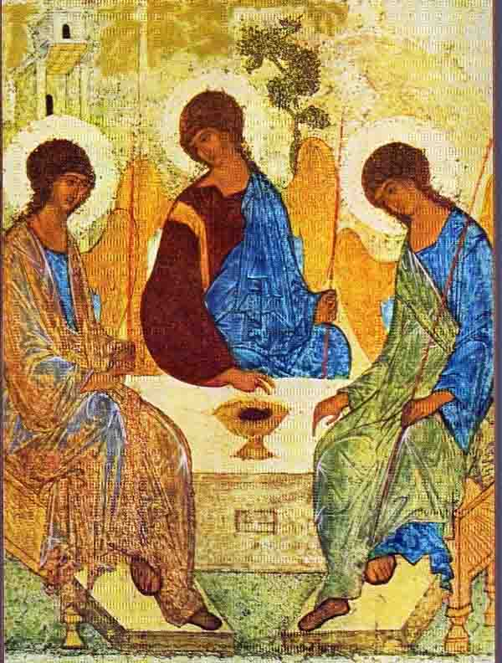
Abraham and hospitality
The Lord appeared to Abraham . . . He looked up and saw three men standing over against him. On seeing them, he hurried from his tent door to meet them, and bowed down. [Turning to G-d] he said: “My G-d, if I have found favour in your eyes, do not leave your servant [i.e. Please wait until I have given hospitality to these men].” [He then turned to the men and said:] “Let me send for some water so that you may bathe your feet and rest under this tree…”
Notes:
Abraham is sitting at the entrance to his tent in the heat of the day when three strangers pass by. He urges them to rest and take some food. The text calls them men. They are in fact angels, coming to tell Sarah that she will have a child.
The chapter seems simple. It is, however, complex and ambiguous. It consists of three sections:
Verse 1: G-d appears to Abraham.
Verses 2-16: Abraham and the men/angels.
Verses 17-33: The dialogue between G-d and Abraham about the fate of Sodom.
How are these sections related to one another? Are they one scene, two or three? The most obvious answer is three. Each of the above sections is a separate event. First, G-d appears to Abraham, as Rashi explains, “to visit the sick” after Abraham’s circumcision. Then the visitors arrive with the news about Sarah’s child. Then takes place the great dialogue about justice.
Maimonides (Guide for the Perplexed II: 42) suggests that there are two scenes (the visit of the angels, and the dialogue with G-d). The first verse does not describe an event at all. It is, rather, a chapter heading.
The third possibility is that we have a single continuous scene. G-d appears to Abraham, but before He can speak, Abraham sees the passers-by and asks G-d to wait while he serves them food. Only when they have departed – in verse 17 – does he turn to G-d, and the conversation begins.
How we interpret the chapter will affect the way we translate the word Adonai in the third verse. It could mean (1) G-d or (2) ‘my lords’ or ‘sirs’. In the first case, Abraham would be addressing heaven. In the second, he would be speaking to the passers-by.
Several English translations take the second option. Here is one example:
The Lord appeared to Abraham . . . He looked up, and saw three men standing over against him. On seeing them, he hurried from his tent door to meet them. Bowing low, he said, “Sirs, if I have deserved your favour, do not go past your servant without a visit.”
The same ambiguity appears in the next chapter (19: 2), when two of Abraham’s visitors (in this chapter they are described as angels) visit Lot in Sodom:
The two angels came to Sodom in the evening while Lot was sitting by the city gates. When he saw them, he rose to meet them and bowing low he said, “I pray you, sirs, turn aside to your servant’s house to spend the night there and bathe your feet.”
Normally, differences of interpretation of biblical narrative have no halakhic implications. They are matters of legitimate disagreement. This case is unusual, because if we translate Adonai as ‘G-d’, it is a holy name, and both the writing of the word by a scribe, and the way we treat a parchment or document containing it, have special stringencies in Jewish law. If we translate it as ‘my lords’ or ‘sirs’, then it has no special sanctity.
The simplest reading of both texts – the one concerning Abraham, the other, Lot – would be to read the word in both cases as ‘sirs’. Jewish law, however, ruled otherwise. In the second case – the scene with Lot – it is read as ‘sirs’, but in the first it is read as ‘G-d’. This is an extraordinary fact, because it suggests that Abraham interrupted G-d as He was about to speak, and asked Him to wait while he attended to his guests. This is how tradition ruled that the passage should be read:
The Lord appeared to Abraham . . . He looked up and saw three men standing over against him. On seeing them, he hurried from his tent door to meet them, and bowed down. [Turning to G-d] he said: “My G-d, if I have found favour in your eyes, do not leave your servant [i.e. Please wait until I have given hospitality to these men].” [He then turned to the men and said:] “Let me send for some water so that you may bathe your feet and rest under this tree…”
This daring interpretation became the basis for a principle in Judaism: “Greater is hospitality than receiving the Divine presence.” Faced with a choice between listening to G-d, and offering hospitality to [what seemed to be] human beings, Abraham chose the latter. G-d acceded to his request, and waited while Abraham brought the visitors food and drink, before engaging him in dialogue about the fate of Sodom.
How can this be so? Is it not disrespectful at best, heretical at worst, to put the needs of human beings before attending on the presence of G-d?
What the passage is telling us, though, is something of immense profundity. The idolaters of Abraham’s time worshipped the sun, the stars, and the forces of nature as gods. They worshipped power and the powerful. Abraham knew, however, that G-d is not in nature but beyond nature. There is only one thing in the universe on which He has set His image: the human person, every person, powerful and powerless alike.
The forces of nature are impersonal, which is why those who worship them eventually lose their humanity. As the Psalm puts it:
Their idols are silver and gold, made by human hands. They have mouths, but cannot speak, eyes, but cannot see; they have ears, but cannot hear, nostrils but cannot smell… Their makers become like them, and so do all who put their trust in them. (Psalm 115)
You cannot worship impersonal forces and remain a person: compassionate, humane, generous, forgiving. Precisely because we believe that G-d is personal, someone to whom we can say ‘You’, we honour human dignity as sacrosanct. Abraham, father of monotheism, knew the paradoxical truth that to live the life of faith is to see the trace of G-d in the face of the stranger. It is easy to receive the Divine presence when G-d appears as G-d. What is difficult is to sense the Divine presence when it comes disguised as three anonymous passers-by. That was Abraham’s greatness. He knew that serving G-d and offering hospitality to strangers were not two things but one.
One of the most beautiful comments on this episode was given by R. Shalom of Belz who noted that in verse 2, the visitors are spoken of as standing above Abraham [nitzavim alav]. In verse 8, Abraham is described as standing above them [omed alehem]. He said: at first, the visitors were higher than Abraham because they were angels and he a mere human being. But when he gave them food and drink and shelter, he stood even higher than the angels. We honour G-d by honouring His image, humankind.

Slide 25
“Greater is hospitality than
receiving the Divine presence.”
God will feel joy when He sees you love one another as true brothers and sisters even more than you love God. What a wonderful sight would that be to Heavenly Father. In order to become true sons and daughters you must first love each other more than your parents; that is the most beautiful gift you can give your parents. In the Unification Church we have one common rule about who is the true member of the church; he is the one who truly supports and loves brothers and sisters more than he loves Rev. Moon. God Himself is that way. This same principle works in every single level. This is a simple principle.” True Father, April 15, 1979

Slide 26
Abraham and collective responsibility
God said, “The cries of the victims in Sodom and Gomorrah are deafening; the sin of those cities is immense. I’m going down to see for myself, see if what they’re doing is as bad as it sounds. Then I’ll know.”
Abraham confronted God, “Are you serious? Are you planning on getting rid of the good people right along with the bad? What if there are fifty decent people left in the city; will you lump the good with the bad and get rid of the lot? Wouldn’t you spare the city for the sake of those fifty innocents? I can’t believe you’d do that, kill off the good and the bad alike as if there were no difference between them. Doesn’t the Judge of all the Earth judge with justice?”
Notes:
God invites Abraham’s challenge! If God had not spoken out loud – that He was going to destroy the cities, that He had heard of the evil from the cities and it was very grievous, and so on – if He had not spoken it out loud in the presence of Abraham, Abraham would never have known! God invites the dialogue. He says it explicitly. “Shall I hide from Abraham that which I am about to do?” In other words, God knew that Abraham would challenge him. He invited him to challenge Him.
The first, of course, hits us between the eyes. Abraham’s challenge to God. When he hears from God about the prospective fate of the cities of the plain of Sodom and Gomorrah, Abraham says to God in words that are still stunning – I mean, they send a shiver down my spine whenever I read them. says Abraham, “God forbid that You should do such a thing– to kill the righteous with the wicked so that the righteous should have the same fate as the wicked, God forbid! – Shall the Judge of all the earth not do justice?”
How can a human being who says, as Abraham says, “I am but dust and ash”, how can human finitude say such words to God? In any other faith, it seems to me, those words would be close to, maybe even tantamount to, blasphemy! And yet there they are at the core of Jewish faith, one of the great prophetic utterances in our literature. Abraham is not alone.
Genesis 18
¹ And the LORD appeared to him by the oaks of Mamre, as he sat at the door of his tent in the heat of the day. ² He lifted up his eyes and looked, and behold, three men were standing in front of him. When he saw them, he ran from the tent door to meet them and bowed himself to the earth ³ and said, “O Lord, if I have found favour in your sight, do not pass by your servant. ⁴ Let a little water be brought, and wash your feet, and rest yourselves under the tree, ⁵ while I bring a morsel of bread, that you may refresh yourselves, and after that you may pass on—since you have come to your servant.” So they said, “Do as you have said.” ⁶ And Abraham went quickly into the tent to Sarah and said, “Quick! Three seahs of fine flour! Knead it, and make cakes.” ⁷ And Abraham ran to the herd and took a calf, tender and good, and gave it to a young man, who prepared it quickly. ⁸ Then he took curds and milk and the calf that he had prepared, and set it before them. And he stood by them under the tree while they ate.
⁹ They said to him, “Where is Sarah your wife?” And he said, “She is in the tent.” ¹⁰ The LORD said, “I will surely return to you about this time next year, and Sarah your wife shall have a son.” And Sarah was listening at the tent door behind him. ¹¹ Now Abraham and Sarah were old, advanced in years. The way of women had ceased to be with Sarah. ¹² So Sarah laughed to herself, saying, “After I am worn out, and my lord is old, shall I have pleasure?” ¹³ The LORD said to Abraham, “Why did Sarah laugh and say, ‘Shall I indeed bear a child, now that I am old?’ ¹⁴ Is anything too hard^{[d]} for the LORD? At the appointed time I will return to you, about this time next year, and Sarah shall have a son.” ¹⁵ But Sarah denied it, saying, “I did not laugh”, for she was afraid. He said, “No, but you did laugh.”
¹⁶ Then the men set out from there, and they looked down towards Sodom. And Abraham went with them to set them on their way. ¹⁷ The LORD said, “Shall I hide from Abraham what I am about to do, ¹⁸ seeing that Abraham shall surely become a great and mighty nation, and all the nations of the earth shall be blessed in him? ¹⁹ For I have chosen^{[f]} him, that he may command his children and his household after him to keep the way of the LORD by doing righteousness and justice, so that the LORD may bring to Abraham what he has promised him.” ²⁰ Then the LORD said, “Because the outcry against Sodom and Gomorrah is great and their sin is very grave, ²¹ I will go down to see whether they have done altogether according to the outcry that has come to me. And if not, I will know.”
Abraham Intercedes for Sodom
²² So the men turned from there and went towards Sodom, but Abraham still stood before the LORD. ²³ Then Abraham drew near and said, “Will you indeed sweep away the righteous with the wicked? ²⁴ Suppose there are fifty righteous within the city. Will you then sweep away the place and not spare it for the fifty righteous who are in it? ²⁵ Far be it from you to do such a thing, to put the righteous to death with the wicked, so that the righteous fare as the wicked! Far be that from you! Shall not the Judge of all the earth do what is just?” ²⁶ And the LORD said, “If I find at Sodom fifty righteous in the city, I will spare the whole place for their sake.” ²⁷ Abraham answered and said, “Behold, I have undertaken to speak to the Lord, I who am but dust and ashes. ²⁸ Suppose five of the fifty righteous are lacking. Will you destroy the whole city for lack of five?” And he said, “I will not destroy it if I find forty-five there.” ²⁹ Again he spoke to him and said, “Suppose forty are found there.” He answered, “For the sake of forty I will not do it.” ³⁰ Then he said, “Oh let not the Lord be angry, and I will speak. Suppose thirty are found there.” He answered, “I will not do it, if I find thirty there.” ³¹ He said, “Behold, I have undertaken to speak to the Lord. Suppose twenty are found there.” He answered, “For the sake of twenty I will not destroy it.” ³² Then he said, “Oh let not the Lord be angry, and I will speak again but this once. Suppose ten are found there.” He answered, “For the sake of ten I will not destroy it.” ³³ And the LORD went his way, when he had finished speaking to Abraham, and Abraham returned to his place.
Genesis 19
God Rescues Lot
¹ The two angels came to Sodom in the evening, and Lot was sitting in the gate of Sodom. When Lot saw them, he rose to meet them and bowed himself with his face to the earth ² and said, “My lords, please turn aside to your servant's house and spend the night and wash your feet. Then you may rise up early and go on your way.” They said, “No; we will spend the night in the town square.” ³ But he pressed them strongly; so they turned aside to him and entered his house. And he made them a feast and baked unleavened bread, and they ate. ⁴ But before they lay down, the men of the city, the men of Sodom, both young and old, all the people to the last man, surrounded the house. ⁵ And they called to Lot, “Where are the men who came to you tonight? Bring them out to us, that we may know them.” ⁶ Lot went out to the men at the entrance, shut the door after him, ⁷ and said, “I beg you, my brothers, do not act so wickedly. ⁸ Behold, I have two daughters who have not known any man. Let me bring them out to you, and do to them as you please. Only do nothing to these men, for they have come under the shelter of my roof.” ⁹ But they said, “Stand back!” And they said, “This fellow came to sojourn, and he has become the judge! Now we will deal worse with you than with them.” Then they pressed hard against the man Lot, and drew near to break the door down. ¹⁰ But the men reached out their hands and brought Lot into the house with them and shut the door. ¹¹ And they struck with blindness the men who were at the entrance of the house, both small and great, so that they wore themselves out groping for the door.
¹² Then the men said to Lot, “Have you anyone else here? Sons-in-law, sons, daughters, or anyone you have in the city, bring them out of the place. ¹³ For we are about to destroy this place, because the outcry against its people has become great before the LORD, and the LORD has sent us to destroy it.” ¹⁴ So Lot went out and said to his sons-in-law, who were to marry his daughters, “Up! Get out of this place, for the LORD is about to destroy the city.” But he seemed to his sons-in-law to be jesting.
¹⁵ As morning dawned, the angels urged Lot, saying, “Up! Take your wife and your two daughters who are here, lest you be swept away in the punishment of the city.” ¹⁶ But he lingered. So the men seized him and his wife and his two daughters by the hand, the LORD being merciful to him, and they brought him out and set him outside the city. ¹⁷ And as they brought them out, one said, “Escape for your life. Do not look back or stop anywhere in the valley. Escape to the hills, lest you be swept away.” ¹⁸ And Lot said to them, “Oh, no, my lords. ¹⁹ Behold, your servant has found favour in your sight, and you have shown me great kindness in saving my life. But I cannot escape to the hills, lest the disaster overtake me and I die. ²⁰ Behold, this city is near enough to flee to, and it is a little one. Let me escape there—is it not a little one?—and my life will be saved!” ²¹ He said to him, “Behold, I grant you this favour also, that I will not overthrow the city of which you have spoken. ²² Escape there quickly, for I can do nothing till you arrive there.” Therefore the name of the city was called Zoar.^{[a]}
God Destroys Sodom
²³ The sun had risen on the earth when Lot came to Zoar. ²⁴ Then the LORD rained on Sodom and Gomorrah sulphur and fire from the LORD out of heaven. ²⁵ And he overthrew those cities, and all the valley, and all the inhabitants of the cities, and what grew on the ground. ²⁶ But Lot's wife, behind him, looked back, and she became a pillar of salt.
Quality of hospitality. Why did god choose A? loved God and neigbour/enemy. That was his tradition. Content of tradition is internal. Expressed in myriad of different external ways. Living for the sake of others. THAT is the tradition and THAT is what we will be judged on.
50 -> 10. will you destroy the righteous with the wicked? Shall not the judge of the earth do right?

Slide 27
God said, “If I find fifty decent people in the city of Sodom, I’ll spare the place just for them.”
Abraham came back, “Do I, a mere mortal made from a handful of dirt, dare open my mouth again to my Master? What if the fifty fall short by five—would you destroy the city because of those missing five?”
He said, “I won’t destroy it if there are forty-five.”
Abraham spoke up again, “What if you only find forty?”
“Neither will I destroy it if for forty.”
He said, “Master, don’t be irritated with me, but what if only thirty are found?”
“No, I won’t do it if I find thirty.”
He pushed on, “I know I’m trying your patience, Master, but how about for twenty?”
“I won’t destroy it for twenty.”
He wouldn’t quit, “Don’t get angry, Master—this is the last time. What if you only come up with ten?”
“For the sake of only ten, I won’t destroy the city.”
When God finished talking with Abraham, he left. And Abraham went home.

Slide 28
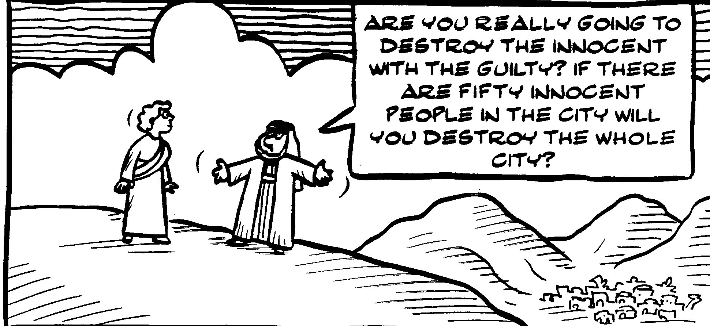
Abraham challenged God
Abraham was to become the role model and initiator of a new faith, one
that would not defend the human status quo but challenge it. So he had
to have the courage to challenge God if his descendants were to challenge
human rulers, as Moses and the Prophets did.
Notes:
One of the most fundamental questions about the Torah turns out to be one of the hardest to answer. What, from the call of God to Abraham in Genesis 12 to the death of Joseph in Genesis 50, is the basic religious principle being taught? What does the entire set of stories about Abraham, Isaac and Jacob and their wives, together with Jacob’s sons and daughter, actually tell us? Abraham brought monotheism to a world that had forgotten it, but where do we see this in the actual text of the Torah itself?
Here is the problem. The first eleven chapters of Genesis teach us many fundamentals of faith: that God brought the universe into being and declared it good; that God made the human person in His image; that God gave us freedom and thus the ability to do not only good but also bad; that the good is rewarded, the bad punished and that we are morally responsible for our actions. Chapters 8 and 9 also tell us that God made a covenant with Noah and through him with all humanity.
It is equally easy to say what the rest of the Torah, from Exodus to Deuteronomy, teach us: that God rescued the Israelites from slavery, setting them on the road to freedom and the Promised Land; that God made a covenant with the people as a whole on Mount Sinai, with its 613 commands and its purpose, to establish Israel as a kingdom of priests and a holy nation. In short, Genesis 1-11 is about creation. Exodus to Deuteronomy is about revelation and redemption. But what are Genesis 12-50 about?
Abraham, Isaac and Jacob all recognise God. But so do non-Jews like Malkizedek, Abraham’s contemporary, described as “priest of God most high” (14:18). So even does the Pharaoh of Joseph’s day, who says about him, ‘Can there be another person who has God’s spirit in him as this man does?’ (41:38). God speaks to Abraham, Isaac and Jacob, but He does likewise to Avimelech king of Gerar (Gen. 20:3-7), and to Laban (31:24). So what is special about the patriarchs?
They seem to teach no new principle of faith. Other than childbirth and rescue from danger, God performs no world-transforming miracles through them. They deliver no prophecies to the people of their generation. Other than an ambiguous hint when the Torah says that Abraham took with him on his journey “the souls they had gathered” (12:5), which may refer to converts they had made, but may equally merely refer to their servants, they attracted no disciples. There is nothing explicit in the text that says they sought to persuade people of the truth of monotheism or that they did battle against idolatry. At most there is a story about how Rachel stole her father’s teraphim (31:19) which may or may not have been idols.
To be sure, a persistent theme of the patriarchal stories is the two promises God made to each of them, [1] that they would have many descendants and [2] they would inherit the land of Canaan. But God also makes promises to Ishmael and Esau, and the Torah seems to go out of its way to tell us that these promises were fulfilled for them before they were fulfilled for the children of the covenant (see Gen. 25:12-18 for the account of Ishmael’s children, and Gen. 36 for those of Esau). About Esau’s children, for example, it says, “These are the kings who ruled in the land of Edom before any king reigned over the Israelites” (36:31).
So the question is real and puzzling. What was different about the patriarchs? What new did they bring to the world? What difference did monotheism make in their day?
There is an answer but it is an unexpected one. One theme appears no less than six (possibly even seven) times. Whenever a member of the covenantal family leaves his or her own space and enters the wider world of their contemporaries, they encounter a world of sexual free-for-all.
Three times, Abraham (Gen. 12 and 20) and Isaac (Gen. 26) are forced to leave home because of famine. Twice they go to Gerar. Once Abraham goes to Egypt. On all three occasions the husband fears he will be killed so that the local ruler can take his wife into his harem. All three times they put forward the story that their wife is actually their sister. At worst this is a lie, at best a half-truth. In all three cases the local ruler (Pharaoh, Avimelekh), protests at their behaviour when the truth becomes known. Clearly the fear of death was real or the patriarchs would not have been party to deception.
In the fourth case, Lot in Sodom (Gen. 19), the people cluster round Lot’s house demanding that he bring out his two visitors so that they can be raped. Lot offers them his virgin daughters instead. Only swift action by the visitors – angels – who smite the people with blindness, saves Lot and his family from violence.
In the fifth case (Gen. 34), Shechem, a local prince, rapes and abducts Dina when she “went out to visit some of the local girls.” He holds her hostage, causing Shimon and Levi to practise deception and bloodshed in the course of rescuing her.
Then comes a marginal case (Gen. 38), the story of Judah and Tamar, more complex than the others and not part of the overall pattern. Finally there is the sixth episode, in this week’s parsha, when Potiphar’s wife attempts to seduce Joseph. Failing, she accuses him of rape and has him imprisoned.
In other words, there is a continuing theme in Genesis 12-50, a contrast between the people of the Abrahamic covenant and their neighbours, but it is not about idolatry, but rather about adultery, promiscuity, sexual license, seduction, rape and sexually motivated violence.
The patriarchal narrative is surprisingly close to the view of Freud, that eros is one of the two primal drives governing human behaviour (the other is thanatos, the death instinct), and the view of at least one evolutionary psychologist (David Buss, in his books The Evolution of Desire and The Murderer Next Door) that sex is the main cause of violence amongst humans.
This gives us an entirely new way of thinking about Abrahamic faith. Emunah, the Hebrew word normally translated as faith, does not mean what it is taken to mean in English: a body of dogma, a set of principles, or a cluster of beliefs often held on non-rational grounds. Emunah means faithfulness, loyalty, fidelity, honouring your commitments, doing what you said you would do and acting in such a way as to inspire trust. It has to do with relationships, first and foremost with marriage.
Sex belongs, for the Torah, within the context of marriage, and it is marriage that comes closest to the deep resonances of the biblical idea of covenant. A covenant is a mutual act of commitment in which two persons, honouring their differences, each respecting the dignity of the other, come together in a bond of love to join their destinies and chart a future together. When the prophets want to speak of the covenantal relationship between God and His people, they constantly use the metaphor of marriage.
The God of Abraham is the God of love and trust who does not impose His will by force or violence, but speaks gently to us, inviting an answering response of love and trust. Genesis’ argument against idolatry – all the more impressive for being told obliquely, through a series of stories and vignettes – is that it leads to a world in which the combination of unchecked sexual desire, the absence of a code of moral self-restraint, and the worship of power, leads eventually to violence and abuse.
That domestic violence and abuse still exist today, even among religious Jews, is a disgrace and source of shame. Against this stands the testimony of Genesis that faithfulness to God means and demands faithfulness to our marriage partners. Faith – whether between us and God or between us and our fellow humans – means love, loyalty and the circumcision of desire.
What the stories of the patriarchs and matriarchs tell us is that faith is not proto- or pseudo-science, an explanation of why the natural universe is as it is. It is the language of relationships and the choreography of love. It is about the importance of the moral bond, in particular as it affects our most intimate relations. Sexuality matters to Judaism, not because it is puritanical but because it represents the love that brings new life into the world.
When a society loses faith, eventually it loses the very idea of a sexual ethic, and the result in the long term is violence and the exploitation of the powerless by the powerful. Women suffer. Children suffer. There is a breakdown of trust where it matters most. So it was in the days of the patriarchs. Sadly, so it is today. Judaism, by contrast, is the sanctification of relationship, the love between husband and wife which is as close as we will ever get to understanding God’s love for us.

Slide 29
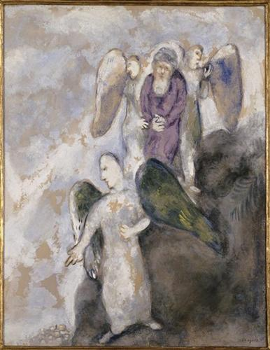
Lot and his family
And they called to Lot, “Where are the men who came to you tonight? Bring them out to us, that we may know them.” Lot went out to the men at the entrance, shut the door after him, and said, “Brothers, please, don’t be vile! Look, I have two daughters, virgins; let me bring them out; you can take your pleasure with them, but don’t touch these men—they’re my guests.” But they said, “Stand back!” They said, “Get lost! You drop in from nowhere and now you’re going to tell us how to run our lives. We’ll treat you worse than them!”
Genesis 19:8-9
Lot’s family flee
Notes:
God invites Abraham’s challenge! If God had not spoken out loud – that He was going to destroy the cities, that He had heard of the evil from the cities and it was very grievous, and so on – if He had not spoken it out loud in the presence of Abraham, Abraham would never have known! God invites the dialogue. He says it explicitly. “Shall I hide from Abraham that which I am about to do?” In other words, God knew that Abraham would challenge him. He invited him to challenge Him.
The first, of course, hits us between the eyes. Abraham’s challenge to God. When he hears from God about the prospective fate of the cities of the plain of Sodom and Gomorrah, Abraham says to God in words that are still stunning – I mean, they send a shiver down my spine whenever I read them – “Halilah lecha mei’asot kadavar hazeh,” says Abraham, “God forbid that You should do such a thing – lehamit tzadik im-rasha – to kill the righteous with the wicked – vehaya katzadik karasha halilah lach – so that the righteous should have the same fate as the wicked, God forbid! – hashofet kol-ha’aretz lo ya’aseh mishpat? – Shall the Judge of all the earth not do justice?”
How can a human being who says, as Abraham says, “I am but dust and ash”, how can human finitude say such words to God? In any other faith, it seems to me, those words would be close to, maybe even tantamount to, blasphemy! And yet there they are at the core of Jewish faith, one of the great prophetic utterances in our literature. Abraham is not alone.
Genesis 18
¹ And the LORD appeared to him by the oaks of Mamre, as he sat at the door of his tent in the heat of the day. ² He lifted up his eyes and looked, and behold, three men were standing in front of him. When he saw them, he ran from the tent door to meet them and bowed himself to the earth ³ and said, “O Lord, if I have found favour in your sight, do not pass by your servant. ⁴ Let a little water be brought, and wash your feet, and rest yourselves under the tree, ⁵ while I bring a morsel of bread, that you may refresh yourselves, and after that you may pass on—since you have come to your servant.” So they said, “Do as you have said.” ⁶ And Abraham went quickly into the tent to Sarah and said, “Quick! Three seahs of fine flour! Knead it, and make cakes.” ⁷ And Abraham ran to the herd and took a calf, tender and good, and gave it to a young man, who prepared it quickly. ⁸ Then he took curds and milk and the calf that he had prepared, and set it before them. And he stood by them under the tree while they ate.
⁹ They said to him, “Where is Sarah your wife?” And he said, “She is in the tent.” ¹⁰ The LORD said, “I will surely return to you about this time next year, and Sarah your wife shall have a son.” And Sarah was listening at the tent door behind him. ¹¹ Now Abraham and Sarah were old, advanced in years. The way of women had ceased to be with Sarah. ¹² So Sarah laughed to herself, saying, “After I am worn out, and my lord is old, shall I have pleasure?” ¹³ The LORD said to Abraham, “Why did Sarah laugh and say, ‘Shall I indeed bear a child, now that I am old?’ ¹⁴ Is anything too hard^{[d]} for the LORD? At the appointed time I will return to you, about this time next year, and Sarah shall have a son.” ¹⁵ But Sarah denied it, saying, “I did not laugh”, for she was afraid. He said, “No, but you did laugh.”
¹⁶ Then the men set out from there, and they looked down towards Sodom. And Abraham went with them to set them on their way. ¹⁷ The LORD said, “Shall I hide from Abraham what I am about to do, ¹⁸ seeing that Abraham shall surely become a great and mighty nation, and all the nations of the earth shall be blessed in him? ¹⁹ For I have chosen^{[f]} him, that he may command his children and his household after him to keep the way of the LORD by doing righteousness and justice, so that the LORD may bring to Abraham what he has promised him.” ²⁰ Then the LORD said, “Because the outcry against Sodom and Gomorrah is great and their sin is very grave, ²¹ I will go down to see whether they have done altogether according to the outcry that has come to me. And if not, I will know.”
Abraham Intercedes for Sodom
²² So the men turned from there and went towards Sodom, but Abraham still stood before the LORD. ²³ Then Abraham drew near and said, “Will you indeed sweep away the righteous with the wicked? ²⁴ Suppose there are fifty righteous within the city. Will you then sweep away the place and not spare it for the fifty righteous who are in it? ²⁵ Far be it from you to do such a thing, to put the righteous to death with the wicked, so that the righteous fare as the wicked! Far be that from you! Shall not the Judge of all the earth do what is just?” ²⁶ And the LORD said, “If I find at Sodom fifty righteous in the city, I will spare the whole place for their sake.” ²⁷ Abraham answered and said, “Behold, I have undertaken to speak to the Lord, I who am but dust and ashes. ²⁸ Suppose five of the fifty righteous are lacking. Will you destroy the whole city for lack of five?” And he said, “I will not destroy it if I find forty-five there.” ²⁹ Again he spoke to him and said, “Suppose forty are found there.” He answered, “For the sake of forty I will not do it.” ³⁰ Then he said, “Oh let not the Lord be angry, and I will speak. Suppose thirty are found there.” He answered, “I will not do it, if I find thirty there.” ³¹ He said, “Behold, I have undertaken to speak to the Lord. Suppose twenty are found there.” He answered, “For the sake of twenty I will not destroy it.” ³² Then he said, “Oh let not the Lord be angry, and I will speak again but this once. Suppose ten are found there.” He answered, “For the sake of ten I will not destroy it.” ³³ And the LORD went his way, when he had finished speaking to Abraham, and Abraham returned to his place.
Genesis 19
God Rescues Lot
¹ The two angels came to Sodom in the evening, and Lot was sitting in the gate of Sodom. When Lot saw them, he rose to meet them and bowed himself with his face to the earth ² and said, “My lords, please turn aside to your servant's house and spend the night and wash your feet. Then you may rise up early and go on your way.” They said, “No; we will spend the night in the town square.” ³ But he pressed them strongly; so they turned aside to him and entered his house. And he made them a feast and baked unleavened bread, and they ate. ⁴ But before they lay down, the men of the city, the men of Sodom, both young and old, all the people to the last man, surrounded the house. ⁵ And they called to Lot, “Where are the men who came to you tonight? Bring them out to us, that we may know them.” ⁶ Lot went out to the men at the entrance, shut the door after him, ⁷ and said, “I beg you, my brothers, do not act so wickedly. ⁸ Behold, I have two daughters who have not known any man. Let me bring them out to you, and do to them as you please. Only do nothing to these men, for they have come under the shelter of my roof.” ⁹ But they said, “Stand back!” And they said, “This fellow came to sojourn, and he has become the judge! Now we will deal worse with you than with them.” Then they pressed hard against the man Lot, and drew near to break the door down. ¹⁰ But the men reached out their hands and brought Lot into the house with them and shut the door. ¹¹ And they struck with blindness the men who were at the entrance of the house, both small and great, so that they wore themselves out groping for the door.
¹² Then the men said to Lot, “Have you anyone else here? Sons-in-law, sons, daughters, or anyone you have in the city, bring them out of the place. ¹³ For we are about to destroy this place, because the outcry against its people has become great before the LORD, and the LORD has sent us to destroy it.” ¹⁴ So Lot went out and said to his sons-in-law, who were to marry his daughters, “Up! Get out of this place, for the LORD is about to destroy the city.” But he seemed to his sons-in-law to be jesting.
¹⁵ As morning dawned, the angels urged Lot, saying, “Up! Take your wife and your two daughters who are here, lest you be swept away in the punishment of the city.” ¹⁶ But he lingered. So the men seized him and his wife and his two daughters by the hand, the LORD being merciful to him, and they brought him out and set him outside the city. ¹⁷ And as they brought them out, one said, “Escape for your life. Do not look back or stop anywhere in the valley. Escape to the hills, lest you be swept away.” ¹⁸ And Lot said to them, “Oh, no, my lords. ¹⁹ Behold, your servant has found favour in your sight, and you have shown me great kindness in saving my life. But I cannot escape to the hills, lest the disaster overtake me and I die. ²⁰ Behold, this city is near enough to flee to, and it is a little one. Let me escape there—is it not a little one?—and my life will be saved!” ²¹ He said to him, “Behold, I grant you this favour also, that I will not overthrow the city of which you have spoken. ²² Escape there quickly, for I can do nothing till you arrive there.” Therefore the name of the city was called Zoar.^{[a]}
God Destroys Sodom
²³ The sun had risen on the earth when Lot came to Zoar. ²⁴ Then the LORD rained on Sodom and Gomorrah sulphur and fire from the LORD out of heaven. ²⁵ And he overthrew those cities, and all the valley, and all the inhabitants of the cities, and what grew on the ground. ²⁶ But Lot's wife, behind him, looked back, and she became a pillar of salt.
Quality of hospitality. Why did god choose A? loved God and neigbour/enemy. That was his tradition. Content of tradition is internal. Expressed in myriad of different external ways. Living for the sake of others. THAT is the tradition and THAT is what we will be judged on.
50 -> 10. will you destroy the righteous with the wicked? Shall not the judge of the earth do right?

Slide 30
“There was only one way to recover this lineage and ownership. This was the path to win the natural subjugation of Satan, to have Satan surrender voluntarily. It can only be accomplished by the power of true love, when we love our enemies more than we love our children.”
True Father
Did it all happen?
Notes:
Two of the angels who had visited Abraham now come to Lot in Sodom. They tell him the city and its inhabitants are about to be destroyed. He and his family must leave immediately. But Lot delays:
The two men said to Lot, “Do you have anyone else here-sons-in-law, sons or daughters, or anyone else in the city who belongs to you? Get them out of here,
13 because we are going to destroy this place. The outcry to the Lord against its people is so great that he has sent us to destroy it.”
14 So Lot went out and spoke to his sons-in-law, who were pledged to marry his daughters. He said, “Hurry and get out of this place, because the Lord is about to destroy the city!” But his sons-in-law thought he was joking.
15 With the coming of dawn, the angels urged Lot, saying, “Hurry! Take your wife and your two daughters who are here, or you will be swept away when the city is punished.” 16 When he hesitated, the men grasped his hand and the hands of his wife and of his two daughters and led them safely out of the city, for the Lord was merciful to them.
Over “he hesitated” is a shalshelet.
Lot’s hesitation goes to the core of his identity. We recall that earlier, when he and Abraham agreed to separate to end the quarrel between their herdsman, “Lot looked up and saw that the whole plain of the Jordan was well watered, like the garden of the Lord , like the land of Egypt, toward Zoar . . . So Lot chose for himself the whole plain of the Jordan and set out toward the east” (13: 10-11) He chose to make his home in Sodom, despite the fact that, as the Torah already states at that point, its inhabitants “were wicked and were sinning greatly against the Lord.”
When we see Lot in chapter 19, he and his family have already become profoundly assimilated. His daughters have married local men. On the phrase at the beginning of the chapter, “Lot was sitting in the gateway of the city” the sages said that “he had just been appointed as a judge” – the gate of the city being the place where, in Abrahamic times, the judges and elders sat to resolve disputes. Lot does not see himself, as did Abraham, as “a stranger and temporary resident.” He has decided to put down roots in the Jordan valley and the cities of the plain. This is henceforth where he belongs – so much so that the visitors have physically to drag him away.
Lot’s sense of belonging, however, is either naiveté or self-deception. The text makes this clear at three points. The first is the attempted sexual assault on Lot’s visitors (19: 4-5). Evidently the people of Sodom do not take kindly to strangers. This is the first hint that perhaps Lot too is, in their eyes, a stranger. In fact, he is. The Torah, in its second indication, is brutally explicit:
“Get out of our way,” they replied [to Lot, when he begged them to respect his visitors]. Then they said, “This fellow came here as an alien, and now he wants to play the judge! We’ll treat you worse than them.”
The third comes when he tells his daughters’ husbands that they must escape because the city is about to be destroyed, “But his sons-in-law thought he was joking.” Lot’s elaborate new identity is about to come crashing down about him – not only because of the impending destruction but because he has discovered in successive blows that he has not been accepted in this place. Sodom hates strangers, they still consider Lot “an alien”, and his sons-in-law regard him as a fool.
Yet despite this, he hesitates. He has invested too much of himself in the project of making his home among the people of the plain. He is a prime example of what Leon Festinger called “cognitive dissonance.” According to Festinger, the need to avoid dissonance is fundamental to human beings; otherwise it creates unbearable tension. It is this tension that Lot cannot resolve – and which is signaled by the shalshelet over “he hesitated.” It was the ultimate existential question, “Who am I?” Having tried so hard to become one-of-them, he finds it almost impossible to tear himself away. (There were, tragically, many Jews in Germany and Austria in the 1930s who refused to leave because they would not or could not believe the evidence around them, that Hitler was serious in his threats to destroy Jews).
Incidentally, Festinger’s theory also explains the behaviour of Lot’s wife who “looked back [against the explicit instruction of the angels] and was turned into a pillar of salt.” Festinger called this syndrome “post-decision dissonance.” He predicted that the more important the issue, the longer the person delays a decision and the harder it is to reverse, the more he or she will agonize over whether they have made the right choice. They have second thoughts; they need reassurance; they “look back”.
The Shalshelet over Lot’s hesitation is no mere detail of the biblical text. It is, in a real sense, the story of the modern Jew. Entering mainstream society for the first time, and yet encountering overt or covert anti-semitism, many nineteenth century European Jews became ambivalent about their identity. They tried to hide it and to assimilate. They became secular marranos. It did not work. The more they strove to be like everyone else, the more conspicuous they were, and the stronger anti-semitism grew. They themselves lost much in the process – not only their Jewish heritage itself, but also the simple capacity to know and take pride in who they were.
The lives of Lot and Abraham exemplify for all time the contrast between ambivalence and the security that comes from knowing who one is and why. Lot, who tried to become someone else, found himself regarded by his neighbours as an alien, an arriviste, an interloper, a parvenu. To his own sons-in-law he was a “joker.” Abraham lived a different kind of life. He fought a war on behalf of his neighbours. He prayed for them. But he lived apart, true to his faith, his mission and his covenant with G-d. What did they think of him? Early in next week’s sedra the Hittites call him “a prince of G-d in our midst.” That equation has not changed. Non-Jews respect Jews who respect Judaism. They are embarrassed by Jews who are embarrassed by Judaism. Never be ambivalent about who and what you are.

Slide 31
What happened next?
The two men said to Lot, “Do you have any other family here? Sons, daughters—anybody in the city? Get them out of here, and now! We’re going to destroy this place. Lot went out and warned the fiancés of his daughters, “Leave this place; God is about to destroy this city!” But his daughters’ would-be husbands treated it as a joke.
Lot was told, “Now run for your life! Don’t look back!” But Lot’s wife looked back and turned into a pillar of salt.
One day the older daughter said to the younger, “Our father is getting old and there’s not a man left in the country by whom we can get pregnant. Let’s get our father drunk with wine and lie with him. We’ll get children through our father—it’s our only chance to keep our family alive.”
The daughters became ancestors of the Moabites and Ammonites. Ruth the ancestor of David was a Moabite
Notes:
Ruth was a Moabite

Slide 32
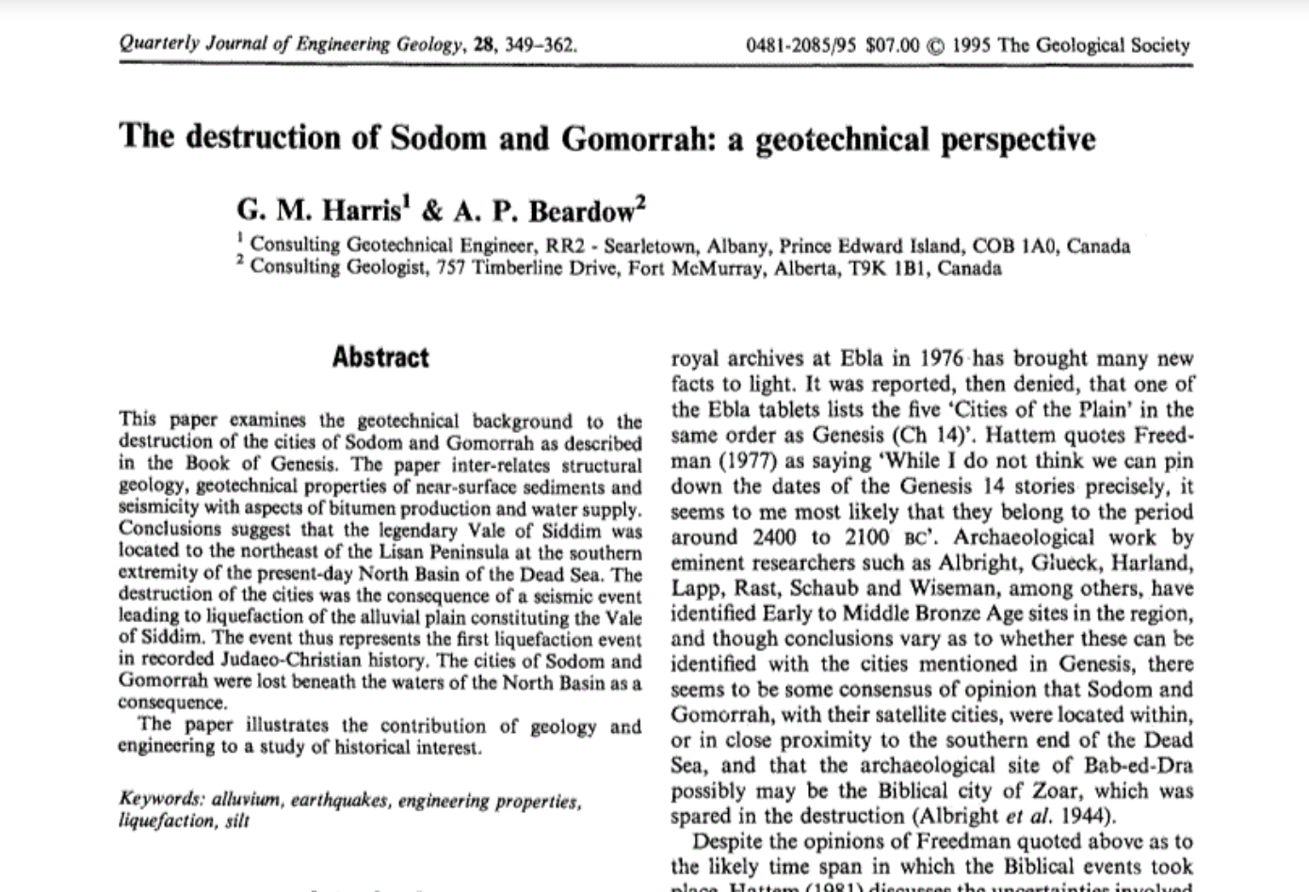
Notes:
The Bible places Sodom and Gomorrah in the region of the Dead Sea, between what are now Israel and Jordan in the Middle East. Harris spent a decade working in the area. He became convinced the conditions there were right for a huge earthquake that would trigger a massive landslide. So complete would be the destruction, the event would pass into folklore.
Could science prove that Harris's scenario might have happened? Professor Lynne Frostick, a geologist from Hull University in England, and Jonathan Tubb from the British Museum, decided to investigate just that.
They travelled to the Middle East to pursue their research, and their findings there enabled Dr Gopal Madabhushi, at the Cambridge University Centrifuge Laboratory back in England, to build an accurate scaled-down model of the buildings in Sodom, and the ground on which they stood. Dr Madabhushi then subjected the model to a simulated earthquake - and his data provided the ultimate proof on whether whole towns could have been destroyed.
Top
Asphalt towns
The destruction of Sodom The dwellings of Sodom slide towards the Dead Sea during the liquefaction event © Jonathan Tubb started by working out whether Sodom and Gomorrah actually existed. The whole area around the Dead Sea is now parched and barren, and the image of thriving towns is incongruous. But there was one point in the history of the region when a wetter climate meant the entire area could well have thrived - in the early Bronze Age, between 1800 BC and 2300 BC.
Tubb excavated a site called Tell es-Sa'idiyeh, north of the Dead Sea. He found evidence of an early olive oil factory, showing how sophisticated life had become, even in these ancient times. Tubb believes the early Bronze Age was the only time that towns matching the descriptions of Sodom and Gomorrah could have existed at all.
So were there big earthquakes in the early Bronze Age? According to American forensic anthropologist Professor Mike Finnegan, the answer is yes. He has examined the skeletons of three men discovered at the early Bronze Age site of Numeira near the Dead Sea. From the way their bones were broken, he concluded that they were crushed to death - possibly because an earthquake brought down a stone tower on top of them. Carbon dating put the date of the tower's beams at 2350 BC - the early Bronze Age.
To establish the magnitude of any earthquakes that may have occurred in the area, Professor Lynne Frostick consulted the Israeli geologist Shmuel Marco.
Tubb believes the early Bronze Age is the only time that towns matching the description of Sodom and Gomorrah could have existed.
Marco showed her a rock face containing layers of chalk and rock. In one place, there was a huge fault line caused by an ancient earthquake. By measuring how far an individual layer slipped, Marco could measure the size of the earthquake. The slippage was one metre and 75cm - meaning an earthquake measuring at least a six, on the Richter scale.
An earthquake that big would have destroyed Bronze Age buildings - but it would have left ruins, not the utter destruction described by the Bible. For Harris's idea to be plausible, the earthquake would have had to trigger a landslide. This is possible when there is loosely packed ground that contains lots of water. Shaken up by an earthquake, the water can rush to the surface, and the ground can turn to water - a phenomenon called liquefaction. On a slope, this can become a landslide.
Professor Frostick believed the ground around the Dead Sea was capable of liquefying. However, the towns had to be built on ground that contained lots of water, so they must have been right on the water's edge.
For Harris's theory to stand up, he needed to explain why towns like Sodom might have been built at the water's edge. He believes the answer is that some towns might have needed to be built as close as possible to a source of asphalt, a naturally occurring substance that was invaluable in ancient times. The Egyptians used asphalt to embalm their dead: their word moumiah, 'mummy' to us, means asphalt.
According to organic chemist Arie Niessenbaum, pure blocks of asphalt can be formed on the Dead Sea floor, and these can then float to the surface. This Dead Sea floating asphalt has been chemically fingerprinted and matched to asphalt contained in early Bronze Age artefacts found in Egypt. That means there was an early Bronze Age trade in asphalt from the Dead Sea to Egypt - and settlements may have existed where people collected it.

Slide 33
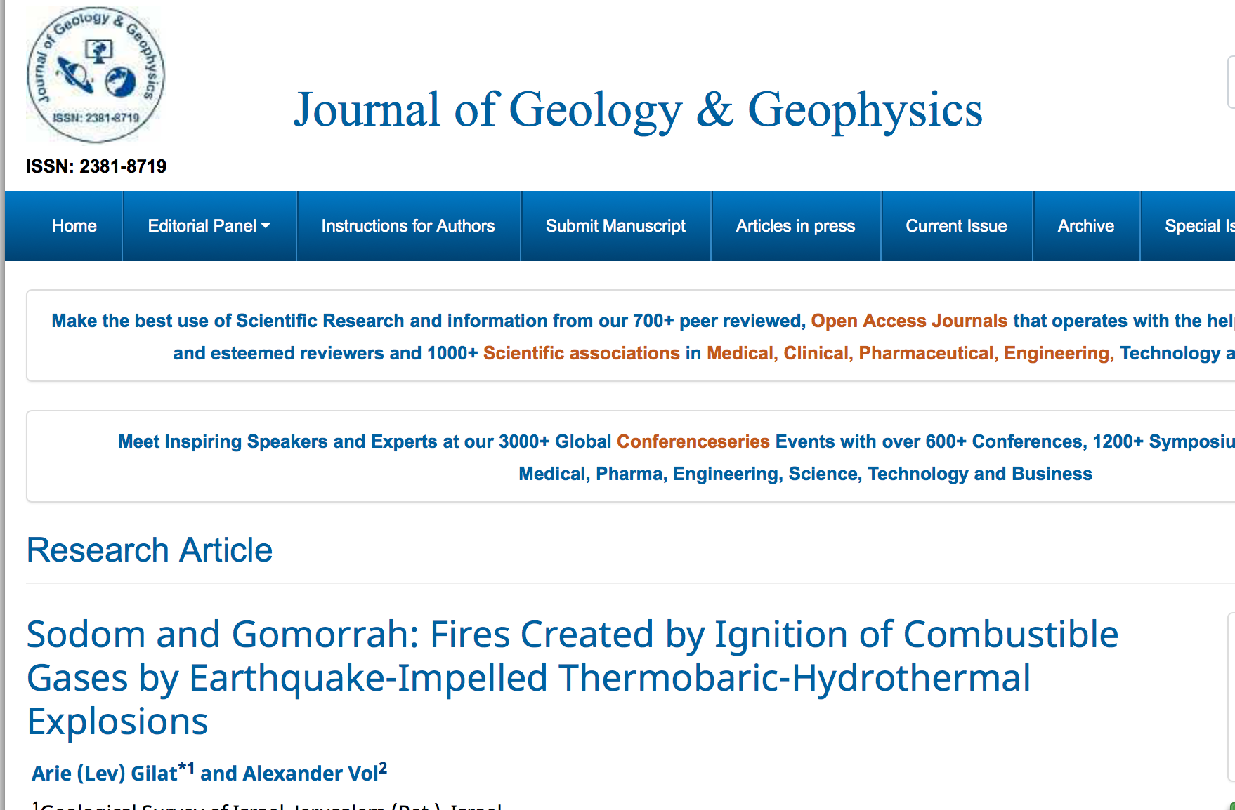
Notes:
“...The Lord rained upon Sodom and upon Gomorrah brimstone and fire from the lord out of heaven; and he overthrew those cities, and all the plain, and all the inhabitants of the cities, and that which grew upon the ground and behold, the steam of the earth went up as the steam of the furnace...”
Genesis, 19:24-25, 28
Most readers of this article, professionals or persons simply interested in natural sciences, know the lines above by heart and thought at least once: what detail makes this biblical case miraculous? Probably, “fire from the Lord out of heaven”; all the rest is familiar from numerous descriptions of major catastrophic earthquakes. We would suggest one of the oldest, from the R.N. Captain Fitz Roy’s (1839) description of the Adventure and Beagle 1835 voyage to Conception, Chile [1]:
“… Convulsive movements … The horrid motion increased; people could hardly stand; buildings waved and tottered – suddenly an awful overpowering shock caused universal destruction – and in less than six seconds the city was in ruins. The stunning noise of falling houses; the horrible cracking of the earth, which opened and shut rapidly and repeatedly in numerous places; the desperate heart-rending outcries of the people; the stifling heat; the blinding, smothering clouds of dust; the utter helplessness and confusion”. “… The water in the bay appeared to be everywhere boiling; bubbles of air, or gas, were rapidly escaping; the water also became black, and exhaled a most disagreeable sulphureous smell. Dead fish were afterwards thrown ashore in quantities; they seemed to have been poisoned or suffocated”. “… near Bacaloo Head an eruption burst through the sea… Smoke and water were thrown up during the greater part of the day, and flames were visible at night… As to the state of neighboring volcanoes, … I heard from Valdivia that directly after the earthquake all the volcanoes from Antuco to Osorno, inclusive, were in full activity” [1 pp. 403-418]. This description bears no resemblance to mechanical rebounds, but trains of monstrous explosions that uplift continents and trigger volcanic eruptions [2,3].
In his article “Geological events in the Bible” [4] Prof. Bentor explores the version of earthquake destroying the Sodom and Gomorrah cities and causing flood, which explains why Lot and his family escaped “brimstone and fire” climbing the steep Zohar mountain instead of running south along the plain (Figure 1). However, Bentor could not explain the fire by natural reasons, because there are no active volcanoes in the Dead Sea area and mud-volcanism remained an enigma in his time. So, he thought that “the editor of the [biblical] account surely felt justified in replacing the flooding by the much more impressive mechanism of fire and brimstone raining down from heaven, the abode of God” [4].
It is a common knowledge that many earthquakes were accompanied by conflagrations that killed many victims and burned their property (the great Lisbon quake of 1755; San Francisco, 1906; Tokyo, 1855, and too many others), which were explained as started “by kitchen-fires, which were left unattended by people who run for safety out of the buildings”.

Slide 34
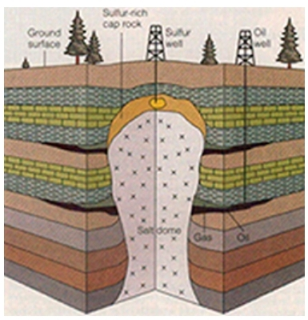

Slide 35


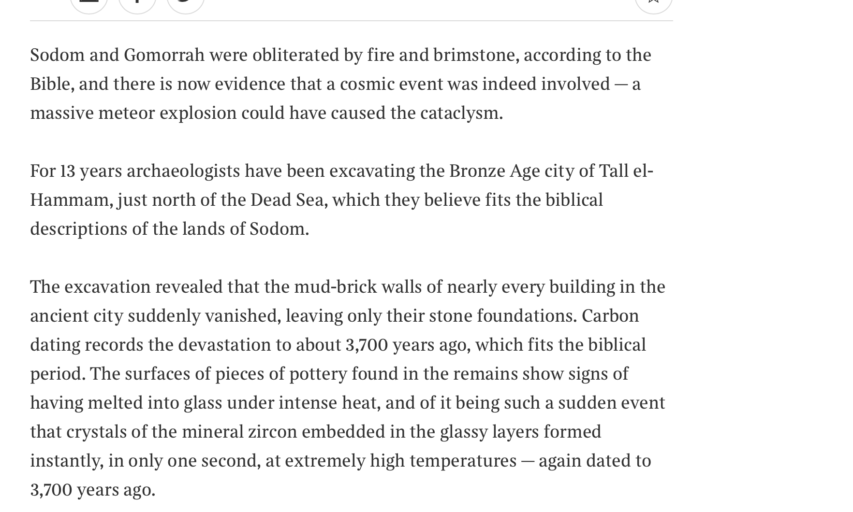

Slide 36
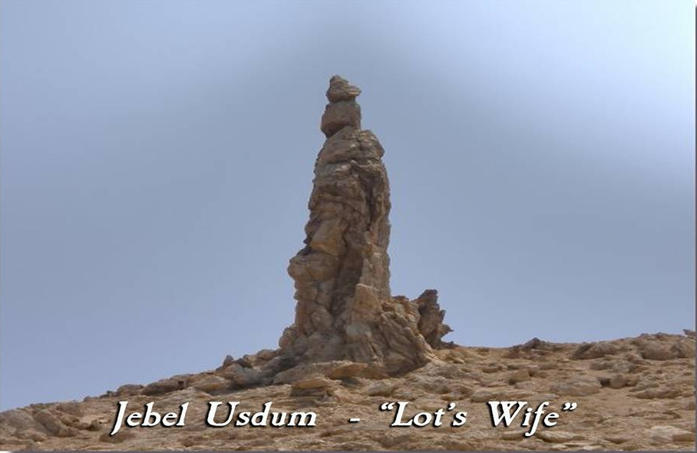
Notes:
Lot’s wife. Looking back. Stuck in the past. Regret. Couldn’t move into the future

Slide 37
What has Abraham been restoring?
Restoration occurs when you find yourself in a similar position to Adam, Eve, the archangel, Cain or Abel etc.
And you have to face the same temptation to make the same mistake that they did and continue the pattern of fallen history
But you choose not to do so and instead of acting out of your fallen nature you act according to your original nature and follow your conscience. You break the cycle of abuse and pattern of fallen history

Slide 38
Restoring responsibility
Personal responsibility
  Adam blamed Eva and Eve blamed the archangel
  In quarrel with Lot no blame just problem solving
Moral responsibility
  Cain – “Am I my brother’s keeper?”
  Abraham – “I am my brother’s son Lot’s keeper”
Collective responsibility
  Noah did not protest about the Flood
  Abraham argued with God over Sodom and Gomorrah
Notes:
The early history of humanity is set out in the Torah as a series of disappointments. God gave human beings freedom, which they then misused. Adam and Eve ate the forbidden fruit. Cain murdered Abel. Within a relatively short time, the world before the Flood became dominated by violence. All flesh perverted its way on the earth. God created order, but humans created chaos. Even after the Flood, humanity, in the form of the builders of Babel, were guilty of hubris, thinking that people could build a tower that “reaches heaven" (Gen. 11:4).
Humans failed to respond to God, which is where Abraham enters the picture. We are not quite sure, at the beginning, what it is that Abraham is summoned to do. We know he is commanded to leave his land, birthplace and father’s house and travel “to the land I will show you,” (Gen. 12:1) but what he is to do when he gets there, we do not know. On this the Torah is silent. What is Abraham’s mission? What makes him special? What makes him more than a good man in a bad age, as was Noah? What makes him a leader and the father of a nation of leaders?
To decode the mystery we have to recall what the Torah has been signalling prior to this point. I suggested in previous weeks that a - perhaps the - key theme is a failure of responsibility. Adam and Eve lack personal responsibility. Adam says, “It wasn’t me; it was the woman.” Eve says, “It wasn’t me, it was the serpent.” It is as if they deny being the authors of their own stories – as if they do not understand either freedom or the responsibility it entails.
Cain does not deny personal responsibility. He does not say, “It wasn’t me. It was Abel’s fault for provoking me.” Instead he denies moral responsibility: “Am I my brother’s keeper?”
Noah fails the test of collective responsibility. He is a man of virtue in an age of vice, but he makes no impact on his contemporaries. He saves his family (and the animals) but no one else. According to the plain reading of the text, he does not even try.
If we understand this, we understand Abraham. He exercises personal responsibility. In parshat Lech Lecha, a quarrel breaks out between Abraham's herdsmen and those of his nephew Lot. Seeing that this was no random occurrence but the result of their having too many cattle to be able to graze together, Abraham immediately proposes a solution:
Abram said to Lot, “Let there not be a quarrel between you and me, or between your herders and mine, for we are brothers. Is not the whole land before you? Let’s part company. If you go to the left, I will go to the right; if you go to the right, I’ll go to the left.” (Gen. 13:8-9)
Note that Abraham passes no judgment. He does not ask whose fault the argument was. He does not ask who will gain from any particular outcome. He gives Lot the choice. He sees the problem and acts.
In the next chapter of Bereishit we are told about a local war, as a result of which Lot is among the people taken captive. Immediately Abraham gathers a force, pursues the invaders, rescues Lot and with him, all the other captives. He returns these captives safely to their homes, refusing to take any of the spoils of victory that he is offered by the grateful king of Sodom.
This is a strange passage – it depicts Abraham very differently from the nomadic shepherd we see elsewhere. The passage is best understood in the context of the story of Cain. Abraham shows he is his brother’s (or brother’s son’s) keeper. He immediately understands the nature of moral responsibility. Despite the fact that Lot chose to live where he did with its attendant risks, Abraham does not say, “His safety is his responsibility, not mine.”
Then, in this week’s parsha of Vayera, comes the great moment: a human being challenges God Himself for the very first time. God is about to pass judgment on Sodom. Abraham, fearing that this will mean that the city will be destroyed, says:
“Will you sweep away the righteous with the wicked? What if there are fifty righteous people in the city? Will you really sweep it away and not spare the place for the sake of the fifty righteous people in it? Far be it from you to do such a thing—to kill the righteous with the wicked, treating the righteous and the wicked alike. Far be it from you! Will not the Judge of all the earth do justice?” (Gen. 18:23–25)
This is a remarkable speech. By what right does a mere mortal challenge God Himself?
The short answer is that God Himself signalled that he should. Listen carefully to the text:
Then the Lord said, “Shall I hide from Abraham what I am about to do? Abraham will surely become a great and powerful nation, and all nations on earth will be blessed through him” ... Then the Lord said, “The outcry against Sodom and Gomorrah is so great and their sin so grievous that I will go down and see if what they have done is as bad as the outcry that has reached Me.” (Gen. 18:17–21)
Those words, “Shall I hide from Abraham what I am about to do?” are a clear hint that God wants Abraham to respond; otherwise why would He have said them?
The story of Abraham can only be understood against the backdrop of the story of Noah. There too, God told Noah in advance that he was about to bring punishment to the world.
So God said to Noah, “I am going to put an end to all people, for the earth is filled with violence because of them. I am surely going to destroy both them and the earth” (Gen. 6:13).
Noah did not protest. To the contrary, we are told three times that Noah “did as God commanded him” (Gen. 6:22; 7:5; 7:9). Noah accepted the verdict. Abraham challenged it. Abraham understood the third principle we have been exploring over the past few weeks: collective responsibility.
The people of Sodom were not Abraham's brothers and sisters, so he was going beyond even what he did in rescuing Lot. He prayed on their behalf because he understood the idea of human solidarity, immortally expressed by John Donne:
No man is an island,
Entire of itself ...
Any man's death diminishes me,
For I am involved in mankind.[1]
But a question remains. Why did God call on Abraham to challenge Him? Was there anything Abraham knew that God didn’t know? That idea is absurd. The answer is surely this: Abraham was to become the role model and initiator of a new faith, one that would not defend the human status quo but challenge it.
Abraham had to have the courage to challenge God if his descendants were to challenge human rulers, as Moses and the Prophets did. Jews do not accept the world that is. They challenge it in the name of the world that ought to be. This is a critical turning point in human history: the birth of the world’s first religion of protest – the emergence of a faith that challenges the world instead of accepting it.
Abraham was not a conventional leader. He did not rule a nation. There was as yet no nation for him to lead. But he was the role model of leadership as Judaism understands it. He took responsibility. He acted; he didn’t wait for others to act. Of Noah, the Torah says, “he walked with God” (Gen. 6:9). But to Abraham, God says, “Walk before Me,” (Gen. 17:1), meaning: be a leader. Walk ahead. Take personal responsibility. Take moral responsibility. Take collective responsibility.
Judaism is God’s call to responsibility.

Slide 39
5. Restoring the Archangel-Eve-Adam relationship

Slide 40
What is restoration?
Restoration occurs when you find yourself in a similar position to Adam, Eve, the archangel, Cain or Abel etc.
And you have to face the same temptation to make the same mistake that they did and continue the pattern of fallen history
But you choose not to do so and instead of acting out of your fallen nature you act according to your original nature and follow your conscience. You break the cycle of abuse and pattern of fallen history

Slide 41
What needs to be restored?
Relationship between Archangel and Eve
  Men have inherited the archangelic nature to want to control and possess and have sexual relationship with women for their own pleasure and gratification. Lust, not love
    Droit du seigneur – ‘lord’s right’
    Sexual harassment and worse
  Women have inherited the tendency to be seduced by powerful men and to seduce

Slide 42
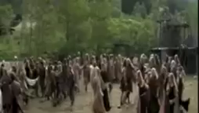

Slide 43
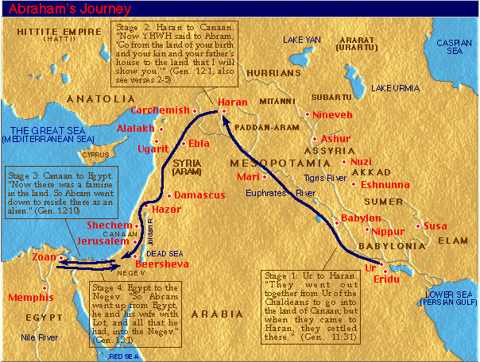
Abram’s journey
Notes:
Went with Terah to haran. Then after Terah died moved to Canaan

Slide 44
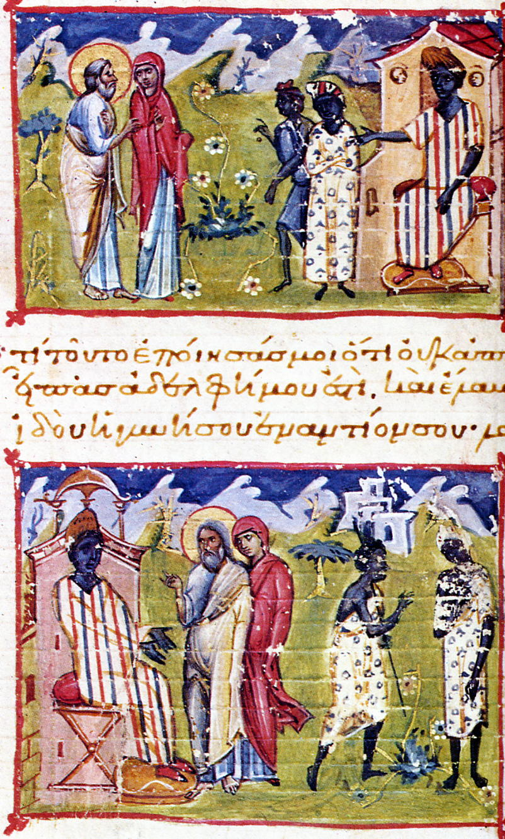
Abram, Sarah and Pharaoh
Now there was a famine in the land and so Abram went down to Egypt to stay there. When he was about to enter Egypt, he said to Sarai his wife, “I know that you are a woman beautiful in appearance, and when the Egyptians see you, they will say, ‘This is his wife.’ Then they will kill me, but they will let you live. Say you are my sister, that it may go well with me because of you, and that my life may be spared for your sake.” When Abram entered Egypt, the Egyptians saw that the woman was very beautiful. And when the princes of Pharaoh saw her, they praised her to Pharaoh. And the woman was taken into Pharaoh's house. And for her sake he dealt well with Abram.
Notes:
When a famine struck the land, Abram went down toward Egypt to live as an immigrant since the famine was so severe in the land. ¹¹ Just before he arrived in Egypt, he said to his wife Sarai, “I know you are a good-looking woman. ¹² When the Egyptians see you, they will say, ‘This is his wife,’ and they will kill me but let you live. ¹³ So tell them you are my sister so that they will treat me well for your sake, and I will survive because of you.”
¹⁴ When Abram entered Egypt, the Egyptians saw how beautiful his wife was. ¹⁵ When Pharaoh’s princes saw her, they praised her to Pharaoh; and the woman was taken into Pharaoh’s household. ¹⁶ Things went well for Abram because of her: he acquired flocks, cattle, male donkeys, men servants, women servants, female donkeys, and camels. ¹⁷ Then the Lord struck Pharaoh and his household with severe plagues because of Abram’s wife Sarai. ¹⁸ So Pharaoh summoned Abram and said, “What’s this you’ve done to me? Why didn’t you tell me she was your wife? ¹⁹ Why did you say, ‘She’s my sister,’ so that I made her my wife? Now, here’s your wife. Take her and go!” ²⁰ Pharaoh gave his men orders concerning Abram, and they expelled him with his wife and everything he had.

Slide 45
What is going on here?
Satan
Eve
Adam
Humanity
Creation
Notes:
Before the fall Adam and Eve were like brother and sister. Eve was more attracted to Lucifer who appeared sophisticated.

Slide 46
What is going on here?
Pharaoh
Sarah
Abraham
Lot, Hagar
Wealth
Notes:
Before the fall Adam and Eve were like brother and sister. Eve was more attracted to Lucifer who appeared sophisticated.

