Slide 1
3. Indemnity and restoration

Slide 2
What is restoration?
Restoration occurs when you find yourself in a similar position to Adam, Eve, the archangel, Cain or Abel etc.
And you have to face the same temptation to make the same mistake that they did and continue the pattern of fallen history
But you choose not to do so and instead of acting out of your fallen nature you act according to your original nature and follow your conscience. You break the cycle of abuse and pattern of fallen history
”If the function of the conscience were absent in fallen people, God’s providence of restoration would be impossible”. EDP. 36

Slide 3
Restoration through indemnity
To restore something one must make the necessary effort or pay the due price
Indemnity is the process of restoring the original position
An indemnity condition is what has to be done to restore something to its original position or state
An indemnity condition is a reversal of the process which led to the loss of the original position or state
Wiedergutmachung
Notes:
To recover lost position or reputation or health make necessary effort or pay the price
To bring about reconciliation have to do appropriate things
e.g. you break someone’s vase -> problem in relationship. To restore relationship have to apologise. If that’s not enough have to repair vase. If that’s not enough have to replace it. If too expensive to replace? Do something with sincere repentant heart.
Indemnity what ever needs to be done to restore something to the way it was before something went wrong
Equal indemnity - replace something. Compensation, repair something.
Lesser indemnity - apologise, forgiveness, don’t worry, its all right,
Greater indemnity - pay fine, parking, court, state satan, stick in time saves 9
Principle of justice – eye for an eye -> satisfies desire for justice.
Indmenity is not suffering. Indemnity is not makijng mistakes but correcting the, indmnity is not repeating errors of history but doing whjat is necessary to not repeat. Indemnity is not stupidity.

Slide 4
How does a condition compare with the value of what was lost?
Equal amount – (human justice)
  Compensation, restitution, ‘tit for tat’
  “Eye for eye” Exodus 21:23
Lesser amount – (divine/parental justice)
  Sincerity of heart, forgiveness
  Belief in Jesus and sacraments Matthew 26:27
Greater amount – (Satan’s justice)
  Increased amount due to failure or insincerity of heart
  40 days 40 years Numbers 14:34
Notes:
God does not expect or demand complete repayment. Impossible.
Lesser - forgiveness of most of debt cos tool big and unrepayable. Bankruptcy. Forgiveness. Redemption through the cross
Family based on forgiveness.
Equal - tit for tat. Normal justice. Punish robbers. Unjust to forgive robbers and murderers
Greater - overtime on parking -> massive fine. Satan’s way. Bully.
Revenge
Progressive Judaism does not aim to resurrect the act of sacrifice as a way of developing a connection to God, however it still embraces the intention behind the act of sacrifices, of finding a way of linking ourselves more closely to the divine. We now have to strive to find a way to do this. Tefillah is a tool that can help us embark on the path to a connection with the Unknowable. Professor Art Green has written "Since the destruction of the Temple in Jerusalem, prayer has taken the place of sacrifice, but that does not imply that sacrifice was abolished when the sacrificial rite went out of existence. Prayer is not a substitute for sacrifice. Prayer is sacrifice. What has changed is the substance of sacrifice: the self takes the place of the thing. The spirit is the same... The word is but an altar. We do not sacrifice. We are the sacrifice. Prayer is a hazard, a venture of peril. Every person who prays is a kohen at the greatest of all temples. The whole universe is the Temple. "However if the intention behind our prayer is only to seek forgiveness, will they be heard? Surely, to release ourselves in prayer, we need to follow the example of our ancestors, who gave of the little they had, equivalent to their whole being, to make a connection with the divine. We don’t need to give up our possessions any more to connect with the unknown, but maybe if we put our nefesh, our very essence on the line, as our forebears tried to do, we might bring ourselves one step closer to God.

Slide 5
Indemnity as reversal
We have to root out self-centered love. So therefore we have to go through this revolutionary process, rooting out original sin, finding the true love. How can we do it? By reversing Satan’s pattern. Satan is arrogant. So we become humble. Satan is self-serving. Therefore we become sacrificial. Satan doesn’t want to do anything for the sake of others. We want to do everything for the sake of others.
Sun Myung Moon July 2nd 1982

Slide 6
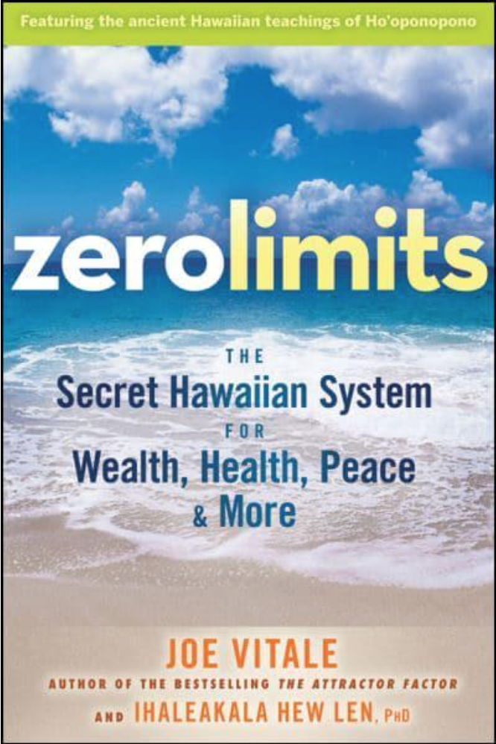
Cleansing the inherited memory bank
I love you: praise
I am sorry: repentance
Forgive me: penitence
Thank you: gratitude
Check out some psalms

Slide 7
How should we read the stories of restoration?

Slide 8
God’s providence to send the messiah
Abraham
Isaac
Jacob in
Haran
Jacob to
Egypt
Brothers
divided
Adam
Noah
Jacob
1600
400
120
40
21
40
Slavery in
Egypt
United
Kingdom
Divided Kingdom
Babylonian Captivity
Jesus
Judges
Preparation
400
400
120
400
210
400
Lord of
Second
Advent
United
Kingdom
Persecution
In Rome
Papal
Captivity
Patriarchs
Divided Kingdom
Preparation
400
400
120
400
210
400
Conclusion
Notes:
8

Slide 9
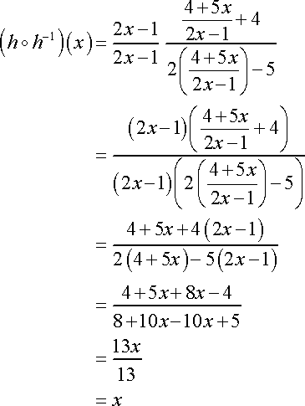
Notes:
Approach very instrumental and repetitive. Always focused on reaching the same conclusion

Slide 10
A different way of reading the stories of restoration
Providential families are restoring the four great realms of heart
Healing relationships
Narrative as mode of understanding
  Man as a teller of stories
Truth and ethics as story – reveals the nuances and complexity of human nature
  c.f. truth and ethics as system
Truth through time vs. timeless truths
Notes:
More of a pastoral approach
About daily life
Scripture is human centred
According to Kant, human beings occupy a special place in creation, and morality can be summed up in an imperative, or ultimate commandment of reason, from which all duties and obligations derive. He defined an imperative as any proposition declaring a certain action (or inaction) to be necessary.
A categorical imperative, on the other hand, denotes an absolute, unconditional requirement that must be obeyed in all circumstances and is justified as an end in itself. It is best known in its first formulation:
Act only according to that maxim whereby you can, at the same time, will that it should become a universal law

Slide 11
Stories of restoration
Parent – child
  Noah - Ham
  Abraham and Isaac
  Rebecca and Jacob
Husband and wife
  Isaac and Rebecca
Sister – sister
  Sarah and Hagar
  Rachel and Leah
Adam – Eve – Lucifer
  Abraham – Sarah - Pharaoh
Lucifer – Adam
  Cain and Abel
  Esau and Jacob
  Joseph and his brothers

Slide 12
What should have happened?

Slide 13
The two conditions
For Adam and Eve to realize the purpose of creation, they were supposed to fulfill two conditions.
First, Adam and Eve should have established the foundation of faith.
The second condition which Adam and Eve were supposed to fulfill in order to realize the purpose of creation was to establish the foundation of substance. After Adam and Eve established an unshakable foundation of faith, they were then to become one with God, thereby establishing the foundation of substance. This means they would have become the perfect incarnation of the Word with perfect character, fulfilling God’s first blessing.

Slide 14
Adam and Eve should have kept their sexual purity
Developed their spiritual life
Followed their conscience
The commandment was to protect Adam and Eve
Faith is the confident belief or trust in the truth or trustworthiness of a person, concept or thing.
God
Vertical
Word
Archangel
Adam
Eve
Foundation of Faith
Creation
Notes:
Faith is the confident belief or trust in the truth or trustworthiness of a person, concept or thing.
Adam and eve should have had faith in the commandment God gave them and obeyed it. They thus would have resisted any temptation from the AA.
Original responsibility
For Adam to realize the purpose of creation, he was supposed to fulfill two conditions. First, Adam should have established the foundation of faith. The person to lay this foundation was Adam himself. The condition to establish this foundation was to keep strictly to God’s commandment not to eat of the fruit of the tree of the knowledge of good and evil. In fulfilling this condition, Adam would have passed through a set growing period, which was the time allotted for him to fulfill his portion of responsibility. This period represents some numbers of providential significance. Hence, the growing period may be thought of as a period to fulfill certain numbers.
The second condition which Adam was supposed to fulfill in order to realize the purpose of creation was to establish the foundation of substance. After Adam established an unshakable foundation of faith, he was then to become one with God, thereby establishing the foundation of substance. This means he would have become the perfect incarnation of the Word7 with perfect character, fulfilling God’s first blessing. In this way, had he not fallen, Adam would have completed the purpose of creation. For a fallen person to establish the foundation for the Messiah, he must pass through a similar course: establishing first the foundation of faith and then the foundation of substance.

Slide 15



Adam and Eve should have reached maturity
God
Lord of Creation
Proper order in the created world
Word
Word
Horizontal
Foundation of Substance
Notes:
Beyond just having faith in God’s Word A&E should have come to embody the word. They should have become the substantiation or incarnation of the word just as Jesus later became. Thus Jesus could say, “I am the way, the truth and the life.” They should have reached perfection. If they did, God would have dwelled in them. Then Lucifer would have respected a mature and perfect A&E because they would have stood as God before him and from them he would have received God’s love and truth and guidance. Lucifer would have loved Adam and Eve in the right way and served them. Thus the proper order would have been established and goodness would have been multiplied.
Formed by the word. Conform oneself to the word

Slide 16
No foundation of faith or substance established
God
Lost faith in God’s Word
Didn’t keep commandment
Didn’t follow conscience
Didn’t keep sexual purity
Dominated by Archangel
Developed Fallen Nature
Word
Eve
Archangel
Adam
Creation
Notes:
The AA couldn’t respect and love A&E from God’s point of view. He didn’t think they deserved respect and didn’t think they were qualified to be Lords of Creation and certainly not his Lord. So he decided to see if he could gain control over them. He drew Eve towards himself and tempted her to eat the fruit. Eve lost faith in God’s commandment when she couldn’t answer the AA questions. She turned away from God and became self-centred. She allowed the AA to dominate her. Then she tempted Adam to eat the fruit and instead of resisting her he gave in to her and allowed her to dominate him. So instead of perfecting themselves A&E developed fallen nature – self-centred instead of God centred.

Slide 17
How is the foundation of faith restored?
The foundation of faith is restored by
making an acceptable symbolic offering
EDP, 195
Central figure
  Me
Object or gift/offering
Foundation to restore creation - e.g. gift
Restore oneself symbolically
Tithing, reading, prayer, bows etc. - consistent
Time period
Moses and
the fox
Decides
ownership
Condition to stand as central person in foundation of substance
Notes:
In offering a thing I am offering myself to God. Can be done on a desert island. Not confronted with FN.
First, there must be a central figure. From the time Adam failed to establish the foundation of faith, God has been looking for central figures who could restore the lost foundation of faith. God had Cain and Abel offer sacrifices for this purpose. Likewise, God called men such as Noah, Abraham, Isaac, Jacob, Moses, the kings and John the Baptist for the purpose of raising them up as central figures.
Second, an object for the condition must be offered. When Adam lost faith in God, he lost the Word of God which had been given him for the fulfillment of the condition to establish the foundation of faith. As a result, fallen people could no longer directly receive the Word of God to restore the foundation of faith. It then became necessary to offer objects for the condition as substitutes for the Word. Human beings were degraded by the Fall to a status lower than the things of creation, as it is written, "the heart is deceitful above all things." 8(Jer. 17:9)CEV|KJ|NI Hence, in the age prior to the giving of the Old Testament, people could establish the foundation of faith by offering a sacrifice or its equivalent, such as the ark, procured from the natural world. Thus, the foundation of faith also functioned as the foundation to restore all things, which had been defiled by Satan. In the Old Testament Age, either the Word as revealed in the Law of Moses or representatives of the Word - such as the Ark of the Covenant, the Temple and various central figures - served as objects for the condition, substituting for the original Word. In the New Testament Age, the Word as revealed in the Gospels and Jesus, the incarnation of the Word, were the objects for the condition. From the standpoint of human beings, these objects for the condition were offered for the purpose of establishing the foundation of faith. From God's perspective, the offering of objects for the condition would secure God's ownership of the dispensation.
Third, a numerical period of indemnity must be completed. To accomplish a task need to have deadline. If no deadline failure.
Restoring self symbolically – right frame of mind to do substantial
Moses and the fox
Moses finds a shepherd in the desert. He spends the day with the shepherd and helps him milk his ewes, and at the end of the day he sees that the shepherd puts the best milk he has in a wooden bowl, which he places on a flat stone some distance away. So Moses asks him what it is for, and the shepherd replies, "This is God's milk." Moses is puzzled and asks him what he means. The shepherd says, "I always take the best milk I possess, and I bring it as an offering to God." Moses, who is far more sophisticated than the shepherd with his naive faith, asks, "And does God drink it?" "Yes", replies the shepherd, "He does." Then Moses feels compelled to enlighten the poor shepherd and he explains that God, being pure spirit, does not drink milk. Yet the poor shepherd is sure that he does, and so they have a short argument, which ends with Moses telling the shepherd to hide behind the bushes to find out whether in fact God does come to drink the milk. Moses then goes out to pray in the desert. The shepherd hides, the night comes, and in the moonlight the shepherd sees a little fox that comes trotting from the desert, looks right, looks left and heads straight for the milk, which he laps up, and disappears into the desert again. The next morning Moses finds the shepherd quite depressed and downcast. "What's the matter?" he asks. The shepherd says, "You were right, God is pure spirit and he doesn't want my milk." Moses is surprised. He says, "You should be happy. You know more about God than you did before." "Yes, I do," says the shepherd, "but the only thing I could do to express my love for Him has been taken away from me." Moses sees the point. He retires into the desert and prays hard. In the night in a vision, God speaks to him and says, "Moses, you were wrong. It is true that I am pure spirit. Nevertheless I always accepted with gratitude the milk which the shepherd offered me, as the expression of his love, but since being pure spirit, I do not need milk, I shared it with this little fox, who is very fond of milk."
Anthony Bloom, School for Prayer, London: D.L.T., 1970.
Progressive Judaism does not aim to resurrect the act of sacrifice as a way of developing a connection to God, however it still embraces the intention behind the act of sacrifices, of finding a way of linking ourselves more closely to the divine. We now have to strive to find a way to do this. Tefillah is a tool that can help us embark on the path to a connection with the Unknowable. Professor Art Green has written "Since the destruction of the Temple in Jerusalem, prayer has taken the place of sacrifice, but that does not imply that sacrifice was abolished when the sacrificial rite went out of existence. Prayer is not a substitute for sacrifice. Prayer is sacrifice. What has changed is the substance of sacrifice: the self takes the place of the thing. The spirit is the same... The word is but an altar. We do not sacrifice. We are the sacrifice. Prayer is a hazard, a venture of peril. Every person who prays is a kohen at the greatest of all temples. The whole universe is the Temple."However if the intention behind our prayer is only to seek forgiveness, will they be heard? Surely, to release ourselves in prayer, we need to follow the example of our ancestors, who gave of the little they had, equivalent to their whole being, to make a connection with the divine. We don’t need to give up our possessions any more to connect with the unknown, but maybe if we put our nefesh, our very essence on the line, as our forebears tried to do, we might bring ourselves one step closer to God.

Slide 18
Notes:
The laws of sacrifices that dominate the early chapters of the Book of Leviticus are among the hardest in the Torah to relate to in the present. It has been almost two thousand years since the Temple was destroyed and the sacrificial system came to an end. But Jewish thinkers, especially the more mystical among them, strove to understand the inner significance of the sacrifices and the statement they made about the relationship between humanity and God. They were thus able to rescue their spirit even if their physical enactment was no longer possible. Among the simplest yet most profound was the comment made by Rabbi Shneur Zalman of Liadi, the first Rebbe of Lubavitch. He noticed a grammatical oddity about the second line of this parsha:
Speak to the Children of Israel and say to them: “When one of you offers a sacrifice to the Lord, the sacrifice must be taken from the cattle, sheep, or goats.”
Lev. 1:2Or so the verse would read if it were constructed according to the normal rules of grammar. However, the word order of the sentence in Hebrew is strange and unexpected. We would expect to read: adam mikem ki yakriv, “when one of you offers a sacrifice.” Instead, what it says is adam ki yakriv mikem, “when one offers a sacrifice of you.”
The essence of sacrifice, said Rabbi Shneur Zalman, is that we offer ourselves. We bring to God our faculties, our energies, our thoughts and emotions. The physical form of sacrifice – an animal offered on the altar – is only an external manifestation of an inner act. The real sacrifice is mikem, “of you.” We give God something of ourselves.[1]
What exactly is it that we give God when we offer a sacrifice? The Jewish mystics, among them Rabbi Shneur Zalman, spoke about two souls that each of us has within us – the animal soul (nefesh habeheimit) and the Godly soul. On the one hand we are physical beings. We are part of nature. We have physical needs: food, drink, shelter. We are born, we live, we die. As Ecclesiastes puts it:
Man’s fate is like that of the animals; the same fate awaits them both: as one dies, so dies the other. Both have the same breath; man has no advantage over the animal. Everything is a mere fleeting breath.
Eccl. 3:19Yet we are not simply animals. We have within us immortal longings. We can think, speak, and communicate. We can, by acts of speaking and listening, reach out to others. We are the one life-form known to us in the universe that can ask the question “why?” We can formulate ideas and be moved by high ideals. We are not governed by biological drives alone. Psalm 8 is a hymn of wonder on this theme:
When I consider Your heavens,
the work of Your fingers,
the moon and the stars,
which You have set in place,
what is man that You are mindful of him,
the son of man that You care for him?
Yet You made him a little lower than the angels
and crowned him with glory and honour.
You made him ruler over the works of Your hands;
You put everything under his feet.
Ps. 8:4–7Physically, we are almost nothing; spiritually, we are brushed by the wings of eternity. We have a Godly soul. The nature of sacrifice, understood psychologically, is thus clear. What we offer God is (not just an animal but) the nefesh habeheimit, the animal soul within us.
How does this work out in detail? A hint is given by the three types of animal mentioned in the verse in the second line of parshat Vayikra (see Lev. 1:2): beheimah (animal), bakar (cattle), and tzon (flock). Each represents a separate animal-like feature of the human personality.
Beheimah represents the animal instinct itself. The word refers to domesticated animals. It does not imply the savage instincts of the predator. What it means is something more tame. Animals spend their time searching for food. Their lives are bounded by the struggle to survive. To sacrifice the animal within us is to be moved by something more than mere survival.
Wittgenstein, when asked what was the task of philosophy, answered, “To show the fly the way out of the fly-bottle.”[2] The fly, trapped in the bottle, bangs its head against the glass, trying to find a way out. The one thing it fails to do is to look up. The Godly soul within us is the force that makes us look up, beyond the physical world, beyond mere survival, in search of meaning, purpose, goal.
The Hebrew word bakar, cattle, reminds us of the word boker, dawn, literally to “break through,” as the first rays of sunlight break through the darkness of night. Cattle, stampeding, break through barriers. Unless constrained by fences, cattle are no respecters of boundaries. To sacrifice the bakar is to learn to recognise and respect boundaries – between holy and profane, pure and impure, permitted and forbidden. Barriers of the mind can sometimes be stronger than walls.
Finally, the word tzon, flocks, represents the herd instinct – the powerful drive to move in a given direction because others are doing likewise.[3] The great figures of Judaism – Abraham, Moses, the Prophets – were distinguished precisely by their ability to stand apart from the herd; to be different, to challenge the idols of the age, to refuse to capitulate to the intellectual fashions of the moment. That, ultimately, is the meaning of holiness in Judaism. Kadosh, the holy, is something set apart, different, separate, distinctive. Jews were the only minority in history consistently to refuse to assimilate to the dominant culture or convert to the dominant faith.
The noun korban, “sacrifice,” and the verb lehakriv, “to offer something as a sacrifice,” actually mean “that which is brought close” and “the act of bringing close.” The key element is not so much giving something up (the usual meaning of sacrifice), but rather bringing something close to God. Lehakriv is to bring the animal element within us to be transformed through the Divine fire that once burned on the altar, and still burns at the heart of prayer if we truly seek closeness to God.
By one of the ironies of history, this ancient idea has become suddenly contemporary. Darwinism, the decoding of the human genome, and scientific materialism (the idea that the material is all there is) have led to the widespread conclusion that we are all animals, nothing more, nothing less. We share 98 per cent of our genes with the primates. We are, as Desmond Morris used to put it, “the naked ape.”[4] On this view, Homo sapiens exists by mere accident. We are the result of a random series of genetic mutations and just happened to be more adapted to survival than other species. The nefesh habeheimit, the animal soul, is all there is.
The refutation of this idea – and it is surely among the most reductive ever to be held by intelligent minds – lies in the very act of sacrifice itself as the mystics understood it. We can redirect our animal instincts. We can rise above mere survival. We are capable of honouring boundaries. We can step outside our environment. As Harvard neuroscientist Steven Pinker put it: “Nature does not dictate what we should accept or how we should live,” adding, “and if my genes don’t like it they can go jump in the lake.”[5] Or, as Katharine Hepburn majestically said to Humphrey Bogart in The African Queen, “Nature, Mr Allnut, is what we were put on earth to rise above.”
We can transcend the beheimah, the bakar, and the tzon. No animal is capable of self-transformation, but we are. Poetry, music, love, wonder – the things that have no survival value but which speak to our deepest sense of being – all tell us that we are not mere animals, assemblages of selfish genes. By bringing that which is animal within us close to God, we allow the material to be suffused with the spiritual and we become something else: no longer slaves of nature but servants of the living God.

Slide 19
How is the foundation of substance restored?
The foundation of substance is restored by making
an acceptable substantial offering which is fulfilling
the indemnity condition to remove fallen nature.
Person in Cain’s position honours the person in Abel’s
position and sets him above himself as an offering.
Restoring the relationship between archangel and Adam
Through this they are restored as good children.
Condition for restoration of parents

Slide 20
In a nutshell . . .
What does Adam have to do? First he has to become one with God, and second he has to love the archangel. He must win the archangel's recognition. The archangel must acknowledge, saying, "You are truly the son of God, and therefore the heir apparent." At this moment, the person in the position of archangel is Cain, and one in the position of Adam is Abel. You have to understand this clearly. Father (34-85)

Slide 21
History as memory
“There is a profound difference between history and memory. History is his story – an event that happened sometime else to someone else. Memory is my story – something that happened to me and is part of who I am. History is information. Memory, by contrast, is part of identity. I can study the history of other peoples, cultures and civilizations. They deepen my knowledge and broaden my horizons. But they do not make a claim on me. They are the past as part. Memory is the past as present, as it lives on in me. Without memory there can be no identity.” Rabbi Jonathan Sacks

Slide 22
History and I
As an individual, each one of us is a product of the history of the providence of restoration. Hence, the person who is to accomplish the purpose of history is none other than I, myself. I must take up the cross of history and accept responsibility to fulfill its calling. To this end, I must fulfill in my lifetime (horizontally), through my efforts, the indemnity conditions which have accumulated through the long course of the providence of restoration (vertically). Only by doing this can I stand proudly as the fruit of history, the one whom God has eagerly sought throughout His providence. In other words, I must restore through indemnity, during my own generation, all the unaccomplished missions of past prophets and saints who were called in their time to carry the cross of restoration. Otherwise, I cannot become the individual who completes the purpose of the providence of restoration. To become such an historical victor, I must understand clearly the Heart of God when He worked with past prophets and saints, the original purpose for which God called them, and the details of the providential missions which He entrusted to them. EDP

