Slide 1
2. The Fall and corruption of human relationships

Slide 2





How did we get into this state?
Tree of the Knowledge of Good and Evil
Tree of Life
Fruit
Serpent
Adam
Eve

Slide 3
Where does this story come from?
God in the Hebrew is called ‘El’
Canaanite name for God
Canaanite creation myth with story about how evil came about
Like other ancient myths the rebellion started among the deities
  Horon: rebelled – expelled – became a serpent poisoning the Tree of Life
Abraham would have known this myth but recast it to be:
  Ethical monotheism
  Human responsible for what went wrong
Notes:
In Ugarit and other Canaanite states the Creator of All was El who in Ugarit was still called Ilu. The ending u was a case ending which disappeared in the first millennium BCE. In order to avoid cumbersome repetition we shall cite names in this paper according to their later Hebrew form if this is possible. No other great creator or creatress in the ancient Near East bore the same name, with the exception of the God of Israel. So it seems logical to surmise that the religion of Israel should be seen as rooted in its Canaanite environment
El created in various manners. His main wife was Ashera, mother of his seventy children and a creatress in her own right. Creation by word or thought alone is attested for both of them. However, like other creators in the ancient Near East, El also ‘created’ by impregnating other goddesses and earthly women. On other occasions he creates by molding clay like a potter (cf. Gen. 2:7).
El dwelt in a ‘tent’ at the four headwaters of the Euphrates and Tigris. Possibly this ‘tent’ was the heavenly firmament itself, but in any case it is also described as a luxurious palace, both in Ugarit and in the Bible. We have strong reasons to surmise that El was thought to dwell on Mt Ararat, the highest point of Turkey/Armenia and the mountain on which according to biblical and Mesopotamian accounts the ark presumably landed.
According to all major religions of the ancient Near East, the religion of Israel excepted, the first rebellion against the Creator took place not among human beings, but in the world of the deities. In the few cases where primeval humans were involved in rebellions against the highest deity they were still divine or semi-divine beings.
Initially there was probably only one Tree of Life in the Canaanite version of Paradise, an enormously tall ‘Welt- baum’, the top of which touched the sky.
In Ugarit the rebel god was Horon, also known in Phoenician, Egyptian, Hebrew and Greek literature. There are strong indications that he rebelled against El and was punished by expulsion from the snow-capped, volcanic mountain of El and thrown down in the Hauran, part of the Syrian desert, where he started his own volcanic activity. His revenge seems to have consisted in making the Tree of Life inaccessible to the gods by positing himself as a huge serpent in the tree, a huge monster like the biblical Leviathan, whose poison turned the Tree of Life into a Tree of Death. As a result the whole world started to wither and a poisonous fog enveloped everything.
So the identification of the Devil with a poisonous serpent has a very long history. We believe that the serpent was a huge kind of Cerastes, a horned serpent. Hence the Devil’s horns, up to our own days. The great gods decided to send one of them, Adam, to the earth with the assignment to undo this deplorable situation. They gave him total power over the earth (cf. Gen. 1:28), but when he arrived at the tree, the serpent bit him immediately and he started to die. However, the sun goddess took pity on Adam and summoned all the great deities to charm the serpent before it would be too late. Because his own offspring, the serpents, would also be destroyed by such a massive alliance, Horon enters the garden, uproots the Tree of Death and detoxifies it by removing its morbid growths.

Slide 4
Where do angels fit in?
Created by God
  “You, Lord alone made heaven, the heaven of heavens, with all their host, (angels) the earth and everything.” Nehemiah. 9:6
How were they created?
  Praise ye him all his angels,
  Let them praise the name of the Lord, for he commanded and they were created. Psalm. l48:2,5

Slide 5
When were they created?
  Where were you when I laid the foundations of the earth? When the morning stars sang together, and all the sons of God (angels) shouted for joy? Job 38:1,4,7
Helped God with the creation of man
  “Let us make man in our image . . . .” Genesis 1:26
Servants and messengers of God
Take care of Adam and Eve
To serve Adam and Eve
  “Do you not know that we are to judge the angels?” I Corinthians 8:3
Notes:
Angels helped God with creation of humans. God is pure light and love. Cannot be seen only felt. Angels directed the development and evolution of the universe and also life on earth. Formation of DNA. And finally Adam and Eve. Lucifer decided not happy. Like bad fairy. Other angels tried to stop him. Couldn’t Adam and Eve had free will. As did angels and everything else. After Fall good angels been directing providence of restoration. Intervening. Abraham second Adam. Had personal break through.
I recently revealed this: did God have a brother or not? What do you think? God created Adam, Eve and the angelic world not only by Himself. Nobody knows this. I found out as the responsible person for this world that God didn’t create Adam only by Himself. Then who created His brother? God, to become the elder brother, created His younger brother, the archangel, which is 종 / servant. God couldn’t do the creation by Himself, but did it together with His brother. God and His brother, as the subject and object partners, discussed and supported each other for the purpose. Without a partner, there is no happiness and so in the process of creation there was elder brother’ and younger brother.’ God, together with His younger brother, started to create Adam and Eve. Why did God create His brother half-perfected and started to create Adam and Eve? Adam and Eve would have been son and daughter of Elder Brother (God)' and there was an amazing promise that after Adam and Eve started their family, the Elder Brother (God) would give an even better son and daughter for His younger brother.’ That’s why Lucifer as the younger brother, was happy in the process of the creation. From this perspective, the beginning of the cosmos is Adam’s family created with joy by elder and younger brothers. SMM

Slide 6
Did God create Satan?
Everything God created was good
Evil did not exist from the beginning
Lucifer was created as a good angel
He became an evil being
The Principle rejects dualism
  Good and evil ‘gods’ always existed
  Spiritual is good; physical is evil
Notes:
Mention gnosticism, manicheaism. Zoroastrianism, -> marxism
Can have good without evil. Evil is a mistake

Slide 7
What should have happened?
Adam and Eve should have achieved individual maturity – the First Blessing
Then God would have blessed them in divine marriage – the Second Blessing
They would have had children and established a happy family
Notes:
The happiest day for God would have been seeing his children happily married and having a happy family

Slide 8
Where did Lucifer fit in?
God
God
God
Closest
to God
I Cor. 8:3
Adam & Eve
Adam & Eve
Lucifer
Lucifer
Lucifer
Immature
Angels
Angels
Angels
Universe
Universe
Universe
An angel is good and pure, but until the appearance of perfected Adam and
Eve, the angel is not able to perfect himself. Without the perfection of Adam
and Eve the angelic world cannot be perfected. 18.4.1977
Notes:
This is what should have happened. A&E should have grown to maturity to be incarnation of the word of God. As such they would have won the respect of Lucifer who would have joyfully become their servant. He would have realised that God dwelled in A&E and by serving them he could serve God. God wanted A&E to be Lords of Creation including lord of angels. I Cor. 8:3 “Do you not know that we are to judge the angels?”
God loved Lucifer very much and he basked in God’s glory. However, God loved A&E as his children. L didn’t think they deserved it. He thought God had made a mistake.

Slide 9
What should Adam and Eve have done?
Adam and Eve were supposed to become Lords of Creation
To do this they had to win the respect of the angelic world by reaching perfection through fulfilling their own responsibility
They should not have given into the temptation from the archangel
They should have won the archangel’s respect by keeping the commandment and reaching perfection
Lucifer’s desire for love would have been completely satisfied

Slide 10
Why did the fall take place?

Slide 11
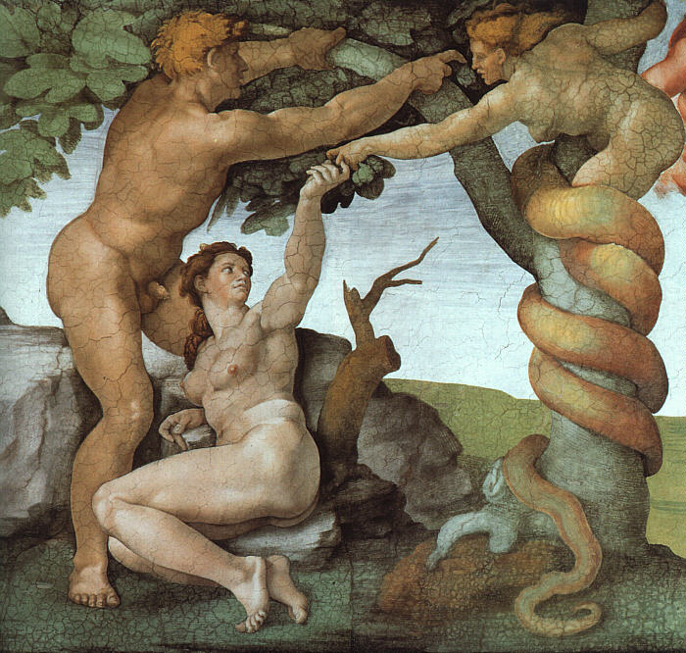
How did it all start?
Lucifer was the channel of God's love to the angelic world. In this position he virtually monopolized the love of God. God loved his children much more than he loved his servant Lucifer. God’s love for Lucifer did not change. It was the same before and after the creation of human beings. When Lucifer saw that God loved Adam and Eve more than him, he felt as if there had been a decrease in the love he received from God. EDP, 63
Notes:
Michaelangelo
The fundamental motivation which engendered these primary characteristics of the
fallen nature lay in the envy the Archangel felt toward Adam, the beloved of God. How
can there be anything such as envy and jealousy in an archangel, whom God created
for a good purpose? The Archangel was endowed with desire and intellect as a part of
his original nature. Because the Archangel possessed an intellect, he could compare
and discern that God's love for human beings was greater than the love God gave to
him. Because he also possessed desires, he had a natural yearning for God to love him
more. This desire of the heart was naturally conducive to envy and jealousy. Envy is
an inevitable by-product of the original nature, like the shadow cast by an object in
the light.

Slide 12
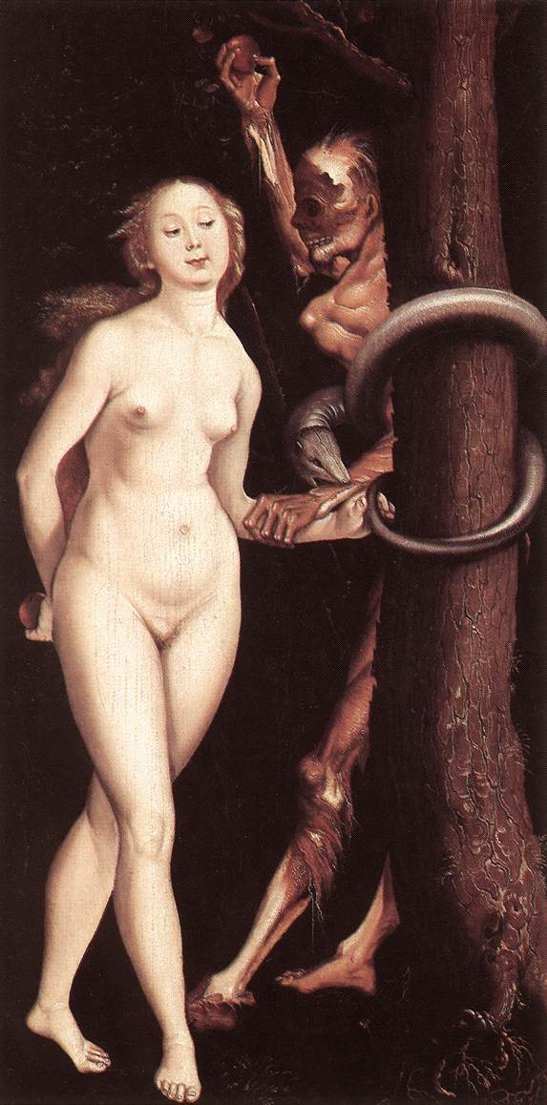
What was the motivation for the fall?
Lucifer, feeling as though he was receiving less love than he deserved, wanted to grasp the same central position in human society as he enjoyed in the angelic world, as the channel of God’s love. This was why he seduced Eve and this was the motivation of the spiritual fall. EDP, 64
Notes:
Lucifer was channel of God’s love to angelic world. He was closer to God than any other being as he was the most like God.
After God created A&E as his children he loved them many times more than he loved Lucifer. Whom he created and loved as his servant. A&E more like God than Lucifer so had a greater capacity to receive God’s love. God’s love to Lucifer didn’t change.
Parable of labourers in Vinneyard. Mt 20:1-15
Lucifer wanted a lineage
After she ate the fruit Eve realised that she had sinned and felt guilty and cut off from God. Her eyes had been opened – she had lost her innocence. She realised that Adam was supposed to be her husband and not Lucifer.

Slide 13
How did the fall start?
God
Closest to
God
Adam
Felt less love
Jealousy
Eve
Lucifer
The fundamental motivation . . .
lay in the envy the Archangel felt
towards Adam, the beloved of God.
EDP, 72
Wanted to
rule humans

Slide 14
What are envy and jealousy?
Jealousy is the result or fear of losing someone or something that one is attached to or possesses that one believes one deserves to another person (e.g. the transfer of a lover's affections)
Envy is the resentment caused by another person having something that one does not have, but desires for oneself
  Malicious envy - wish that the other lacked something and happy if they lose it even if one doesn’t get it
  Benign envy - a type of positive motivational force
Notes:
What is envy? In philosophy terms, Aristotle got in early, presumably to the envy of later philosophers. He takes what you might call the Morrissey view: we hate it when our friends become successful. It’s the same as that Gore Vidal line: “Every time a friend succeeds, I die a little.” When we envy, says Aristotle, we feel pain at the good fortune of others. This, he reckons, makes it distinct from jealousy. “For the one,” he writes, “makes himself get good things by jealousy, while the other does not allow his neighbour to have them through envy.”
It is, in other words, more than aspiration. Envy is not just that you want to have stuff. Envy entails, also, that you want others not to have it. Embedded in there is a desire to have it all by taking it all away.

Slide 15
How could Lucifer feel jealous?
How can there be anything such as envy and jealousy in an archangel, whom God created for a good purpose? The archangel was endowed with desire and intellect as a part of his original nature. Because the archangel possessed an intellect, he could compare and discern that God's love for human beings was greater than the love God gave to him. Because he also possessed desires, he had a natural yearning for God to love him more. This desire of the heart was naturally conducive to envy and jealousy. Envy is an inevitable by-product of the original nature, like the shadow cast by an object in the light.

Slide 16
What should Lucifer have done?
Without love, life becomes barren and fruitless but with love it grows and flourishes. Love is a two-way thing, a giving and receiving. Never sit there expecting to be loved without giving love. The more love you pour out the more you will receive. So when you feel the lack of love, look within yourselves and see where and how you can love more and as you do something about it, love will come pouring in filling your whole life and then going out and out into the lives of others.
Shoulder your responsibilities and cease looking at the other people expecting them to change. Do something about it and start with yourself. Put your own house in order and see what happens.
Eileen Caddy, Findhorn Foundation

Slide 17
Lucifer tempts Eve
When Eve responded to his
temptation, the angel felt
the stimulation of her love
to be deliciously enticing.
EDP, 64
God
Adam
Eve
Lucifer
Wanted to experience
love before time was ripe
Desire for unprincipled love

Slide 18

Freedom and the law
Since Eve’s heart and intellect
were still immature when she was
tempted by the angel, she
became confused emotionally
and intellectually. Although the
freedom of her original mind
induced in her a sense of
foreboding, she crossed
the boundary and fell. EDP, 75
STOP
Prescriptive law
Loss of freedom
Descriptive law
Notes:
Freedom and restoration. Original mind seeks for freedom - freedom to be good, be repsonsibilnsiblee
to own
Descriptive law - gravity
Prescriptive law - ‘do not’

Slide 19
How would the commandment work?
No matter how freely Eve related to
the angel, if she had maintained
faith in the commandment and not
responded to the temptation, then
the power of unprincipled love
would not have been generated and
she would not have fallen. EDP, 75
God
Prayer is the education of desire
Eve
Lucifer
No unprincipled relationship possible

Slide 20
Fall between Lucifer and Eve
Eve was traumatised by her relationship with Lucifer
  Sexually, emotionally, psychologically abused
  Sense of worthlessness and being needy
  Wanting to be loved
Loss of innocence
Notes:
uncle

Slide 21
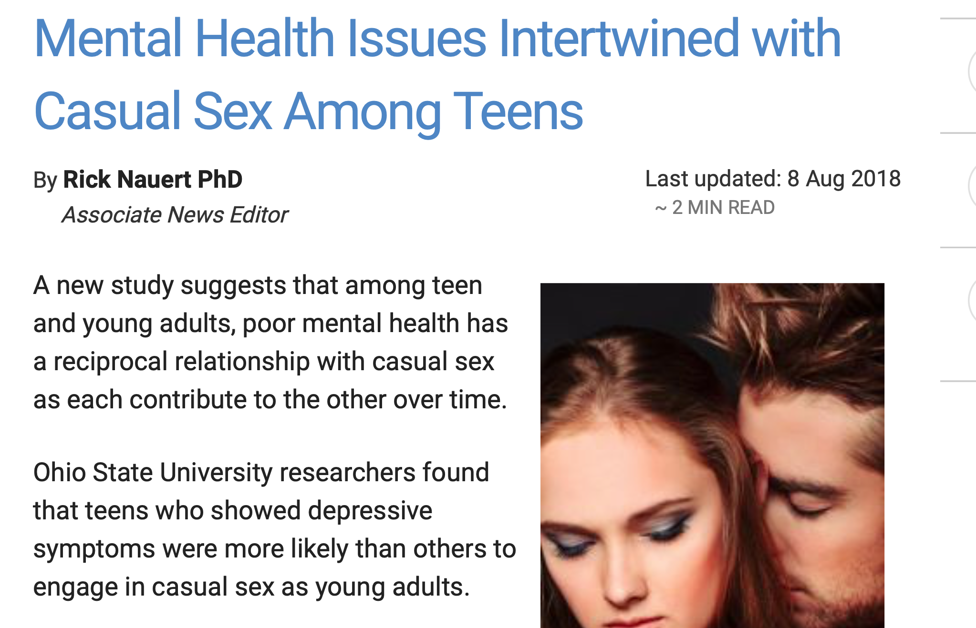

Slide 22
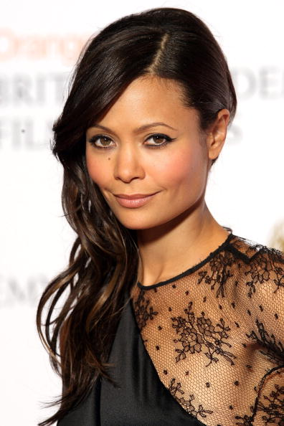
Results of sexual abuse
In recent years Thandie Newton has been vocal about the secret torment that plagued much of her early life, instigated by a relationship she had for four years from the age of 16 with the 39-year-old director John Duigan, who went on to cast her in her film debut, the Australian comedy Flirting. Only after years of therapy did Newton realise her struggles with mental health were a result of the relationship.
Notes:
What effects does abuse have on a child’s sexuality?
When a child is sexually abused, his/her normal sexual development is cut short. Being forced to be sexual on an adult level leaves the child not being able to develop his own desire, sexual orientation or interest. He/she doesn’t get a chance to explore sex in an age-appropriate way. The child learns that the abusers sexual desire is a scary, out of control, force and his/her first sexual experiences of arousal are linked with shame, disgust, pain and humiliation. This makes for powerful imprinting. If the abuse was linked with affection and nurturing, the child grows up confused about the difference between affection and sex, intimacy and intrusion.
What effects does abuse have on an adult’s sexuality?
In adulthood this can play out in several different ways: Some survivors chose celibacy or chose partners who don’t want sex. Sometimes they spend many years and a great deal of energy trying to find ways to avoid having sex. Some view sex as “dirty” or see it as an obligation that they must perform. Survivors may force themselves for years to go through the motions even though they are numb, absent or in a panic. They may think that they are frigid, or be confused about homosexuality, or maybe they just feel that they are dysfunctional all together because they do not understand that they are suffering from the effects of the abuse. They may have violent or abusive fantasies that arose them but then cause them great shame. Other times the survivor may confuse the partner with the abuser during sex, Sex becomes a mine field of painful associations and memories. Other survivors act out or become promiscuous believing that they are only good or loved for sex. He or She then fulfills this legacy sometimes with total disregard for his/her own safety. They feel they cannot say NO to sex and end up having sex with anyone that wants them.
The sense of well being and self-esteem gets hooked up with sexual desirability. The survivor might only feel a sense of self-worth when being sexually desired. Also here is the fact that many survivors find one-night stands sexually enjoyable. This is because they are disconnected with any emotional or intimate feelings regarding sex. As a child, survivors become programmed to disconnect from sex and from anyone who loved him and wanted sex with him. So as an adult, sex with an intimate partner may become a “skin crawling” experience. Many have noticed that the deeper the relationship became, the less they wanted sex with this person. They may feel so confused as to why they enjoyed sex before but suddenly can’t stand to be touched by the partner. I will get into how this effects the partners in the next paragraph. They may continually be unfaithful to their partners because they want to enjoy a sexual experience, they want to confirm to themselves that they are “sexually normal” that they can enjoy sex. They may come to believe that this may mean they are not “in love” with the partner and even break up the relationship because of the sexual turn off that they feel. This then becomes a pattern. They can meet someone new, enjoy sex for a time and then as the relationship goes to a deeper more connected level, the same thing happens. They can’t stay disconnected from sex in an intimate relationship and they can’t connect sex with love. I have seen cases where because of this, survivors feel that they must be homosexual. They find a same sex partner, enjoy the sex in the beginning and then all the same things start happening to them. This leaves them feeling totally confused and dysfunctional.
How does this effect the Partner?
For partners of Survivors, this whole aspect is very frustrating. The partner can wind up feeling like a failure for not be able to give pleasure or express their true feelings to the survivor. They may feel rejected and at a loss on what to do about this situation. Their own sexual desires are put on hold. They love the survivor but have needs of their own also. It is important to remember that the survivor is feeling these feelings because of the abuse they suffered and it is not that the partner is lacking as a lover. It is hard not to take it personally as what could be more personal than your sex life, however, it really is not your fault. You could be the best lover on the planet and that would only serve to make the survivor more confused, more guilt ridden. Survivors feel a tremendous sense of guilt for not being sexually available for their partners…for not enjoying sex the way they wish they could. The survivor probably loves you very much but it is just too scary to feel this with his/her body too. In fact, the fact that they are willing to stay in the relationship and have to deal with this sexual issue every day, is proof that the survivor must care for you a great deal. IT takes a big toll on someone to try and avoid sex, make excuses, panic at being touched in the night, have all those feelings continually brought up.
When the survivor starts being honest about his or her feelings with the partner, the partner might feel shocked, angry and bewildered, especially if the survivor seemed to enjoy sex before. Sudden upheaval of sexual issues is the norm when survivors start to work on abuse issues. Patience with the survivor is key. Survivors often cannot work on sexual issues until the later stages of healing. If a survivor feels pressure to have sex during this time, it only serves to make him/her feel worse. Especially if there is fighting or threats about this. The survivor feels like this is the original abuse because they feel manipulated again. This only shuts the survivor down further. When the pressure for sex is taken off of the survivor, this allows him or her room to heal sexually. As a partner, you do have a choice, you can leave the relationship and find someone else to have sex with but the survivor can’t. Unless she/he heals sexually, these problems will follow her into every relationship for the rest of her life. Her/his motivation to heal and change is greater than yours. You cannot make someone heal sexually. You can’t set deadlines or orchestrate the survivors progress. You can set mutual goals and work toward them. You can make your feelings and needs known and say that sex is important to you and that you want, eventually, to have a mutual sexual relationship. The survivor understands this, they want the same thing. Things will change and can even though it may not seem like it now. Ultimately, you will be rewarded with a whole and healthy person.
Working with a survivor on sexual healing takes an incredible amount of patience, persistence and an acceptance of the fact that you are growing as a person too. Survivors often need to be the initiators of sex in order to feel in control. This is an important thing for partners to understand.
Let the survivor make the moves and set the pace for your love making. If the survivor feels in control, often this makes a very big difference. Try not to feel rejected when you reach over in bed and your partner flinches from your touch. Remember that a lot of survivors do not like to be touched when they are sleeping. For obvious reasons, this is very triggering for them. Avoid power struggles over sex. During this time, partners may find it extremely helpful to join a support group.

Slide 23
What effects does abuse have on a child’s sexuality?
When a child is sexually abused, his/her normal sexual development is cut short. Being forced to be sexual on an adult level leaves the child not being able to develop his/her own desire, sexual orientation or interest. He/she doesn’t get a chance to explore sex in an age-appropriate way. The child learns that the abusers sexual desire is a scary, out of control, force and his/her first sexual experiences of arousal are linked with shame, disgust, pain and humiliation. This makes for powerful imprinting. If the abuse was linked with affection and nurturing, the child grows up confused about the difference between affection and sex, intimacy and intrusion.
Notes:
What effects does abuse have on an adult’s sexuality?
In adulthood this can play out in several different ways: Some survivors chose celibacy or chose partners who don’t want sex. Sometimes they spend many years and a great deal of energy trying to find ways to avoid having sex. Some view sex as “dirty” or see it as an obligation that they must perform. Survivors may force themselves for years to go through the motions even though they are numb, absent or in a panic. They may think that they are frigid, or be confused about homosexuality, or maybe they just feel that they are dysfunctional all together because they do not understand that they are suffering from the effects of the abuse. They may have violent or abusive fantasies that arose them but then cause them great shame. Other times the survivor may confuse the partner with the abuser during sex, Sex becomes a mine field of painful associations and memories. Other survivors act out or become promiscuous believing that they are only good or loved for sex. He or She then fulfills this legacy sometimes with total disregard for his/her own safety. They feel they cannot say NO to sex and end up having sex with anyone that wants them.
The sense of well being and self-esteem gets hooked up with sexual desirability. The survivor might only feel a sense of self-worth when being sexually desired. Also here is the fact that many survivors find one-night stands sexually enjoyable. This is because they are disconnected with any emotional or intimate feelings regarding sex. As a child, survivors become programmed to disconnect from sex and from anyone who loved him and wanted sex with him. So as an adult, sex with an intimate partner may become a “skin crawling” experience. Many have noticed that the deeper the relationship became, the less they wanted sex with this person. They may feel so confused as to why they enjoyed sex before but suddenly can’t stand to be touched by the partner. I will get into how this effects the partners in the next paragraph. They may continually be unfaithful to their partners because they want to enjoy a sexual experience, they want to confirm to themselves that they are “sexually normal” that they can enjoy sex. They may come to believe that this may mean they are not “in love” with the partner and even break up the relationship because of the sexual turn off that they feel. This then becomes a pattern. They can meet someone new, enjoy sex for a time and then as the relationship goes to a deeper more connected level, the same thing happens. They can’t stay disconnected from sex in an intimate relationship and they can’t connect sex with love. I have seen cases where because of this, survivors feel that they must be homosexual. They find a same sex partner, enjoy the sex in the beginning and then all the same things start happening to them. This leaves them feeling totally confused and dysfunctional.
How does this effect the Partner?
For partners of Survivors, this whole aspect is very frustrating. The partner can wind up feeling like a failure for not be able to give pleasure or express their true feelings to the survivor. They may feel rejected and at a loss on what to do about this situation. Their own sexual desires are put on hold. They love the survivor but have needs of their own also. It is important to remember that the survivor is feeling these feelings because of the abuse they suffered and it is not that the partner is lacking as a lover. It is hard not to take it personally as what could be more personal than your sex life, however, it really is not your fault. You could be the best lover on the planet and that would only serve to make the survivor more confused, more guilt ridden. Survivors feel a tremendous sense of guilt for not being sexually available for their partners…for not enjoying sex the way they wish they could. The survivor probably loves you very much but it is just too scary to feel this with his/her body too. In fact, the fact that they are willing to stay in the relationship and have to deal with this sexual issue every day, is proof that the survivor must care for you a great deal. IT takes a big toll on someone to try and avoid sex, make excuses, panic at being touched in the night, have all those feelings continually brought up.
When the survivor starts being honest about his or her feelings with the partner, the partner might feel shocked, angry and bewildered, especially if the survivor seemed to enjoy sex before. Sudden upheaval of sexual issues is the norm when survivors start to work on abuse issues. Patience with the survivor is key. Survivors often cannot work on sexual issues until the later stages of healing. If a survivor feels pressure to have sex during this time, it only serves to make him/her feel worse. Especially if there is fighting or threats about this. The survivor feels like this is the original abuse because they feel manipulated again. This only shuts the survivor down further. When the pressure for sex is taken off of the survivor, this allows him or her room to heal sexually. As a partner, you do have a choice, you can leave the relationship and find someone else to have sex with but the survivor can’t. Unless she/he heals sexually, these problems will follow her into every relationship for the rest of her life. Her/his motivation to heal and change is greater than yours. You cannot make someone heal sexually. You can’t set deadlines or orchestrate the survivors progress. You can set mutual goals and work toward them. You can make your feelings and needs known and say that sex is important to you and that you want, eventually, to have a mutual sexual relationship. The survivor understands this, they want the same thing. Things will change and can even though it may not seem like it now. Ultimately, you will be rewarded with a whole and healthy person.
Working with a survivor on sexual healing takes an incredible amount of patience, persistence and an acceptance of the fact that you are growing as a person too. Survivors often need to be the initiators of sex in order to feel in control. This is an important thing for partners to understand.
Let the survivor make the moves and set the pace for your love making. If the survivor feels in control, often this makes a very big difference. Try not to feel rejected when you reach over in bed and your partner flinches from your touch. Remember that a lot of survivors do not like to be touched when they are sleeping. For obvious reasons, this is very triggering for them. Avoid power struggles over sex. During this time, partners may find it extremely helpful to join a support group.

Slide 24
What effects does abuse have on an adult’s sexuality?
In adulthood this can play out in several different ways: Some survivors chose celibacy or chose partners who don’t want sex. Sometimes they spend many years and a great deal of energy trying to find ways to avoid having sex. Some view sex as “dirty” or see it as an obligation that they must perform. Survivors may force themselves for years to go through the motions even though they are numb, absent or in a panic. They may think that they are frigid, or be confused about homosexuality, or maybe they just feel that they are dysfunctional all together because they do not understand that they are suffering from the effects of the abuse. They may have violent or abusive fantasies that arose them but then cause them great shame. Other times the survivor may confuse the partner with the abuser during sex. Sex becomes a mine field of painful associations and memories. Other survivors act out or become promiscuous believing that they are only good or loved for sex. He or She then fulfils this legacy sometimes with total disregard for his/her own safety. They feel they cannot say NO to sex and end up having sex with anyone that wants them.

Slide 25
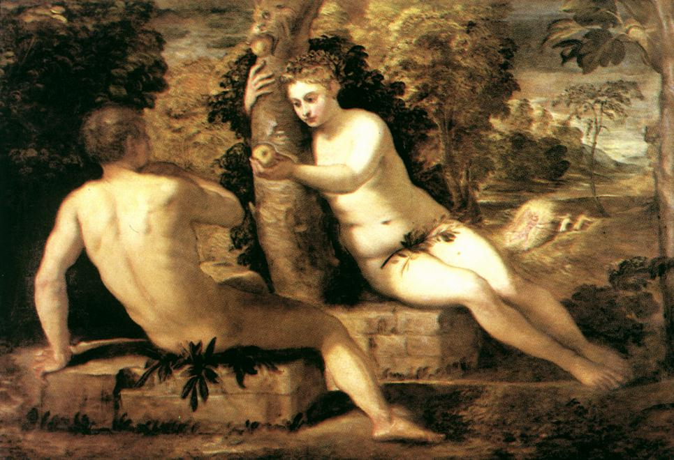
Adam and Eve

Slide 26
Eve tempts Adam
Eve very needy. Vulnerable.
Hurt. Abused. Wanted to be
comforted and loved. Wanted
To receive love and comfort
from Adam who she realised
should be her spouse
God
Adam
Eve
Lucifer
Rid herself of guilt
and stand before God

Slide 27
Results of the second fall
God
Adam
Fear
Guilt
Premature knowledge
Eve
Lucifer
Notes:
Protecting behaviour to eliminate our fear (Baer)
LYING
Attacking
Acting like a victim
Running away

Slide 28
How does this effect the Partner?
For partners of Survivors, this whole aspect is very frustrating. The partner can wind up feeling like a failure for not be able to give pleasure or express their true feelings to the survivor. They may feel rejected and at a loss on what to do about this situation. Their own sexual desires are put on hold. They love the survivor but have needs of their own also. It is important to remember that the survivor is feeling these feelings because of the abuse they suffered and it is not that the partner is lacking as a lover. It is hard not to take it personally as what could be more personal than your sex life, however, it really is not your fault. You could be the best lover on the planet and that would only serve to make the survivor more confused, more guilt ridden. Survivors feel a tremendous sense of guilt for not being sexually available for their partners…for not enjoying sex the way they wish they could. The survivor probably loves you very much but it is just too scary to feel this with his/her body too. In fact, the fact that they are willing to stay in the relationship and have to deal with this sexual issue every day, is proof that the survivor must care for you a great deal. IT takes a big toll on someone to try and avoid sex, make excuses, panic at being touched in the night, have all those feelings continually brought up.

Slide 29
Steps towards healing
When the survivor starts being honest about his or her feelings with the partner, the partner might feel shocked, angry and bewildered, especially if the survivor seemed to enjoy sex before. Sudden upheaval of sexual issues is the norm when survivors start to work on abuse issues. Patience with the survivor is key. Survivors often cannot work on sexual issues until the later stages of healing. If a survivor feels pressure to have sex during this time, it only serves to make him/her feel worse. Especially if there is fighting or threats about this. The survivor feels like this is the original abuse because they feel manipulated again. This only shuts the survivor down further. When the pressure for sex is taken off of the survivor, this allows him or her room to heal sexually. As a partner, you do have a choice, you can leave the relationship and find someone else to have sex with but the survivor can’t. Unless she/he heals sexually, these problems will follow her into every relationship for the rest of her life. Her/his motivation to heal and change is greater than yours. You cannot make someone heal sexually. You can’t set deadlines or orchestrate the survivors progress. You can set mutual goals and work toward them. You can make your feelings and needs known and say that sex is important to you and that you want, eventually, to have a mutual sexual relationship. The survivor understands this, they want the same thing. Things will change and can even though it may not seem like it now. Ultimately, you will be rewarded with a whole and healthy person.
Working with a survivor on sexual healing takes an incredible amount of patience, persistence and an acceptance of the fact that you are growing as a person too. Survivors often need to be the initiators of sex in order to feel in control. This is an important thing for partners to understand.

Slide 30
Why was the ‘spiritual fall’ worse than the ’physical fall’?
Eve’s relationship with the archangel was unprincipled and should never have happened
  Relationship with paedophile, uncle, teacher
The relationship with Adam was supposed to happen but in the right way
  Teenagers who fall
Eve’s motivation for first relationship was excessive desire to experience ‘love’
Eve’s motivation for the second was to be comforted and return to God

Slide 31
Shame, blame and victimhood
God: “Where are you?”
“Who told you that you were naked?
“Have you eaten of the tree of which I told you not to eat?”
Lucifer
Eve
“The serpent tricked me, and I ate.”
Adam
“The woman whom you gave to be with me,
she gave me the fruit of the tree and I ate.”
Adam blamed Eve; Eve blamed Lucifer.
Denial of responsibility; denial of position; loss of freedom
Notes:
Fight from responsibility into victimhood
So Jews developed a morality of guilt in place of what the Greeks had, a morality of shame. A morality of guilt makes a sharp distinction between the person and the act, between the sinner and the sin. Because we are not wholly defined by what we do, there is a core within us that remains intact – “My God, the soul you gave me is pure” – so that whatever wrong we may have done, we can repent and be forgiven. That creates a language of hope, the only force strong enough to defeat a culture of despair.
It is that power of hope, born whenever God’s love and forgiveness gives rise to human freedom and responsibility, that has made Judaism the moral force it has always been to those who minds and hearts are open. But that hope, says Moses with a passion that still sears us whenever we tread it afresh, does not just happen. It has to be worked for and won. The only way it is achieved is by not blaming God. He is not corrupt. The defect is in us, His children. If we seek a better world, we must make it. God teaches us, inspires us, forgives us when we fail and lifts us when we fall, but we must make it. It is not what God does for us that transforms us; it is what we do for God.
The first humans lost paradise when they sought to hide from responsibility. We will only ever regain it if we accept responsibility and become a nation of leaders, each respecting and making space for those not like us. People do not like people who remind them of their responsibility. That is one of the reasons (not the only one, to be sure) for Judeophobia through the ages. But we are not defined by those who do not like us. To be a Jew is to be defined by the One who loves us.
The deepest mystery of all is not our faith in God but God’s faith in us. May that faith sustain us as we heed the call to responsibility and take the risk of healing some of the needless wounds of an injured but still wondrous world.
Don’t blame God when things go wrong. That is what Moses feels so passionately. Don’t believe, he says, that God is there to serve us. We are here to serve Him and through Him be a blessing to the world. God is straight; it is we who are complex and self-deceiving. God is not there to relieve us of responsibility. It is God who is calling us to responsibility.
With these words Moses brings to closure the drama that began in the beginning with Adam and Eve in the Garden of Eden. When they sinned, Adam blamed the woman, the woman blamed the serpent. So it was in the beginning and so it still is in the twenty-first century secular time.
The story of humanity has been for the most part a flight from responsibility. The culprits change. Only the sense of victimhood remains. It wasn’t us. It was the politicians. Or the media. Or the bankers. Or our genes. Or our parents. Or the system, be it capitalism, communism or anything between. Most of all, it is the fault of the others, the ones not like us, infidels, sons of Satan, children of darkness, the unredeemed. The perpetrators of the greatest crime against humanity in all of history were convinced it wasn’t them. They were “only obeying orders.” When all else fails, blame God. And if you don’t believe in God, blame the people who do. To be human is to seek to escape from responsibility.
That is what makes Judaism different. It is what made some people admire Jews and others hate them. For Judaism is God’s call to human responsibility. From this call you can’t hide, as Adam and Eve discovered when they tried, and you can’t escape, as Jonah learnt in the belly of a fish.

Slide 32
Victimisation and victimhood
We are all likely to be victimised in some way in the course of our lives. At some point we will suffer some kind of affliction or calamity or abuse, caused by circumstances or people or institutions over which we have little or no control. This is life. And this is victimisation. It comes from the outside.
In contrast, victimhood comes from the inside. No one can make you a victim but you. We become victims not because of what happens to us but when we choose to hold on to our victimisation. We develop a victim’s mind – a way of thinking and being that is rigid, blaming, pessimistic, stuck in the past, unforgiving, punitive, and without healthy limits or boundaries.
“I’ve learned not to look for happiness, because that is external. You were born with love and you were born with joy. That’s inside. It’s always there.”
Edith Egar, The Choice: even in hell hope can flower (testament of a holocaust survivor)

Slide 33
What were the consequences of the fall?
Notes:
Protecting behaviour to eliminate our fear (Baer)
LYING
Attacking
Acting like a victim
Running away

Slide 34
As a result of the fall . . .
Eve was traumatised by her relationship with Lucifer
  Sexually, emotionally, psychologically abused
  Sense of worthlessness and being needy
  Wanting to be loved
Adam was damaged by his relationship with Eve
  Inherited the archangelic nature of wanting to own and control
  Weak and hard to respect
Influenced by malign spiritual forces
Notes:
Give and take of love -> exchange of elements.
Eve TRAUMATISED
And yes, William Haines, I believe that the "original sin" could be renamed "original trauma". I found, in my work as an Emotion Code practitioner that, with women esp., the negative trapped emotion of worthlessness is found over and over and over. One day, i had an epiphany. I felt that this goes way back, all the way back to Eve. This has been transmitted for generations and many women , as in Arabic cultures, still pay the price just for 'being a woman. not just emotionally but by physical limitations/even abuse'.
It is really time to restore all that, the suffering has gone on way to long. It is time, for women and for men to reclaim their original status as loved and loving children of God. But the work needs to be done by each individual to consciously drop what no longer serves them which is the shame and guilt and feelings of lack of value that are all residues from the original ancestral trauma.
Isn't that what is called "being reborn" in Christianity?

Slide 35
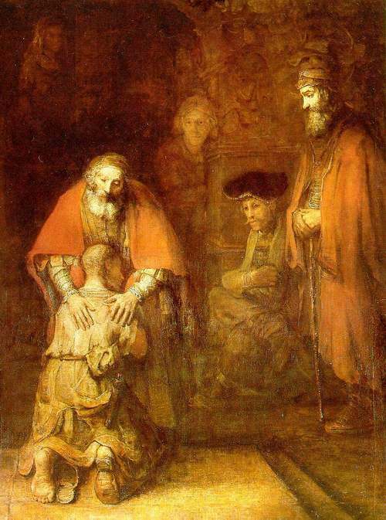
Why did God not prevent the Fall?
God gave the commandment to protect Adam and Eve
God wants us to become Lords of Creation
  Have to qualify by winning the respect of the angelic world
God gave freedom and responsibility
  God respects us
God cannot intervene
  Love not power
The Parable of the Prodigal Son
  God believed in Adam and Eve and trusted them
Notes:
God foresaw the possibility of the fall and so to protect and guide his children he gave the commandment with clear explanation of consequences of breaking it.
If God had prevented fall he would have been interfering in human responsibility – which would show lack of respect for them. How does a teenager feel is treated as a child?
Heart of God – heart of creation, heart of fall, heart of restoration and reconciliation. If the father had not allowed the son to have his inheritance and insisted he stay at home, the father would have kept the son’s body but lost his heart. The son’s heart and mind would be in the city. God gives people the freedom to be responsible, to make mistakes and hopes we will learn from them.

Slide 36
God’s heart was broken
God lost object of his love, the very purpose for which He had created the universe
Infinite love infinite grief, sorrow, hurt
God was betrayed by Lucifer whom He had trusted to take care of His children
God screaming at what happened to His children
God weeps at the way His world is

Slide 37
All people affected by the fall
Original sin is transmitted through the physical body.
EDP, 392
Lucifer
Evil elements (imprinting)
Evil elements
Adam
Eve
Evil elements
Evil elements
Children
“Original Sin”
Original damage
Original trauma
Descendants
Notes:
Evil elements – fallen patterns of thought, feeling, behaviour. Lucifer’s nature ‘imprinted’ onto Eve. She was corrupted through the relationship. She was damaged heartistically and emotionally and psychologically. Through her Adam was also damaged. They had an abusive marriage and their children were born damaged and the trauma of the fall was passed on

Slide 38
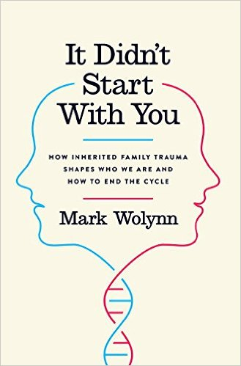

Slide 39
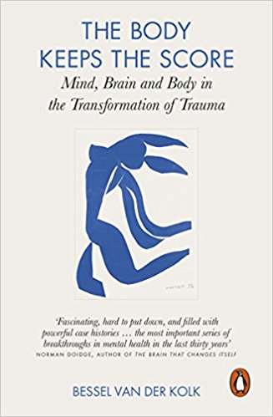

Slide 40
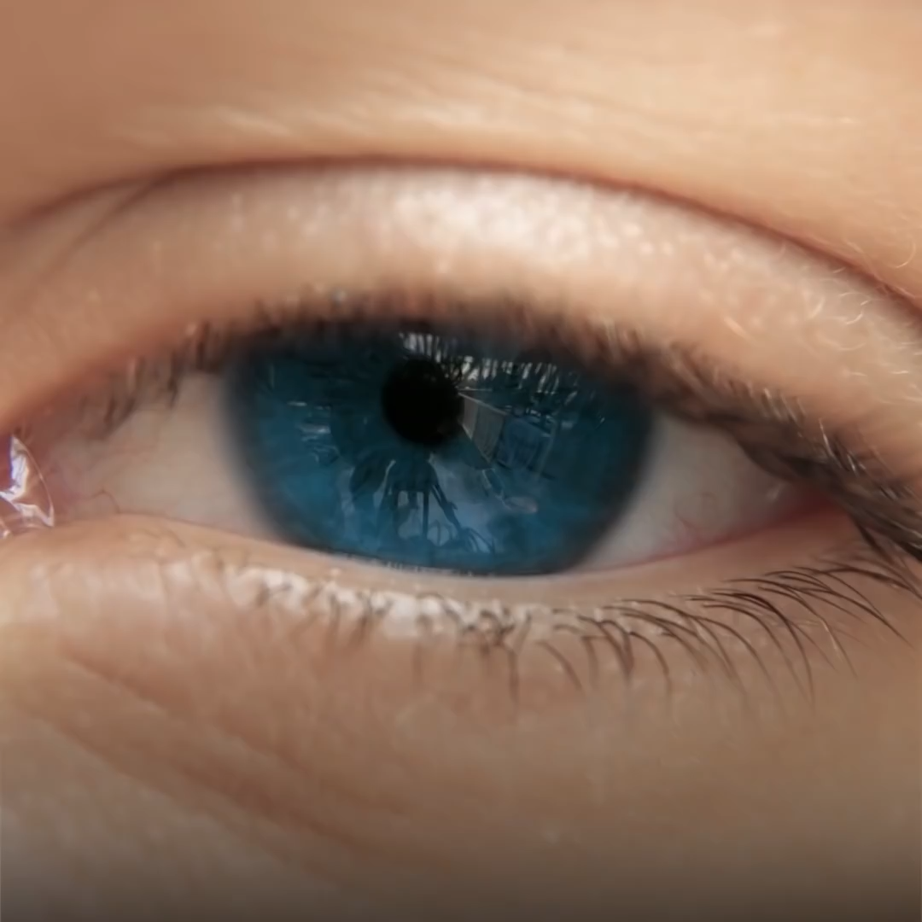

Slide 41
What happened at the fall?
All the relationships of the Four Great Realms of Heart were corrupted and distorted
  Man – woman
  Husband – wife
  Parents – children
  Sibling – sibling
Restoration is putting all these relationships right

Slide 42
Loss of the three blessings . . .
People struggle to attain mind-body unity
  Alcoholism, laziness, lying, identity crisis
People struggle to achieve good relations
  Divorce, conflict, loneliness, ‘bad sex’
People struggle to manage the ‘world’
  Finances, tidiness, pollution

Slide 43
Three worst crimes
Murder
  Violation of heart
  1st blessing
Rape
  Violation of lineage
  2nd blessing
Robbery
  Violation public property
  3rd blessing

Slide 44
After the Fall: sex and violence
When the human race began to increase, with more and more daughters being born, the sons of God [rulers] noticed that the daughters of men were beautiful. They looked them over and picked out wives for themselves.
This was back in the days when there were titans in the land. The titans came from the union of the sons of God and the daughters of men. These were the mighty men of ancient lore, the famous ones.
God saw that human evil was out of control. People thought evil, imagined evil—evil, evil, evil from morning to night. God was sorry that he had made the human race in the first place; it broke his heart. Genesis 6:1-6
Notes:
Who were the ‘sons of God’ and the titans? Most commentators translate the the first phrase as ‘sons of rulers, judges’. They were people in positions of power. Maimonedes understands the phrase ‘daughters of man’ as girls or women of the lower classes, commoners or slaves. Titans is a graphic word for alpha males. In the evolution from hunter gatherers to settled populations and the growth of civilisation there was a breakdown in sexual ethics. The primary driver of violence is sexual desire.
The central message of Genesis is that sexual anomie – the unfettered play of Darwinian forces and alpha males – leads to a society marked by widespread violence. Such behaviour priviliges some people against others. It turns women into instruments of male desire. It places power, not love, at the heart of human relationships. It treats women as objects rather than as subjects with equal dignity and integrity. It divorces sex from compassion and concern. It dishonours the most intimate human bond, the one in which we are most like God himself: the love that brings new life into the world.
Above all, though, it leads to violence which is the greatest threat to humanity. Murder, the supreme prohibition of the Noahide Code is not merely a crime but a sin since the human person is in the image of God and murder is therefore a form of sacrilege.

Slide 45
With the development of agriculture, cities and economic surplus, some humans became richer and more powerful than others. Kings, rulers, pharaohs – human alpha males – could command an almost open ended gratification of sexual desire. Polygamy became possible for a minority of males. Harems made their appearance. Abraham and Isaac were afraid of being killed for their wives.
The central message of Genesis is that sexual anomie – the unfettered play of Darwinian forces and alpha males – leads to a society marked by widespread violence. Such behaviour privileges some people against others. It turns women into instruments of male desire. It places power, not love, at the heart of human relationships. It treats women as objects rather than as subjects with equal dignity and integrity. It divorces sex from compassion and concern. It dishonours the most intimate human bond, the one in which we are most like God himself: the love that brings new life into the world.
Jonathan Sacks

Slide 46
Primary driver of violence: sexual desire
In almost all species, males spend most of their time fighting among themselves for access to females. The unique social contract of monogamy – a male for every female, a female for every male – lowers the temperature of sexual competition and frees its members to work together in co-operation. It is at this juncture that human societies – even human civilisation – are born.
William Tucker, Marriage and Civilisation: How Monogamy Made Us Human
Notes:
With the development of agriculture, cities and economic surplus, some humans became richer and more powerful than others. Kings, rulers, pharaohs – human alpha males – could command an almost open ended gratification of sexual desire. Polygamy became possible for a minority of males. Harems made their appearance. Abraham and Isaac were afraid of being killed for their wives. Jus primae noctis – the right of a feudal lord to deflower the bride of any of his tenants on the first night of marriage.

Slide 47
What needs to be restored?
Relationship between Archangel and Adam
Relationship between Archangel and Eve
Relationship between Adam and Eve
The relationship between parents and children
Archetypal relationships

Slide 48
What needs to be restored?
Relationship between Archangel and Adam
  Adam needs to win the respect of the AA to become the Lord of creation
  Abel, in the position of Adam, needs to restore the birthright by winning the respect of Cain, in the position of the AA, and become the elder brother, head of the family
  This takes many attempts

Slide 49
What needs to be restored?
Relationship between Archangel and Eve
  Men have inherited the archangelic nature to want to control and possess and have sexual relationships with women for their own pleasure and gratification. Lust, not love
    Droit du seigneur – ‘lord’s right’
    Sexual harassment and worse
  Women have inherited the tendency to be seduced by a powerful men and to seduce

Slide 50
What needs to be restored?
Relationship between Adam and Eve
  Man needs the respect of his wife
  Man needs to love his wife
  Become a good subject
  Woman needs the love of her husband
  Woman needs to respect her husband
  Become a good object

Slide 51
What needs to be restored?
The relationship between parents and children
  Parents need to love and take care of their children
  Children need to honour their parents

