Slide 1
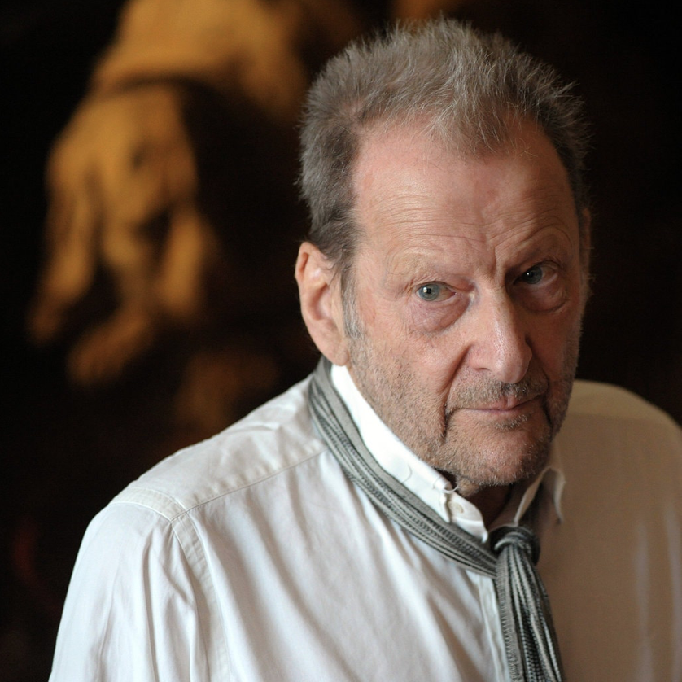
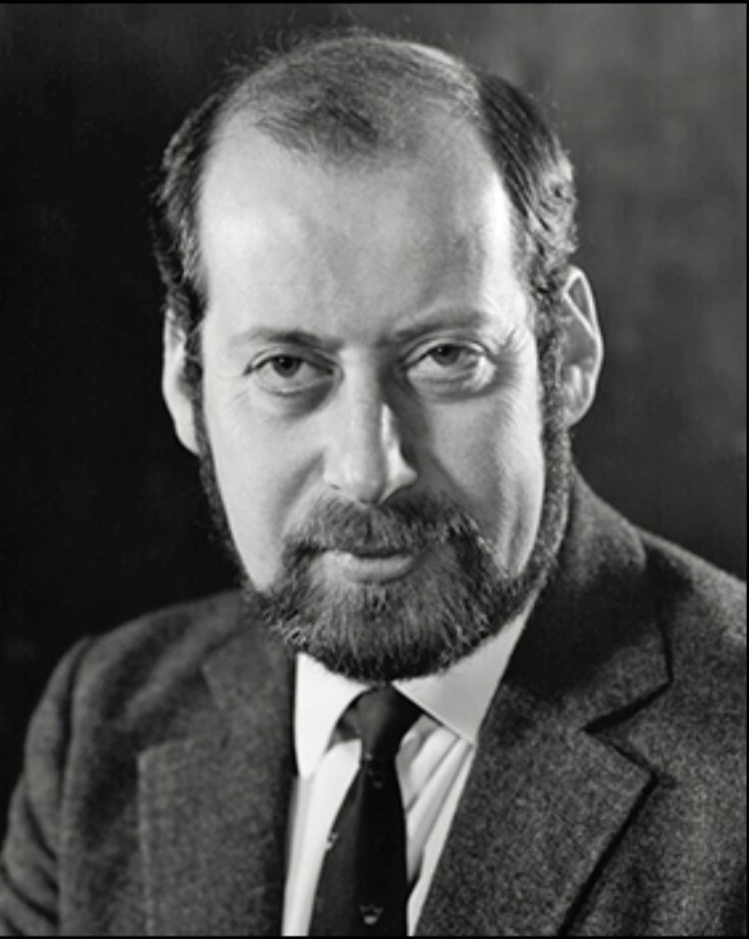
A tale of two brothers
Lucian Freud, whose 1995 painting Benefits Supervisor Sleeping set a world record price for a work by a living artist when it was sold last month for $33.6 million is said not to have spoken to his brother Clement, 84, in more than 50 years. Last week he was quoted as saying they would not exchange another word.
"Why on earth would I want to speak to him or see him again?" he said.
"Family is not important to me," he added. "It doesn't bother me in the slightest."
The origins of the rift between the pair, who are grandsons of Sigmund Freud, the psychoanalyst, are clouded in mystery.
Lucian Freud OM (1922-2011)
Sir Clement Freud (1924–2009)
Notes:
Lucian Michael Freud, OM CH[1] (/frɔɪd/; 8 December 1922 – 20 July 2011) was a British painter and draughtsman, specialising in figurative art, and is known as one of the foremost 20th-century portraitists. He was born in Berlin, the son of Jewish architect Ernst L. Freud and the grandson of Sigmund Freud. Freud got his first name "Lucian" from his mother in memory of the ancient writer Lucian of Samosata. His family moved to England in 1933 to escape the rise of Nazism. From 1942–43 he attended Goldsmiths College, London. He served at sea with the British Merchant Navy during the Second World War.
His early career as a painter was influenced by surrealism, but by the early 1950s his often stark and alienated paintings tended towards realism.[2] Freud was an intensely private and guarded man, and his paintings, completed over a 60-year career, are mostly of friends and family. They are generally sombre and thickly impastoed, often set in unsettling interiors and urban landscapes. The works are noted for their psychological penetration and often discomforting examination of the relationship between artist and model. Freud worked from life studies, and was known for asking for extended and punishing sittings from his models.
Sir Clement Raphael Freud (24 April 1924 – 15 April 2009)[1][2][3] was a British broadcaster, writer, politician and chef.
The grandson of Sigmund Freud and brother of Lucian Freud, he moved to the United Kingdom from Germany as a child and later worked as a prominent chef and food writer before becoming known to a wider audience as a television and radio personality. He was elected as a Liberal Member of Parliament in 1973, retaining his seat until 1987, when he received a knighthood.

Slide 2
7c. Restoring the relationship between Adam and the Archangel
Joseph and his brothers

Slide 3
Jacob’s family
Leah
Jacob
Rachel
Zilpah
Bilhah
Asher
Gad
8
Joseph
Benjamin
7
Simeon
11
12
2
Reuben
Levi
Dan
Napthali
1
3
5
6
Judah
4
Issachar
9
Zebulun
Dinah
10

Slide 4
Leah’s heart
Leah conceived and bore a son, and she named him Reuben; for she said, ‘Because the Lord has looked on my affliction; surely now my husband will love me.’
She conceived again and bore a son, and said, ‘Because the Lord has heard that I am hated, he has given me this son also’; and she named him Simeon.
Again she conceived and bore a son, and said, ‘Now this time my husband will be joined to me, because I have borne him three sons’; therefore he was named Levi.
She conceived again, and when she gave birth to a son she said, ‘This time I will praise the Lord.’ So she named him Judah. Then she stopped having children.
Notes:
This was important for her, since a woman’s status depended to a large extent on the number of male children she produced. Leah's own story is filled with pathos. She bore Reuben, then Simeon, then Levi, then Judah. Each time she had another son she prayed that Jacob would finally love her. He did not.
Her pitiful words emphasize her isolation and longing for love, love she would never receive, no matter how many sons she gave Jacob. He would never trust her, and Rachel was still the one he loved.

Slide 5
Rachel’s heart
When Rachel saw that she bore Jacob no children, she envied her sister; and she said to Jacob, ‘Give me children, or I shall die!’ Jacob became very angry with Rachel and said, ‘Am I in the place of God, who has withheld from you the fruit of the womb?’ Then she said, ‘Here is my maid Bilhah; go in to her, that she may bear upon my knees and that I too may have children through her.

Slide 6
Bitter rivalry
Then Rachel said, ‘God has judged me, and has also heard my voice and given me a son’; therefore she named him Dan. Rachel’s maid Bilhah conceived again and bore Jacob a second son. Then Rachel said, ‘With mighty wrestlings I have wrestled with my sister, and have prevailed’; so she named him Naphtali.
When Leah saw that she had ceased bearing children, she took her maid Zilpah and gave her to Jacob as a wife. Then Leah’s maid Zilpah bore Jacob a son. And Leah said, ‘Good fortune!’ so she named him Gad. Leah’s maid Zilpah bore Jacob a second son. And Leah said, ‘Happy am I! For the women will call me happy’; so she named him Asher.
Notes:
Rachel faced a different problem. No matter how she prayed to God, no matter how much she was loved by Jacob, Rachel did not conceive. In desperation she gave her maid Bilhah to Jacob, so that he could conceive a child with Bilhah as a surrogate mother for Rachel. This practice was common in the ancient world; the woman became a concubine instead of a servant, and it was a step up the social ladder for her. She might become the mother of the future tribal leader.
Bilhah had a son, whom Rachel named Dan. Then she had a second son, and Rachel called him Naphtali. In response, Leah gave her own maid Zilpah to Jacob, and this resulted in yet more sons: Gad and Asher. A bitter rivalry grew up between the two women.

Slide 7
Still struggling
In the days of wheat harvest Reuben went and found mandrakes in the field, and brought them to his mother Leah. Then Rachel said to Leah, ‘Please give me some of your son’s mandrakes.’ But she said to her, ‘Is it a small matter that you have taken away my husband? Would you take away my son’s mandrakes also?’ Rachel said, ‘Then he may lie with you tonight for your son’s mandrakes.’
Then Leah said, ‘God has endowed me with a good dowry; now my husband will honour me, because I have borne him six sons’; so she named him Zebulun.
Notes:
The root is hallucinogenic and narcotic. In sufficient quantities, it induces a state of unconsciousness and was used as an anaesthetic for surgery in ancient times.[14] In the past, juice from the finely grated root was applied externally to relieve rheumatic pains.[14] It was also used internally to treat melancholy, convulsions, and mania.[14] When taken internally in large doses, however, it is said to excite delirium and madness

Slide 8
Rachel has her own son
Then God remembered Rachel, and God heeded her and opened her womb. She conceived and bore a son, and said, ‘God has taken away my reproach’; and she named him Joseph
In the Bible polygamy always leads to problems within the family and is not approved of

Slide 9
Father’s comments
In the family of Jacob, Rachel should have become the first wife, not Leah. However, Leah became the first wife. Therefore, in this regard, that particular providence failed. The mother was supposed to assist her daughters so that order could be established in the correct way. However, this was reversed. If Rachel's mother had been totally united with Rachel and had pushed Leah away, then at the tribal level Rachel could have become the first wife of Jacob.
Originally, Rachel, the second wife, was supposed to produce the elder son of Jacob. However, because of the conflict between Leah and Rachel, she lost that right. 2/13/97
Leah's mother and her mother-in-law (Rebecca) should have united with Jacob and helped him reverse the positions of Leah (the legal wife) and Rachel (the concubine). Once Leah's position was corrected the 10 elder brothers and the youngest brother (Benjamin) had to follow Joseph, who was supposed to be Abel. If the 10 brothers were united with Leah they could be restored. Thus the order of love was to be established centred on Leah and then connected with Rachel as the centre. 1/2/97
Notes:
Plan A: Jacob should have had only one wife. IMO it should have been Leah who had a deeper soul
Plan B: Jacob ends up with 2 wives. Leah (Cain) and Rachel (Abel). Rachel should have restored position of elder sister or first wife by winning love and respect of Leah her older sister. Their mother (Adinah) should have done what Rebecca should have done to help sisters establish right relationship. Then Rachel’s son could have been ancestor of messiah. But she couldn’t that establish relationship.
Plan C: Joseph to slavery and Judah became ancestor of messiah

Slide 10
My comments
Plan A: Jacob should have had only one wife. IMO it should have been Leah who had a deeper soul
Plan B: Jacob ends up with 2 wives. Leah (Cain) and Rachel (Abel). Rachel should have restored position of elder sister or first wife by winning love and respect of Leah her older sister. Their mother (Adinah) should have done what Rebecca should have done with Jacob and Esau and help sisters establish right relationship. Then Rachel’s son could have been ancestor of messiah? But she couldn’t that establish relationship.

Slide 11
What happened next?
When his brothers saw that their father loved him more than all his brothers, they hated him and could not speak peacefully to him. Genesis 37:4
God
God
Father’s favourite
Robe
Dreams
Bad reports
They saw him from afar, and before he
came near to them they conspired against
him to kill him. Genesis 37:18
Joseph
Brothers
Joseph
(Abel)
(Cain)
Reuben defended pit
Should Jacob have loved Joseph more?
Anticipated what might happen?
Notes:
If a man has two wives, and he loves one but not the other, and both bear him sons but the firstborn is the son of the wife he does not love, when he wills his property to his sons, he must not give the rights of the firstborn to the son of the wife he loves in preference to his actual firstborn, the son of the wife he does not love. He must acknowledge the son of his unloved wife as the firstborn by giving him a double share of all he has. That son is the first sign of his father’s strength. The right of the firstborn belongs to him. (Deut. 21:15-17)
Note that the Hebrew word here translated as “does not love” or “unloved” is senuah, which normally means “hated.” We will see later why this strong word is used.
On the face of it, this is a straightforward, logical law. It tells us that love must not override justice. The firstborn, in ancient Israel and elsewhere, have special rights, especially in connection with inheritance. In most societies they tended to succeed to their father’s position. That was the case in Israel in relation to kingship and priesthood.1 They did not inherit all the father’s property, but they did inherit twice as much as the other children.
It was important to have rules like the above to avoid damaging family splits every time a death occurred or was imminent. The Torah gives us a graphic example of the court intrigue that went on, as David lay dying, as to which of his children should be his heir. More recently, lehavdil, there have been several examples of Hassidic dynasties irreparably torn apart because different groups wanted different individuals to inherit the leadership.
There is a tension between individual liberty and the common good. Individual liberty says, “This wealth is mine. I should be able to do with it what I like, including deciding to whom to hand it on.” But there is also the welfare of others, including the other children, other family members, and the
1 Significantly, this was not the case when it came to Torah and positions based on it. See Nedarim 81a.
Does Love Conquer All? 1 Ki Teitse 5780
community and society that are damaged by family disputes. The Torah here draws a line, acknowledging the rights of the biological firstborn and circumscribing the rights of the father.
The law as such is straightforward. What makes it remarkable is that it reads as if it were directed against a specific biblical figure, namely Jacob. One connection is linguistic. The key terms in our law are an opposition between ahuvah, “loved,” and senuah, “hated/unloved.” This opposition occurs ten times in the Torah. Three have to do with the relationship between us and God: “those who hate Me and those who love Me.” That leaves seven other cases. Four are in the paragraph above. The other three are all about Jacob: two of them about his love for Rachel in preference to Leah (Genesis 29:30-31, 32-33), the third about his love for Joseph in preference to the other sons (Genesis 37:4). Both caused great grief within the family and had devastating consequences in the long run.
This is how the Torah describes Jacob’s feelings for Rachel:
Jacob loved Rachel and said, “I’ll work for you (Laban) seven years in return for your younger daughter Rachel” ... So Jacob served seven years for Rachel, but they seemed like only a few days to him because of his love for her ... And Jacob cohabited with Rachel also; indeed, he loved Rachel more than Leah. And he served him (Laban) another seven years. (Genesis 29:18-30)
And this is its description of the impact it had on Leah:
When the Lord saw that Leah was hated, He enabled her to conceive, but Rachel remained childless. Leah conceived and bore a son, and named him Reuben; for she declared, “It means: ‘The Lord has seen my affliction’; it also means: ‘Now my husband will love me.’” She conceived again and bore a son, and declared, “This is because the Lord heard that I was hated and has given me this one also,” so she named him Simeon. (Gen. 29:31-33)
I have translated the word senuah here as “hated” simply to give a sense of the shock of the text as it is in Hebrew. We also understand why this word is used. Leah was, as the text says, loved less than Rachel. Jacob did not hate her, but she felt hated, because less loved, thus unloved. This feeling dominated her marriage as we see in the names she gave her
eldest children. The rivalry continues and intensifies in the
next generation:
When his brothers saw that their father loved him (Joseph) more than any of his brothers, they hated him and could not speak a peaceful word to him. (Genesis 37:4)
Less loved, the brothers felt hated, and so they hated the more loved Joseph. Love generates conflict, even though none of the parties want conflict. Jacob didn’t hate Leah or her sons or the sons of the handmaids. He did not deliberately decide to love Rachel and later Joseph. Love doesn’t work like that. It happens to us, usually not of our choosing. Yet those outside the relationship can feel excluded and unloved. This feels like being hated. The Torah uses the word senuah to tell us how serious the feeling is. It is not enough to say “I love you too,” when every act, every word, every look says, “I love someone else more.”
Does Love Conquer All? 2 Ki Teitse 5780
“Love generates conflict, even though none of the parties want conflict.”
Which brings us to inheritance. Joseph was the eleventh of Jacob’s twelve sons, but the firstborn of Jacob’s beloved Rachel. Jacob proceeded to do what our parsha tells us not to do. He deprived Reuven, his and Leah’s firstborn, of the birthright, the double portion, and gave it instead to Joseph. To Joseph he said:
Now, your two sons, who were born to you in the land of Egypt before I came to you in Egypt, shall be mine; Ephraim and Manasseh shall be mine no less than Reuben and Simeon. (Gen. 48:5)
Later in the same chapter, he says: “I am about to die; but God will be with you and bring you back to the land of your fathers. And now, I assign to you one portion more than to your brothers, which I wrested from the Amorites with my sword and bow” (Gen. 48:21-22). There are many interpretations of this verse, but according to Rashi, “This refers to the birthright, that Joseph’s children should receive two portions when Canaan would be divided amongst the tribes.” Jacob’s other children would receive one portion, while Joseph would receive two, one for each of his sons Ephraim and Manasseh.
It is against this practice that the law in our parsha is directed. That is what is extraordinary. Jacob/Israel is the father of our people. But specifically in this respect, his conduct must not be taken as a precedent. We are forbidden to act as he did.
The Torah is not telling us that Jacob did wrong. There are all sorts of explanations that reconcile his behaviour with later law. Jacob did not keep the Torah except in the land of Israel (Ramban), and his gift of a double portion to Joseph happened in Egypt. We are forbidden to transfer the birthright on grounds of love alone, but we may do so if we believe that the firstborn has significant character deficiencies, which Jacob believed to be true of Reuben (Gen. 49:3-4; Abarbanel).
But the law is telling us something very profound indeed. Love is the highest of emotions. We are commanded to love God with all our heart, soul and might. But it is also, in family contexts, fraught
with danger. Love ruined Jacob’s life, time and again: in his
relationship with Esau (Isaac loved Esau, Rebecca loved Jacob), in
the relationship between Leah and Rachel, and in the relationship
between Joseph and his brothers. Love brings joy. It also brings
tears. It brings some people close, but makes others feel distanced, rejected.
Therefore, says the Torah, in our command: when love is likely to be the cause of conflict, it must take second place to justice. Love is partial, justice is impartial. Love is for someone specific; justice is for everyone. Love brings personal satisfaction; justice brings social order.
Judaism is the most effective attempt in history to provide the proper balance between the particular and the universal. It is both. It worships the universal God by way of a particular faith. It believes in a universal connection between God and humanity – we are all in God’s image (Gen. 1:27) – and a particular one – “My child, My firstborn, Israel” (Ex. 4:22). It believes in a universal covenant with Noah, and a particular one, with Abraham and later the Israelites. So, it believes in the universality of justice and the particularity of love and the importance of both.
Does Love Conquer All? 3 Ki Teitse 5780
“Love is the highest of emotions. But it is also fraught with danger.”
When it comes to the relationship between humans, there is an order of priority. First create justice, then express love. For if we let those priorities be reversed, allowing injustice in the name of love, we will divide and destroy families and groups and suffer the consequences for a long time.
A seemingly minor law about inheritance is in fact a major statement of Jewish values. I believe that Judaism got it right by placing love at the heart of the religious life – love of God, neighbour and stranger – but at the same time recognising that without justice, love will not save us. It may even destroy us. The quote, "Love conquers all," comes from the Roman poet Virgil. The Prioress in Chaucer's The Canterbury Tales wears a brooch engraved "Amor Vincit Omnia" (Love conquers all). The Prioress’ Tale is notorious for its antisemitism: it contains a 14th century version of the Blood Libel. This itself should give us pause.
Joseph - arrogant Abel. Brought bad reports about brothers, father’s favourite, long robe, dreams
Brothers - jealous, hated
The classical rabbinical sources argue that Simeon was very fearless, but also was particularly envious, and so had always been antagonistic and spiteful towards Joseph, owing to Joseph being Jacob's favourite son. The midrashic book of Jasher argues that Simeon was the one who proposed that the brothers should kill Joseph, and other classical sources argue that it was Simeon who threw Joseph into a pit, and became furious when he found out that Judah had sold Joseph rather than killed him;
Plotted to kill him. Reuben defended so threw into pit. Judah suggested seeling to Ishmaelite instead of killing him. Reuben distraught.

Slide 12
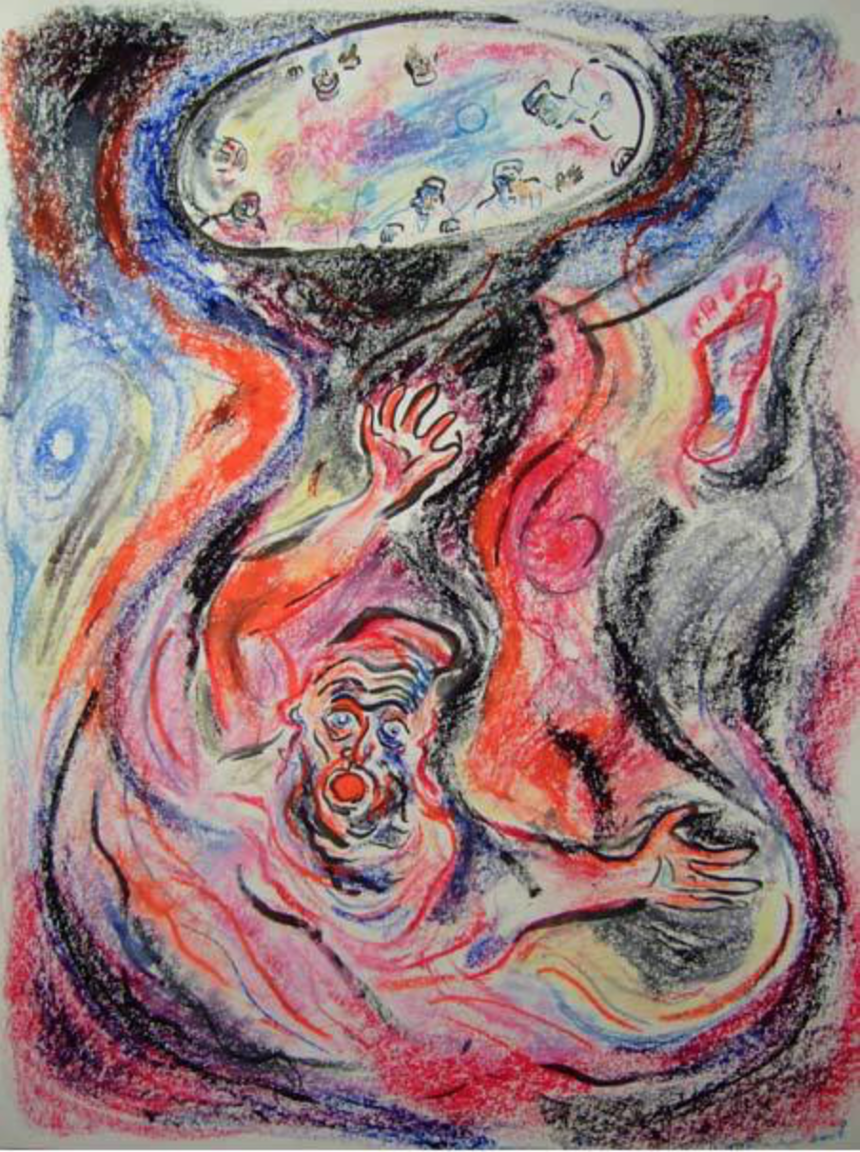
Joseph in the pit,
Shoshannah Brombacher, 2008

Slide 13
Should Jacob have loved Joseph more?
Through painful experience, Jacob must learn a truth about love. There are times when love not only unites but also divides. It did so in his childhood, when Isaac loved Esau and Rebekah loved Jacob. It did so again when he married two sisters. It did so a third time when he loved Rachel’s child Joseph more than his other sons. What Jacob learned – and what we learn, reading his story – is that love is not enough. We must also heed those who feel unloved. Without that, there will be conflict and tragedy. That requires a specific capacity – the ability to listen, in Jacob’s case, to the unspoken tears of Leah and her feeling of rejection, made explicit in the names she gave her sons. Jonathan Sacks

Slide 14
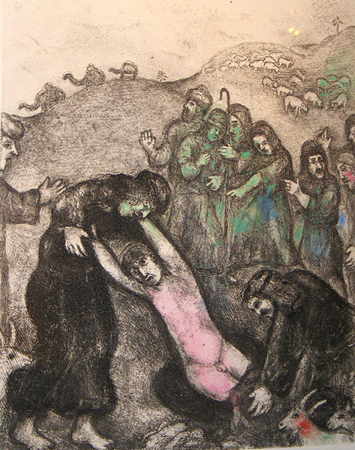
Joseph sold into slavery
Then Judah said to his brothers, “What profit is it if we kill our brother and conceal his blood? Come, let us sell him to the Ishmaelites, and let not our hand be upon him, for he is our brother, our own flesh.” And his brothers listened to him. Then Midianite traders passed by. And they drew Joseph up and lifted him out of the pit, and sold him to the Ishmaelites. They took Joseph to Egypt.
Genesis 37:26-28
Joseph sold into slavery, Chagall
Joseph’s trauma
Notes:
Brothers use animal blood to deceive Jacob and gain his favour. Clear from this that Jacob’s deception of Esau using animal skins was wrong
17 years old

Slide 15
In Potiphar’s house
The Lord was with Joseph so that he prospered, and he lived in the house of his Egyptian master. When his master saw that the Lord was with him and that the Lord gave him success in everything he did, Joseph found favour in his eyes and became his attendant. Potiphar put him in charge of his household, and he entrusted to his care everything he owned. From the time he put him in charge of his household and of all that he owned, the Lord blessed the household of the Egyptian because of Joseph. The blessing of the Lord was on everything Potiphar had, both in the house and in the field. So Potiphar left everything he had in Joseph’s care; with Joseph in charge, he did not concern himself with anything except the food he ate.

Slide 16
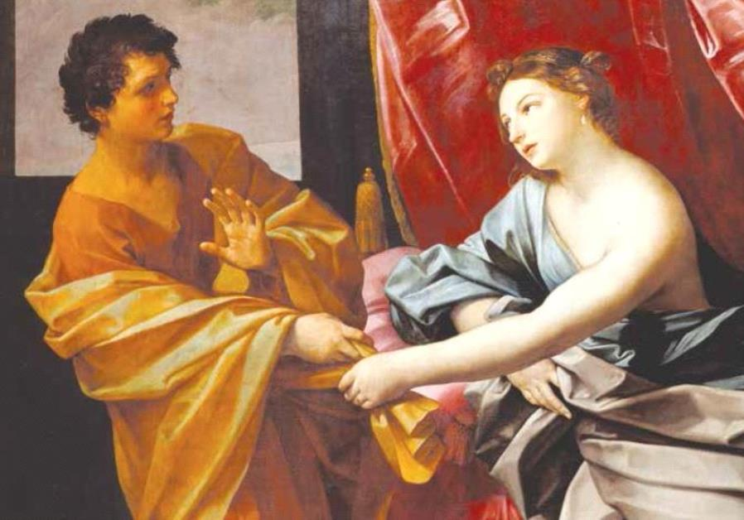
Potiphar – Zuleika - Joseph
Now Joseph was well-built and handsome, and after a while his master’s wife took notice of Joseph and said, ‘Come to bed with me," But he refused and said, "Behold, because of me my master has no concern about anything in the house, and he has put everything that he has in my charge. He has not kept back anything from me except yourself, because you are his wife. How then can I do this great wickedness and sin against God?" And as she spoke to Joseph day after day, he would not listen to her, to lie beside her or to be with her. Genesis 39:7-10
Potiphar’s wife tries to seduce Joseph
Notes:
Joseph faces same temptation as Adam and overcomes and preserves purity. Restores Adam’s position?
The third brings us to Egypt and the life of Joseph. Sold by his brothers as a slave, he is now working in the house of an eminent Egyptian, Potiphar. Left alone in the house with his master’s wife, he finds himself the object of her desire. He is handsome. She wants him to sleep with her. He refuses. To do such a thing, he says, would be to betray his master, her husband. It would be a sin against God. Yet over “he refused” is a shalshelet, (Genesis 39: 8) indicating – as some rabbinic sources and mediaeval commentaries suggest – that he did so at the cost of considerable effort. He nearly succumbed. This was more than the usual conflict between sin and temptation. It was a conflict of identity. Recall that Joseph was now living in, for him, a new and strange land. His brothers had rejected him. They had made it clear that they did not want him as part of their family. Why then should he not, in Egypt, do as the Egyptians do? Why not yield to his master’s wife if that is what she wanted? The question for Joseph was not just, “Is this right?” but also, “Am I an Egyptian or a Jew?”
When Potiphar"s wife invites Joseph to lie with her, Torah tells us he refused. He said to his master"s wife, "Look, with me here, my master gives no thought to anything in this house; he has withheld nothing from me except yourself, since you are his wife. How then could I do this wicked thing and sin before God?"
The Torah published by the Conservative Movement, notes that Joseph puts forward three arguments to counter Potiphar’s wife’s advances. The first regards Joseph’s position of responsibility in the house; it is prudent for him to act uprightly. The second refers to the legal culture of Egyptian aristocracy; wives are property of their husbands, and Potiphar’s wife has been reserved for her husband. It is the third argument that approaches our notion of conscience: Joseph seems to have an inner sense that this would be a "sin before God". Nowhere prior to Joseph’s tale is this designated a sin; the Torah itself had not yet been revealed to the world, and we have no evidence that Joseph had learned it as an ethical norm from any other source. Where has Joseph’s recognition that his act would be a "sin before God" come from? Presumably it is the result of an inner ethical realisation.
According to the story, Zuleika was mocked by other aristocratic Egyptian ladies, her circle of friends, for being infatuated with a Hebrew slave boy. Inviting her friends to her home, Zuleika gave them all apples and knives to slice them with. While they engaged in this task, Zuleika had Joseph walk through the room. Distracted by his handsomeness, all the ladies accidentally cut themselves with the knives, drawing blood. Zuleika then reminded her friends that she had to see Joseph every day. Following this incident, her contemporaries no longer mocked her.

Slide 17
Crisis of identity
This was more than the usual conflict between sin and temptation. It was a conflict of identity. Recall that Joseph was living in a new and strange land. His brothers had rejected him. They had made it clear that they did not want him as part of their family. Why then should he not, in Egypt, do as the Egyptians do? Why not yield to his master’s wife if that is what she wanted? The question for Joseph was not just, “Is this right?” but also, “Am I an Egyptian or a Hebrew?”
There are times when each of us has to decide, not just “What shall I do?” but “What kind of person shall I be?”
Rabbi Jonathan Sacks
Notes:
https://mailchi.mp/rabbisacks/tzav-245244?e=128f3a2574

Slide 18
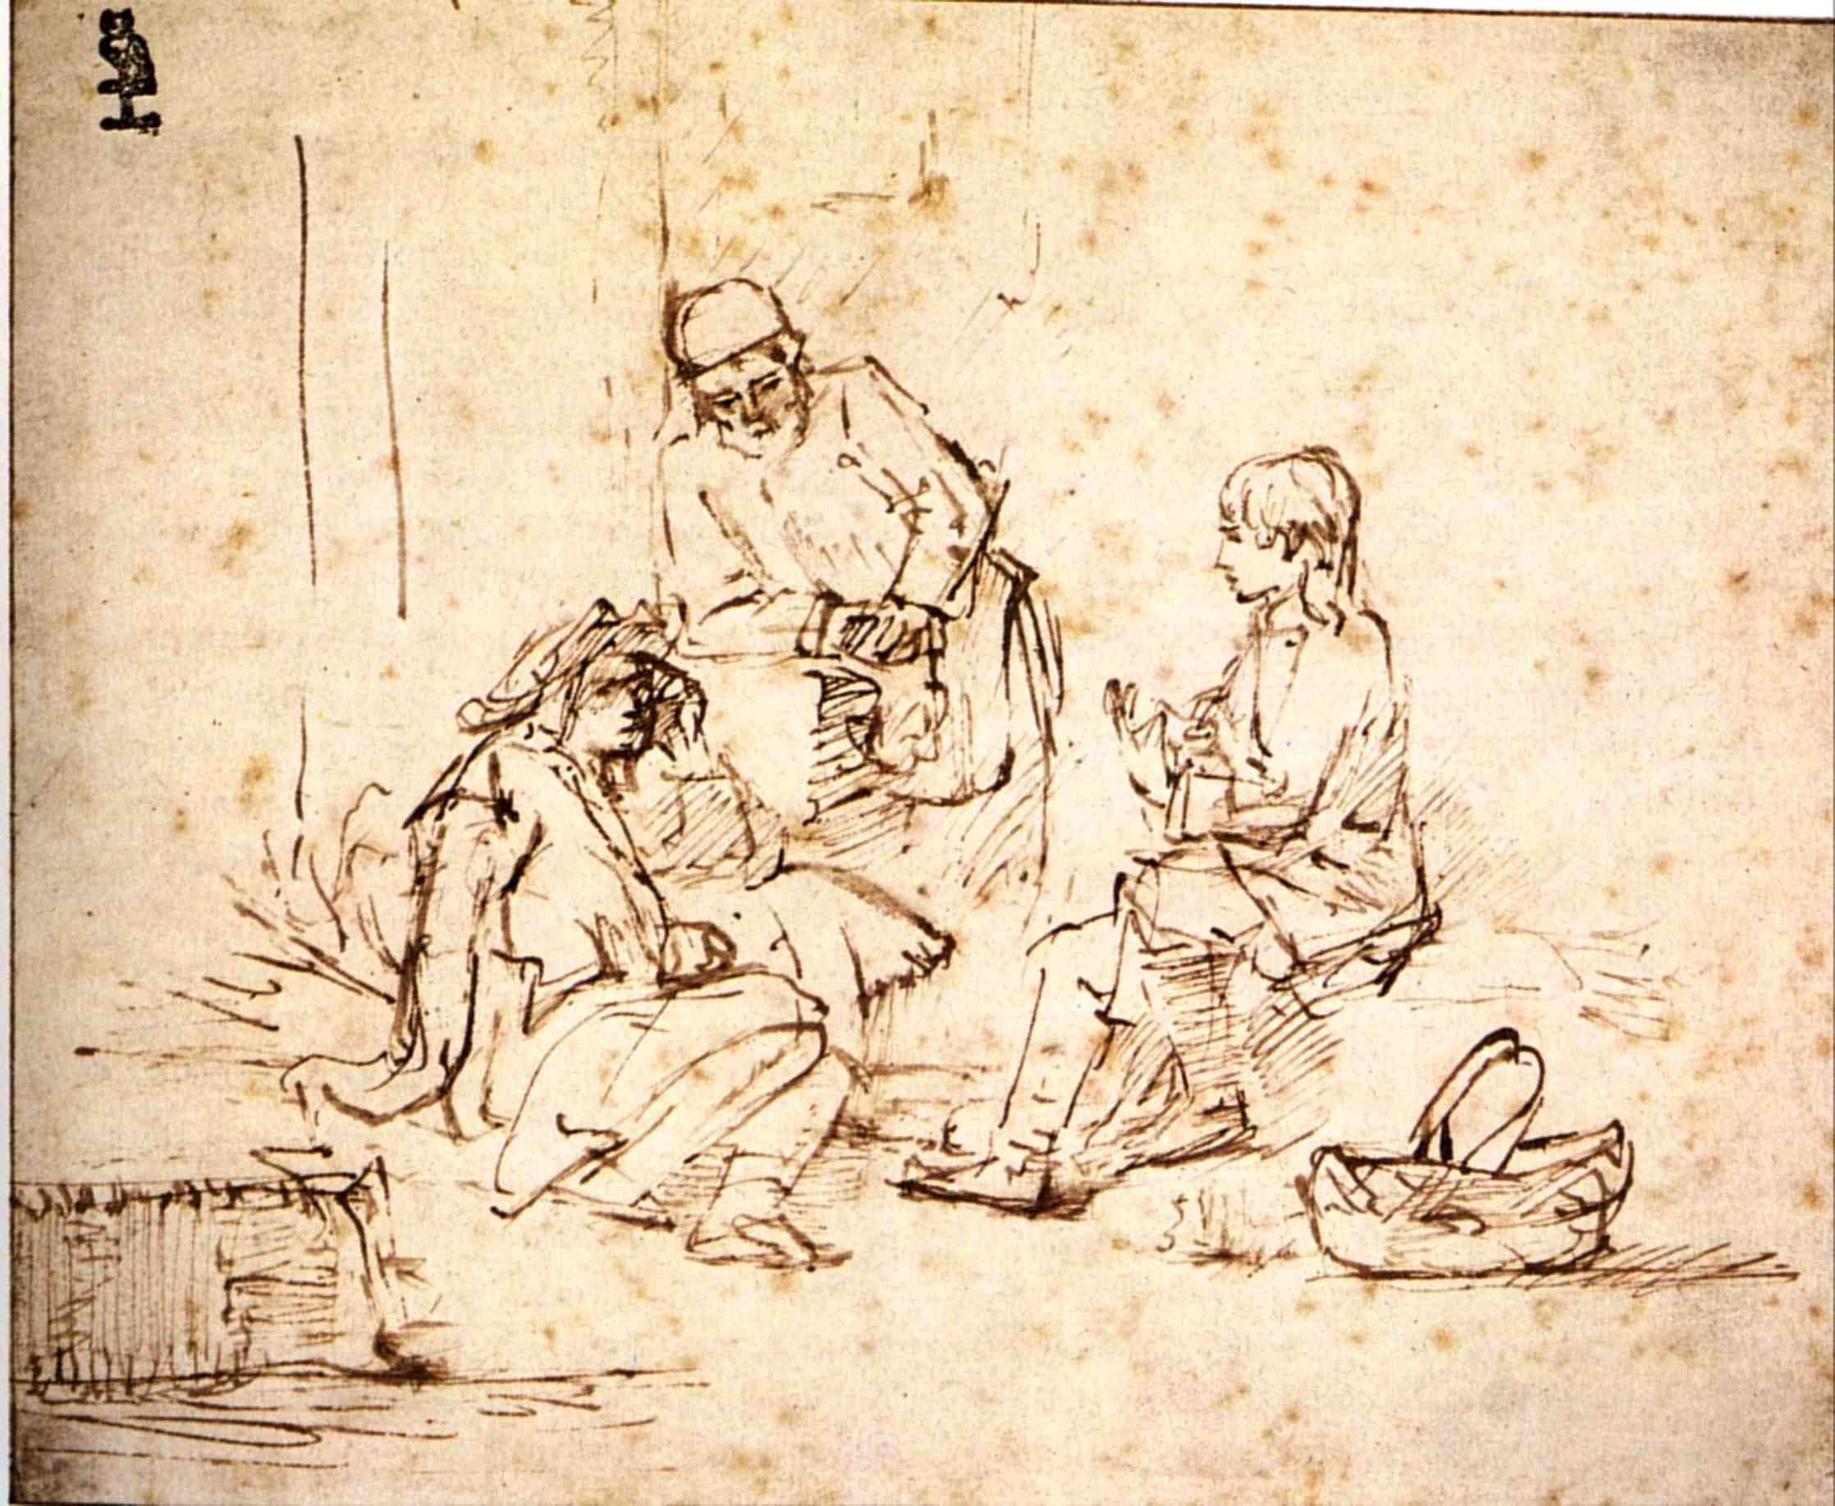
Joseph in prison
But the Lord was with Joseph and showed him steadfast love and gave him favour in the sight of the keeper of the prison. And the keeper of the prison put Joseph in charge of all the prisoners who were in the prison. Whatever was done there, he was the one who did it. The keeper of the prison paid no attention to anything that was in Joseph’s charge, because the Lord was with him. And whatever he did, the Lord made it succeed.
Genesis 39:21-23
Joseph interprets dreams
Notes:
Butler - vine 3 branches of grapes. And pharaoh’s cup. -> 3 days released
Baker - 3 baskets cakes on head. Birds ate it. -> 3 days be hanged
Rembrandt
We live life looking forward but we understand it only looking back.
As we live from day to day, our life can seem like a meaningless sequence of random events, a series of accidents and happenstances that have no shape or inner logic. A traffic jam makes us late for an important meeting. A stray remark we make offends someone in a way we never intended. By a hair’s-breadth we fail to get the job we so sought. Life as we experience it can sometimes feel like Joseph Heller’s definition of history: “a trashbag of random coincidences blown open in a wind.”
Yet looking back, it begins to make sense. The opportunity we missed here led to an even better one there. The shame we felt at our unintentionally offensive remark makes us more careful about what we say in the future. Our failures, seen in retrospect many years later, turn out to have been our deepest learning experiences. Our hindsight is always more perceptive than our foresight. We live life facing the future, but we understand life only when it has become our past.
Nowhere is this set out more clearly than in the story of Joseph in this week’s parsha. It begins on a high note: “Now Israel loved Joseph more than all his sons, because he was a son of his old age, and he made a richly embroidered robe.” But with dramatic speed, that love and that gift turn out to be Joseph’s undoing. His brothers began hating him. When he told them his dream, they hated him even more. His second dream offended even his father. Later, when he went to see his brothers tending their flocks, they first plotted to kill him, and eventually sold him as a slave.
At first, in Potiphar’s house, he seemed to be favoured by fortune. But then his master’s wife tried to seduce him and when he refused her advances she accused him of attempted rape and he was sent to prison with no way of proving his innocence. He seemed to have reached his nadir. There was nowhere lower for him to fall.
Then came an unexpected ray of hope. Interpreting the dream of a fellow prisoner, who had once been Pharaoh’s cup-bearer, he predicted his release and return to his former elevated role. And so it happened. Joseph asked only one thing in return: “Remember me when it goes well with you, and please show me kindness: mention me to Pharaoh, and get me out of this place. For I was forcibly taken from the land of the Hebrews, and here also I have done nothing to deserve being put in this pit.”
The last line of the parsha is one of the cruelest blows of fate in the Torah: “The chief cupbearer did not remember Joseph; he forgot him.” Seemingly his one chance of escape to freedom is now lost. Joseph, the beloved son in his magnificent robe has become Joseph, the prisoner bereft of hope. This is as near the Torah gets to Greek tragedy. It is a tale of Joseph’s hubris leading, step after step, to his nemesis. Every good thing that happens to him turns out to be only the prelude to some new and unforeseen misfortune.
Yet a mere two years later, at the beginning of next week’s parsha, we discover that all this has been leading to Joseph’s supreme elevation. Pharaoh makes him Viceroy over Egypt, the greatest empire of the ancient world. He gives him his own signet ring, has him dressed in royal robes and a gold chain, and has him paraded in a chariot to the acclaim of the crowds. A mere thirty years old, he has become the second most powerful man in the world. From the lowest pit he has risen to dizzying heights. He has gone from zero to hero overnight.
What is stunning about the way this story is told in the Torah is that it is constructed to lead us, as readers, in precisely the wrong direction. Parshat Vayeshev has the form of a Greek tragedy. Mikketz then comes and shows us that the Torah embodies another worldview altogether. Judaism is not Athens. The Torah is not Sophocles. The human condition is not inherently tragic. Heroes are not fated to fall.
The reason is fundamental. Ancient Israel and the Greece of antiquity – the two great influences on Western civilisation – had profoundly different understandings of time and circumstance. The Greeks believed in moira or ananke, blind fate. They thought that the gods were hostile or at best indifferent to humankind, so there was no way of avoiding tragedy if that is what fate had decreed. Jews believed, and still believe, that God is with us as we travel through time. Sometimes we feel as if we are lost, but then we discover, as Joseph did, that He has been guiding our steps all along.
Initially Joseph had flaws in his character. He was vain about his appearance;[1] he brought his father evil reports about his brothers;[2] his narcissism led directly to the advances of Potiphar’s wife.[3] But the story of which he was a part was not a Greek tragedy. By its end – the death of Joseph in the final chapter of Genesis – he had become a different human being entirely, one who forgave his brothers the crime they committed against him, the man who saved an entire region from famine and starvation, the one Jewish tradition calls “the tzaddik.”[4]
Don’t think you understand the story of your life at half-time. That is the lesson of Joseph. At the age of twenty-nine he would have been justified in thinking his life an abject failure: hated by his brothers, criticised by his father, sold as a slave, imprisoned on a false charge and with his one chance of freedom gone.
The second half of the story shows us that Joseph’s life was not like that at all. His became a tale of unprecedented success, not only politically and materially, but also morally and spiritually. He became the first person in recorded history to forgive. By saving the region from famine, he became the first in whom the promise made by God to Abraham came true: “Through you, all the families of the land will be blessed” (Gen. 12:3). There was no way of predicting how the story would end on the basis of the events narrated in parshat Vayeshev. The turning-point in his life was a highly improbable event that could not have been predicted but which changed all else, not just for him but for large numbers of people and for the eventual course of Jewish history. God’s hand was at work, even when Joseph felt abandoned by every human being he had encountered.
We live life forward but we see the role of Providence in our lives only looking back. That is the meaning of God’s words to Moses: “You will see My back” (Ex. 33:23), meaning, “You will see Me only when you look back.”
Joseph’s story is a precise reversal of the narrative structure of Sophocles’ Oedipus. Everything Laius and his son Oedipus do to avert the tragic fate announced by the oracle in fact brings it closer to fulfilment, whereas in the story of Joseph, every episode that seems to be leading to tragedy turns out in retrospect to be a necessary step to saving lives and the fulfilment of Joseph’s dreams.
Judaism is the opposite of tragedy. It tells us that every bad fate can be averted (hence our prayer on the High Holy Days that “penitence, prayer and charity avert the evil decree”) – while every positive promise made by God will never be undone.[5]
Hence the life-changing idea: Despair is never justified. Even if your life has been scarred by misfortune, lacerated by pain, and your chances of happiness seem gone forever, there is still hope. The next chapter of your life can be full of blessings. You can be, in Wordsworth’s lovely phrase, “surprised by joy.”
Every bad thing that has happened to you thus far may be the necessary prelude to the good things that are about to happen because you have been strengthened by suffering and given courage by your ability to survive. That is what we learn from the heroes of endurance from Joseph to the Holocaust survivors of today, who kept going, had faith, refused to despair, and were privileged to write a new and different chapter in the book of their lives.
Seen through the eye of faith, today’s curse may be the beginning of tomorrow’s blessing. That is a thought that can change a life.

Slide 19
Human responsibility
There is no achievement without effort. That is the first principle. God saved Noah from the flood, but first Noah had to build the ark. God promised Abraham the land, but first he had to buy the cave of Machpelah in which to bury Sarah. God promised the Israelites the land, but they had to fight the battles. Joseph became a leader, as he dreamed he would. But first he had to hone his practical and administrative skills, first in Potiphar’s house, then in prison. Even when God assures us that something will happen, it will not happen without our effort. A Divine promise is not a substitute for human responsibility. To the contrary, it is a call to responsibility.
Jonathan Sacks

Slide 20
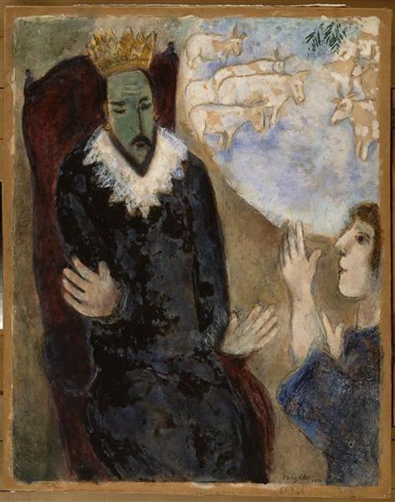
Joseph and Pharaoh
Joseph interprets Pharaoh’s dream
7 years of plenty followed by 7 years of famine
Joseph appointed Prime Minister of Egypt when 30 years old
Marries Asenath
  Joseph named his firstborn Manasseh, saying, “It is because God has made me forget all my trouble and all my father’s household.” Gen. 41:50
Joseph interprets Pharaoh’s dream
Notes:
Dinah was already pregnant by Shechem, and bore him a posthumous daughter. Her brothers wished to kill the child, as custom demanded, lest any Canaanite might say 'The maidens of Israel are without shame!' Jacob, however, restrained them, hung about his grand-daughter's neck a silver disk on which were engraved the words 'Holy to God!', and laid her underneath a thorn bush -- hence she was called 'Asenath'. That same day Michael, in the shape of an eagle, flew off with Asenath to On in Egypt, and there laid her beside God's altar. The priest, by name Potipherah, seeing his wife was barren, brought up Asenath as his own child. Many years later, when Joseph had saved Egypt from famine and made a progress through the land, women threw him thank-offerings. Among them was Asenath who, having no other gift, tossed Joseph her silver disk, which he caught as it flew by. He recognized the inscription and, knowing that she must be his own niece, married her.^{[5]}
Genesis records nothing more about Asenath, but her story is elaborated in the apocryphal Joseph and Asenath. There, she is a virgin who rejects several worthy suitors in favor of Joseph, but Joseph will not have a pagan for a wife. She locks herself in a tower and rejects her idolatry in favor of Joseph's God Yahweh, and receives a visit from an angel who accepts her conversion. A ritual involving a honeycomb follows. Bees cover her and sting her lips to remove the false prayers to the pagan gods of her past. Joseph now consents to marry her. She bears him their sons Mannaseh and Ephraim. Pharaoh's son wants Asenath for himself, however, and with the aid of Joseph's brothers Dan and Gad, he conspires to kill her husband. The loyal brother Benjamin interferes, and Pharaoh's son is ultimately slain. Asenath forgives the conspirators, and she and Joseph rule over Egypt for 48 years, after which they pass the crown to Pharaoh's grandson.
It began with Joseph who, in this week’s parsha, became the world’s first economist. Interpreting Pharaoh’s dreams, he develops a theory of trade cycles – seven fat years followed by seven lean years – a cycle that still seems approximately to hold. Joseph also intuited that when a head of state dreams about cows and ears of corn, he is probably unconsciously thinking about macro-economics. The disturbing nature of the dreams suggested that God was sending an advance warning of a “black swan,” a rare phenomenon for which conventional economics is unprepared.

Slide 21
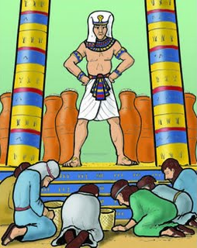
Joseph meets his brothers
10 brothers go to Egypt to buy grain
They said to one another, “Surely we are being punished because of our brother. We saw how distressed he was when he pleaded with us for his life, but we would not listen; that’s why this distress has come on us” … They did not realize that Joseph could understand them, since he was using an interpreter. He turned away from them and began to weep, but then came back and spoke to them again. Genesis 42:21-24
Joseph, “You are spies.”
All in prison for 3 days
Simeon to remain behind
“Bring youngest brother next time.”
The brothers before Joseph
Notes:
3 days – separation from Satan?
Then they said to one another, "In truth we are guilty concerning our brother, in that we saw the distress of his soul, when he begged us and we did not listen. That is why this distress has come upon us.” And Reuben answered them, "Did I not tell you not to sin against the boy? But you did not listen. So now there comes a reckoning for his blood.” They did not know that Joseph understood them, for there was an interpreter between them. Then he turned away from them and wept.
Joseph weeps. Not out for revenge
Simeon had wanted to kill Joseph. Used violence against men who raped sister. Simon and Levi both fanatical. Levi fanatic about purity and law, justice. Moses kills Egyptian, Levites became priests. As too extreme not given land and not rulers
The classical rabbinical sources argue that Simeon was very fearless, but also was particularly envious, and so had always been antagonistic and spiteful towards Joseph, owing to Joseph being Jacob's favourite son. The midrashic book of Jasher argues that Simeon was the one who proposed that the brothers should kill Joseph, and other classical sources argue that it was Simeon who threw Joseph into a pit, and became furious when he found out that Judah had sold Joseph rather than killed him;
At almost every stage of fraught encounter between Joseph and his family in Egypt, Joseph weeps. There are seven scenes of tears:1. When the brothers came before him in Egypt for the first time: They said to one another, “Surely we are being punished because of our brother. We saw how distressed he was when he pleaded with us for his life, but we would not listen; that’s why this distress has come on us” … They did not realize that Joseph could understand them, since he was using an interpreter. He turned away from them and began to weep, but then came back and spoke to them again. [42: 21-24]2. On the second occasion, when they brought Benjamin with them: Deeply moved at the sight of his brother, Joseph hurried out and looked for a place to weep. He went into his private room and wept there. [43: 29-30]3. When, after Judah’s impassioned speech, Joseph is about to disclose his identity: Then Joseph could no longer control himself before all his attendants, and he cried out, “Have everyone leave my presence!” So there was no one with Joseph when he made himself known to his brothers. And he wept so loudly that the Egyptians heard him, and Pharaoh’s household heard about it. [45: 1-2]4. Immediately after he discloses his identity: Then he threw his arms around his brother Benjamin and wept, and Benjamin embraced him, weeping. And he kissed all his brothers and wept over them. [45: 14-15]5. When he meets his father again after their long separation: Joseph had his chariot made ready and went to Goshen to meet his father Israel. As soon as Joseph appeared before him, he threw his arms around his father and wept for a long time. [46: 29]6. On the death of his father:Joseph threw himself on his father and wept over him and kissed him. [50: 1]7. Some time after his father’s death: When Joseph’s brothers saw that their father was dead, they said, “What if Joseph holds a grudge against us and pays us back for all the wrongs we did to him?” So they sent word to Joseph, saying, “Your father left these instructions before he died: ‘This is what you are to say to Joseph: I ask you to forgive your brothers the sins and the wrongs they committed in treating you so badly.’ Now please forgive the sins of the servants of the God of your father.” When their message came to him, Joseph wept. [50: 15-17]No one weeps as much as Joseph. Esau wept when he discovered that Jacob had taken his blessing (Gen. 27: 38). Jacob wept when he saw the love of his life, Rachel, for the first time (29: 11). Both brothers, Jacob and Esau, wept when they met again after their long estrangement (33: 4). Jacob wept when told that his beloved son Joseph was dead (37: 35).But the seven acts of Joseph’s weeping have no parallel. They span the full spectrum of emotion, from painful memory to the joy of being reunited, first with his brother Benjamin, then with his father Jacob. There are the complex tears immediately before and after he discloses his identity to his brothers, and there are the tears of bereavement at Jacob’s deathbed. But the most intriguing are the last, the tears he sheds when he hears that his brothers fear that he will take revenge on them now that their father is no longer alive. In a fine essay, “Yosef’s tears,”Rav Aharon Lichtenstein suggests that this last act of weeping is an expression of the price Joseph pays for the realisation of his dreams and his elevation to a position of power. Joseph has done everything he could for his brothers. He has sustained them at a time of famine. He has given them not just refuge but a place of honour in Egyptian society. And he has made it as clear as he possibly can that he does not harbour a grudge against them for what they did to him all those many years before. As he said when he disclosed his identity to them: “And now, do not be distressed and do not be angry with yourselves for selling me here, because it was to save lives that God sent me ahead of you . . . God sent me ahead of you to preserve for you a remnant on earth and to save your lives by a great deliverance. So then, it was not you who sent me here, but God” (45: 5-8). What more could he say? Yet still, all these years later, his brothers do not trust him and fear that he may still seek their harm.This is Rav Lichtenstein’s comment: “At this moment, Yosef discovers the limits of raw power. He discovers the extent to which the human connection, the personal connection, the family connection, hold far more value and importance than does power – both for the person himself and for all those around him.” Joseph “weeps over the weakness inherent in power, over the terrible price that he has paid for it. His dreams have indeed been realised, on some level, but the tragedy remains just as real. The torn shreds of the family have not been made completely whole.”On the surface, Joseph holds all the power. His family are entirely dependent on him. But at a deeper level it is the other way round. He still yearns for their acceptance, their recognition, their closeness. And ultimately he has to depend on them to bring his bones up from Egypt when the time comes for redemption and return (50: 25).Rav Lichtenstein’s analysis reminds us of Rashi and Ibn Ezra’s commentary to the last verse in the book of Esther. It says that “Mordechai the Jew was second to King Ahasuerus, and was great among the Jews and well received by most of his brethren” (Est. 10: 3) – “most” but not all. Rashi (quoting Megillah 16b) says that some members of the Sanhedrin were critical of him because his political involvement (his “closeness to the king”) distracted from the time he spent studying Torah. Ibn Ezra says, simply: “It is impossible to satisfy everyone, because people are envious [of other people’s success].” Joseph and Mordechai/Esther are supreme examples of Jews who reached positions of influence and power in non-Jewish circles. In modern times they were called Hofjuden, “court Jews,” and other Jews were often held deeply ambivalent feelings about them.But at a deeper level, Rav Lichtenstein’s remarks recall Hegel’s famous master-slave dialectic, an idea that had huge influence on nineteenth century, especially Marxist, thought. Hegel argued that the early history of humanity was marked by a struggle for power in which some became masters, others slaves. On the face of it, masters rule while slaves obey. But in fact the master is dependent on his slaves – he has leisure only because they do the work, and he is the master only because he is recognised as such by his slaves. Meanwhile the slave, through his work, acquires his own dignity as a producer. Thus the slave has “inner freedom” while the master has “inner bondage.” This tension creates a dialectic – a conflict worked out through history – reaching equilibrium only when there are neither masters nor slaves, but merely human beings who treat one another not as means to an end but as ends in themselves. Thus understood, Joseph’s tears are a prelude to the master-slave drama about to be enacted in the book of Exodus between Pharaoh and the Israelites. Rav Lichtenstein’s profound insight into the text reminds us of the extent to which Torah, Tanakh and Judaism as a whole are a sustained critique of power. Prior to the Messianic age we cannot do without it – consider the tragedies Jews suffered in the centuries in which they lacked it. But power alienates. It breeds suspicion and distrust. It diminishes those it is used against, and thus diminishes those who use it.Even Joseph “the righteous” weeps when he sees the extent to which power sets him apart from his brothers. Judaism is about an alternative social order which depends not on power but on love, loyalty and the mutual responsibility created by covenant. That is why Nietzsche, who based his philosophy on “the will to power,” correctly saw Judaism as the antithesis of all he believed in.Power may be a necessary evil, but it is an evil, and the less we have need of it, the better.

