Slide 1
”Reading our lives through the Principle"
Notes:
Who are you?
Who am I?
Journey together

Slide 2
Stories and reframing the Principle

Slide 3
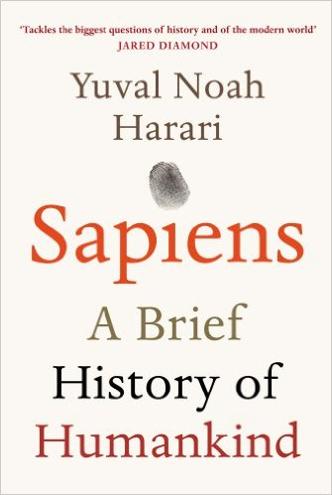

Slide 4
What makes homo sapiens different to other humans?
70 000 years ago ‘cognitive revolution’
Maximum cooperation 150
What changed?
  Language
  What does language enable one to do?
  Abstract entities and stories
― Yuval Noah Harari, Sapiens: A Brief History of Humankind
Notes:
The truly unique feature of our language is not its ability to transmit information about men and lions. Rather, it's the ability to transmit information about things that do not exist at all. As far as we know, only Sapiens can talk about entire kinds of entities that they have never seen, touched or smelled. Legends, myths, gods and religions appeared for the first time with the Cognitive Revolution. Many animals and human species could previously say, "Careful! A lion!." Thanks to the Cognitive Revolution, Homo sapiens acquired the ability to say, "The lion is the guardian spirit of our tribe." This ability to speak about fictions is the most unique feature of Sapiens language. It's easy to agree that only Homo sapiens can speak about things that don't really exist, and believe six impossible things before breakfast. You could never convince a monkey to give you a banana by promising him limitless bananas after death in monkey heaven. But why is it important? After all, fiction can be dangerously misleading or distracting. People who go to the forest looking for fairies and unicorns would seem to have less chance of survival than people who go looking for mushrooms and deer. And if you spend hours praying to non-existing guardian spirits, aren't you wasting precious time, time better spent finding food and fighting? But fiction has enabled us not merely to imagine things, but to do so collectively. We can weave common myths such as the biblical creation story, the Dreamtime myths of Aboriginal Australians, and the nationalist myths of modern states. Such myths give Sapiens the unprecedented ability to cooperate flexibly in large numbers. Ants and bees can also work together in huge numbers, but they do so in a very rigid manner and only with close relatives. Wolves and chimpanzees cooperate far more flexibly than ants, but they can do so only with small numbers of other individuals that they know intimately. Sapiens can cooperate in extremely flexible ways with countless numbers of strangers. That's why Sapiens rule the world, whereas ants eat our leftovers and chimps are locked up in zoos and research laboratories. Any large-scale human cooperation -- whether a modern state, a medieval church, an ancient city or an archaic tribe -- is rooted in common myths that exist only in people's collective imagination. Churches are rooted in common religious myths. Two Catholics who have never met can nevertheless go together on crusade or pool funds to build a hospital because they both believe that God was incarnated in human flesh and allowed Himself to be crucified to redeem our sins. States are rooted in common national myths. Two Serbs who have never met might risk their lives to save one another because both believe in the existence of the Serbian nation, the Serbian homeland and the Serbian flag. Judicial systems are rooted in common legal myths. Two lawyers who have never met can nevertheless combine efforts to defend a complete stranger because they both believe in the existence of laws, justice, human rights -- and the money paid out in fees. Yet none of these things exists outside the stories that people invent and tell one another. There are no gods in the universe, no nations, no money, no human rights, no laws, and no justice outside the common imagination of human beings. Telling effective stories is not easy. The difficulty lies not in telling the story, but in convincing everyone else to believe it. Much of history revolves around this question: how does one convince millions of people to believe particular stories about gods, or nations, or limited liability companies? Yet when it succeeds, it gives Sapiens immense power, because it enables millions of strangers to cooperate and work towards common goals. Just try to imagine how difficult it would have been to create states, or churches, or legal systems if we could speak only about things that really exist, such as rivers, trees, and lions. Over the years, people have woven an incredibly complex network of stories. Within this network, fictions such as Mercedes not only exist, but also accumulate immense power. The kinds of things that people create through this network of stories are known in academic circles as "fictions," "social constructs," or "imagined realities." An imagined reality is not a lie. I lie when I say that there is a lion near the river when I know perfectly well that there is no lion there. Unlike lying, an imagined reality is something that everyone believes in, and as long as this communal belief persists, the imagined reality exerts force in the world. Most millionaires sincerely believe in the existence of money and limited liability companies. Most human-rights activists sincerely believe in the existence of human rights. No one was lying when, in 2011, the UN demanded that the Libyan government respect the human rights of its citizens, even though the UN, Libya and human rights are all figments of our fertile imagination. Ever since the Cognitive Revolution, Sapiens have thus been living in a dual reality. On the one hand, the objective reality of rivers, trees and lions; and on the other hand, the imagined reality of gods, nations and corporations. As time went by, the imagined reality became ever more powerful, so that today the very survival of rivers, trees and lions depends on the grace of imagined entities such as the United States and Google.

Slide 5
Why stories?
Man is essentially a story-telling animal. He becomes through his history, a teller of stories that aspire to truth. But the key question for men is not about their authorship; I can only answer the question 'What am I to do?' if I can answer the prior question 'Of what story or stories do I find myself a part?'
We enter human society with one or more imputed characters - roles into which we have been born - and we have to learn what they are in order to be able to understand how others respond to us and how our responses to them are apt to be misconstrued.
Alasdair Macintyre, After Virtue, 1985
Notes:
What am I to do with my life? – What is my role in life? – What is the story that I am a part of?
Stories make life meaningful
Providential involvement because feel one is part of a cosmic drama. Everything one does is meaningful
How to have the same feeling when one is not directly involved in a providential organisation?
How to feel that one’s place of work is the front line.
How to apply the Principle to daily life
How to read our lives through the Principle
Tribal messiahship
Home church

Slide 6
It is through hearing stories about wicked step-mothers, lost children . . . that children learn or
mis-learn both what a child and what a parent is, what the cast of characters may be in the drama into which they have been born and what the ways of the world are. Deprive children of stories and you leave them unscripted, anxious stutterers in their actions as in their words. Hence there is no way to give us an understanding of any society, including our own, except through the stock of stories which constitute its initial dramatic resources.
Alasdair Macintyre, After Virtue, 1985

Slide 7
Family narrative
“The single most important thing you can do for your family may be the simplest of all: develop a strong family narrative.” Bruce Feiler, The Secrets of Happy Families
A family narrative connects children to something larger than themselves. It helps them make sense of how they fit into the world that existed before they were born. It gives them the starting-point of an identity. That in turn becomes the basis of confidence. It enables children to say: This is who I am. This is the story of which I am a part. These are the people who came before me and whose descendant I am. These are the roots of which I am the stem reaching upward toward the sun.

Slide 8
We are stories
The great questions – “Who are we?” “Why are we here?” “What is our task?” – are best answered by telling a story.
“We dream in narrative, daydream in narrative, remember, anticipate, hope, despair, believe, doubt, plan, revise, criticise, construct, gossip, learn, hate and love by narrative.” Barbara Hardy
It’s like everyone tells a story about themselves, inside their own head. Always. All the time. That story makes you what you are. We build ourselves out of that story. Patrick Rothfuss, Name of the Wind
Identity, which is always particular, is based on story, the narrative that links me to the past, guides me in the present, and places on me responsibility for the future. Jonathan Sacks

Slide 9
The power of stories
“If you don’t know the trees you may be lost in the forest, but if you don’t know the stories you may be lost in life.” Siberian Elder
“Story gives people enough space to think for themselves.” Annette Simmons
“Perhaps it is how we are made; perhaps words of truth reach us best through the heart, and stories and songs are the language of the heart.” Stephen R. Lawhead
“People think that stories are shaped by people. In fact, it’s the other way around.” Terry Pratchett
“The stories we tell literally make the world. If you want to change the world, you need to change your story.” Michael Margolis
Notes:
Howard Gardner, professor of education and psychology at Harvard University, is one of the great minds of our time. He is best known for his theory of “multiple intelligences,” the idea that there is not one thing that can be measured and defined as intelligence but many different things – one dimension of the dignity of difference. He has also written many books on leadership and creativity, including one in particular, Leading Minds.
Gardner’s argument is that what makes a leader is the ability to tell a particular kind of story – one that explains ourselves to ourselves and gives power and resonance to a collective vision. So Churchill told the story of Britain’s indomitable courage in the fight for freedom. Gandhi spoke about the dignity of India and non-violent protest. Margaret Thatcher talked about the importance of the individual against an ever-encroaching State. Martin Luther King told of how a great nation is colour-blind. Stories give the group a shared identity and sense of purpose.
Philosopher Alasdair MacIntyre has also emphasised the importance of narrative to the moral life. “Man,” he writes, “is in his actions and practice as well as in his fictions, essentially a story-telling animal.” It is through narratives that we begin to learn who we are and how we are called on to behave. “Deprive children of stories and you leave them unscripted, anxious stutterers in their actions as in their words.”[2] To know who we are is in large part to understand of which story or stories we are a part.
The great questions – “Who are we?” “Why are we here?” “What is our task?” – are best answered by telling a story. As Barbara Hardy put it: “We dream in narrative, daydream in narrative, remember, anticipate, hope, despair, believe, doubt, plan, revise, criticise, construct, gossip, learn, hate and love by narrative.” This is fundamental to understanding why Torah is the kind of book it is: not a theological treatise or a metaphysical system but a series of interlinked stories extended over time, from Abraham and Sarah’s journey from Mesopotamia to Moses’ and the Israelites’ wanderings in the desert. Judaism is less about truth as system than about truth as story. And we are part of that story. That is what it is to be a Jew.
A large part of what Moses is doing in the book of Devarim is retelling that story to the next generation, reminding them of what God had done for their parents and of some of the mistakes their parents had made. Moses, as well as being the great liberator, is the supreme storyteller. Yet what he does in parshat Ki Tavo extends way beyond this.
He tells the people that when they enter, conquer and settle the land, they must bring the first ripened fruits to the central sanctuary, the Temple, as a way of giving thanks to God. A Mishnah in Bikkurim[3] describes the joyous scene as people converged on Jerusalem from across the country, bringing their first-fruits to the accompaniment of music and celebration. Merely bringing the fruits, though, was not enough. Each person had to make a declaration. That declaration become one of the best known passages in the Torah because, though it was originally said on Shavuot, the festival of first-fruits, in post-biblical times it became a central element of the Haggadah on seder night:
My father was a wandering Aramean, and he went down into Egypt and lived there, few in number, there becoming a great nation, powerful and numerous. But the Egyptians ill-treated us and made us suffer, subjecting us to harsh labour. Then we cried out to the Lord, the God of our ancestors, and the Lord heard our voice and saw our misery, toil and oppression. So the Lord brought us out of Egypt with a mighty hand and an outstretched arm, with great terror and with signs and wonders. (Deut. 26:5-8)
Here for the first time the retelling of the nation’s history becomes an obligation for every citizen of the nation. In this act, known as vidui bikkurim, “the confession made over first-fruits,” Jews were commanded, as it were, to become a nation of storytellers.
This is a remarkable development. Yosef Hayim Yerushalmi tells us that, “Only in Israel and nowhere else is the injunction to remember felt as a religious imperative to an entire people.” Time and again throughout Devarim comes the command to remember: “Remember that you were a slave in Egypt.” “Remember what Amalek did to you.” “Remember what God did to Miriam.” “Remember the days of old; consider the generations long past. Ask your father and he will tell you, your elders, and they will explain to you.”
The vidui bikkurim is more than this. It is, compressed into the shortest possible space, the entire history of the nation in summary form. In a few short sentences we have here “the patriarchal origins in Mesopotamia, the emergence of the Hebrew nation in the midst of history rather than in mythic prehistory, slavery in Egypt and liberation therefrom, the climactic acquisition of the land of Israel, and throughout – the acknowledgement of God as lord of history.”
We should note here an important nuance. Jews were the first people to find God in history. They were the first to think in historical terms – of time as an arena of change as opposed to cyclical time in which the seasons rotate, people are born and die, but nothing really changes. Jews were the first people to write history – many centuries before Herodotus and Thucydides, often wrongly described as the first historians. Yet biblical Hebrew has no word that means “history” (the closest equivalent is divrei hayamim, “chronicles”). Instead it uses the root zachor, meaning “memory.”
There is a fundamental difference between history and memory. History is “his story,”[6] an account of events that happened sometime else to someone else. Memory is “my story.” It is the past internalised and made part of my identity. That is what the Mishnah in Pesachim means when it says, “Each person must see themselves as if he (or she) personally went out of Egypt.”[7]
Throughout Devarim Moses warns the people – no less than fourteen times – not to forget. If they forget the past they will lose their identity and sense of direction and disaster will follow. Moreover, not only are the people commanded to remember, they are also commanded to hand that memory on to their children.
This entire phenomenon represents are remarkable cluster of ideas: about identity as a matter of collective memory; about the ritual retelling of the nation’s story; above all about the fact that every one of us is a guardian of that story and memory. It is not the leader alone, or some elite, who are trained to recall the past, but every one of us. This too is an aspect of the devolution and democratisation of leadership that we find throughout Judaism as a way of life. The great leaders tell the story of the group, but the greatest of leaders, Moses, taught the group to become a nation of storytellers.
You can still see the power of this idea today. As I point out in my book The Home We Build Together, if you visit the Presidential memorials in Washington you will see that each one carries an inscription taken from their words: Jefferson’s ‘We hold these truths to be self-evident . . .’, Roosevelt’s ‘The only thing we have to fear, is fear itself’, Lincoln’s Gettysburg Address and his second Inaugural, ‘With malice toward none; with charity for all . . .’ Each memorial tells a story.
London has no equivalent. It contains many memorials and statues, each with a brief inscription stating who it represents, but there are no speeches or quotations. There is no story. Even the memorial to Churchill, whose speeches rivalled Lincoln’s in power, carries only one word: Churchill.
America has a national story because it is a society based on the idea of covenant. Narrative is at the heart of covenantal politics because it locates national identity in a set of historic events. The memory of those events evokes the values for which those who came before us fought and of which we are the guardians.
A covenantal narrative is always inclusive, the property of all its citizens, newcomers as well as the home-born. It says to everyone, regardless of class or creed: this is who we are. It creates a sense of common identity that transcends other identities. That is why, for example, Martin Luther King was able to use it to such effect in some of his greatest speeches. He was telling his fellow African Americans to see themselves as an equal part of the nation. At the same time, he was telling white Americans to honour their commitment to the Declaration of Independence and its statement that ‘all men are created equal’.
England does not have the same kind of national narrative because it is based not on covenant but on hierarchy and tradition. England, writes Roger Scruton, “was not a nation or a creed or a language or a state but a home. Things at home don’t need an explanation. They are there because they are there.”[8] England, historically, was a class-based society in which there were ruling elites who governed on behalf of the nation as a whole. America, founded by Puritans who saw themselves as a new Israel bound by covenant, was not a society of rulers and ruled, but rather one of collective responsibility. Hence the phrase, central to American politics but never used in English politics: “We, the people.”
By making the Israelites a nation of storytellers, Moses helped turn them into a people bound by collective responsibility – to one another, to the past and future, and to God. By framing a narrative that successive generations would make their own and teach to their children, Moses turned Jews into a nation of leaders.
Shabbat Shalom

Slide 10
Change story to change the world
Neither revolution nor reformation can ultimately change a society, rather you must tell a new powerful tale, one so persuasive that it sweeps away the old myths and becomes the preferred story, one so inclusive that it gathers all the bits of our past and our present into a coherent whole, one that even shines some light into the future so that we can take the next step… If you want to change a society, then you have to tell an alternative story. Ivan Illich, Austrian priest, educator and anarchist
Only the most basic elements of morality are universal: “thin” abstractions like justice or liberty tend to mean different things to different people in different places and different times. But if we want our children and our society to be moral, we need a collective story that tells us where we came from and what our task is in the world. Jonathan Sacks
Notes:
Ivan Illich (/ɪˈvɑːn ˈɪlɪtʃ/; 4 September 1926 – 2 December 2002) was a Croatian-Austrian philosopher, Roman Catholic priest, and critic of the institutions of modern Western culture, who addressed contemporary practices in education, medicine, work, energy use, transportation, and economic development.^{[1][2][3]} The book that brought Ivan Illich to public attention was Deschooling Society published in 1971. It was a groundbreaking critique of compulsory mass education. He argued that the oppressive structure of the school system could not be reformed but must be dismantled in order to free humanity from the crippling effects of lifelong institutionalization.

Slide 11
There are stories that ennoble, and others that stultify, leaving us prisoners of ancient grievances or impossible ambitions. The Jewish story is in its way the oldest of all, yet ever young, and we are each a part of it. It tells us who we are and who our ancestors hoped we would be. Storytelling is the great vehicle of moral education. It was the Torah’s insight that a people who told their children the story of freedom and its responsibilities would stay free for as long as humankind lives and breathes and hopes.

Slide 12
What is a myth?
All cultures, religions, political philosophies etc. have myths
A myth is a sacred narrative in the sense that it holds religious or spiritual significance for those who tell it, and it contributes to and expresses systems of thought and values. Use of the term by scholars implies neither the truth nor the falseness of the narrative. To the source culture, however, a myth by definition is "true", in that it embodies beliefs, concepts, and ways of questioning and making sense of the world.
  May or may not have a historical basis

Slide 13
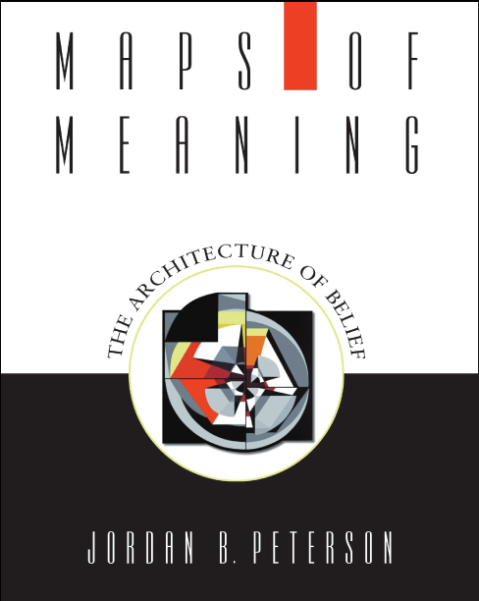

Slide 14
Science and myth
Science might be considered as (1) description of the world with regards to those aspects that are consensually apprehensible.
  Laws of gravity
(2) specification of the most effective mode of reaching an end.
  How to reach the moon
Myth can be regarded as a description of the world as it signifies for action.
  Myth is not primitive proto-science
  Myth is not ‘historical’
  Myth is about meaning
What is? (Meaning of the current state of affairs)
What should be? (Towards what end should we be moving)
How therefore should we act? (To transform the present state)
Notes:
Jordan Peterson
American ‘way of life’

Slide 15
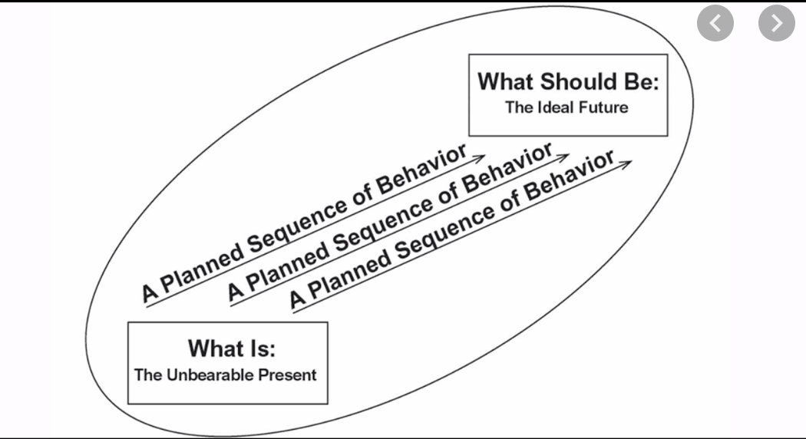

Slide 16
Is the world better without myth?
The individual cannot live without belief – without action and valuation – and science cannot provide that belief. Are the myths we have turned to since the rise of science more sophisticated, less dangerous, and more complete than those we rejected? The ideological structures that dominated social relations in the twentieth century appear no less absurd, on the face of it, than the older belief systems they supplanted; they lacked in addition, any of the incomprehensible mystery that necessarily remains a part of genuinely artistic and creative production. The fundamental propositions of fascism and communism were rational, logical, stateable, comprehensible – and terribly wrong. No great ideological struggle presently tears at the soul of the world, but it is difficult to believe we have outgrown our gullibility.
Jordan Peterson, Maps of Meaning, 1999

Slide 17
So what?
When one gives up Christian belief one deprives oneself of the right to Christian morality. For the latter is absolutely not self-evident: one must make this point clear again and again, in spite of English shallowpates. . . Christianity is a consistently thought out and complete view of things. If one breaks out of it a fundamental idea, the belief in God, one breaks the whole thing to pieces: one has nothing of any consequence in one’s hands. Christianity presupposes that man does not know, cannot know what is good for him and what is evil. God alone knows. Christian morality possesses truth only if God is truth – it stands or falls with belief in God. If modern people really do believe they know of their own accord, intuitively, what is good and evil; if they think they no longer have need of Christianity as a guarantor of morality that is merely a consequence of the ascendancy of Christian evaluation . . . The origin of modern morality has been forgotten so the highly conditional nature of its right to exist is no longer felt.
Friedrich Nietzsche, Twilight of the Idols, 1888
Notes:
shallowpate (plural shallowpates). (derogatory) One whose thinking is shallow or superficial

Slide 18

The Hindu myth
How is it possible for Indians to accept and not question or challenge a society which to us appears to be very unfair and unjust?
Extremes of wealth and poverty
Notes:
He begins with Chaos, a yawning nothingness. Out of the void emerged Gaia (the Earth) and some other primary divine beings: Eros (Love), the Abyss (the Tartarus), and the Erebus. Without male assistance, Gaia gave birth to Uranus (the Sky) who then fertilized her. From that union were born first the Titans—six males: Coeus, Crius, Cronus, Hyperion, Iapetus, and Oceanus; and six females: Mnemosyne, Phoebe, Rhea, Theia, Themis, and Tethys. After Cronus was born, Gaia and Uranus decreed no more Titans were to be born. They were followed by the one-eyed Cyclopes and the Hecatonchires or Hundred-Handed Ones, who were both thrown into Tartarus by Uranus. This made Gaia furious. Cronus ("the wily, youngest and most terrible of Gaia's children"), was convinced by Gaia to castrate his father. He did this, and became the ruler of the Titans with his sister-wife Rhea as his consort, and the other Titans became his court.
A son is born to King Laius and Queen Jocasta of Thebes. After Laius learns from an oracle that "he is doomed/To perish by the hand of his own son", he tightly binds the feet of the infant together with a pin and orders Jocasta to kill the infant. Hesitant to do so, she orders a servant to commit the act for her. Instead, the servant takes the baby to a mountain top to die from exposure. A shepherd rescues the infant and names him Oedipus (or "swollen feet"). (The servant directly hands the infant to the shepherd in most versions.) The shepherd carries the baby with him to Corinth, where Oedipus is taken in and raised in the court of the childless King Polybus of Corinth as if he were his own.As a young man in Corinth, Oedipus hears a rumour that he is not the biological son of Polybus and his wife Merope. He asks the Delphic Oracle who his parents really are. The Oracle seems to ignore this question, telling him instead that he is destined to "Mate with [his] own mother, and shed/With [his] own hands the blood of [his] own sire". Desperate to avoid his foretold fate, Oedipus leaves Corinth in the belief that Polybus and Merope are indeed his true parents and that, once away from them, he will never harm them.On the road to Thebes, he meets Laius, his true father, with several other men. Unaware of each other's identities, Laius and Oedipus quarrel over whose chariot has right-of-way. King Laius moves to strike the insolent youth with his sceptre, but Oedipus throws him down from the chariot and kills him, thus fulfilling part of the oracle's prophecy.Shortly after, Oedipus solves the riddle of the Sphinx, which has baffled many diviners. It isn’t known for certain what exactly the riddle was, it isn’t repeated in the play, but a later tradition gives it as: "What is the creature that walks on four legs in the morning, two legs at noon, and three in the evening?" To this Oedipus replies, "Man" (who crawls on all fours as an infant, walks upright later, and needs a walking stick in old age), and the distraught Sphinx throws herself off the cliffside.[7] Oedipus's reward for freeing the kingdom of Thebes from her curse is the kingship and the hand of Queen Dowager Jocasta, his biological mother.[8] The prophecy is thus fulfilled, although none of the main characters know it.
Prior to the start of Oedipus Rex, Oedipus has become the king of Thebes while unwittingly fulfilling a prophecy that he would kill his father, Laius (the previous king), and marry his mother, Jocasta (whom Oedipus took as his queen after solving the riddle of the Sphinx). The action of Sophocles' play concerns Oedipus' search for the murderer of Laius in order to end a plague ravaging Thebes, unaware that the killer he is looking for is none other than himself. At the end of the play, after the truth finally comes to light, Jocasta hangs herself while Oedipus, horrified at his patricide and incest, proceeds to gouge out his own eyes in despair.

Slide 19
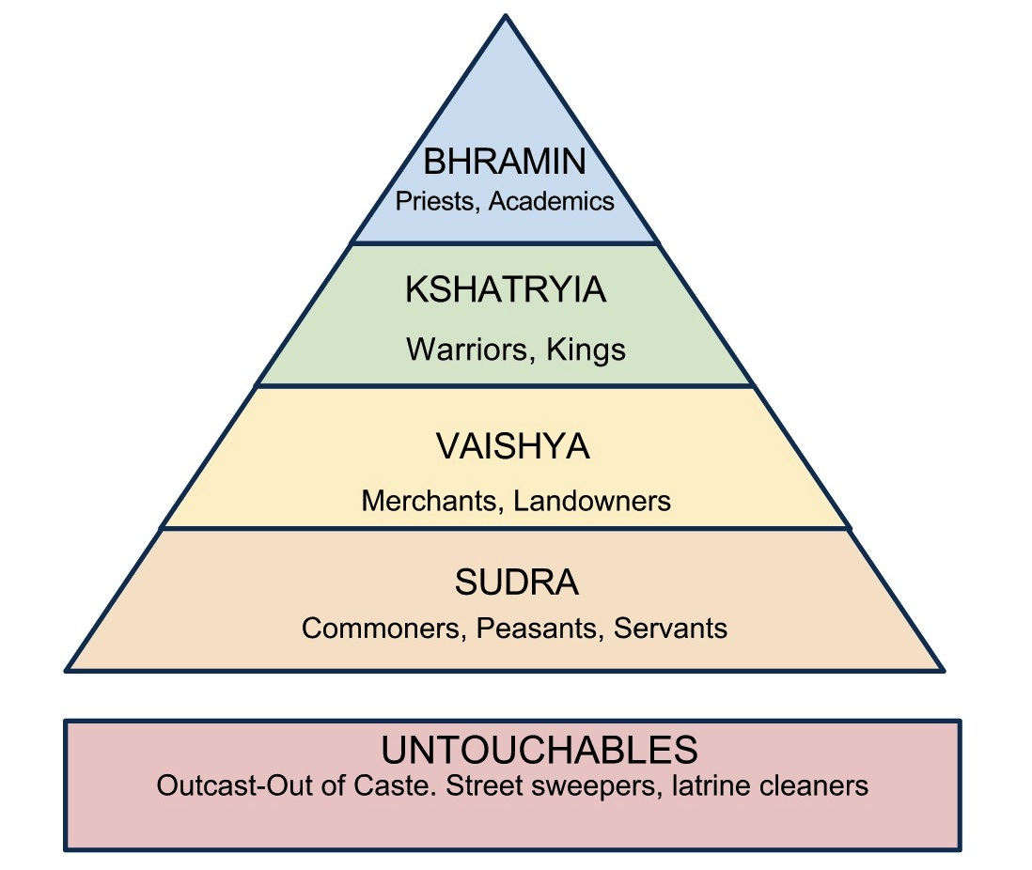
Caste system in India
Notes:
People believe the way things are is the way things are supposed to be. It is not unfair some are untouchables by birth and have to live and die as untouchables.

Slide 20
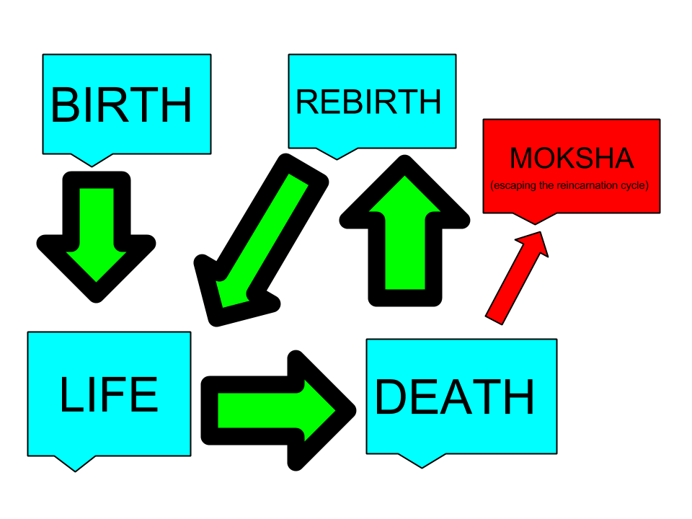
Reincarnation
The way things are is the way things are supposed to be
Therefore do not criticise or challenge the status quo
Myths support the status quo
Notes:
The life you are born into depends on the way you lived your previous life

Slide 21
What myths lie at the basis of our culture?
Greek myth and philosophy is one of the main sources of European and Western culture
The Bible is the other
Notes:
He begins with Chaos, a yawning nothingness. Out of the void emerged Gaia (the Earth) and some other primary divine beings: Eros (Love), the Abyss (the Tartarus), and the Erebus. Without male assistance, Gaia gave birth to Uranus (the Sky) who then fertilized her. From that union were born first the Titans—six males: Coeus, Crius, Cronus, Hyperion, Iapetus, and Oceanus; and six females: Mnemosyne, Phoebe, Rhea, Theia, Themis, and Tethys. After Cronus was born, Gaia and Uranus decreed no more Titans were to be born. They were followed by the one-eyed Cyclopes and the Hecatonchires or Hundred-Handed Ones, who were both thrown into Tartarus by Uranus. This made Gaia furious. Cronus ("the wily, youngest and most terrible of Gaia's children"), was convinced by Gaia to castrate his father. He did this, and became the ruler of the Titans with his sister-wife Rhea as his consort, and the other Titans became his court.

Slide 22
Introduction to Greek mythology
Hesiod’s cosmogony, Mount Olympus
Notes:
He begins with Chaos, a yawning nothingness. Out of the void emerged Gaia (the Earth) and some other primary divine beings: Eros (Love), the Abyss (the Tartarus), and the Erebus. Without male assistance, Gaia gave birth to Uranus (the Sky) who then fertilized her. From that union were born first the Titans—six males: Coeus, Crius, Cronus, Hyperion, Iapetus, and Oceanus; and six females: Mnemosyne, Phoebe, Rhea, Theia, Themis, and Tethys. After Cronus was born, Gaia and Uranus decreed no more Titans were to be born. They were followed by the one-eyed Cyclopes and the Hecatonchires or Hundred-Handed Ones, who were both thrown into Tartarus by Uranus. This made Gaia furious. Cronus ("the wily, youngest and most terrible of Gaia's children"), was convinced by Gaia to castrate his father. He did this, and became the ruler of the Titans with his sister-wife Rhea as his consort, and the other Titans became his court.

Slide 23


Slide 24
Some implications
All the action takes place on Mount Olympus
The gods are the major characters
  Where are the human beings?
Sexual confusion
Gods are not moral
Might is right – all about power
A lot of conflict
How are husband – wife relations?
How are parent – child relations?

Slide 25

Oedipus Rex by Sophocles
Notes:
Prior to the start of Oedipus Rex, Oedipus has become the king of Thebes while unwittingly fulfilling a prophecy that he would kill his father, Laius (the previous king), and marry his mother, Jocasta (whom Oedipus took as his queen after solving the riddle of the Sphinx). The action of Sophocles' play concerns Oedipus' search for the murderer of Laius in order to end a plague ravaging Thebes, unaware that the killer he is looking for is none other than himself. At the end of the play, after the truth finally comes to light, Jocasta hangs herself while Oedipus, horrified at his patricide and incest, proceeds to gouge out his own eyes in despair.
A son is born to King Laius and Queen Jocasta of Thebes. After Laius learns from an oracle that "he is doomed/To perish by the hand of his own son", he tightly binds the feet of the infant together with a pin and orders Jocasta to kill the infant. Hesitant to do so, she orders a servant to commit the act for her. Instead, the servant takes the baby to a mountain top to die from exposure. A shepherd rescues the infant and names him Oedipus (or "swollen feet"). (The servant directly hands the infant to the shepherd in most versions.) The shepherd carries the baby with him to Corinth, where Oedipus is taken in and raised in the court of the childless King Polybus of Corinth as if he were his own.As a young man in Corinth, Oedipus hears a rumour that he is not the biological son of Polybus and his wife Merope. He asks the Delphic Oracle who his parents really are. The Oracle seems to ignore this question, telling him instead that he is destined to "Mate with [his] own mother, and shed/With [his] own hands the blood of [his] own sire". Desperate to avoid his foretold fate, Oedipus leaves Corinth in the belief that Polybus and Merope are indeed his true parents and that, once away from them, he will never harm them.On the road to Thebes, he meets Laius, his true father, with several other men. Unaware of each other's identities, Laius and Oedipus quarrel over whose chariot has right-of-way. King Laius moves to strike the insolent youth with his sceptre, but Oedipus throws him down from the chariot and kills him, thus fulfilling part of the oracle's prophecy.Shortly after, Oedipus solves the riddle of the Sphinx, which has baffled many diviners. It isn’t known for certain what exactly the riddle was, it isn’t repeated in the play, but a later tradition gives it as: "What is the creature that walks on four legs in the morning, two legs at noon, and three in the evening?" To this Oedipus replies, "Man" (who crawls on all fours as an infant, walks upright later, and needs a walking stick in old age), and the distraught Sphinx throws herself off the cliffside.[7] Oedipus's reward for freeing the kingdom of Thebes from her curse is the kingship and the hand of Queen Dowager Jocasta, his biological mother.[8] The prophecy is thus fulfilled, although none of the main characters know it.

Slide 26
Implications
Fate
  The future is closed and cannot be escaped
Predestination - Christian doctrine
  It is predestined whether a person goes to heaven or hell
  Everything that happens is part of God’s plan
  Augustine - Felix culpa – O happy fall (of man)
Determinism
  Scientific
  “The basis of the vision of classical physics was the conviction that the future is determined by the present, and therefore a careful study of the present permits an unveiling of the future...We may perhaps even call it the founding myth of classical science." Ilya Prigogine (Nobel Laureate for non-linear thermodynamics)
  Historical – Karl Marx – inevitability of communism
  Social - social deprivation
  Economic – poverty causes crime

Slide 27
Implications – I am a victim and not responsible for my actions
In The Iliad Agamemnon ascribes his behaviour in wronging Achilles by taking his wife, Briseis, to Zeus:
  Not I, not I was the cause of the act,
  but Zeus and my fate (Moira) and the Furies (Eriyns)
  Who walks in darkness;
  they it was who in the assembly put wild Folly (Atë) in my
  understanding. On that day when I arbitrarily took
  Achilles' prize from him.
Homer Iliad 19.74-95.
Notes:
Erinys), also known as the Furies, were female chthonic deities of vengeance, sometimes referred to as "infernal goddesses”
Aite is the Greek goddess of mischief, delusion, ruin, and folly. Até also refers to an action performed by a hero that leads to their death or downfall. Mythology personifies Atë as the daughter either of Zeus or of Eris.
In the legends, Briseis was the wife of King Mynes of Lyrnessus, an ally of Troy. Achilles slew Mynes and the brothers of Briseis (children of Briseus), then received her as his war prize. Even though she was a war prize, Achilles and Briseis fell in love with each other, and Achilles may have gone to Troy intending to spend much time in his tent with her, as was portrayed in the movie. But then Agamemnon took Briseis from Achilles. Agamemnon did this not merely to make an arbitrary statement about his superior power—as shown in the movie, but because he had been obliged to return his own war prize, Chryseis, to her father. Chryses, the father of Chryseis, was a priest of Apollo. In the movie, Briseis is a priestess of Apollo. After Chryses learned of his daughter's abduction, he tried to ransom her. Agamemnon refused. The gods responded ... The seer Calchas told Agamemnon that the Greeks were suffering from a plague sent by Apollo because he wouldn't return Chryseis to Chryses. When, reluctantly, Agamemnon agreed to return his prize, he decided he needed another one to replace his loss, so he took Achilles' and said to Achilles:
" Go home, then, with your ships and comrades to lord it over the Myrmidons. I care neither for you nor for your anger; and thus will I do: since Phoebus Apollo is taking Chryseis from me, I shall send her with my ship and my followers, but I shall come to your tent and take your own prize Briseis, that you may learn how much stronger I am than you are, and that another may fear to set himself up as equal or comparable with me."
Iliad Book I
Achilles was enraged and refused to fight for Agamemnon. He wouldn't fight even after Agamemnon had returned Briseis—untouched (as was shown in the movie). But when Achilles' friend Patroclus died, killed by Hector, Achilles went mad and determined to get revenge, which meant going to war.

Slide 28
Why are we looking at Greek myths?
“In Hesiod's cosmogony it is Moira, Fate or Destiny, which partitions the world imposing order. Moira is later replaced by Zeus who in turn is superseded by Reason.”
"But the function of the supreme power remains the same, to 'introduce distinction and order.'"
F.M. Cornford, From Religion to Philosophy:
A Study in the Origins of Western Speculation

Slide 29
How do myths work?
Most myths support status quo
  Hinduism and caste system
Values of myths become embedded in cultural assumptions
  Greek myth – fatalism, determinism
Notes:
One of the things we know about the culture of the Ancient Near East is that it was typical for a king to erect as many images of himself as he could. He would do this as a way of establishing the extent of his kingdom. The closest parallel we have today is a nation’s flag. Just as the presence of an American flag overhead let’s us know that we are in the United States, so people living in the Ancient Near East could tell whose dominion they were in based on the images. At a time before mass communication, the geographical extent of a king’s images played a very important role in establishing the extent of his territorial sovereignty. For the most powerful rulers, such as the Pharaohs of Egypt or the Emperors of Babylon, their images would extend over tens of thousands of miles. If a rival ruler wanted to challenge the king’s authority, then he would deface the king’s images, replacing them with images of his own.
In addition to this geographical focus of images, there was also a numerical focus. The amount of images a king could erect was crucial for establishing his wealth. In the bronze age, it was expensive to construct images. A wealthy king might be able to spread ten images over five miles, whereas a pour king might only be able to afford three. Thus, the number of images, and also the material out of which they were constructed, testified to the ruler’s wealth. Wealth, of course, was related to power, since the greater a king’s wealth, the more armies he could afford to amass.
Kings in the Ancient Near East were often believed to represent their nation’s particular god. For example, the pharaohs of Egypt were associated with their god Ra. Similarly, many Mesopotamian and Babylonian rulers justified their political authority by claiming to be substantiations of particular deities. This practice continued up to the times of the Roman Emperors, many of whom claimed divine honors. Thus, when a king received glory by placing his images throughout his land, this also reflected back to the prototype, namely the god that the king was associated with. By being associated with their god, kings were believed to stand between heaven and earth. With this came the special task of learning the will of the gods and then using royal power to enforce that heavenly will on earth.
Temples in the Ancient World
Images were closely tied to temples. In the religious imagination of the Ancient Near East, a god’s temple was usually associated either with a garden or a mountain. Ziggurats in ancient Mesopotamia are examples of a mountain temple, while something like the Hanging Gardens of Babylon are an example of an attempt to combine garden and mountain symbolism into a single structure. A nation’s god was believed to be enthroned in a central temple, which symbolized his reign in the heavens over the gods of the other nations. The building of a temple would culminate in a ceremony to place the god’s image inside, thus enabling the god to descend from heaven to dwell within that image (while also continuing to live and rule in the heavens). Once the god came to rest in the temple, this served as his earthly dwelling from which he exercised dominion over the world. This worldwide sovereignty would find expression in the dominion of the god’s favored nation. John Walton, a scholar of the Ancient Near East, likens the functions of ancient temples to a god’s “control room.” Here’s how Walton explains it:
“The role of the temple in the ancient world is not primarily a place for people to gather in worship in modern churches. It is a place for the deity—a sacred space. It is his home, but more importantly his headquarters—the control room. When the deity rests in the temple it means that he is taking command, that he is mounting to his throne to assume his rightful place and his proper role.” (From The Lost World of Genesis 1).

Slide 30
“One of the functions of ancient creation narratives, is to literarily encode the religious and political overthrow of one culture by another. When a king or kingdom would rise to power in the ancient world, they would often displace the vassal culture’s creation stories with their own stories of how their deities triumphed over others to create the world in which they now lived…. Genesis 1 is the legitimation of Yahweh, the God of Israel, and his authority and power over all things, including the gods of Canaan, who are in fact, reduced to nothing.”
Brian Godawara, Biblical Creation and Storytelling: Cosmogony, Combat and Covenant

