Slide 1
God intervenes
When Rehoboam arrived in Jerusalem, he mustered all Judah and the tribe of Benjamin to go to war against Israel and to regain the kingdom.
The word of God came to Shemaiah the man of God: ‘Say to Rehoboam, to all Judah and Benjamin, and to the rest of the people, “This is what the Lord says: do not go up to fight against your brothers, the Israelites. Go home, every one of you, for this is my doing.”’ So they obeyed the word of the Lord and went home again, as the Lord had ordered. 1 Kings 12:21-24

Slide 2
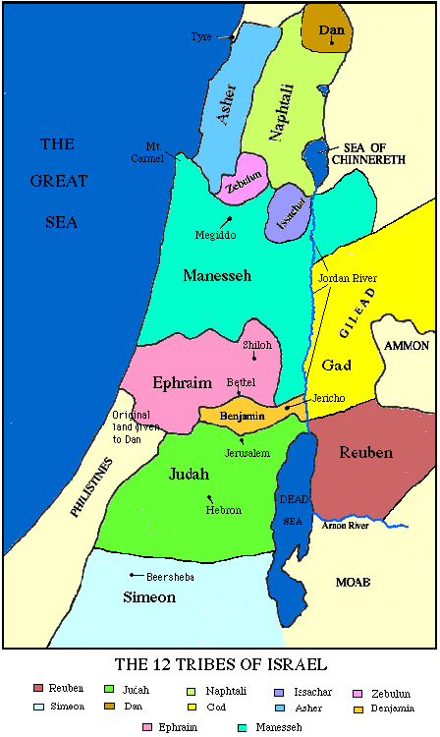
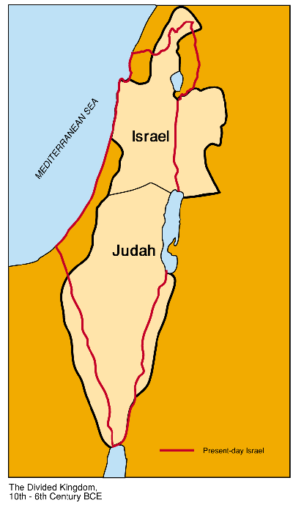
How was the kingdom divided?
Notes:
In the fifth year of King Rehoboam, Shishak king of Egypt attacked Jerusalem. 26 He carried off the treasures of the temple of the Lord and the treasures of the royal palace. He took everything, including all the gold shields Solomon had made.
Ark of Covenant too? Maybe that’s why Copts have it

Slide 3
New kingdom, new religion
Jeroboam thought to himself, ‘The kingdom is now likely to revert to the house of David. If these people go up to offer sacrifices at the temple of the Lord in Jerusalem, they will again give their allegiance to their lord, Rehoboam king of Judah. They will kill me and return to King Rehoboam.’ 1 Kings 12:26-27
Shrines at Dan and Bethel
Golden calves
  Not idols (Baal) but images
Allowed anyone to function as a priest
Changed calendar
He functioned as a priest performing sacrificial service

Slide 4
Jeroboam’s sin
A man of God came from Judah to Bethel, as Jeroboam was standing by the altar to make an offering. By the word of the Lord he cried out against the altar: ‘Altar, altar! ‘This is the sign the Lord has declared: the altar will be split apart and the ashes on it will be poured out.’
The altar was split apart and its ashes poured out according to the sign given by the man of God by the word of the Lord.
Even after this, Jeroboam did not change his evil ways, but once more appointed priests for the high places from all sorts of people. This was the sin of the house of Jeroboam that led to its downfall and to its destruction from the face of the earth. 1 Kings 13:1-3,5,32-34

Slide 5
Commentary
Even a leader designated by God may not ignore God’s word. Jeroboam knew only one place of worship was permitted in the Torah. He had been designated by God to establish a new administration but Jerusalem and the Temple should have remained the religious focal point. Had he not allowed his resentment to the house of David to dominate, then the Jewish people might have remained a single nation with two states and two administrative centres. Alex Israel, 1 Kings: Torn in Two

Slide 6
God’s verdict
“I raised you up from among the people and appointed you ruler over my people Israel. I tore the kingdom away from the house of David and gave it to you, but you have not been like my servant David, who kept my commands and followed me with all his heart, doing only what was right in my eyes. You have done more evil than all who lived before you. You have made for yourself other gods, idols made of metal; you have aroused my anger and turned your back on me. Because of this, I am going to bring disaster on the house of Jeroboam.” God will uproot Israel from this good land that he gave to their ancestors and scatter them beyond the River Euphrates, because they aroused the Lord’s anger by making Asherah poles. 1 Kings 14:7-15

Slide 7
Rehoboam
After Rehoboam’s position as king was established and he had become strong, he and all Israel with him abandoned the law of the Lord. 2 Chronicles 12:1
Judah did evil in the eyes of the Lord. By the sins they committed they stirred up his jealous anger more than those who were before them had done. They also set up for themselves high places, sacred stones and Asherah poles on every high hill and under every spreading tree. There were even male shrine-prostitutes in the land; the people engaged in all the detestable practices of the nations the Lord had driven out before the Israelites.
In the fifth year of King Rehoboam, Shishak king of Egypt attacked Jerusalem. He carried off the treasures of the temple of the Lord and the treasures of the royal palace. He took everything. 1 Kings 14:22-28

Slide 8
Divine plan, human decisions
Rehoboam responded very harshly to Jeroboam and the leaders of Israel:
So the king did not listen to the people, for this turn of events was from the Lord, to fulfil the word the Lord had spoken to Jeroboam son of Nebat through Ahijah the Shilonite. 1 Kings 12:15

Slide 9
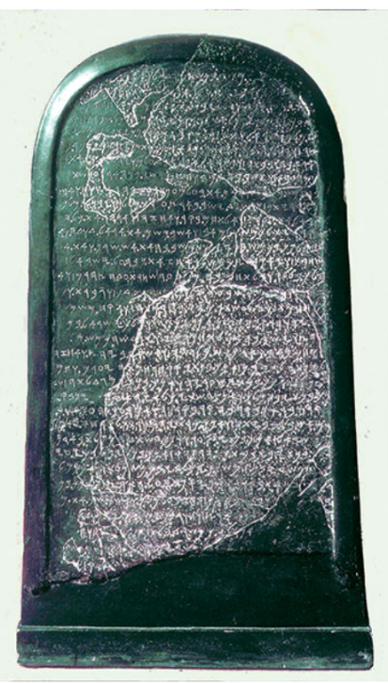
King Ahab
Ahab son of Omri became king of Israel, and he reigned in Samaria over Israel for twenty-two years. Ahab did more evil in the eyes of the Lord than any of those before him. He not only considered it trivial to commit the sins of Jeroboam son, but he also married Jezebel daughter of Ethbaal king of the Sidonians, and began to serve Baal and worship him. He set up an altar for Baal in the temple of Baal that he built in Samaria. Ahab also made an Asherah pole and did more to arouse the anger of the Lord, the God of Israel, than did all the kings of Israel before him. 1 Kings 16:29-31
Mesha Stele
Notes:
A king of Moab has become famous not so much because he is mentioned by name in the Bible (only once), but primarily because the episode recounted from the Israelite point of view in the Bible is recorded as the Moabites saw it in the famous Mesha Stele. The Bible records how Israel’s king Omri conquered Moab, while the Mesha Stele, a 3-foot-high black basalt stone that displays about 34 lines of writing, recounts how the Moabite king Mesha liberated Moab from the Israelites.^{f} The Mesha Stele is now a featured display in the Louvre.

Slide 10

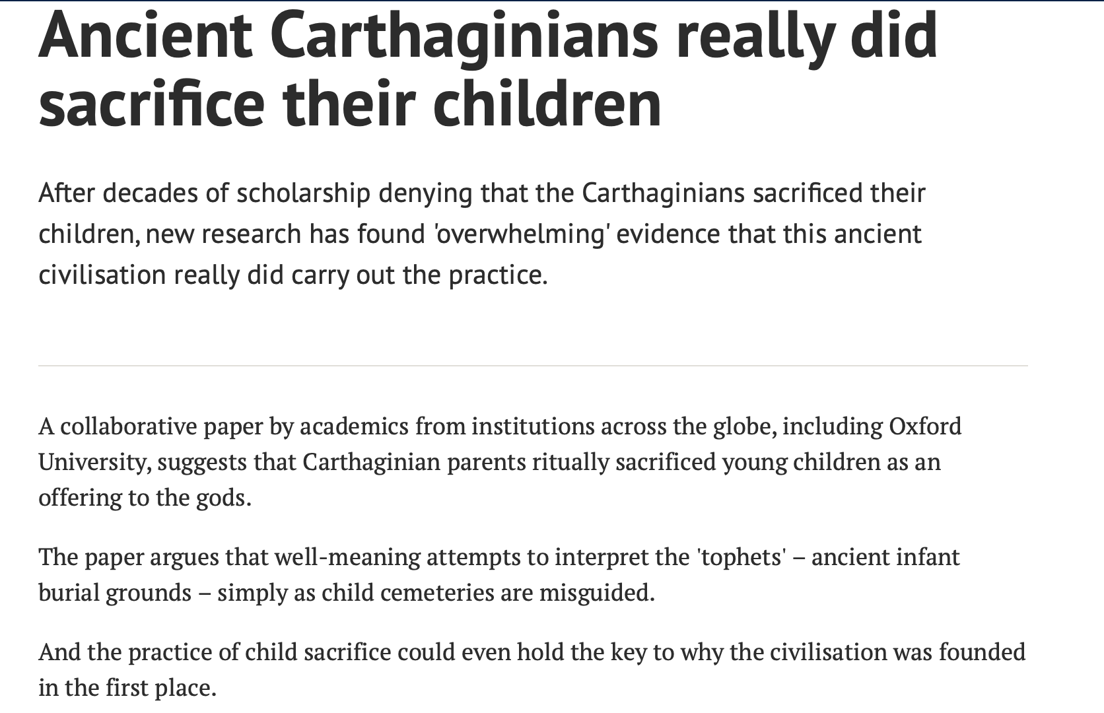
Phoenicia

Slide 11
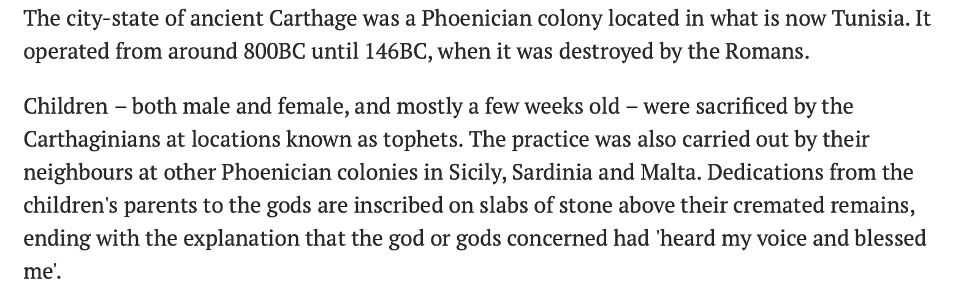
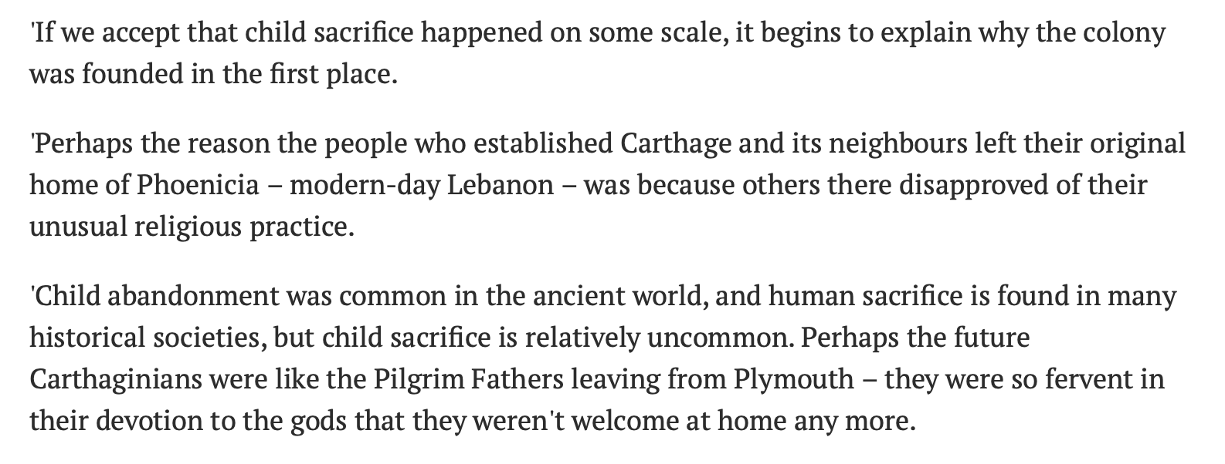

Slide 12
Baal worship becomes official
The alliance with Phoenicia thrusts Baal worship into the very centre of life in the northern kingdom. Jezebel is an ardent ruthless missionary of Baal. With her hundreds of idolatrous prophets she outlaws the worship of God and persecutes those who prophesy in his name. Jezebel’s lack of conscience is unprecedented. Her dominance of her husband coupled with her fearless resolve contribute significantly to Israel’s spiritual deterioration. Under Ahab Baal becomes the official religion. The Israelites had dabbled with other gods before but had always been in a fundamental alignment with the God of Israel. Alex Israel, 1 Kings: Torn in Two

Slide 13
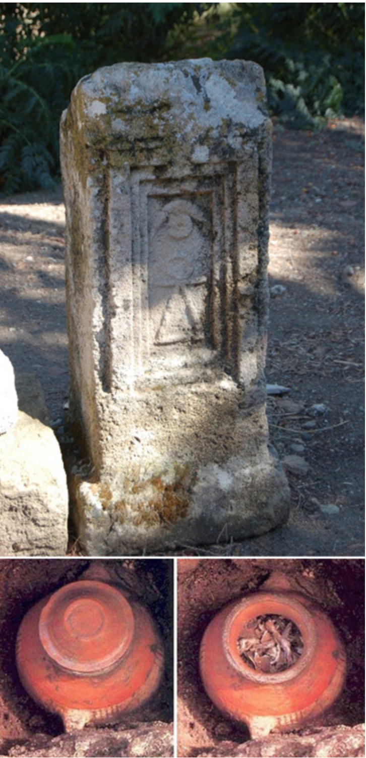
Cultural impact
Whenever Israel allies itself economically and militarily with a regional power, wider social and cultural effects – including religious influences – are not far behind.
Stone grave marker and a terracotta funerary urn containing the charred remains of an infant.
Notes:
These images show a stone grave marker carved with symbols and a terracotta funerary urn containing the charred remains of an infant. The Tophet of Carthage is a cemetery for infants in the ruins of the North African city of Carthage, now located in a suburb of Tunis. It was once located on the edge of ancient Carthage, which was destroyed by the Romans in 146 BCE. The cemetery is the subject of historical controversy because both ancient texts and archaeological evidence point to the possibility that the children buried in the tophet were child sacrifices. The cemetery was used for over 600 years, between 730 BCE and 146 BCE. Changes in the grave markers and burials indicate three different periods of use.
The Carthage tophet has no adult graves, and many of the grave stelae are marked with dedications to Baal and Tanit, the patron deities of Carthage. The word tophet comes from the Hebrew topheth derived from "drum" or "place of burning," an open area for sacrifice. Numerous tophets have been identified in the eastern Mediterranean region. The Tophet of Carthage, excavated between 1920 and 1970, shows burials of young infants, interred in small vaults with beads and amulets, and sometimes the bones of small animals. Low thrones or stones marked the early graves.
In later periods, buried a layer above the original graves, sandstone markers were covered with stucco and painted yellow, red, or blue. Narrow, limestone grave stelae with pediments appear, inscribed with representations of Baal and Tanit. Many featured the sign of Tanit shown on the stela in the image—a triangle with a disc at the apex and a line through the apex with upturned ends, which looks perhaps like a child or a doll with outstretched arms.
Jewish and Christian scriptures refer to places of child sacrifice. Roman writer Diodorus Siculus described the sacrifice of upper class children to the deity Baal in 310 BCE, a reference seen as the main source of the claim of child sacrifice. Later elaborations made by writers even into the 19th century include the description of a metal fire pit in the form of the deity, with grates that mechanically tipped infants into the fire. Sacrifices to appease the deities or to ask favours seem to be supported by some inscriptions, but there may also be evidence that small animals were sacrificed in place of the children.

Slide 14
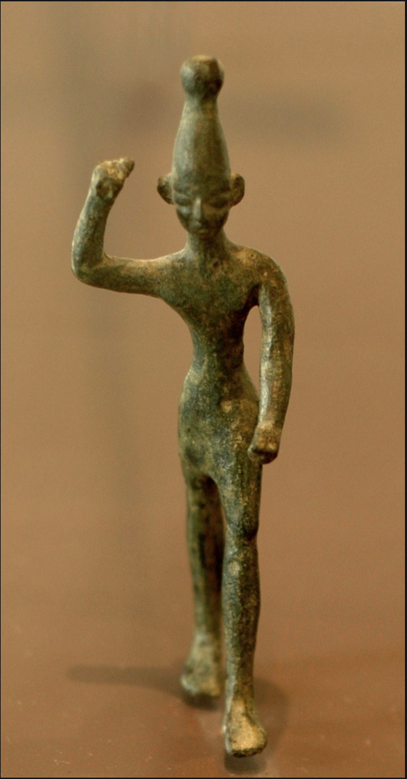
Who is Baal?
Rain god responsible for fertility and agricultural success
Guaranteed rain very important in such a landscape
God of Israel – observe the Torah to have rain
Baal – worship and sacrifice to have rain

Slide 15
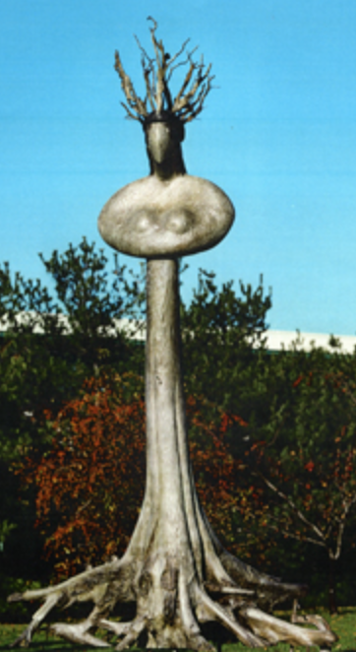
What was Baal worship?
Baal was the male representation of the rain god. Its female counterpart was Asherah. The theory was that Baal (rain) fertilised Asherah (tree). The union of male and female led to cultic sexual rites in the temples of Baal. The sexual union of the male and female temple prostitutes bringing the desired rainfall. Thus we can appreciate the connection made in the Torah between idolatry and illicit sexual practices. Alex Israel, 1 Kings: Torn in Two
Asherah tree

Slide 16
Rebuilding of Jericho: abandoning heritage
Joshua pronounced this solemn oath: ‘Cursed before the Lord is the one who undertakes to rebuild this city, Jericho:
‘At the cost of his firstborn son
he will lay its foundations;
at the cost of his youngest
he will set up its gates.’ Joshua 6:26
In Ahab’s time, Hiel of Bethel rebuilt Jericho. He laid its foundations at the cost of his firstborn son Abiram, and he set up its gates at the cost of his youngest son Segub, in accordance with the word of the Lord spoken by Joshua son of Nun. 1 Kings 16:34

Slide 17
Enter Elijah
Elijah and Ahab went to comfort Hiel. Ahab said to Elijah, ‘Is it possible that the curse of the student [Joshua] was fulfilled but the curse of our teacher Moses was not?
Be careful, or you will be enticed to turn away and worship other gods and bow down to them. Then the Lord’s anger will burn against you, and he will shut the heavens so that it will not rain and the ground will yield no produce, and you will soon perish from the good land the Lord is giving you. Deuteronomy 11:16-17

Slide 18
No more rain
Now Elijah the Tishbite, from Gilead, said to Ahab, ‘As the Lord, the God of Israel, lives, whom I serve, there will be neither dew nor rain in the next few years except at my word.’ 1 Kings 17:1
Did God tell him to do this? Or own initiative?
Is he ‘forcing’ God’s hand?
Elijah pronounces and God listens!
A lot of suffering. Drought, starvation, death
  Widow and widow’s son
When will Elijah relent and retract his oath?

Slide 19
Showdown on Mount Carmel
The word of the Lord came to Elijah in the third year, saying, ‘God appear before Ahab and I will send rain upon the earth.’ 1 Kings 18:1
Ahab went to meet Elijah. When he saw Elijah, he said to him, ‘Is that you, you troubler of Israel?’
‘I have not made trouble for Israel,’ Elijah replied. ‘But you and your father’s family have. You have abandoned the Lord’s commands and have followed the Baals. Now summon the people from all over Israel to meet me on Mount Carmel. And bring the four hundred and fifty prophets of Baal and the four hundred prophets of Asherah, who eat at Jezebel’s table.’ 1 Kings 18:16-19

Slide 20
The choice
Elijah went before the people and said, ‘How long will you waver between two opinions? If the Lord is God, follow him; but if Baal is God, follow him.’ But the people said nothing. 1 Kings 18:21
God or Baal
Israel or Phoenicia

Slide 21
Prophets of Baal go first
At noon Elijah began to taunt them. ‘Shout louder!’ he said. ‘Surely he is a god! Perhaps he is deep in thought, or busy, or travelling. Maybe he is sleeping and must be awakened.’ So they shouted louder and slashed themselves with swords and spears, as was their custom, until their blood flowed. Midday passed, and they continued their frantic prophesying until the time for the evening sacrifice. But there was no response, no one answered, no one paid attention. 1 Kings 18:27-29

Slide 22
Elijah’s offering
Repairs the altar with twelve stones
  Possibility of repentance
Twelve jugs of water
  12 represents both kingdoms as one nation
God Abraham, Isaac and Israel
Then the fire of the Lord fell and burned up the sacrifice, the wood, the stones and the soil. When all the people saw this, they fell prostrate and cried, ‘The Lord – he is God! The Lord – he is God!’ 1 Kings 18:38-39

Slide 23
Then . . .
Prophets of Baal put to death
Elijah prays for rain
Runs before Ahab’s chariot
Arrive in Jezreel
Now Ahab told Jezebel everything Elijah had done and how he had killed all the prophets with the sword. So Jezebel sent a messenger to Elijah to say, ‘May the gods deal with me, be it ever so severely, if by this time tomorrow I do not make your life like that of one of them.’ Elijah was afraid and ran for his life. 1 Kings 19:1-3

Slide 24
Elijah in despair
When he came to Beersheba in Judah, he left his servant there, while he himself went a day’s journey into the wilderness. He came to a broom bush, sat down under it and prayed that he might die. ‘I have had enough, Lord,’ he said. ‘Take my life; I am no better than my ancestors.’ Then he lay down under the bush and fell asleep. 1 Kings 19:3-5

Slide 25
Why?
Elijah succeeded in turning the king around and drawing the nation to proclaim allegiance to God. But now, in a single day, the entire project lies shattered in ruins. Elijah decided all his achievements were spurious. The depth of his fall and despair is in proportion to the height of his expectation and self-confidence. He expected things to turn out differently. Alex Israel, 1 Kings: Torn in Two

Slide 26
Conversation on Mount Sinai
And the word of the Lord came to him: ‘What are you doing here, Elijah?’
He replied, ‘I have been very zealous for the Lord God Almighty. The Israelites have rejected your covenant, torn down your altars, and put your prophets to death with the sword. I am the only one left, and now they are trying to kill me too.’
The Lord said, ‘Go out and stand on the mountain in the presence of the Lord, for the Lord is about to pass by.’

Slide 27
The still small voice
Then a great and powerful wind tore the mountains apart and shattered the rocks before the Lord, but the Lord was not in the wind. After the wind there was an earthquake, but the Lord was not in the earthquake. After the earthquake came a fire, but the Lord was not in the fire. And after the fire came a still small voice. When Elijah heard it, he pulled his cloak over his face and went out and stood at the mouth of the cave. 1 Kings 19:11-13

Slide 28
The conversation repeated
Then a voice said to him, ‘What are you doing here, Elijah?’
He replied, ‘I have been very zealous for the Lord God Almighty. The Israelites have rejected your covenant, torn down your altars, and put your prophets to death with the sword. I am the only one left, and now they are trying to kill me too.’
Despite the encounter with the Divine Elijah has not changed. He has not understood that God now wants him to exercise a different kind of leadership, defending Israel not criticising it (Rashi).
Notes:
'The Courage to Grow'
I vividly remember the surprise and delight I had when I first read Jane Austen’s Emma. It was the first time I have read a novel in which you see a character changing over time. Emma is an intelligent young woman who believes she understands other people better than they do. So she sets about arranging their lives – she is an English shadchan – with disastrous consequences, because not only does she not understand others; she does not even understand herself. By the end of the novel, though, she is a different person: older, wiser and humbler. Of course, since this is a Jane Austen story, it ends happily ever after.
In the more than 40 years that have passed since I read the book, one question has fascinated me. Where did Western civilisation get the idea that people can change? It is not an obvious idea. Many great cultures have simply not thought in these terms. The Greeks, for instance, believed that we are what we are, and we cannot change what we are. They believed that character is destiny, and the character itself is something we are born with, although it may take great courage to realise our potential. Heroes are born, not made. Plato believed that some human beings were gold, others silver, and others bronze. Aristotle believed that some are born to rule, and others to be ruled. Before the birth of Oedipus, his fate and that of his father, Laius, have already been foretold by the Delphic Oracle, and nothing they can do will avert it.
This is precisely the opposite of the key sentence we say on Rosh Hashanah and Yom Kippur, that “Teshuvah, tefillah and tzedakah avert the evil decree.” That is what happened to the inhabitants of Nineveh in the story we read at Minchah on Yom Kippur. There was a decree: “In forty days Nineveh will be destroyed.” But the people of Nineveh repent, and the decree is cancelled. There is no fate that is final, no diagnosis without a second opinion – half of Jewish jokes are based on this idea.
The more I studied and researched, the more I realised that Judaism was the first system in the world to develop a clear sense of human free will. As Isaac Bashevis Singer wittily put it, “We have to be free; we have no choice.”
This is the idea at the heart of teshuvah. It is not just confession, not just saying Al chet shechatanu. It is not just remorse: Ashamnu. It is the determination to change, the decision that I am going to learn from my mistakes, that I am going to act differently in future, that I determined to become a different kind of person.
To paraphrase Rabbi Soloveitchik, to be a Jew is to be creative, and our greatest creation is our self. As a result, more than 3000 years before Jane Austen, we see in Torah and in Tanach, a process in which people change.
To take an obvious example: Moshe Rabbeinu. We see him at the start of his mission as a man who cannot speak easily or fluently. “I am not a man of words.” “I am slow of speech and tongue.” “I have uncircumcised lips.” But by the end he is the most eloquent and visionary of all the prophets. Moses changed.
One of the most fascinating contrasts is between two people who were often thought to resemble one another, indeed were sometimes identified as the same person in two incarnations: Pinchas and Elijah. Both were zealots. But Pinchas changed. God gave him a covenant of peace and he became a man of peace. We see him in later life (in Joshua 22) leading a peace negotiation between the rest of the Israelites and the tribes of Reuben and Gad who had settled on the far side of the Jordan, a mission successfully accomplished.
Elijah was no less a zealot than Pinchas. Yet there is a remarkable scene some time after his great confrontation with the prophets of Baal at Mount Carmel. He is at Mount Horeb. God asks him, “What are you doing here, Elijah?” Elijah replies, “I have been very zealous for the Lord God Almighty.” God then sends a whirlwind, shaking mountain and shattering rocks, but God was not in the wind. Then God sends an earthquake, but God was not in the earthquake. Then God sends fire, but God was not in the fire. Then God speaks in a kol demamah dakah, a still small voice. He asks Elijah the same question again, “What are you doing here, Elijah?” and Elijah replies in exactly the same words as he had done before: “I have been very zealous for the Lord God Almighty.” At that point God tells Elijah to appoint Elisha as his successor (1 Kings 19).
Elijah has not changed. He has not understood that God now wants him to exercise a different kind of leadership, defending Israel not criticising it (Rashi). He is asking Elijah to make a similar transformation to the one Pinchas made when he became a man of peace, but Elijah, unlike Pinchas, did not change. Even his words do not change, despite the momentous vision. He had become too holy for this world, so God took him to heaven in a chariot of fire.
It was Judaism, through the concept of teshuvah, that brought into the world the idea that we can change. We are not predestined to continue to be what we are. Even today, this remains a radical idea. Many biologists and neuroscientists believe that our character and actions are wholly determined by our genes, our DNA. Choice, character change, and free will, are – they say – illusions.
They are wrong. One of the great discoveries of recent years has been the scientific demonstration of the plasticity of the brain. The most dramatic example of this is the case of Jill Bolte Taylor. In 1996, aged 37, she suffered a massive stroke that completely destroyed the functioning of the left hemisphere of her brain. She couldn’t walk, talk, read, write, or even recall the details of her life. But she was very unusual in one respect. She was a Harvard neuroscientist. As a result, she was able to realise precisely what had happened to her.
For eight years she worked every day, together with her mother, to exercise her brain. By the end, she had recovered all her faculties, using her right hemisphere to develop the skills normally exercised by the left brain. You can read her story in her book, My Stroke of Insight, or see her deliver a TED lecture on the subject. Taylor is only the most dramatic example of what is becoming clearer each year: that by an effort of will, we can change not just our behaviour, not just our emotions, nor even just our character, but the very structure and architecture of our brain. Rarely was there a more dramatic scientific vindication of the great Jewish insight, that we can change.
That is the challenge of teshuvah.
There are two kinds of problem in life: technical and adaptive. When you face the first, you go to an expert for the solution. You are feeling ill, you go to the doctor, he diagnoses the illness, and prescribes a pill. That is a technical problem. The second kind
is where we ourselves are the problem. We go to the doctor, he listens carefully, does various tests, and then says: “I can prescribe a pill, but in the long-term, it is not going to help. You are overweight, underexercised and overstressed. If you don’t change your lifestyle, all the pills in the world will not help.” That is an adaptive problem.
Adaptive problems call for teshuvah, and teshuvah itself is premised on the proposition that we can change. All too often we tell ourselves we can’t. We are too old, too set in our ways. It’s too much trouble. When we do that, we deprive ourselves of God’s greatest gift to us: the ability to change. This was one of Judaism’s greatest gifts to Western civilisation.
It is also God’s call to us on Yom Kippur. This is the time when we ask ourselves where have we gone wrong? Where have we failed? When we tell ourselves the answer, that is when we need the courage to change. If we believe we can’t, we won’t. If we believe we can, we may.
The great question Yom Kippur poses to us is: Will we grow in our Judaism, our emotional maturity, our knowledge, our sensitivity, or will we stay what we were? Never believe we can’t be different, greater, more confident, more generous, more understanding and forgiving than we were. May this year be the start of a new life for each of us. Let us have the courage to grow.

Slide 29
The faith of Elijah
Elijah speaks the language of fiery passion. He knows what is true and when the world around him fails to correspond to the truth that burns within he cannot accept the travesty. He cannot accept a government of Israel that is hostile to God. He cannot stand that God will sit by and watch as the nation adopts Baal as its deity. God wishes to function in the world via a ‘small still voice.’ Elijah wants fire, thunder, and earthquake. He cannot accommodate a world where Jezebel can rule with a free hand, and he does not understand why God will not bring the world to order. Even when God instructs him to act differently, Elijah informs him that he cannot. Elijah cannot identify with the ‘still, small voice.’ Alex Israel, 1 Kings: Torn in Two

Slide 30
Moses and Elijah
Moses pleads for the nation. Elijah blames the nation. Moses knows how to present God’s demands to the people. Moses stands boldly before God and demands national forgiveness. Elijah stands before God and accuses the nation of abrogating the covenant. The cave at Sinai should have resounded with the mandate to defend and shield the nation despite its sin. Instead Elijah chooses to bemoan, malign and accuse Israel of breaching the covenant. Alex Israel, 1 Kings: Torn in Two
God allows Elijah to resign and tells him to commission Elisha in his place

