Slide 1
Conclusion of the book of Judges
It is the revulsion of every man doing “that which is right in his own eyes” that is the central theme of the Biblical account of the period of the judges. In the end it becomes clear than anarchy is unlivable. The only alternative to anarchy is the establishment of a standing political and military power that will be strong enough to maintain order internally and protect the people from the predations of foreigners – that is the establishment of a political state, or kingdom. Yoram Hazony, Philosophy of Hebrew Scripture
Notes:
Judges – kings look back . Show need for king
Honest history. All nations there by invasion.

Slide 2
What does that imply?
A ruler - a king or a monarch
  The term kingship refers to a relatively complex and hierarchical structure of society in which a central figure — a king or, in certain cases, a queen — undertakes a unifying role that acts as a value reference for the various groups that constitute the society.
  Of the two main theories on the origin of kingship, the first holds that it originates from within the social group, while the other holds that it has external origins, such as the result of military conquest. The majority of available historical and ethnographic data supports the second hypothesis. Encyclopedia.com
Notes:
Of the two main theories on the origin of kingship, the first holds that it originates from within the social group, while the other holds that it has external origins, such as the result of military conquest. The majority of available historical and ethnographic data supports the second hypothesis.

Slide 3
How does that happen?
Within – election
  Public acclaim, elders, parliament, democracy
  Why?
    Successful warrior – Gideon
    Charisma – judge. ‘Majesty’
    Force – gang leader – Bolsheviks, CCP
    Coup
Without – invasion and conquest
How to legitimise power?

Slide 4
How to legitimise this power?
Divine origin
  Egypt (Ra, the sun god)
  Japan (Amaterasu, the sun goddess)
  Divine being
  Divine legitimacy for position and power
  Divine right – above the law – tyranny
  Divine origin of a people – racism
Divine sanction
  Religious coronation
  Limits to king’s power

Slide 5
Who is to be the next king?
Civil war between competing families
  Wars of the Roses
Royal family
  Rules of succession
  Oldest or most capable descendent or relative
New election
  Democracy
Peaceful and legitimate transfer of power and authority very important

Slide 6
The role of the king
When you enter the land that God, your God, is giving you and take it over and settle down, and then say, “I’m going to get me a king, a king like all the nations around me,” make sure you get yourself a king whom God, your God, chooses. Choose your king from among your kinsmen; don’t take a foreigner—only a kinsman.
And make sure he doesn’t build up a war machine, amassing military horses and chariots. And make sure he doesn’t build up a harem, collecting wives who will divert him from the straight and narrow. And make sure he doesn’t pile up a lot of silver and gold. Deuteronomy 17:14-17
Restraining appetite of king for money, power

Slide 7
The attitude of a king
This is what must be done: When he sits down on the throne of his kingdom, the first thing he must do is make himself a copy of this teaching on a scroll, copied under the supervision of the priests. That scroll is to remain at his side at all times; he is to study it every day so that he may learn what it means to fear his God, living in reverent obedience before these rules and regulations by following them. He must not think himself better than his fellow Israelites or change the commands at whim to suit himself or making up his own versions. If he reads and learns, he will have a long reign as king in Israel, he and his sons. Deuteronomy 17:18-20

Slide 8


Slide 9
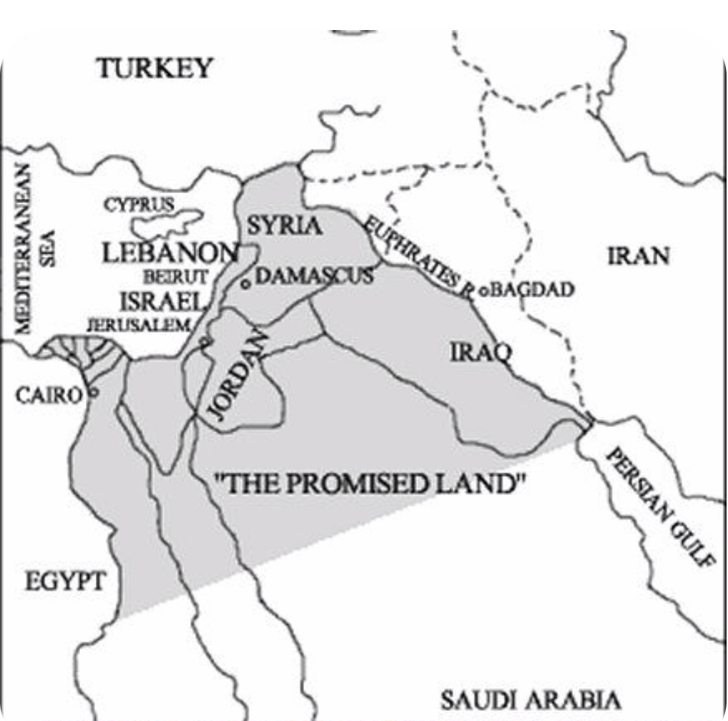
Boundaries of the Promised Land
To your descendants I have given this land, from the river of Egypt as far as the great river, the River Euphrates. the land of the Kenites, Kenizzites, Kadmonites, Hittites, Perizzites, Rephaites, Amorites, Canaanites, Girgashites and Jebusites.” Genesis 15.18

Slide 10
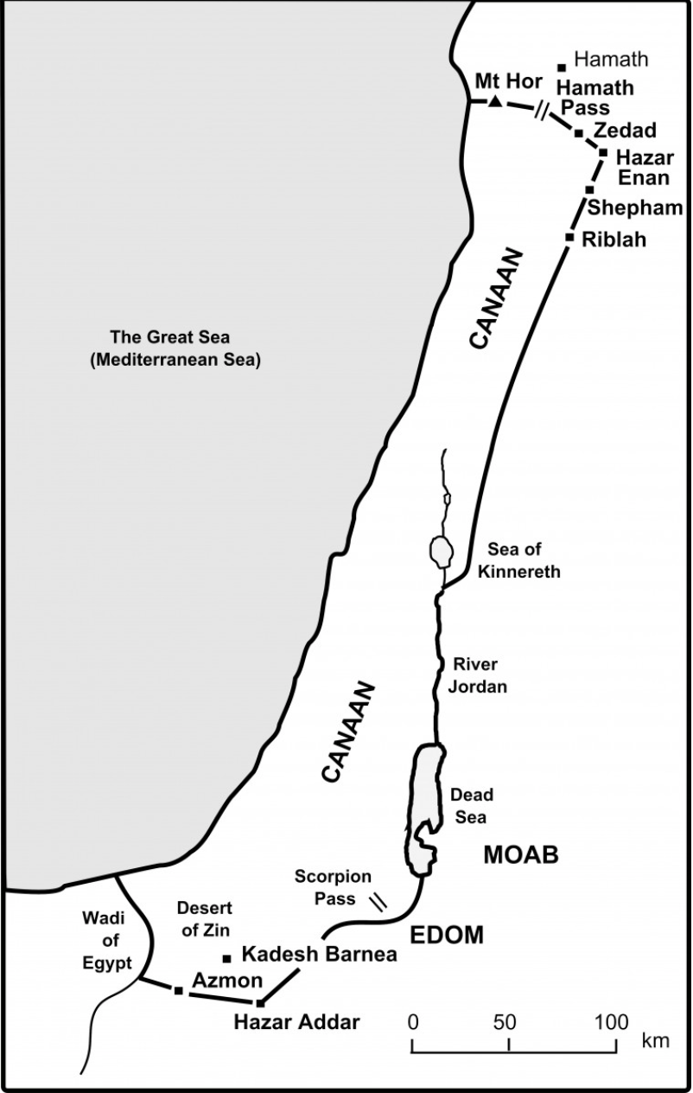
Boundaries of Canaan
The Lord said to Moses, “Command the Israelites and say to them: ‘When you enter Canaan, the land that will be allotted to you as an inheritance is to have these boundaries: Numbers 34:1-2
Territory has boundaries – must not conquer others and create empire like other nations do
Notes:
“‘Your western boundary will be the coast of the Mediterranean Sea. This will be your boundary on the west.
Then the boundary will go down along the Jordan and end at the Dead Sea.
“‘This will be your land, with its boundaries on every side.’”

Slide 11
The people demand a king
People said to Samuel: “We want a king over us. Then we will be like all the other nations, with a king to lead us and to go out before us and fight our battles.”
God replied to Samuel: “Listen to all that the people are saying to you; it is not you they have rejected, but they have rejected me as their king.” Samuel 8
Notes:
God allows himself to be voted out. Government by consent
10 Samuel told all the words of the LORD to the people who were asking him for a king. 11 He said, "This is what the king who will reign over you will do: He will take your sons and make them serve with his chariots and horses, and they will run in front of his chariots. 12 Some he will assign to be commanders of thousands and commanders of fifties, and others to plow his ground and reap his harvest, and still others to make weapons of war and equipment for his chariots. 13 He will take your daughters to be perfumers and cooks and bakers. 14 He will take the best of your fields and vineyards and olive groves and give them to his attendants. 15 He will take a tenth of your grain and of your vintage and give it to his officials and attendants. 16 Your menservants and maidservants and the best of your cattle [b] and donkeys he will take for his own use. 17 He will take a tenth of your flocks, and you yourselves will become his slaves. 18 When that day comes, you will cry out for relief from the king you have chosen, and the LORD will not answer you in that day."

Slide 12
What will the king do?
God warned the people that a king would:
  Conscript their sons as soldiers
  Turn their daughters into servants
  Take best fields and vineyards
  Take one tenth of harvest
  Take one tenth of flocks
  “You shall be his slaves”
Notes:
Israel Finkelstein's book David and Solomon and I would like to share with you and others, who are interested in history a few thoughts. My first impression was disappointment. Why did I expect that modern archeology will prove our DP theory of 120 years of United kingdom of Israel true? But the more I have read, the more fascinated story appears in front of me. Much longer than 120 years, much more colorful, with all possible influences shaping the real lineage of king David and especially the legend, which is the most powerful legend in human history. I again realized, that we are just one generation in the long stream flowing throughout times. And I had to re-evaluate some points of my faith, despite the fact, that Israel Finkelstein can be wrong in some points, but generally his explanation is very realistic. So first of all, there was no United kingdom of Israel in the time of Saul, David and Solomon, or at least there was no kingdom of the size, power and glory as the Bible explains. But it does not mean there was no unity. Most probably there was a small united area ruled by David, whom people called king. The core of biblical story can be true, but it happened in much more humble environment. Mr. Finkelstein pictures Saul as a local king of Northern part, which was more rich, with more people, more villages and small cities. David is presented like Robin Hood of that time. He lived in South, more poor area with hills and little villages. With his group he lived like mercenary, some time worked for Saul, some time for Philistines, sometimes protecting villages and gaining support of people. He was certainly more popular in South and he had opponents in North. When he became king after Saul's death, North and South united under him, but he could not erase Saul from the people's memory and heroic stories of both kings and their relationship spread among the people and mixed together. Most probably the fragile unity of his "kingdom" did not last long and South and North divided again. North developed into somehow powerful kingdom during Omri dynasty, with great palaces, strong army, developed trade and agriculture and capital city Samaria. South was small, unimportant and undeveloped, with Jerusalem in the size of bigger village. But there was time of "unity" again. In the 7. generation after David there was king Jehoram, who married Athaliah. She was sister or daughter of Southern king Ahab, whose wife was Jezebel. So two lineages united through their marriage and kingdom developed. It was the time of Eliah. I had always feeling, that if Eliah's mission was to prepare the way for the Messiah, he came a bit late, since he lived about 100 years after David, but may be it was just the right time. The failure of his mission is obvious. Despite of the fact, that two families united, two kingdom united, Omri's dynasty finished and all were killed by their army leader Jehu. And Athaliah was also somehow crazy. After the death of her husband and son, she killed all David's descendants, except one baby, which was hidden. So David's lineage survived and started again from one person and North and South developed again independently. But the time of unity came again. Another 7 generation passed and in 14. generation of David's lineage appeared king Hezekiah. He is described in the Bible as a righteous king. He really made significant religious reforms. But we must know why. The northern kingdom was destroyed by Assyrians. I was always thinking, that Assyria took all people and moved them to unknown place, but it is not completelly true. Many people from North escaped to South. Mr. Finkelstein explains, that population in South increased three times. It means there came a huge amount of refugees, who brought with them their own legends and heroes and gods. That is why the biblical story is so rich. Northern kings could not be forgotten, but it was important to emphasize the right of David's descendants to keep the power. During Hezekiah's reign people from North and from South mixed together in one kingdom and so we can see some kind of unity too. Actually there were more those, who came from North, so Hezekiah had to react on this situation and the best way was uniting the cult under one God, center on one temple and making royal propaganda. The legend of Saul, David and Solomon was probably written down at that time, since it was also time when people were already literate and written text was powerfull tool to influence people's mind. Hezekiah's great grandson Josiah continued the reforms. He asked priests to write down Israelites history and he viewed himself as the second David. Sadly he was killed and his nation was taken to captivity. After 17 generation Davidic lineage lost its earthly kingdom. But the dream did not die. It was modified in Babylon into the messianic vision and later again when the story was translated to Greek and it became model for Christian kings. At least it was great inspiration for Charlemagne, who consider himself to be new David. So we can see the develpment through four centuries of actual kingdom whith the idea carried on by one king after another. And we can see the the formation of legend, hopefully not only with the purpose to serve current king, but also with God's inspiration behind and with the desire to create model for future, kind of ideal.

Slide 13
Saul is made king
But am I not a Benjamite, from the smallest tribe of Israel, and is not my clan the least of all the clans of the tribe of Benjamin? Then Samuel took a flask of olive oil and poured it on Saul’s head and kissed him, saying, “Has not the Lord anointed you ruler over his inheritance? . . . Do whatever your hand finds to do, God is with you. Go down ahead of me to Gilgal. As Saul turned to leave Samuel, God changed Saul’s heart. . . But Saul did not tell his uncle what Samuel had said about the kingship.
Saul son of Kish was taken. But when they looked for him, he was not to be found. So they inquired further of the Lord, “Has the man come here yet?” And the Lord said, “Yes, he has hidden himself among the supplies.” I Samuel 10
Notes:
Saul does not tell his family what Samuel told him and when Samuel gathers the nation to announce that Saul has been chosen has king, Saul goes to hide. When a few people mock Saul as unsuitable to be king he remains silent. When we could say that his actions are a sign of his humility and modesty, in reality this is where we first see the weakness of his character.
The Talmud is very clear that Saul is not only head and shoulders above everyone physically, he's head and shoulders above everyone morally and ethically. He's an exemplary human being, but he has one weakness ― his sense of humility interferes with his duty as king. If a prophet of tells you that you're king-you don't argue and you can't reject the offer. Saul has no desire for honor or power, but true leadership requires the leader to take the initiative and distinguish between honor due him and the honor due his position. 3
As great as Saul is, his innate modesty and humility inhibit his ability to properly lead the Jewish people. To lead the Jewish people requires a unique combination of iron will and diplomacy ― as we saw in the difficulties Moses faced leading the Israelites in the wilderness. If the leader is not strong enough the Jewish people will walk all over him, but if he's too aggressive or tries to bully the Jewish people they'll rebel. The problem of flawed leadership ― which begins with Saul ― is something that will plague the Jewish people throughout history as will become glaringly apparent.
When the Ammonites invade, Saul finally rises to the occasion and accepts kingship. He goes on to lead the Jewish people in series of victories against her enemies and thus establishes his authority as king and solidifies his leadership.
According to most sources, Saul's reign lasts from 884 to 882 BCE. He's king for only two years and he dies a tragic death. Indeed, his brief reign is largely tragic. While his great weakness, his misplaced modesty, causes him to make a fatal mistake at the beginning of his kingship. He disobeys the commandment of God to wipe out the nation of Amalek.
One of the key commandments that the Jewish people are given upon entering the Land of Israel is "to wipe out Amalek."
Amalek is the ultimate enemy of the Jewish people in history. This is the people that symbolize evil, and there is a commandment in the Bible to wipe them off the face of the earth, because their pathological hatred for Jews is so great, if they have a chance they will wipe the Jews off the face of the earth.
Amalek's major ambition is to rid the world of the Jews and their moral influence and return the planet to idolatry, paganism, and barbarism.
Since this is a cosmic war between good and evil which cannot be settled with treaties, God commands the Jews to destroy Amalek ― the entire nation, down to the last cow. 4
Saul has the opportunity to do so. He wages war against Amalek as commanded and wins, but when it comes to fulfilling the decree he falters-some of the Amalekites are left alive. At the behest of the people the cows are spared, and worse ― through Saul's misplaced mercy Agag, the king of the Amalekites, is spared also.

Slide 14
Dual legitimacy – people and God
“So here is the king you wanted, the king you asked for. God has let you have your own way, given you a king. If you fear God, worship and obey him, and don’t rebel against what he tells you. If both you and your king follow God, no problem. God will be sure to save you. But if you don’t obey God and rebel against what he tells you, king or no king, you will fare no better than your fathers.
But I beg of you, fear God and worship him honestly and heartily. You’ve seen how greatly he has worked among you! Be warned: If you live badly, both you and your king will be thrown out.” Samuel 12:13-15, 25
Notes:
Normal society just a social contract between people
Fear God – reverence. Conscience

Slide 15
Dual legitimacy in the Principle
The three branches of government in the ideal world - the legislative, judicial and executive branches - will interact in harmonious and principled relationships when they follow God’s guidance as conveyed through Christ and people of God.
When the government was divided into the three branches - legislative, judicial and executive - political parties took on distinct roles. With the establishment of constitutional democracy, the framework for the ideal political system was set up. EDP, 288

Slide 16
Saul’s character
Saul is not only head and shoulders above everyone physically, he's head and shoulders above everyone morally and ethically. He's an exemplary human being, but he has one weakness ― his sense of humility interferes with his duty as king. Saul has no desire for honour or power, but true leadership requires the leader to take the initiative and distinguish between honour due him and the honour due his position. When the Ammonites invade, Saul finally rises to the occasion and accepts kingship. Rabbi Ken Spiro

Slide 17
Saul and the Amalekites
Who are the Amalekites?
Attacked the Israelites when they were in the desert
Then the Lord said to Moses, “. . . I will utterly blot out the memory of Amalek from under heaven.” And Moses said, “A hand upon the throne of the Lord! The Lord will have war with Amalek from generation to generation.” Exodus 7:14,16

Slide 18
Actions of evil people
“Remember what Amalek did to you on the way as you came out of Egypt, how he attacked you on the way when you were faint and weary, and cut off your tail, those who were lagging behind you, and he did not fear God. Therefore when the Lord your God has given you rest from all your enemies around you, in the land that the Lord your God is giving you for an inheritance to possess, you shall blot out the memory of Amalek from under heaven; you shall not forget. Deuteronomy 25: 17-19

Slide 19
Ideology of Amalek
Amalek's major ambition is to rid the world of the People of Israel and their moral influence and return the planet to idolatry, paganism, sexual immorality and barbarism.
Since this is a cosmic war between good and evil which cannot be settled with treaties, God commands the Israelites to destroy Amalek ― the entire nation, down to the last cow.
Who are the Amalekites today? – an ideology not a people
“Yes, we are barbarians! We want to be barbarians. It is an honourable title to us . . . Providence has ordained that I should be the greatest liberator of humanity. I free man from . . . the degrading self-mortification of a false vision called conscience and morality . . . Conscience is a Jewish invention.” Hitler Speaks, pp. 87, 220-222.
Give into the desires of the flesh, hedonism, consumerism
Notes:
Give into the desires of the flesh

Slide 20
God’s instruction
Samuel said to Saul, “This is what the Lord Almighty says: ‘I will punish the Amalekites for what they did to Israel when they waylaid them as they came up from Egypt. Now go, attack the Amalekites and totally destroy all that belongs to them. Do not spare them; put to death men and women, children and infants, cattle and sheep, camels and donkeys.’” I Samuel 15:2-3

Slide 21
What did Saul do?
Saul attacked the Amalekites. But Saul spared Agag the king of the Amalekites and the best of the sheep and cattle. Everything that was despised and weak the Israelites totally destroyed.
Then the word of the Lord came to Samuel: “I regret that I have made Saul king, because he has turned away from me and has not carried out my instructions.” Samuel was angry, and he cried out to the Lord all that night.
“Saul has gone to Carmel. There he has set up a monument in his own honour.”

Slide 22
Judgement on Saul
Samuel: "Though you may be small in your own eyes, you are the head of the tribes of Israel; and God anointed you to be king over Israel. Why did you not obey the voice of God?
Saul: “I have sinned. I violated the Lord’s command and your instructions. I was afraid of the men and so I gave in to them.”
I shall not return to you for you have rejected the word of the Lord and the Lord has rejected you from being King over Israel.” I Samuel 15

Slide 23
Responsibility of leadership
According to your level of knowledge is your level of responsibility. The mistakes of people in positions of power have huge consequences.
According to your level of responsibility is your level of accountability. The greater you are, the bigger the impact of your decisions, therefore you must be held to an extremely high standard.
Rabbi Ken Spiro
Danger of misplaced compassion
Leadership is not to give into popular demand but guide it and do the right thing
Notes:
As we have seen in both Vayetse and Vaera, leadership is marked by failure. It is the recovery that is the true measure of a leader. Leaders can fail for two kinds of reason. The first is external. The time may not be right. The conditions may be unfavourable. There may be no one on the other side to talk to. Machiavelli called this Fortuna: the power of bad luck that can defeat even the greatest individual. Sometimes, despite our best efforts, we fail. Such is life.
The second kind of failure is internal. A leader can simply lack the courage to lead. Sometimes leaders have to oppose the crowd. They have to say no when everyone else is crying yes. That can be terrifying. Crowds have a will and momentum of their own. To say no could place your career, or even your life, at risk. That is when courage is needed, and not showing it can constitute a moral failure of the worst kind.
The classic example is King Saul, who failed to carry out Samuel’s instructions in his battle against the Amalekites. Saul was told to spare no one and nothing. This is what happened:
When Samuel reached him, Saul said, “The Lord bless you! I have carried out the Lord’s instructions.”
How Leaders Fail 1 Ki Tissa 5781
But Samuel said, “What then is this bleating of sheep in my ears? What is this lowing of cattle that I hear?”
Saul answered, “The soldiers brought them from the Amalekites; they spared the best of the sheep and cattle to sacrifice to the Lord your God, but we totally destroyed the rest.”
“Enough!” Samuel said to Saul. “Let me tell you what the Lord said to me last night.” “Tell me,” Saul replied.
Samuel said, “Although you may be small in your own eyes, are you not head of the tribes of Israel? The Lord anointed you King over Israel. And He sent you on a mission, saying, ‘Go and completely destroy those wicked people, the Amalekites; wage war against them until you have wiped them out.’ Why did you not obey the Lord? Why did you pounce on the plunder and do evil in the eyes of the Lord?”
“But I did obey the Lord,” Saul said. “I went on the mission the Lord assigned me. I completely destroyed the Amalekites and brought back Agag their King. The soldiers took sheep and cattle from the plunder, the best of what was devoted to God, in order to sacrifice them to the Lord your God at Gilgal.” (I Sam. 15:13–21)
Saul makes excuses. The failure was not his; it was the fault of his soldiers. Besides which, he and they had the best intentions. The sheep and cattle were spared to offer as sacrifices. Saul did not kill King Agag but brought him back as a prisoner. Samuel is unmoved. He says, “Because you have rejected the word of the Lord, He has rejected you as King.” (I Sam. 15:23). Only then does Saul admit, “I have sinned.” (I Sam 15:24) But by this point it is too late. He has proven himself unworthy to begin the lineage of kings of Israel.

Slide 24
Principle commentary
In the Bible God ordered the Israelites to destroy the seven tribes of Canaan. When Saul disobeyed Him, leaving some of the Amalekites alive with their cattle, God severely punished him. While on that occasion God commanded the Israelites to destroy the Gentiles, at another time, when the Israelites of the northern kingdom turned to evil, God delivered them into the hands of the Assyrians. We must understand that God’s only intention by these events was to obliterate the sovereignty of evil and restore the sovereignty of good. Wars conducted by a good sovereignty to destroy an evil sovereignty are good in that they further the fulfilment of the providence of restoration.

Slide 25
Choosing a new king
God addressed Samuel: “So, how long are you going to mope over Saul? You know I’ve rejected him as king over Israel. Fill your flask with anointing oil and get going. I’m sending you to Jesse of Bethlehem. I’ve spotted the very king I want among his sons.” When they arrived, Samuel took one look at Eliab and thought, “Here he is! God’s anointed!”
But God told Samuel, “Looks aren’t everything. Don’t be impressed with his looks and stature. I’ve already eliminated him. God judges persons differently than humans do. Men and women look at the face; God looks into the heart.”

Slide 26
Anointing of David
Jesse presented his seven sons to Samuel. Samuel was blunt with Jesse, “God hasn’t chosen any of these.” Then he asked Jesse, “Is this it? Are there no more sons?” “Well, yes, there’s the runt. But he’s out tending the sheep.” Samuel ordered Jesse, “Go get him.” Jesse sent for him. He was brought in, the very picture of health — bright-eyed, good-looking. God said, “Up on your feet! Anoint him! This is the one.” Samuel took his flask of oil and anointed him, with his brothers standing around watching. The Spirit of God entered David like a rush of wind vitally empowering him for the rest of his life.

