Slide 1
Augustine of Hippo (354-430)
Mother a Christian, father a pagan
  Romanised Berber
  As a child stole fruit ‘because it was not permitted’. 'It was foul, and I loved it. I loved my own error—not that for which I erred, but the error itself.” Confessions
  Joined Manichaeism
    Developed Gnosticism – dualism
    Lover, illegitimate child
    Theodocius I in 382 decree all Manichean monks sentenced to death
Became a Christian monk and bishop
410 – Sack of Rome traumatised Christian world
  Why did God not protect it?
  Punishment for abandoning traditional gods
  City of God
Notes:
Augustine of Hippo (/ɔːˈɡʌstɪn/; Latin: Aurelius Augustinus Hipponensis; 13 November 354 – 28 August 430[22]), also known as Saint Augustine, was a theologian, philosopher, and the bishop of Hippo Regius in Numidia, Roman North Africa. His writings influenced the development of Western philosophy and Western Christianity, and he is viewed as one of the most important Church Fathers of the Latin Church in the Patristic Period. His many important works include The City of God, On Christian Doctrine, and Confessions.
According to his contemporary, Jerome, Augustine "established anew the ancient Faith".[a] In his youth he was drawn to the major Persian religion, Manichaeism, and later to Neoplatonism. After his conversion to Christianity and baptism in 386, Augustine developed his own approach to philosophy and theology, accommodating a variety of methods and perspectives.[23] Believing the grace of Christ was indispensable to human freedom, he helped formulate the doctrine of original sin and made significant contributions to the development of just war theory. When the Western Roman Empire began to disintegrate, Augustine imagined the Church as a spiritual City of God, distinct from the material Earthly City.[24] His thoughts profoundly influenced the medieval worldview. The segment of the Church that adhered to the concept of the Trinity as defined by the Council of Nicaea and the Council of Constantinople[25] closely identified with Augustine's On the Trinity.
Manichaeism taught an elaborate dualistic cosmology describing the struggle between a good, spiritual world of light, and an evil, material world of darkness.[7] Through an ongoing process that takes place in human history, light is gradually removed from the world of matter and returned to the world of light, whence it came. Its beliefs were based on local Mesopotamian religious movements and Gnosticism.[8] It revered Mani as the final prophet after Zoroaster, Gautama Buddha, and Jesus.

Slide 2
Profound inner life
Belatedly I loved thee, O Beauty so ancient and so new, belatedly I loved thee. For see, thou were within and I was without, and I sought thee out there. Unlovely, I rushed heedlessly among the lovely things thou had made. Thou was with me, but I was not with thee. These things kept me far from thee; even though they were not at all unless they were in thee. Thou did call and cry aloud, and did force open my deafness. Thou did gleam and shine, and did chase away my blindness. Thou did breathe fragrant odours and I drew in my breath; and now I pant for thee. I tasted, and now I hunger and thirst. Thou did touch me, and I burned for thy peace. Augustine, Confessions

Slide 3
City of God
Despite Christianity's designation as the official religion of the Empire, Augustine declared its message to be spiritual rather than political. Christianity, he argued, should be concerned with the mystical, heavenly city, the New Jerusalem, rather than with earthly politics.
History of the world universal warfare between God and the Devil. God moves (by divine intervention, Providence) those governments, political/ideological movements and military forces aligned (or aligned the most) with the Catholic Church (the City of God) in order to oppose by all means—including military—those governments, political/ideological movements and military forces aligned (or aligned the most) with the Devil (the City of the World)

Slide 4
Some teachings
He saw the human being as a perfect unity of soul and body. He exhorted respect for the body on the grounds it belonged to the very nature of the human person. Augustine's favourite figure to describe body-soul unity is marriage: – your body is your wife
Donatist controversy (311- )
  What to do with those who compromise during persecution
  Validity of the administration of the sacraments
  Augustine - a sacrament was from God, and administered by priests irrespective of personal character
  State power justified to persecute ‘heretics’
Notes:
Donatist schism in Carthage. During period of persecution some Xns compromised. Question. What to do about them afterwards? Readmit them into Church, as equals? One Bishop called Felix was accused of betrayal in surrendering scriptures to the police. He took part in the ordination of a new bishop Caecilian. One part of the Church refused to recognize Caecilian and chose Donatus instead.
Constantine was sending aid to the victims of persecution. Aid went to the official church led by Caecilian. Donatists appealed to Emperor to transfer dispute to Gallican bishops. Constantine wanted peace and liked universality of Xty so agreed. Gallican bishops chaired by the Pope reaffirmed earlier verdict. Upheld the official church structure. Donatists appealed to Constantine again. Instead of referring to the decision of the Church he ordered a new investigation. Blow to independence of Church. New condemnation of Donatists who again appealed. When Constantine recognized Donatists wrong he unleashed state persecution. It was Augustine who mobilised and justified the use of the totalitarian state apparatus of late imperial Rome to persecute them. He inaugurated the total Christian society in which he was prepared to use coercion to impose uniformity of belief and practice. Many martyrs over next 300 years. This was the beginning of the end of African Church. They all turned to Islam some time later.
The Roman Emperor as head of the State religion had been responsible for relations gods and people. Constantine saw himself in same position.
"I am going to make plain to them what kind of worship is to be offered to God. . . What higher duty have I as Emperor than to destroy error and repress rash indiscretions, and so cause all to offer to Almighty God true religion, honest concord and due worship?"

Slide 5
Original sin – the human fall
Pride led to disobedience then eating fruit
  They would not have fallen into pride and lack of wisdom if Satan hadn't sown into their senses "the root of evil”
  Self-centeredness made Adam and Eve eat of it
  As a result their nature was wounded by concupiscence (sinful lust), which affected human intelligence and will, as well as affections and desires
After the fall
  Sexual lust is an evil result of the Fall, necessary for copulation and therefore, evil must inevitably accompany sexual intercourse
  Before the Fall sex was a passionless affair, "just like many a laborious work accomplished by the compliant operation of our other limbs, without any lascivious heat”
Notes:
Developed ideas in argument with Pelagius
Pelagius from Britain
Did not agree original sin wounded human will and mind, insisting human nature was given the power to act, to speak, and to think as when God created it. Human nature cannot lose its moral capacity for doing good, but a person is free to act or not act in a righteous way. Pelagius gave an example of eyes: they have capacity for seeing, but a person can make either good or bad use of it

Slide 6
Inherited original sin
Developed ideas in argument with Pelagius
  Pelagius from Britain – Celtic church
    Did not agree original sin wounded human will and mind, insisting human nature was given the power to act, to speak, and to think as when God created it. Human nature cannot lose its moral capacity for doing good. A person is free to act or not act in a righteous way. Pelagius gave an example of eyes: they have capacity for seeing, but a person can make either good or bad use of it. While rejecting concupiscence, and embracing a concept similar to Judaism’s yetzer hara, Pelagius rejected humanity's universal need for grace.
Augustine taught that Original Sin is transmitted to Adam’s descendants by concupiscence
  Humanity a massa damnata (mass of perdition) much enfeebling, though not destroying, the freedom of the will
  Augustine introduced the concept of inherited guilt from Adam whereby an infant was eternally damned at birth
Notes:
Adam and Eve, via sexual reproduction, recreated human nature. Their descendants now live in sin, in the form of concupiscence, a term Augustine used in a metaphysical
Augustine taught that human sexuality has been wounded, together with the whole of human nature, and requires redemption of Christ. That healing is a process realized in conjugal acts. The virtue of continence is achieved thanks to the grace of the sacrament of Christian marriage, which becomes therefore a remedium concupiscentiae – remedy of concupiscence.[147][148] The redemption of human sexuality will be, however, fully accomplished only in the resurrection of the body.

Slide 7
Need for physical redemption
Augustine taught that human sexuality has been wounded, together with the whole of human nature, and requires redemption of Christ. That healing is a process realized in conjugal acts. The virtue of continence is achieved thanks to the grace of the sacrament of Christian marriage, which becomes therefore a remedy of concupiscence. The redemption of human sexuality will be, however, fully accomplished only in the resurrection of the body.
Augustine, De continentia

Slide 8
Predestination and free will
Augustine said sin of pride consists in assuming "we are the ones who choose God or that God chooses us (in his foreknowledge) because of something worthy in us", and argued that God's grace causes individual act of faith
  Double predestination?
“Every early Christian author before Augustine advanced human free choice rather than a deterministic God. Augustine taught traditional free choice until 412, when he reverted to his earlier Manichaean and Stoic deterministic training when battling the Pelagians” The Foundation of Augustinian-Calvinism, Kenneth Wilson, Professor of Systematic Theology and Church History
Notes:
every early Christian author with extant writings who wrote on the topic prior to Augustine of Hippo (412) advanced human free choice rather than a deterministic God.[192] According to Wilson, Augustine taught traditional free choice until 412, when he reverted to his earlier Manichaean and Stoic deterministic training when battling the Pelagians.

Slide 9
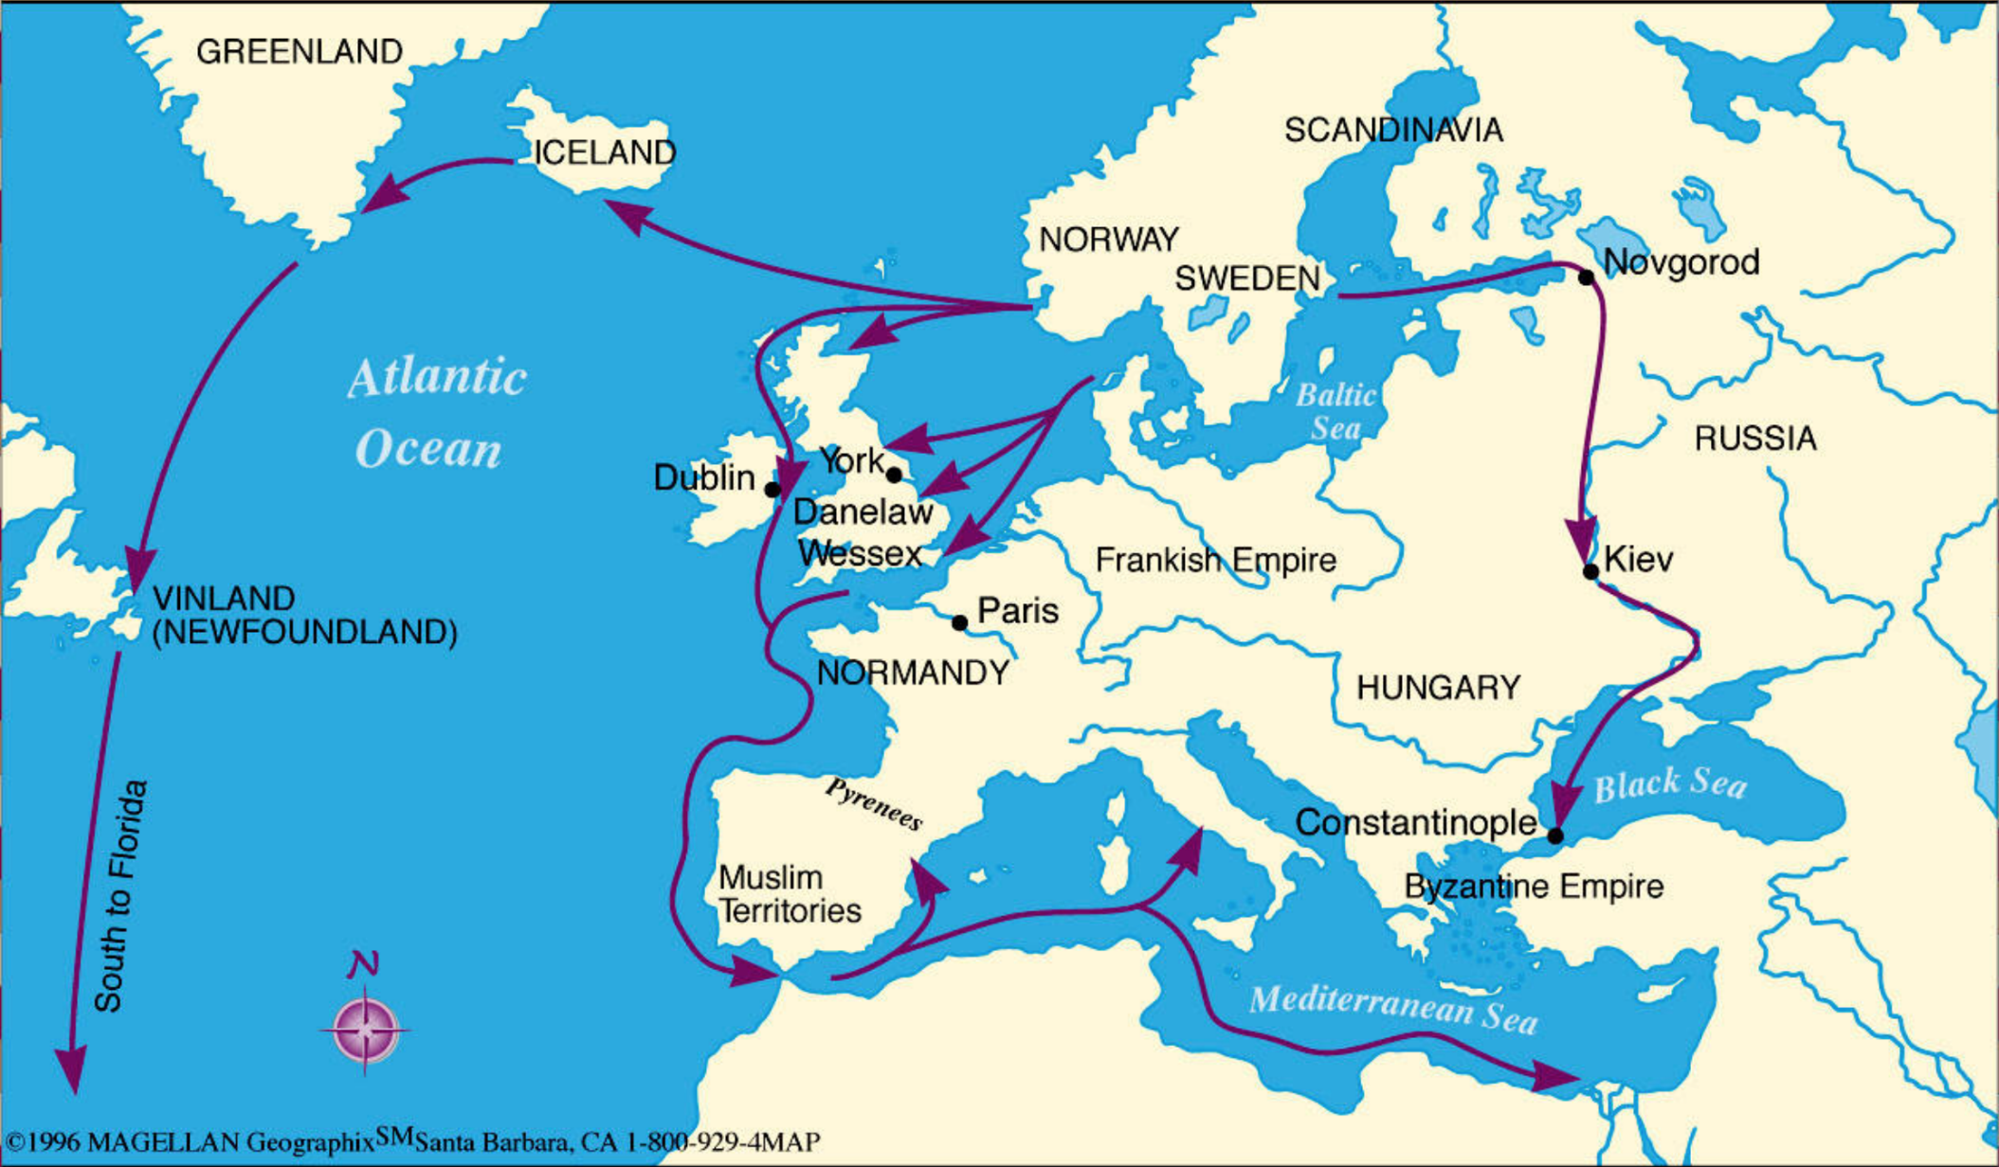
Viking exploration and conquest
Norse – North Germanic tribes

Slide 10
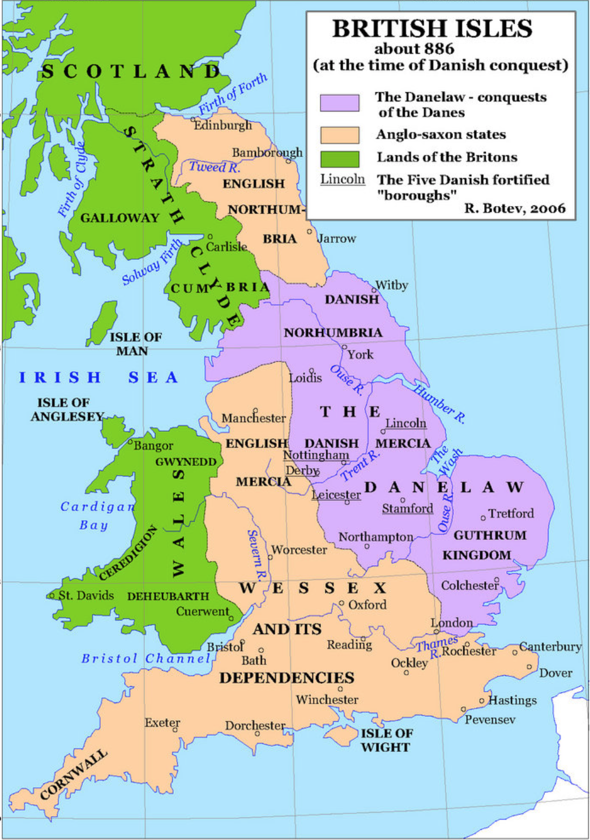
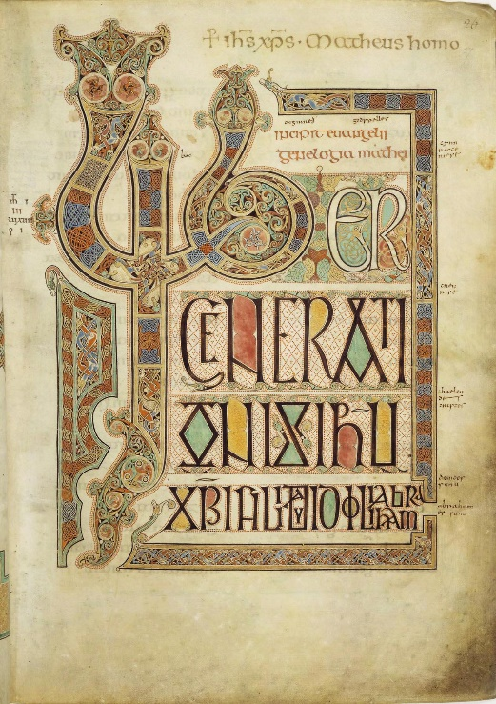
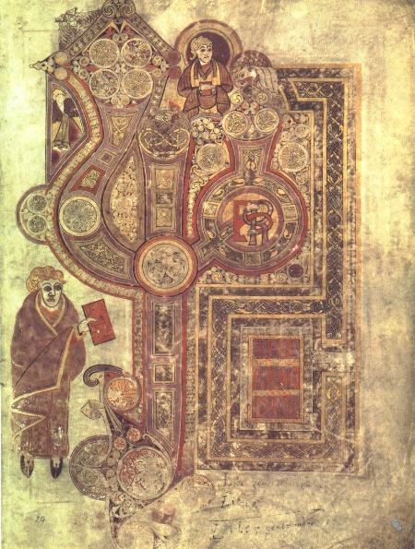
Viking invasions
Lindisfarne 793
Iona 794
Battle Eddington 878
Book of Kells
Lindisfarne Gospel

Slide 11
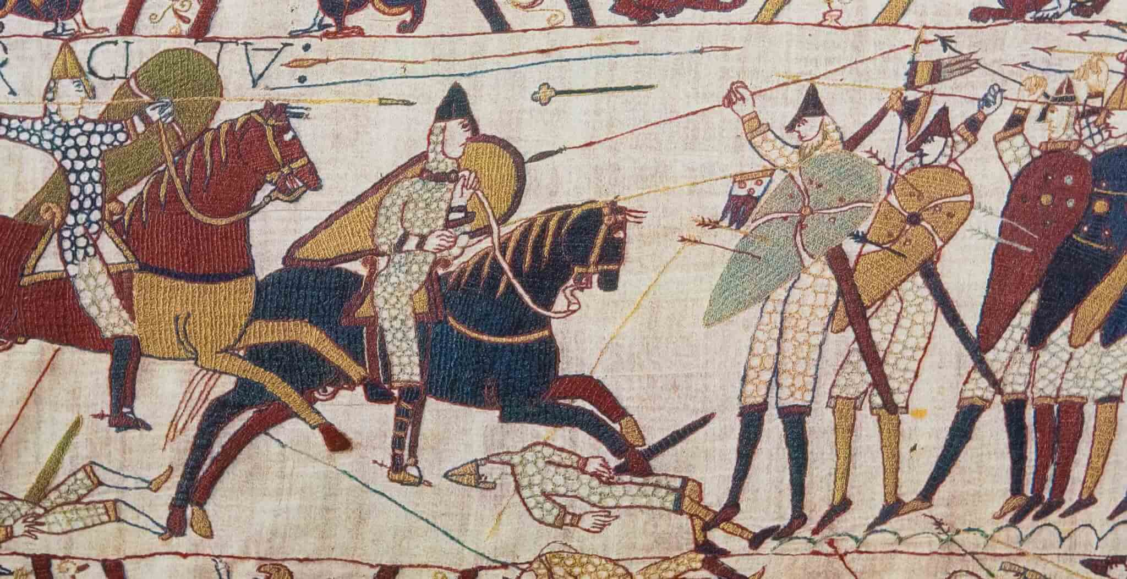
Norman conquest 1066
Death Edward the Confessor
  Died childless
  Harold, Earl of Wessex elected king by the Witan
William, Duke of Normandy
  Wanted to conquer England
  For wealth
  Papal authority
Weakness of decentralised Germanic system
  King Harold Hardrada of Norway
  Battle of Hastings
Bayeux tapestry
Notes:
William's strategy, implemented during the winter of 1069–70 (he spent Christmas 1069 in York), has been described by William E. Kapelle and some other modern scholars as an act of genocide.[16][17][a] Contemporary biographers of William considered it to be his cruellest act and a "stain upon his soul".[19] Writing about the Harrying of the North, over fifty years later, the Anglo-Norman chronicler Orderic Vitalis wrote (summarized):
The King stopped at nothing to hunt his enemies. He cut down many people and destroyed homes and land. Nowhere else had he shown such cruelty. This made a real change. To his shame, William made no effort to control his fury, punishing the innocent with the guilty. He ordered that crops and herds, tools and food be burned to ashes. More than 100,000 people perished of starvation.
I have often praised William in this book, but I can say nothing good about this brutal slaughter. God will punish him.[20]
The land was ravaged on either side of William's route north from the River Aire. His army destroyed crops and settlements and forced rebels into hiding. In the New Year of 1070 he split his army into smaller units and sent them out to burn, loot, and terrify.[21] Florence of Worcester said that from the Humber to the Tees, William's men burnt whole villages and slaughtered the inhabitants. Food stores and livestock were destroyed so that anyone surviving the initial massacre would succumb to starvation over the winter. The survivors were reduced to cannibalism.[22]Refugees from the harrying are mentioned as far away as Worcestershire in the Evesham Abbey chronicle.[23][24][25][b]
In 1086, Yorkshire and the North Riding still had large areas of waste territory. The Domesday Book entries indicate wasteas est or hoc est vast (it is wasted) for estate after estate; in all a total of 60% of all holdings were waste. It states that 66% of all villages contained wasted manors. Even the prosperous areas of the county had lost 60% of its value compared to 1066. Only 25% of the population and plough teams remained with a reported loss of 80,000 oxen and 150,000 people.[26][27]
Independent archaeological evidence supports the massive destruction and displacement of people. The archaeologist Richard Ernest Muir wrote that there was evidence for the "violent disruption [that] took place in Yorkshire in 1069–71, in the form of hoards of coins which were buried by the inhabitants."[26] B.K. Roberts in his book The Making of the English Village, suggests the reason that large numbers of villages have been laid out in regular pattern in Durham and Yorkshire, was through a restructuring at a single point in time, as opposed to natural settlement growth. He goes on to say that it is highly unlikely that such plans could have resulted from piecemeal additions and must have been necessary after the Harrying of the North. The dating is thought to be secure as it is known that Norman lords used similar regular plans in founding new towns in the 'plantation' of rural settlements in other conquered parts of the British Isles.[28][29][30]

Slide 12
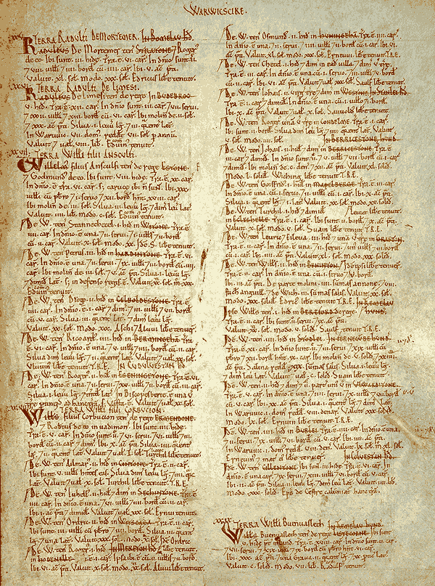
Consequences
All land became property of the Crown
Introduction of feudalism
  Aristocracy
  High levels of taxation
200 years French language
Castles and cathedrals
Militaristic expansion
Wales, Scotland, Ireland
European superpower
  English wealth + Norman organisation and militarism
Doomsday Book

Slide 13
Genocide
William's men burnt whole villages and slaughtered the inhabitants. Food stores and livestock were destroyed so that anyone surviving the initial massacre would succumb to starvation over the winter. The survivors were reduced to cannibalism. In 1086, Yorkshire and the North Riding still had large areas of waste territory. The Domesday Book entries indicate wasteas est (it is wasted) for estate after estate; in all a total of 60% of all holdings were waste. It states that 66% of all villages contained wasted manors. Even the prosperous areas of the county had lost 60% of its value compared to 1066. Only 25% of the population and plough teams remained with a reported loss of 80,000 oxen and 150,000 people. William’s men salted the land to make it infertile

Slide 14
Harrying of the North
The King stopped at nothing to hunt his enemies. He cut down many people and destroyed homes and land. Nowhere else had he shown such cruelty. This made a real change. To his shame, William made no effort to control his fury, punishing the innocent with the guilty. He ordered that crops and herds, tools and food be burned to ashes. More than 100,000 people perished of starvation. I have often praised William in this book, but I can say nothing good about this brutal slaughter. God will punish him.” Orderic Vitalis (Ango-Saxon Chronicler)

Slide 15
God’s providence to the Slavs
St Andrew
Armenian Church 300
Georgian Church 325
Bulgars
  Boris 852
  Christianity without Byzantium
Traders from Kiev with Constantinople → converts
863 Cyril & Methodius “Apostles to the Slavs” Moravia
955 Olga grandmother of Vladimir baptized
Notes:
Boris toyed with Rome. Not so glamorous though considered it seriously.
Constantinople refused
Battle between Boris and Constantinople —> Boris baptised 869. Emperor Michael was godfather.
Bodyguard and nobles rebelled —> Boris slaughtered them
=> need ecclesiastical independence
Byzantium refused
Wanted to absorb and control Bulgaria
—> approached Rome. Rome offered archbishopric as a start. Started Latinization
Byzantium then offered semi-autonomous archbishopric. Done purely out of necessity

Slide 16
Vladimir (980-1015)
Looking for a unifying religion to serve state purposes
Viking gods from House of Rurik
986 visited by missions from different religions:
  Muslims
  Roman Catholics
  Jewish Khazars.
  Greek philosopher of Orthodoxy
988 Vladimir baptized
Notes:
Looking for a uniform religion to replace animism. Religion to serve state purposes.
Tried Viking gods. Failed
986 visited by missions from different religions:
-Muslims from Bulgars of Volga (no alcohol)
-R.C. from Germany (Latin & West)
-Jewish Khazars.
->which accepted ->future cultural dev of Rus. Political & spiritual considerations
->sent reps himself to view religions
Ones sent to Constantinople said when attended service in St. Sophia's did not know whether on earth or in heaven. attracted by liturgy not theology.
emphasis on beauty, mercy & forgiveness
-988 Vladimir baptized. Completion of very long process of conversion as well as new beginning.
-Vladimir himself changed. Married Anna, sister of Emperor. new joy in life. helped poor, sick and hungry. abolished capital punishment. Russian view that law breakers treated as unfortunate victims of own & others sins. i.e. not responsible

