Slide 1
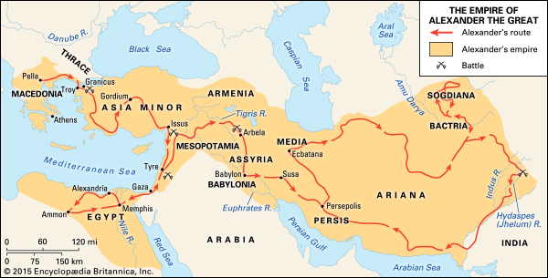
Empire of Alexander the Great (356 - 323 BC)
Spread of Greek culture = Hellenisation
Notes:
Buddhism influenced by Greek ideas and religion

Slide 2
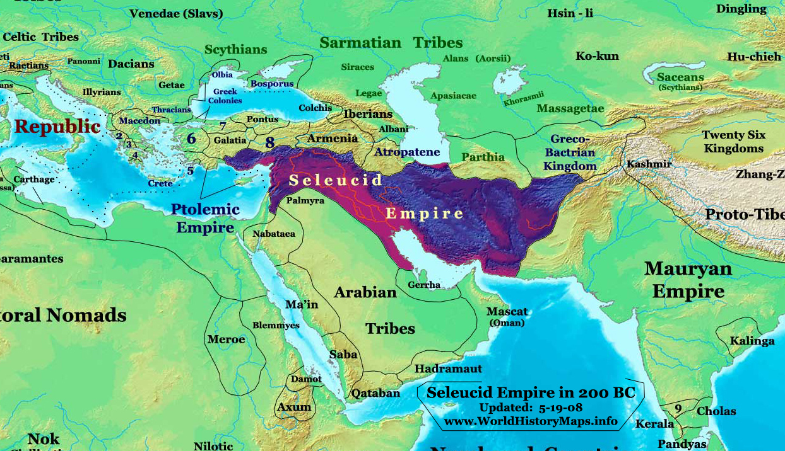
Seleucid Empire (312 to 63 BC)
198 BC Seleucids under Antiochus III pushed Ptolomys out of Judea and Samaria
Notes:
The Seleucid Empire (/sɪˈljuːsɪd/;[6] Ancient Greek: Βασιλεία τῶν Σελευκιδῶν, Basileía tōn Seleukidōn) was a Hellenistic state in Western Asia that existed from 312 BC to 63 BC. It was founded by Seleucus I Nicator following the division of the Macedonian Empire established by Alexander the Great.[7][8][9][10] After receiving Babylonia in 321 BC, Seleucus expanded his dominions to include much of Alexander's Near Eastern territories, establishing a dynasty that would rule for over two centuries. At its height, the empire spanned Anatolia, Persia, the Levant, Mesopotamia, and what are now Kuwait, Afghanistan, and parts of Turkmenistan.
The Seleucid Empire was a major center of Hellenistic culture, privileging Greek customs and language while generally tolerating the wide variety of local traditions. An urban Greek elite formed the dominant political class, and was reinforced by steady immigration from Greece.[10][11][12][13] The empire's western territories were repeatedly contested with Ptolemaic Egypt, a rival Hellenistic state. To the east, conflict with Chandragupta of the Maurya Empire in 305 BC led to the cession of vast territory west of the Indus and a political alliance.
In the early second century BC, Antiochus III the Great attempted to project Seleucid power and authority into Hellenistic Greece, but his attempts were thwarted by the nascent Roman Republic and its Greek allies; the Seleucids were forced to pay costly war reparations and relinquish territorial claims west of the Taurus Mountains, marking the gradual decline of their empire.
Mithridates I of Parthia conquered much of the remaining eastern lands of the Seleucid Empire in the mid-second century BC, while the independent Greco-Bactrian Kingdom continued to flourish in the northeast. The Seleucid kings were thereafter reduced to a rump state in Syria, until their conquest by Tigranes the Great of Armenia in 83 BC and ultimate overthrow by the Roman general Pompey in 63 BC.

Slide 3
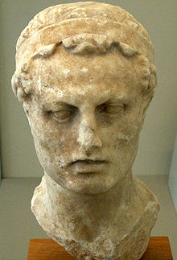
Attempted destruction of Judaism
168-164 BC
Internal disunity
  Hellenising Jews vs. conservative Jews
Antiochus defeated in Egypt 167 BC
Mass slaughter
Banned rituals
Attacked on Sabbath
Statute of Zeus erected in the Temple
Sacrificed pigs
What to do?
  Maccabean revolt
  Hanukkah
Antiochus Epiphanes IV
Notes:
The Seleucids, like the Ptolemies before them, held a mild suzerainty over Judea: they respected Jewish culture and protected Jewish institutions. This policy was drastically reversed by Antiochus IV, resulting in harsh persecutions and a revolt against his rule, the Maccabean Revolt.[13]:238 Scholars of Second Temple Judaism therefore sometimes refer to Antiochus' reign as the 'Antiochene crises' for the Jews.[14]
Coin depicting Antiochus IV, Greek inscription reads ΘΕΟΥ ΕΠΙΦΑΝΟΥΣ ΝΙΚΗΦΟΡΟΥ / ΒΑΣΙΛΕΩΣ ΑΝΤΙΟΧΟΥ (King Antiochus, God manifest, bearer of victory)
The Seleucids, like the Ptolemies before them, held a mild suzerainty over Judea: they respected Jewish culture and protected Jewish institutions. This policy was drastically reversed by Antiochus IV, resulting in harsh persecutions and a revolt against his rule, the Maccabean Revolt.[13]:238 Scholars of Second Temple Judaism therefore sometimes refer to Antiochus' reign as the 'Antiochene crises' for the Jews.[14]
Books of Maccabees[edit]
According to the authors of the Books of the Maccabees, while Antiochus was busy in Egypt, a rumor spread that he had been killed. In Judea, the deposed High Priest Jason gathered a force of 1,000 soldiers and made a surprise attack on the city of Jerusalem.[15] Menelaus, the High Priest appointed by Antiochus, was forced to flee Jerusalem during a riot. King Antiochus returned from Egypt in 168 BC, enraged by his defeat; he attacked Jerusalem and restored Menelaus, then executed many Jews.[16]
When these happenings were reported to the king, he thought that Judea was in revolt. Raging like a wild animal, he set out from Egypt and took Jerusalem by storm. He ordered his soldiers to cut down without mercy those whom they met and to slay those who took refuge in their houses. There was a massacre of young and old, a killing of women and children, a slaughter of virgins and infants. In the space of three days, eighty thousand were lost, forty thousand meeting a violent death, and the same number being sold into slavery.
— 2 Maccabees 5:11–14
Antiochus decided to side with the Hellenized Jews in order to consolidate his empire and to strengthen his hold over the region. He outlawed Jewish religious rites and traditions kept by observant Jews and ordered the worship of Zeus as the supreme god (2 Maccabees 6:1–12). This was anathema to the Jews and they refused, so Antiochus sent an army to enforce his decree. The city of Jerusalem was destroyed because of the resistance, many were slaughtered, and Antiochus established a military Greek citadel called the Acra.
The date of Antiochus's persecution of the Jews in Jerusalem is variously given as 168 or 167 BC. In their commentary on the Book of Daniel, Newsom and Breed argue for 167, although they state that good arguments can be made for either chronology.[17]

Slide 4
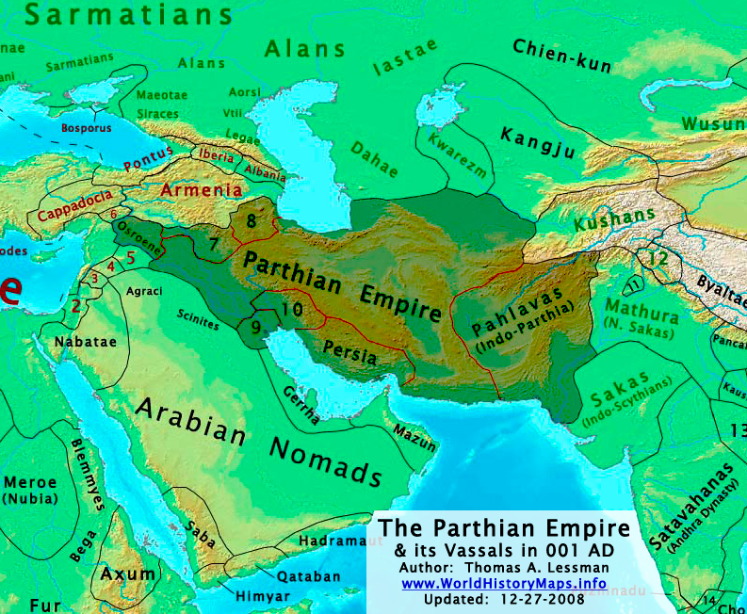
Parthian Empire
Parthian Empire
Defeated Seleucids
Culturally hetero-
geneous.
Religious pluralistic
Defeated Romans
53BC
40 BC captured the Levant
Appointed a king in Judea
37 BC Antony invaded and
installed Herod as king
Later invaded by Rome
Would have been better
for Israel to be part of
Parthian than Roman
Empire
Notes:
The Parthian Empire 247 BC – 224 AD), also known as the Arsacid Empire was a major Iranian political and cultural power in ancient Iran better known as ancient Persia. Its latter name comes from Arsaces I of Parthia who, as leader of the Parni tribe, founded it in the mid-3rd century BC when he conquered the Parthia region in Iran’s northeast, then a satrapy (province) in rebellion against the Seleucid Empire.
The Parthians largely adopted the art, architecture, religious beliefs, and royal insignia of their culturally heterogeneous empire, which encompassed Persian, Hellenistic, and regional cultures. For about the first half of its existence, the Arsacid court adopted elements of Greek culture, though it eventually saw a gradual revival of Iranian traditions.
The earliest enemies of the Parthians were the Seleucids in the west and the Scythians in the east. However, as Parthia expanded westward, they came into conflict with the Kingdom of Armenia, and eventually the late Roman Republic. Rome and Parthia competed with each other to establish the kings of Armenia as their subordinate clients. The Parthians soundly defeated Marcus Licinius Crassus at the Battle of Carrhae in 53 BC, ) Crassus' defeat at Carrhae was one of the worst military defeats of Roman history) and in 40–39 BC, Parthian forces captured the whole of the Levant, excepting Tyre, from the Romans. In Judea, the pro-Roman Jewish forces of high priest Hyrcanus II, Phasael, and Herod were defeated by the Parthians and their Jewish ally Antigonus II Mattathias (r. 40–37 BC); the latter was made king of Judea while Herod fled to his fort at Masada.[However, Mark Antony led a counterattack against Parthia and several Roman emperors invaded Mesopotamia during the Roman-Parthian Wars. The Romans captured the cities of Seleucia and Ctesiphon on multiple occasions during these conflicts, but were never able to hold onto them.
Marcus Licinius Crassus, one of the triumvirs, who was now proconsul of Syria, invaded Parthia in 53 BC in belated support of Mithridates.[81] As his army marched to Carrhae (modern Harran, southeastern Turkey), Orodes II invaded Armenia, cutting off support from Rome's ally Artavasdes II of Armenia (r. 53–34 BC). Orodes persuaded Artavasdes to a marriage alliance between the crown prince Pacorus I of Parthia (d. 38 BC) and Artavasdes' sister.[82]
Surena, with an army entirely on horseback, rode to meet Crassus.[83] Surena's 1,000 cataphracts (armed with lances) and 9,000 horse archers were outnumbered roughly four to one by Crassus' army, comprising seven Roman legions and auxiliaries including mounted Gauls and light infantry.[84] Using a baggage train of about 1,000 camels, the Parthian army provided the horse archers with a constant supply of arrows.[84] The horse archers employed the "Parthian shot" tactic: feigning retreat to draw enemy out, then turning and shooting at them when exposed. This tactic, executed with heavy composite bows on the flat plain, devastated Crassus' infantry.[85]
With some 20,000 Romans dead, approximately 10,000 captured, and roughly another 10,000 escaping west, Crassus fled into the Armenian countryside.[86] At the head of his army, Surena approached Crassus, offering a parley, which Crassus accepted. However, he was killed when one of his junior officers, suspecting a trap, attempted to stop him from riding into Surena's camp.[87] Crassus' defeat at Carrhae was one of the worst military defeats of Roman history.[88] Parthia's victory cemented its reputation as a formidable if not equal power with Rome.[89] With his camp followers, war captives, and precious Roman booty, Surena traveled some 700 km (430 mi) back to Seleucia where his victory was celebrated. However, fearing his ambitions even for the Arsacid throne, Orodes had Surena executed shortly thereafter.[88]
Roman aurei bearing the portraits of Mark Antony (left) and Octavian (right), issued in 41 BC to celebrate the establishment of the Second Triumvirate by Octavian, Antony and Marcus Lepidus in 43 BC
Emboldened by the victory over Crassus, the Parthians attempted to capture Roman-held territories in Western Asia.[90] Crown prince Pacorus I and his commander Osaces raided Syria as far as Antioch in 51 BC, but were repulsed by Gaius Cassius Longinus, who ambushed and killed Osaces.[91] The Arsacids sided with Pompey in the civil war against Julius Caesar and even sent troops to support the anti-Caesarian forces at the Battle of Philippi in 42 BC.[92]
Emboldened by the victory over Crassus, the Parthians attempted to capture Roman-held territories in Western Asia.[90] Crown prince Pacorus I and his commander Osaces raided Syria as far as Antioch in 51 BC, but were repulsed by Gaius Cassius Longinus, who ambushed and killed Osaces.[91] The Arsacids sided with Pompey in the civil war against Julius Caesar and even sent troops to support the anti-Caesarian forces at the Battle of Philippi in 42 BC.[92]
Quintus Labienus, a general loyal to Cassius and Brutus, sided with Parthia against the Second Triumvirate in 40 BC; the following year he invaded Syria alongside Pacorus I.[93] The triumvir Mark Antony was unable to lead the Roman defense against Parthia due to his departure to Italy, where he amassed his forces to confront his rival Octavian and eventually conducted negotiations with him at Brundisium.[94]
After Syria was occupied by Pacorus' army, Labienus split from the main Parthian force to invade Anatolia while Pacorus and his commander Barzapharnes invaded the Roman Levant.[93] They subdued all settlements along the Mediterranean coast as far south as Ptolemais (modern Acre, Israel), with the lone exception of Tyre.[95] In Judea, the pro-Roman Jewish forces of high priest Hyrcanus II, Phasael, and Herod were defeated by the Parthians and their Jewish ally Antigonus II Mattathias (r. 40–37 BC); the latter was made king of Judea while Herod fled to his fort at Masada.[93]
Despite these successes, the Parthians were soon driven out of the Levant by a Roman counteroffensive. Publius Ventidius Bassus, an officer under Mark Antony, defeated and then executed Labienus at the Battle of the Cilician Gates (in modern Mersin Province, Turkey) in 39 BC.[96] Shortly afterward, a Parthian force in Syria led by general Pharnapates was defeated by Ventidius at the Battle of Amanus Pass.[96]
As a result, Pacorus I temporarily withdrew from Syria. When he returned in the spring of 38 BC, he faced Ventidius at the Battle of Mount Gindarus, northeast of Antioch. Pacorus was killed during the battle, and his forces retreated across the Euphrates. His death spurred a succession crisis in which Orodes II chose Phraates IV (r. c. 38–2 BC) as his new heir.[97]
"
Upon assuming the throne, Phraates IV eliminated rival claimants by killing and exiling his own brothers.[98] One of them, Monaeses, fled to Antony and convinced him to invade Parthia.[99] Antony defeated Parthia's Judaean ally Antigonus in 37 BC, installing Herod as a client king in his place.
The following year, when Antony marched to Theodosiopolis, Artavasdes II of Armenia once again switched alliances by sending Antony additional troops. Antony invaded Media Atropatene (modern Iranian Azerbaijan), then ruled by Parthia's ally Artavasdes I of Media Atropatene, with the intention of seizing the capital Praaspa, the location of which is now unknown. However, Phraates IV ambushed Antony's rear detachment, destroying a giant battering ram meant for the siege of Praaspa; after this, Artavasdes II abandoned Antony's forces.[100]

Slide 5
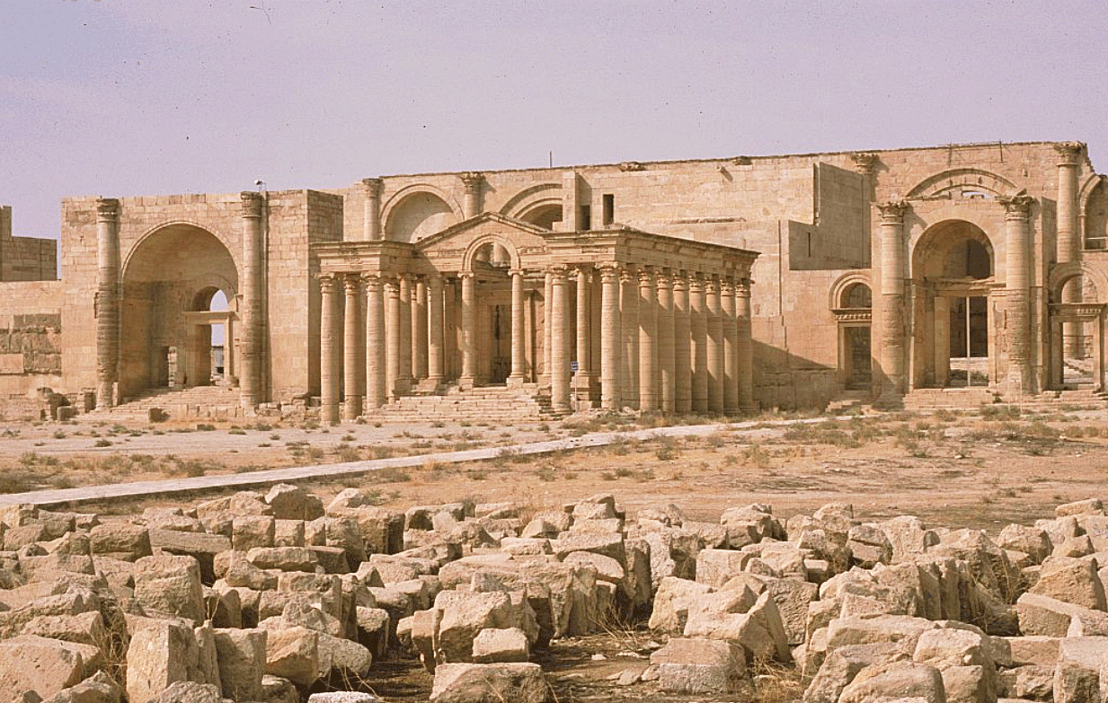
Hatra Temple

Slide 6
Will the messiah be born in a Muslim country?
Foundation for the Messiah
  Foundation of Faith
    Separation from Satan
    Time period
  Foundation of Substance
    Cain and Abel unity
    Internal and external
    Faith and reason
    Science and religion
    Hellenism and Hebraism
Only by Cain-type Hellenism submitting to Abel-type Hebraism could Satan be separated from the prevailing spirit of the age. Then the foundation of substance necessary for receiving Christ at the Second Advent could be established worldwide. EDP, 350

Slide 7
Following the death of Muhammad
Disagreement about who should inherit authority and leadership
  Socio-political – most capable - Abu Bakr
  Spiritual – family – Ali (husband of Fatima)
Shia believed ruler should be from family of the Prophet. Mostly in Persia/Iran & Iraq
Sunni believed ruler could be any qualified person. Arabs and most Muslim countries
Some differences in practice and belief
Notes:
The division between Sunnis and Shi'as is the largest and oldest in the history of Islam.
They both agree on the fundamentals of Islam and share the same Holy Book (The Qur'an), but there are differences mostly derived from their different historical experiences, political and social developments, as well as ethnic composition.
These differences originate from the question of who would succeed the Prophet Muhammad as leader of the emerging Muslim community after his death. To understand them, we need to know a bit about the Prophet's life and political and spiritual legacy.
The Prophet Muhammad
When the Prophet died in the early 7th century he left not only the religion of Islam but also a community of about one hundred thousand Muslims organised as an Islamic state on the Arabian Peninsula. It was the question of who should succeed the Prophet and lead the fledgling Islamic state that created the divide.
The larger group of Muslims chose Abu Bakr, a close Companion of the Prophet, as the Caliph (politico-social leader) and he was accepted as such by much of the community which saw the succession in political and not spiritual terms. However another smaller group, which also included some of the senior Companions, believed that the Prophet's son-in-law (his wife was Fatima) and cousin, Ali, should be Caliph. They understood that the Prophet had appointed him as the sole interpreter of his legacy, in both political and spiritual terms. In the end Abu Bakr was appointed First Caliph.
Leadership claims
Both Shi'as and Sunnis have good evidence to support their understanding of the succession. Sunnis argue that the Prophet chose Abu Bakr to lead the congregational prayers as he lay on his deathbed, thus suggesting that the Prophet was naming Abu Bakr as the next leader. The Shi'as' evidence is that Muhammad stood up in front of his Companions on the way back from his last Hajj, and proclaimed Ali the spiritual guide and master of all believers. Shi'a reports say he took Ali's hand and said that anyone who followed Muhammad should follow Ali.
Muslims who believe that Abu Bakr should have been the Prophet's successor have come to be known as Sunni Muslims. Those who believe Ali should have been the Prophet's successor are now known as Shi'a Muslims. It was only later that these terms came into use. Sunni means 'one who follows the Sunnah' (what the Prophet said, did, agreed to or condemned). Shi'a is a contraction of the phrase 'Shiat Ali', meaning 'partisans of Ali'.
The use of the word "successor" should not be confused to mean that those leaders that came after the Prophet Muhammad were also prophets - both Shi'a and Sunni agree that Muhammad was the final prophet.
Top
The division
Seeds of division
Ali did not initially pledge allegiance to Abu Bakr. A few months later, and according to both Sunni and Shi'a belief, Ali changed his mind and accepted Abu Bakr, in order to safeguard the cohesion of the new Islamic State.
The Second Caliph, Umar ibn al-Khattab, (previously leading opponent of Muhammad) was appointed by Abu Bakr on his death, followed by the third Caliph, Uthman ibn 'Affan, who was chosen from six candidates nominated by Umar.
Ali was eventually chosen as the fourth Caliph following the murder of Uthman. He moved the capital of the Islamic state from Medina to Kufa in Iraq. However, his Caliphate was opposed by Aisha, the favoured wife of the Prophet and daughter of Abu Bakr, who accused Ali of being lax in bringing Uthman's killers to justice. In 656 CE this dispute led to the Battle of the Camel in Basra in Southern Iraq, where Aisha was defeated. Aisha later apologised to Ali but the clash had already created a divide in the community.
Widening of the divide
Islam's dominion had already spread to Syria by the time of Ali's caliphate. The governor of Damascus, Mu'awiya, angry with Ali for not bringing the killers of his kinsman Uthman to justice, challenged Ali for the caliphate. The famous Battle of Siffin in 657 demonstrates the religious fervour of the time when Mu'awiya's soldiers flagged the ends of their spears with verses from the Qur'an.
Ali and his supporters felt morally unable to fight their Muslim brothers and the Battle of Siffin proved indecisive. Ali and Mu'awiya agreed to settle the dispute with outside arbitrators. However this solution of human arbitration was unacceptable to a group of Ali's followers who used the slogan "Rule belongs only to Allah", justified by the Qur'anic verse:
The decision is for Allah only. He telleth the truth and He is the Best of Deciders
Qur'an
This group, known as the Kharijites, formed their own sect that opposed all contenders for the caliphate. In 661 the Kharijites killed Ali while he was praying in the mosque of Kufa, Iraq. In the years that followed, the Kharijites were defeated in a series of uprisings. Around 500,000 descendents of the Kharijites survive to this day in North Africa, Oman and Zanzibar as a sub-sect of Islam known as the Ibadiyah.
Shortly after the death of Ali, Mu'awiya, assumed the Caliphate of the Islamic state, moving the capital from Kufa to Damascus. Unlike his predecessors who maintained a high level of egalitarianism in the Islamic state, Mu'awiya's Caliphate was monarchical. This set the tone for the fledgling Ummayad dynasty (c.670-750 CE) and in 680 on the death of Mu'awiya, the Caliphate succeeded to his son Yazid.
by the people of Kufa in Iraq to become their leader. Hussein set off for Kufa from his home in Medina with his followers and family, but was met by Yazid's forces in Karbala before reaching his destination.
Despite being hopelessly outnumbered, Hussein and his small number of companions refused to pay allegiance to Yazid and were killed in the ensuing battle. Hussein is said to have fought heroically and to have sacrificed his life for the survival of Shi'a Islam.
The Battle of Karbala is one of the most significant events in Shi'a history, from which Shi'a Islam draws its strong theme of martyrdom. It is central to Shi'a identity even today and is commemorated every year on the Day of Ashura. Millions of pilgrims visit the Imam Hussein mosque and shrine in Karbala and many Shi'a communities participate in symbolic acts of self- flagellation.

Slide 8
One empire after another
Umayyad dynasty (661-750) Sunni, Arab, capital Damascus. Later Spain
Abbasid dynasty (750-1258) Sunni/Shia, Arab/Persian, capital Bagdad. Power fractured amongst regional dynasties
Ottoman Empire (1299-1922)
Safavid dynasty (1501-1722) based in Persia
Notes:
The Umayyad Caliphate (Arabic: الخلافة الأموية‎, trans. Al-Ḫilāfat al-ʾumawiyya) was the second of the four major Islamic caliphates established after the death of Muhammad. This caliphate was centered on the Umayyad dynasty (Arabic: الأمويون‎, al-ʾUmawiyyūn, or بنو أمية, Banū ʾUmayya, "Sons of Umayya"), hailing from Mecca. The Umayyad family had first come to power under the third caliph, Uthman ibn Affan (r. 644–656), but the Umayyad regime was founded by Muawiya ibn Abi Sufyan, long-time governor of Syria, after the end of the First Muslim Civil War in 661 CE/41 AH. Syria remained the Umayyads' main power base thereafter, and Damascus was their capital. The Umayyads continued the Muslim conquests, incorporating the Caucasus, Transoxiana, Sindh, the Maghreb and the Iberian Peninsula (Al-Andalus) into the Muslim world. At its greatest extent, the Umayyad Caliphate covered 5.17 million square miles (13,400,000 km²), making it the largest empire the world had yet seen, and the fifth largest ever to exist.^{[7]}

Slide 9
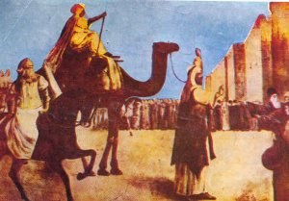
Conquest of the Holy Land
Caliph Umar conquered Palestine & Jerusalem from Byzantines in 638
Ease of expansion due to weakness of Byzantium due to the plague of Justinian (541-549)
Al-Aksa Mosque built 674
Dome of the Rock built in 687
Jewish and Christian pilgrims allowed to freely visit holy sites
Caliph Umar enters Jerusalem
Notes:
Umar, also spelled Omar (Arabic: عمر بن الخطاب, translit.: `Umar ibn Al-Khattāb, Umar Son of Al-Khattab, born 579 CE – died 3 November 644 CE), was one of the most powerful and influential Muslim caliphs (guardians) in history.[3] He was a Sahabah or companion of the Islamic prophet Muhammad. He succeeded Abu Bakr (632–634) as the second Rashid of the Rashidun Caliphate on 23 August 634. He was an expert Islamic jurist and is best known for his pious and just nature, which earned him the title Al-Faruq ("the one who distinguishes between right and wrong"). He is sometimes referred to as Umar I by historians of Islam, since a later Umayyad caliph, Umar II, also bore that name.
Under Umar, the Rashidun Caliphate expanded at an unprecedented rate, ruling the whole Sasanian Empire and more than two thirds of the Byzantine Empire.^{[4]} His attacks against the Sassanid Persian Empire resulted in the conquest of Persia in fewer than two years.^{[5]} It was Umar, according to Jewish tradition, who set aside the Christian ban on Jews and allowed them into Jerusalem and to worship.^{[6]}
The Plague of Justinian or Justinianic Plague (541–549 AD) was the beginning of the first plague pandemic, the first Old World pandemic of plague, the contagious disease caused by the bacterium Yersinia pestis. The disease afflicted the entire Mediterranean Basin, Europe, and the Near East, severely affecting the Sasanian Empire and the Roman Empire and especially its capital, Constantinople.[1][2][3] The plague is named for the Roman emperor in Constantinople, Justinian I (r. 527–565) who, according to his court historian Procopius, contracted the disease and recovered in 542, at the height of the epidemic which killed about a fifth of the population in the imperial capital.[1][2] The contagion arrived in Roman Egypt in 541, spread around the Mediterranean Sea until 544, and persisted in Northern Europe and the Arabian Peninsula, until 549.[1]
In 2013, researchers confirmed earlier speculation that the cause of the Plague of Justinian was Yersinia pestis, the same bacterium responsible for the Black Death (1347–1351).[4][5] The latter was much shorter, but still killed an estimated one-third to one-half of Europeans. Ancient and modern Yersinia pestis strains closely related to the ancestor of the Justinian plague strain have been found in Tian Shan, a system of mountain ranges on the borders of Kyrgyzstan, Kazakhstan, and China, suggesting that the Justinian plague originated in or near that region.[6][7]
The Plague of Justinian is the first and the best known outbreak of the first plague pandemic, which continued to recur until the middle of the 8th century.[1][8] Some historians believe the first plague pandemic was one of the deadliest pandemics in history, resulting in the deaths of an estimated 15–100 million people during two centuries of recurrence, a death toll equivalent to 25–60% of Europe's population at the time of the first outbreak

Slide 10
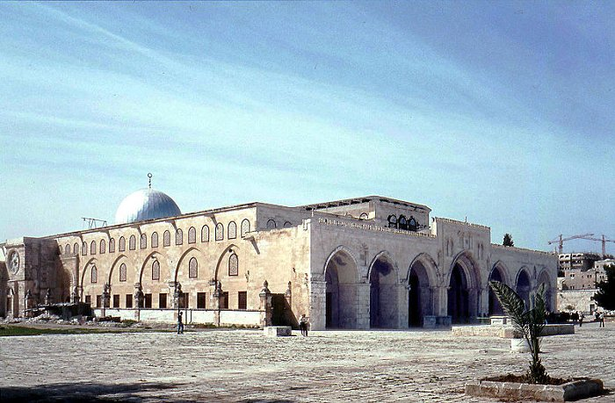
Al-Aksa Mosque

Slide 11
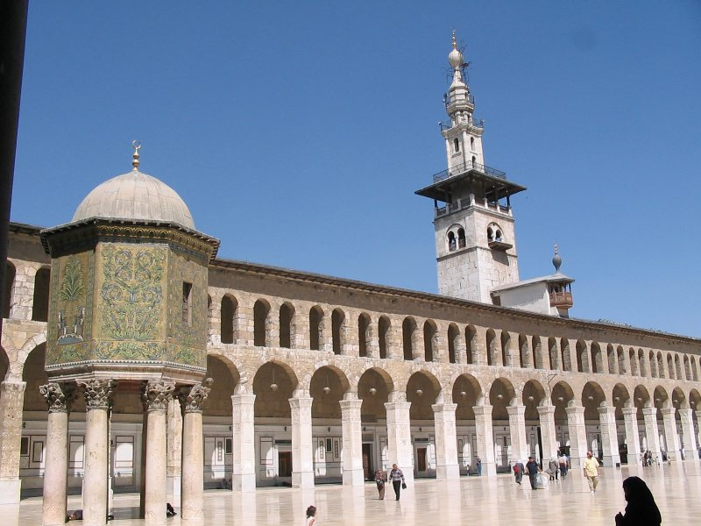
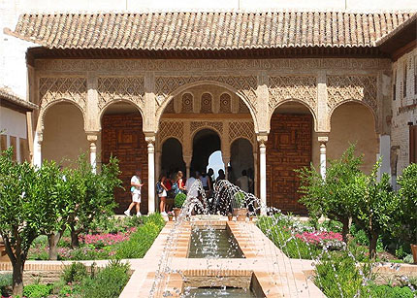
Umayyad dynasty (661-750)
Sunni Arab
Capital Damascus
Huge expansion of Islamic lands
Continued in Spain until 1031

Slide 12
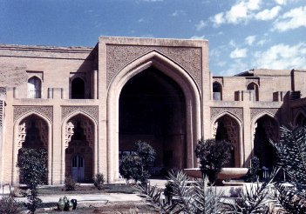
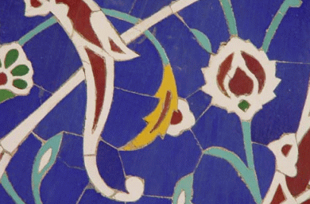
Abbasid dynasty (750-1258)
Sunni/Shia
Arab/Persian
Capital Bagdad
Power fractured amongst regional dynasties
Dynasty ended with the sack of Bagdad by the Mongols
Notes:
Reaction against Arab domination. Appealed to non Arab Muslim converts. Rule by Persian bureaucracy replaced Arab aristocracy. Weakened by decentralising power.
The Abbasid Caliphate (Arabic: الخلافة العباسية‎ / ALA-LC: al-Khilāfah al-‘Abbāsīyyah), was the third of the Islamic caliphates to succeed the Islamic prophet Muhammad. The Abbasid dynasty descended from Muhammad's youngest uncle, Abbas ibn Abd al-Muttalib (566–653 CE). They ruled as caliphs, for most of their period from their capital in Baghdad in modern-day Iraq, after taking over authority of the Muslim empire from the Umayyads in 750 CE (132 AH).
The Abbasid caliphate first centered their government in Kufa, but in 762 the caliph Al-Mansur founded the city of Baghdad, north of the Persian capital city of Ctesiphon. The choice of a capital so close to Persia proper reflects a growing reliance on Persian bureaucrats, most notably of the Barmakid family, to govern the territories conquered by Arab Muslims, as well as an increasing inclusion of non-Arab Muslims in the ummah. Despite this cooperation, the Abbasids of the 8th century were forced to cede authority over Al-Andalus and Maghreb to the Umayyads, Morocco to the Idrisid dynasty, Ifriqiya to the Aghlabids, and Egypt to the Shi'ite Caliphate of the Fatimids. The political power of the caliphs largely ended with the rise of the Buyids and the Seljuq Turks.
Although Abbasid leadership over the vast Islamic empire was gradually reduced to a ceremonial religious function, the dynasty retained control over its Mesopotamian demesne. The capital city of Baghdad became a center of science, culture, philosophy and invention during the Golden Age of Islam. This period of cultural fruition ended in 1258 with the sack of Baghdad by the Mongols under Hulagu Khan. The Abbasid line of rulers, and Muslim culture in general, recentered themselves in the Mamluk capital of Cairo in 1261. Though lacking in political power, the dynasty continued to claim authority in religious matters until after the Ottoman conquest of Egypt (1517).^{[1]}

Slide 13
Golden age of Islam
Encountered and conquered advanced civilisations
Desired to assimilate their knowledge
  Greek, Christian, Indian, Chinese
Founding of city of Bagdad – 762
  World centre of education and culture 500 years
Centre of translation of Greek and other texts
  Nestorian/Assyrian Christians
Building of libraries (House of Wisdom) schools, hospitals, museums and mosques
Book publishing
Notes:
In about 762 CE, the Abbasid dynasty took over the rule of the vast Muslim world and moved the capital to the newly-founded city of Baghdad. Over the next five centuries, the city would become the world's center of education and culture. This period of glory has become known as the "Golden Age" of Islamic civilization, a time when scholars of the Muslim world made important contributions in both the sciences and humanities: medicine, mathematics, astronomy, chemistry, literature, and more. Under Abbasid rule, Baghdad became a city of museums, hospitals, libraries, and mosques.
Most of the famous Muslim scholars from the 9th to 13th centuries had their educational roots in Baghdad. One of the most famous centers of learning was Bayt al-Hikmah (the House of Wisdom), which attracted scholars from all over the world, from many cultures and religions. Here, teachers and students worked together to translate Greek manuscripts, preserving them for all time. They studied the works of Aristotle, Plato, Hippocrates, Euclid, and Pythagoras. The House of Wisdom was home to, among others, the most famous mathematician of the time: Al-Khawarizmi, the "father" of algebra (this branch of mathematics is actually named after his book "Kitab al-Jabr").
While Europe festered in the Dark Ages, Baghdad was thus at the heart of a vibrant and diverse civilization. It was known as the world's richest and most intellectual city of the time and was second in size only to Constantinople.
Christians, especially the adherents of the Church of the East (Nestorians), contributed to Islamic civilization during the reign of the Ummayads and the Abbasids by translating works of Greek philosophers and ancient science to Syriac and afterwards to Arabic.[21][22] They also excelled in many fields, in particular philosophy, science (such as Hunayn ibn Ishaq,[23][24] Yusuf Al-Khuri,[25] Al Himsi,[26] Qusta ibn Luqa,[27] Masawaiyh,[28][29] Patriarch Eutychius,[30] and Jabril ibn Bukhtishu[31]) and theology. For a long period of time the personal physicians of the Abbasid Caliphs were often Assyrian Christians.[32][33] Among the most prominent Christian families to serve as physicians to the caliphs were the Bukhtishu dynasty.[34][35]
Throughout the 4th to 7th centuries, Christian scholarly work in the Greek and Syriac languages was either newly translated or had been preserved since the Hellenistic period. Among the prominent centers of learning and transmission of classical wisdom were Christian colleges such as the School of Nisibis[36] and the School of Edessa,[37] the pagan University of Harran[38][39] and the renowned hospital and medical academy of Jundishapur, which was the intellectual, theological and scientific center of the Church of the East.[40][41][42] The House of Wisdom was founded in Baghdad in 825, modelled after the Academy of Gondishapur. It was led by Christian physician Hunayn ibn Ishaq, with the support of Byzantine medicine. Many of the most important philosophical and scientific works of the ancient world were translated, including the work of Galen, Hippocrates, Plato, Aristotle, Ptolemy and Archimedes. Many scholars of the House of Wisdom were of Christian background.[43]
Among the various countries and cultures conquered through successive Islamic conquests, a remarkable number of scientists originated from Persia, who contributed immensely to the scientific flourishing of the Islamic Golden Age. According to Bernard Lewis: "Culturally, politically, and most remarkable of all even religiously, the Persian contribution to this new Islamic civilization is of immense importance. The work of Iranians can be seen in every field of cultural endeavor, including Arabic poetry, to which poets of Iranian origin composing their poems in Arabic made a very significant contribution."[44] Science, medicine, philosophy and technology in the newly Islamized Iranian society was influenced by and based on the scientific model of the major pre-Islamic Iranian universities in the Sassanian Empire. During this period hundreds of scholars and scientists vastly contributed to technology, science and medicine, later influencing the rise of European science during the Renaissance.[45]

Slide 14

Muslim contributions
Learned, inherited and built upon knowledge from Greece and India
Science
  Chemistry
    Al-Chemy
  Physics
    Lens
  Biology
    Horticulture
    Botany
Mathematics
  Algebra
  Numbers
  Trigonometry
Arabic numerals
Notes:
The Arabic numerals are the ten digits (0, 1, 2, 3, 4, 5, 6, 7, 8, 9). They are descended from the Hindu-Arabic numeral system developed by Indian mathematicians, by which a sequence of digits such as "975" is read as a whole number. The Indian numerals were adopted by the Persian mathematicians in India, and passed on to the Arabs further west. The numerals were modified in shape as they were passed along, and developed their European shapes by the time they reached North Africa. From there they were transmitted to Europe in the Middle Ages. The use of Arabic numerals spread around the world through European trade, books and colonialism. Today they are the most common symbolic representation of numbers in the world.
The reason that they are more commonly known as "Arabic numerals" in Europe and the Americas is that they were introduced to Europe in the tenth century from Arabs of North Africa. Arabs, on the other hand, call the system "Hindu numerals” referring to their origin in India.
The legacy of Muslim chemists includes the discovery of alcohol, nitric and sulphuric acids, silver nitrate and potassium, the determination of the weight of many bodies, the mastery of techniques of sublimation, crystallization and distillation. Muslim chemistry also took many industrial uses including: tinctures and their applications in tanning and textiles; distillation of plants, of flowers, the making of perfumes and therapeutic pharmacy. Translated into Latin 12C
Physics in medieval Islam included experimental physics, mathematical physics and theoretical physics. The fields of physics that were studied by Muslim scientists during this time also included optics and magnetism (which are both now part of electromagnetism), mechanics (including statics, dynamics, kinematics and motion), and astrophysics (see Islamic astronomy). These studies flourished in the Islamic world during the Islamic Golden Age, variously dated from the 8th century to the 16th century.

Slide 15

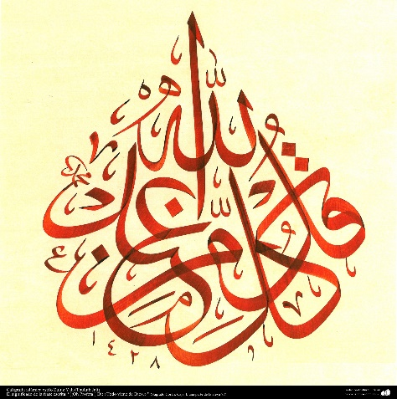
More contributions
Medicine
  Standard textbooks
Historiography
Geography
Commerce
Libraries
University
Art
Architecture
Inventions
  Telescope, pendulum, watch
Islamic tile
Notes:
University of Al-Karaouine, Fez. Morroco

Slide 16
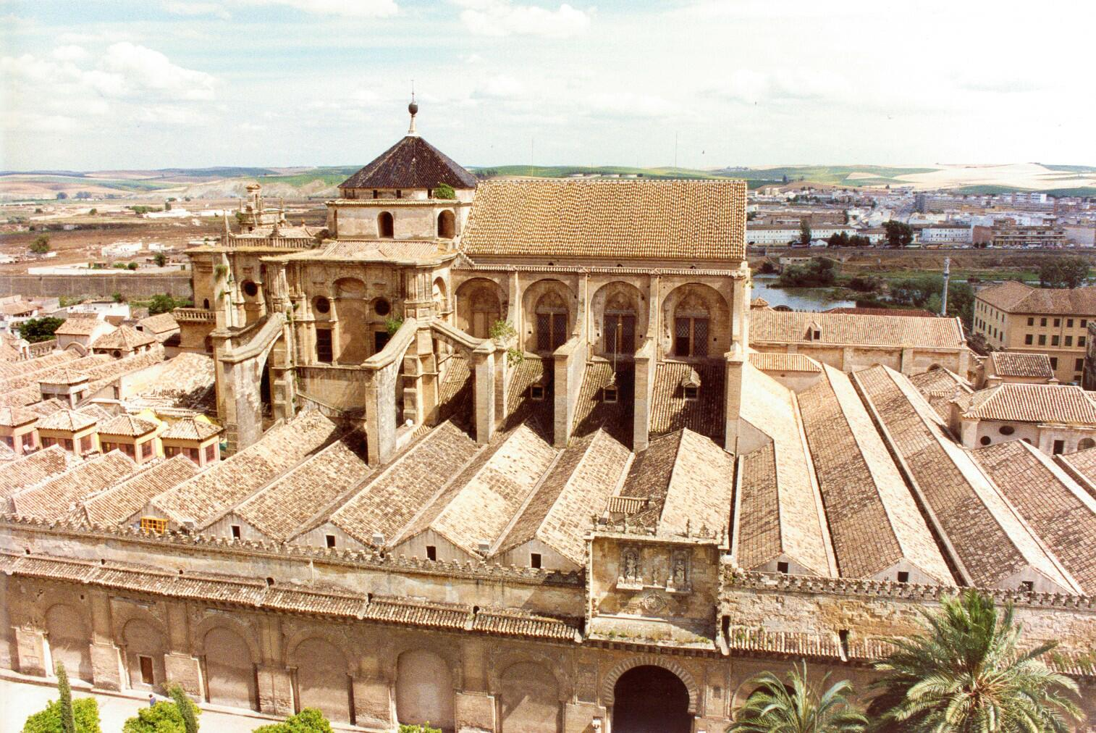
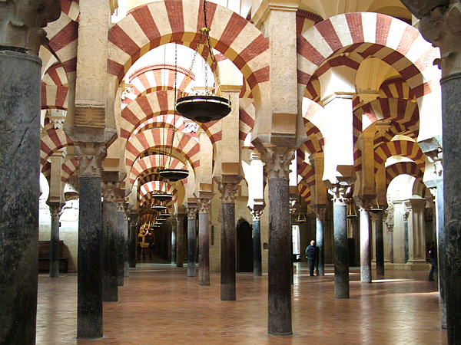
Islamic Spain - Al-Andalus
711-1492
Caliphate of Cordoba 929-1031
  Almoravids, Almohad
Golden age of culture, science, art, architecture, philosophy, libraries, medicine, astronomy
Relatively tolerant of Jews and Christians
  Dhimmitude
Great Mosque, Cordoba
Notes:
The traditional story is that in the year 711, an oppressed Christian chief, Julian, went to Musa ibn Nusair, the governor of North Africa, with a plea for help against the tyrannical Visigoth ruler of Spain, Roderick.
Musa responded by sending the young general Tariq bin Ziyad with an army of 7000 troops. The name Gibraltar is derived from Jabal At-Tariq which is Arabic for 'Rock of Tariq' named after the place where the Muslim army landed.
The story of the appeal for help is not universally accepted. There is no doubt that Tariq invaded Spain, but the reason for it may have more to do with the Muslim drive to enlarge their territory.
The Muslim army defeated the Visigoth army easily, and Roderick was killed in battle.
After the first victory, the Muslims conquered most of Spain and Portugal with little difficulty, and in fact with little opposition. By 720 Spain was largely under Muslim (or Moorish, as it was called) control.
Reasons
One reason for the rapid Muslim success was the generous surrender terms that they offered the people, which contrasted with the harsh conditions imposed by the previous Visigoth rulers.
The ruling Islamic forces were made up of different nationalities, and many of the forces were converts with uncertain motivation, so the establishment of a coherent Muslim state was not easy.
Life for non-Muslims in Islamic Spain
Jews and Christians did retain some freedom under Muslim rule, providing they obeyed certain rules. Although these rules would now be considered completely unacceptable, they were not much of a burden by the standards of the time, and in many ways the non-Muslims of Islamic Spain (at least before 1050) were treated better than conquered peoples might have expected during that period of history.
they were not forced to live in ghettoes or other special locations
they were not slaves
they were not prevented from following their faith
they were not forced to convert or die under Muslim rule
they were not banned from any particular ways of earning a living; they often took on jobs shunned by Muslims;
these included unpleasant work such as tanning and butchery
but also pleasant jobs such as banking and dealing in gold and silver
they could work in the civil service of the Islamic rulers
Jews and Christians were able to contribute to society and culture
The alternative view to the Golden Age of Tolerance is that Jews and Christians were severely restricted in Muslim Spain, by being forced to live in a state of 'dhimmitude'. (A dhimmi is a non-Muslim living in an Islamic state who is not a slave, but does not have the same rights as a Muslim living in the same state.)
In Islamic Spain, Jews and Christians were tolerated if they:
acknowledged Islamic superiority
accepted Islamic power
paid a tax called Jizya to the Muslim rulers and sometimes paid higher rates of other taxes
avoided blasphemy
did not try to convert Muslims
complied with the rules laid down by the authorities. These included:
restrictions on clothing and the need to wear a special badge
restrictions on building synagogues and churches
not allowed to carry weapons
could not receive an inheritance from a Muslim
could not bequeath anything to a Muslim
could not own a Muslim slave
a dhimmi man could not marry a Muslim woman (but the reverse was acceptable)
a dhimmi could not give evidence in an Islamic court
dhimmis would get lower compensation than Muslims for the same injury
At times there were restrictions on practicing one's faith too obviously. Bell-ringing or chanting too loudly were frowned on and public processions were restricted.
Many Christians in Spain assimilated parts of the Muslim culture. Some learned Arabic, some adopted the same clothes as their rulers (some Christian women even started wearing the veil); some took Arabic names. Christians who did this were known as Mozarabs.
The Muslim rulers didn't give their non-Muslim subjects equal status; as Bat Ye'or has stated, the non-Muslims came definitely at the bottom of society.

Slide 17
Status of non-Muslims: dhimmitude
Acknowledge Islamic superiority and accept Islamic power
Pay a tax called Jizya to the Muslim rulers
Avoided blasphemy
Do not try to convert Muslims
Follow with the rules
  Restrictions on clothing and wearing a special badge
  No new synagogues or churches
  A dhimmi man could not marry a Muslim woman (but the reverse was acceptable)
  A dhimmi could not give evidence in an Islamic court

Slide 18
But . . .
They were not forced to live in ghettoes
They were not slaves
They were not prevented from following their faith
They were not forced to convert or die
They were not banned from any particular ways of earning a living; they often took on jobs shunned by Muslims;
  These included unpleasant work such as tanning and butchery
  But also pleasant jobs such as banking and dealing in gold and silver

Slide 19
‘Class’ society
Society was sharply divided along ethnic and religious lines, with the Arab tribes at the top of the hierarchy, followed by the Berbers who were never recognized as equals, despite their Islamization; lower in the scale came converts and, at the very bottom, the dhimmi Christians and Jews. Bat Ye'or, Islam and Dhimmitude, 2002
In contrast to Christian anti-Semitism, the Muslim attitude toward non-Muslims is one not of hate or fear or envy but simply of contempt.
Bernard Lewis, The Jews of Islam, 1984

Slide 20
How did Islamic thought develop?
Al-Farabi (870-950) Turkic/Persian – “2nd Teacher”
  Bagdad. Preserved Greek texts
  Revelation and philosophy 2 ways to same truth
  Synthesis of Sufism and philosophy
  Contributed to logic, mathematics, music, philosophy, psychology, and education.
Avicenna (980-1037) Uzbekistan
  Physician (Father of early modern medicine) philosopher, scientist, musician, psychologist, sociologist, logic, theology, maths, physics, poetry
  Synthesised Islam and Aristotle
Notes:
Translated Greek classics into Arabic in Baghdad. Distributed throughout Islamic Empire.
Al-darabi. Based in Bagdad. polymath and one of the greatest scientists and philosophers of the Islamic world in his time. He was also a cosmologist, logician, musician, psychologist and sociologist. known to the Arabs as the 'Second Master' (after Aristotle) 'Father of Islamic Neoplatonism and while he was also saturated with Aristotelianism and certainly deploys the vocabulary of Aristotle, it is this Neoplatonic dimension which dominates much of his corpus. This is apparent in his most famous work, al-Madina al-fadila (The Virtuous City) which, far from being a copy or a clone of Plato's Republic, is imbued with the Neoplatonic concept of God.
Avicenna was a Persian[4][5][6] polymath who is regarded as one of the most significant physicians, astronomers, thinkers and writers of the Islamic Golden Age,[7] and the father of early modern medicine.[8][9][10] Sajjad H. Rizvi has called Avicenna "arguably the most influential philosopher of the pre-modern era".[11] He was a Muslim Peripatetic philosopher influenced by Aristotelian philosophy. Of the 450 works he is believed to have written, around 240 have survived, including 150 on philosophy and 40 on medicine.[12]
His most famous works are The Book of Healing, a philosophical and scientific encyclopedia, and The Canon of Medicine, a medical encyclopedia[13][14][15] which became a standard medical text at many medieval universities[16] and remained in use as late as 1650.[17]
Besides philosophy and medicine, Avicenna's corpus includes writings on astronomy, alchemy, geography and geology, psychology, Islamic theology, logic, mathematics, physics and works of poetry.[18]7 learnt Koran. Medical texts standard works in Europe. Prayed to understand Aristotle.

Slide 21
Turning away . . .
Al-Ghazali (1058-1111) Persia
  Sunni philosopher, theologian, jurists, logician and mystics – called ”Proof of Islam”
  Systematised Sufism
  Criticised Avicenna and previous Islamic philosophers in The Incoherence of the Philosophers
  Rejected Plato and Aristotle
Notes:
His 11th century book titled The Incoherence of the Philosophers marks a major turn in Islamic epistemology. The encounter with skepticism led al-Ghazali to investigate a form of theological occasionalism, or the belief that all causal events and interactions are not the product of material conjunctions but rather the immediate and present will of God.
In the next century, Averroes drafted a lengthy rebuttal of al-Ghazali's Incoherence entitled The Incoherence of the Incoherence; however, the epistemological course of Islamic thought had already been set.[41] Al-Ghazali gave as an example of the illusion of independent laws of cause the fact that cotton burns when coming into contact with fire. While it might seem as though a natural law was at work, it happened each and every time only because God willed it to happen—the event was "a direct product of divine intervention as any more attention grabbing miracle". Averroes, by contrast insisted while God created the natural law, humans "could more usefully say that fire caused cotton to burn—because creation had a pattern that they could discern."[42] [43][44]
The Incoherence also marked a turning point in Islamic philosophy in its vehement rejections of Aristotle and Plato. The book took aim at the falasifa, a loosely defined group of Islamic philosophers from the 8th through the 11th centuries (most notable among them Avicenna and Al-Farabi) who drew intellectually upon the Ancient Greeks.

Slide 22
The Incoherence of the Philosophers was a major turn in Islamic epistemology. The encounter with skepticism led al-Ghazali to believe that all causal events and interactions are not the product of material conjunctions but rather the immediate and present will of God.
Cotton burns when it comes into contact with fire. While it might seem as though a natural law was at work, it happened each and every time only because God willed it to happen—the event was "a direct product of divine intervention as much as any more attention grabbing miracle".
The Incoherence also marked a turning point in Islamic philosophy in its vehement rejection of Aristotle and Plato.

Slide 23
Averroes (1126-1198)
Cordova, Spain
  Philosophy, theology, medicine, astronomy, physics, psychology, mathematics, Islamic law
  Reconciled Islam and Aristotle while critiquing Plato
Incoherence of the Incoherence
  He drafted a lengthy rebuttal of al-Ghazali's Incoherence however, the epistemological course of Islamic thought had already been set
Exiled, books burnt, disowned by Islamic scholars
  Started to be studied again in the 19th century
Huge influence on Judaism and Christianity
  Greek texts re-entered Europe through translation
  “The Commentator and Father of rationalism”
Notes:
a master of Aristotelian philosophy, Islamic philosophy, Islamic theology, Maliki law and jurisprudence, logic, psychology, politics, Arabic music theory, and the sciences of medicine, astronomy, geography, mathematics, physics and celestial mechanics. He was born in Córdoba, Al Andalus, modern-day Spain, and died in Marrakech, modern-day Morocco. His school of philosophy is known as Averroism. He has been described by some^{[1]} as the founding father of secular thought in Western Europe and "one of the spiritual fathers of Europe,”
Averroes's works were spread over 20,000 pages covering a variety of different subjects, including early Islamic philosophy, logic in Islamic philosophy, Arabic medicine, Arabic mathematics, Arabic astronomy, Arabic grammar, Islamic theology, Sharia (Islamic law), and Fiqh (Islamic jurisprudence). In particular, his most important works dealt with Islamic philosophy, medicine and Fiqh. He wrote at least 67 original works, which included 28 works on philosophy, 20 on medicine, 8 on law, 5 on theology, and 4 on grammar, in addition to his commentaries on most of Aristotle's works and his commentary on Plato's The Republic.
Averroes was a strong proponent of Aristotelianism; he attempted to restore what he considered the original teachings of Aristotle and opposed the Neoplatonist tendencies of earlier Muslim thinkers, such as Al-Farabi and Avicenna. He also defended the pursuit of philosophy against criticism by Ashari theologians such as Al-Ghazali. Averroes argued that philosophy was permissible in Islam and even compulsory among certain elites. He also argued scriptural text should be interpreted allegorically if it appeared to contradict conclusions reached by reason and philosophy. In Islamic jurisprudence, he wrote the Bidāyat al-Mujtahid on the differences between Islamic schools of law and the principles that caused their differences. In medicine, he proposed a new theory of stroke, described the signs and symptoms of Parkinson's disease for the first time, and might have been the first to identify the retina as the part of the eye responsible for sensing light. His medical book Al-Kulliyat fi al-Tibb, translated into Latin and known as the Colliget, became a textbook in Europe for centuries.

Slide 24
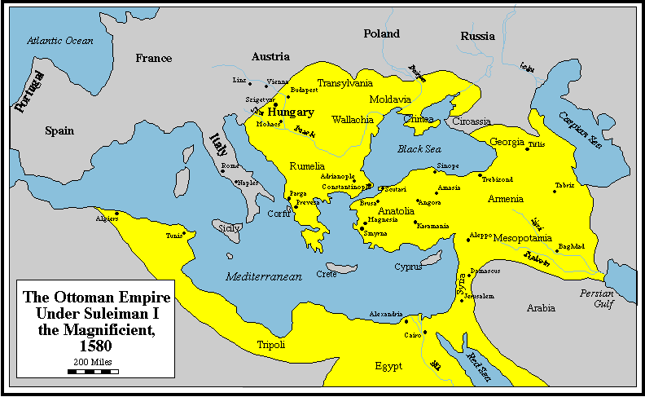
Ottoman Empire (1299 - 1923)
Ottoman Empire expanded into Europe
until defeated at 2nd siege of Vienna 1683
Notes:
Ottoman expansion into Europe for 300 years. 1683 Ottomans besieged Vienna for 2nd time – a long term target for conquest. Many countries answered Pope’s call to defend Christian Europe. Holy League led by King Sobieski of Poland defeated Ottomans. (French didn’t help but attacked the Germans from the rear)

Slide 25
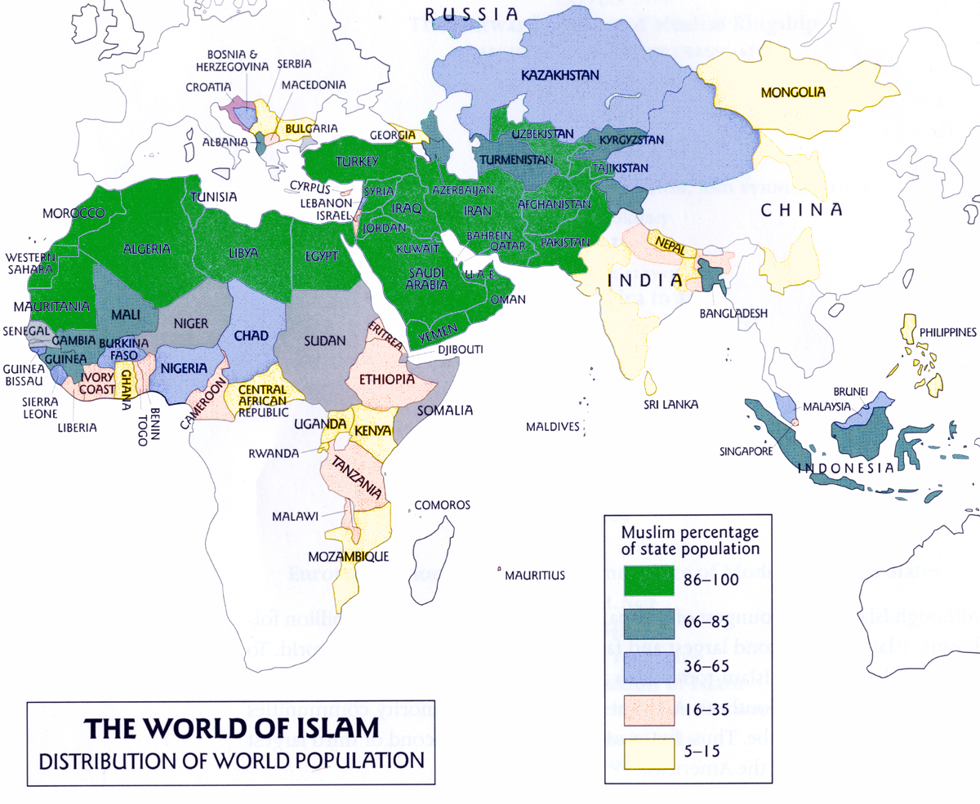
Islam today

Slide 26
Islam
Hebraism but rejected Hellenism
No foundation to receive Messiah
Cultural, economic, political decline
Islamic extremism
Very limited religious freedom

Slide 27
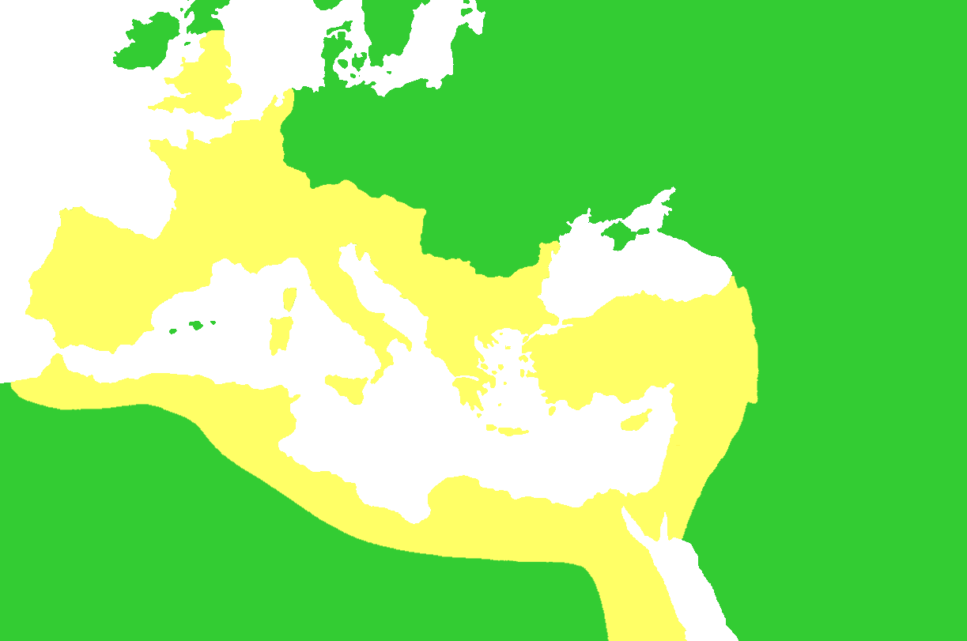
Period of the Church Patriarchs
Angles
Saxons
Huns
Missionaries
Germanic Tribes
410
Rome
Constantinople
Antioch
Jerusalem
Alexandria
God raised up the Germanic
tribes as a new chosen people.
EDP, 317
Arabs
Notes:
The Sack of Rome occurred on August 24, 410. The city was attacked by the Visigoths, led by Alaric I. At that time, Rome was no longer the capital of the Western Roman Empire, by Ravenna. Nevertheless, the city of Rome retained a paramount position as "the eternal city" and a spiritual center of the Empire. The sack was to prove a major shock to contemporaries, friends and foes of the Empire alike. This was the first time in almost 800 years that Rome had fallen to an enemy. Founding story of Rome – Romulus and Remus
Division within between patriarchs – Five Sees: Jerusalem, Alexandria, Antioch, Constantinople, Rome. Power over secular life too.
Theology ossifies – strict boundaries – main mission forgotten
Augustine (City of God) brought vision of kingdom under God, but church not pure and focused enough to implement it.
Germanic tribes – failure in Roman Empire due to state dominating religion – no freedom. God’s providence move to Germanic tribes. More freedom

Slide 28
Who were the Germanic tribes?
Shared language group
Very decentralised
  Tacitus – small family groups, villages, tribes, agrarian
  Banded together for defence or attack
  Arminius united tribe to drive out Romans and then poisoned
Not literate - runes
Great migration
  Huns moved in, they moved to Italy, Spain, France, Britain
  Created the Europe we know today
Notes:
The Germanic tribes lived in rather small settlements, barely the size of villages and even rarer were actual towns. According to Tacitus they preferred to live on their own or in small family groups, rather than in large cities. Although Tacitus described the early Germans as a semi-nomadic people, archaeologists discovered that they were an agrarian society, living off of crops for the most part, substituted by meat mainly from domesticated animals from time to time.
Only for the purpose of raiding other tribes or Roman territory they banded together in larger groups to achieve their more or less ambitious goals. It would take until the migration period for the Germanic peoples to form their first proper kingdoms.
For the first few centuries or even millennia of their existence, depending to what point in time the ethnogenesis of the Germanic peoples is dated they most likely were illiterate, before some learned the Latin alphabet from the Romans and later developed their own script, the famous runes, which exact origins are still shrouded in mystery.
Until the beginning of the Migration Period, which we shall be looking into shortly, the Germans didn’t know kingdoms in the classical sense. Although there was a recoreded king of the Suebians, which had settled in modern-day Alsace by 55 BC, the translation and interpretation of the word “rex” (usually lat. “King”) is disputed. For the most part it seems like the Germans were devided into tribes and probably furthermore into family groups or clans with their own leaders. As mentioned before, they only banded together for raiding other tribes or defending themselves from such raids. In times like these a supreme military leader might’ve been chosen, who ruled the tribe(s) for the duration of the raid and perhaps for a bit longer, but usually their rule didn’t last too long. A good example for this is the famous Arminius who united many northwestern Germanic tribes to drive the Romans out of Germania. Even though Arminius certainly intendet to rule these tribes and possible even to unite all Germanic tribes against the Romans his ambition was his downfall and he was probably poisoned by his own people.
Although the Germans were certainly less sophisticated than their contemporary Romans, Greeks, Egyptians or even the neighboring Celts, which to the Mediterranean world were already considered barbarians, they were to a large degree responsible for the fall of the Western Roman Empire. The Kingdoms which they built upon the ruins of the Imperium gave Europe a new face which can still be recognized today in countries such as France, which was the kingdom and later the Empire of the Franks under Charlemagne (as was Germany) or England, literally the country of the Angles, a tribe from northern Germany which conquered England from the Romano-Britons together with the Saxons, Jutes and Frisians.

Slide 29
‘Dark Ages’
Huns move west from central Asia
  Pagan, shamanist
  Attacked the Visigoths 376
Visigoths move south west into Roman Empire
  Arian
  Alaric sacked Rome 410
Huns under Attila attacked Eastern and Western Roman Empires 440—450s
Destruction of infrastructure
Destruction of literature

Slide 30
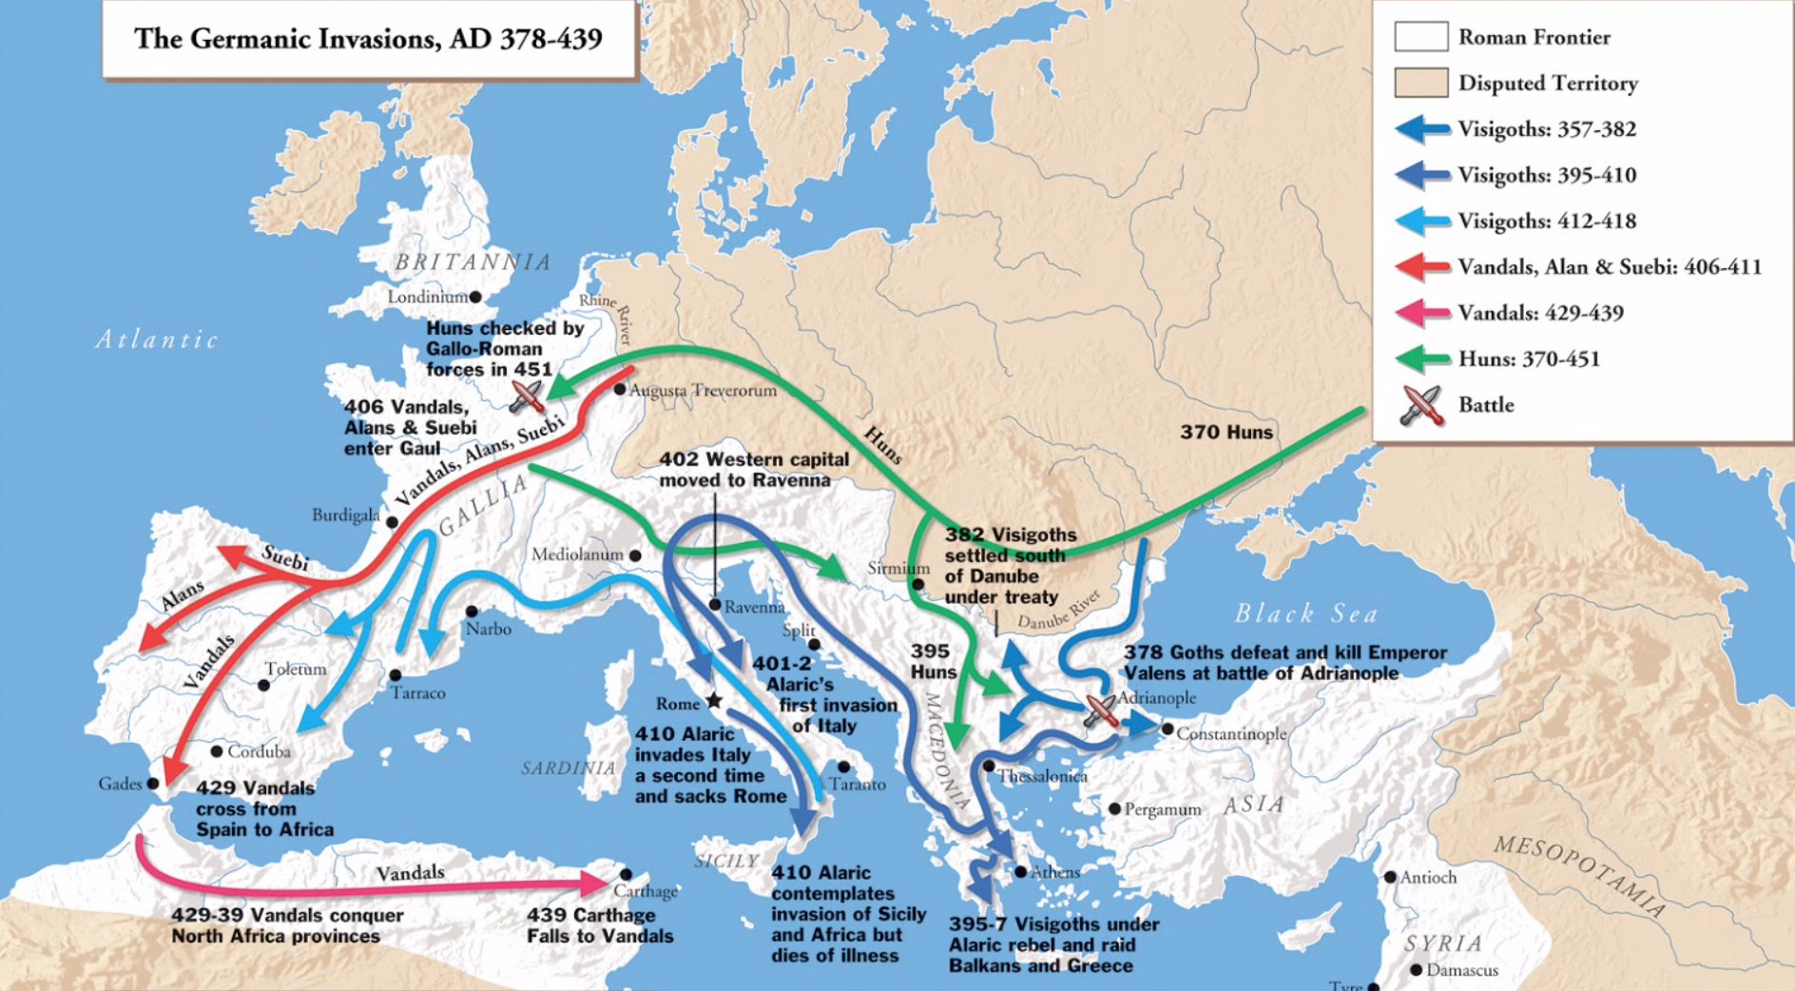
Migrations

Slide 31
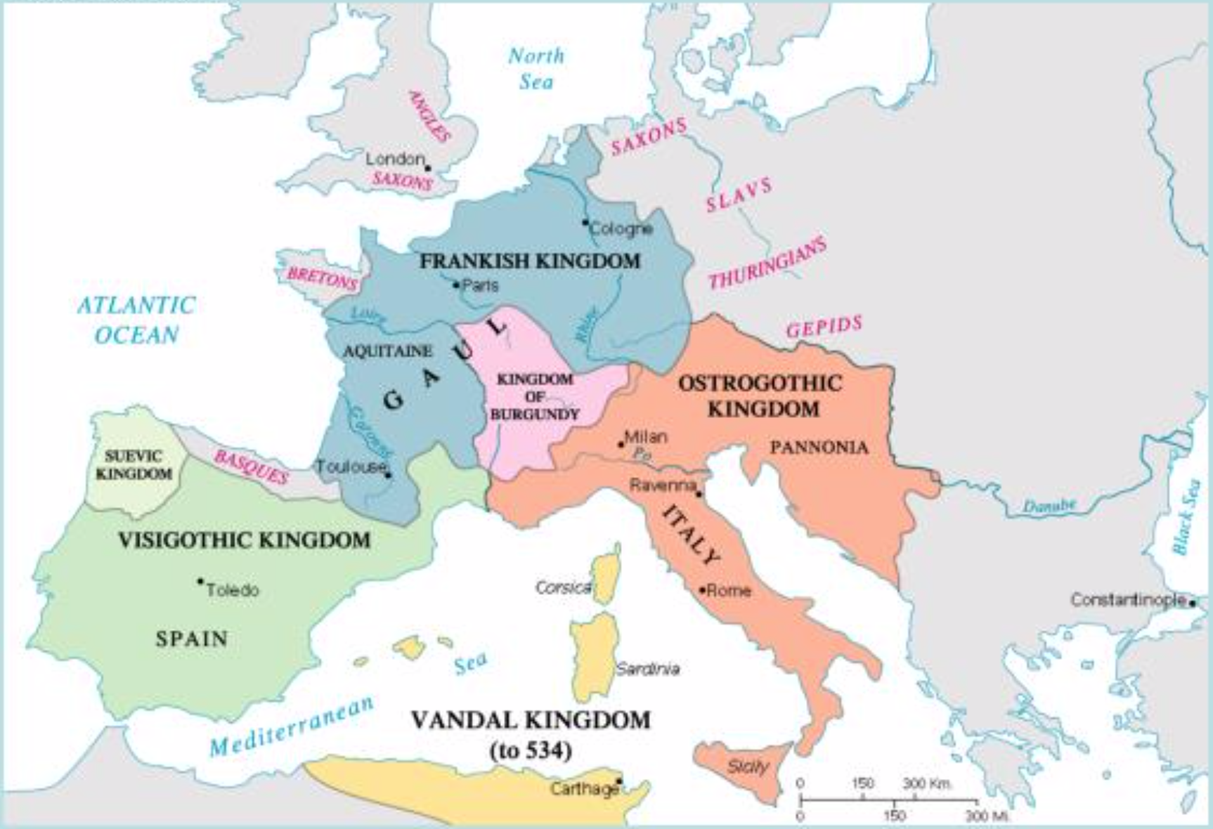
Germanic tribes settle

Slide 32
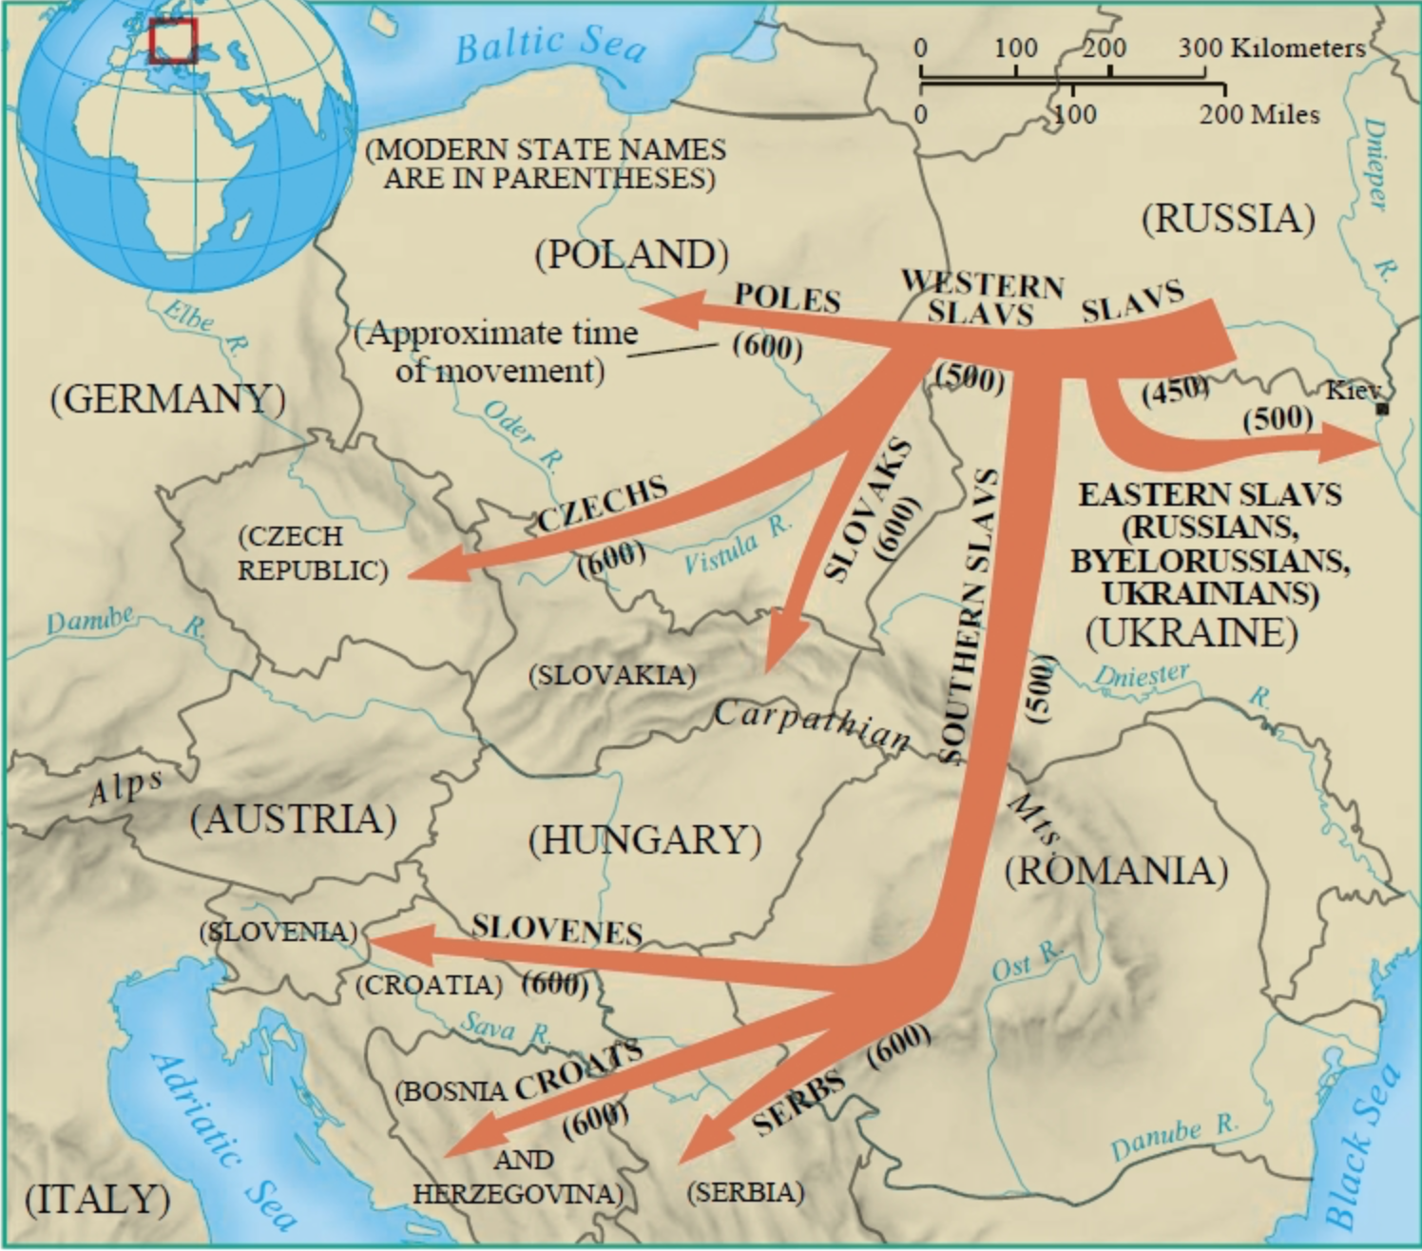
Slavic tribe migrations

Slide 33
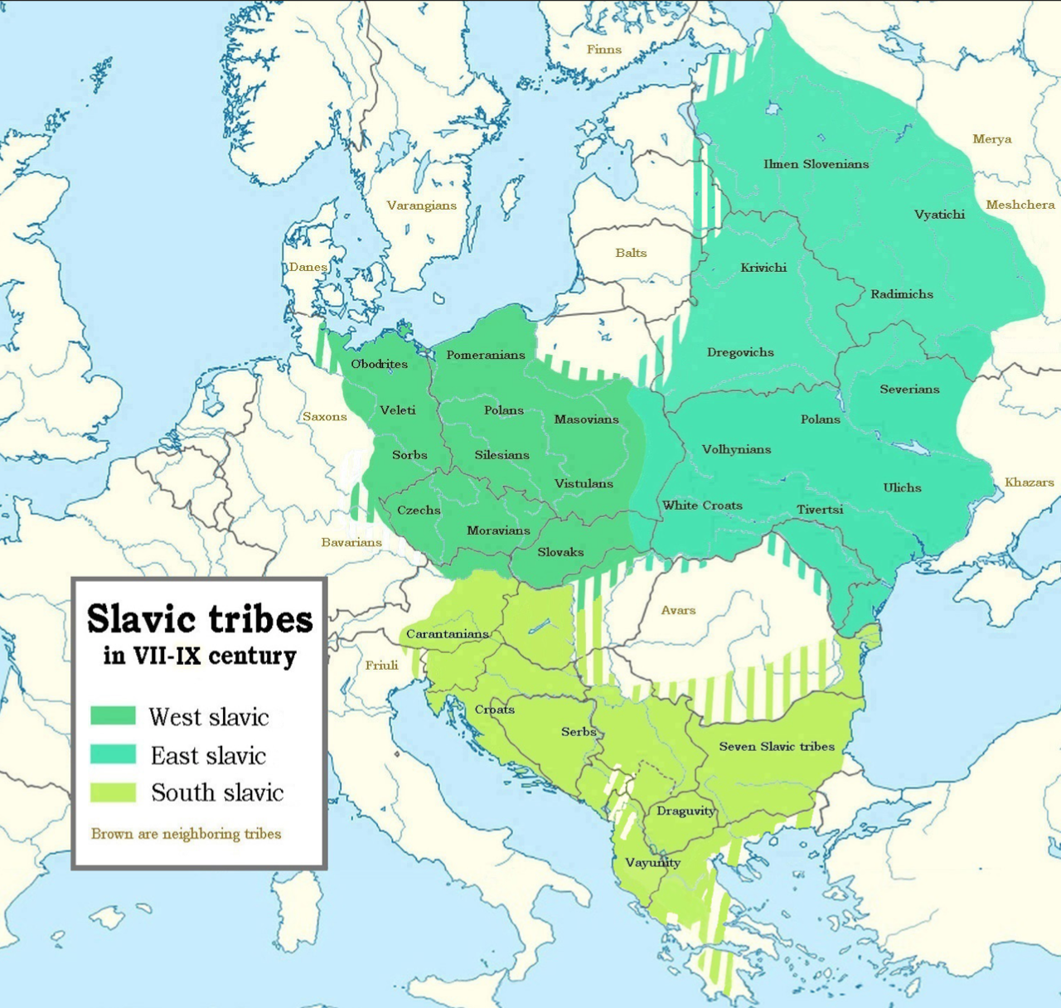
Slavic tribes

Slide 34
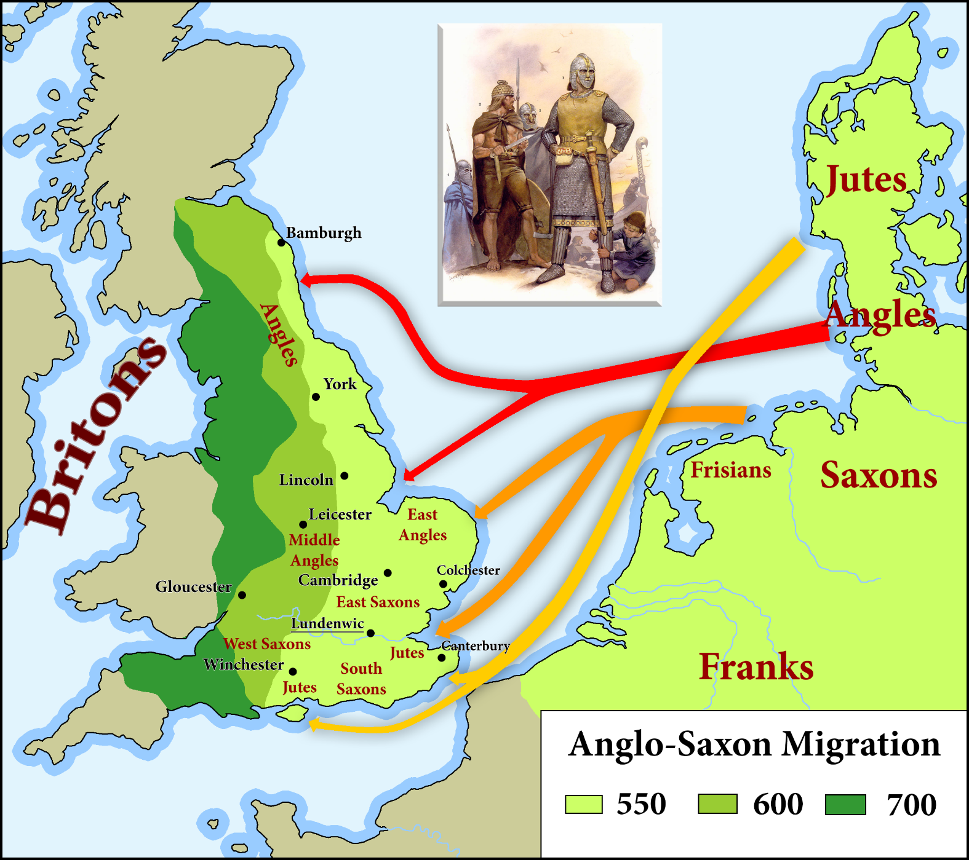
Invasion of Britain
410 Roman
protection of
Britain withdrawn

Slide 35
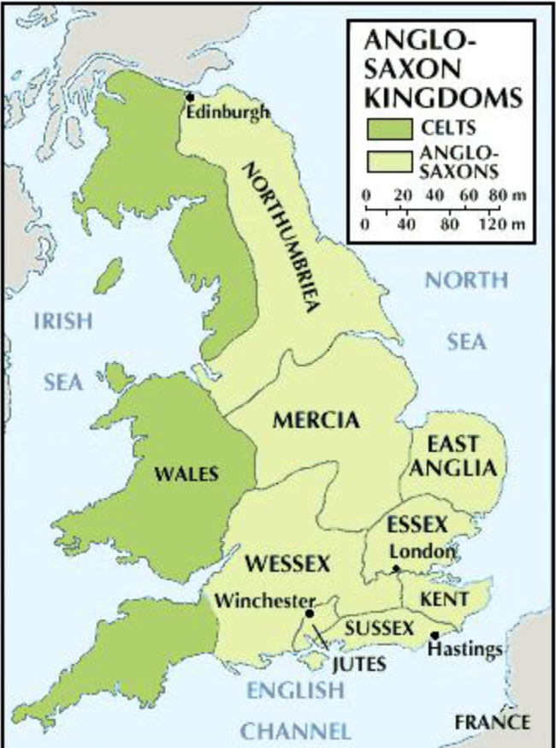
Anglo-Saxon
Freeholders
Village
Village-moot
100 villages
Own meeting
Shire
Witenagemot
King
Freedom
Customary law
Trial by jury
Notes:
ORIGIN OF MODERN DEMOCRACY
Modern democracy is the fruit of several different strains of historical experience and thought. Although the oldest continuous parliament is in Iceland, most people trace the development of modern democracy to England.
The government of the English in the 10th century before the Norman conquest and the imposition of feudalism, was derived from the customs of the Germanic tribes who invaded and settled in England in the fifth century. The English were a nation of freeholders living in homesteads. A group of these homesteads formed a village which had an assembly, the village-moot presided over by the village-reeve. A 100 or so of such villages constituted a Hundred which like the village also had a meeting presided over by the elder where they managed their own affairs. A number of hundreds formed a shire presided over by an earldorman appointed by the King and Witan. The kingdom made up of these shires was ruled by the Witenagemot and the King. The Witenagemot was the "Meeting of the Wise Men" who could elect and depose the King, decide questions of war and peace, make and amend the laws, confirm the appointment of bishops and earldormen and settle disputes. The King being a descendant of Woden was greatly respected but could not alter the law, levy a tax or make a grant of land without the consent of the Witenagemot. His main responsibility was to lead the army in war.
The English system of government worked from below upwards, from the freeman to the King, every man holding his own land as his right, choosing his own earldorman, who in turn helped to choose the King. The law was customary law which formed the basis of Common Law, a body of general rules prescribing social conduct, which were later enforced by the ordinary royal courts, and characterized by the development of its own principles in actual legal controversies, by the procedure of trial by jury, and by the doctrine of the supremacy of law. The law was not made but discovered. It was based on custom immemorial. It was God's law and had been handed down through custom from generation to generation. Thus no one had the authority to unilaterally go against the wisdom of the past generations and make new law.
When the Normans under William the Conqueror invaded England the feudal system which worked from the top down was imposed. The King owned all the land and gave it to his knights, earls, and barons under mutual conditions. In this way he gathered up, and concentrated in himself, the whole power of the state. The celebrated Doomsday Book was nothing other than a register of property so that the king could steal the money from his subjects, a practice now known by the euphemism taxation.
English history has been a long struggle to reassert the Anglo-Saxon principles of government against foreign ideas and armies from the continent. Some landmarks in this not always progressive struggle are: the attempt to bring the Church under the law of the land so that priests who committed murder could be punished (1164); the crystallisation of trial by jury (1166); the Magna Carta, issued by King John under pressure from the barons lead by the Archbishop of Canterbury (1215), which restated the ancient principle that no person should be imprisoned, deprived of his property or outlawed but by the judgment of his equals or by the law of the land; the Provisions of Oxford and the Mad Parliament which demanded that there should be three Parliaments a year and that the King could not act without the authority of his appointed advisors (1258); the first House of Commons summoned by Simon de Montefort with representa­tives from all classes of the kingdom (1265); the First Complete Parliament (1297) summoned by Edward I on the principle that, "it was right that what concerned all, should be approved by all," which passed the Statute that there was to be no taxation without the consent of the realm; the right of the Commons to impeach any servant of the Crown who had done wrong (1376) and the necessity that the two Houses of Parliament should concur for the law to be changed; the abolition of the authority of the Pope in England (1534); the growth of non conformity and the notion that a congregation should be able to elect its own minister; Parliament asserted its right to control its own elections and that its privileges are of right and not grace; the declaration by the Commons that their privileges were not the gift of the Crown, but the natural birthright of Englishmen, that they could discuss matters of public interest and that they had the right to liberty of speech (1621); the Petition of Right (1628) which demanded that no man could be taxed without consent of Parliament, no subject imprisoned without just cause, and that sailors and soldiers not be billeted in private houses; the National Covenant (1637) signed in Scotland to resist the imposition of Popery and Episco­pacy; the abolition of the Star Chamber (1640) and the Civil War which arose because of the arbitrary government of Charles I who tried to rule without Parliament; there was extraordinary amount of religious freedom and an outpouring of spirituality at this time; the Putney debates at which every theory of political economy conceivable was discussed and argued about; the Habeas Corpus Act (1679) restated the ancient principle that indefinite and illegal imprisonment was unlawful and that no person could be recommitted for the same offence; the Glorious Revolution in which William of Orange was invited to defend the rights and liberties of the people of England from James II who wanted to rule absolutely and impose Catholicism on the country; the Toleration Act (1689) allowing freedom of worship to all Protestants; the Declaration of Right (1689) that declared illegal: the pretended power to suspend or dispense the law, levying of money without consent of parliament and the maintaining of a standing army without the consent of parliament; there continued fierce debate between the Tories who believed in the divine right of kings and the Whigs who regarded the King as an official answerable to the people and who could be dethroned if he acted illegally; the Declaration of Independence (1776) and the expansion of the franchise in England in the mid 19th Century while expanding democracy was the result of the input of a rationalism which did not understand fully the nature of society and the importance of tradition and custom and has been the downfall of liberty.
The main point of this potted history is that people demanded representation because it was thought that a democratically accountable government was the best way to preserve freedom and prevent the King from usurping his position and acting arbitrarily and contrary to the law of the land. However with the expansion of the franchise came the growth of government as politicians pandered to the electorate so as to be elected and the reversal of many of the gains of previous centuries. It is wrongly thought that the will of a democratically elected government should not be constrained because this would be undemocratic whereas the whole raison d'etre of democracy was to preserve not to justify the destruction of liberty.
On the continent a different type of democracy evolved reflecting a very different political culture. For many centuries envious of the liberty of Englishmen the French finally revolted against their government in the name of abstract ideals and values. On the continent reason was king. Anything that did not conform to reason was rejected and debased. Not realising that the rules of morality, language, family, religion and indeed all the most significant institutions of society are not the product of reason they rejected it all and enslaved themselves and others.
Roman law came to replace Common Law in every country. It was only in England that the Abel-type traditions of the Germanic tribes persisted in the long struggle between the people who used to be represented by Parliament and the King.
The source of authority in Roman Law was the Emperor who was regarded as God. When Roman Law was reintroduced into western Europe it supported absolutism. This view culminated in Hegel's assertion that the State was the living embodiment of God on the earth. (In England the state is a servant and anyone who works for it is looked down upon. In Germany government jobs are very prestigious). Thus on the continent there was seldom any questioning of the power and authority of the state, but only who should wield that power. Thus people came to power suffering from the fatal conceit that society was the product of design and then tried to redesign it. Thus began the two centuries of social engineering and arbitrary government which finally culminated in totalitarianism. The will of the people was sovereign and knew no bounds. How could the people be wrong? Why should their will be thwarted as the representatives of the people knew better than they what was good for them. On the continent people are free to do whatever the law says they can do. In England people are free to do whatever they like as long as they do not break the law.
Anglo-Saxon democracy evolved as an attempt to preserve liberty, the rule of law and ancient rights and customs of the people. Continental democracy as a reaction against natural order and an attempt to create a new order based on general will of the people which by definition was right and should therefore not be limited.

Slide 36
Governance of Germanic tribes
The government of the English was derived from the customs of the Germanic tribes. The English were a nation of freeholders living in homesteads. A group of these homesteads formed a village which had an assembly, the village-moot presided over by the village-reeve. A 100 or so of such villages constituted a Hundred which like the village also had a meeting presided over by the elder where they managed their own affairs. A number of hundreds formed a shire presided over by an earldorman appointed by the King and Witan.

Slide 37
Governance of Germanic tribes
The kingdom made up of these shires was ruled by the Witenagemot and the King. The Witenagemot was the "Meeting of the Wise Men" who could elect and depose the King, decide questions of war and peace, make and amend the laws, confirm the appointment of bishops and earldormen and settle disputes. The King being a descendant was greatly respected but could not alter the law, levy a tax or make a grant of land without the consent of the Witenagemot. His main responsibility was to lead the army in war.

Slide 38
The English system of government worked from below upwards. The law was customary law which formed the basis of Common Law, a body of general rules prescribing social conduct, which were later enforced by the ordinary royal courts, and characterized by the development of its own principles in actual legal controversies, by the procedure of trial by jury, and by the doctrine of the supremacy of law. The law was not made but discovered. It was based on custom immemorial. It was God's law and had been handed down through custom from generation to generation. Thus no one had the authority to unilaterally go against the wisdom of the past generations and make new law.

Slide 39
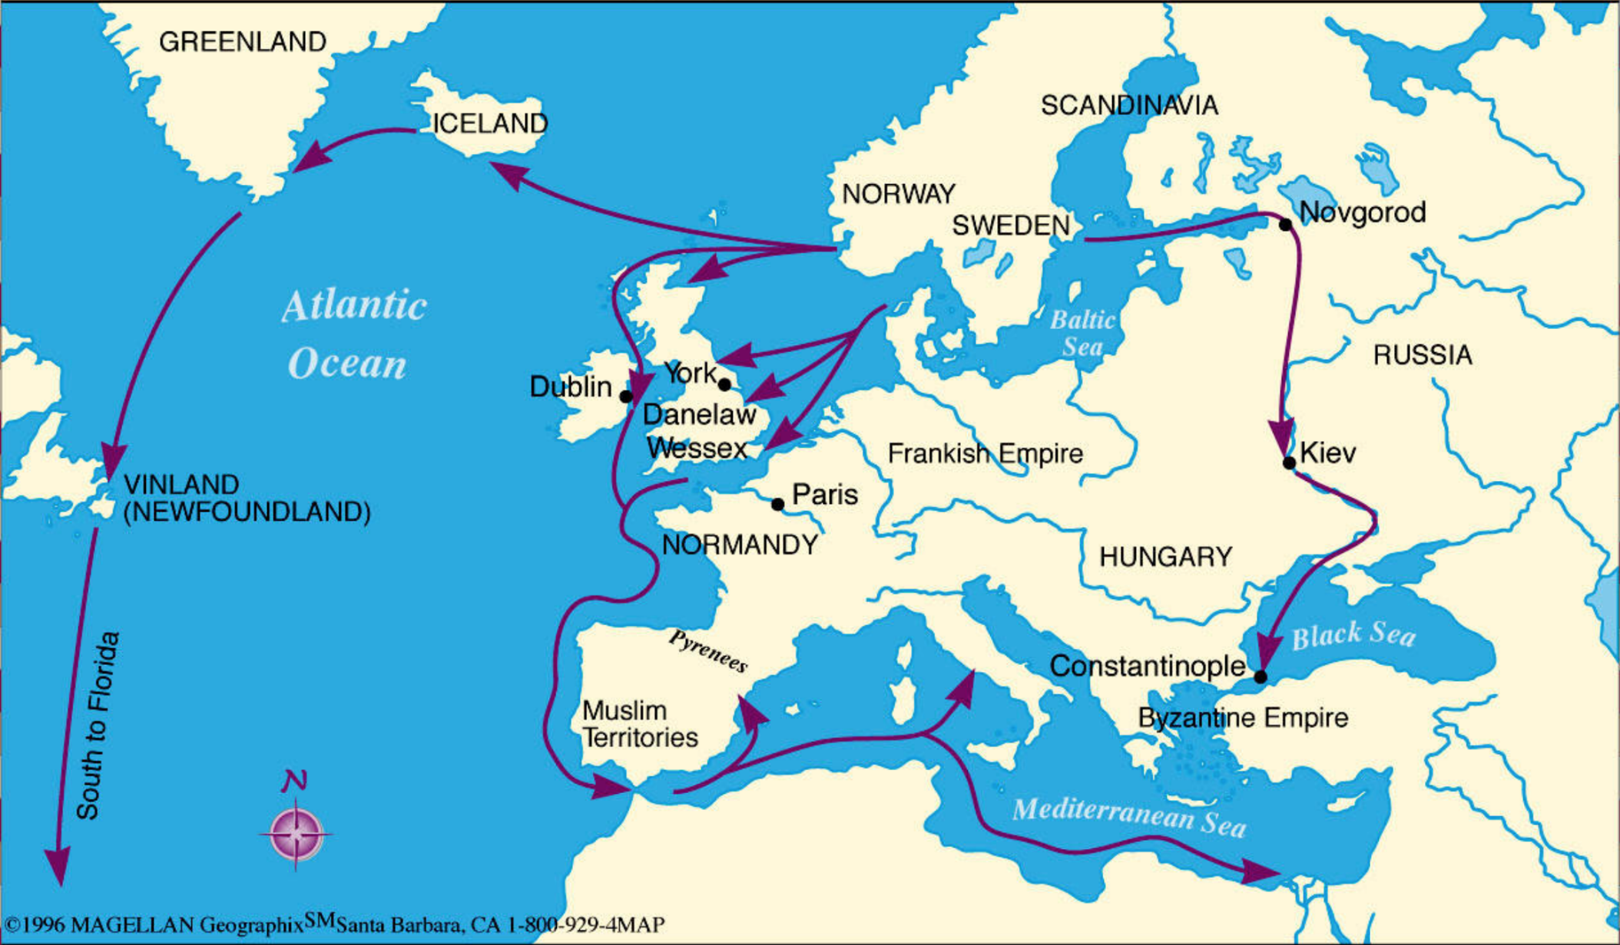
Viking exploration and conquest
Norse – North Germanic tribes

Slide 40
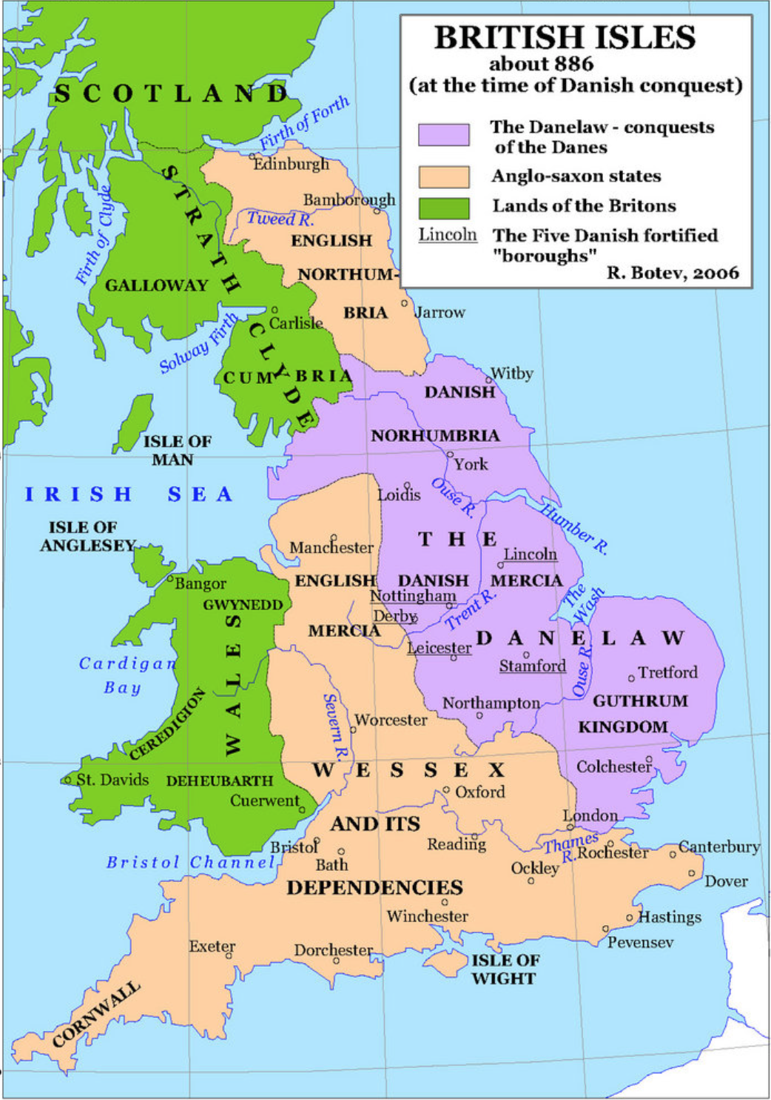
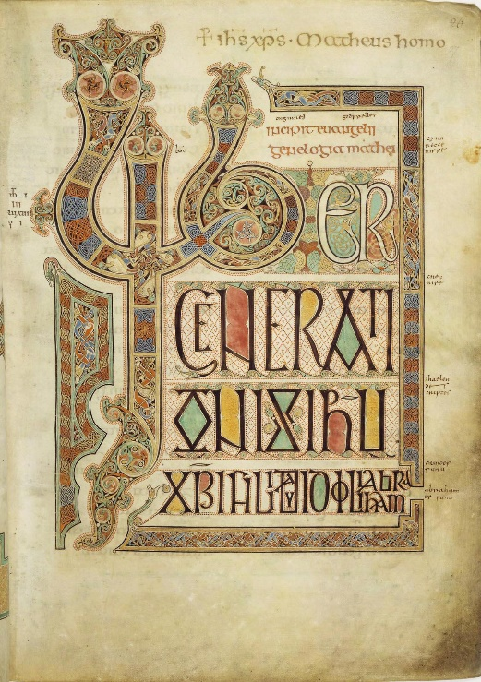
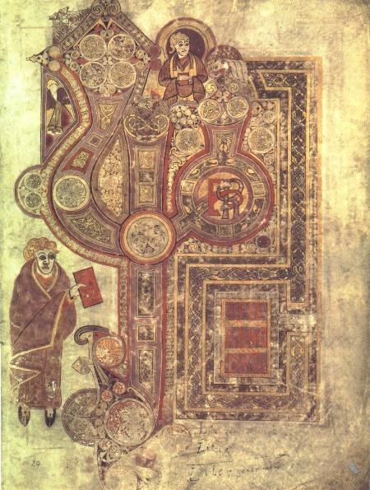
Viking invasions
Lindisfarne 793
Iona 794
Battle Eddington 878
Book of Kells
Lindisfarne Gospel

