Slide 1
Why bother with Gnosticism?
Sir, The articles in The Times: “Gender-fluid world is muddling young minds”, “Social media is making gender meaningless”, and the letters about children wanting to be pandas, dogs or mermaids, show that the confusion about gender identity is a modern, and now internet-fuelled, form of the ancient philosophy of Gnosticism. The Gnostic, one who “knows”, has discovered the secret of “who I really am”, behind the deceptive outward appearance (the “ungainly, boring, fleshy one”). This involves denying the goodness, or even the ultimate reality, of the natural world. Nature, however, tends to strike back, with the likely victims in this case being vulnerable and impressionable youngsters who, as confused adults, will pay the price for their elders’ fashionable fantasies.
The Right Rev Professor Tom Wright (former Bishop of Durham)
St Mary’s College, St Andrews University, Scotland
Notes:
(1) "The present world of space, time and matter is a bad place, not only a place where wickedness flourishes unchecked but a place which, had it not been for an evil God going ahead in creating it, would not have existed at all."
Unlike Christianity which depicts human beings as evil and fallen Gnosticism posits that an incompetent, arrogant and foolish lower god created the material world - that the material realm is a mistake.
(2) "The world as we know it was made by bad stupid and perhaps capricious God. There is another divine being, a pure, wise and true divinity who is quite different from this creator God. Sometimes this alternate high God is called the Father which is confusing for Christians who associate that title with the God who made the world..."
(3) "The main aim of any right-thinking human being, therefore will be to escape the wicked world and the outward human existence altogether. Salvation means exactly this: attaining deliverance from the material cosmos and all that it means. Only so can one make one's way to the pure higher spiritual existence where freed from the trammels of space, time, and matter one will be able to enjoy the bliss unavailable to those who cling to the physical world and who mistakenly worship is creator."
Bishop Wright goes on to explain that gnosis or what could be called spiritual knowledge has no relation to what is taught in textbooks or school: (4) "Rather this special gnosis is arrived at through attaining knowledge about the true God, about the true origin of the wicked world, and not least about one's own true identity. And this knowledge can only come if someone reveals it."
Further:
"What is needed in other words is a revealer who will come from the realms beyond, from the pure upper spiritual world, to reveal to the chosen few that they have within themselves the spark of light, the divine identity hidden deep within their shabby gross outward material form."
To summarize the Christian position from Bishop Wright:
"A wicked world; a wicked God who made it; salvation consisting of rescue from it; and rescue coming through the imparting of secret knowledge, especially knowledge that one has the divine spark within one's own self these are the for distinguishing marks of Gnosticism as we find it, not only in the polemic of Irenaeus and other early Christian teachers, but in the texts themselves: the codices from Nag Hammadi and elsewhere, and now the Gospel of Judas."

Slide 2
Gnosticism within the church
“Walter Bauer, in his work on early Christian heresy, points out that the gnostics were, for the most part, firmly ensconced within the churches. According to Bauer, it took centuries for Christians to arrive at an ‘orthodox’ position, to free themselves from an entangling alliance with gnostic thought.
…the familiar presence of Gnosticism is as close at hand as the reality we call Protestantism… something like the ancient misalliance has occurred in our own time, particularly in the North American expression of Protestantism… Philip Lee, Against the Protestant Gnostics, 1987

Slide 3
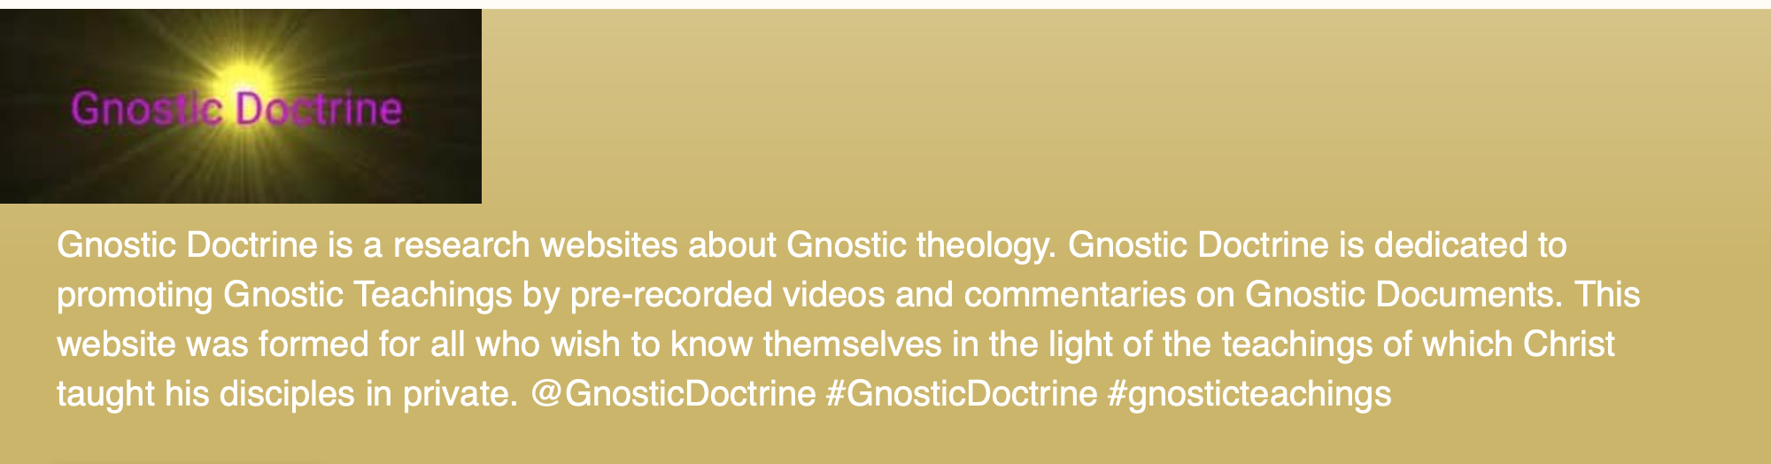
“A good many Christian hymns and poems, wander off unthinkingly in the direction of Gnosticism.”
Professor N.T Wright, Surprised by Hope: Rethinking Heaven, the Resurrection, and the Mission of the Church. 2008

Slide 4
The danger and challenge
Sociologists of religion emphasize categories such as “implicit theology” and the “social imaginary.” What these concepts point towards is that the most influential ideas animating religious cultures can sometimes be ideas which are only tacitly articulated and which may even exist in tension to direct doctrinal formulations. Put another way, assumptions may often percolate slightly beneath the surface so that they colour and modulate religious practice and thought even if they are rarely encountered in a distilled form.

Slide 5
E.g. Valentinus 100 – c. 160
In the second century, Valentinus set up a school in Rome where he taught an elaborate system that separated God from creation by a series of devolving emanations. On this scheme of things, Jesus should not to be identified with the defective creator (a demigoddess named Sophia). The highest God (the one Jesus called Father) shows us how to escape from material things. Through his quick wit, charismatic personality, and diplomatic sagacity, Valentinus managed to create a movement within the church that extended to the boundaries of the Roman Empire. He was even almost elected pope, but lost by a few votes.
Notes:
Valentinianism is the name for the school of gnostic philosophy tracing back to Valentinus. It was one of the major gnostic movements, having widespread following throughout the Roman Empire and provoking voluminous writings by Christian heresiologists. Notable Valentinians included Heracleon, Ptolemy, Florinus, Marcus and Axionicus.
Valentinus professed to have derived his ideas from Theodas or Theudas, a disciple of Paul. Valentinus drew freely on some books of the New Testament. Unlike a great number of other gnostic systems, which are expressly dualist, Valentinus developed a system that was more monistic, albeit expressed in dualistic terms.[15]
While Valentinus was alive he made many disciples, and his system was the most widely diffused of all the forms of Gnosticism, although, as Tertullian remarked, it developed into several different versions, not all of which acknowledged their dependence on him ("they affect to disavow their name"). Among the more prominent disciples of Valentinus were Heracleon, Ptolemy, Marcus and possibly Bardaisan.
Many of the writings of these Gnostics, and a large number of excerpts from the writings of Valentinus, existed only in quotes displayed by their orthodox detractors, until 1945, when the cache of writings at Nag Hammadi revealed a Coptic version of the Gospel of Truth, which is the title of a text that, according to Irenaeus, was the same as the Gospel of Valentinus mentioned by Tertullian in his Against All Heresies.[16]
Cosmology[edit]
Valentinian literature described the primal being, called Bythos, as the beginning of all things. After ages of silence and contemplation, Bythos gave rise to other beings by a process of emanation. The first series of beings, the aeons, were thirty in number, representing fifteen syzygies or pairs sexually complementary. Through the error of Sophia, one of the lowest aeons, and the ignorance of Sakla, the lower world with its subjection to matter is brought into existence. Man, the highest being in the lower world, participates in both the psychic and the hylic (material) nature, and the work of redemption consists in freeing the higher, the spiritual, from its servitude to the lower. This was the word and mission of Jesus and the holy spirit. Valentinius' Christology may have posited the existence of three redeeming beings, but Jesus while on Earth had a supernatural body which, for instance, "did not experience corruption" by defecating, according to Clement:[17] there is also no mention of the account of Jesus's suffering in First Epistle of Peter, nor of any other, in any Valentinian text. The Valentinian system was comprehensive, and was worked out to cover all phases of thought and action.
Valentinius was among the early Christians who attempted to align Christianity with Platonism,[citation needed] drawing dualist conceptions from the Platonic world of ideal forms (pleroma) and the lower world of phenomena (kenoma). Of the mid-2nd century thinkers and preachers who were declared heretical by Irenaeus and later mainstream Christians, only Marcion of Sinope is as outstanding as a personality. The contemporary orthodox counter to Valentinius was Justin Martyr, though it was Irenaeus of Lyons who presented the most vigorous challenge to the Valentinians.
According to Irenaeus, the Valentinians believed that at the beginning there was a Pleroma (literally, a 'fullness'). At the centre of the Pleroma was the primal Father or Bythos, the beginning of all things who, after ages of silence and contemplation, projected thirty Aeons, heavenly archetypes representing fifteen syzygies or sexually complementary pairs. Among them was Sophia. Sophia's weakness, curiosity and passion led to her fall from the Pleroma and the creation of the world and man, both of which are flawed. Valentinians identified the God of the Old Testament as the Demiurge,[8] the imperfect creator of the material world. Man, the highest being in this material world, participates in both the spiritual and the material nature. The work of redemption consists in freeing the former from the latter. One needed to recognize the Father, the depth of all being, as the true source of divine power in order to achieve gnosis (knowledge).[9] The Valentinians believed that the attainment of this knowledge by the human individual had positive consequences within the universal order and contributed to restoring that order,[10] and that gnosis, not faith, was the key to salvation. Clement wrote that the Valentinians regarded Catholic Christians "as simple people to whom they attributed faith, while they think that gnosis is in themselves. Through the excellent seed that is to be found in them, they are by nature redeemed, and their gnosis is as far removed from faith as the spiritual from the physical".[11]

Slide 6
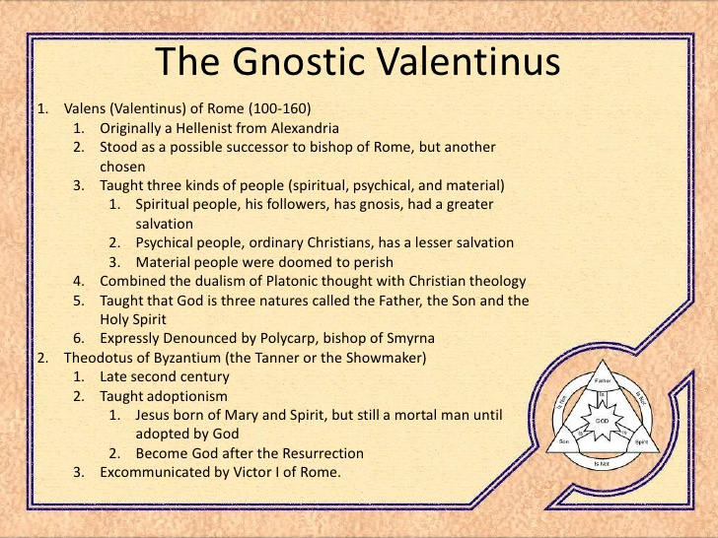

Slide 7
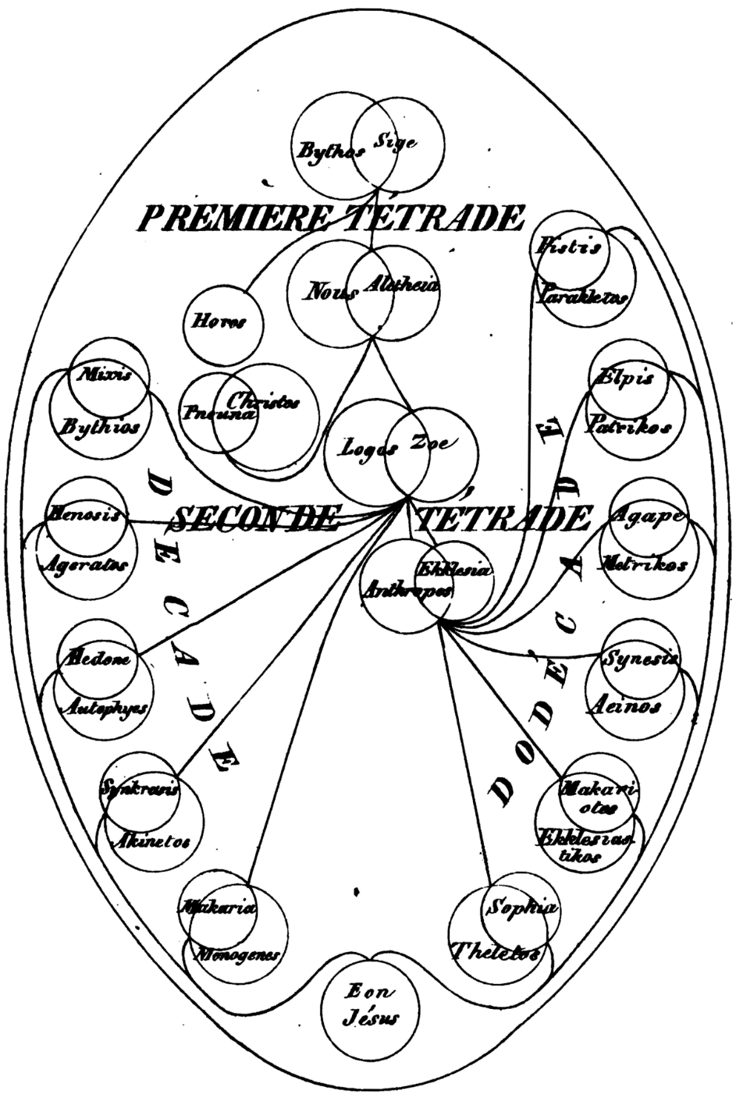
Summary
"A wicked world; a wicked God who made it; salvation consisting of rescue from it; and rescue coming through the imparting of secret knowledge, especially knowledge that one has the divine spark within one's own self these are the for distinguishing marks of Gnosticism as we find it, not only in the polemic of Irenaeus and other early Christian teachers, but in the texts themselves: the codices from Nag Hammadi and elsewhere, and now the Gospel of Judas."
Notes:
"The present world of space, time and matter is a bad place, not only a place where wickedness flourishes unchecked but a place which, had it not been for an evil God going ahead in creating it, would not have existed at all.
"The world as we know it was made by bad stupid and perhaps capricious God. There is another divine being, a pure, wise and true divinity who is quite different from this creator God. Sometimes this alternate high God is called the Father which is confusing for Christians who associate that title with the God who made the world...”
"The main aim of any right-thinking human being, therefore will be to escape the wicked world and the outward human existence altogether. Salvation means exactly this: attaining deliverance from the material cosmos and all that it means. Only so can one make one's way to the pure higher spiritual existence where freed from the trammels of space, time, and matter one will be able to enjoy the bliss unavailable to those who cling to the physical world and who mistakenly worship is creator."

Slide 8
Gospel of Judas
“We are trapped here, in these bodies of flesh, and we need to learn how to escape…Salvation does not come by worshiping the God of this world or accepting his creation. It comes by denying this world and rejecting the body that binds us to it…” Bart Ehrman, “The Alternative Vision of the Gospel of Judas,” in Rodolphe Kasser, Marvin W Meyer, and Gregor Wurst, eds., The Gospel of Judas (Washington, D.C.: National Geographic, 2006)

Slide 9
Judas as saint
In the Gospel of Judas, Jesus gives Judas permission to betray Him in order that the spiritual person imprisoned within the body might be liberated through death. The Jesus of the Gospel of Judas is quoted as saying, “You will do more than all of them. For the man which clothes me, you will sacrifice him.”

Slide 10
Why was Gnosticism popular?
Gnosticism became popular because it allowed its followers to retain their Christian faith without the demands of new creation theology. In emphasizing the unimportance of the present world, the Gnostics were able to avoid the types of confrontations with imperial powers that became characteristic of orthodox Christianity. Professor N.T. Wright

Slide 11
Absorption of pagan categories
The transformation of culture had a political dimension to it, which forms part of the context for early persecutions. Archaeological and textual evidence from the 1st century shows a variety of names and phrases associated with Caesar and with the goals of the Roman state. What is interesting is that the New Testament writers take up many of these same categories but ascribe them to Jesus and the gospel. Christians, like the Caesars, taught that they held the answer for bringing justice, order and peace to the world (Luke 2:13-14; John 14:27). Professor N.T. Wright

Slide 12
Jesus as a new Caesar
Christians, like the Caesars, claimed that a single man had rightful dominion over the whole earth (Matthew 28:18). Christians, like the Caesars, offered a sense of community to previously warring pluralities (Galatians 3:28). Christians, like the Caesars, were intent on evangelizing the world (Matthew 28:19). But although Christians shared many of Caesars’ goals, their methods couldn’t have been more distinct. Whereas the Caesars sought to transform the world through force and violence, the way of Christianity was to transform culture through love, peace, and the power of Christ’s resurrection. Professor N.T. Wright

Slide 13
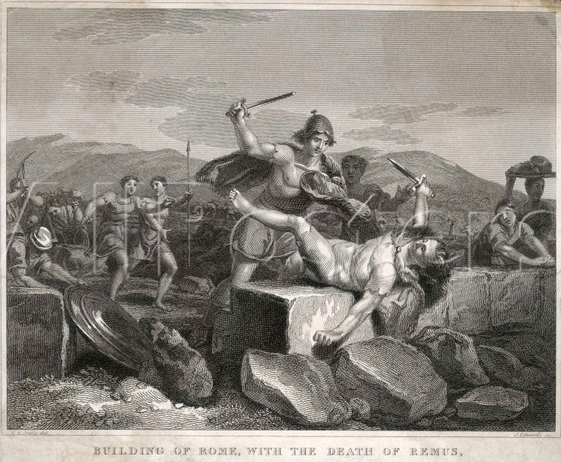
Who were the Romans?
Founding myth of Rome
  Romulus and Remus
  Might is right – power
Militaristic and expansionist
  Glorified war. Gladiators, wild beasts in Colosseum
Notes:
In Roman mythology, Romulus and Remus are twin brothers, whose story tells the events that led to the founding of the city of Rome and the Roman Kingdom by Romulus. The killing of Remus by his brother, and other tales from their story, have inspired artists throughout the ages. Since ancient times, the image of the twins being suckled by a she-wolf has been a symbol of the city of Rome and the Roman people. Although the tale takes place before the founding of Rome around 750 BC, the earliest known written account of the myth is from the late 3rd century BC. Whether the twins' myth was an original part of Roman myth or a later development is a subject of ongoing debate.

Slide 14
Roman religion: paganism
"Like all the states of antiquity, Rome had its gods, its national-political religion. This was neither a system of beliefs nor of morals. It was a ritual worked out to the last detail, of sacrifices and prayers, a cult of primarily political and state significance. Rome had no other symbol to express and maintain its unity and to symbolise faith in itself. Although in this troubled period very few believed in the symbol, to reject it meant disloyalty, being a rebel. Rome demanded only outward participation in the state cult as an expression of loyalty; all that was required of a citizen was to burn few sticks of incense before the images of the national gods, call the emperor 'Lord" and celebrate the rites. Once he had fulfilled this, he was free to seek the eternal meaning of life wherever he wished.

Slide 15
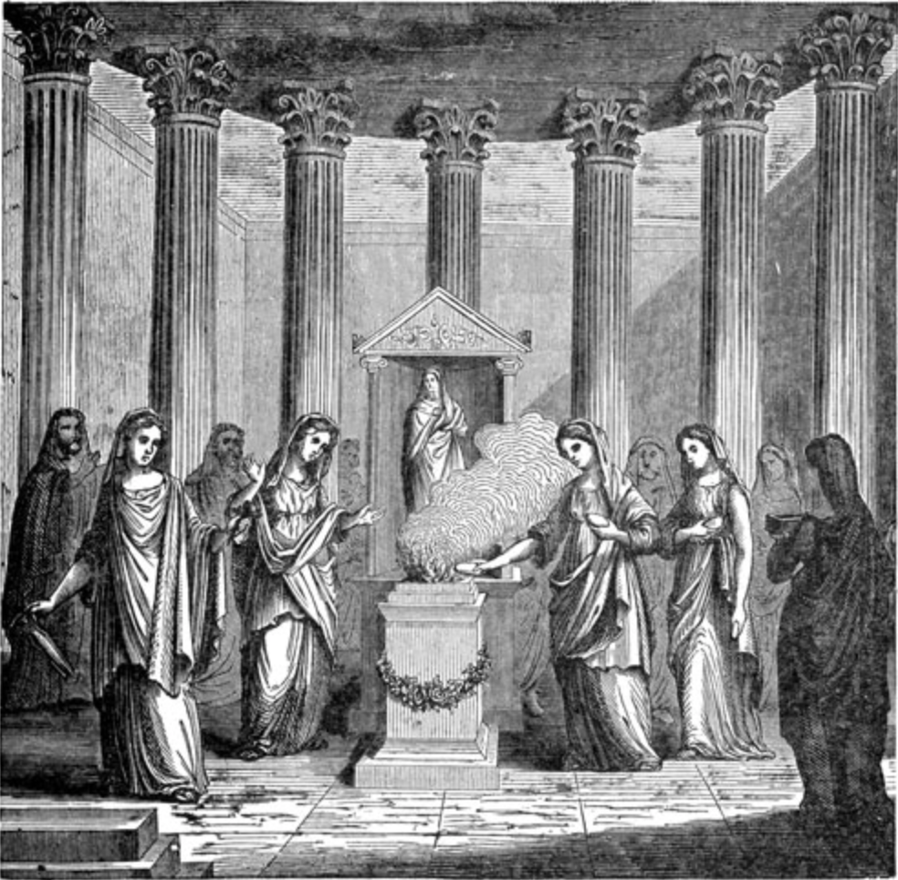
State religion
Vestal Virgins were priestesses of Vesta, goddess of the hearth. The college of the Vestals was regarded as fundamental to the continuance and security of Rome. These individuals cultivated the sacred fire that was not allowed to go out. Vestals were freed of the usual social obligations to marry and bear children and took a 30-year vow of chastity in order to devote themselves to the study and correct observance of state rituals that were forbidden to the colleges of male priests
Vestal virgins
Notes:
Paganism: belief in subjection of man to irrational forces which he senses in nature—a concept of the world and of life in it as a fate dependent on these forces. Man can somehow propitiate them or redeem himself by sacrifice and worship. To some extent he can even control such forces with magic; but he can never comprehend them, still less liberate himself from them.

Slide 16
For a man of the ancient world the validity of such a demand was self-evident. Religion was not a problem of personal choice but a family, tribal and state matter. One's personal faith or lack of it had nothing to do with religion, since religion itself had never been a problem of truth, but only an acknowledgment of the existing system, its legitimacy and justifiability.”
Expanded East:
  Hellenic paganism
  Greek philosophy
  Oriental mystery religions

Slide 17
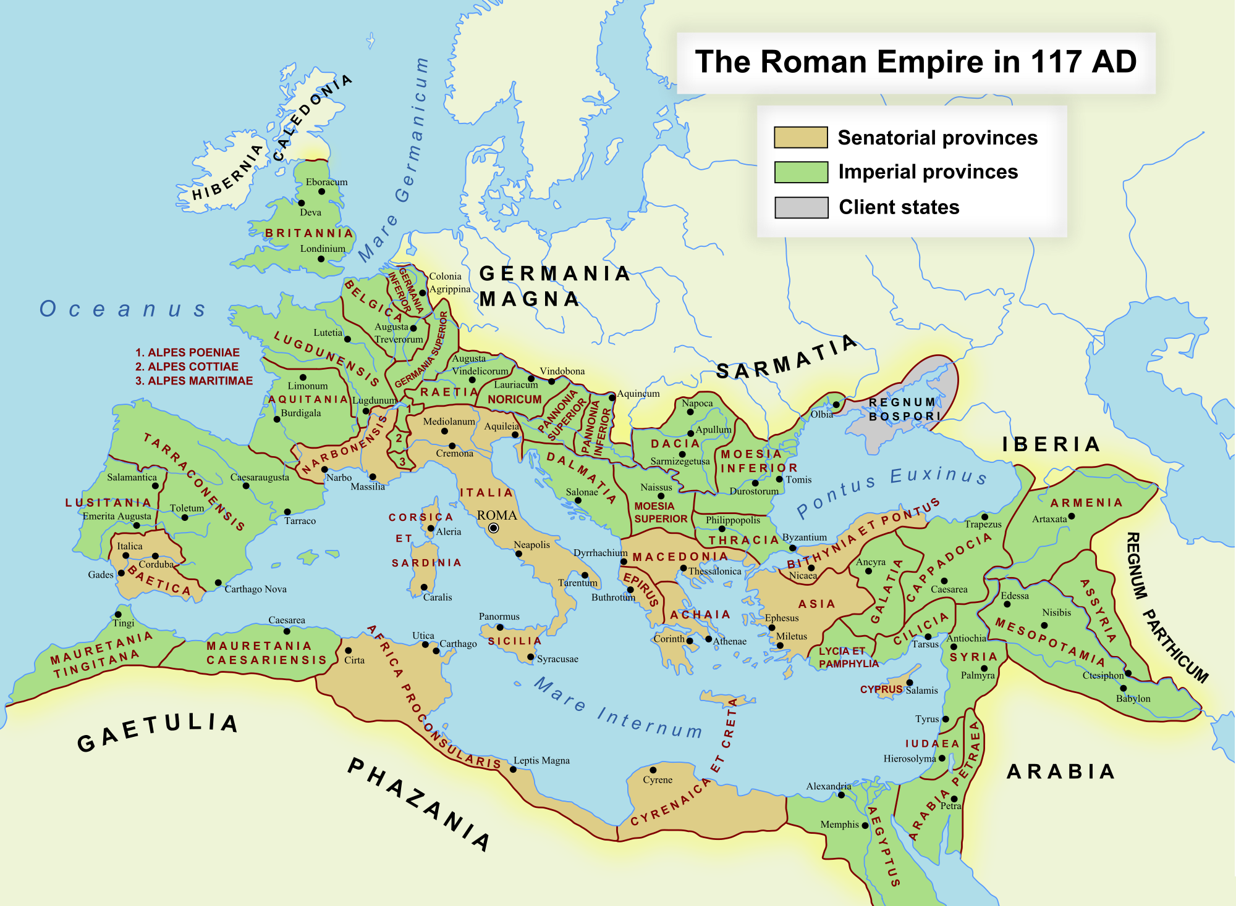
Roman Empire
Notes:
How Rome come to occupy Israel

Slide 18
Rome influenced
As the Roman armies moved East, the conquering city was viewed by the vanquished as a deity and in Alexandria, Caesar allowed himself to be proclaimed a god. In Rome though, he remained a mere mortal, of which he was reminded during victory parades by someone standing at his elbow. In time as they collected more and more foreign gods and citizens, Roman tradition was turned upside down. Whereas before the emperor was merely the "Princeps" amongst the Roman aristocracy, the pressures of legitimation of such a far flung empire led to the development of an imperial cult:

Slide 19
Emperor as god
"The person and power of the sovereign were holy things, that is, consecrated to the gods and approved by them, but they were not divine things. Flattery and the influence of Eastern ways of thought tended from the reign of Augustus onwards to obliterate this distinction. The Imperial power, as it really was, namely, the concentration of supreme authority in the hands of one man, was the Roman version of Eastern kingship, of which divinity was the attribute".

Slide 20
Roman religion: Paganism
From the time of Emperor Augustus the emperor would assume the title of pontifex maximus or chief priest, Son of god, later god
Theocratic State
  State highest form of human community
  State is god (no higher value or power)
  Religion and the gods exists to serve the state
  State source of law, identity
  State to be worshipped and served
  Rome the eternal city
Notes:
Constantine converted not as a man but as the emperor. Christ sanctioned his power and made him his intended representative and through Constantine bound the empire to Himself by special bonds. Therefore conversion of Constantine not followed by review or critique of theocratic conception of empire. He was a Christian outside the Church yet the Church silently and sincerely accepted and recognized him. Theocratic absolutism of ancient state not revised by gospel but instead became an inseparable part of the Xn worldview. State seen as bearer of religion. Theocratic nature of the state untouched; religion primarily a state matter, because the state itself was a divine establishment, a divine form of human society. Freedom of religion granted in Edict of Milan 313 so that "the divinity abiding in the heavens might be mercifully and favorably inclined toward us, and to all who are under our authority." Pagan attitude
Justinian didn't distinguish Roman state tradition from Xty. Saw himself as fully Roman Emperor and Christian emperor. Empire and religion united and indivisible. The Empire in his time became essentially totalitarian with the state regulating every aspect of human life. There was no part of human life that the state did not have the right and duty to be concerned with.
"Here lay the deepest of all misunderstandings between the Church and the empire. The Roman state could accept the ecclesiastical doctrine of God and Christ comparatively easily as its official religious doctrine; it could render the Church great help in rooting out paganism and implanting Xty; and finally, it could Christianize its own laws to a certain extent. But it could not really recognize that the Church was a community distinct from itself; it did not understand the Church's ontological independence of the world. The religious absolutism of the Roman state and the emperor's belief that he was the representative of God on earth prevented it.
From the beginning Justinian regarded the religious unity of the empire as self-evident and natural as state unity. Stern measures were taken against all possible heretical sects. He also closed the pagan university in Athens and opened a Christian university in Constantinople. He spent a long time trying to reconcile the Orthodox and Monophysites by supporting first one side then the other and then trying to engineer and enforce compromises.
Rome was known as the “Eternal City” because civilizations had lived there for thousands of years. The ancient Roman Empire was very powerful, and it had many enemies. Yet, ancient Romans managed to defeat the Carthaginians and Etruscans and extended their empire throughout Europe and Africa. No-one underestimated the greatness of the ancient Roman Empire.

Slide 21
God, man and the state
“Christianity never denied the benefits of the state or the possibility that it could be enlightened by the Light of Christ. Yet the meaning of the Church's appearance in the world as a community and a visible organism was that it revealed the limitations of the state, destroying its claim to absolutism forever, however ‘sacral’ its nature might be; and it was just this sacral quality that had been the essence of the ancient pagan state.

Slide 22
Two absolutes
The Church revealed to the world that there are only two absolute, eternal, and sacred values: God and man, and that everything else, including the state, is limited by its very nature—by belonging wholly only to this world; and secondly, is a blessing only to the extent that it serves God's plan for man. Therefore the ‘enlightenment’ of the state means primarily its recognition of its own limitations, its refusal to regard itself as an absolute value. It was for this enlightenment that Christians had suffered and died in the era of persecutions, when they rejected the right of the state to subject the whole of man to itself.” Alexander Schmemann

Slide 23
The clash
Christians from the beginning were loyal and prayed for the emperor. But they could not recognize the emperor as 'Lord' and they could not bow down to idols. Lord meant absolute master and ruler. For Christians there was only one Lord. Jesus Christ. By rejecting the formal requirement of the state they summoned it to submit to the Lord of the world. Not a matter of freedom of conscience but an upheaval in world history, 'the appearance of the Lord to do battle with one who had usurped His authority.' One martyr in 180 said "I do not recognize the empire of this world."

Slide 24
Conversion of Constantine
Constantine converted not as a man but as the emperor. Christ sanctioned his power and made him his intended representative and through Constantine bound the empire to Himself by special bonds. Therefore conversion of Constantine was not followed by review or critique of theocratic conception of empire. He was a Christian outside the Church yet the Church silently and sincerely accepted and recognized him. Theocratic absolutism of ancient state not revised by gospel but instead became an inseparable part of the Christian worldview.

Slide 25
The concept of state
The state itself was seen as the only community established by God, and embraced the whole life of man. The visible representative of God within it, who performed his will and dispensed His blessings was the emperor. He was obliged to be concerned with both the religious and material well being of his subjects, and his power was not only from God but was divine in its own nature. The only distinction between this pattern and pagan theocracy was that the empire, by choice of its emperor, had found its true God and true religion in Christianity. Christ had left his authority to forgive, heal, sanctify and teach to the priests. Therefore they must be surrounded in the state with special honour, for on them, on their prayers and sacraments, would depend the prosperity of the empire.

Slide 26
State was seen as bearer of religion. The theocratic nature of the state was untouched; religion remained primarily a state matter because the state itself was a divine establishment, a divine form of human society.
Freedom of religion granted in Edict of Milan 313 so that "the divinity abiding in the heavens might be mercifully and favourably inclined toward us, and to all who are under our authority.” Constantine

Slide 27
Pagan traditions come in
We almost see the rites of the pagans introduced into the churches under the pretext of religion; ranks of candles are lit in full daylight; and everywhere people kiss and adore some piece of dust in a little pot, wrapped in precious fabric.” Christian priest
”Christianity adopted and assimilated many forms of pagan religion, not only because they were the eternal forms of religion in general but also because the intention of Christianity was not to replace all forms in this world by new ones but to fill them with new and true meaning. So paganism a distortion of something by nature true and good." Schmemann

Slide 28
Sayings of emperors
"I am going to make plain to them what kind of worship is to be offered to God. . . What higher duty have I as Emperor than to destroy error and repress rash indiscretions, and so cause all to offer to Almighty God true religion, honest concord and due worship?”
  Constantine ‘bishop for external affairs’
"Whatever I will, shall be regarded as a canon . . either obey or go into exile."
  Constantius
"The well-being of the Church is the defence of the empire" "If these pure hands and these consecrated souls will pray for the Empire, its armies will be stronger, the well-being of the state will be greater, fertility and trade will flourish, due to God's undoubted favour."
  Justinian
Theodosius 380 declared Xty required faith. Church no longer a community of believers, it was also a community of those obliged to believe.
Christianity came to the Slavs in Byzantine theocratic aspect
Notes:
In official Byzantine doctrine the state was compared to a body, not in this early Xn sense, nor because all the subjects of the empire had become Church members. Actually the figure was derived wholly from pagan premises which had not been replaced, according to which the state itself was conceived to be the only community established by God, and embraced the whole life of man. The visible representative of God within it, who performed his will and dispensed His blessings was the emperor. He was obliged to be concerned with both the religious and material well being of his subjects, and his power was not only from God but was divine in its own nature. The only distinction between this pattern and pagan theocracy was that the empire, by choice of its emperor, had found its true God and true religion in Christianity. Christ had left his authority to forgive, heal, sanctify and teach to the priests. Therefore they must be surrounded in the state with special honour, for on them, on their prayers and sacraments, would depend the prosperity of the empire.

Slide 29
"I am going to make plain to them what kind of worship is to be offered to God. . . What higher duty have I as Emperor than to destroy error and repress rash indiscretions, and so cause all to offer to Almighty God true religion, honest concord and due worship?” Constantine
Daniel Schowalter (Oxford History of the Biblical World) says, “By the end of the fourth century, both anti-pagan and anti-Jewish legislation would serve as licenses for the increasing number of acts of vandalism and violent destruction directed against pagan and Jewish places of worship carried out by Christian mobs, often at the instigation of the local clergy.”

