Slide 1
Parting of the ways
Jewish-Roman Wars 132-135 AD
  Bar-Kokhba proclaimed messiah by Rabbi Akiva
    To Christian Jews he was a false messiah
    Church establishing own identity as separate religion
Changing identity of next generations
  Children of Jews-who-believed-in-Jesus didn’t think of themselves as Jews but as Christians and inherited anti-Jewish sentiments of their parents
  Who wants to belong to a ‘failed’ religion?
Church becomes Gentile
  Dispensational/Replacement/supersessionist theology
  Judaism rejected as ‘failed’. Church the New Israel
  Blame for crucifixion put on the Jews

Slide 2
Who actually killed Jesus?
In the tangled mass of evangelical accounts of Jesus's trial, one point stands out with clarity: he was arrested as “a rebel,” accused before Pilate as “King of the Jews,” found guilty as such, and executed as such. None of the later accretions which in the Gospels overlay the original primitive account, and none of the editorial modifications from the hands of successive evangelists, can hide or disguise the fact that Jesus of Nazareth was arrested, accused, tried, sentenced, and executed on a charge of insurrection against Roman rule in Judaea.
Paul Winter, The Trial of Jesus, Commentary, Sept. 1964
Notes:
Paul Winter (1904–1969) was born in Moravia. He was a successful barrister in Czechoslovakia but fled in 1939 due to the Nazi takeover (he was a Jew), became a British soldier.[1]
While performing research at libraries in London Winter worked menial jobs such as a porter and died in 1969 in London, in poverty, after having published around a hundred articles in scholarly journals concerning earliest Christianity.[1] Winter's 1961 book On the Trial Of Jesus, received hundreds of reviews, because it detailed critical analysis of the evidence regarding the trial of Jesus, from the standpoint of the legal practices which were applied during the 1st century, analyzed according to Jewish Law, and separately according to Roman Law.[1]
Winter's general conclusion was that Jesus was tried, and ultimately convicted and crucified, solely for his having violated Roman Law, sedition, because he claimed to be the king of the Jews, despite Rome's having appointed the Herodian family to that post. Crucifixion was solely a Roman form of execution, for sedition and other serious violations of Roman Law. Jewish Law did not employ crucifixion, not even for crimes which were capital offenses under Jewish Law.

Slide 3
Why were the Jews blamed for the death of Jesus?
Christians witnessing in the Roman Empire
Christians being persecuted
Didn’t want Jesus to come across as a political subversive and rebel against Roman authority especially following two Roman - Jewish wars
Didn’t want to blame the Romans for the crucifixion
Transferred blame for the crucifixion from the Romans onto the Jews
Accused the Jews of rejecting and murdering Jesus
That is why the picture of the Romans in the gospels is so favourable

Slide 4
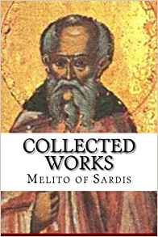
Melito of Sardis (d.180)
Bishop of Sardis (died c.180)
Most influential bishop in Asia
Jerome says Tertullian saw him as prophet due to his work on the 1st OT canon
Polycrates, “Melito whose whole walk was in the Holy Spirit”
Christian Jew by birth
Author of Peri Pascha - On The Passover
Notes:
Melito of Sardis (died c. 180) was the bishop of Sardis near Smyrna in western Anatolia, and a great authority in early Christianity. He was Jewish by birth. Melito held a foremost place in terms of Bishops in Asia due to his personal influence on Christianity and his literary works, most of which have been lost but of what has been recovered has provided a great insight into Christianity during the second century. Jerome, speaking of the Old Testament canon established by Melito, quotes Tertullian to the effect that he was esteemed as a prophet by many of the faithful. This work by Tertullian has been lost but pieces regarding Melito are quoted by Jerome as to the high regard that Melito was considered at the time. Melito is remembered for his work on developing the first Old Testament Canon. Though it cannot be determined what date he was elevated to episcopacy, it is probable that he was bishop during the arising controversy at Laodicea in regard to the observance of Easter, which resulted in him writing his most famous work, an Apology for Christianity to Marcus Aurelius. Little is known of his life outside of what works are quoted or read by Clement of Alexandria, Origen, and Eusebius. A letter of Polycrates of Ephesus to Pope Victor about 194 (Eusebius, Church History V.24) states that "Melito the eunuch [this is interpreted "the virgin" by Rufinus in his translation of Eusebius], whose whole walk was in the Holy Spirit", was buried at Sardis.[1] His feast day is celebrated on April 1.
Polycrates of Ephesus, a notable bishop of the time, was a contemporary of Melito, and in one of the letters preserved by Eusebius, Polycrates describes Melito as having fully lived in the Spirit. Jewish by birth, Melito lived in an atmosphere where the type of Christianity practiced was largely oriented toward the Jewish form of the Christian faith. Coming out of and representing the Johannine tradition, Melito's theological understanding of Christ often mirrored that of John. However, like most of his contemporaries, Melito was fully immersed in Greek culture. This Johannine tradition led Melito to consider the Gospel of John as the chronological timeline of Jesus’s life and death. This in turn led to Melito’s standpoint on the proper date of Easter discussed in Peri Pascha which he held as the 14th of Nisan.
Melito gave the first Christian list of the canon in the Old Testament. In his canon he excludes the Books of Esther, Nehemiah, and the Apocrypha. Around 170 after traveling to Palestine, and probably visiting the library at Caesarea Maritima, Melito compiled the earliest known Christian canon of the Old Testament, a term he coined. A passage cited by Eusebius contains Melito's famous canon of the Old Testament. Melito presented elaborate parallels between the Old Testament or Old Covenant, which he likened to the form or mold, and the New Testament or New Covenant, which he likened to the truth that broke the mold, in a series of Eklogai, six books of extracts from the Law and the Prophets presaging Christ and the Christian faith. His opinion of the Old Covenant was that it was fulfilled by Christians, whereas the Jewish people failed to fulfill it. The New Covenant is the truth found through Jesus Christ.
Melito was especially skilled in the literature of the Old Testament, and was one of the most prolific authors of his time. Eusebius furnished a list of Melito's works. While many of these works are lost, the testimony of the fathers remains to inform us how highly they were viewed. Eusebius presents some fragments of Melito's works and some others are found in the works of different writers.
Polycrates "belonged to a family in which he was the eighth Christian bishop; and he presided over the church of Ephesus, in which the traditions of St. John were yet fresh in men's minds at the date of his birth. He had doubtless known Polycarp, and Irenaeus also. He seems to have presided over a synod of Asiatic bishops (A.D. 196) which came together to consider this matter of the Paschal feast. It is surely noteworthy that nobody doubted that it was kept by a Christian and Apostolic ordinance."

Slide 5
Jews blamed for murder of Jesus
72. This one was murdered. And where was he murdered? In the very centre of Jerusalem! Why? Because he had healed their lame, and had cleansed their lepers, and had guided their blind with light, and had raised up their dead.
73. Why, O Israel did you do this strange injustice? You dishonoured the one who had honoured you. You held in contempt the one who held you in esteem. You denied the one who publicly acknowledged you. You renounced the one who proclaimed you his own. You killed the one who made you to live. Why did you do this, O Israel?
Notes:
Jesus was not murdered but executed by the Romans on a political charge of subversion and attempted overthrow of the regime
The statement Jesus murdered also in DP

Slide 6
Accusation of deicide
96. The one who hung the earth in space, is himself hanged; the one who fixed the heavens in place, is himself impaled; the one who firmly fixed all things, is himself firmly fixed to the tree. The Lord is insulted, God has been murdered, the King of Israel has been destroyed by the right hand of Israel.
Notes:
Reverberated through centuries
Justifed mistreatment of Jews as justified punishment
Even holocaust justified as punishment for this crime
Deicide

Slide 7
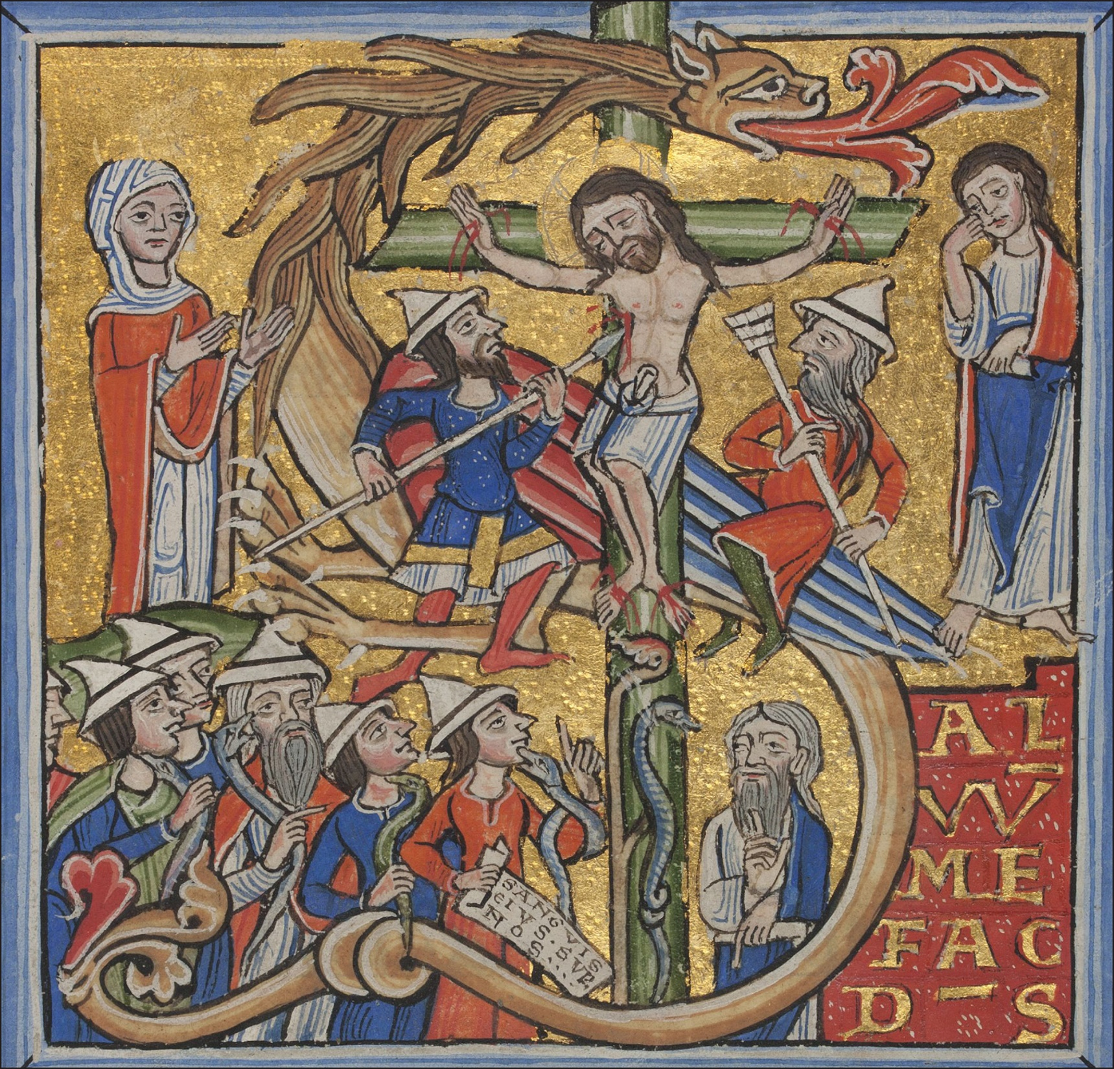
Notes:
Jews mocking and crucifying and killing Jesus
The crucifixion and brazen serpent. Initial to Psalm 68, Peter Lombard, Commentary on Psalms, Paris (?), 1166.
Jews froced to wear pointed hats in Germany to distinguish them

Slide 8
The Jews blamed
Christianity started as a heretical movement within Judaism; its four gospels contain unmistakeable elements of hostility to what was then the Jewish establishment, including shifting blame for Jesus’s death from the Romans to Jewish authorities. By an accident of history, Christians then gained established status in the Roman Empire. Powerful Christianity could now use earlier rhetoric against the Jews to marginalise them.
Diarmaid MacCulloch, Professor of the history of the church, University of Oxford

Slide 9
Conflict in the gospels
Is the conflict between Jesus and the Jews?
Jesus born, lived and died a practising Jew
All Jesus’ followers were Jews
The early church were Jews who believed in Jesus
Conflicts in the gospels are conflicts between Jews
The Pharisees were liberal reforming Jews who became the leaders of Judaism after 70 AD
Jesus was probably a Pharisee

Slide 10
Why does the New Testament appear to be anti-Jewish?
The gospels were written by Jews who believed in Jesus at a time when there was a lot of conflict between the early church and rabbinic Judaism
They were written to try to convince Jews that Jesus was the messiah
Parting of the Ways – defining identities
Conflicts projected back into Jesus time
  Pharisees (ancestors of rabbinic Judaism) accused when in reality it was the High Priest (Sadducees who disappeared)
Gospel writers blamed the Jews and not the Romans for the crucifixion
Notes:
In A.D. 324 Constantine became the ruler of the entire Roman Empire.
The pagan emperor Constantine wanted to unify the rival Christian factions in the Roman Empire for political reasons.
In A.D. 325, he convened the Council of Nicea.
Jesus of Nazareth was declared divine. Jesus was now a god, not a mortal prophet.
Only four of the gospels were chosen as the official gospels of the Church.
New versions of the gospels had to be written. They were edited to make the Romans less culpable and the Jews more culpable for the Crucifixion of Jesus.
Over three hundred other gospels were ordered to be destroyed
(including all Gospels written in Hebrew).
An edict was issued stating that anyone found in possession of
an unauthorized gospel would be put to death.
The Council of Nicea changed the birthday of Jesus from January 6th to December 25th (Natalis Invictus) to match the birthday of Sun-God Sol Invictus (Mithras), and shifted the Sabbath from Saturday to Sunday.
This assimilation of aspects of the pagan Roman religion made Christianity more palatable to the Roman masses.
The Romans felt great animosity toward the Jews because of their constant rebellions against Roman rule.
Blaming the Crucifixion of Jesus on the Jews, unified the Roman pagans and the Christians.

Slide 11
Why is Matthew the way it is?
Written in Antioch by Jews who believed in Jesus for other Jews – 70-90 AD?
  Hebrew Bible the scripture and source of authority for Jews and Christians
  Jesus lineage from Abraham
  Five narratives and discourses – Pentateuch?
  Jesus presented as new Moses
    Sermon on the Mount
    You have heard . . . But I say to you
  Many proof texts – quotes to show that Jesus fulfilled the prophets
Critique of Pauline antinomianism
  Jesus fulfilling and not destroying the law
Notes:
Matthew's prime concern was that the Jewish tradition should not be lost in a church that was increasingly becoming gentile.[1] This concern lies behind the frequent citations of Jewish scripture, the evocation of Jesus as the new Moses along with other events from Jewish history, and the concern to present Jesus as fulfilling, not destroying, the Law.[44] Matthew must have been aware of the tendency to distort Paul's teaching of the law no longer having power over the New Testament Christian into antinomianism, and addressed Christ's fulfilling of what the Israelites expected from the "Law and the Prophets" in an eschatological sense, in that he was all that the Old Testament had predicted in the Messiah.[45]

Slide 12
Why Luke?
Written by author of Acts of the Apostles
Companion of Paul
Written for Pauline church
Jesus lineage traced back to Adam
Gentiles feature frequently
  Of the Roman centurion Jesus said, ‘I tell you, not even in Israel have I found such faith.’
Pauline view of salvation and death of Jesus

Slide 13
And the Gospel of Mark
No birth stories or ancestry
No resurrection
Similar to a Greek tragedy
No particular structure
Incorrect geographical information
Written in Rome?
Written for non-Jews by a Jew
  Explains Jewish customs
  Interpreted as presenting Jesus as breaking with Jewish custom

Slide 14
Dispute over kashrut
Now when the Pharisees who had come from Jerusalem gathered around him, they noticed that some of his disciples were eating with defiled hands, that is, without washing them. (For the Pharisees, and all the Jews, do not eat unless they thoroughly wash their hands, thus observing the tradition of the elders; and they do not eat anything from the market unless they wash it.)
Jesus said to his disciples, ’Do you not see that whatever goes into a person from outside cannot defile, since it enters, not the heart but the stomach, and goes out into the sewer?’ (Thus he declared all foods clean.) Mark 7
Notes:
Jesus Kept Kosher: The Jewish Christ of the Gospel of Mark
By Daniel Boyarin | March 2, 2012
Jesus in Delicatessen
Most scholars say Jesus rejected the Torah's kosher laws in the Gospel of Mark, but did he? A closer look at Mark 7 reveals a Jewish Christ—not a "parting of the ways" between Judaism and Christianity. Credit: Laura Beckman (laurabeckman.com).
In conventional readings of the Gospel of Mark, Jesus’s relationship to the Jewish dietary laws is taken as a watershed moment in religious history, when one set of fundamental beliefs is cast out in favor of a new worldview. For centuries, Christian preachers, scholars, and lay readers of Mark have read the Gospel as teaching us not only that Jesus did not keep kosher but also that he permitted all foods that the Torah had forbidden Jews to eat. This would be a shift of no small moment, as indeed the dietary laws were then and remain today one of the very hallmarks of Jewish religious practice. If Mark has been misread, however, and his Jesus did not abandon or abrogate such basic Jewish practices as keeping kosher, then our entire sense of where the Jesus movement stands in relation to the Judaism of its time is quite changed. In short, if the earliest of Christians believed that Jesus kept kosher, then we have good reason to view that Christianity as another contending branch of Judaism.
The question of the “Jewishness” of Mark lies at the very heart of our understanding of the historical meaning of the Jesus movement in its earliest period. Jesus was, according to the view I defend here, not fighting against the Jews or Judaism but with some Jews for what he considered to be the right kind of Judaism. This kind of Judaism included the idea of a second divine person who would be found on earth in human form as the Messiah (and in the person of that Jesus). The only controversy surrounding Jesus was whether this son of the carpenter of Nazareth truly was the one for whom the Jews were waiting. Taking himself to be that very Jewish Messiah, Son of Man, however, Jesus surely would not have spoken contemptuously of the Torah but would have upheld it.
As read by most commentators, Mark 7 establishes the beginning of the so-called parting of the ways between Judaism and Christianity. This is because, according to the traditional interpretation and virtually all modern scholarly ones, in this chapter Jesus declares a major aspect of the Torah’s laws, the laws of kashrut (keeping kosher), no longer valid, thus representing a major rupture with the beliefs and practices of virtually all other Jews, Pharisaic or not. The representatives of what are arguably the three most central and important scholarly biblical commentary series in the United States, ranging from the Word series for evangelical scholars to the Anchor Bible for the non-confessional and more general (but advanced) audience and then to the very scholarly and secular Hermeneia—which, taken together, represent the closest thing we have to an authoritative modern reading of the passage—all agree on this in their commentaries on Mark 7, even while disagreeing on much else. Thus Adela Yarbro Collins, in her Hermeneia commentary, writes of verse 19 (“and thus he purified all foods”), “The comment of v. 19c [third clause of v. 19] takes a giant step further and implies, at the very least, that the observance of the food laws for followers of Jesus is not obligatory.”
In the evangelical scholarly Word commentary, Robert A. Guelich too writes, “Jesus’ saying in 7:15 explained with reference to what one eats by 7:18b–19 means that no foods, even those forbidden by the Levitical law (Lev. 11–15), could defile a person before God. In essence, Jesus ‘makes all foods clean.’” In his commentary in the time-honored Anchor Bible, Joel Marcus writes that “anyone who did what the Markan Jesus does in our passage, denying this dietary distinction and declaring all food to be permissible (7:19), would immediately be identified as a seducer who led the people’s heart astray from God (cf. 7:6) and from the holy commandment he had given to Moses (cf. 7:8, 9, 13).” This view is the commonly held interpretation of the passage in both the pious and scholarly traditions.
But did the Markan Jesus do this sacrilegious thing, and is this passage truly a parting of the ways between Judaism and Christianity? Reading the text backward from later Christian practices and beliefs about the written Torah and its abrogations, interpreters and scholars have found a point of origin, even a legend of origin, for their version of Christianity in this chapter. In contrast, reading the text through lenses colored by years of immersion in the Jewish religious literature of the times around Jesus and the evangelists produces a very different perspective on the chapter from the one that has come to be so dominant. Anchoring Mark in its proper historical and cultural context, we find a very different text indeed, one that reveals an inner Jewish controversy, rather than an abrogation of the Torah and denial of Judaism.{{{subscriber|2.00}}} [trackrt]
What Did Mark Really Say?
It will be well to have the entire narrative in mind for this discussion, so let me begin by citing the text (presented here without verse numbers, for ease of reading) from the NRSV translation:
Now when the Pharisees and some of the scribes who had come from Jerusalem gathered around him, they noticed that some of his disciples were eating with defiled hands, that is, without washing them. (For the Pharisees, and all the Jews, do not eat unless they thoroughly wash their hands, thus observing the tradition of the elders; and they do not eat anything from the market unless they wash it; and there are also many other traditions that they observe, the washing of cups, pots, and bronze kettles.) So the Pharisees and the scribes asked him, “Why do your disciples not live according to the tradition of the elders, but eat with defiled hands?” He said to them, “Isaiah prophesied rightly about you hypocrites, as it is written, ‘This people honors me with their lips, but their hearts are far from me; in vain do they worship me, teaching human precepts as doctrines.’ You abandon the commandment of God and hold to human tradition.” Then he said to them, “You have a fine way of rejecting the commandment of God in order to keep your tradition! For Moses said, ‘Honor your father and your mother’; and, ‘Whoever curses of father or mother must surely die.’ But you say that if anyone tells father or mother, ‘Whatever support you might have had from me is Corban’ (that is, an offering to God)—then you no longer permit doing anything for a father or mother, thus making void the word of God through your tradition that you have handed on. And you do many things like this.” Then he called the crowd again and said to them, “Listen to me, all of you, and understand: there is nothing outside a person that by going in can defile, but the things that come out are what defile.” When he had left the crowd and entered the house, his disciples asked him about the parable. He said to them, “Then do you also fail to understand? Do you not see that whatever goes into a person from outside cannot defile, since it enters, not the heart but the stomach, and goes out into the sewer?” (Thus he declared all foods clean.) And he said, “It is what comes out of a person that defiles. For it is from within, from the human heart, that evil intentions come: fornication, theft, murder, adultery, avarice, wickedness, deceit, licentiousness, envy, slander, pride, folly. All these evil things come from within, and they defile a person.”
There is such a long history of interpreting this passage that it alone would fill a book. The demons that beset the “tradition history” of this passage are legion; some scholars consider some verses original and others later additions, while others argue just the opposite as to which verses were original and which added later. I am going to cast the demons out by ignoring them and trying to read the text as it is. My goal is to get closer to a sense of what the canonical Gospel of Mark might have meant in its original cultural, religious context, a context that has to be thoroughly known and clearly articulated to do its interpretative work.
The first thing that must be acknowledged is that while the readers of Mark are clearly expected to be far away from traditional Jewish practice as well as from the Aramaic and Hebrew languages, the writer of Mark is anything but distant from and ignorant of these matters. He demonstrates, in fact, a fine and clear understanding of Jewish practice and the Jewish languages, as does his Jesus. This distinction has been missed in much of the earlier work on Mark and especially on this chapter.
Food Can Be Kosher But Not Pure
In contrast to virtually all Christian commentators, I propose that whatever Jesus is portrayed as doing in the above text from Mark—including “and thus he purified all foods”—it is not permitting the eating of all foods, even if we accept every word of the passage as it is before us in the text.
In order to make this proposition stick, it’s very important that we make some distinctions between different domains of the Torah’s law and especially the dietary laws, for there has been much confusion on this score. To call food kosher refers to its permissibility or impermissibility for eating by Jews as defined in the Bible and the later rabbinic literature. Among the foods forbidden are nonruminants such as pigs and rabbits, birds of prey, and sea creatures that have no fins or scales. Meat, to be kosher, has also to be slaughtered in a special way deemed painless to the animal, and milk and meat foods must be kept separate from each other. These laws are observed to the letter by pious Jews even today. Although, somewhat confusingly, animals that are not kosher are referred to as “impure” animals, these kashrut laws have nothing to do with purity and impurity of the body or other items. There is a separate set of rules that define when any food—kosher or not—is pure or impure, depending on how that food was handled and what other things it may have come into contact with. Indeed, there are kosher foods that in some circumstances and for some Jews were forbidden to be eaten, despite the fact that they are in themselves made of entirely kosher ingredients, cooked in kosher pots, and not incorporating milk with meat. Such foods have become impure through some mishap, such as being touched by a person with a flux from his or her body. While all Jews are forbidden always to eat pork, lobster, milk and meat together, and meat that has not been properly slaughtered, only some Jews, some of the time, are forbidden to eat kosher food that has become contaminated with ritual impurity. While in English they are sometimes confused, the system of purity and impurity laws and the system of dietary laws are two different systems within the Torah’s rules for eating, and Mark and Jesus knew the difference. One of the biggest obstacles to this understanding has been in the use of the English words “clean” and “unclean” to refer both to the laws of permitted and forbidden foods and to the laws of pollution or impurity and purity. These translate two entirely different sets of Hebrew words, muttar and tahor. It would be better to translate the first set by “permitted” and “forbidden” and use “clean” and “unclean,” or “pure” and “impure,” only for the latter set.
On one hand, the Torah lists various species of birds, fish and other sea creatures, and land animals that may never be eaten. It also forbids the eating of the sciatic nerve, the consumption of certain kinds of fat on otherwise kosher animals, the consumption of blood, and cooking a kid in its mother’s milk (taken early on by most Jews, apparently, to mean not to cook meat and milk together). Together these rules make up what is called the Jewish dietary laws or kosher rules. As I have mentioned, they apply to all Jews everywhere and always.
Bacon creme cupcakes
The misinterpretation of the Gospel of Mark stems from the conflation of two entirely different systems of rules: kosher dietary laws, which forbid Jews from eating foods such as these creamy bacon cupcakes, and purity laws. Creative Commons/CleverCupcakes.
Purity and impurity, or pollution (tuma’h vetaharah), is an entirely separate system of rules and regulations that apply to a different sphere of life, namely, the laws having to do with the touching of various objects, such as dead humans or humans who have touched dead humans and not washed properly, as well as with other causes of impurity such as skin diseases or fluxes from the body, including menstrual blood and semen (but not excreta), which render a person “impure” according to the Torah but carry no moral opprobrium. People may become impure without any deed on their parts at all. In fact, most Israelites were impure most of the time (and today we all are all the time), since it requires a trip to the Temple to be purified from some kinds of ubiquitous impurities. The touch of such “impure” persons renders certain perfectly kosher foods forbidden to be eaten by Priests or by Israelites who are entering the Temple. During Second Temple times, there is much evidence that many Jews sought to avoid such impurity and to purify themselves as quickly as they could according to the rules from the Torah even if they were not planning to go to the Temple. The Pharisees extended these practices, even legislating that eating kosher food that has been in contact with impurities renders one impure.
According to the biblical system (to which, apparently, the Galilean practice might very well have corresponded), the two sets of rules are kept quite strictly apart. A Jew did not eat nonkosher food, but rules around defiled kosher food depended on various circumstances of the eater’s life and certainly did not render the body of the eater impure.
Carrion in a bag
Carrion (like the putrefying chicken below) is the only food that can render a body impure, according to the Torah. Creative Commons/JessicaReeder.
The pharisaic tradition seems to have extended that prohibition against eating defiled kosher food and also rendered the eater him- or herself impure through this eating. The Pharisees sought to convince other Jews to adhere to their new standards of strictness (this is apparently the meaning of them going over land and sea to convert—they were attempting to “convert” other Jews, not Gentiles). They therefore instituted a practice of ritual hand purification by pouring water over the hands before eating bread, so that the hands would not make the bread impure.
Thus, in order to understand what Jesus is talking about in the Gospel, we must have a clearer sense of what his terminology might have meant in his cultural world, not ours. In the Gospel, we are told that Pharisees have come from Jerusalem, apparently to proselytize for their understanding of the Torah and its rules, including these extensions of the purity regulations, such as the washing of the hands. Jesus protests, asserting that foods that go into the body don’t make the body impure; only things that come out of the body have that power to contaminate. So really what the Gospel describes is a Jesus who rejects the pharisaic extension of these purity laws beyond their original specific biblical foundations. He is not rejecting the Torah’s rules and practices but upholding them.
Mark Reveals His Own Jewishness
In contrast to many earlier views, it’s clear that Mark knew very well what he was talking about when he discussed the pharisaic ritual practices and purity rules. The clearest demonstration of this involves a word in the Greek that is usually obscured in English translations of Mark 7:3: “οἱ γὰρ Φαρισαῖοι καὶ πάντες οἱ Ἰουδαῖοι ἐὰν μὴ πυγμῇ νίψωνται τὰς χεῖρας οὐκ ἐσθίουσιν, κρατοῦντες τὴν παράδοσιν τῶν πρεσβυτέρων [For the Pharisees and all of the Judaeans do not eat unless they wash the hands with a fist, according to the tradition of the Elders].” Scholarship has only recently adopted the translation “with a fist” after centuries of emendation of the text against the dominant textual tradition. The usage “with a fist,” albeit for fighting or hitting, is attested in the ancient Greek translation of the Bible, the Septuagint, more than once (Exodus 21:8; Isaiah 58:4).
As anyone who has seen Jews actually performing the ritual of hand washing would guess immediately, Mark is referring to the process of forming a loose fist with one hand and pouring water over that fist with the other. I would suggest, moreover, that Mark’s emphasis on “with a fist” might well be a description of the practice itself but also an allusive, almost punning reference to the pugnaciousness of these Pharisees. But regardless of that last point, when the Gospel is understood in this manner it provides incredibly precious evidence, available nowhere else, of the great antiquity of a Jewish practice otherwise attested only later. If Mark was such a close observer and manifests such intimate knowledge of Pharisaic practice, then my assumption as I read the passage is that he knew of what he spoke all the way down. This suggests strongly that his perspective (as well as that of his Jesus) is firmly from within the Jewish world—nearly the opposite of what has been usually said of Mark.
Loyal to the Written Torah, Jesus Attacks the Pharisees’ Innovations
Yair Furstenberg, a young Talmud scholar at the Hebrew University, has recently provided a convincing explanation of the basic controversy between Jesus and those Pharisees. Furstenberg writes that Jesus’s statement needs to be read literally to mean that the body is made impure not through ingesting impure foods but only through various substances that come out from the body. As noted, according to the Torah it is not what goes into the body that makes one impure but only things that come out of the body: fluxes of blood, semen, and gonorrhea. The only food, according to the Torah, that renders a body impure is carrion—certainly not the eating of permitted food that has become impure, or of forbidden foods generally. According to the Talmud itself, it was the Rabbis (or the legendary Pharisees) who innovated the washing of the hands before meals—which implies that the ingesting of defiled or polluted foods renders one impure. It was thus against those Pharisaic innovations, which they are trying to foist on his disciples, that Jesus railed, and not against the keeping of kosher at all. This is a debate between Jews about the correct way to keep the Torah, not an attack on the Torah. Furstenberg has brilliantly argued that in its original sense, Jesus’s attack on the Pharisees here is literal: they have changed the rules of the Torah. This is made clear in Zabim 5:12, a key rabbinic text, which, while much later than the Gospel, ascribes a change in the Halakha to the time of Mark:
These categories render the priestly offering unfit [to be eaten by the Priests]: He who eats directly impure food; ... and he who drinks impure fluids; ... and the hands.
If someone eats or drinks impure food, then his touch renders the priestly portion impure and unfit for the priests. This innovative ruling is, moreover, explicitly connected in the list with the hands as well, just as the Markan Jesus associates them. Now, these rulings are explicitly marked within the talmudic tradition as being of rabbinic origin and not as rulings of the Torah. That is to say, the classical rabbis themselves maintained a distinction between what was written in the Torah and what had been added by them or by their Pharisaic forebears. They explicitly remark that here we have a Pharisaic extension of the Torah, thus confirming what Jesus said. According to the Torah, only that which comes out of the body (fluxes of various types) can contaminate, not foods that go in. Thus, if the Pharisees argue that food itself contaminates, that is a change in the law.
The attack on hand washing in the story is, moreover, consistent with Jesus’s subsequent attack on the vow that releases one from supporting one’s parents:
But you say that if anyone tells father or mother, “Whatever support you might have had from me is Corban” (that is, an offering to God) then you no longer permit doing anything for a father or mother, thus making void the word of God through your tradition that you have handed on. And you do many things like this.
Jesus here accuses the Pharisees of having abandoned the plain sense of the Torah, which requires that Jews support their elderly parents. They have allegedly done this by asserting that one who takes a vow not to allow his parents to use any of his possessions—as if those possessions were a sacrifice dedicated to God—has effectively prohibited himself from providing such support.
This represents another instance in which the Pharisees apparently supplant the Torah with their “tradition of the Elders.” Once again, Jesus and Mark have got it exactly right in terms of the Torah and the oral traditions exemplified by the Pharisees and other innovators. For Jesus (Mark) the “tradition of the elders” is a human creation, as opposed to the written Torah, which is divine. Hence the force of the citation from Isaiah, in which Jesus says to the Pharisees, “Isaiah prophesied rightly about you hypocrites, as it is written, ‘This people honors me with their lips, but their hearts are far from me; in vain do they worship me, teaching human precepts as doctrines.’ You abandon the commandment of God and hold to human tradition.”
From Jesus’s point of view, the “tradition of the elders”—later called the oral Torah—is exactly “human precepts” being taught as doctrines, as in the prophetic formulation. For the Pharisees, and later for the Rabbis, the “tradition of the elders” is divine word and not human precepts (though they were transmitted orally rather than scripturally). In this case, moreover, we have an admittedly Pharisaic innovation, contested even by some other Pharisees. No wonder that Jesus would balk and protest. What I hope to have shown in this section is that when Mark wrote the words “καθαρίζων πάντα τὰ βρώματα [purifying all foods],” there is little reason to believe that it meant “thus he permitted all foods,” but rather, “thus he purified all foods,” meaning that he rejected the extra-stringent laws of defiled foods to which the Pharisees were so devoted—not the kosher rules. Jesus was certainly not sanctioning here the eating of bacon and eggs; rather, exactly as the text says, he was permitting the eating of bread without ritual washing of the hands, quite a different matter. The controversy ends where it began, in a contest over the question of bodily impurity caused by the ingestion of impure foods. It is highly unlikely that in its original context Mark was read as meaning that Jesus had abrogated the rules of forbidden and permitted animals.
What makes this not merely “a halakhic [legalistic] squabble between first-century Jews” (to echo a colorful bon mot of John Paul Meier’s) is Jesus’s use of the controversy to make a strong theological claim in the form of the parable. Whether or not the Pharisees were hypocrites (I would imagine that some were and some were not), it is certainly the case that to concern oneself with extraordinary performances of external piety while ignoring (or worse) the ethical and spiritual requirements of the Torah is poor religion, on the order perhaps of preaching that Jesus is love but hates homosexuals. We should remember, however, that “in general, in ancient Jewish and Christian contexts a ‘hypocrite’ is a person whose interpretation of the Law differs from one’s own,” as Joel Marcus has so sharply put it. There is a story of the nineteenth-century Rabbi Mendel of Kotzk (the famous Kotzker Rebbe) who said that many Jews concern themselves more with a blood spot on an egg than a blood spot on a ruble, but surely he himself remained just as careful about blood spots on eggs and expected no less from his followers “and all the Jews.” (Recently Marcus has re-cited the Kotzker’s apophthegm in precisely this Markan context.) Jesus’s homily is indeed in this radically critical Jewish tradition that began with the great prophets and continued for millennia.

Slide 15
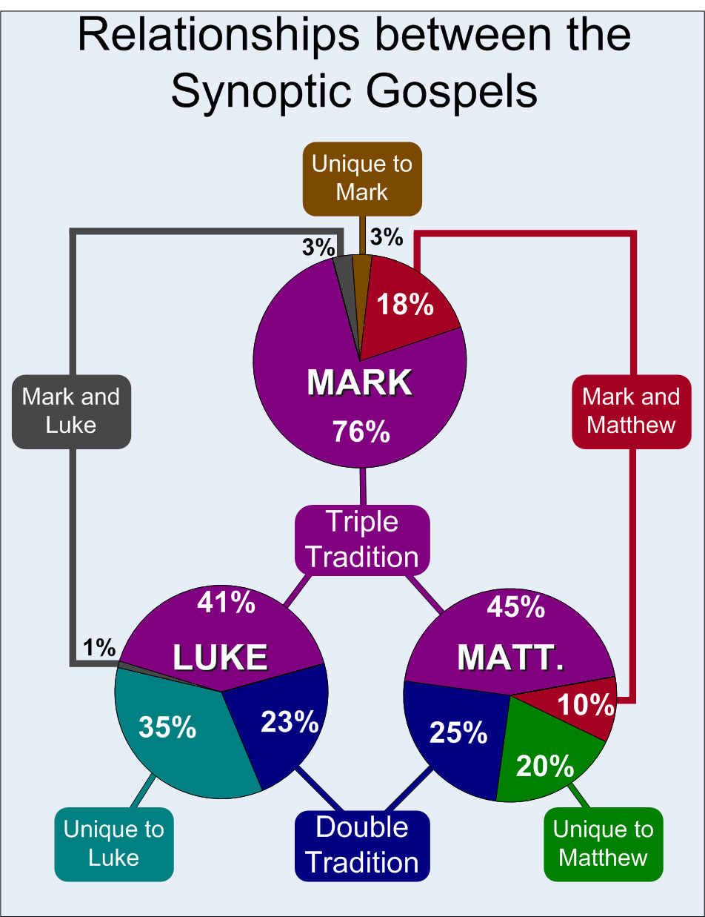
The synoptic problem
There is a lot of overlap in the text of the 1st three gospels
What is the relationship between them?
Which is the oldest?
Augustine thought Matthew was oldest, Mark based on Matthew plus teachings of Peter and Luke last
Notes:
The Augustinian hypothesis is a solution to the synoptic problem, which concerns the origin of the Gospels of the New Testament. The hypothesis holds that Matthew was written first, by Matthew the Evangelist (see the Gospel According to the Hebrews and the Jewish-Christian Gospels). Mark the Evangelist wrote the Gospel of Mark second and used Matthew and the preaching of Peter as sources. Luke the Evangelist wrote the Gospel of Luke and was aware of the two Gospels that preceded him. Unlike some competing hypotheses, this hypothesis does not rely on, nor does it argue for, the existence of any document that is not explicitly mentioned in historical testimony. Instead, the hypothesis draws primarily upon historical testimony, rather than textual criticism, as the central line of evidence. The foundation of evidence for the hypothesis is the writings of the Church Fathers: historical sources dating back to as early as the first half of the 2nd century, which have been held as authoritative by most Christians for nearly two millennia. Adherents to the Augustinian hypothesis view it as a simple, coherent solution to the synoptic problem.

Slide 16
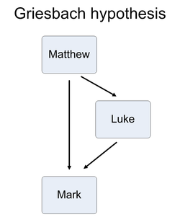
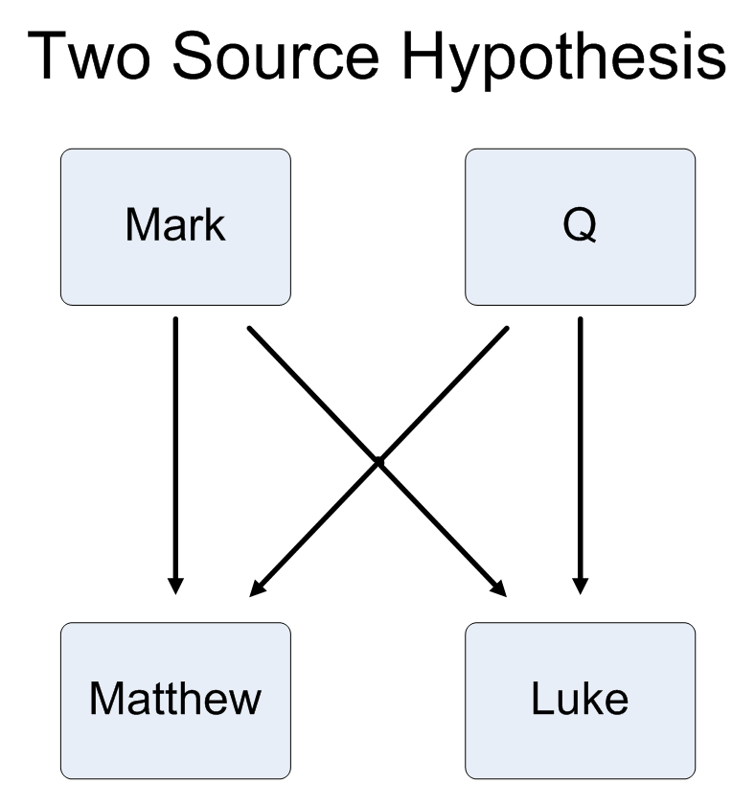
Basic solutions

Slide 17

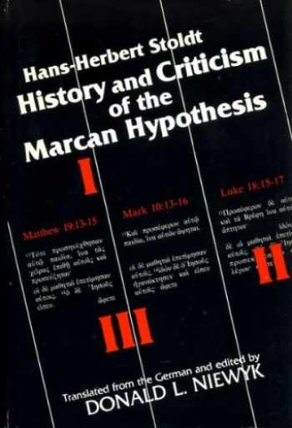

Slide 18
Judaism
One God
God is good – love and justice
God is the creator of the world
The created or natural world is good
All humans beings are God’s children
  Absolute separation. No divine people
Human beings have free will
People should live a moral life
People should create a good society
Life in the world to come
Covenant with the people of Israel
  Unconditionally God’s chosen people
  Living in the Land of Israel though is conditional

Slide 19
Some key gnostic tenets
Dualism
  Good and evil principles
  Spirit is good matter is evil
  Material world created by demi-urge
Pre-existent Christ
  Descending – ascending redeemer
  Redeemed redeemer
Some people have divine spark
  Predestined to be saved
Salvation through gnosis
  Knowing the passwords to get past the archons

Slide 20
Origins of Gnosticism
If you had been a thinking Jew who had lived through the hope and disappointment of that period, there aren’t a lot of options. Either you can go on hoping that someone else will arise to be the real Messiah of Israel. Or secondly, you could abandon Judaism completely. If you chose the latter course, you could embrace Christianity with its teaching that the Messiah of Israel had already arrived in the person of Jesus Christ, but that the redemption He brought looked very different to the revolutionary agendas of Bar-Kokhba and other would-be Messiahs. Or thirdly, you might be tempted to retain some remnants of Judaism but to start reading your Old Testament upside down in which the God of Israel is now the bad guy.
Notes:
Worse than Babylon. The just 10 000 into exile.

Slide 21
Focus is salvation - escape
As Jews who took this third option began reading the scriptures backwards, they began to realize that the world is a corrupt and low-grade realm precisely because it was created by a corrupt and low-grade god, himself the offspring of a higher deity of which we occasionally catch a glimpse. Known sometimes as “father”, the God behind the bad creator god offers us redemption, but not the physical redemption that Israel had always hoped for; rather, salvation is now seen in terms of salvation from the space-time universe. Salvation is a chance for certain enlightened individuals to escape from the world that the bad god of Genesis 1 erroneously proclaimed to be good. Robin Phillips
Notes:
Salvation as Escape from the Body (Gnosticism and Evangelicalism, part 1)
FEBRUARY 6, 2012
READ NEXT
Resurrection and the Sanctification of Matter (Gnosticism & Evangelicalism, 2)
This article was originally published in my column at the Colson Center. It is republished here with permission. For a complete directory of all my Colson Center articles, click here.
“Now if Christ is proclaimed as raised from the dead, how can some of you say that there is no resurrection of the dead?” 1 Corinthians 15:12
Resurrection or disembodiment?
In his book Heaven is Not My Home: Learning to Live in God’s Creation, Paul Marshall quotes a Time Magazine report from the close of last century. Time had reported that two thirds of Americans who say they believe in the resurrection of the dead do not believe they will have bodies after the resurrection.
More recently, a Scripps Howard/Ohio University poll interviewed 1,007 American adults and discovered that only 36% of them said “yes” to the question: “Do you believe that, after you die, your physical body will be resurrected someday?” Yet most of these same Americans also acknowledged being believers and going to church.
The Christians who were polled reflect the increasingly common notion that the culmination of salvation is to live in heaven for eternity as disembodied spirits rather than to have our physical body raised from the dead. The Time Magazine poll suggests that this is now often what people assume the word ‘resurrection’ means.
Many who rightly consider it a sign of theological liberalism to spiritualize Christ’s resurrection into something non-physical are quite comfortable doing just that when it comes to their own. This stands in contrast to both the Bible (particularly 1st Corinthians 15) and ancient Christian creeds (particularly the Apostles Creed and the Nicene Creed), which taught that the resurrection of the physical body is the culmination of salvation.
The physical against the spiritual?
Although the Christians who were polled did not realize it, their thinking had been deeply tinctured by the heresy of Gnosticism. Gnosticism was a movement that developed in the second and third century based, among other things, on a radical separation of the physical and spiritual realms. The doctrine of resurrection (both Christ’s resurrection and our future bodily resurrection) was deeply troubling for the Gnostics, given that they understood the material realm (including physical bodies) to be inherently unspiritual.
Tinctured with Gnosticism
The doctrine of resurrection is not the only area that the contemporary Christian community has been infected with Gnostic assumptions.
Have you ever run into the pietistic idea that the Biblical worldview is primarily about what happens in our heart, rather than something that applies to all of culture and the world?
Have you ever heard someone say that Christianity isn’t a religion, it’s a relationship, where the person who says this is wishing to de-emphasizes the corporate and structural connotations that come with the term ‘religion’?
Have you ever come across the idea that there is a complete discontinuity between what happens in this world and what will happen in the age to come?
Have you ever come across the notion that institutional religion and/or religious rituals are at odds with genuine heart-felt faith, and that whatever we give to the former is less we have left over for the latter?
Have you ever heard someone argue that Christians shouldn’t raise their hands in worship or make the sign of the cross on themselves since worship is more spiritual if it doesn’t involve the body?
Have you ever encountered the notion that God isn’t concerned with issues of ecology and how we treat the created world?
Have you ever heard someone say that rock music is evil because the rhythms appeal to our body rather than to our spirit or soul?
If you answered yes to any of the above questions, then there is a high probability that you have been exposed to some form of Gnosticism or its derivations. In fact, you may even have some Gnostic ideas yourself without realizing it. The fact is that Gnosticism tends to be so pervasive that it tinctures our thinking in so many areas, even influencing how we read the Bible.
This year at the Chuck Colson Center, I will be using the Perspectives column to present an ongoing series in which I will consider the impact that Gnostic assumptions have had on the contemporary church. I hope to disentangle many of the Gnostic concepts we take for granted from what the Bible actually teaches. However, before we are in a position to do that, we need to have a little history lesson about who the Gnostics were and what they actually believed.
The Nag Hammadi discoveries
Although it is probable that certain parts of the New Testament (perhaps 1 Timothy 1:4 and 1 John) were written to combat the early genesis of a Gnosticized Christianity, and while many of the church fathers regarded the sorcerer Simon Magus of Acts 8:9-24 as being the founder of the movement, it was not until the second century that there is any evidence of Gnosticism fully formed.
Until the second half of the 20th century, our knowledge of Gnosticism was primarily limited to the writings of men who had opposed it, such as Saint Irenaeus. However, in 1945, thirteen ancient codices containing over fifty texts were discovered at Nag Hammadi in Egypt. This has greatly expanded our understanding of the movement, in addition to raising some uncomfortable questions concerning the parallels between ancient Gnosticism and contemporary Christianity, particularly evangelicalism.
What the Nag Hammadi discoveries made clear is that Classical Gnosticism included to a broad network of religious movements which developed independently of Christianity in the second century, possibly earlier, but which quickly morphed to take on a Christian hue. Being fundamentally syncretistic, the various Gnostic systems absorbed different aspects of Judaism, Hellenic philosophy and Christianity, using the categories familiar to these religions but subtlety altering them.
The origins of Gnosticism
Since the discoveries at Nag Hammadi, many scholars have speculated about the origins of Gnosticism. In his book Judas and the Gospel of Jesus, Tom Wright suggests that the first Gnostics may have been deeply discontented Jews who wanted to preserve the basic storyline of the Jewish religion while interpreting it in radically subversive ways.
There is a certain plausibility to Wright’s suggestion. Imagine being a faithful Jew who had lived to see the destruction of Jerusalem in AD 70. In 132 you pin all your hopes on Bar Kokhba, a would be Jewish Messiah who promised to rebuild the temple. You join tens of thousands of other faithful Jews in announcing that the redemption of Israel has finally arrived. In fact, you and the other revolutionaries are so excited that you even commemorate the occasion by the minting new coins inscribed with the year 1. Then in 135, following a two-year war, the Romans bitterly crushed your movement, doing to Bar Kokhba what they always did to Jewish Messianic figures.
If you had been a thinking Jew who had lived through the hope and disappointment of that period, there aren’t a lot of options. Either you can go on hoping that someone else will arise to be the real Messiah of Israel. Or secondly, you could abandon Judaism completely. If you chose the latter course, you could embrace Christianity with its teaching that the Messiah of Israel had already arrived in the person of Jesus Christ, but that the redemption He brought looked very different to the revolutionary agendas of Bar-Kokhba and other would-be Messiahs. Or thirdly, you might be tempted to retain some remnants of Judaism but to start reading your Old Testament upside down in which the God of Israel is now the bad guy.
As Jews who took this third option began reading the scriptures backwards, they began to realize that the world is a corrupt and low-grade realm precisely because it was created by a corrupt and low-grade god, himself the offspring of a higher deity of which we occasionally catch a glimpse. Known sometimes as “father”, the God behind the bad creator god offers us redemption, but not the physical redemption that Israel had always hoped for; rather, salvation is now seen in terms of salvation from the space-time universe. Salvation is a chance for certain enlightened individuals to escape from the world that the bad god of Genesis 1 erroneously proclaimed to be good.
Strange as this retelling of the Jewish story sounds, the discoveries of the last century suggest that the genesis of Gnosticism may indeed lay in the frustrated conjectures of tired and highly cynical Jews who had lived through the crushed hopes of the 130’s.
Other scholars have suggested that the Gnostic dialectic emerged from the intersection of Middle Eastern dualism, Jewish theism and Hellenistic astrology in the Post Alexander the Great world. Whatever its origins, one thing is certain: Gnosticism became highly attractive to cynics who had lost hope in the goodness of creation. Against mainline Jewish and early Christian thought, the texts of the Nag Hammadi collection are characterized by what Marvin Meyer and James Robinson have called “an estrangement from the mass of humanity, an affinity to an ideal order that completely transcends life as we know it, and…a withdrawal from involvement in the contamination that destroys clarity of vision.”
SEE ALSO
GNOSTICISM
Plato and the Physical Body
The Gnostic doctrine of salvation
At its most basic level, the Gnostics taught that salvation could be achieved through the attainment of hidden, esoteric knowledge (‘Gnosis’ in Greek). Significantly, this was not salvation from sin; rather, it was salvation from the inherently bad material world. Indeed, the pursuit of a spirituality independent of the trappings of time and matter was the goal toward which Gnostic soteriology strived. Only those who were willing to reject the trappings of space, time and matter could find deliverance in the realm of pure spiritual bliss.
Jesus, they suggested, is not to be identified with the evil creator of the world; rather, He is the redeemer who shows us how to escape from the universe. He comes from the realms beyond (the upper spiritual realm undiluted by matter) to show the chosen few that they have within themselves a divine spark. By listening to this divine spark instead of the pressing influences of the material world around them, the elect can achieve enlightenment in this life and immortality in the next.
While there were a variety of reasons the Gnostics thought that the physical world is bad, the most basic reason is because they believed the universe to be the product of an inferior deity. As Philip Lee put it in his book Against the Protestant Gnostics:
“the material world itself is the result of a cosmic faux pas, a temporary disorder within the pleroma. The ancient gnostic, looking at the world through despairing eyes, saw matter in terms of decay, place in terms of limitation, time in terms of death. In light of this tragic vision, the logical conclusion seemed to be that the cosmos itself – matter, place, time, change, body and everything seen, heard, touched or smelled – must have been a colossal error.”
While many Gnostics had different theories concerning the origins of the world, they did all share the same basic soteriology: the pathway to salvation lies in escaping from the material world to a realm of pure spirit. Jesus played an important role in this process since offered the gnosis necessary for the liberation of our spirits. But unlike the salvation offered by the Christ of the canonical tradition, which was publicly available to all, the Jesus of Gnosticism offered salvation only to an elite. The opaque and cryptic remarks attributed to Jesus by the various Gnostic texts (most notably, The Gospel of Thomas), together with an appeal to a secret oral tradition transmitted through the apostles, helped to keep salvation the preserve of an enlightened elite and separate from the mass of humanity. The Gnostics thus took a very negative view of the visible church.
Summary of Gnostic theology
We can summarize the main tenants of Gnosticism as follows:
Doctrine of Creation: The created world is corrupt precisely because it is material. That which is physical is inherently non-spiritual.
Doctrine of the Fall: Man’s fundamental problem is not that he is a sinner but that he is material.
Doctrine of Christ: Jesus merely appeared to have a material body (Docetism). The human and physical element in the person of Christ is a deceptive appearance. As church historian J.N.D. Kelly put it in Early Christian Doctrines, “Because in general they disparaged matter and were disinterested in history, the Gnostic (in the narrower, more convenient sense of the term) were prevented from giving full value to the fundamental Christian doctrine of the incarnation of the Word.” In some versions of Gnosticism, such as the one reflected in the Gospel of Judas, Jesus did have a physical body but He wished to escape from it.
Doctrine of Salvation: Salvation lies in escaping from the material world to a realm of pure spirit. This is attained through private gnosis/knowledge offered by Jesus – a gnosis that awakens a divine spark within the individual.
Doctrine of the Church: The people of God are the enlightened elite who have obtained the gnosis necessary for salvation. This stood in sharp contrast to the institutional or visible church.
Doctrine of the World: What happens in the world is of little to no importance.
Doctrine of Revelation: True revelation comes through a secret oral tradition handed down by the apostles, in contrast to the open, public tradition of the universal church embedded in the sacred writings.
When the tenants of Gnosticism are distilled like this, it is hard to see any point of contact with evangelical Christianity. However, like a species struggling for evolutionary survival, Gnosticism has always had a curious knack of being able to blend into its contemporary environment, shedding certain characteristics and taking on others to the degree necessary for its own perpetuation. As such, Gnosticism should not be seen as a fixed ideology like Epicureanism or Platonism, but as a living, organic principle that constantly mutates to meet the demands of its environment.
Despite all its placidity, complexity and ambiguity, however, Gnosticism can be reduced to two primary narratives: the quest for hidden ‘gnosis’, on the one hand, and a hostility towards the material world, on the other. Although the two of these are usually related (indeed, the function of ‘gnosis’ was to enable the subject to escape from the material realm), we will see that it is the latter narrative that yields insight into the psychology of much contemporary evangelicalism, not least in its frequent denials of bodily resurrection.
Implicit theology
Finally, it is important to understand that when I talk about Gnostic influences on evangelicalism, I am not referring to specific causal links between a second- and third-century Mediterranean movement and what Christians today espouse. Rather, I have in mind a correlation of ideas which exist on the level of implicit theology.
I am using the term “idea” here in the broad sense that Tom Wright articulated when he wrote about worldviews in The New Testament and the People of God or that Charles Taylor has described as the “social imaginary” in A Secular Age or that James Davison Hunter talked about with the language of “pre-reflective frameworks” in To Change the World or that James K.A. Smith articulated as being the ‘adaptive unconscious’ in Desiring the Kingdom. What these and other authors have tried to focus our attention on is not ideas that exist as disengaged concepts in a person’s head, nor ideas that can be reduced to a set of propositions on paper; rather, they are all urging us to give attention to ideas that exist as unstated understandings that make up the ‘background’ to how a people make sense of their world.
Such “ideas” exist as implicit understandings and may or may not ever be explicitly articulated or cognitively recognized. They are, as Taylor describes it, the largely unfocussed background which gives cohesiveness to group experience, “something much broader and deeper than the intellectual schemes people may entertain when they think about social reality in a disengaged mode.” It is on this deeper level that I suggest evangelicalism bears the Gnostic imprint in many ways. Indeed, questions about evangelical crypto-Gnosticism need to be addressed at this more operational and implicit level, since we are dealing more with concepts embedded in the adaptive unconscious than doctrines expounded from the pulpit or lectern. We are dealing with a network of inchoate practices, assumptions and conventions which implicitly ‘carry’ certain Gnostic notions, even while the doctrinal formulations may not explicitly affirm them.
Next steps
Review this first article in Robin’s series. Then, complete the following sentence: “You might be a Gnostic if…” Next, evaluate your own faith in Jesus Christ. Can you see any areas where Gnosticism is trying to undermine your faith in the Lord?

Slide 22
A new gospel
The gospel of Jesus
  Repent, the kingdom of God is at hand
    Political, social, economic, cultural transformation to create model society – theocracy
      Authentic teaching – never happened – so what to do?
    Required personal transformation
    Required resolving the issue of the Roman occupation
The gospel of Paul
  Repent and be born again and be saved so that when you die you will go to heaven
    We preach Christ crucified for the forgiveness of sins
    Return of Christ and Kingdom of God immanent
    Spiritualised message – spiritual salvation

Slide 23
Marcion of Sinope 85 – 160
Rejected the Hebrew Scriptures
Rejected the God of the Old Testament
  Harsh, cruel, spiteful, vindictive, genocidal
  Not Jesus’ loving Father
God is perfect love and merciful
  Not a God of justice and law
  Jesus came to free man from the law
  The preaching in the church today that we are no longer under the Law but under grace alone is part of his theology – Lewis Loffin
Notes:
Marcion's Church Not Really Gnostic?
Compiled from various sources by Lewis Loflin.
Grace - a word which has so oftentimes been mentioned by the lips of Christians. There has been so much emphasis on grace that most Christians have comparatively little knowledge and understanding of the Law as in the Old Testament.
The fact the Church and Protestants in particular won't really follow anything in the Old Testament or even Jesus himself in Matthew, Mark, and Luke has always puzzled me. "In God we trust" will now be required to be hung in every school in Virginia yet none of God's Commandments are followed at all and never have been.
Most amazing is the level of brainwashing is so severe that Christians in general are not even aware that this shift of focus had been propagated in the 2nd century.
At the beginning, after all the apostles had died, the leaders who replaced them were mostly Gentile pagans. These Gentiles had comparatively little understanding of the Old Testament Scriptures unlike the Jewish apostles who had been exposed to the teachings of the Law and the Prophets since birth.
This caused a shift in focus to the New Testament (written by fellow converts) and the elimination of anything Jewish. This was very true of the moral codes which Jesus exalted his followers to obey. So what caused the church to virtually ignore the Law, the Hebrew Prophets, all the Apostles (except the Gnostic John), and even Jesus himself and focus full attention to Paul and his writings on grace? The name is Marcion.
Marcion was born around 100 C.E. at Sinope, a seaport located on the Black Sea coast of modern Turkey. His father was a leader in the church and so Marcion grew up in fellowship with the church in Asia Minor. Around 138 C.E., he traveled to Rome and became a member of one of the Roman churches.
As a wealthy ship-owner, he made large contributions to the church and he became a respected member in the Christian community. He was eloquent and learned in the contemporary form of the Gospel and the early Christian community and so gave the impression of being a Christian teacher with apostolic authority.
While Marcion was later condemned as a heretic over his unorthodox views and booted out of the Church in Rome, by the end of the 2nd century his doctrine became a serious threat to the mainstream Christian Church. His strange kind of Christianity had swept across large sections of the Roman Empire.
Marcion's reference was always the teachings of Paul (the only apostle whom he trusted), especially that of the saving grace. In his belief, the saving grace of God was miraculous.
He held the Gnostic idea the whole creation to be faulty, being the creation of a lesser god, thus containing no element of the divine. Marcion was influenced by Persian dualism (or two forces in the universe, one good and one bad, who are constantly fighting it out for supremacy) and believed that the Creator God who created the material universe was the God of Israel, who was a totally different God from the Father spoken of in the gospel of Christ.
This is where Orthodox Christians and Gnostic Christians part company is on the Creation. Orthodox believe Creation (physical world and man) became "corrupt" with Adam and "the Fall" where Gnostics believe Creation was corrupt to begin with while spirit was good.
All of this nonsense ran contrary to the Hebrew Scriptures. "In Hebrew thought, the chief virtue was in oneness, wholeness, "shalom." There is one God, Yahweh. There is one world consisting of the heavens, the earth, and Sheol under the earth, and all creation is good. Each human being is wonderfully made as one cohesive unit. Salvation is found in living life in covenant relationship with Yahweh, and salvation is experienced in immediate time, as well as in the future...
In Hebrew thought, the Messiah is a human being, raised up from the people, chosen by God and anointed to serve and cause redemption to come to the people Israel. In Gnostic thought, the Savior is a god, sent down from the pleroma to Earth by the main good god to teach all who will listen to the magic words, for the salvation of their souls. " Thus Christians kept only parts of Gnosticism at Nicaea in 325 CE, The Savior became God under the Trinity. The Savior is God, not a god.
The Father Marcion held as the highest was perfect, good and merciful. He was love and He was not the god of justice and the lawgiver of the Old Testament, the bad God. Christians today don't see it this way but have mentally merged the Old Testament bible-god who committed numerous acts of horror with the good god of Marcion. He further claimed no good could be found in the Old Testament and that after Jesus Christ, the Law was obsolete. Jesus had come to free man from the Law.
He believed that the gospel is entirely a gospel of love to the exclusion of the Mosaic Law. The preaching in the church today that we are no longer under the Law but under grace alone is part of his theology. I suspect many later writings attributed to Paul may have come from or were edited by Marcion's followers, but we will never know for sure.
Marcion, therefore, rejected the entire Old Testament. Today, many believers also make a clear division between the Old Testament Law and New Testament grace, and view the Law as opposed to grace. The Law is seen as obsolete and of little use to a Christian. They shun the Old Testament God because He is too stern. They would rather focus on the "New Testament God" who does not expect obedience to His laws.
All of this puts Christians in a quandary; they want the moral authority of the Old Testament they just don't want to follow most of it. For Marcion, the church was to replace the synagogue, grace was to replace the Law, pagan holidays were to replace the Holy Days of the Lord as found in Leviticus 23, spiritual Israel was to replace physical Israel, and the church was Israel's replacement and was now to receive all that had been promised to Israel.
While this found favor his other ideas didn't. One was not allowed to eat meat, fish, eggs, etc or drink wine. Christians could not serve as guards or soldiers and were not allowed to bear weapons. There was to be no contact with the opposite sex. The institution of marriage was scorned and birth of children forbidden.
Although there was conversion in his church, the lay community did not like his message. Even church officials who used certain passages in the Bible, especially in the Old Testament, to acquire wealth (the Old Testament preserved gifts, offerings and tithes for the priesthood) saw Marcion's theology as a threat to their treasury.
For several generations, Marcion's church survived. Although Marcion's anti-Jewish, pro-Paul churches spread throughout the Roman Empire and became a threat to the Messianic faith, the irony remains that his replacement theology has infiltrated into the church of today. So it's just grace alone based only on faith alone that is taught in fundamentalist' churches today. No morals, no Law, just grace and do whatever one wants unto everybody else.
Simon was a Samaritan magus or religious figure of the 1st century AD and a convert to Christianity, baptised by Philip the Evangelist. Simon later clashed with Peter. Accounts of Simon by writers of the second century exist, but are not considered verifiable.[1][2] Surviving traditions about Simon appear in orthodox texts, such as those of Irenaeus, Justin Martyr, Hippolytus, and Epiphanius, where he is often described as the founder of Gnosticism
Cerdo (Greek: Κέρδων) was a Syrian gnostic who was deemed a heretic by the Early Church around the time of his teaching, circa 138 AD. Cerdo started out as a follower of Simon Magus, like Basilides and Saturninus, and taught at about the same time as Valentinus, Marcion and them. According to Irenaeus, he was a contemporary of the Roman bishop Hyginus, residing in Rome as a prominent member of the Church until his forced expulsion therefrom.
He taught that there were two gods, one that demanded obedience while the other was good and merciful. According to Cerdo, the former was the God of the Old Testament who had created the world. He also said that the latter God was superior but that he was only known through his son, Jesus. Like later gnostics, he was a docetist who rejected the bodily resurrection of the dead.

Slide 24
Impact of Marcion
Conceived the first New Testament Canon
  Purged of Jewish elements
  Gospel Luke with Jewish elements edited out
    Gospel of Mark?
  10 Pauline letters, abrogated OT law
  Led to early church determining the canon
Strict vegetarian, no wine, marriage or sex
Excommunicated 144 in Rome
  Irenaeus: Adversus haereses: "Detection and Overthrow of the False Knowledge"
Marcionites in Khorasan in 10th century

Slide 25
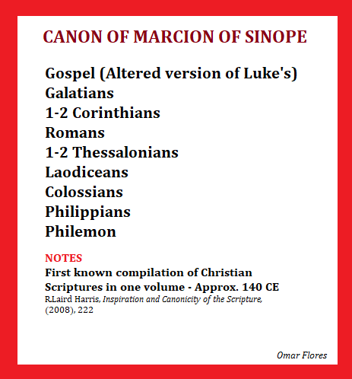
Marcion’s canon
Like the Gnostics, Marcion believed Jesus was essentially a divine spirit who appeared to human beings in human form, but did not actually take on a fleshly human body.
Marcion considered Paul to be the correct interpreter and transmitter of Jesus' teachings
Notes:
Cerdo (Greek: Κέρδων) was a Syrian gnostic who was deemed a heretic by the Early Church around the time of his teaching, circa 138 AD. Cerdo started out as a follower of Simon Magus, like Basilides and Saturninus, and taught at about the same time as Valentinus, Marcion and them. According to Irenaeus, he was a contemporary of the Roman bishop Hyginus, residing in Rome as a prominent member of the Church until his forced expulsion therefrom.
He taught that there were two gods, one that demanded obedience while the other was good and merciful. According to Cerdo, the former was the God of the Old Testament who had created the world. He also said that the latter God was superior but that he was only known through his son, Jesus. Like later gnostics, he was a docetist who rejected the bodily resurrection of the dead.

Slide 26
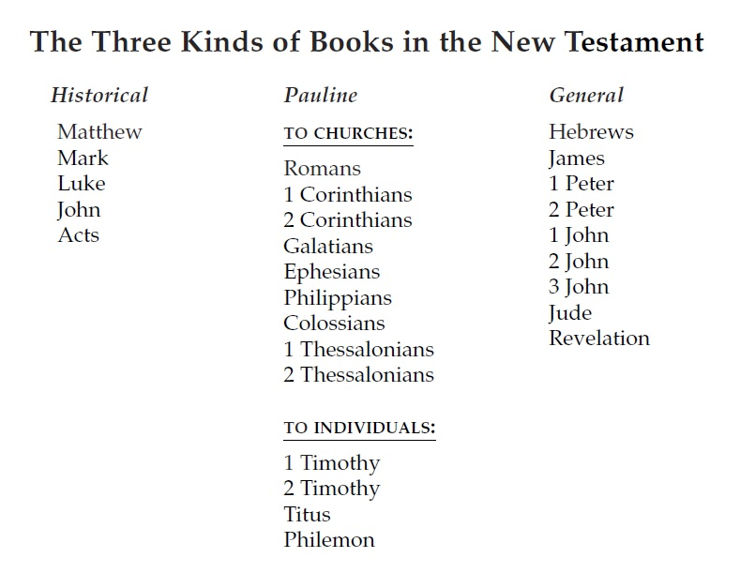
New Testament cannon

Slide 27
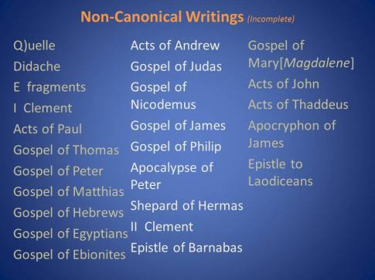

Slide 28
Tertullian and the Rule of Faith
Tertullian 155 – 240 ‘Father of Latin Christianity’
  Carthage, Berber
Prescription against the Heresies
  Christians must abstain from philosopher’s quest for truth because restless seeking for understanding leads to heresy
  ”All doctrine which agrees with the apostolic churches must be reckoned for truth, as undoubtedly containing that which they received from apostles, the apostles from Christ and Christ from God”
  ”This rule of faith was taught by Christ and rasises among ourselves no other questions than those which heresies introduce.”
  “We want no curious disputation after possessing Christ Jesus, no inquisition after enjoying the gospel! With our faith, we desire no further belief. For this is our faith . . . That there is nothing we ought to believe besides.”
Notes:
Tertullian (/tərˈtʌliən/; Latin: Quintus Septimius Florens Tertullianus; c. 155 – c. 240 AD[1]) was a prolific early Christian author from Carthage in the Roman province of Africa.[2] Of Berber and Phoenician origin,[3][4][5][6][7] he was the first Christian author to produce an extensive corpus of Latin Christian literature. He was an early Christian apologist and a polemicist against heresy, including contemporary Christian Gnosticism.[8] Tertullian has been called "the father of Latin Christianity"[9][10] and "the founder of Western theology."[11]
Though conservative in his worldview, Tertullian originated new theological concepts and advanced the development of early Church doctrine. He is perhaps most famous for being the first writer in Latin known to use the term trinity (Latin: trinitas).

