Slide 1
1st century religious landscape

Slide 2
Judaism
One God
God is good
God is the creator of the world
The created or natural world is good
All humans beings are God’s children
  Absolute separation. No divine people
Human beings have free will
People should live a moral life
People should create a good society
Life in the world to come

Slide 3
India
Hinduism
  polytheist, mythological
  Reincarnation - samsara
  Overcome ignorance and desire – moksha
Buddhism
  4 noble truths
  8 fold path
  Enlightenment - nirvana

Slide 4
Zoroastrianism – Persia
Cosmic dualism – battle good and evil
  Ahura Mazda – good God with 6 Holy Immortals – heaven
  Angra Mainyu – destructive spirit source of evil, death – hell
'Good Words, Good Thoughts, and Good Deeds'
Notes:
It is important to understand that Angra Mainyu is not God's equal opposite, rather that Angra Mainyu is the destructive energy that opposes God's creative energy. This creative energy is called Spenta Mainyu. God created a pure world through his creative energy, which Angra Mainyu continues to attack, making it impure. Aging, sickness, famine, natural disasters, death and so on are attributed to this.

Slide 5
Greek religion
Polytheism – many gods
Gods are in conflict and not good
Fate
After life
  Hades
  Tartarus
  Elysian Fields

Slide 6
Orphic myth
The infant Dionysus, son of Zeus and Persephone, is killed, torn apart, and consumed by the Titans. In retribution, Zeus strikes the Titans with a thunderbolt, turning them to ash. From these ashes, humanity is born. Humanity has a dual nature: body (sōma), inherited from the Titans, and a divine spark or soul (psychē), inherited from Dionysus. In order to achieve salvation from the Titanic, material existence, one had to be initiated into the Dionysian mysteries and undergo a ritual purification and reliving of the suffering and death of the god. Orphics believed that they would, after death, spend eternity alongside Orpheus and other heroes in the Elysian Fields. The uninitiated would be reincarnated indefinitely.
Notes:
Dionysus is the god of the grape-harvest, winemaking and wine, of fertility, orchards and fruit, vegetation, insanity, ritual madness, religious ecstasy, festivity and theatre in ancient Greek religion and myth.[2][3][4]
In his religion, identical with or closely related to Orphism, Dionysus was believed to have been born from the union of Zeus and Persephone, and to have himself represented a chthonic or underworld aspect of Zeus.

Slide 7
Orphic mystery cults
The Orphics were an ascetic sect; wine, to them, was only a symbol, as, later, in the Christian sacrament. The intoxication that they sought was that of "enthusiasm," of union with the god. They believed themselves, in this way, to acquire mystic knowledge (gnosis) not obtainable by ordinary means. This mystical element entered into Greek philosophy with Pythagoras, who was a reformer of Orphism as Orpheus was a reformer of the religion of Dionysus. From Pythagoras Orphic elements entered into the philosophy of Plato, and from Plato into most later philosophy that was in any degree religious. Bertrand Russell

Slide 8
Roman religion: Paganism
A cult of primarily political and state significance. Religion itself had never been a problem of truth, but only an acknowledgment of the existing system, its legitimacy and justifiability.”
  Polytheism
From the time of Emperor Augustus the emperor would assume the title of pontifex maximus or chief priest, Son of god, later god
Theocratic State
  State highest form of human community
  State is god (no higher value or power)
  Religion and the gods exists to serve the state
  State source of law, identity
  State to be worshipped and served
  Rome the eternal city
Notes:
Constantine converted not as a man but as the emperor. Christ sanctioned his power and made him his intended representative and through Constantine bound the empire to Himself by special bonds. Therefore conversion of Constantine not followed by review or critique of theocratic conception of empire. He was a Christian outside the Church yet the Church silently and sincerely accepted and recognized him. Theocratic absolutism of ancient state not revised by gospel but instead became an inseparable part of the Xn worldview. State seen as bearer of religion. Theocratic nature of the state untouched; religion primarily a state matter, because the state itself was a divine establishment, a divine form of human society. Freedom of religion granted in Edict of Milan 313 so that "the divinity abiding in the heavens might be mercifully and favorably inclined toward us, and to all who are under our authority." Pagan attitude
Justinian didn't distinguish Roman state tradition from Xty. Saw himself as fully Roman Emperor and Christian emperor. Empire and religion united and indivisible. The Empire in his time became essentially totalitarian with the state regulating every aspect of human life. There was no part of human life that the state did not have the right and duty to be concerned with.
"Here lay the deepest of all misunderstandings between the Church and the empire. The Roman state could accept the ecclesiastical doctrine of God and Christ comparatively easily as its official religious doctrine; it could render the Church great help in rooting out paganism and implanting Xty; and finally, it could Christianize its own laws to a certain extent. But it could not really recognize that the Church was a community distinct from itself; it did not understand the Church's ontological independence of the world. The religious absolutism of the Roman state and the emperor's belief that he was the representative of God on earth prevented it.
From the beginning Justinian regarded the religious unity of the empire as self-evident and natural as state unity. Stern measures were taken against all possible heretical sects. He also closed the pagan university in Athens and opened a Christian university in Constantinople. He spent a long time trying to reconcile the Orthodox and Monophysites by supporting first one side then the other and then trying to engineer and enforce compromises.
Rome was known as the “Eternal City” because civilizations had lived there for thousands of years. The ancient Roman Empire was very powerful, and it had many enemies. Yet, ancient Romans managed to defeat the Carthaginians and Etruscans and extended their empire throughout Europe and Africa. No-one underestimated the greatness of the ancient Roman Empire.

Slide 9
Gnosticism
The extent of the Gnostic sphere . . . (comprises) in the West . . . The Hellenistic mystery cults, especially Mithraism, the Hermetic writings and, in the speculative sphere, the philosophy of Late Antiquity, especially Neoplatonism; in the East (it comprises), in much more powerful and original form, the apocalyptic and eschatological movements, the great Gnostic systems, the newly founded religions all the way down to Manicheism; and ﬁnally, across East and West, (it comprises) Early Christianity together with its heresies, especially Marcionism. Hans Jonas, Gnosis und spätantiker Geist, 1:80
Notes:
346 JOURNAL OF EARLY CHRISTIAN STUDIES
The nihilist existential posture which lies at the heart of Gnosticism is
not merely an attitude of the individuals who happen to have composed
particular Gnostic texts. It is the attitude, Jonas claims, of a transindividual
and transgenerational Spirit, “the Spirit of Late Antiquity,” which is the
true “author” of Gnostic texts:
. . . the task of the hermeneutic return is to ﬁnd the real author, namely
historical existence understood as a totality (das geschichtliche
Gesamtdasein) which reached beyond individuals and generations to
produce this expression (Auslegung) of itself—of what is most essential to
it—and preserved itself for an entire epoch of history as the only mode of
being which was at that epoch’s disposal, often perhaps in only latent form
or congealed in convention, but always open to being actualized. Only this
“subject of the history of Spirit” (geistesgeschichtliches Subjekt) is what
philosophical hermeneutics looks for.13
Schenke summarizes Jonas’ position on this point as follows:
The subject of existential posture for Jonas is by no means an empirical
human being or a group of empirical human beings, but something that lies
behind them, a sort of intelligible Self that has not yet been split into
empirical selves. This Self is not located in empty space, as it were, but is
tied to empirical human beings and it is inﬂuenced by the history of the
human race in the formation of its posture. However, it is free from the
causal fabric of the world and can act into that fabric from the outside, as
it were.14
The texts which scholars had classiﬁed as Gnostic already before Jonas
are for Jonas privileged windows into the very heart of “the Spirit of Late
Antiquity.” Yet the extension of this same Gnostic Spirit is considerably
wider: it includes almost all of the epoch’s religious phenomena, Judaism,
speciﬁcally in its rabbinic form, being one of the few exceptions:

Slide 10
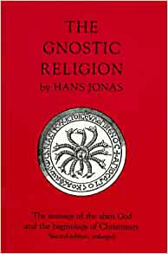
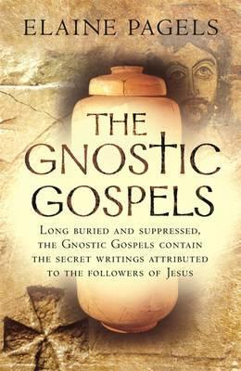

Slide 11
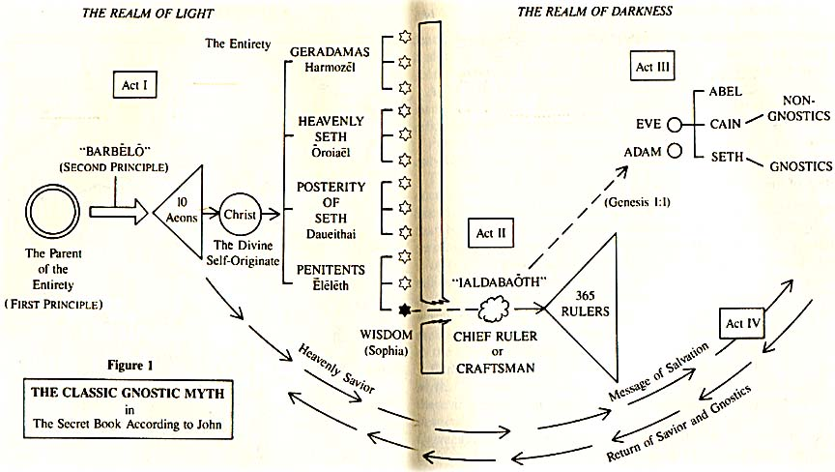

Slide 12
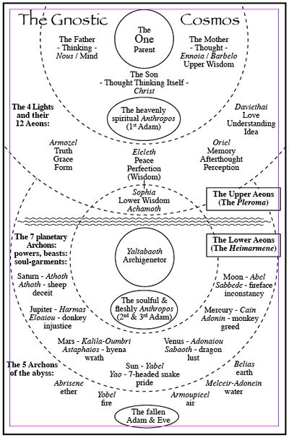
Archons
Rulers, Principalities
Demonic rulers of the material realm
Associated with planets
Send the prophets – Moses, Amos etc.
Stop people reaching heavenly realm
Need passwords – gnosis

Slide 13
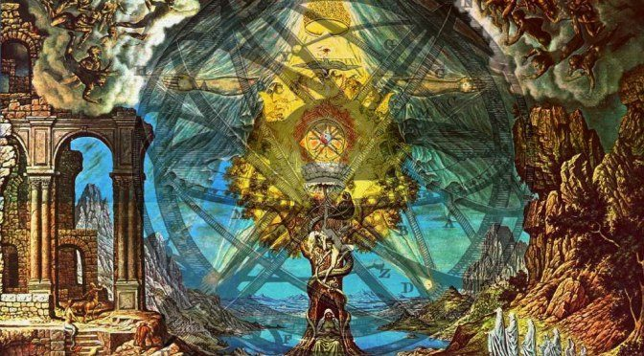

Slide 14
Salvation in gnosticism
The Gnostic view of salvation is through the divine knowledge or gnosis. Simply acquiring this gnosis will bring about salvation. The Gnostics hold that evolutionary forces alone are insufficient to bring about spiritual freedom, thus, the individual must free themselves from the bondage of the material world.
Gnostics believe that Jesus was the saviour but they do not look to salvation from sin; rather, they look to salvation from ignorance – the ignorance of spiritual realities. It was not through Christ’s suffering and death, but through his life and his teachings that humanity will be saved.

Slide 15
Some key gnostic tenets
Dualism
  Good and evil principles
  Spirit is good matter is evil
  Material world created by demi-urge
Pre-existent Christ
  Descending – ascending redeemer
  Redeemed redeemer
Some people have divine spark
  Predestined to be saved
Salvation through gnosis
  Knowing the passwords to get past the archons

Slide 16
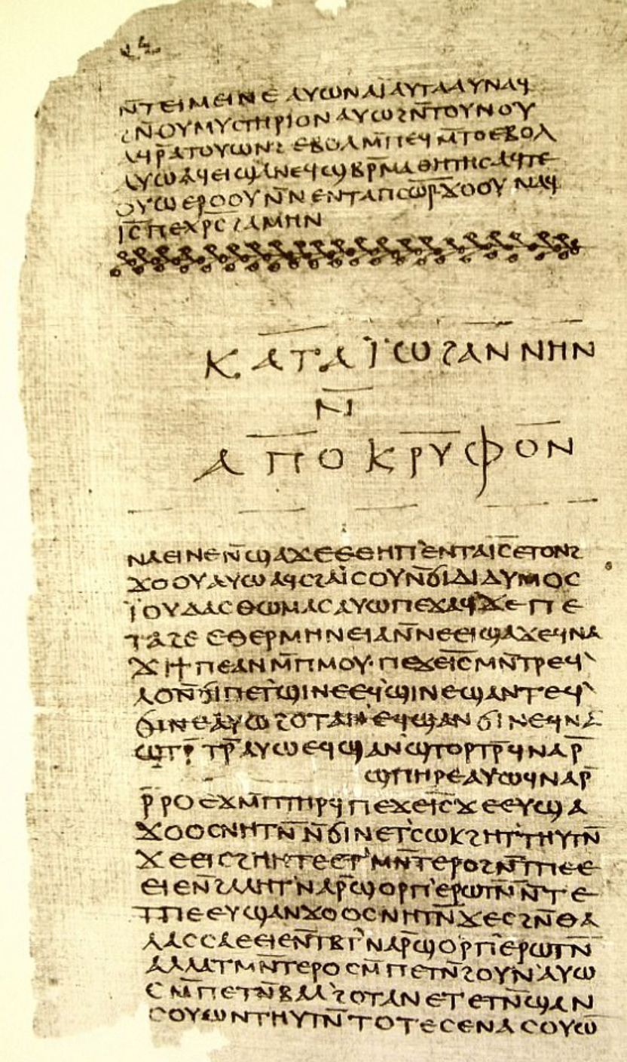
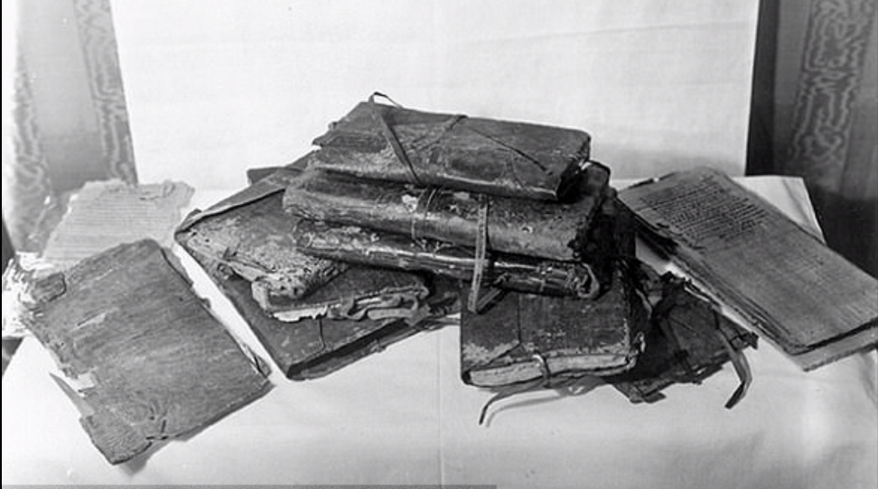
Gnostic literature
Nag Hammadi texts
First Apocalypse of James
Notes:
Upon death, the general Gnostic philosophy states that the divine spark of the soul, which seeks to return to the Pleroma, is confused, distracted, disoriented, and lied to by the agents of the Ialdabaoth/Demiurge, known as the archons. For in order for the Demiurge’s false material simulation/creation to continue, it requires that the divine spark be returned to the material world.
Or as I interpret it: our divine spark (which was brought here by Sophia’s error) wishes to return to the Godhead upon death, but is intentionally blocked/confused by the archons. This archonic intervention prevents our spark from returning to the Pleroma and is returned to this miserable, physical existence. This simple, deceptive cycle not only keeps the Demiurge’s simulation intact, but it also prevents the Demiurge’s creation from collapsing upon itself. Should enough divine sparks return to their origin known as the Pleroma, the reunion would bring upon a complete ruin of the Demiurge’s simulation. This collapse would bring an end to the physical universe, the archons, and the arrogant/ignorant/misguided Ialdabaoth.
Fortunately for James (but not the rest of us), Jesus conveyed to him the passwords that allowed his divine spark to maneuver through the 72 levels of games played by the archons and a return to the Godhead. How lucky was James?
https://driftlessabyss.blogspot.com/2018/02/passwords-to-pleroma.html

Slide 17
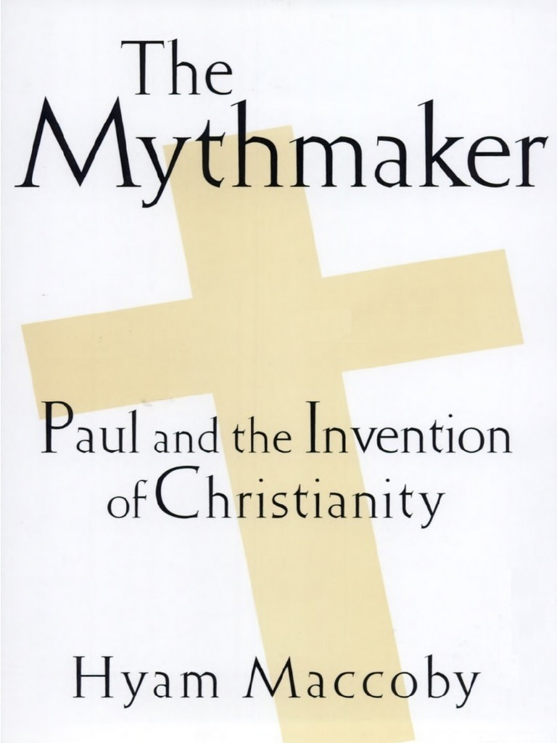
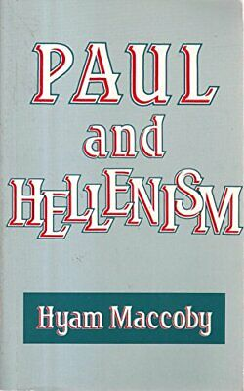
Paul the gnostic?

Slide 18
Paul and Gnosticism
Paul, essentially, adopted and adapted Gnostic ideas and images and Christianized them. Where the Gnostics spoke of an inferior creator Paul says an evil power has taken over this world. Where the Gnostics say it was an evil power that produced the Torah, Paul says angels did it and God has now replaced it. In Acts and Hebrews where the angelic origin of the Torah is also mentioned, it is again Paul’s lead that is being followed.
In other words Paul borrowed from pagans but was not a pagan. He borrowed from Gnostics but was not a Gnostic. Hyam Maccoby

Slide 19
God to send an angel
God: “You led the people out of the land of Egypt. Now get ready to lead them to the land of I promised their ancestors Abraham. Isaac and Jacob. I will send an angel before you but I will not go up among you, or I would consume you on the way, for you are a stiff-necked people.”
Exodus 33:1-3
Notes:
The more I study the Torah, the more conscious I become of the immense mystery of Exodus 33. This is the chapter set in the middle of the Golden Calf narrative, between chapter 32 describing the sin and its consequences, and chapter 34, God’s revelation to Moses of the “Thirteen attributes of Mercy”, the second set of tablets and the renewal of the covenant. It is, I believe, this mystery that frames the shape of Jewish spirituality.
What makes chapter 33 perplexing is, first, that it is not clear what it is about. What was Moses doing? In the previous chapter he had already prayed twice for the people to be forgiven. In chapter 34 he prays for forgiveness again. What then was he trying to achieve in chapter 33?
Second, Moses’ requests are strange. He says, “Show me now Your ways” and “Show me now Your glory” (33:13, 33:18). These seem more requests for metaphysical understanding or mystical experience than for forgiveness. They have to do with Moses as an individual, not with the people on whose behalf he was praying. This was a moment of national crisis. God was angry. The people were traumatised. The whole nation was in disarray. This was not the time for Moses to ask for a seminar in theology.
Third, more than once the narrative seems to be going backward in time. In verse 4, for example, it says “No man put on his ornaments”, then in the next verse God says, “Now, then, remove your ornaments.” In verse 14, God says, “My presence will go with you.” In verse 15, Moses says, “If Your presence does not go with us, do not make us leave this place.” In both cases, time seems to be reversed: the second sentence is responded to by the one before. The Torah is clearly drawing our attention to something, but what?
Add to this the mystery of the calf itself – was it or was it not an idol? The text states that the people said, “This, Israel, is your God who brought you out of Egypt” (32:4). But it also says that they sought the calf because they did not know what had happened to Moses. Were they seeking a replacement for him or God? What was their sin?
Surrounding it all is the larger mystery of the precise sequence of events involved in the long passages about the Mishkan, before and after the Golden Calf. What was the relationship between the Sanctuary and the Calf?
At the heart of the mystery is the odd and troubling detail of verses 7-11. This tells us that Moses took his tent and pitched it outside the camp. What has this to do with the subject at hand, namely the relationship between God and the people after the Golden Calf? In any case, it was surely the worst possible thing for Moses to do at that time under those circumstances. God had just announced that “I will not go in your midst” (33:3). At this, the people were deeply distressed. They “went into mourning” (33:4). For Moses, then, to leave the camp must have been doubly demoralising. At times of collective distress, a leader has to be close to the people, not distant.
There are many ways of reading this cryptic text, but it seems to me the most powerful and simple interpretation is this. Moses was making his most audacious prayer, so audacious that the Torah does not state it directly and explicitly. We have to reconstruct it from anomalies and clues within the text itself.
The previous chapter implied that the people panicked because of the absence of Moses, their leader. God himself implied as much when he said to Moses, “Go down, because your people, whom you brought up out of Egypt, have become corrupt” (32:7). The suggestion is that Moses’ absence or distance was the cause of the sin. He should have stayed closer to the people. Moses took the point. He did go down. He did punish the guilty. He did pray for God to forgive the people. That was the theme of chapter 32. But in chapter 33, having restored order to the people, Moses now began on an entirely new line of approach. He was, in effect, saying to God: what the people need is not for me to be close to them. I am just a human, here today, gone tomorrow. But You are eternal. You are their God. They need You to be close to them.
It was as if Moses was saying, “Until now, they have experienced You as a terrifying, elemental force, delivering plague after plague to the Egyptians, bringing the world’s greatest empire to its knees, dividing the sea, overturning the very order of nature itself. At Mount Sinai, merely hearing Your voice, they were so overwhelmed that they said, if we continue to hear the voice, ‘we will die’ (Ex. 20:16).” The people needed, said Moses, to experience not the greatness of God but the closeness of God, not God heard in thunder and lightning at the top of the mountain but as a perpetual Presence in the valley below.
That is why Moses removed his tent and pitched it outside the camp, as if to say to God: it is not my presence the people need in their midst, but Yours. That is why Moses sought to understand the very nature of God Himself. Is it possible for God to be close to where people are? Can transcendence become immanence? Can the God who is vaster than the universe live within the universe in a predictable, comprehensible way, not just in the form of miraculous intervention?
To this, God replied in a highly structured way. First, He said, you cannot understand My ways. “I will be gracious to whom I will be gracious and I will show mercy to whom I will show mercy” (33:19). There is an element of divine justice that must always elude human comprehension. We cannot fully enter into the mind of another human being, how much less so the mind of the Creator Himself.
Second, “You cannot see My face, for no one can see Me and live” (33:20). Humans can at best “See My back.” Even when God intervenes in history, we can see this only in retrospect, looking back. Steven Hawking was wrong.[1] Even if we decode every scientific mystery, we still will not know the mind of God.
However, third, you can see My “glory”. That is what Moses asked for once he realised that he could never know God’s “ways” or see His “face”. That is what God caused to pass by as Moses stood “in a cleft of the rock” (v. 22). We do not know at this stage, exactly what is meant by God’s glory, but we discover this at the very end of the book of Exodus. Chapters 35-40 describe how the Israelites built the Mishkan. When it is finished and assembled we read this:
Then the cloud covered the tent of meeting, and the glory of the Lord filled the Mishkan. Moses could not enter the tent of meeting because the cloud had settled on it, and the glory of the Lord filled the Mishkan. (Ex. 40:34-35)
We now understand the entire drama set in motion by the making of the Golden Calf. Moses pleaded with God to come closer to the people, so that they would encounter Him not only at unrepeatable moments in the form of miracles but regularly, on a daily basis, and not only as a force that threatens to obliterate all it touches but as a Presence that can be sensed in the heart of the camp.
That is why God commanded Moses to instruct the people to build the Mishkan. It is what He meant when He said: “Let them make Me a sanctuary and I will dwell (ve-shakhanti) among them” (Ex. 25:8). It is from this verb that we get the word Mishkan, “Tabernacle” and the post-biblical word Shekhinah, meaning the Divine presence. A shakhen is a neighbour, one who lives next door. Applied to God it means “the Presence that is close.” If this is so – it is, for example, the way Judah Halevi understood the text[2] – then the entire institution of the Mishkan was a Divine response to the sin of the Golden Calf, and an acceptance by God of Moses’ plea that He come close to the people. We cannot see God’s face; we cannot understand God’s ways; but we can encounter God’s glory whenever we build a home, on earth, for His presence.
That is the ongoing miracle of Jewish spirituality. No one before the birth of Judaism ever envisaged God in such abstract and awe-inspiring ways: God is more distant than the furthest star and more eternal than time itself. Yet no religion has ever felt God to be closer. In Tanakh the prophets argue with God. In the book of Psalms King David speaks to Him in terms of utmost intimacy. In the Talmud God listens to the debates between the sages and accepts their rulings even when they go against a heavenly voice. God’s relationship with Israel, said the prophets, is like that between a parent and a child, or between a husband and a wife. In The Song of Songs it is like that between two infatuated lovers. The Zohar, key text of Jewish mysticism, uses the most daring language of passion, as does Yedid nefesh, the poem attributed to the sixteenth century Tzefat kabbalist R. Elazar Azikri.
That is one of the striking differences between the synagogues and the cathedrals of the Middle Ages. In a cathedral you sense the vastness of God and the smallness of humankind. But in the Altneushul in Prague or the synagogues of the Ari and R. Joseph Karo in Tzefat, you sense the closeness of God and the potential greatness of humankind. Many nations worship God, but Jews are the only people to count themselves His close relatives (“My child, my firstborn, Israel” Ex. 4:22).
Between the lines of Exodus 33, if we listen attentively enough, we sense the emergence of one of the most distinctive and paradoxical features of Jewish spirituality. No religion has ever held God higher, but none has ever felt Him closer. That is what Moses sought and achieved in Exodus 33 in his most daring conversation with God.

Slide 20
Moses not happy
Then Moses said to him, “If your Presence does not go with us, do not send us up from here. How will anyone know that you are pleased with me and with your people unless you go with us? What else will distinguish me and your people from all the other people on the face of the earth?”
And the Lord said to Moses, “I will do the very thing you have asked, because I am pleased with you and I know you by name. Exodus 33:15-17
Notes:
12 Moses said to the Lord, “You have been telling me, ‘Lead these people,’ but you have not let me know whom you will send with me. You have said, ‘I know you by name and you have found favor with me.’ 13 If you are pleased with me, teach me your ways so I may know you and continue to find favor with you. Remember that this nation is your people.”
14 The Lord replied, “My Presence will go with you, and I will give you rest.”
15 Then Moses said to him, “If your Presence does not go with us, do not send us up from here. 16 How will anyone know that you are pleased with me and with your people unless you go with us? What else will distinguish me and your people from all the other people on the face of the earth?”
17 And the Lord said to Moses, “I will do the very thing you have asked, because I am pleased with you and I know you by name.”
18 Then Moses said, “Now show me your glory.”
19 And the Lord said, “I will cause all my goodness to pass in front of you, and I will proclaim my name, the Lord, in your presence. I will have mercy on whom I will have mercy, and I will have compassion on whom I will have compassion. 20 But,” he said, “you cannot see my face, for no one may see me and live.”
21 Then the Lord said, “There is a place near me where you may stand on a rock. 22 When my glory passes by, I will put you in a cleft in the rock and cover you with my hand until I have passed by. 23 Then I will remove my hand and you will see my back; but my face must not be seen.”

Slide 21
Predestination
But we speak God’s wisdom in a mystery, the hidden wisdom which God predestined before the ages to our glory;
For those whom He foreknew, He also predestined to become conformed to the image of His Son, so that He would be the firstborn among many brethren; and these whom He predestined, He also called; and these whom He called, He also justified; and these whom He justified, He also glorified. Romans 8:29-30

Slide 22
Paul and the eucharist
“For I received from the Lord that which I also delivered to you: that the Lord Jesus on the same night in which He was betrayed took bread; and when He had given thanks, He broke it and said, ‘Take, eat; this is My body which is broken for you; do this in remembrance of Me.’ In the same manner He also took the cup after supper, saying, ‘This cup is the new covenant in My blood. This do, as often as you drink it, in remembrance of Me.’ 1 Corinthians 11:23-25

Slide 23
Eucharist in the gospels
So Jesus said to them, ‘Very truly, I tell you, unless you eat the flesh of the Son of Man and drink his blood, you have no life in you. Those who eat my flesh and drink my blood have eternal life, and I will raise them up on the last day; for my flesh is true food and my blood is true drink. Those who eat my flesh and drink my blood abide in me, and I in them. Just as the living Father sent me, and I live because of the Father, so whoever eats me will live because of me. John 6:53-56

Slide 24
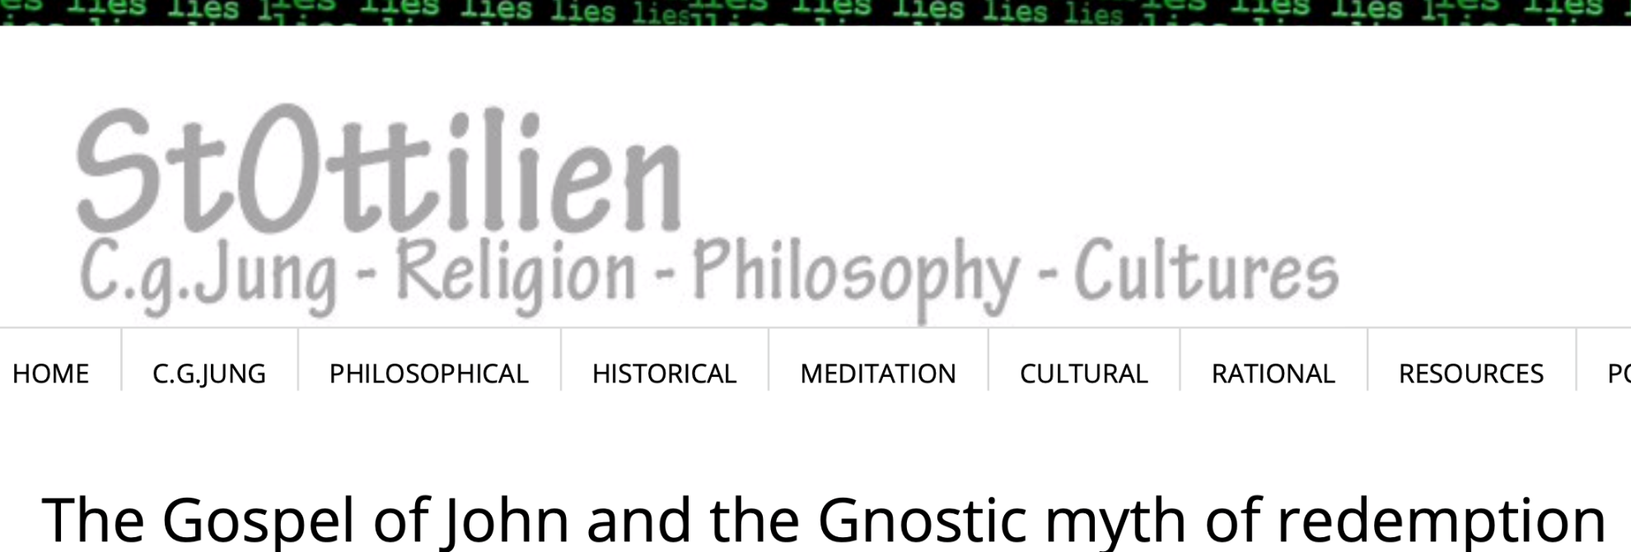

Slide 25
The prologue to John
In the beginning was the Word, and the Word was with God, and the Word was God. He was in the beginning with God. All things came into being through him, and without him not one thing came into being. What has come into being in him was life, and the life was the light of all people. The light shines in the darkness, and the darkness did not overcome it. He was in the world, and the world came into being through him; yet the world did not know him. He came to what was his own, and his own people did not accept him. But to all who received him, who believed in his name, he gave power to become children of God, And the Word became flesh and lived among us. The law indeed was given through Moses; grace and truth came through Jesus Christ. No one has ever seen God. It is God the only Son, who is close to the Father’s heart, who has made him known.

