Slide 1
How should one read the gospels?
They are not biographies of Jesus
  Stylised theological accounts to convert people
Contextually
  When were they written?
  Who wrote them?
  Who were they written for?
  What was the writer and editors trying to say?
  How to recognise the theology or ‘angle’ of the editor.
  Watch out for the “spin”
  What was the social context and argument they reflected?

Slide 2
Reading critically
Does the verse or passage contradict the traditional narrative or theology?
  Probably authentic
  What is the traditional narrative?
    Jesus was born to die
    He was rejected by the Jewish people
    He was God – ‘son of man’
Does it support traditional theology?
  Maybe an editorial addition
    ‘He said this because he knew he was going to die’

Slide 3
Why are there so many quotes from the prophets
The New Testament was written by Jews who believed in Jesus
They were trying to persuade Jews who didn’t believe in Jesus that Jesus was the messiah
The Hebrew scriptures were the common source of authority
Jesus life is written so as to fulfil as many prophecies as possible
  “This is just as it is written in Scripture . . .
  ‘This happened as Isaiah the prophet had said it would
  ‘But then how would the Scriptures come true? They say it must happen in this way.” Matthew 26:54

Slide 4
Teachings of Jesus
Jesus upheld the Mosaic Law
  “Not one letter, not one stroke of a letter, will pass from the law”
Jesus was probably a Pharisee
  His teachings and practices were on the spectrum between between Rabbis Shamai and Hillel
    “The Pharisees” said . . . Better to say “Some Pharisees said . . .”
  He told his disciples: “The teachers of the law and the Pharisees sit in Moses’ seat. So you must be careful to do everything they say.” Matthew 23:2
  His way of teaching – use of parables – was typical of Pharisees
  The freedom of interpretation meant that even if Jesus had original interpretations he would not be accused of heresy
  The criticisms he made of the Pharisees were typical of the criticisms they made of themselves and each other

Slide 5


Slide 6
A Jesus who taught like a Jew and an early Christian community that looked like a Jewish sect troubled many 19th-century German Lutheran scholars, who preferred to envision a Jesus who taught a new and unique doctrine that overthrew the established tradition. Albrecht Ritschl “solved” the problem by attacking the Jews. For him, Jesus did not reform or transform Judaism, he condemned it. Jesus the Jew, in Ritschl’s view, transcended Judaism by purifying Christianity of its Jewish elements. From the middle of the 19th century until World War II, numerous German scholars, including Adolf Harnack and Rudolf Bultmann, followed Ritschl’s lead in one way or another. None were Nazis, but reading them after the Holocaust leaves us with an eerie sensation. Anthony J. Saldarini , Bible Review, June 1999

Slide 7
To wrench Jesus out of his Jewish world destroys Jesus and destroys Christianity, the religion that grew out of his teachings. Even Jesus’ most familiar role as Christ is a Jewish role. If Christians leave the concrete realities of Jesus’ life and of the history of Israel in favour of a mythic, universal, spiritual Jesus and an otherworldly kingdom of God, they deny their origins in Israel, their history, and the God who has loved and protected Israel and the church. They cease to interpret the actual Jesus sent by God and remake him in their own image and likeness. The dangers are obvious. If Christians violently wrench Jesus out of his natural, ethnic and historical place within the people of Israel, they open the way to doing equal violence to Israel, the place and people of Jesus. This is a lesson of history that haunts us all at the end of the 20th century. Anthony J. Saldarini , Bible Review, June 1999

Slide 8
Who said this?
"First, to set fire to their synagogues or schools … This is to be done in honour of our Lord and of Christendom, so that God might see that we are Christians …” "Second, I advise that their houses also be razed and destroyed.” "Third, I advise that all their prayer books and Talmudic writings, in which such idolatry, lies, cursing, and blasphemy are taught, be taken from them.” "Fourth, I advise that their rabbis be forbidden to teach henceforth on pain of loss of life and limb …” "Fifth, I advise that safe-conduct on the highways be abolished completely for the Jews. For they have no business in the countryside …” "Sixth, I advise that usury be prohibited to them, and that all cash and treasure of silver and gold be taken from them …” "Seventh, I recommend putting a flail, an axe, a hoe, a spade, a distaff, or a spindle into the hands of young, strong Jews and Jewesses and letting them earn their bread in the sweat of their brow … But if we are afraid that they might harm us or our wives, children, servants, cattle, etc., … then let us emulate the common sense of other nations such as France, Spain, Bohemia, etc., … then eject them forever from the country …” Martin Luther

Slide 9
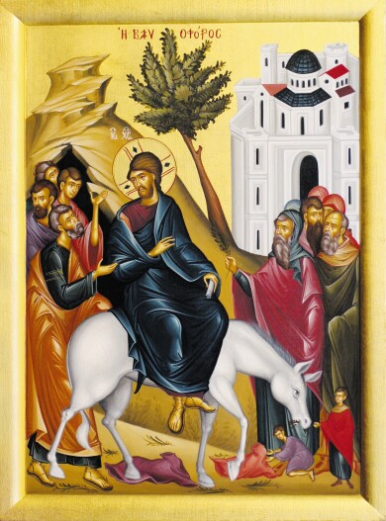
Entry into Jerusalem
“Hosanna!” “Blessed is he who comes in the name of the Lord!” “Blessed is the King of Israel!”
“Look how the whole world has gone after him!”
Yet at the same time many even among the leaders believed in him.
John 12: 13,19,42
Notes:
Jesus cheered, not jeered.

Slide 10
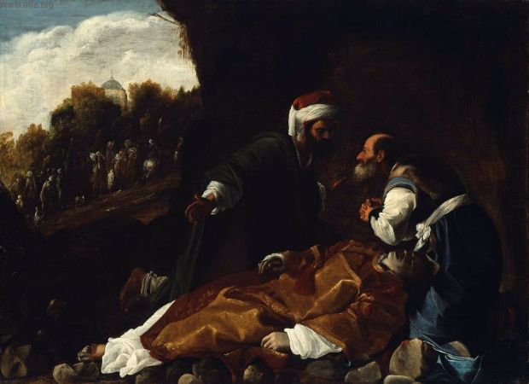
Which leaders?
Joseph of Arimathea
  Member of Sanhedrin
  Rich man
Nicodemus
  Member of Sanhedrin
  Pharisee
Gamaliel
  Leader of Pharisees
Jairus
  Leader of synagogue
Nicodemus and Joseph of A.
mourning St Stephen
Notes:
In the Talmud, Gamaliel is described as bearing the titles Nasi and Rabban (our master), as the president of the Great Sanhedrin in Jerusalem; although some dispute this, it is not doubted that he held a senior position in the highest court in Jerusalem. Gamaliel holds a reputation in the Mishnah for being one of the greatest teachers in all the annals of Judaism:
The Acts of the Apostles introduces Gamaliel as a Pharisee and celebrated doctor of the Mosaic Law in Acts 5:34–40. In the larger context, Peter and the other apostles are described as being prosecuted before the sanhedrin and senate (or elders) for continuing to preach the gospel, despite the Jewish authorities having previously prohibited it. The passage describes Gamaliel as presenting an argument against killing the apostles, reminding them about the previous revolts of Theudas and Judas of Galilee which had collapsed quickly after the deaths of those individuals.
Ecclesiastical tradition maintains that Gamaliel had embraced the Christian faith and his tolerant attitude toward the Early Christians is explained by this. According to Photius, he was baptized by Saint Peter and Saint John, together with his son and Nicodemus. The Clementine Literature suggested that he maintained secrecy about the conversion and continued to be a member of the Sanhedrin for the purpose of covertly assisting his fellow Christians

Slide 11
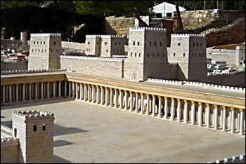
What effect did this have?
‘King of Israel’ and Messiah are political titles
  Jesus rejected attempt to make him king
  Jesus told disciples not to say he was messiah
Threat to Roman authority and rule
High Priest responsible for reporting rebels
Roman fortress next to the Temple
Notes:
Antonia fortress built by Herod

Slide 12
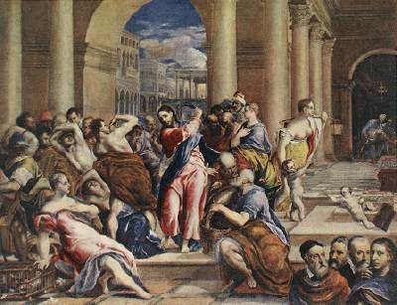
Cleansing the Temple – threat to the priestly establishment
”The importance of the episode is signalled by the fact that within a week of this incident, Jesus is dead. Matthew, Mark, and Luke agree that this is the event that functioned as the 'trigger' for Jesus' death.”
Professor David Landry of the University of St. Thomas
Christ driving the money
changers from the Temple
Notes:
And making a whip of cords, he drove them all out of the temple, with the sheep and oxen. And he poured out the coins of the money-changers and overturned their tables. And he told those who sold the pigeons, "Take these things away; do not make my Father's house a house of trade".
— John 2:13–16
And Jesus went into the temple of God, and cast out all them that sold and bought in the temple, and overthrew the tables of the money changers, and the seats of them that sold doves, And said unto them, It is written, My house shall be called the house of prayer; but ye have made it a den of thieves.
— Matthew 21:12–13
Palm Sunday. People welcomed Jesus. Actually people followed him everywhere.
Cleansed Temple - mistake. Threatened the Temple system. Threatened to cause unrest and riots. Threatened to bring Romans down on people. Threatened the position of priestly authorities who were charged with keeping order. Passover was the time when expected the messiah to come.
Temple offerings - Jesus critising the Shammite practice of not accepting Gentile offerings. Moneychangers accepted gifts from Gentiles but Zealot moneychangers didn't pass money on but pocketed it. Zealots controlled. Temple and siphoning off Gentile offerings/money. Refusal of Emperors sacrifice led to estruction of Temple.
During Passover the Roman governor and extra troops in Jerusalem to maintain order.
Religious authorities couldn’t arrest Jesus in the Temple or by day because he was so popular. So had to do it slyly by night and trial by night and execute next morning.
Picture El Greco

Slide 13
Other suggestions . . .
Toledot Yeshu (Jewish parody of Jesus with possibly very early sources) claims that Jesus entered the Temple with 310 of his followers and that Christ's followers had entered the Temple, and the Holy of Holies
Bishop Epiphanius of Salamis (4th century) agreed and claimed James wore the breastplate of the high priest and the high priestly diadem on his head and actually entered the Holy of Holies, and that John the Beloved had become a sacrificing priest who wore the mitre which was the headdress of the high priest.
Notes:
There are a number of later embellishments to the narrative of the incident that are generally regarded as legendary or polemical by scholars. The Toledot Yeshu, a parody gospel probably first written down about 1,000 years later but possibly dependent on second-century Jewish-Christian gospel[21] if not oral traditions that might go back all the way to the formation of the canonical narratives themselves,[22] claims that Yeshu had entered the Temple with 310 of his followers. That Christ's followers had indeed entered the Temple, and in fact the Holy of Holies,[23] is also claimed by Epiphanius, who claims that James wore the breastplate of the high priest and the high priestly diadem on his head and actually entered the Holy of Holies,[24] and that John the Beloved had become a sacrificing priest who wore the mitre,[25] which was the headdress of the high priest.
Epiphanius of Salamis (Greek: Ἐπιφάνιος; c. 310–320 – 403) was the bishop of Salamis, Cyprus at the end of the 4th century. He is considered a saint and a Church Father by both the Orthodox and Roman Catholic Churches. He gained a reputation as a strong defender of orthodoxy. He is best known for composing the Panarion, a very large compendium of the heresies up to his own time, full of quotations that are often the only surviving fragments of suppressed texts. According to Ernst Kitzinger, he "seems to have been the first cleric to have taken up the matter of Christian religious images as a major issue", and there has been much controversy over how many of the quotations attributed to him by the Byzantine Iconoclasts were actually by him.

Slide 14
Clash with chief priests
When Jesus entered the temple, the chief priests and elders of the people came to him as he was teaching. They asked, “What kind of authority do you have for doing these things? Who gave you this authority?” Jesus replied, “I have a question for you. If you tell me the answer, I’ll tell you what kind of authority I have to do these things. Where did John get his authority to baptize? Did he get it from heaven or from humans?” They argued among themselves, “If we say ‘from heaven,’ he’ll say to us, ‘Then why didn’t you believe him?’ But we can’t say ‘from humans’ because we’re afraid of the crowd, since everyone thinks John was a prophet.” Then they replied, “We don’t know.” Jesus said to them, “Neither will I tell you what kind of authority I have to do these things. Matthew 21:23-27

Slide 15
Parable of the tenants
“Listen to another parable. There was a landowner who planted a vineyard. He put a fence around it, dug a winepress in it, and built a tower. Then he rented it to tenant farmers and took a trip. When it was time for harvest, he sent his servants to the tenant farmers to collect his fruit. But the tenant farmers grabbed his servants. They beat some of them, and some of them they killed. Some of them they stoned to death. “Again he sent other servants, more than the first group. They treated them in the same way.

Slide 16
Finally he sent his son to them. ‘They will respect my son,’ he said. “But when the tenant farmers saw the son, they said to each other, ‘This is the heir. Come on, let’s kill him and we’ll have his inheritance.’ They grabbed him, threw him out of the vineyard, and killed him. “When the owner of the vineyard comes, what will he do to those tenant farmers?” They said, “He will totally destroy those wicked farmers and rent the vineyard to other tenant farmers who will give him the fruit when it’s ready.” Therefore, I tell you that God’s kingdom will be taken away from you and will be given to a people who produce its fruit. Now when the chief priests and the Pharisees heard the parable, they knew Jesus was talking about them. They were trying to arrest him, but they feared the crowds, who thought he was a prophet.
Matthew 21:33-45
Notes:
Pharisees are added in as part of late 1st century polemic
Isaiah 5
Let me sing for my loved one
a love song for his vineyard.
My loved one had a vineyard on a fertile hillside.
² He dug it,
cleared away its stones,
planted it with excellent vines,
built a tower inside it,
and dug out a wine vat in it.
He expected it to grow good grapes—
but it grew rotten grapes.
³ So now, you who live in Jerusalem, you people of Judah,
judge between me and my vineyard:
⁴ What more was there to do for my vineyard
that I haven’t done for it?
When I expected it to grow good grapes,
why did it grow rotten grapes?
⁵ Now let me tell you what I’m doing to my vineyard.
I’m removing its hedge,
so it will be destroyed.
I’m breaking down its walls,
so it will be trampled.
⁶ I’ll turn it into a ruin;
it won’t be pruned or hoed,
and thorns and thistles will grow up.
I will command the clouds not to rain on it.
⁷ The vineyard of the Lord of heavenly forces is the house of Israel,
and the people of Judah are the plantings in which God delighted.

Slide 17
What does the parable reference?
Let me sing for my loved one
a love song for his vineyard.
My loved one had a vineyard on a fertile hillside.
He dug it,
cleared away its stones,
planted it with excellent vines,
built a tower inside it,
and dug out a wine vat in it.
He expected it to grow good grapes—
but it grew rotten grapes.
The vineyard of the Lord who rules over all is the nation of Israel, and the people of Judah are the vines in which God delighted. Isaiah 5:1-2,7
Notes:
The vineyard of the Lord who rules over all
is the nation of Israel.
The people of Judah
are the vines he took delight in.

Slide 18
What does this parable mean?
Landlord = God
Vineyard = Israel
Tenants = Leaders
Servants = Prophets
Son = Jesus
“Therefore I tell you, the Kingdom of God will be taken away from you [the chief priests] and given to a people producing the fruits of it.” Matthew 21:43
Jews who believe in Jesus would
become leaders of Israel

Slide 19
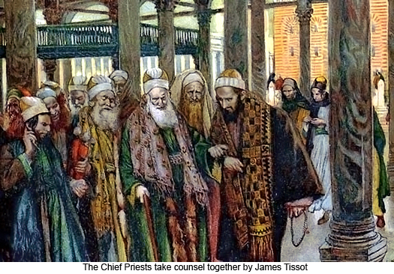
Chief priests plot against Jesus
Then the chief priests and elders gathered and took counsel to arrest Jesus by stealth and kill him. But they said, “Not during the feast, lest there be a tumult among the people.”
Matthew 26:3-5
Notes:
They felt their authority and position challenged by Jesus. Realised Jesus much more popular than them

Slide 20
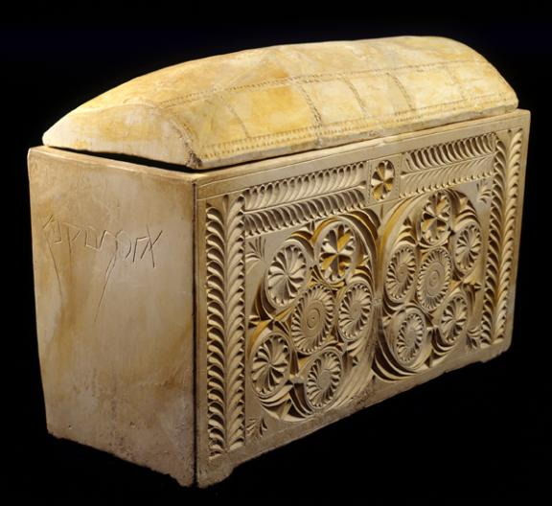
Why did they do this?
“If we let him go on like this, every one will believe in him, and the Romans will come and destroy our holy place and our nation.” Caiaphas said, “It is expedient that one man should die for the people, and that the whole nation should not perish.”
John 11:48-51
Ossuary of the high priest
Joseph Caiaphas
Notes:
Discovered 1990. 1st centruy

Slide 21
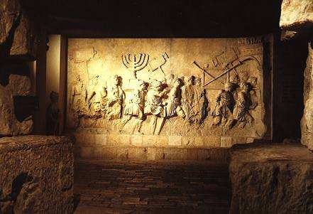
A very real and present risk
First Jewish revolt against Roman rule
Destruction of Jerusalem and the Temple 70 CE
Second Jewish revolt 132-135 CE
500,000 Jews killed, 985 villages destroyed
Jews forbidden to live in Jerusalem
Judea renamed Palaestina
Arch of Titus in Rome
Notes:
Picture – relief from Arch of Titus in Rome built to celebrate Titus’ conquest of Judea 66-70. Construction of the Colosseum began under the rule of the Emperor Vespasian] in around 70–72 AD, funded by the spoils taken from the Jewish Temple after the Siege of Jerusalem[
The Bar Kokhba revolt (132–136 CE),^{[20]} (Hebrew: מרד בר כוכבא‎ or mered bar kokhba), was the third major rebellion by the Jews of Judaea Province and Eastern Mediterranean against the Roman Empire and the last of the Jewish–Roman Wars. Simon bar Kokhba, the commander of the revolt, was acclaimed as a Messiah, a heroic figure who could restore Israel. The revolt established an independent state of Israel over parts of Judea for more than two years, but a Roman army made up of six full legions with auxiliaries and elements from up to six additional legions finally crushed it.^{[21]} The Romans then barred Jews from Jerusalem, except to attend Tisha B'Av. Although Jewish Christians hailed Jesus as the Messiah and did not support Bar Kokhba,^{[22]} they were barred from Jerusalem along with the rest of the Jews.^{[citation needed]} The war and its aftermath helped differentiate Christianity as a religion distinct from Judaism (see also Split of early Christianity and Judaism).^{[23]} The rebellion is also known as The Third Jewish–Roman War or The Third Jewish Revolt, though some historians relate it as Second Jewish Revolt, not counting the Kitos War, 115–117 CE.^{[citation needed]}

Slide 22
Who was the High Priest?
As an appointee of the Romans, the High Priest was not just a ceremonial official with jurisdiction over the Temple; he was, in effect, a chief of police with his own armed force, his own police tribunal and prisons for political offences. In the case of serious insurrection against the power of Rome, he would hand over the offender to the occupying Roman power.
Hyam Maccoby, The Mythmaker
Notes:
§

Slide 23
What is the problem here?
The High Priest does not know who Jesus is and does not know what Jesus is teaching
Who should have been the bridge between Jesus and the High Priest?
John the Baptist
  Son of a priest
But he didn’t follow Jesus and was executed
So the High Priest misunderstood who Jesus was and what his plans were

Slide 24
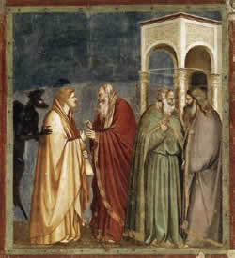
Judas sets up a meeting with Jesus
Judas Iscariot, went to the chief priests and said, “What will you give me if I deliver him to you?” And they paid him thirty pieces of silver.
Matthew 26:14
Judas getting paid
Notes:
²⁰ When evening came, Jesus was at the table with his 12 disciples. ²¹ While they were eating, he said, “What I’m about to tell you is true. One of you will hand me over to my enemies.”
²² The disciples became very sad. One after the other, they began to say to him, “Surely you don’t mean me, Lord, do you?”
²³ Jesus replied, “The one who has dipped his hand into the bowl with me will hand me over. ²⁴ The Son of Man will go just as it is written about him. But how terrible it will be for the one who hands over the Son of Man! It would be better for him if he had not been born.”
²⁵ Judas was the one who was going to hand him over. He said, “Surely you don’t mean me, Teacher, do you?”
Jesus answered, “You have said so.”

Slide 25
What did Jesus know?
“One of you is going to hand me over to my enemies.” “It is the one I will give this piece of bread to. I will give it to him after I have dipped it in the dish.” He dipped the piece of bread. Then he gave it to Judas, son of Simon Iscariot. As soon as Judas took the bread, Satan entered into him. So Jesus told Judas, “What you are about to do, do quickly.” But no one at the meal understood why Jesus said this to him. Since Judas had charge of the money, some thought Jesus was telling him to buy what was needed for the festival, or to give something to the poor. John 13:27-29
Notes:
The disciples did not know what was going on. They didn’t know what Jesus and Judas were planning. Therefore the rest is speculation. ‘Satan entered into Judas’ – editorial addition to try to rationalize Judas’ behavior.
If Jesus wanted to be crucified then he must have agreed with Judas about the ‘betrayal’ which in this case is not a betrayal but what Jesus wants. Therefore Judas was carrying out God’s will.
If Jesus did not want to be crucified why would he tell Judas to go and ‘do it quickly’? He would have told him not to.
Gospel writers try to make sense of what happened and try to preserve authentic sayings but also add other bits.
The whole thing doesn’t make sense

Slide 26
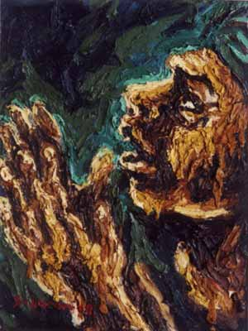
Prayer in Gethsemane
And being in great agony he prayed more earnestly and his sweat became like great drops of blood falling down onto the ground.
Luke 22:44
“My Father, if it be possible, let this cup pass from me, nevertheless, not as I will but as thou wilt.”
Matthew 26:39
Notes:
After the Last Supper they went to stay in the Garden of Gethsemane (Olive Press). Jesus went to pray with 3 disciples who fell asleep.
Agony in front of God – why? What was the content of his prayer?

Slide 27
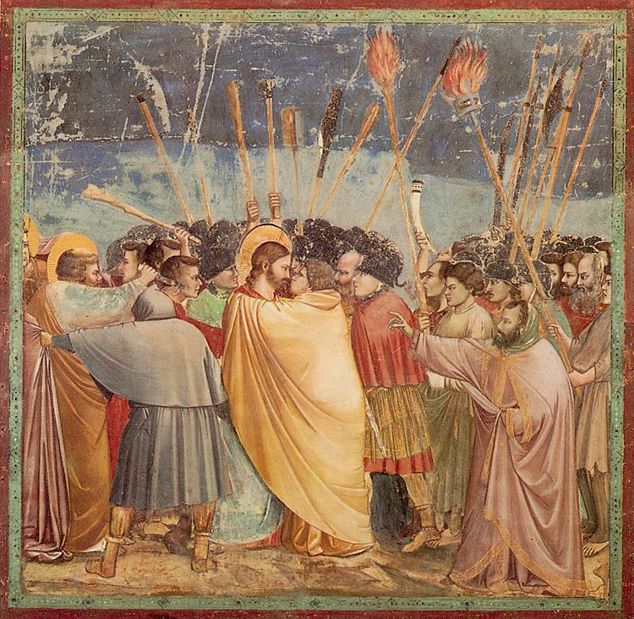
Jesus arrested
So Judas came to the grove, guiding a detachment of soldiers and some officials from the chief priests.
"Am I leading a rebellion, that you have come with swords and clubs?”
Then the detachment of soldiers with its commander and the Jewish officials arrested Jesus.
John 18:3,12
Judas identifies Jesus with a kiss
Notes:
All four Gospels report that Jesus was arrested at night. According to Mark, Matthew, and Luke, his arrest was carried out by a team, some men being armed with swords, others with staves or cudgels. According to John, the arrest was carried out by a detachment of soldiers under the command of a Roman officer, and accompanied by Jewish policemen. At first sight, these reports conflict with each other, but the conflict is resolved if we remember that Roman soldiers carried swords, while the Jewish police carried batons. Thus the men who are mentioned in Mark as having been armed with staves are Jewish policemen, while those members of the crowd whom Mark describes as carrying swords are identical with the detachment that is specified as a cohort of soldiers by John.
Mark, we must remember, was written in Rome, at a time when Christians were exposed to attack by the Roman mob, and were subject to suspicion on the part of Roman officials. Therefore, the evangelist may well have had cogent reasons for not wishing to draw attention to the fact that Jesus had been arrested by Roman soldiers or mercenaries in the service of Rome; and this may well have made him substitute the vague and colorless expression “a crowd with swords” for the more definite designation of his source—a source which still comes to the fore in the Johannine account. Jesus was arrested by Roman soldiers who were accompanied, probably as guides, by some Jewish policemen.

Slide 28
The trials of Jesus
In the High Priest’s house
The chief priests and the whole Sanhedrin were looking for something to use against Jesus. They wanted to put him to death. But they did not find any proof, even though many false witnesses came forward. Matthew 26:59
  At night – Sanhedrin cannot meet at night
  High priest’s police tribunal
  Not proper procedure
  Not valid charge
  No real evidence
  Try to frame him
Notes:
Jesus was let down by nearly everyone. The prophecies in Isaiah of the Lord of Suffering come to pass. Jesus was accused but never defended himself.

Slide 29
Judas response to what happens
When Judas saw that Jesus was condemned, he was seized with remorse and returned the thirty pieces of silver to the chief priests and the elders. “I have sinned,” he said, “for I have betrayed innocent blood.” “What is that to us?” they replied. “That’s your responsibility.” So Judas threw the money into the temple and left. Then he went away and hanged himself. Matthew 27:3-5
Notes:
Judas regretted what happened and killed himself. Therefore the outcome is not what he expected. If he did it for the money he would have pocketed the money and gone home. If he wanted Jesus out of the way so he could marry Mary M he would have taken the money and her. So what happened is not what he wanted to happen. He had been betrayed and tricked by the representatives of the high priest. He could no longer live with what he realised he had unwittingly done and killed himself.

Slide 30
The place of Judas in Christian thought
Judas = Judah = Jews
Associated with money and a thief
Betrayed Jesus = Jews betrayed Jesus
In the Bible, the whole is often named after the part: as Judas was called the devil and the devil’s workman, he gives his name to the whole race. Pope Gelasius I (5th century)

Slide 31
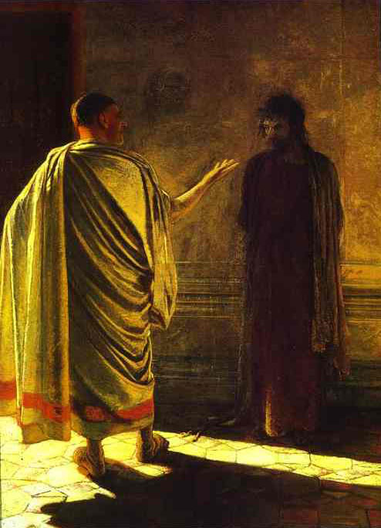
Jesus in front of Pontius Pilate
Pilate asked him, “Are you the King of the Jews?” Jesus said to him, “You have said so.” But when he was accused by the chief priests he made no answer, not even a single word. Matthew 27:11-12
Pilate asks “What is truth?”
Jesus was killed after being branded a
heretic by religious leaders and a rebel by the Roman Empire. EDP, 283
Notes:
Gay Nikolay Nikolayevich (1831-1894)
The construct of a trial by the Jewish High Priest and the Jewish mobs screaming for the execution of Jesus, (These were the same Jews who celebrated Jesus' triumphant entry into Jerusalem on the back of a donkey on Sunday. These were the same Jews who thronged the streets waving palm branches to welcome Him. They shouted "Hosanna" and laid their cloaks and palm branches from the nearby trees in His path.) served as means to blame the Jews for the death of Jesus and make the conversion of pagan Romans to Christianity more palatable. All four Gospel stories were edited to make Jewish authorities, not Roman authorities, primarily responsible for the death of Jesus of Nazareth.
Pilate orders Jesus to be scourged. Christian Gospels portray Pilate as "innocent".
[Philo (Ad Gaium, 38) describes him as inflexible, merciless, and obstinate. Pontius Pilate was an exceptionally cruel and corrupt man. Pontius Pilate routinely crucified Jews without benefit of trial. He was so brutal that the Romans withdrew him (in A.D. 36) in disgrace to Rome because of his excesses.]
The Romans were absolved, the Jews were blamed.
Many historians attribute these accounts of the trial of Jesus to efforts by early Christians to make their message more palatable to Roman audiences.
Pontius Pilate sentenced Jesus of Nazareth to crucifixion.
The Romans and their Roman collaborators (Caiaphas, who the Romans appointed as High-Priest) killed Jesus of Nazareth not the Jewish People.
Many historical experts and Biblical scholars have expressed doubt that Jesus ever appeared before Jewish or Roman leaders before his execution.
During World War II, The Nazis invaded France. They installed a puppet government in Vichy.
The Vichy Government was responsible for numerous atrocities.
When the Allies recaptured France, the members of the Vichy Government were tried and executed.
The French people were not held responsible for the atrocities of the Vichy Government.
However, for 2,000 years the Jewish people have been held responsible for the acts of a puppet government installed by the Romans.

Slide 32
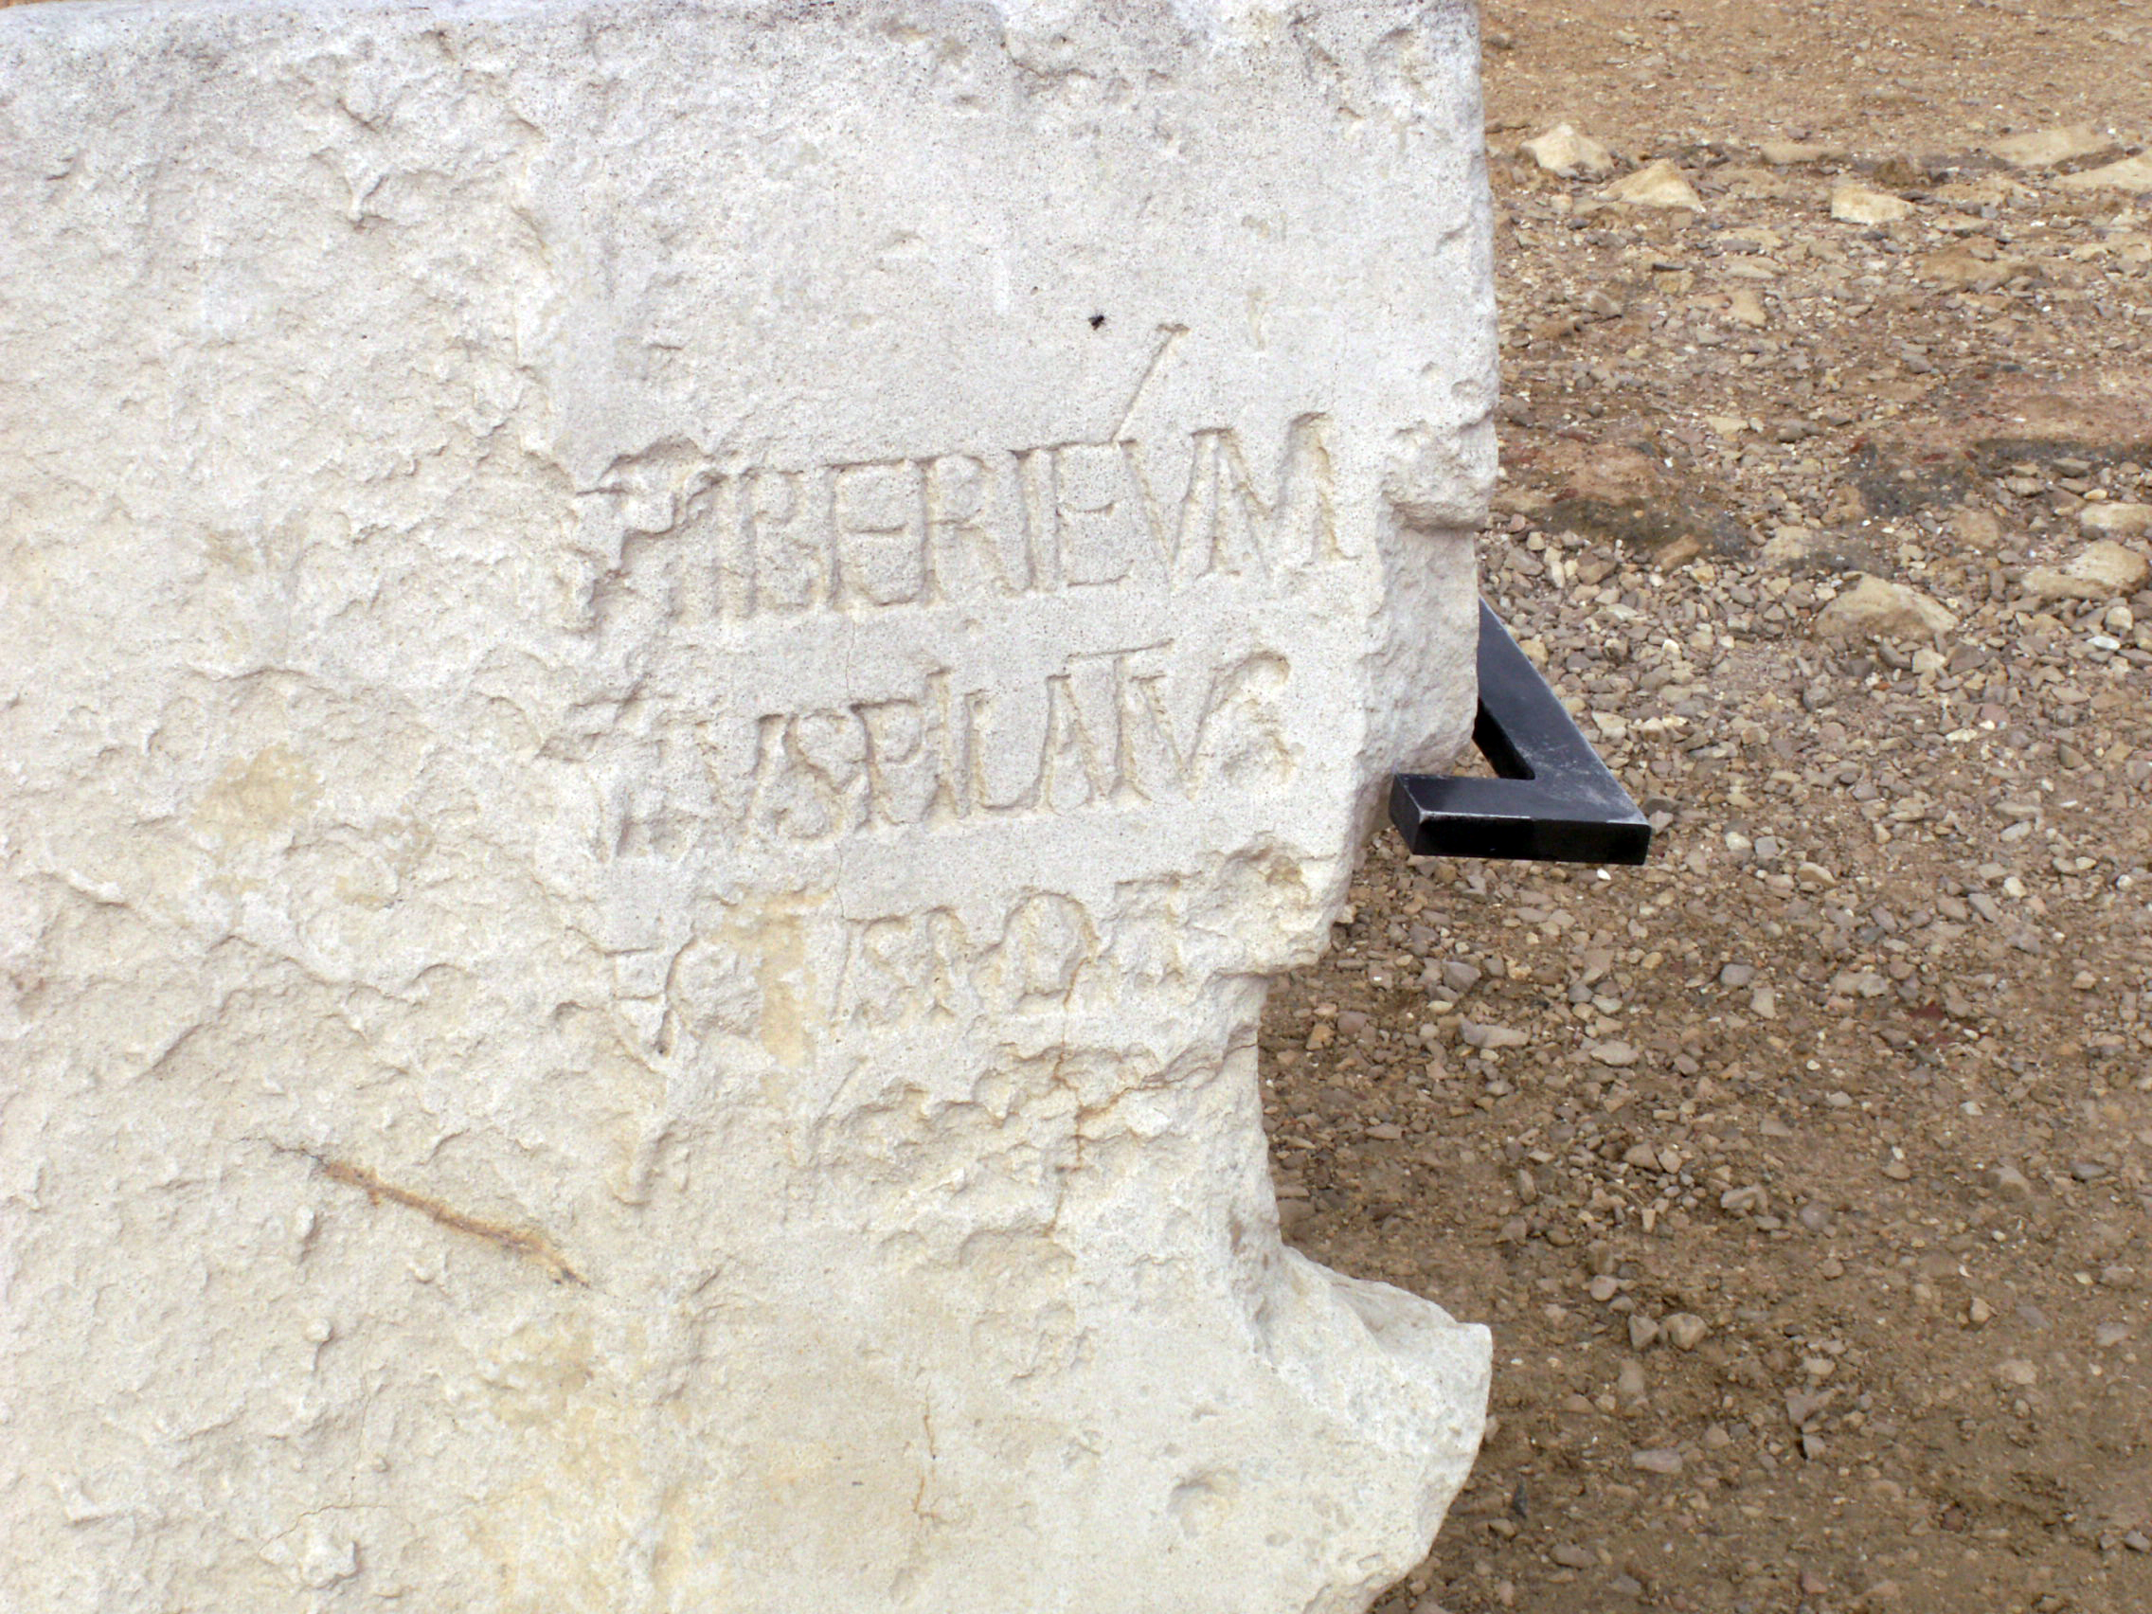
Who was Pilate?
Roman governor of Judaea 26-36 AD
Disrespected Jewish traditions
  Chastised by Emperor
Took Temple money
Slaughtered Samaritans
  Withdrawn by Rome
Pilate Stone (1961)
Pilate's tenure was associated with "briberies, insults, robberies, outrages,
wanton injustices, constantly repeated executions without trial, and
ceaseless and grievous cruelty.” Philo of Alexandria
Notes:
[Philo (Ad Gaium, 38) describes him as inflexible, merciless, and obstinate. Pontius Pilate was an exceptionally cruel and corrupt man. Pontius Pilate routinely crucified Jews without benefit of trial. He was so brutal that the Romans withdrew him (in A.D. 36) in disgrace to Rome because of his excesses.]
For millennia there is one thing that people of every faith and none have accepted as an unquestioned and unquestionable truth: “The Jews rejected and killed Jesus.” Many have gone further and accused them of murdering him. It is this belief that lies at the heart of anti-Semitism and the contempt with which Jews have been held. The Divine Principle itself says, "Jesus was killed after being branded . . . a rebel by the Roman Empire." (3.3.2 The Course to Restore Substantial Canaan under the Leadership of Christ at the Second Advent) This 50 year old insight has not been examined or fleshed out very much in the past. However over the last few decades many New Testament scholars have reached the same conclusion. Here are a selection of quotes that I came across recently:
There is no doubt in my mind that the persons responsible for the execution of Jesus were the Romans. The Romans practised crucifixion. While it was not unknown to the Jewish people it was not a form of Jewish execution. (Eric M Meyers – Professor Duke, Oxford, Princeton)
Pilate . . . probably regarded [Jesus] as a religious fanatic whose fanaticism had become so extreme that it posed a threat to law and order. (EP Sanders – Professor Oxford)
A quick reading of the Gospels might give the impression that Pontius Pilate was a decent harassed administrator, reluctantly pressured into executing Jesus. Gospel critics, considering for example Luke 13:1, already questioned this picture of Pilate. But we know a good deal more about Pilate from a variety of sources outside the New Testament. It confirms what Gospel critics already suspected from internal evidence, that Pilate was really a very hard man who would unhesitatingly order the execute of a Galilean who seemed to him sufficiently troublesome. The tragic myth of Pilate as a decent fellow pushed into a terrible mistake has to go. It was evolved by way of reconciling Christianity with the Roman State, but it is not historical. (Don Cupitt and Peter Armstrong – Cambridge and BBC)
Jesus was executed in a land under Roman military occupation and by the Roman authorities. Only the Romans were allowed to crucify and only the Romans had the authority to condemn a man to death. Crucifixion was a punishment for those who threated the political status quo, not those accused of theological heresy. Of course, in first-century Palestine, as today, theology is politics. A charismatic leader who proclaimed a kingdom with God and not Caesar at its head was an immediate threat to the authorities. And as with all occupations, there were local stooges who acted on behalf of the Romans. But no one was in any doubt who was ultimately in charge. The Romans were responsible for the death of Christ. All of which makes the story of Pontius Pilate washing his hands of the decision to execute a political / theological troublemaker entirely implausible. Brutal crowd suppression was Pilate’s speciality. Governors of troublesome outposts of the Roman Empire were hard-nosed career politicians who would not flinched from taking a man’s life before breakfast. … moreover, given that much of the anti-Jewish rhetoric of the Gospels was written after Roman legions had returned to crush the Jewish rebellion of AD 66, some have seen the desire to blame “the Jews” as whitewashing Roman responsibility so as not to antagonise Roman power . . . Christians have too often preferred an anti-Semitic lie to a disturbingly relevant truth: Jesus was destroyed by the logic of empire. (Giles Fraser – Church of England priest, Oxford)
. . . several episodes recorded by Josephus of where eschatological prophets emerge and Pilate has no hesitation in eliminating them or in suppressing episodes of potential conflict or revolt within that territory. (Harold Attridge – Professor Yale)
The picture of Jesus we have is based on religious canonical documents that, to a large extent, have been rewritten so that the family and those close to Jesus have been written out and a huge amount of anti-Semitism written in . . . [Jesus] is made to appear as if he doesn’t like his own people. He says things like “a prophet is never accepted in his own house”, “who are my mother and brothers?” These are polemics – the Greek idea to put your own ideas into the mouth of an important person to give them credibility. Jesus is made to like Roman Centurions – and to praise them – and the centurions are presented as not wanting to execute Jesus, which is unrealistic and a complete invention. Real Jewish sympathisers would never write those sorts of things. (Robert Eisenman – Professor California State, Oxford)
The Romans knew two types of threat. One was violent threat, and they were dynamite with that. That’s what the legions were for. But a non-violent threat is still a threat. Jesus is gathering people around the Kingdom of God. That is a pointed term. He could have chosen other terms — “kinship,” “family,” whatever. But he chose “kingdom.” Only Rome could appoint the King of the Jews — and that king was Herod. So it all makes sense. Pilate would have agreed that if someone is talking about the Kingdom of God, he must think he’s the king. One empire, two kings — and that’s trouble! (John Dominic Crossan – Professor Chicago)
Fully relevant to the case of Jesus, is [the first century Jewish historian] Josephus’ account of the execution of John the Baptist. . . John’s downfall was due to the powerful appeal of his preaching . . . his execution in secret was a drastic preventive measure against a potentially dangerous public figure, who dealt with religion today, but who tomorrow could become the leader of a revolution. In a similar way, Jesus, a persuasive preacher, sealed his fate by the affray he caused in the commercial quarter of the Temple by overturning the tables of the merchants and money-changers. . . this was an act which the high priestly guardians of law and order would have been ill-advised to tolerate. So they handed him over to the cruel representative of a political system which, when faced with the threat of insurrection, often demonstrated outstanding brutality and savagery. (Geza Vermes – Professor Oxford)
Most Christians did not want to be enemies of the Roman Empire and they soon sought to play down the role of the Romans in the story. So the Passion narratives shifted the blame on to the Jewish authorities and . . . Pontius Pilate . . . was portrayed as inquisitive and bewildered, cross-questioning the seditious prisoner before him as if Jesus were an equal and making every effort to get him off the hook. . . Matthew shifted blame for Jesus’ death . . . to the Jewish crowed, who in his narrative roared out “His blood be on us, and on our children!” . . . It would have been better for the moral health of Christianity if the blame had stayed with Pilate. (Diarmaid MacCulloch – Professor Oxford)
According to the Gospels, Barabbas was released. The story sounds unlikely: the Romans usually executed murderous rebels. (Simon Sebag Montefiore – Professor University of Buckingham)
The traditional account of the sentencing . . . does not ring true. The Gospels claim that the priests insisted they did not have the authority to pass death sentences, but it is far from clear that this is true. The high priest, writes Josephus” will adjudicate in cases of dispute, punish those convicted of crime”. The Gospels, written or amended after the destruction of the Temple in 70, blamed the Jews and acquitted the Romans, keen to show loyalty to the empire. Yet the charges against Jesus, and the punishment itself, tell their own story: this was a Roman operation. (Simon Sebag Montefiore – Professor University of Buckingham)

Slide 33
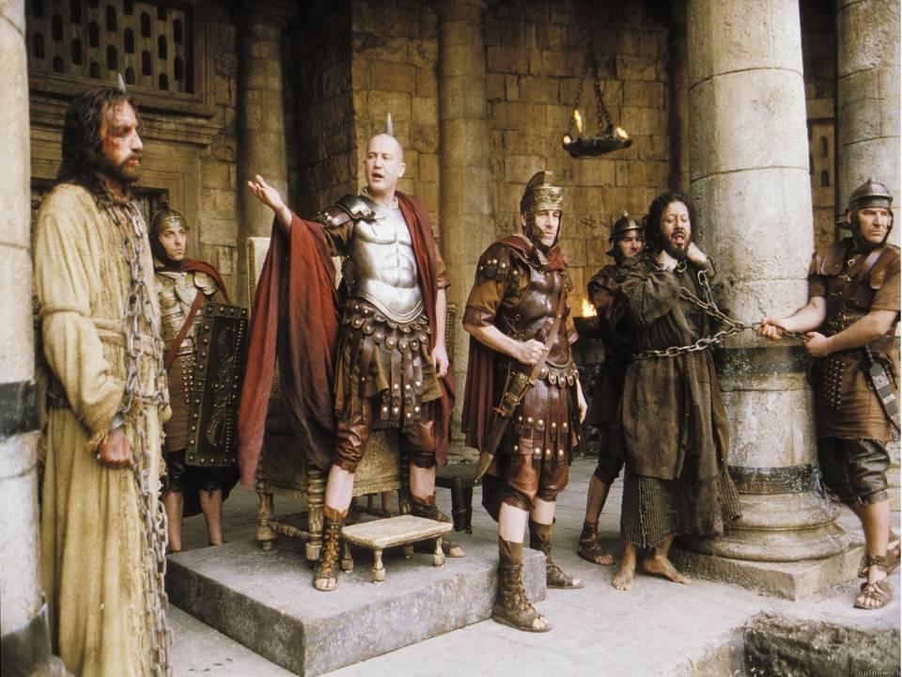
Jesus or Barabbas?
Now at the festival the governor was accustomed to release a prisoner for the crowd, anyone whom they wanted. Matthew 27:15
“Scholars have looked for evidence and so far have never found anything in reference to the so-called custom of releasing a prisoner on Passover.” Stephen J. Patterson, Professor New Testament
Notes:
“Scholars have looked for evidence," Patterson says, and so far "have never found anything in reference to the so-called custom of releasing a prisoner on Passover.”
Barabbas or Jesus?
¹⁵ Now at the festival the governor was accustomed to release a prisoner for the crowd, anyone whom they wanted. ¹⁶ At that time they had a notorious prisoner, called Jesus^{[g]} Barabbas. ¹⁷ So after they had gathered, Pilate said to them, ‘Whom do you want me to release for you, Jesus^{[h]} Barabbas or Jesus who is called the Messiah?’^{[i]} ¹⁸ For he realized that it was out of jealousy that they had handed him over. ¹⁹ While he was sitting on the judgement seat, his wife sent word to him, ‘Have nothing to do with that innocent man, for today I have suffered a great deal because of a dream about him.’ ²⁰ Now the chief priests and the elders persuaded the crowds to ask for Barabbas and to have Jesus killed. ²¹ The governor again said to them, ‘Which of the two do you want me to release for you?’ And they said, ‘Barabbas.’ ²² Pilate said to them, ‘Then what should I do with Jesus who is called the Messiah?’^{[j]} All of them said, ‘Let him be crucified!’ ²³ Then he asked, ‘Why, what evil has he done?’ But they shouted all the more, ‘Let him be crucified!’
Pilate Hands Jesus over to Be Crucified
²⁴ So when Pilate saw that he could do nothing, but rather that a riot was beginning, he took some water and washed his hands before the crowd, saying, ‘I am innocent of this man’s blood;^{[k]} see to it yourselves.’ ²⁵ Then the people as a whole answered, ‘His blood be on us and on our children!’ ²⁶ So he released Barabbas for them; and after flogging Jesus, he handed him over to be crucified.

Slide 34
Jesus or Barabbas?
While he was sitting on the judgement seat, his wife sent word to him, ‘Have nothing to do with that innocent man, for today I have suffered a great deal because of a dream about him’. Matthew 27:19
Notes:
“Scholars have looked for evidence," Patterson says, and so far "have never found anything in reference to the so-called custom of releasing a prisoner on Passover.”
Barabbas or Jesus?
¹⁵ Now at the festival the governor was accustomed to release a prisoner for the crowd, anyone whom they wanted. ¹⁶ At that time they had a notorious prisoner, called Jesus^{[g]} Barabbas. ¹⁷ So after they had gathered, Pilate said to them, ‘Whom do you want me to release for you, Jesus^{[h]} Barabbas or Jesus who is called the Messiah?’^{[i]} ¹⁸ For he realized that it was out of jealousy that they had handed him over. ¹⁹ While he was sitting on the judgement seat, his wife sent word to him, ‘Have nothing to do with that innocent man, for today I have suffered a great deal because of a dream about him.’ ²⁰ Now the chief priests and the elders persuaded the crowds to ask for Barabbas and to have Jesus killed. ²¹ The governor again said to them, ‘Which of the two do you want me to release for you?’ And they said, ‘Barabbas.’ ²² Pilate said to them, ‘Then what should I do with Jesus who is called the Messiah?’^{[j]} All of them said, ‘Let him be crucified!’ ²³ Then he asked, ‘Why, what evil has he done?’ But they shouted all the more, ‘Let him be crucified!’
Pilate Hands Jesus over to Be Crucified
²⁴ So when Pilate saw that he could do nothing, but rather that a riot was beginning, he took some water and washed his hands before the crowd, saying, ‘I am innocent of this man’s blood;^{[k]} see to it yourselves.’ ²⁵ Then the people as a whole answered, ‘His blood be on us and on our children!’ ²⁶ So he released Barabbas for them; and after flogging Jesus, he handed him over to be crucified.

Slide 35

Likely?
“If Jesus was causing trouble at a gathering like Passover, when the city was crowded to bursting, I don’t think Pilate would have spent much time worrying about what to do with him. It was entirely up to the governor as to how he dealt with the case, and after hearing the evidence he no doubt thought that getting rid of Jesus was the best course of action.”
Helen Bond, Professor of Christian Origins, Edinburgh University

Slide 36
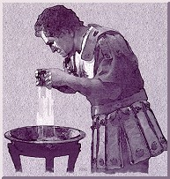
The blood curse
So when Pilate saw that he could do nothing, but rather that a riot was beginning, he took some water and washed his hands before the crowd, saying, "I am innocent of this man's blood; see to it yourselves." Then the people as a whole answered, "His blood be on us and on our children!”
Matthew 27:24–25
Notes:
Told by gospel writer to transfer blame for crucifixion onto the Jews and not the Roman. Even if had said it doesn’t work like that. Excuse for Christians to blame and mistreat Jews for 2000 years. Jesus forgave so no one else has authority to blame or accuse let alone punish
THE PEOPLE AS A WHOLE ANSWERED – the people as a whole were not there. Small crowd. Editorial bias
You handed him over to be killed, and you disowned him before Pilate, though he had decided to let him go. ¹⁴ You disowned the Holy and Righteous One and asked that a murderer be released to you. Acts 1

Slide 37
What just happened?
Pilate, Rome and the Empire were absolved of responsibility for the crucifixion of Jesus
Responsibility was transferred to the Jewish people as a whole and their descendants
Even though in reality Jesus was received very well by the people and many leaders
Creation of the ‘culture of contempt’
Christians didn’t feel guilty but justified in mistreating Jews

Slide 38
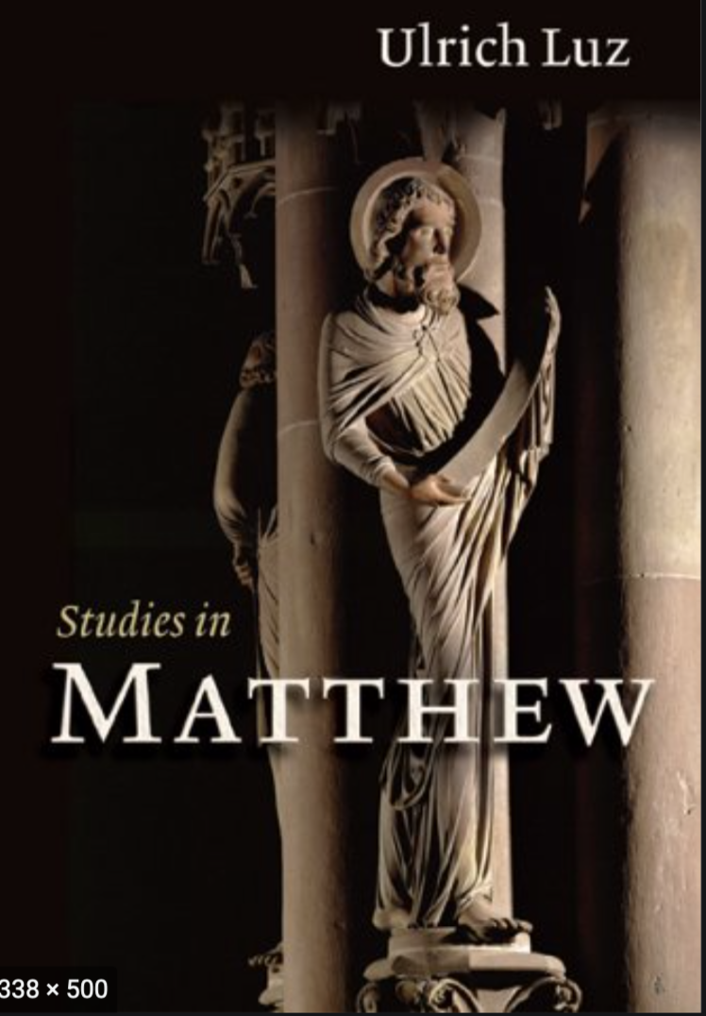
An interpolation
Ulrich Luz describes the incident as a "redactional fiction" invented by the author of the Matthew Gospel. (2005)
Professor of New Testament at the universities of Göttingen and Bern
Matthew says that while the Romans actually carried out the deed, the Jews were responsible—a line of argument that has of course had disastrous consequences ever since. Helen Bond
Notes:
The blood curse scene is a fabrication

Slide 39
Why?
Christians witnessing in the Roman Empire
Christians being persecuted
Didn’t want Jesus to come across as a political subversive and rebel against Roman authority
Didn’t want to blame the Romans for the crucifixion
Transferred blame for the crucifixion from the Romans onto the Jews
Accused the Jews of rejecting and murdering Jesus
That is why the picture of the Romans in the gospels is so favourable
Jesus turned into a spiritual messiah bringing forgiveness of sins. Political dimension removed

Slide 40
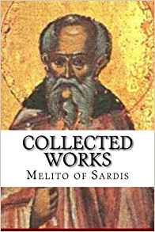
Melito of Sardis (d.180)
Bishop of Sardis (died c.180)
Most influential bishop in Asia
Jerome says Tertullian saw him as prophet due to his work on the 1st OT canon
Polycrates, “Melito whose whole walk was in the Holy Spirit”
Jewish by birth
Author of Peri Pascha - On The Passover
Notes:
Melito of Sardis (died c. 180) was the bishop of Sardis near Smyrna in western Anatolia, and a great authority in early Christianity. He was Jewish by birth. Melito held a foremost place in terms of Bishops in Asia due to his personal influence on Christianity and his literary works, most of which have been lost but of what has been recovered has provided a great insight into Christianity during the second century. Jerome, speaking of the Old Testament canon established by Melito, quotes Tertullian to the effect that he was esteemed as a prophet by many of the faithful. This work by Tertullian has been lost but pieces regarding Melito are quoted by Jerome as to the high regard that Melito was considered at the time. Melito is remembered for his work on developing the first Old Testament Canon. Though it cannot be determined what date he was elevated to episcopacy, it is probable that he was bishop during the arising controversy at Laodicea in regard to the observance of Easter, which resulted in him writing his most famous work, an Apology for Christianity to Marcus Aurelius. Little is known of his life outside of what works are quoted or read by Clement of Alexandria, Origen, and Eusebius. A letter of Polycrates of Ephesus to Pope Victor about 194 (Eusebius, Church History V.24) states that "Melito the eunuch [this is interpreted "the virgin" by Rufinus in his translation of Eusebius], whose whole walk was in the Holy Spirit", was buried at Sardis.[1] His feast day is celebrated on April 1.
Polycrates of Ephesus, a notable bishop of the time, was a contemporary of Melito, and in one of the letters preserved by Eusebius, Polycrates describes Melito as having fully lived in the Spirit. Jewish by birth, Melito lived in an atmosphere where the type of Christianity practiced was largely oriented toward the Jewish form of the Christian faith. Coming out of and representing the Johannine tradition, Melito's theological understanding of Christ often mirrored that of John. However, like most of his contemporaries, Melito was fully immersed in Greek culture. This Johannine tradition led Melito to consider the Gospel of John as the chronological timeline of Jesus’s life and death. This in turn led to Melito’s standpoint on the proper date of Easter discussed in Peri Pascha which he held as the 14th of Nisan.
Melito gave the first Christian list of the canon in the Old Testament. In his canon he excludes the Books of Esther, Nehemiah, and the Apocrypha. Around 170 after traveling to Palestine, and probably visiting the library at Caesarea Maritima, Melito compiled the earliest known Christian canon of the Old Testament, a term he coined. A passage cited by Eusebius contains Melito's famous canon of the Old Testament. Melito presented elaborate parallels between the Old Testament or Old Covenant, which he likened to the form or mold, and the New Testament or New Covenant, which he likened to the truth that broke the mold, in a series of Eklogai, six books of extracts from the Law and the Prophets presaging Christ and the Christian faith. His opinion of the Old Covenant was that it was fulfilled by Christians, whereas the Jewish people failed to fulfill it. The New Covenant is the truth found through Jesus Christ.
Melito was especially skilled in the literature of the Old Testament, and was one of the most prolific authors of his time. Eusebius furnished a list of Melito's works. While many of these works are lost, the testimony of the fathers remains to inform us how highly they were viewed. Eusebius presents some fragments of Melito's works and some others are found in the works of different writers.
Polycrates "belonged to a family in which he was the eighth Christian bishop; and he presided over the church of Ephesus, in which the traditions of St. John were yet fresh in men's minds at the date of his birth. He had doubtless known Polycarp, and Irenaeus also. He seems to have presided over a synod of Asiatic bishops (A.D. 196) which came together to consider this matter of the Paschal feast. It is surely noteworthy that nobody doubted that it was kept by a Christian and Apostolic ordinance."

Slide 41
Jews blamed for murder of Jesus
72. This one was murdered. And where was he murdered? In the very centre of Jerusalem! Why? Because he had healed their lame, and had cleansed their lepers, and had guided their blind with light, and had raised up their dead.
73. Why, O Israel did you do this strange injustice? You dishonoured the one who had honoured you. You held in contempt the one who held you in esteem. You denied the one who publicly acknowledged you. You renounced the one who proclaimed you his own. You killed the one who made you to live. Why did you do this, O Israel?
Notes:
Jesus was not murdered but executed by the Romans on a political charge of subversion and attempted overthrow of the regime
The statement Jesus murdered also in DP

Slide 42
Accusation of deicide
96. The one who hung the earth in space, is himself hanged; the one who fixed the heavens in place, is himself impaled; the one who firmly fixed all things, is himself firmly fixed to the tree. The Lord is insulted, God has been murdered, the King of Israel has been destroyed by the right hand of Israel.
Notes:
Revererated through centuries
Justifed mistretament of Jews as justified punishment
Even holocaust justified as punishment for this crime
Deicide

Slide 43
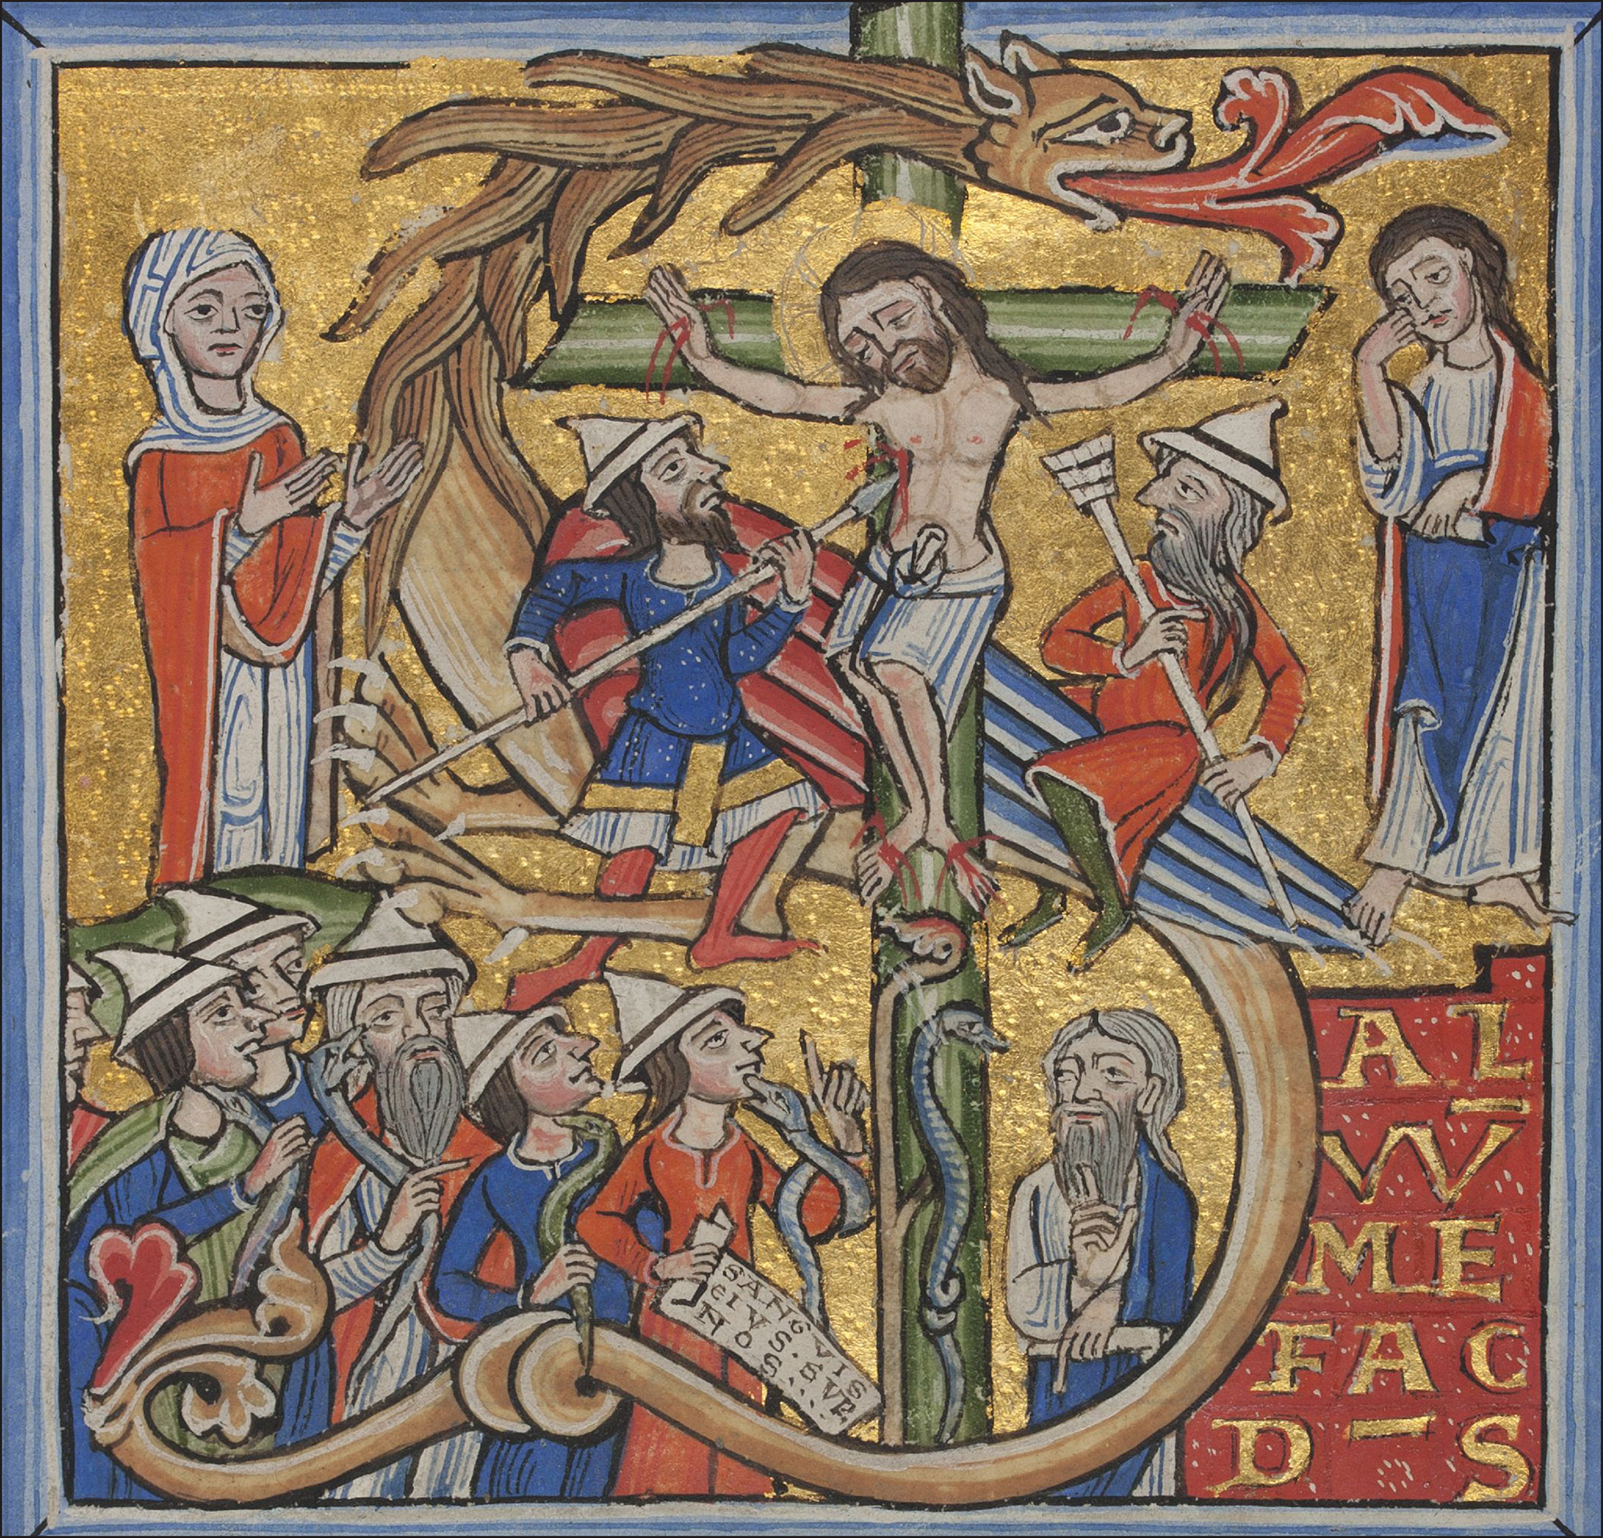
Notes:
Jews mocking and crucifying and killing Jesus
The crucifixion and brazen serpent. Initial to Psalm 68, Peter Lombard, Commentary on Psalms, Paris (?), 1166.
Jews froced to wear pointed hats in Germany to distinguish them

Slide 44
Who actually killed Jesus?
In the tangled mass of evangelical accounts of Jesus's trial, one point stands out with clarity: he was arrested as “a rebel,” accused before Pilate as “King of the Jews,” found guilty as such, and executed as such. None of the later accretions which in the Gospels overlay the original primitive account, and none of the editorial modifications from the hands of successive evangelists, can hide or disguise the fact that Jesus of Nazareth was arrested, accused, tried, sentenced, and executed on a charge of insurrection against Roman rule in Judaea.
Paul Winter, The Trial of Jesus, Commentary, Sept. 1964
Notes:
Paul Winter (1904–1969) was born in Moravia. He was a successful barrister in Czechoslovakia but fled in 1939 due to the Nazi takeover (he was a Jew), became a British soldier.[1]
While performing research at libraries in London Winter worked menial jobs such as a porter and died in 1969 in London, in poverty, after having published around a hundred articles in scholarly journals concerning earliest Christianity.[1] Winter's 1961 book On the Trial Of Jesus, received hundreds of reviews, because it detailed critical analysis of the evidence regarding the trial of Jesus, from the standpoint of the legal practices which were applied during the 1st century, analyzed according to Jewish Law, and separately according to Roman Law.[1]
Winter's general conclusion was that Jesus was tried, and ultimately convicted and crucified, solely for his having violated Roman Law, sedition, because he claimed to be the king of the Jews, despite Rome's having appointed the Herodian family to that post. Crucifixion was solely a Roman form of execution, for sedition and other serious violations of Roman Law. Jewish Law did not employ crucifixion, not even for crimes which were capital offenses under Jewish Law.

Slide 45
The Jews blamed
Christianity started as a heretical movement within Judaism; its four gospels contain unmistakeable elements of hostility to what was then the Jewish establishment, including shifting blame for Jesus’s death from the Romans to Jewish authorities. By an accident of history, Christians then gained established status in the Roman Empire. Powerful Christianity could now use earlier rhetoric against the Jews to marginalise them.
Diarmaid MacCulloch, Professor of the history of the church, University of Oxford

Slide 46
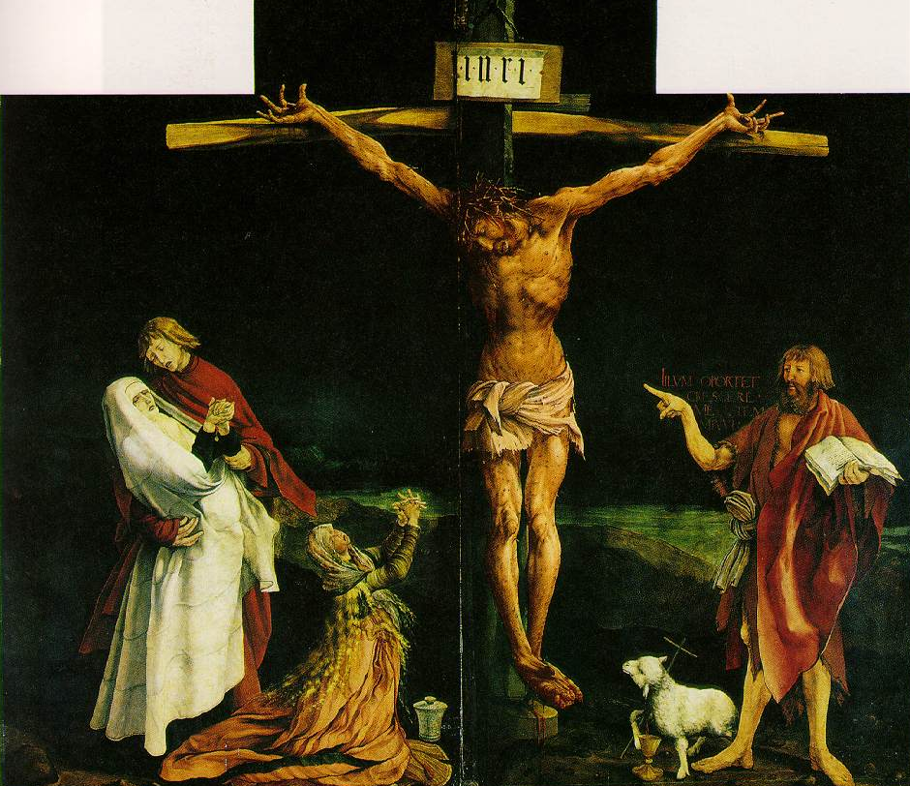
The crucifixion of Christ
And those who passed by derided him, wagging their heads and saying, “You would destroy the temple and build it up in three days, save yourself.”
Matthew 27:39-40
Notes:
Jesus must have been in such pain. On Palm Sunday they were shouting Hosanna. 5 days later they were mocking him. Yet despite this Jesus never changed his heart or attitude.

Slide 47
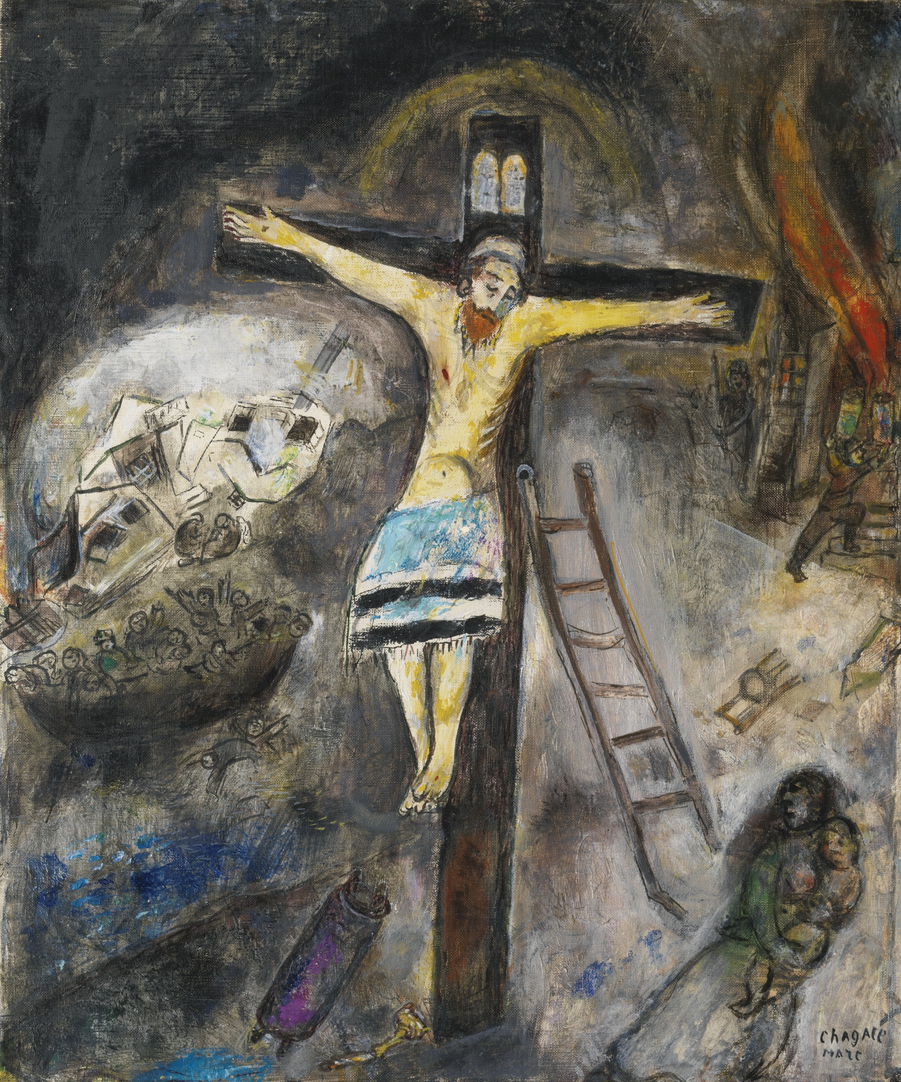
What were Jesus’ last words?
On the cross Jesus established the foundation of faith and substance
“My God, my God, why have you forsaken me?” Mark 15:34 (Psalm 22)
“Father, forgive them; for they know not what they do.” Luke 23:34
“Father, into your hands I commit my spirit.” Luke 23:46
Notes:
Despite being mocked Jesus never left the position of being the son of God. He didn’t curse the people for rejecting and crucifying him. Instead he practised what he preached and asked God to forgive them. He loved and gave his life for his enemies. Satan couldn’t accuse Jesus. He had done his utmost to destroy and break Jesus but had been unsuccessful. Satan had tempted and dominated Adam, but he couldn’t tempt Jesus. Even on the cross Jesus continued to love. Even when he didn’t feel God’s presence, Jesus still kept faith. Even though things didn’t turn out how he expected, Jesus continued to love and trust God. Satan had to bow down and acknowledge that Jesus was greater than he was. So Satan had to release anyone who believed in Jesus.
Psalm 22
¹ My God, my God, why have you forsaken me?
Why are you so far from saving me,
so far from my cries of anguish?
² My God, I cry out by day, but you do not answer,
by night, but I find no rest.^{[b]}
³ Yet you are enthroned as the Holy One;
you are the one Israel praises.^{[c]}
⁴ In you our ancestors put their trust;
they trusted and you delivered them.
⁵ To you they cried out and were saved;
in you they trusted and were not put to shame.
⁶ But I am a worm and not a man,
scorned by everyone, despised by the people.
⁷ All who see me mock me;
they hurl insults, shaking their heads.
⁸ “He trusts in the LORD,” they say,
“let the LORD rescue him.
Let him deliver him,
since he delights in him.”
⁹ Yet you brought me out of the womb;
you made me trust in you, even at my mother’s breast.
¹⁰ From birth I was cast on you;
from my mother’s womb you have been my God.
¹¹ Do not be far from me,
for trouble is near
and there is no one to help.
¹² Many bulls surround me;
strong bulls of Bashan encircle me.
¹³ Roaring lions that tear their prey
open their mouths wide against me.
¹⁴ I am poured out like water,
and all my bones are out of joint.
My heart has turned to wax;
it has melted within me.
¹⁵ My mouth is dried up like a potsherd,
and my tongue sticks to the roof of my mouth;
you lay me in the dust of death.
¹⁶ Dogs surround me,
a pack of villains encircles me;
they pierce my hands and my feet.
¹⁷ All my bones are on display;
people stare and gloat over me.
¹⁸ They divide my clothes among them
and cast lots for my garment.
¹⁹ But you, LORD, do not be far from me.
You are my strength; come quickly to help me.
²⁰ Deliver me from the sword,
my precious life from the power of the dogs.
²¹ Rescue me from the mouth of the lions;
save me from the horns of the wild oxen.
²² I will declare your name to my people;
in the assembly I will praise you.
²³ You who fear the LORD, praise him!
All you descendants of Jacob, honor him!
Revere him, all you descendants of Israel!
²⁴ For he has not despised or scorned
the suffering of the afflicted one;
he has not hidden his face from him
but has listened to his cry for help.
²⁵ From you comes the theme of my praise in the great assembly;
before those who fear you I will fulfill my vows.
²⁶ The poor will eat and be satisfied;
those who seek the LORD will praise him—
may your hearts live forever!
²⁷ All the ends of the earth
will remember and turn to the LORD,
and all the families of the nations
will bow down before him,
²⁸ for dominion belongs to the LORD
and he rules over the nations.
²⁹ All the rich of the earth will feast and worship;
all who go down to the dust will kneel before him—
those who cannot keep themselves alive.
³⁰ Posterity will serve him;
future generations will be told about the Lord.
³¹ They will proclaim his righteousness,
declaring to a people yet unborn:
He has done it!
He was even abandoned by God. But he didn’t lose faith or curse God. He said, “Father, into thy hands I commit my spirit.”
On the cross Jesus restored Foundation of Faith and Substance – kept faith in God even though he felt abandoned by God, and loved his enemies. This was condition for him to be resurrected
Jesus did not stand in a position of meekness and humility because he was incapable and unworthy. He deserved to be higher and enjoy more glory than anyone else, but Jesus forsook all this and stood in a position of meekness and humility. Although Satan tried to fight with Jesus, because Jesus knew that Satan was bound to the condition that required him to submit before God, he could remain meek and humble to the end. A meek and humble nature like this is the opposite of Satan's original nature of arrogance and fury.
Moreover, because Satan was aware of the existence of the laws of the heavenly way, eventually he had to recognize Jesus. In other words, if you move forward in meekness and humility, then even the satanic world will be brought to natural submission. Jesus understood this principle, and he took position of meekness and humility of which Satan was utterly incapable. Similarly, you have to understand that only when you stand in a position of meekness and humility can you pioneer the new path heading toward God, who works through the center.

Slide 48
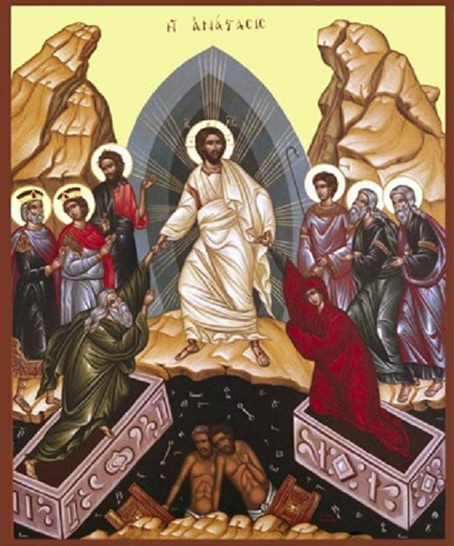
The harrowing of hell
Jesus went and made a proclamation to the spirits in prison, who in former times did not obey, when God waited patiently in the days of Noah.
I Peter 3:19-20
Notes:
Satan nor death could hol dhim

Slide 49
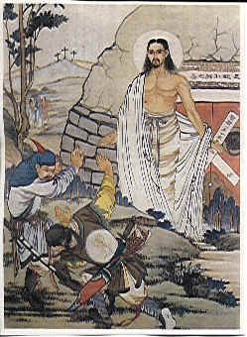
Resurrection
In compensation for Satan’s exercise of his maximum power in killing Jesus, God exercised his maximum power and resurrected Jesus.
EDP, 279
Notes:
Because Jesus kept his position of the son of God, Satan couldn’t keep him. Jesus was victorious over death. He resurrected and during 40 days Jesus revived the faith and spirits of his disciples and thus established the church, the body of Christ against which “the gates of hell cannot prevail.”

Slide 50
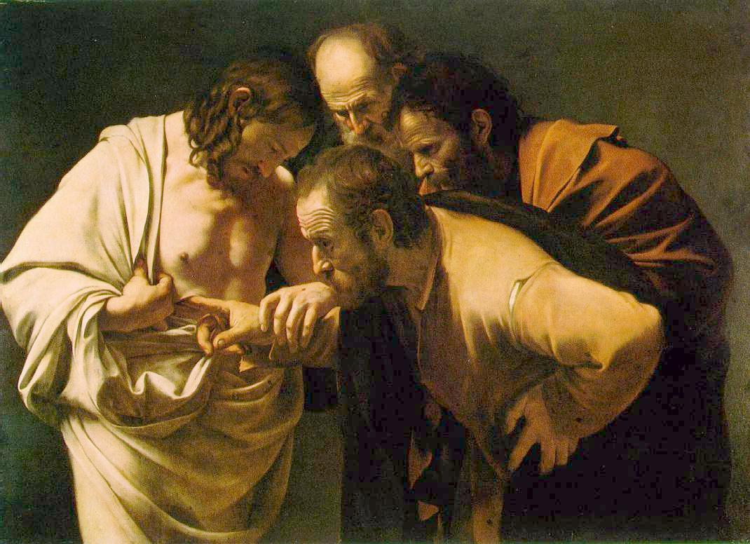
What happened at the resurrection?
The empty tomb
Missing body
Appeared to
500 followers
Appeared in
locked room
Ate food
Special body
Jesus and Thomas
Jesus’ body disappeared. EDP 228
Notes:
caravaggio

Slide 51
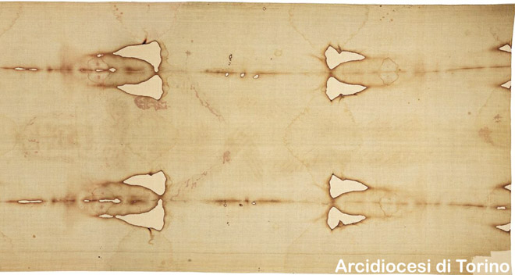
Shroud of Turin

Slide 52
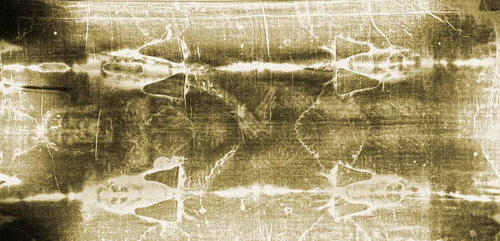
Shroud of Turin in negative
Notes:
Markings on the lines include:^{[22]}
one wrist bears a large, round wound, claimed to be from piercing (the second wrist is hidden by the folding of the hands)
upward gouge in the side penetrating into the thoracic cavity. Proponents claim this was a post-mortem event and there are separate components of red blood cells and serum draining from the lesion
small punctures around the forehead and scalp
scores of linear wounds on the torso and legs. Proponents claim that the wounds are consistent with the distinctive dumbbell wounds of a Roman flagrum.
swelling of the face from severe beatings
streams of blood down both arms. Proponents claim that the blood drippings from the main flow occurred in response to gravity at an angle that would occur during crucifixion
no evidence of either leg being fractured
large puncture wounds in the feet as if pierced by a single spike
Pollen, dirt from Palestine. Clothe typical 1st century Syria. Folding pattern 1st century Palestine. Blood same on shroud and sudarium. AB
No pigment, no photo method,
The Americans – who called themselves the Shroud of Turin Research Project or STURP – conducted 120 hours of X-rays and ultraviolet light tests on the linen cloth.
They concluded that the marks were not made by paints, pigments or dyes and that the image was not "the product of an artist", but that at the same time it could not be explained by modern science.
"There are no chemical or physical methods known which can account for the totality of the image, nor can any combination of physical, chemical, biological or medical circumstances explain the image adequately."
The US team – which included nuclear physicists, thermal chemists, biophysicists and forensic pathologists – concluded: "The image is an ongoing mystery." One of Christianity's greatest objects of veneration, the shroud appears to show the imprint of a man with long hair and a beard whose body bears wounds consistent with having been crucified.

Slide 53
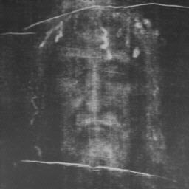
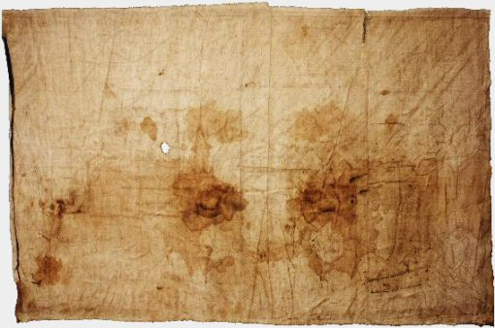
The face of Jesus?
The Sudarium of Oviedo
Shroud of Turin
Notes:
One of the relics held by the cathedral in the town of Oviedo, in the north of Spain, is a piece of cloth measuring approximately 84 x 53 cm. There is no image on this cloth. Only stains are visible to the naked eye, although more is visible under the microscope. The remarkable thing about this cloth is that both tradition and scientific studies claim that the cloth was used to cover and clean the face of Jesus after the crucifixion. We are going to present and look into these claims.
Such a cloth is known to have existed from the gospel of John, chapter 20, verses 6 and 7. These verses read as follows, "Simon Peter, following him, also came up, went into the tomb, saw the linen cloth lying on the ground, and also the cloth that had been over his head; this was not with the linen cloth but rolled up in a place by itself." John clearly differentiates between this smaller face cloth, the sudarium, and the larger linen that had wrapped the body.
According to this history, the sudarium was in Palestine until shortly before the year 614, when Jerusalem was attacked and conquered by Chosroes II, who was king of Persia from 590 to 628. It was taken away to avoid destruction in the invasion, first to Alexandria by the presbyter Philip, then across the north of Africa when Chosroes conquered Alexandria in 616. The sudarium entered Spain at Cartagena, along with people who were fleeing from the Persians. The bishop of Ecija, Fulgentius, welcomed the refugees and the relics, and surrendered the chest, or ark, to Leandro, bishop of Seville. He took it to Seville, where it spent some years.

Slide 54
Why do Christians believe the crucifixion was God’s will?
That same day two of them were walking to the village Emmaus, about seven miles out of Jerusalem. They were deep in conversation, going over all these things that had happened. In the middle of their talk and questions, Jesus came up and walked along with them. But they were not able to recognize who he was. He asked, “What’s this you’re discussing so intently as you walk along?”
They just stood there, long-faced, like they had lost their best friend. Then one of them, his name was Cleopas, said, “Are you the only one in Jerusalem who hasn’t heard what’s happened during the last few days?”
He said, “What has happened?”

Slide 55
They said, “The things that happened to Jesus the Nazarene. He was a man of God, a prophet, dynamic in work and word, blessed by both God and all the people. Then our high priests and leaders betrayed him, got him sentenced to death, and crucified him. And we had our hopes up that he was the One, the One about to deliver Israel. And it is now the third day since it happened. But now some of our women have completely confused us. Early this morning they were at the tomb and couldn’t find his body. They came back with the story that they had seen a vision of angels who said he was alive. Some of our friends went off to the tomb to check and found it empty just as the women said, but they didn’t see Jesus.”

Slide 56
Then he said to them, “So thick-headed! So slow-hearted! Why can’t you simply believe all that the prophets said? Don’t you see that these things had to happen, that the Messiah had to suffer and only then enter into his glory?”
Then he started at the beginning, with the Books of Moses, and went on through all the Prophets, pointing out everything in the Scriptures that referred to him.
They came to the edge of the village where they were headed. He acted as if he were going on but they pressed him: “Stay and have supper with us. It’s nearly evening; the day is done.”

Slide 57
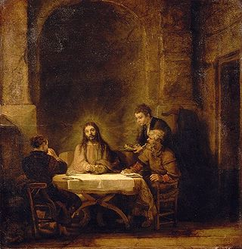
So he went in with them. And here is what happened: He sat down at the table with them. Taking the bread, he blessed and broke and gave it to them. At that moment, open-eyed, wide-eyed, they recognized him. And then he disappeared.
Back and forth they talked. “Didn’t we feel on fire as he conversed with us on the road, as he opened up the Scriptures for us?”
Luke 24:13-35

Slide 58
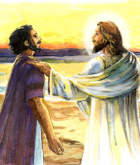
How did Jesus relate to them?
Peter denied Jesus three times
Jesus set up a situation which enabled Peter to restore this
Asked Peter three times, “Do you love me?”
Notes:
John 21
15When they had finished eating, Jesus said to Simon Peter, "Simon son of John, do you truly love me more than these?"
"Yes, Lord," he said, "you know that I love you."
Jesus said, "Feed my lambs.”
16Again Jesus said, "Simon son of John, do you truly love me?"
He answered, "Yes, Lord, you know that I love you."
Jesus said, "Take care of my sheep."
17 The third time he said to him, "Simon son of John, do you love me?"
Peter was hurt because Jesus asked him the third time, "Do you love me?" He said, "Lord, you know all things; you know that I love you."
Jesus said, "Feed my sheep.

Slide 59
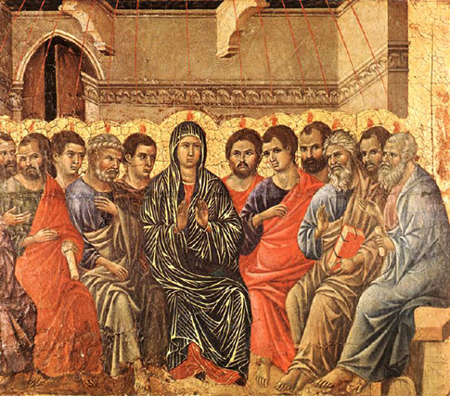
What happened at Pentecost?
Jesus sends Holy Spirit
Jesus and Holy Spirit became spiritual True Parents bringing spiritual rebirth
Spiritual salvation - enter realm where Satan cannot invade
EDP, 280
The Holy Spirit descends

Slide 60
Spiritual salvation
But to all who believed in his name, he gave power to become children of God; who were born, not of blood nor of the will of the flesh nor of the will of man, but of God.
John 1:12-13
God
Jesus
Holy Spirit
Believers
Notes:
Jesus and Holy Spirit are True Parents giving spiritual rebirth to sinful humanity so that we can become ‘children of God.’ Spiritual change of blood lineage. Sins are forgiven, cleansed by the holy Spirit. New life, new beginning.

Slide 61
Destruction of Jerusalem and Israel
First Jewish revolt against Roman rule
Destruction of Jerusalem and the Temple 70 CE
Arch of Titus in Rome
Notes:
The Jews' Great Revolt against Rome in 66 C.E. led to one of the greatest catastrophes in Jewish life and, in retrospect, might well have been a terrible mistake.
No one could argue with the Jews for wanting to throw off Roman rule. Since the Romans had first occupied Israel in 63 B.C.E., their rule had grown more and more onerous. From almost the beginning of the Common Era, Judea was ruled by Roman procurators, whose chief responsibility was to collect and deliver an annual tax to the empire. Whatever the procurators raised beyond the quota assigned, they could keep. Not surprisingly, they often imposed confiscatory taxes. Equally infuriating to the Judeans, Rome took over the appointment of the High Priest (a turn of events that the ancient Jews appreciated as much as modern Catholics would have appreciated Mussolini appointing the popes). As a result, the High Priests, who represented the Jews before God on their most sacred occasions, increasingly came from the ranks of Jews who collaborated with Rome.
At the beginning of the Common Era, a new group arose among the Jews: the Zealots (in Hebrew, Ka-na-im). These anti-Roman rebels were active for more than six decades, and later instigated the Great Revolt. Their most basic belief was that all means were justified to attain political and religious liberty.
The Jews' anti-Roman feelings were seriously exacerbated during the reign of the half-crazed emperor Caligula, who in the year 39 declared himself to be a deity and ordered his statue to be set up at every temple in the Roman Empire. The Jews, alone in the empire, refused the command; they would not defile God's Temple with a statue of pagan Rome's newest deity.
Caligula threatened to destroy the Temple, so a delegation of Jews was sent to pacify him. To no avail. Caligula raged at them, "So you are the enemies of the gods, the only people who refuse to recognize my divinity." Only the emperor's sudden, violent death saved the Jews from wholesale massacre.
Caligula's action radicalized even the more moderate Jews. What assurance did they have, after all, that another Roman ruler would not arise and try to defile the Temple or destroy Judaism altogether? In addition, Caligula's sudden demise might also have been interpreted as confirming the Zealots' belief that God would fight alongside the Jews if only they would have the courage to confront Rome.
In the decades after Caligula's death, Jews found their religion subject to periodic gross indignities, Roman soldiers exposing themselves in the Temple on one occasion, and burning a Torah scroll on another.
Ultimately, the combination of financial exploitation, Rome’s unbridled contempt for Judaism, and the unabashed favoritism that the Romans extended to gentiles living in Israel brought about the revolt.
In the year 66, Florus, the last Roman procurator, stole vast quantities of silver from the Temple. The outraged Jewish masses rioted and wiped out the small Roman garrison stationed in Jerusalem. Cestius Gallus, the Roman ruler in neighboring Syria, sent in a larger force of soldiers. But the Jewish insurgents routed them as well.
This was a heartening victory that had a terrible consequence: Many Jews suddenly became convinced that they could defeat Rome, and the Zealots' ranks grew geometrically. Never again, however, did the Jews achieve so decisive a victory.
When the Romans returned, they had 60,000 heavily armed and highly professional troops. They launched their first attack against the Jewish state's most radicalized area, the Galilee in the north. The Romans vanquished the Galilee, and an estimated 100,000 Jews were killed or sold into slavery.
Throughout the Roman conquest of this territory, the Jewish leadership in Jerusalem did almost nothing to help their beleaguered brothers. They apparently had concluded—too late, unfortunately—that the revolt could not be won, and wanted to hold down Jewish deaths as much as possible.
The highly embittered refugees who succeeded in escaping the Galilean massacres fled to the last major Jewish stronghold—Jerusalem. There, they killed anyone in the Jewish leadership who was not as radical as they. Thus, all the more moderate Jewish leaders who headed the Jewish government at the revolt's beginning in 66 were dead by 68—and not one died at the hands of a Roman. All were killed by fellow Jews.
The scene was now set for the revolt's final catastrophe. Outside Jerusalem, Roman troops prepared to besiege the city; inside the city, the Jews were engaged in a suicidal civil war. In later generations, the rabbis hyperbolically declared that the revolt's failure, and the Temple's destruction, was due not to Roman military superiority but to causeless hatred (sinat khinam) among the Jews (Yoma 9b). While the Romans would have won the war in any case, the Jewish civil war both hastened their victory and immensely increased the casualties. One horrendous example: In expectation of a Roman siege, Jerusalem's Jews had stockpiled a supply of dry food that could have fed the city for many years. But one of the warring Zealot factions burned the entire supply, apparently hoping that destroying this "security blanket" would compel everyone to participate in the revolt. The starvation resulting from this mad act caused suffering as great as any the Romans inflicted.
We do know that some great figures of ancient Israel opposed the revolt, most notably Rabbi Yochanan ben Zakkai. Since the Zealot leaders ordered the execution of anyone advocating surrender to Rome, Rabbi Yochanan arranged for his disciples to smuggle him out of Jerusalem, disguised as a corpse. Once safe, he personally surrendered to the Roman general Vespasian, who granted him concessions that allowed Jewish communal life to continue.
During the summer of 70, the Romans breached the walls of Jerusalem, and initiated an orgy of violence and destruction. Shortly thereafter, they destroyed the Second Temple. This was the final and most devastating Roman blow against Judea.
It is estimated that as many as one million Jews died in the Great Revolt against Rome. When people today speak of the almost two-thousand-year span of Jewish homelessness and exile, they are dating it from the failure of the revolt and the destruction of the Temple. Indeed, the Great Revolt of 66-70, followed some sixty years later by the Bar Kokhba revolt, were the greatest calamities in Jewish history prior to the Holocaust. In addition to the more than one million Jews killed, these failed rebellions led to the total loss of Jewish political authority in Israel until 1948. This loss in itself exacerbated the magnitude of later Jewish catastrophes, since it precluded Israel from being used as a refuge for the large numbers of Jews fleeing persecutions elsewhere.
Picture – relief from Arch of Titus in Rome built to celebrate Titus’ conquest of Judea 66-70. Construction of the Colosseum began under the rule of the Emperor Vespasian] in around 70–72 AD, funded by the spoils taken from the Jewish Temple after the Siege of Jerusalem[
The Great Revolt began in the year 66 CE, originating in the Greek and Jewish religious tensions. The crisis escalated due to anti-taxation protests and attacks upon Roman citizens.^{[4]} The Romans responded by plundering the Jewish Temple and executing up to 6,000 Jews in Jerusalem, prompting a full-scale rebellion. The Roman military garrison of Judaea was quickly overrun by rebels, while the pro-Roman king Agrippa II, together with Roman officials, fled Jerusalem. As it became clear the rebellion was getting out of control, Cestius Gallus, the legate of Syria, brought in the Syrian army, based on Legion XII Fulminata and reinforced by auxiliary troops, to restore order and quell the revolt. Despite initial advances and conquest of Jaffa, the Syrian Legion was ambushed and defeated by Jewish rebels at the Battle of Beth Horon with 6,000 Romans massacred and the Legion's aquila lost - a result that shocked the Roman leadership.

Slide 62
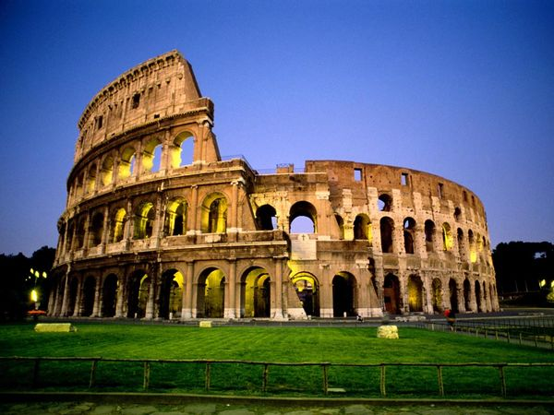
Building of Rome
Vespasian used the treasure from the Temple to rebuild Rome
  Colosseum
  Temple of Peace
  Public baths
  New forum

Slide 63
2nd Jewish revolt
Second Jewish revolt 132-135 CE
500,000 Jews killed, 985 villages destroyed
Jews forbidden to live in Jerusalem
Judea renamed Palaestina
Arch of Titus in Rome
Notes:
Picture – relief from Arch of Titus in Rome built to celebrate Titus’ conquest of Judea 66-70. Construction of the Colosseum began under the rule of the Emperor Vespasian] in around 70–72 AD, funded by the spoils taken from the Jewish Temple after the Siege of Jerusalem[
The Bar Kokhba revolt (132–136 CE),^{[20]} (Hebrew: מרד בר כוכבא‎ or mered bar kokhba), was the third major rebellion by the Jews of Judaea Province and Eastern Mediterranean against the Roman Empire and the last of the Jewish–Roman Wars. Simon bar Kokhba, the commander of the revolt, was acclaimed as a Messiah, a heroic figure who could restore Israel. The revolt established an independent state of Israel over parts of Judea for more than two years, but a Roman army made up of six full legions with auxiliaries and elements from up to six additional legions finally crushed it.^{[21]} The Romans then barred Jews from Jerusalem, except to attend Tisha B'Av. Although Jewish Christians hailed Jesus as the Messiah and did not support Bar Kokhba,^{[22]} they were barred from Jerusalem along with the rest of the Jews.^{[citation needed]} The war and its aftermath helped differentiate Christianity as a religion distinct from Judaism (see also Split of early Christianity and Judaism).^{[23]} The rebellion is also known as The Third Jewish–Roman War or The Third Jewish Revolt, though some historians relate it as Second Jewish Revolt, not counting the Kitos War, 115–117 CE.^{[citation needed]}

Slide 64
Parting of the ways
Jews-who-believed-in-Jesus vs. Jews-who-didn’t-believe-in-Jesus
  How could Jesus be the messiah if he was killed?
  He did not fulfill the messianic role or task
    Establish peace on earth
      "Nation shall not lift up sword against nation, neither shall man learn war anymore." (Isaiah 2:4)
    Defeat Israel’s enemies
    Spread universal knowledge of the God of Israel, which will unite humanity as one.
      "God will be King over all the world – on that day, God will be One and His Name will be One" (Zechariah 14:9)
  Because they had encountered the resurrected Jesus Jews-who-believed-in-Jesus said he was the messiah even though he had been killed
Notes:
Christian Jews regarded as traitors by traditional Jews because fled Jerusalem and couldn’t accept Bar Kochba as the messiah.
The First Jewish–Roman War (66–73 CE), According to Josephus, the revolt, which began at Caesarea in 66, was provoked by Greeks sacrificing birds in front of a local synagogue.^{[3]} The Roman garrison did not intervene and the long-standing Greek and Jewish religious tensions took a downward spiral. In reaction, the son of the Kohen Gadol (high priest) Eliezar ben Hanania ceased prayers and sacrifices for the Roman Emperor at the Temple. Protests over taxation joined the list of grievances and random attacks on Roman citizens and perceived 'traitors' occurred in Jerusalem. Fearing the worst, the pro-Roman king Agrippa fled Jerusalem to Galilee. Cestius Gallus, the legate of Syria, brought a legion as reinforcements to restore order. They invested Jerusalem, then for uncertain reasons, withdrew back towards the coast and were ambushed and defeated at the Battle of Beth Horon, a result that shocked the Roman leadership.
The Roman command of the revolt's suppression was then handed to general Vespasian and his son Titus, who assembled four legions and began cleansing the country, starting with Galilee, in the year 67 CE. The revolt ended when legions under Titus besieged and destroyed the center of rebel resistance in Jerusalem in the year 70 CE, and defeated the remaining Jewish strongholds later on.
The Bar Kokhba revolt (132–136 CE), was the third major rebellion by the Jews of Judaea Province against the Roman Empire and the last of the Jewish-Roman Wars. Simon bar Kokhba, the commander of the revolt, was acclaimed as a Messiah, a heroic figure who could restore Israel. The revolt established an independent state of Israel over parts of Judea for over two years, but a Roman army made up of six full legions with auxiliaries and elements from up to six additional legions finally crushed it.^{[3]} The Romans then barred Jews from Jerusalem
Multiple reasons have been offered for the beginning of the Bar Kokhba revolt. One interpretation is that in 130 CE, Emperor Hadrian visited the ruins of the temple. At first sympathetic towards the Jews, Hadrian promised to rebuild the temple, but the Jews felt betrayed when they found out that his intentions were to build a temple dedicated to Jupiter upon the ruins of the Second Temple. A rabbinic version of this story claims that Hadrian was planning on rebuilding the Temple, but a malevolent Samaritan convinced him not to. An additional legion, the VI Ferrata, was stationed in the province to maintain order, and the works commenced in 131 CE after the governor of Judaea, Tineius Rufus, performed the foundation ceremony of Aelia Capitolina, the city’s projected new name. "Ploughing up the Temple" was a religious offence that turned many Jews against the Roman authorities. The tensions grew higher when Hadrian abolished circumcision which he, a Hellenist, viewed as mutilation.^{[5]} Subsequently, it is known that a Roman coin inscribed Aelia Capitolina was issued in 132, right with the revolt beginnings.
Hadrian attempted to root out Judaism, which he saw as the cause of continuous rebellions. He prohibited the Torah law and the Hebrew calendar, and executed Judaic scholars. The sacred scroll was ceremonially burned on the Temple Mount. At the former Temple sanctuary, he installed two statues, one of Jupiter, another of himself. In an attempt to erase any memory of Judea or Ancient Israel, he wiped the name off the map and replaced it with Syria Palaestina (after the Philistines, the ancient enemies of the Jews^{[citation needed]}), supplanting earlier terms, such as "Judaea" and Israel. Similarly, he re-established Jerusalem but now as the Roman pagan polis of Aelia Capitolina, and Jews were forbidden from entering it, except on the day of Tisha B'Av.^{[13]}
According to a Rabbinic midrash (the Ten Martyrs), in addition to Bar Kokhba the Romans executed ten leading members of the Sanhedrin: the high priest, R. Ishmael; the president of the Sanhedrin, R. Shimon ben Gamaliel; R. Akiba; R. Hanania ben Teradion; the interpreter of the Sanhedrin, R. Huspith; R. Eliezer ben Shamua; R. Hanina ben Hakinai; the secretary of the Sanhedrin, R. Yeshevav; R. Yehuda ben Dama; and R. Yehuda ben Baba. The Rabbinic account describes agonizing tortures: R. Akiba was flayed, R. Ishmael had the skin of his head pulled off slowly, and R. Hanania was burned at a stake, with wet wool held by a Torah scroll wrapped around his body to prolong his death.^{[14]}
The disastrous end of the revolt also occasioned major changes in Jewish religious thought. Messianism was abstracted and spiritualized, and rabbinical political thought became deeply cautious and conservative.

Slide 65
Parting of the ways
Argument moved to Jesus was supposed to die and that everything he did was in fulfillment of prophecy – 300+
  Micah, Isaiah, Psalms, Zechariah, Numbers
  Gospels are an argument to persuade people Jesus was the messiah because he fulfilled prophecies and was supposed to die
  Did the gospel writers present Jesus life in such a way that it would ‘fit’ the prophecies?
At the same time they knew he should not have been killed
Jews argue that these prophecies have been misinterpreted and used as ‘proof texts’
Notes:
Christian Jews regarded as traitors by traditional Jews because fled Jerusalem and couldn’t accept Bar Kochba as the messiah.
The First Jewish–Roman War (66–73 CE), According to Josephus, the revolt, which began at Caesarea in 66, was provoked by Greeks sacrificing birds in front of a local synagogue.^{[3]} The Roman garrison did not intervene and the long-standing Greek and Jewish religious tensions took a downward spiral. In reaction, the son of the Kohen Gadol (high priest) Eliezar ben Hanania ceased prayers and sacrifices for the Roman Emperor at the Temple. Protests over taxation joined the list of grievances and random attacks on Roman citizens and perceived 'traitors' occurred in Jerusalem. Fearing the worst, the pro-Roman king Agrippa fled Jerusalem to Galilee. Cestius Gallus, the legate of Syria, brought a legion as reinforcements to restore order. They invested Jerusalem, then for uncertain reasons, withdrew back towards the coast and were ambushed and defeated at the Battle of Beth Horon, a result that shocked the Roman leadership.
The Roman command of the revolt's suppression was then handed to general Vespasian and his son Titus, who assembled four legions and began cleansing the country, starting with Galilee, in the year 67 CE. The revolt ended when legions under Titus besieged and destroyed the center of rebel resistance in Jerusalem in the year 70 CE, and defeated the remaining Jewish strongholds later on.
The Bar Kokhba revolt (132–136 CE), was the third major rebellion by the Jews of Judaea Province against the Roman Empire and the last of the Jewish-Roman Wars. Simon bar Kokhba, the commander of the revolt, was acclaimed as a Messiah, a heroic figure who could restore Israel. The revolt established an independent state of Israel over parts of Judea for over two years, but a Roman army made up of six full legions with auxiliaries and elements from up to six additional legions finally crushed it.^{[3]} The Romans then barred Jews from Jerusalem
Multiple reasons have been offered for the beginning of the Bar Kokhba revolt. One interpretation is that in 130 CE, Emperor Hadrian visited the ruins of the temple. At first sympathetic towards the Jews, Hadrian promised to rebuild the temple, but the Jews felt betrayed when they found out that his intentions were to build a temple dedicated to Jupiter upon the ruins of the Second Temple. A rabbinic version of this story claims that Hadrian was planning on rebuilding the Temple, but a malevolent Samaritan convinced him not to. An additional legion, the VI Ferrata, was stationed in the province to maintain order, and the works commenced in 131 CE after the governor of Judaea, Tineius Rufus, performed the foundation ceremony of Aelia Capitolina, the city’s projected new name. "Ploughing up the Temple" was a religious offence that turned many Jews against the Roman authorities. The tensions grew higher when Hadrian abolished circumcision which he, a Hellenist, viewed as mutilation.^{[5]} Subsequently, it is known that a Roman coin inscribed Aelia Capitolina was issued in 132, right with the revolt beginnings.
Hadrian attempted to root out Judaism, which he saw as the cause of continuous rebellions. He prohibited the Torah law and the Hebrew calendar, and executed Judaic scholars. The sacred scroll was ceremonially burned on the Temple Mount. At the former Temple sanctuary, he installed two statues, one of Jupiter, another of himself. In an attempt to erase any memory of Judea or Ancient Israel, he wiped the name off the map and replaced it with Syria Palaestina (after the Philistines, the ancient enemies of the Jews^{[citation needed]}), supplanting earlier terms, such as "Judaea" and Israel. Similarly, he re-established Jerusalem but now as the Roman pagan polis of Aelia Capitolina, and Jews were forbidden from entering it, except on the day of Tisha B'Av.^{[13]}
According to a Rabbinic midrash (the Ten Martyrs), in addition to Bar Kokhba the Romans executed ten leading members of the Sanhedrin: the high priest, R. Ishmael; the president of the Sanhedrin, R. Shimon ben Gamaliel; R. Akiba; R. Hanania ben Teradion; the interpreter of the Sanhedrin, R. Huspith; R. Eliezer ben Shamua; R. Hanina ben Hakinai; the secretary of the Sanhedrin, R. Yeshevav; R. Yehuda ben Dama; and R. Yehuda ben Baba. The Rabbinic account describes agonizing tortures: R. Akiba was flayed, R. Ishmael had the skin of his head pulled off slowly, and R. Hanania was burned at a stake, with wet wool held by a Torah scroll wrapped around his body to prolong his death.^{[14]}
The disastrous end of the revolt also occasioned major changes in Jewish religious thought. Messianism was abstracted and spiritualized, and rabbinical political thought became deeply cautious and conservative.

Slide 66
Parting of the ways
Jewish-Roman Wars 66-73AD
  Christian Jews were pacifist
  Fled Jerusalem for Pella
  Accused of betrayal
  Trauma of destruction of the Temple
    No sacrifices, Sadducees disappear
  The Jew’s lament: "on account of our sins we were exiled from our land", was turned by Christian Jews into words of accusation: "on account of your sins you were exiled from your land".
    The Jews had become the "other"
  Accusation - Jews fail to accept Jesus now. They failed to accept Jesus then

Slide 67
Parting of the ways
Jamnia – new centre nascent Judaism 70CE
  Curse on heretics – divinity of Jesus – two Gods
Arguments about
  The person of Jesus Christ and the rejection or acceptance of his divinity
  The observance or abnegation of Jewish law, especially ritual law
  The rival claims of traditional Jews and the Christian Jews to inherit the blessing of Abraham
  Old Israel vs. New Israel
Notes:
Church becomes Gentile
Dispensational/Replacement theology
Judaism rejected/failed. Church the New Israel
Blame for crucifixion put on the Jews
‘You killed Jesus’

Slide 68
Parting of the ways
Jewish-Roman Wars 132-135 AD
  Bar-Kokhba proclaimed messiah by Rabbi Akiva
    To Christians he was a false messiah
    Church establishing own identity as separate religion
Changing identity of next generations
  Children of Jews-who-believed-in-Jesus didn’t think of themselves as Jews but as Christians and inherited anti-Jewish sentiments of their parents
  Who wants to belong to a ‘failed’ religion?
Church becomes Gentile
  Dispensational/Replacement theology
  Judaism rejected/failed. Church the New Israel
  Blame for crucifixion put on the Jews
  ‘You killed Jesus’

Slide 69
Conclusion
If Jesus had been rejected by his Jewish contemporaries he would have faded into obscurity
The reason he was killed was because he was so well received that he was perceived to be a threat to the establishment and so he was executed by the Romans on the political charge of sedition
If things had gone differently he would have mediated a peaceful resolution of the relationship and fulfilled the messianic task
Notes:
Descendants find accusation they rejected messiah unbearable. Christian ancestors believe in and love Jesus

Slide 70
Maybe . . .
He would have been appointed King of the Jews by the Romans
He would have travelled to Rome and Parthia
All the nations of the world would come to worship God in Jerusalem

Slide 71
And then . . .
It shall come to pass in the latter days
that the mountain of the house of the Lord
shall be established as the highest of the mountains,
and shall be raised above the hills;
and all the nations shall flow to it,
and many peoples shall come, and say:
“Come, let us go up to the mountain of the Lord,
to the house of the God of Jacob;
that he may teach us his ways
and that we may walk in his paths.”

Slide 72
For out of Zion shall go forth the law,
and the word of the Lord from Jerusalem.
He shall judge between the nations,
and shall decide for many peoples;
and they shall beat their swords into plough shares,
and their spears into pruning-hooks;
nation shall not lift up sword against nation,
neither shall they learn war any more.
Isaiah 2:2-4

