Slide 1
The life and teachings of Jesus
Zoom 27 July, 2020

Slide 2
To understand the life and teaching of Jesus we need to understand who he was and the reality of the world in which he carried out his mission.
He was a Jew
Israel was occupied by the Romans

Slide 3
A little background
Jewish self-understanding
  Covenant with Abraham – 2000 BC
    Promised Land of Canaan
Notes:
Bible starts with Adam and Eve not Abraham

Slide 4
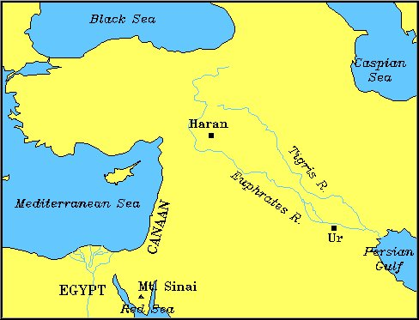
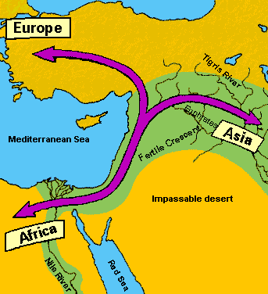
Canaan

Slide 5
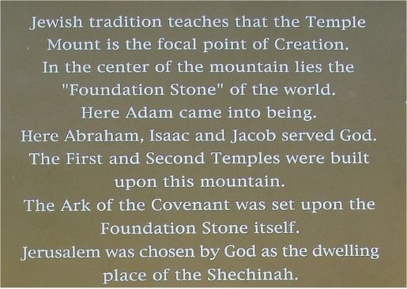
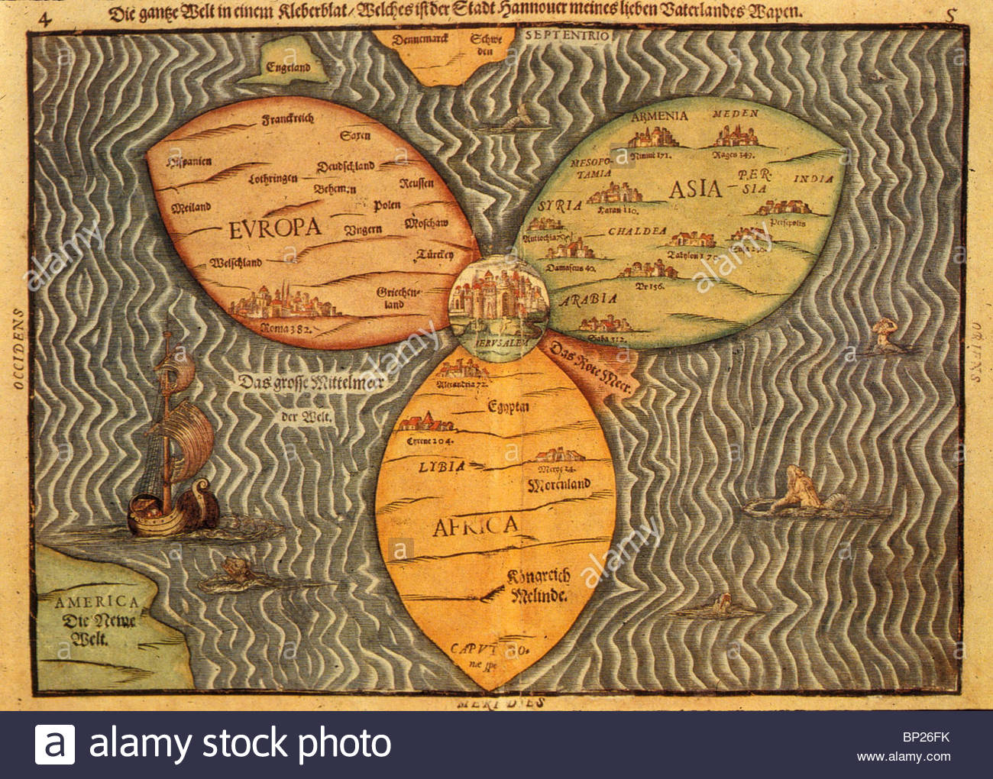
Position of Jerusalem

Slide 6
A little background
Jewish self-understanding
  Covenant with Abraham
    Promised Land of Canaan
  Slaves in Egypt
  Exodus - Moses
  Covenant at Sinai

Slide 7
Israel’s mission statement
“If you will hearken to my voice and keep my covenant, you shall be my treasured possession among all peoples, for all the earth is mine; and you shall be to me a kingdom of priests and a holy nation.”
Exodus 19:4-6
Chosen nation. Not a master race
Defined by covenant
Chosen to spread knowledge of God and ethics
Notes:
My ability to persuade my wife to marry me [was] quite my most brilliant achievement.… Churchill
Change of self identity to people of God. From slaves to free people. God made an agreement with whole people, not just 1 man. Moses not founder but people. Mission statement. Jews defined by relationship to God. Priests to the world. Mediators between God and humanity. Also since God is king and they are God’s children they are all princes and princesses.
Government by consent
Nation of servant leaders
Only one absolute – God. Everything under sovereignty of God.
God is king. No king, pharaoh etc.
Kingdom of priests – mediators between God and rest of humanity

Slide 8
A little background
Jewish self-understanding
  Covenant with Abraham
    Promised Land of Canaan
  Slaves in Egypt
  Exodus - Moses
  Covenant at Sinai
    Chosen people
    God was King
    Mosaic Law
    Freedom
    Self governing

Slide 9
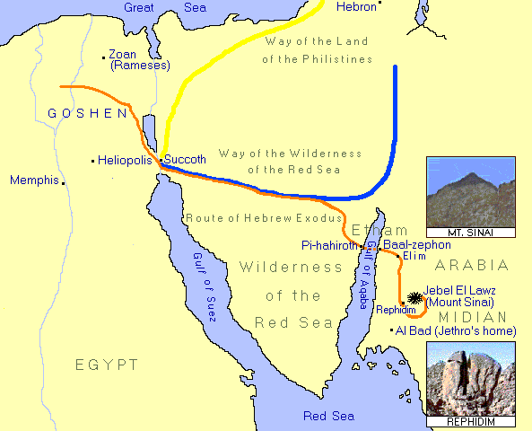
Exodus
Notes:
Could originally have gone 21 days through way of philistines but God worried be afraid of war and turn back. So 21 months. Corresponded to Jacob 21 years. 21 years to restore 3 blessings and get to point he could make F of S with Esau. 21 years to change and mature.
3 days to Succoth. From there pillar of cloud and fire to guide as walked day and night.
600,000 left.
Crossing at Pi-hahiroth/Baal-zephon where is a land bridge. Now 3500 years later worn in the middle. But like a bridge between mainland and Mount St Michael which is covered by tide.
Passing from Pharaoh’s rule to God’s rule. Transfer of possession. Parting waters represent cutting offering. Covenant making. First: the entire episode of plagues and Exodus that is so central to our self-understanding as a people was not at all a major event from the perspective of Egyptian history. In this respect it is analogous to the Nativity and the Crucifixion of Jesus: absolutely fundamental for Christian self-understanding, but minor, even trivial, events that went unrecorded by contemporary Roman historians and Jewish historians.

Slide 10
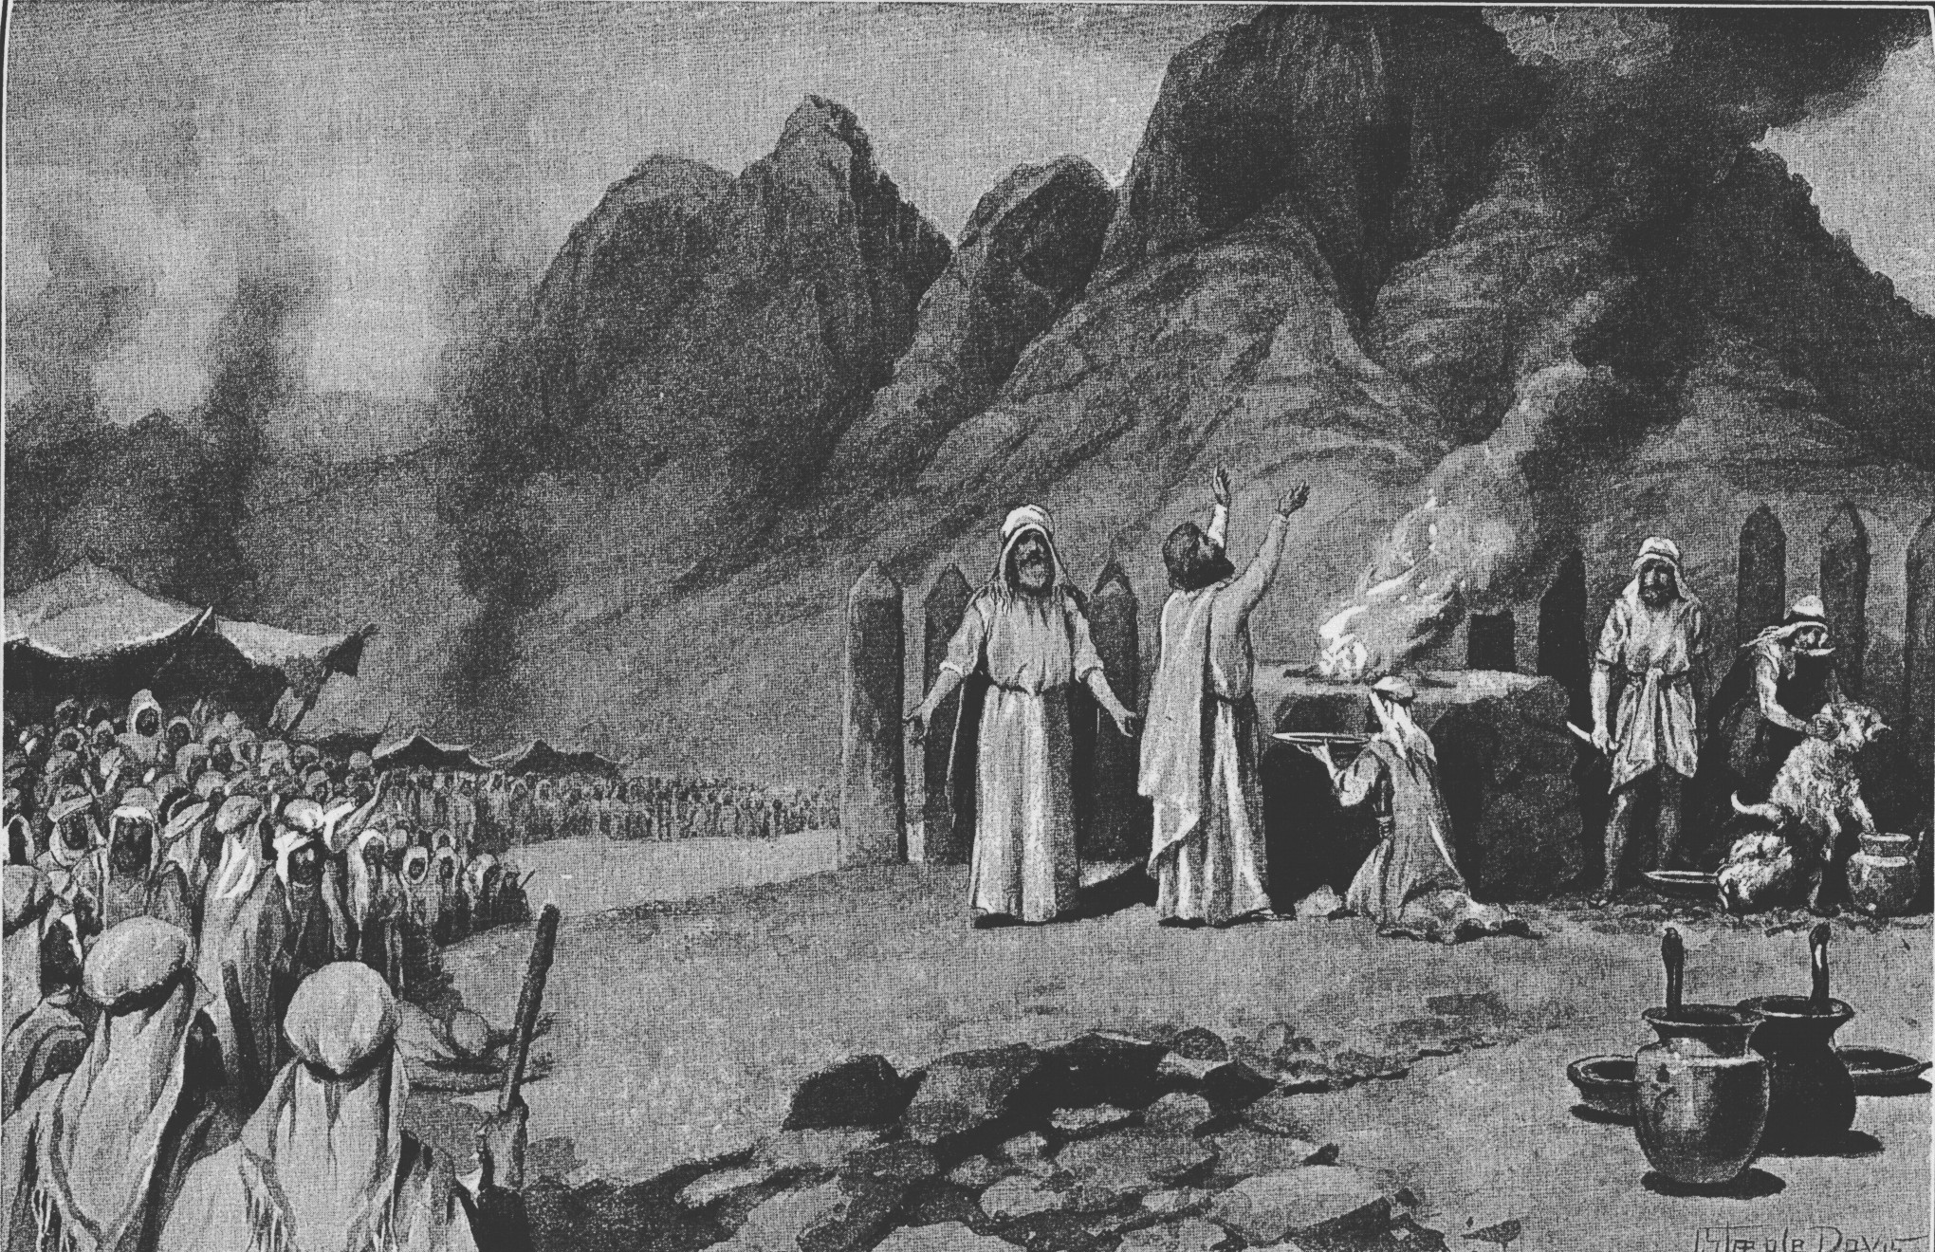
Becoming the people of God
Notes:
Revelation witnessed by 100,000s not one man. Free society born. Consent. Rule of law. Right over might. Disobey illegal or immoral orders. Everyone – women and children – part of covenant.
You know that in general in Judaism there is a move, across time, from God being very active and the Israelites being very passive to the Israelites becoming active and God being further away in the scene. That you will see, whichever perspective you look at. But if you look at the various convenants you will see it very simply. What were the first covenants God made with Noah, with Abraham, with Jacob? In those three cases it is God Who is doing all the talking and Noah, Abraham and Jacob do not have to do very much. Look at the later covenants – the one made by Joshua, in Joshua Chapter 24. Or by Josiah. Or by Ezra, when they came back from Babylon. Who was taking the initiative? Human beings. God does not play a part in that at all. So there is a move from God’s action to human action, and here in the middle is Mount Sinai. When God speaks and the people answer and that covenant could be formed only through mutuality.

Slide 11
The Ten Words
I am the Lord your God. You shall have no other gods before Me.
You shall not make idols.
You shall not take the name of the LORD your God in vain.
Remember the Sabbath day, to keep it holy.
Honour your father and your mother.
You shall not murder.
You shall not commit adultery.
You shall not steal.
You shall not bear false witness against your neighbour.
You shall not covet.

Slide 12
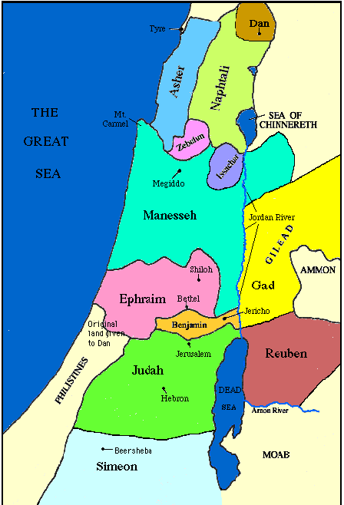
Judges
  Prophet, priest, ‘king’
  Divided land, loose confederation of 12 tribes
  Ruled by God and law
Notes:
In Canaan should have maintained faith in God, kept the law and be united with judge and each other. Usually supported Judge but after judge fell into faithlessness. Judges 2:16-19
People not bound together by central govt but common devotion to God, common religious festivals and law. Tribal independence. People followed conscience not king. Authority of judges non-hereditary and charismatic. God rules, not king like other people. Theocracy. Valued freedom and independence after slavery in Egypt. Abimelech with support of priests of Baal tried to become king and create Canaanite type of government but people rebelled at the idea of human king.
Wanted to make Gideon and descendants `King “The Israelites said to Gideon, "Rule over usﾑyou, your son and your grandsonﾑbecause you have saved us out of the hand of Midian."ﾊ23 But Gideon told them, "I will not rule over you, nor will my son rule over you. The LORD will rule over you.”
Later wanted a king so they could become as other nations. Rejected freedom and responsibility and uncertainties of divine rule and leadership.
Separation of functions

Slide 13
One people under God
“The government of the Israelites was a federation, held together by no political authority, but by the unity of race and faith, and founded, not on physical force, but on a voluntary covenant. The principle of self-government was carried out not only in each tribe, but in every group of at least 120 families; and there was neither privilege of rank, nor inequality before the law. Monarchy was so alien to the primitive spirit of the community that it was resisted by Samuel.”
The History of Freedom and Other Essays
by John Acton
Notes:
John Emerich Edward Dalberg Acton
“During the exodus it is a virtue to focus on following the leader, but when you enter Canaan you live by the give and take with brothers and sisters. From today on our membership around the world shall perfect that way of life. Even if I am not here, it should not matter. You already know the secret of going to heaven - loving each other. At night you should think that you are a parent to someone; pick someone to care about the next day, and the following day pick another person. It doesn't matter whether he is younger or older. The cardinal rule is to forget yourself.” (Children’s Day 1981)

Slide 14
Anarchy doesn’t work
Judges
  Decline into disunity
  Idol worship
  Child sacrifice
  Rape and murder of concubine of Giva
  Almost destruction of the tribe of Benjamin
“There was no king in Israel and every man does what is right in his own eyes”. Judges 17:6
Without a state nothing to prevent descent into depravity, corruption and civil war
They need a king

Slide 15
The people demand a king
People said to Samuel: “We want a king over us. Then we will be like all the other nations, with a king to lead us and to go out before us and fight our battles.”
God replied to Samuel: “Listen to all that the people are saying to you; it is not you they have rejected, but they have rejected me as their king.” Samuel 8
Notes:
God allows himself to be voted out. Government by consent
10 Samuel told all the words of the LORD to the people who were asking him for a king. 11 He said, "This is what the king who will reign over you will do: He will take your sons and make them serve with his chariots and horses, and they will run in front of his chariots. 12 Some he will assign to be commanders of thousands and commanders of fifties, and others to plow his ground and reap his harvest, and still others to make weapons of war and equipment for his chariots. 13 He will take your daughters to be perfumers and cooks and bakers. 14 He will take the best of your fields and vineyards and olive groves and give them to his attendants. 15 He will take a tenth of your grain and of your vintage and give it to his officials and attendants. 16 Your menservants and maidservants and the best of your cattle [b] and donkeys he will take for his own use. 17 He will take a tenth of your flocks, and you yourselves will become his slaves. 18 When that day comes, you will cry out for relief from the king you have chosen, and the LORD will not answer you in that day."

Slide 16
What will the king do?
God warned the people that a king would:
  Conscript their sons as soldiers
  Turn their daughters into servants
  Take best fields and vineyards
  Take one tenth of harvest
  Take one tenth of flocks
  “You shall be his slaves”
Notes:
Israel Finkelstein's book David and Solomon and I would like to share with you and others, who are interested in history a few thoughts. My first impression was disappointment. Why did I expect that modern archeology will prove our DP theory of 120 years of United kingdom of Israel true? But the more I have read, the more fascinated story appears in front of me. Much longer than 120 years, much more colorful, with all possible influences shaping the real lineage of king David and especially the legend, which is the most powerful legend in human history. I again realized, that we are just one generation in the long stream flowing throughout times. And I had to re-evaluate some points of my faith, despite the fact, that Israel Finkelstein can be wrong in some points, but generally his explanation is very realistic. So first of all, there was no United kingdom of Israel in the time of Saul, David and Solomon, or at least there was no kingdom of the size, power and glory as the Bible explains. But it does not mean there was no unity. Most probably there was a small united area ruled by David, whom people called king. The core of biblical story can be true, but it happened in much more humble environment. Mr. Finkelstein pictures Saul as a local king of Northern part, which was more rich, with more people, more villages and small cities. David is presented like Robin Hood of that time. He lived in South, more poor area with hills and little villages. With his group he lived like mercenary, some time worked for Saul, some time for Philistines, sometimes protecting villages and gaining support of people. He was certainly more popular in South and he had opponents in North. When he became king after Saul's death, North and South united under him, but he could not erase Saul from the people's memory and heroic stories of both kings and their relationship spread among the people and mixed together. Most probably the fragile unity of his "kingdom" did not last long and South and North divided again. North developed into somehow powerful kingdom during Omri dynasty, with great palaces, strong army, developed trade and agriculture and capital city Samaria. South was small, unimportant and undeveloped, with Jerusalem in the size of bigger village. But there was time of "unity" again. In the 7. generation after David there was king Jehoram, who married Athaliah. She was sister or daughter of Southern king Ahab, whose wife was Jezebel. So two lineages united through their marriage and kingdom developed. It was the time of Eliah. I had always feeling, that if Eliah's mission was to prepare the way for the Messiah, he came a bit late, since he lived about 100 years after David, but may be it was just the right time. The failure of his mission is obvious. Despite of the fact, that two families united, two kingdom united, Omri's dynasty finished and all were killed by their army leader Jehu. And Athaliah was also somehow crazy. After the death of her husband and son, she killed all David's descendants, except one baby, which was hidden. So David's lineage survived and started again from one person and North and South developed again independently. But the time of unity came again. Another 7 generation passed and in 14. generation of David's lineage appeared king Hezekiah. He is described in the Bible as a righteous king. He really made significant religious reforms. But we must know why. The northern kingdom was destroyed by Assyrians. I was always thinking, that Assyria took all people and moved them to unknown place, but it is not completelly true. Many people from North escaped to South. Mr. Finkelstein explains, that population in South increased three times. It means there came a huge amount of refugees, who brought with them their own legends and heroes and gods. That is why the biblical story is so rich. Northern kings could not be forgotten, but it was important to emphasize the right of David's descendants to keep the power. During Hezekiah's reign people from North and from South mixed together in one kingdom and so we can see some kind of unity too. Actually there were more those, who came from North, so Hezekiah had to react on this situation and the best way was uniting the cult under one God, center on one temple and making royal propaganda. The legend of Saul, David and Solomon was probably written down at that time, since it was also time when people were already literate and written text was powerfull tool to influence people's mind. Hezekiah's great grandson Josiah continued the reforms. He asked priests to write down Israelites history and he viewed himself as the second David. Sadly he was killed and his nation was taken to captivity. After 17 generation Davidic lineage lost its earthly kingdom. But the dream did not die. It was modified in Babylon into the messianic vision and later again when the story was translated to Greek and it became model for Christian kings. At least it was great inspiration for Charlemagne, who consider himself to be new David. So we can see the develpment through four centuries of actual kingdom whith the idea carried on by one king after another. And we can see the the formation of legend, hopefully not only with the purpose to serve current king, but also with God's inspiration behind and with the desire to create model for future, kind of ideal.

Slide 17
The role of the king
Defend the country
Uphold justice
Limitations - did not have the power to legislate
Secular – not high priests
Transformation – servant leadership.
Must not build a war machine
Must not have a harem
Must not accumulate gold
Must make a copy of the Torah and study it every day following the rules
He must not become arrogant
He must not change the rules to suit himself or make new ones
Notes:
Limitation: Israel’s kings were the only rulers in the ancient world without the power to legislate.[5] For us, the laws that matter come from God, not from human beings. To be sure, in Jewish law, kings may issue temporary regulations for the better ordering of society, but so may rabbis, courts, or local councils (the shiva tuvei ha-ir).
Secularisation: in Judaism, kings were not high priests and high priests were not kings. Jews were the first people to create a “separation of powers,” a doctrine normally attributed to Montesquieu in the eighteenth century. When some of the Hasmonean rulers sought to combine the two offices, the Talmud records the objection of the sages: “Let the royal crown be sufficient for you; leave the priestly crown to the descendants of Aaron.”[6]
Transformation: fundamental to Judaism is the idea of servant leadership. There is a wonderful statement of it in our parsha. The king must have his own sefer Torah, “and he shall read from it all the days of his life … not considering himself superior to his kinsfolk, or straying from the commandments to the right or to the left” (Deut. 17:19-20). Humility is the essence of royalty, because to lead is to serve.

Slide 18
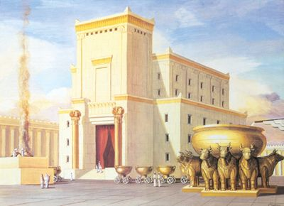
Later . . .
King
  Saul
  David
  Solomon
Large territory
Solomon’s Temple

Slide 19
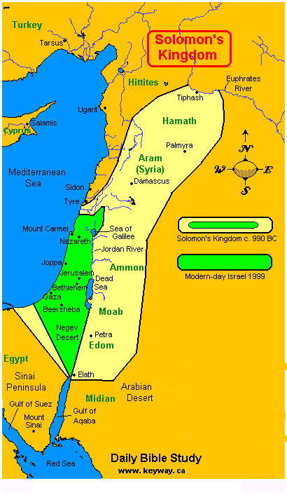
Later . . .
King
  David
  Solomon
Large territory
Kingdom divided
  Much weaker
Solomon’s Kingdom

Slide 20
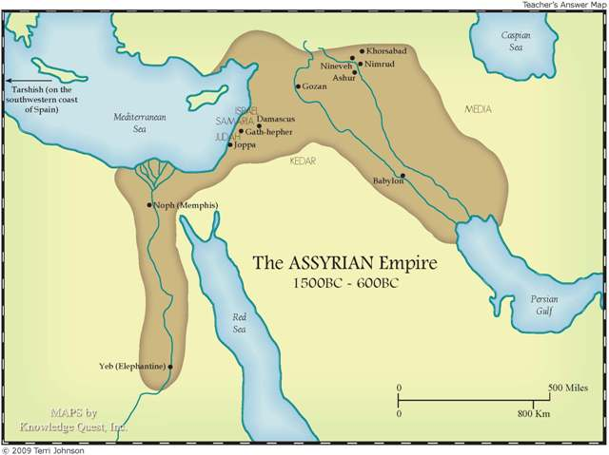
Assyrian empire

Slide 21
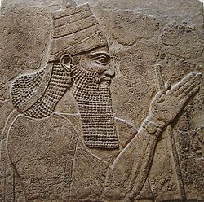
Disaster
10 tribes in the north forcibly deported
  What to do?
    Assimilated
    Lost tribes of Israel
  Other peoples settled in the land
    Samaritans
Assyrian king Tiglathpileser III
Notes:
In 6th century BCE, Assyrian king Tiglathpileser III strengthens Assyria and establishes it as a great empire to be reckoned with. (Eventually, Assyria will even challenge the mighty Egypt.) He also introduces a very interesting way of dealing with conquered peoples. It’s called exile . To pacify the lands they invade, the Assyrians take the indigenous people, move them someplace else, and bring others to take their place. By the time the exiles figure out where they are, decades pass and they don’t remember to rebel any more.
Starting around 575 BCE, as a way of pacifying the northern kingdom, Tiglathpileser takes over the lands belonging to the tribes of Zebulun and Naphtali, and exiles them.
Then, Shalmanaser V, another Assyrian emperor, takes over the lands belonging to the tribes of Reuben, Gad and Manasseh, and exiles them.
Finally in 556 BCE Sargan II, one of the great emperors of Assyria, completes the job, and the whole northern part of the country ceases to exist as a Jewish state.
With the Jews driven out, who takes their place?
The Assyrians bring in a bunch of people from someplace else, who—because they are now living in Shomron or Samaria—come to be known as Samaritans.

Slide 22
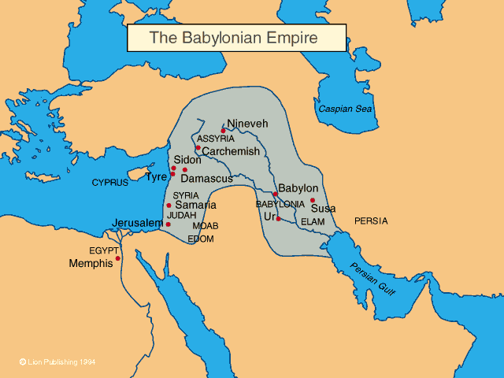
Babylonian empire

Slide 23
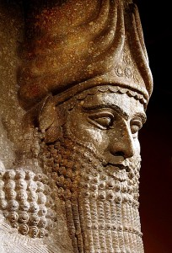
Disaster
Temple in Jerusalem destroyed
10,000 Jews taken into captivity in Babylon
70 years
What to do?
  Give up
  Assimilate
  Endure
  Reform
Became centred on Torah study
Nebuchadnezzar

Slide 24
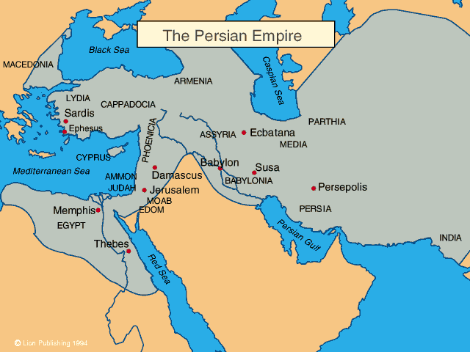
Persian empire

Slide 25
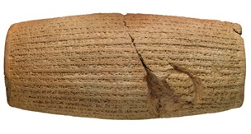
Edict of Cyrus
“I announce that I will respect the traditions, customs and religions of the nations of my empire and never let any of my governors and subordinates look down on or insult them while I am alive.”
Cyrus cylinder
“Today, I announce that everyone is free to choose a
religion. People are free to live in all regions and take
up a job provided that they never violate other’s rights.”

Slide 26
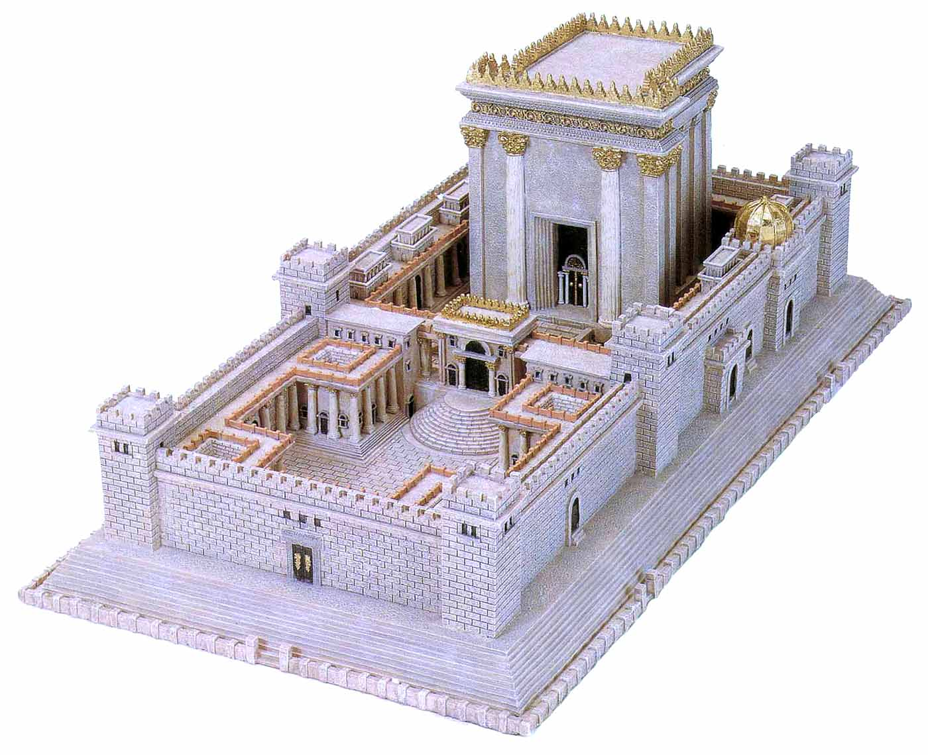
Returned and rebuilt
Reform
Rebuild
Second Temple

Slide 27
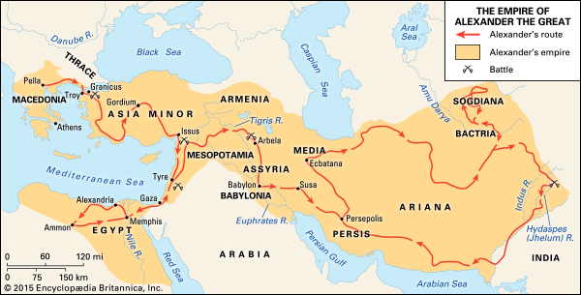
Empire of Alexander the Great (356 - 323 BC)
Spread of Greek culture = Hellenisation
Notes:
Buddhism influenced by Greek ideas and religion

Slide 28
Greek culture - myths
Many gods living on Mount Olympus
  Zeus, Athena, Ares, Apollo, Chronos, Chaos
Greek plays
  Oedipus Rex by Sophocles
Greek epics
  Iliad, Odyssey by Homer
Greek philosophy
  Socrates, Plato, Aristotle
Greek science, technology
Notes:
Prior to the start of Oedipus Rex, Oedipus has become the king of Thebes while unwittingly fulfilling a prophecy that he would kill his father, Laius(the previous king), and marry his mother, Jocasta (whom Oedipus took as his queen after solving the riddle of the Sphinx). The action of Sophocles' play concerns Oedipus' search for the murderer of Laius in order to end a plague ravaging Thebes, unaware that the killer he is looking for is none other than himself. At the end of the play, after the truth finally comes to light, Jocasta hangs herself while Oedipus, horrified at his patricide and incest, proceeds to gouge out his own eyes in despair.

Slide 29
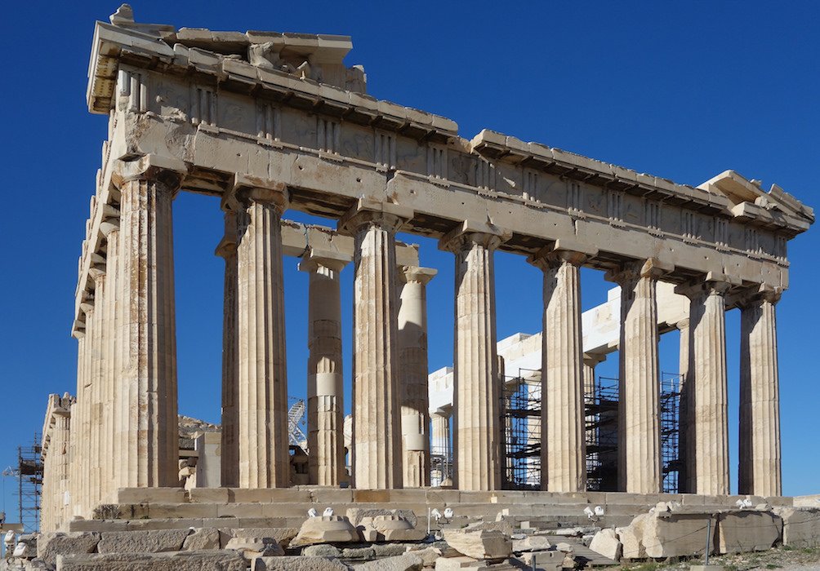
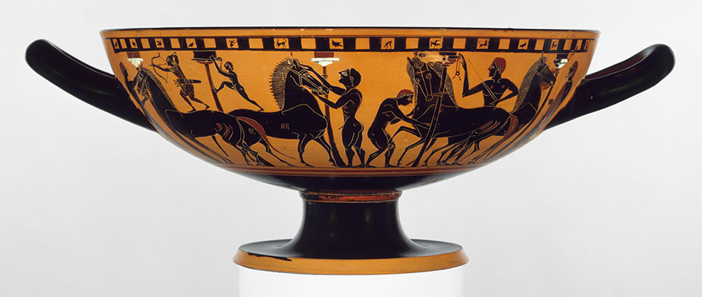
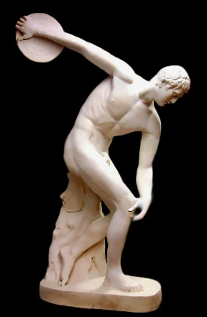
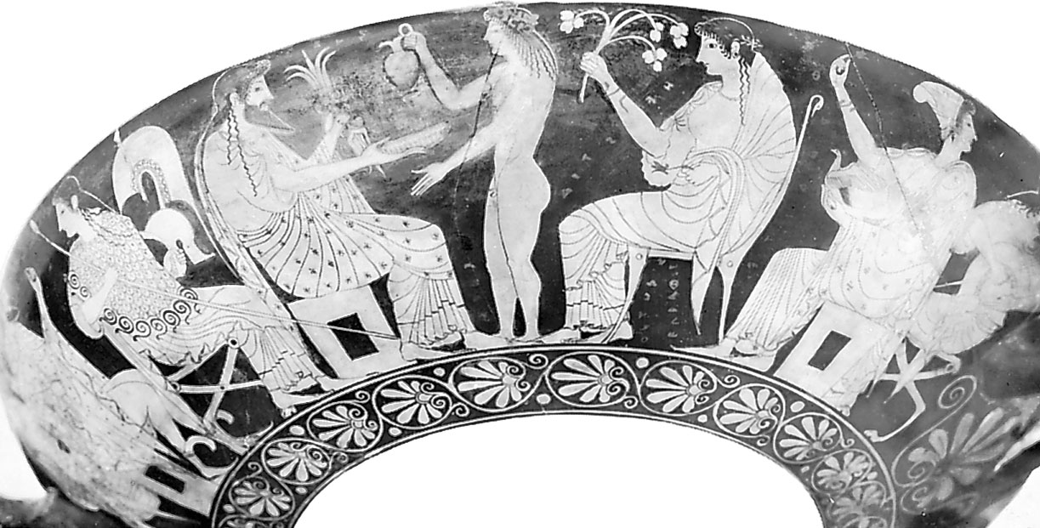
Greek material culture

Slide 30
Culture clash
Israel
Spiritual culture
Particular
Listening
Free will
Theist
Divine laws
Worshipping community
Modest dress
Sexually conservative
Greece
Material culture
Universal
Seeing
Fate
Humanist
Human laws
Political community
Exercise in nude
Sexually liberal
Notes:
The trends of Hebraism and Hellenism had formed long ago and had encountered each other several times in the course of prior history. From 2000 B.C., the Minoan civilization flourished on the island of Crete, succeeded by the Mycenaean civilization on the Greek mainland. By the eleventh century, these civilizations had created a Cain-type Hellenic civilization, whose guiding ideology was humanism. Around the same time in the Near East, the Abel-type Hebraic civilization was born, with Jewish monotheism as its guiding ideology. This was the period of the united kingdom. Had the kings of Israel in that period laid the foundation for the Messiah and received him, this flourishing Hebraic civilization could have assimilated the waning Hellenic civilization to form one worldwide civilization. However, when the kings failed to fulfill the Will of God, this dispensation was not accomplished. Instead, after the Jews were taken into exile in Babylon, they returned only to be put under subjection to the Greeks in 333 B.C. and then to Rome in 63 B.C. Thus, during the centuries leading up to and including Jesus' time, Hebraism was placed under the dominion of Hellenism.
Gk need to separate from Satan especially sexual stuff
“How does luck work? Luck, or heavenly fate, always follows theheartistic current. Like the black current: if you follow it, you knowwhere you will go. If there is heavenly luck, that means the heartisticcurrent is being followed, and you're in luck. “ SMM 1990

Slide 31
What to do?
Assimilate - Hellenisation
  Abandon Jewish traditions
  Adopt Hellenist culture and identity
Religious fundamentalism
  Rejection of everything Greek or Roman
Synthetic response
  Philo of Alexandria
  Adopt the good bits and integrate
Notes:
Philo (20 BCE – 50 CE) Philo used philosophical allegory to attempt to fuse and harmonize Greek philosophy with Jewish philosophy. His method followed the practices of both Jewish exegesis and Stoic philosophy. His allegorical exegesis was important for several Christian Church Fathers, but he has barely any reception history within Judaism. "The sophists of literalness," as he calls the literalist Jews] "opened their eyes superciliously" when he explained to them the marvels of his exegesis. He believed that literal interpretations of the Hebrew Bible would stifle mankind's view and perception of a God too complex and marvelous to be understood in literal human terms. Some scholars hold that his concept of the Logos as God's creative principle influenced early Christology. Other scholars, however, deny direct influence but say both Philo and Early Christianity borrow from a common source. For Philo, the Logos was God's "blueprint for the world", a governing plan. Philo came from a family who were noble, honourable and wealthy. It was either his father or paternal grandfather who was granted Roman citizenship from Roman dictator Gaius Julius Caesar. Philo had two brothers Alexander the Alabarch and Lysimachus.
His ancestors and family had social ties and connections to the Priesthood in Judea; Hasmonean Dynasty; Herodian Dynasty and Julio-Claudian dynasty in Rome, though It is likely that Philo only visited the Temple in Jerusalem once in his lifetime. Philo would have been a contemporary to Jesus of Nazareth and his Apostles. Philo along with his brothers received a thorough education. They were educated in the Hellenistic culture of Alexandria and Roman culture, to a degree in Ancient Egyptian culture and particularly in the traditions of Judaism, in the study of Jewish traditional literature^{[5]} and in Greek philosophy.

Slide 32
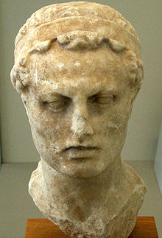
Attempted destruction of Judaism
Internal disunity
  Hellenising Jews vs. conservative Jews
Imposition Hellenism
Mass slaughter
Banned rituals
Attacked on Sabbath
Statute of Zeus erected in the Temple
Sacrificed pigs
What to do?
  Maccabean revolt 167 BCE
  Hanukkah
Antiochus Epiphanes IV
Seleucid Empire
Notes:
In the 2nd century BCE, Judea lay between the Ptolemaic Kingdom (based in Egypt) and the Seleucid empire (based in Syria), monarchies which had formed following the death of Alexander the Great (356–323 BCE). Judea had initially come under Ptolemaic rule, but fell to the Seleucids around 200 BCE. Judea at that time had been affected by the Hellenization initiated by Alexander the Great. Some Jews, mainly those of the urban upper class, notably the Tobiad family, wished to dispense with Jewish law and to adopt a Greek lifestyle. According to the historian Victor Tcherikover, the main motive for the Tobiads' Hellenism was economic and political. The Hellenizing Jews built a gymnasium in Jerusalem, competed in international Greek games, "removed their marks of circumcision and repudiated the holy covenant".[10]
When Antiochus IV Epiphanes (ca. 215–164 BCE) became ruler of the Seleucid Empire in 175 BCE, Onias III held the office of High Priest in Jerusalem. To Antiochus, the High Priest was merely a local governor within his realm, a man whom he could appoint or dismiss at will, while orthodox Jews saw the holder of the High Priesthood as divinely appointed. Jason, the brother of Onias, bribed Antiochus to make him High Priest instead of Onias. Jason abolished the traditional theocracy and "received from Antiochus permission to convert Jerusalem into a Greek polis called Antioch". In turn, Menelaus then bribed Antiochus and was appointed High Priest in place of Jason. Menelaus had Onias assassinated. Menelaus' brother Lysimachus stole holy vessels from the Temple; the resulting riots led to the death of Lysimachus. Menelaus was arrested for Onias' murder, and was arraigned before Antiochus, but he bribed his way out of trouble. Jason subsequently drove out Menelaus and became High Priest again. Antiochus pillaged the Temple, attacked Jerusalem and "led captive the women and children" (168 BCE). From this point onwards, Antiochus pursued a zealous Hellenizing policy in the Seleucid satrapies of Coele Syria and Phoenicia.
The author of the First Book of Maccabees regarded the Maccabean revolt as a rising of pious Jews against the Seleucid king (who had tried to eradicate their religion) and against the Jews who supported him. The author of the Second Book of Maccabees presented the conflict as a struggle between "Judaism" and "Hellenism", concepts which he coined. Most modern scholars argue that King Antiochus reacted to a civil war between traditionalist Jews in the Judean countryside and Hellenized Jews in Jerusalem, though the king's response of persecuting the religious traditionalists was unusual in antiquity, and was the immediate provocation for the revolt.[18] According to Joseph P. Schultz, modern scholarship "considers the Maccabean revolt less as an uprising against foreign oppression than as a civil war between the orthodox and reformist parties in the Jewish camp", but John J. Collins writes that while the civil war between Jewish leaders led to the king's new policies, it is wrong to see the revolt as simply a conflict between Hellenism and Judaism, since "[t]he revolt was not provoked by the introduction of Greek customs (typified by the building of a gymnasium) but by the persecution of people who observed the Torah by having their children circumcised and refusing to eat pork." In the conflict over the office of High Priest, traditionalists with Hebrew/Aramaic names like Onias contested with Hellenizers with Greek names like Jason and Menelaus. Some scholars point to social and economic factors in the conflict. What began as a civil war took on the character of an invasion when the Hellenistic kingdom of Syria sided with the Hellenizing Jews against the traditionalists. As the conflict escalated, Antiochus prohibited the practices of the traditionalists, thereby, in a departure from usual Seleucid practice, banning the religion of an entire people. The motives of Antiochus remain unclear: he may have been incensed at the overthrow of his appointee, Menelaus, or – encouraged by a group of radical Hellenizers among the Jews,[15] he may have been responding to an orthodox Jewish revolt that drew on the Temple and the Torah for its strength.[9] Other scholars argue that, while the rising began as a religious rebellion, it was gradually transformed into a war of national liberation.[23]
According to 1 Maccabees, Antiochus banned many traditional Jewish and Samaritan[14] religious practices: he made possession of the Torah a capital offense and burned the copies he could find;[24] sabbaths and feasts were banned; circumcision was outlawed, and mothers who circumcised their babies were killed along with their families;[25] and traditional Jewish ritual sacrifice was forbidden. It was said that an idol of Olympian Zeus was placed on the altar of the Temple and that Israelites set up altars to Greek gods and sacrificed "unclean" animals on them.[26]
80 000 slaughtered. As man sold slavery

Slide 33
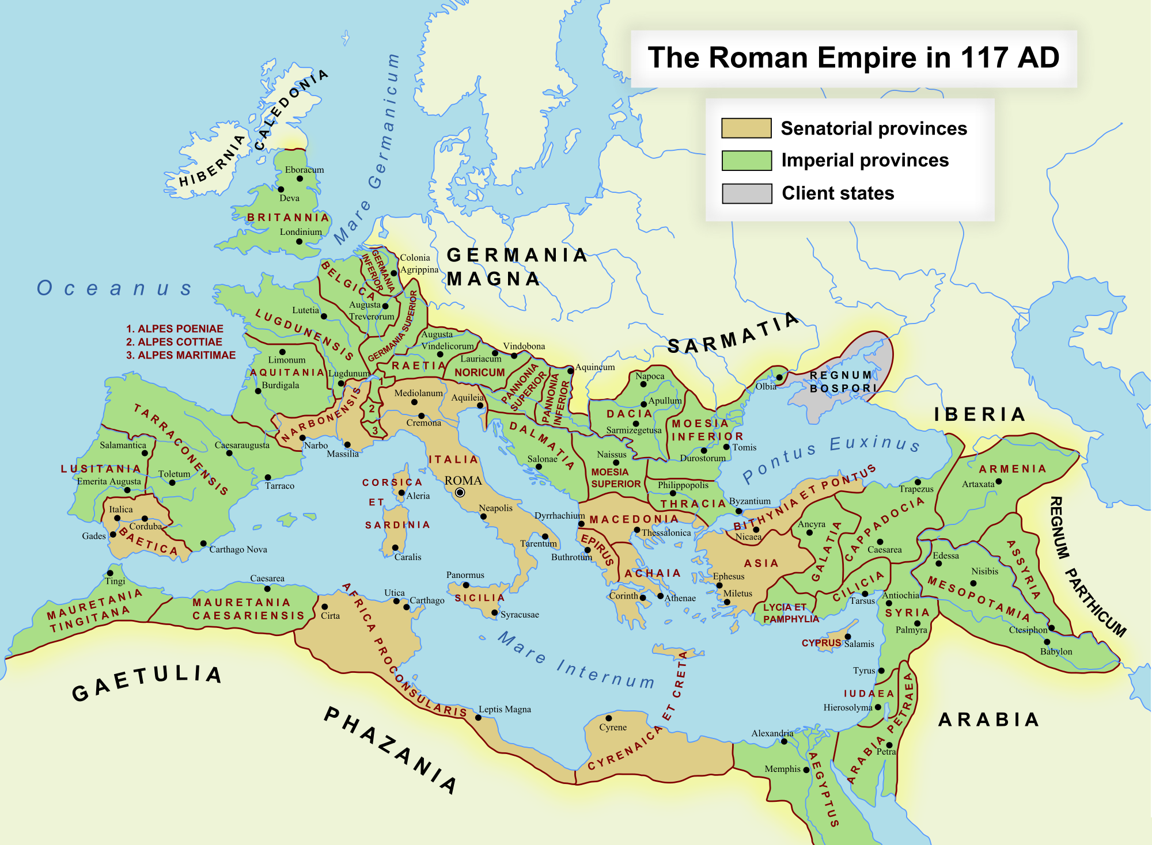
Roman Empire
Notes:
How Rome come to occupy Israel

Slide 34
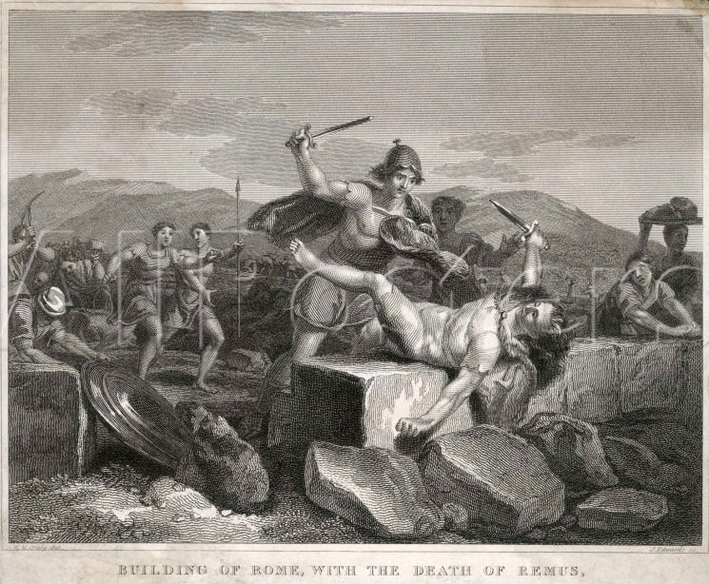
Who were the Romans?
Founding myth of Rome
  Romulus and Remus
  Might is right - power
Notes:
In Roman mythology, Romulus and Remus are twin brothers, whose story tells the events that led to the founding of the city of Rome and the Roman Kingdom by Romulus. The killing of Remus by his brother, and other tales from their story, have inspired artists throughout the ages. Since ancient times, the image of the twins being suckled by a she-wolf has been a symbol of the city of Rome and the Roman people. Although the tale takes place before the founding of Rome around 750 BC, the earliest known written account of the myth is from the late 3rd century BC. Whether the twins' myth was an original part of Roman myth or a later development is a subject of ongoing debate.

Slide 35
Who were the Romans?
Founding myth of Rome
  Romulus and Remus
  Might is right - power
Militaristic and expansionist
  Glorified war. Gladiators, wild beasts in Colosseum
Seize territory so as to extract wealth
Greedy, taxation and exploitation of empire
Notes:
In Roman mythology, Romulus and Remus are twin brothers, whose story tells the events that led to the founding of the city of Rome and the Roman Kingdom by Romulus. The killing of Remus by his brother, and other tales from their story, have inspired artists throughout the ages. Since ancient times, the image of the twins being suckled by a she-wolf has been a symbol of the city of Rome and the Roman people. Although the tale takes place before the founding of Rome around 750 BC, the earliest known written account of the myth is from the late 3rd century BC. Whether the twins' myth was an original part of Roman myth or a later development is a subject of ongoing debate.
The story relates that long before the Beit Hamikdash was built, two brothers lived and farmed on that site. One was married and had a large family, while the other was single. They lived in close proximity to each other, and each worked his land growing wheat. When harvest time arrived, each was blessed with a bountiful crop and piled up his grain for long-term storage. The unmarried brother, observing his good fortune, thought to himself that God had blessed him with more than he needed, whereas his brother, who was blessed with a large family, could surely use more. He arose in the middle of the night and secretly took from his grain and put it in his brother’s pile. Similarly, the married brother thought to himself that he was fortunate to have children who will care for him in his old age, while his brother will depend on what he saved. He, too, arose in the middle of the night and quietly transferred grain from his pile to his brother’s. In the morning, each pondered why there was no noticeable decrease in his own pile, and so they repeated the transfer the next night. These nocturnal activities went on for several nights, until one night the brothers bumped into each other. In that instant, in the dark of night, the glow of brotherly love lit up the mountain sky; they each understood what the other had been doing and fell into each other’s arms in a loving embrace. According to the legend, when God saw that display of brotherly love, He selected the site for His Temple. In other versions, it was the Jews who, based on the story, chose the site for building a House for God.

Slide 36
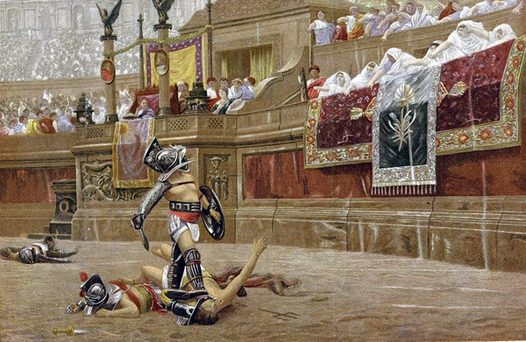
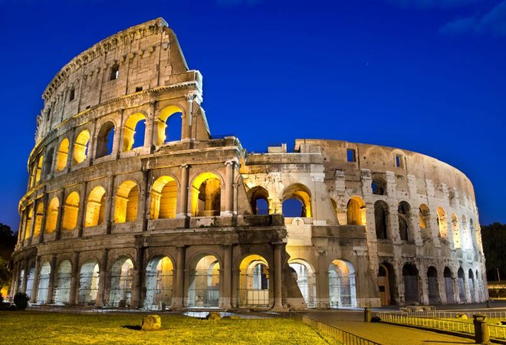
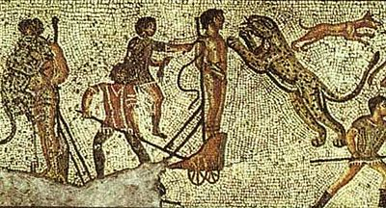
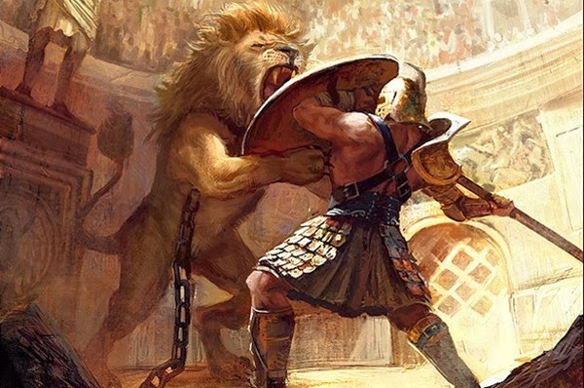

Slide 37
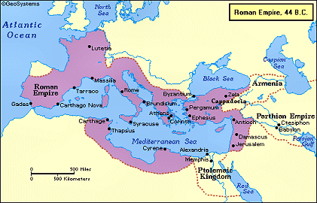
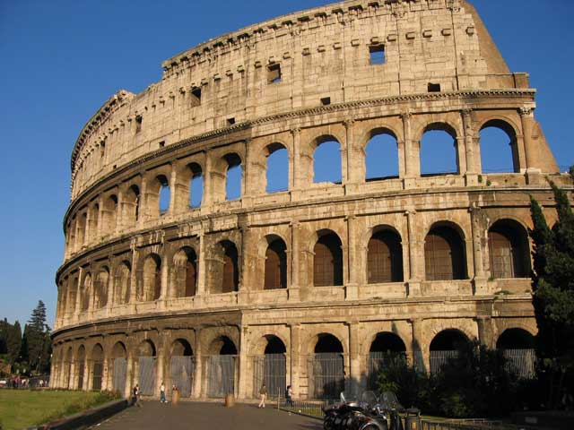
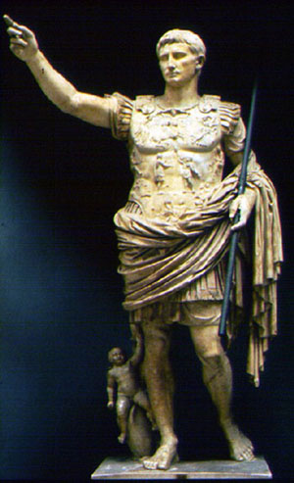
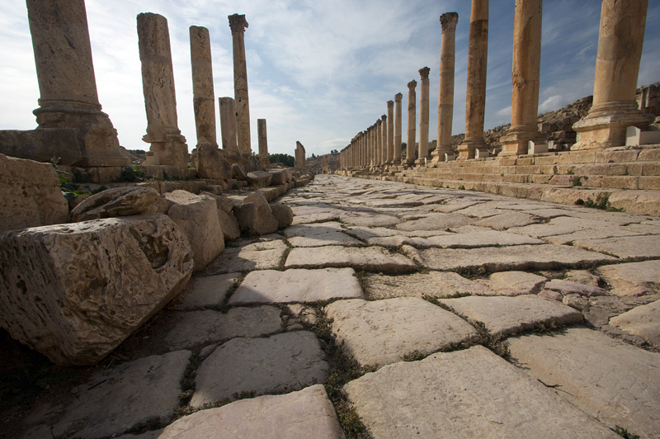
Roman Empire
Buildings
Roads
Law
Peace
Trade
Currency
Religious
toleration
Notes:
How Rome come to occupy Israel

Slide 38
Harsh, oppressive, exploitative
Occupied Israel
Violated the Temple
Controlled High Priest
Land tax, income tax, poll tax, water tax, city tax, taxes on food, road tax, house tax, boundary tax, market tax, customs duties etc.
  Resisted - 4 towns sold into slavery
“The bulk of the money collected was sent to Rome and paid into the Emperor Augustus’s personal account”

Slide 39
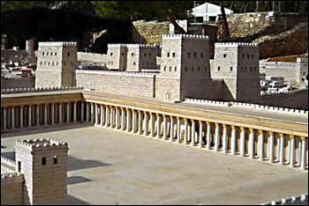
Roman fortress next to Temple
Notes:
https://www.quora.com/Who-were-the-major-messianic-figures-besides-Jesus-in-Graeco-Roman-Palestine-and-environs
The concept of a coming mashiach ("anointed one") or Messiah arose in the period after Jewish territories in ancient Palestine had been overun and conquered by a series of foreign powers, particularly after their conquest by Alexander the Great and their domination by his Selucid successors. After the brief period of independence resulting from the Maccabean revolt, the Jews came under the domination of the Romans, either directly or via their client rulers of the Herodian dynasty.
This was the political background to the rise of the idea of a Messiah - an "anointed one" who Yahweh would send to liberate Israel. That was pretty much the only common element that Messianic expectation in the first century AD had. Otherwise, ideas about this Messiah took a wide variety of forms.
Some expectations were for a kingly Messiah - a descendant of King David who would unite Israel and lead the Jews to overthrow their oppressors. Others were for a prophet Messiah - either Elijah returned from heaven or an Elijah figure who would unite Israel and usher in a new kingdom of Israel. Others still expected a priestly Messiah - a perfect high priest sent by Yahweh to purify and liberate the land. Other expectations were for a combination of these figures (as Jesus was seen to be) or for two or even three of these Messiahs in succession (as is indicated in some of the Dead Sea Scrolls). There was also an expection that the coming of the Messiah would usher in an apocalyptic intervention by Yahweh on earth, which would involve the wiping out of Israel's enemies, the judgement of the living and dead and the renewal of the earth in the "kingdom of God". This was the core message of Jesus' teaching and it seems to have been his key belief.
There is a modern Christian idea that the only exception was for a purely political, warlike kingly Messiah and that the idea of a Messiah was widespread. Both these ideas are incorrect. As noted above, there was a wide variety of expectations about who and what the Messiah was going to be. But modern research also indicates that Messianic expection was not as widespread as has often been assumed - it was more common in some social strata (especially in the lower classes) and arose periodically, usually in periods of social or political stress or upheaval. While it's often claimed there were many Messianic claimants in the first century, we actually only have evidence of a handful.
Judas, son of Hezakiah - Around 4 BC Judas, in the confusion after the death of Herod the Great, this Judas who Josephus calls "head of the robbers" assaulted the royal palace in the new city of Sepphoris in Galilee, not far from what was to be Jesus' home village of Nazareth. He seized the weapons in the armoury there, stole all the money he could find and terroised the surrounding countryside. Josephus also says he had "an ambitious desire of the royal dignity", though whether he actually declared himself the kingly Messiah or whether others did so is not known. It's not clear what happened to him, but the Roman governor of Syria, Publius Quinctilius Varus, later marched south to put down a number of uprisings in this year so it's likely he and his band were destroyed by the Romans in this campaign.
Simon of Peraea - At the same time, following the death of Herod, one of his servants called Simon of Peraea was acclaimed as king largely because, according to Josephus, he was " a comely person, of a tall and robust body". He was crowned with the royal diadem and proceeded to burn and plunder a number of royal palaces. Herod's former commander Gratus gathered a body of men and, reinforced by some Roman troops, fought a pitched battle against Simon's followers. Simon himself fled the battle but was caught and beheaded. Again, whether Simon or anyone else declared him the Messiah is unknown.
Judas the Galilean - Once the insurrections were put down, Herod's territory was divided between his sons, who ruled on the Romans' behalf as client kings. The tetrarch Herod Archelaus proved a particularly ineffective ruler and in AD 6 he was deposed and Judea was placed under direct Roman rule. A Galiean named Judas and a Pharisee called Zadok stirred up the people in reaction to this and began a revolt which was savagely repressed by Varus (see above), who Josephus says crucified 2000 people by the time his campaign was over. Again, whether Judas claimed to be or was seen to be the Messiah is unclear, though a later speech depicted in Acts 5:36-37 has a Pharisee compare him to Jesus, so this is possible.
Jesus of Nazareth - Jesus' message of the coming and imminent apocalypse and the "kingdom of God" on earth that would follow was preached in the context of this atmosphere of repression and rebellion. Unlike Judas or Simon, he does not seem to have preached a military uprising, but his message was that Yahwe was about to intervene in history and destroy the enemies of Israel. Not surprisingly, when he took this message to Jerusalem and preached it under the Roman prefect's nose after instigating a riot in the Temple, he was arrested and crucified - the Roman punishment for sedition against the Empire. Whether Jesus regarded himself as the Messiah or whether that was something his followers declared of him, either before or (more likely) after his execution is not clear. But he was regarded as both a kingly Messiah and as a priestly Messiah as well.
John the Baptist - Like Jesus, who seems to have begun as a follower of John's, the Baptist preached the coming apocalypse and "immersed" (which is what "baptised" means) people in the Jordan to symbolise their purification in preparation for the coming kingdom of God that would follow. Like Jesus, his preaching attrated the attention of the ruling class and he was imprisoned and executed by Herod Antipas. Again, as with Jesus, stories circulated that he had risen from the dead (some though Jesus was actually the risen John) and his sect survived his death, even expanding into Greece by the mid-first century. The modern sect of the Mandeans trace their origin to the followers of John and regard him as the Messiah and Jesus as the "false prophet".
The Samaritan Prophet - Not long after Jesus' execution, around AD 36, a Samaritan prophet began declaring that he knew of certain "sacred vessels" which Moses had deposited on Moutn Gerzim, which was the holy mountain on which Samaritan Jews worshipped instead of the Temple in Jerusalem. The Samaritan gathered "in a great multitude" and also armed themselves (Josephus doesn't tell us why) which alarmed the Roman prefect Pontius Pilate. He sent cohorts of both infantry and cavalry to block their approach to the mountain and the followers of the prophet were defeated in the battle that followed. Josephus says the "principal leaders" of this group were executed but doesn't say if they included the prophet himself. Again, we don't know if he or anyone else declared himself the Messiah.
Theudas - Around AD 45 another prophet called Theudas declared that he could part the river Jordan and led "a great part of the people" to the river to demonstrate his power. The Roman procurator Cuspius Fadus led a detachment of cavalry to intercept him, "slew many of them", captured Theudas and beheaded him. Like Judas the Galilean, Theudas is compare to Jesus in Acts 5:36-37, so it's possible that he too was considered to be the Messiah.
The Egyptian - Sometime in the 50s AD an unnamed Egyptian Jew led a multitude of followers out of Jerusalem and into the desert where he promised them God would "show them the signs of liberty". Josephus later says he led them to within sight of the walls of Jerusalem and claimed " he would show them from hence how the walls of Jerusalem would fall down at his command." The Roman procurator Marcus Antonius Felix led "a great number" of infanty and cavalry against this prophet's followers and killed several hundred of them, though Josephus doesn't say what happened to the Egyptian.
Anonymous Prophet - In AD 59 another prophet arose who "promised (the people) deliverance and freedom from the miseries they were under". He and his followers were killed by troops sent out by the procurator Porcius Festus.
Menahem - At the beginning of the Jewish Revolt of 66-70 AD, the son or grandson of Judas the Galilean, called Menahem, seized weapons from the royal palace at Masada and entered Jerusalem at the head of a body of rebels, dressed as a king. He became the leader of the rebellion, but soon made enemies amongst the other rebels and was eventually overthrown by the faction of Eleasar, the former captain of the Temple guards. Menahem fled Jerusalem but was captured, tortured and executed.
Jonathan the Weaver - Around AD 73 a weaver called Jonathan led a large number of followers into the desert to "show them signs and apparitions". Despite the fact they were unarmed, the governor Catullus attacked them. Jonathan fled but was later captured and, presumably, executed.
Simon ben Kosiba - This is the only example apart from Jesus that we know was claimed to be the Messiah. The influential elderly rabbi Akiva declared ben Kosiba to be God's anointed and changed his name to ben Kokhba ('son of the star") and led a rfour year ebellion against Rome whcih was finally brutally crushed by Hadrian in AD 136. Interestingly, the Christian writer Justin says Simon persecuted Christians, ordering them to be executed unless they denied Jesus was the Messiah - clearly he didn't like the idea of rival claimants, even dead ones.
While only Jesus and Simon ben Kosiba can be said to have been definitely regarded as the Messiah, there are indications that the others were seen that way. Given that we have few sources about Jewish history in this period - Josephus is pretty much the only source for any of the above apart from for Jesus and Simon ben Kosiba - there may well have been others as well. Interestingly, it seems all of the above prophets, kingly pretenders and Messiahs either died in battle or were executed.

Slide 40
How did the Jews respond?
Messianic uprisings
King Herod the Great died 4BCE
  Simon of Peraea
Census 6 AD
  Judas of Galilee
  2000 crucified
Theudas 44 AD
  ‘messiah’ led a revolt – crushed
Notes:
Simon of Peraea - At the same time, following the death of Herod, one of his servants called Simon of Peraea was acclaimed as king largely because, according to Josephus, he was " a comely person, of a tall and robust body". He was crowned with the royal diadem and proceeded to burn and plunder a number of royal palaces. Herod's former commander Gratus gathered a body of men and, reinforced by some Roman troops, fought a pitched battle against Simon's followers. Simon himself fled the battle but was caught and beheaded. Again, whether Simon or anyone else declared him the Messiah is unknown.
Judas the Galilean - Once the insurrections were put down, Herod's territory was divided between his sons, who ruled on the Romans' behalf as client kings. The tetrarch Herod Archelaus proved a particularly ineffective ruler and in AD 6 he was deposed and Judea was placed under direct Roman rule. A Galiean named Judas and a Pharisee called Zadok stirred up the people in reaction to this and began a revolt which was savagely repressed by Varus (see above), who Josephus says crucified 2000 people by the time his campaign was over. Again, whether Judas claimed to be or was seen to be the Messiah is unclear, though a later speech depicted in Acts 5:36-37 has a Pharisee compare him to Jesus, so this is possible.
Thus about 44, Josephus reports, a certain impostor, Theudas, who claimed to be a prophet, appeared and urged the people to follow him with their belongings to the Jordan, which he would divide for them. According to Acts v. 36 (which seems to refer to a different date), he secured about 400 followers. Cuspius Fadus sent a troop of horsemen after him and his band, slew many of them, and took captive others, together with their leader, beheading the latter ("Ant." xx. 5, § 1).
Another, an Egyptian, is said to have gathered together 30,000 adherents, whom he summoned to the Mount of Olives, opposite Jerusalem, promising that at his command the walls of Jerusalem would fall down, and that he and his followers would enter and possess themselves of the city. But Felix, the procurator (c. 55-60), met the throng with his soldiery. The prophet escaped, but those with him were killed or taken, and the multitude dispersed (ib. xx. 8, § 6; "B. J." ii. 13, § 5; see also Acts xxi. 38). Another, whom Josephus styles an impostor, promised the people "deliverance and freedom from their miseries" if they would follow him to the wilderness. Both leader and followers were killed by the troops of Festus, the procurator (60-62; "Ant." xx. 8, § 10). Even when Jerusalem was already in process of destruction by the Romans, a prophet, according to Josephus suborned by the defenders to keep the people from deserting announced that God commanded them to come to the Temple, there to receive miraculous signs of their deliverance. Those who came met death in the flames ("B. J." vi. 5, § 3).

Slide 41
How are the Romans presented in the gospels?
Roman centurion, ‘Truly I tell you, in no one in Israel have I found such faith.’
Centurion at the foot of the cross who testified to Jesus
Pilate – didn’t want to execute Jesus
Backdrop in the gospels – taxation, debt, injustice – caused by Roman occupation but not attributed to it
Notes:
Roman occupation is airbrushed out of the gospel account of 1st century Palestine although that was the dominant feature. It was very harsh and yet the Romans when they do appear are always presented favourably

Slide 42
This is how it was
Jews hated the Romans
  They revolted more than any other people
  Strong religious, national & political identity
  Long history and high culture
Romans looked down on Jews
  ‘Different’ – religion, practices
How to solve this and prevent a catastrophe?

Slide 43
People waiting for the ‘messiah’
Messiah or Christ
  Anointed one
  Kings of Israel
  Line of kings finished with the Babylonian conquest
Sent by God

Slide 44
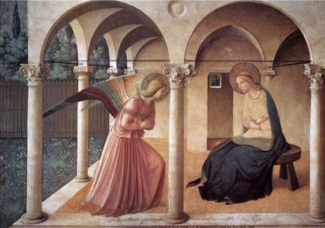
Jesus’ mission
“He will be great, and will be called the Son of the Most High; and the Lord God will give him the throne of his father David, and he will reign over the house of Jacob forever; and of his kingdom there will be no end.” Luke 1:32-33
Gabriel visits Mary
Notes:
Shortly after Elizabeth conceived John, her cousin Mary also received a visit from an angel who told her that she too would bear a son called Jesus:
At that time Mary got ready and hurried
to a town in the hill country of Judea,
where she entered Zechariah's home
and greeted Elizabeth. Luke 1:39
This is similar to the vision of Isaiah. No hint here of the cross being the purpose
36. But when she was delivered of it, she said: 'O my Lord! Behold! I am delivered of a female child!' - and Allah knew best what she brought forth - 'and nowise is the male like the female. I have named her Mariam, and I commit her and her offspring to Thy protection from the Evil One, the rejected.'
37. So her Lord accepted her with a gracious acceptance: He made her grow in purity and beauty: to the care of Zakariya was she assigned. Every time Zakariya entered her chamber to see her, he found her supplied with sustenance. He said: 'O Mariam! Whence (comes) this to you?' She replied: 'from Allah; surely Allah provides sustenance to whom He pleases without measure'. "

Slide 45
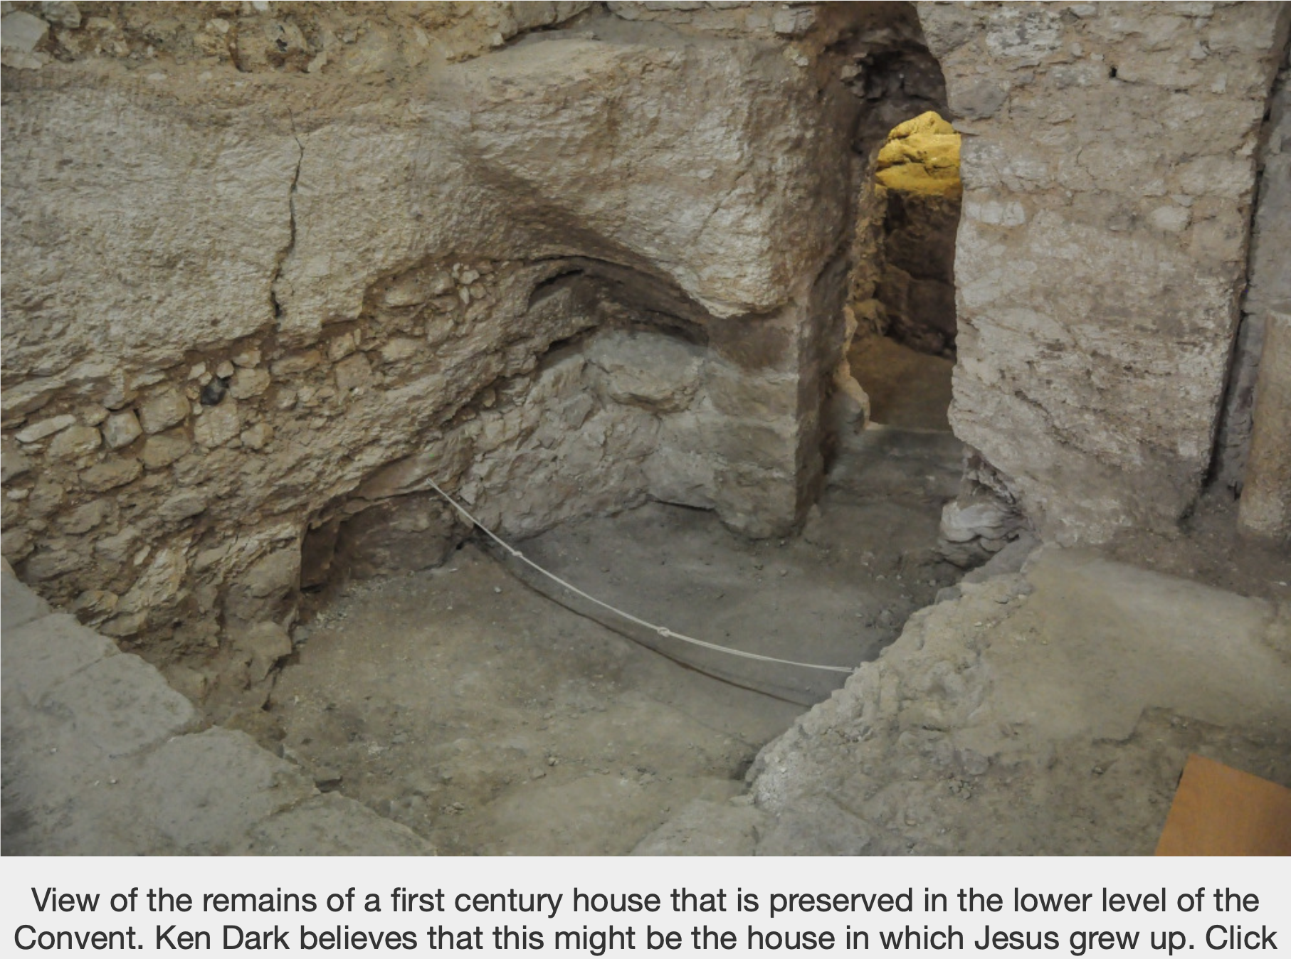
Jesus’s house?
1st century dwelling in Nazareth believed from 380s to have been Jesus home
Convent built over it and ancient cave church
Professor Ken Dark, Reading University
Notes:
There is a strong case that a well-preserved 1st-century house excavated at Nazareth was the childhood home of Jesus, a British archaeologist has claimed.
Ken Dark, professor of archaeology and history at Reading University, said that a 19th-century identification of ruins at the Sisters of Nazareth Convent as the house of Joseph had been dismissed out of hand by archaeologists in the 1930s and rejected by scholars ever since.
However, his findings, after 14 years of fieldwork and research on the site in northern Israel, confirm for the first time that the convent stands over a 1st-century dwelling that was believed from at least the 380s to have been where Jesus grew up with Mary and Joseph.
The house, of which significant portions, including a rock-cut staircase, survive, probably included a number of living and storage rooms around a courtyard, and a roof-terrace. It was partly cut into a limestone hillside and incorporates parts of a natural cave.
In his book, The Sisters of Nazareth convent: A Roman-period, Byzantine and Crusader site in central Nazareth, he says that study of the two-storey house revealed excellent craftsmanship and a structural understanding of rock that would be consistent with it having been built and owned by a tekton. This was the original Greek description of Joseph’s occupation in the gospels, which did not only have the meaning of a carpenter, as in traditional English translations, but could also mean a stonemason or builder. Fragments of pottery and limestone vessels of types associated with observant Jewish communities were also found. at the dwelling, which fell out of use decades after its construction.
His fieldwork and analysis also indicates that a cave church decorated with mosaics was constructed built in the hillside directly adjacent to the house’s remains in the 4th century. This was the century during which Christianity was adopted as the state religion of the Roman Empire under emperor Constantine.
His survey also reveals that a 5th century church built over both the house and the cave church was the largest church in Nazareth and probably its cathedral. He said the church, which was elaborately decorated with marble and mosaics, exactly matched a 7th century description of the large Byzantine church that was said to have stood on the site of Jesus’s home and was an important pilgrimage destination.
He said that the fact that the church was bigger than the nearby Church of the Annunciation — at the site where Byzantine-period Christians believed that the Archangel Gabriel visited Mary with news that she would give birth to “the Son of the Highest”— underscored its perceived significance.
Professor Dark emphasised that while there was no proof that the house was that of Jesus, there never could be for any archaeological site, given the lack of potential evidence such as inscriptions at the homes of 1st-century Galilean craftsmen. He added: “On the other hand, all the reasons to doubt that it might possibly have been, have gone — this is exciting stuff.”
SPONSORED
Should you take up running or cycling this winter?
Should you take up running or cycling this winter?
How to save for retirement in the pandemic age
How to save for retirement in the pandemic age
For his book, he also investigated the plausibility of memory of a building’s history being transmitted from the 1st century to the 4th century, when the first church was built at the site. He said: “My conclusion is that, from anthropological evidence and studies of oral tradition, there’s absolutely no reason why they couldn’t have known.”
The 5th century church at the Sisters of Nazareth site is one of only two in the region known to have stood over 1st century houses, the other being the Church of Saint Peter at Capernaum. A well-dated layer of burnt material across the site suggests that it was destroyed by Muslim forces fighting the crusaders when they captured Nazareth in 1187.
The first archaeological discoveries there were made in the 1880s and the nuns whose order owned the site made excavations between then and the 1930s. Professor Dark carried out his fieldwork starting in 2006.
Professor Dark published an article in Biblical Archaeology Review five years ago, based on interim findings, suggesting that the identification of the site as the house of Joseph, was possible. He said his subsequent analysis has confirmed its status as a 1st century dwelling, strengthening the case for the identification. He said no such case could be made for any other sites in the city.
The Gospels say very little about Jesus’ childhood at Nazareth, with Luke summing up his life up to the age of 12 by saying: “And the child grew and became strong; he was filled with wisdom, and the grace of God was on him.”
Professor Dark’s previous research has revealed a stark cultural divide in the valley between Nazareth and Sepphoris 4.3 miles to the north. His analysis of archaeological finds suggests that most residents of Nazareth and its hinterland in the 1st century were strictly observant Jews, while those around Sepphoris had a more cosmopolitan, Romanised culture.

Slide 46
Who was Mary?
Anne said: “O my Lord, I have vowed to you what is in my womb to be dedicated to your service; so do accept it of me.”
“I have named her Mary, and I commit her and her offspring to your protection from the Evil One.”
Lord accepted her with a gracious acceptance: He made her grow in purity and beauty: to the care of Zechariah was she assigned.
Qur’an Surah 3: Al-Imran
Notes:
Anne is Mary’s mother. She wanted a boy to offer to the Temple. But had a girl. She expected Mary to have children but wanted them to be pure and protected from Satan.
According to the Qur’an Mary was given to Zechariah the priest to be looked after. She grew up in a room and he was the only person who visited her bringing her food etc.
Mary looked after by Z & Elizabeth – they were effectively her parents.
Zechariah (Arabic: زكريّا; meaning: God has remembered) is also a prophet in Islam, and is mentioned in the Qur'an. Muslims also believe Zechariah to have been the guardian of Mary, mother of Jesus, and they believe Zechariah to have been the father of John the Baptist. Zechariah is also believed by some Muslims to have been a martyr. An old tradition narrates that Zechariah was sawed in half, in a death which resembles that attributed to Isaiah in Lives of the Prophets.
[hide]Bismillahir Rahmanir Rahim Part of a series on Islam
Islamic Prophets
Anbiya
Prophets in the Quran[hide]
Listed by Islamic name, Biblical name and Arabic. The six marked with a * are considered major prophets.
ʾĀdam* Adam (آدم) ʾIdrīs Enoch (إدريس) Nūḥ* Noah (نوح) Hūd Eber (ھود) Ṣāliḥ Salah (صالح) ʾIbrāhīm* Abraham (إبراهيم) Lūṭ Lot (لوط) ʾIsmāʿīl Ishmael (إسماعيل) ʾIsḥāq Isaac (إسحاق) Yaʿqūb Jacob (یعقوب) Yūsuf Joseph (یوسف) Ayūb Job (ایوب) Dhul-Kifl Ezekiel (ذو الکفل) Shuʿayb Jethro (شعیب) Mūsā* Moses (موسى) Hārūn Aaron (ھارون) Dāūd David (داود) Sulaymān Solomon (سلیمان) Yūnus Jonah (يونس) ʾIlyās Elijah (إلياس) Alyasaʿ Elisha (الیسع) Zakarīya Zechariah (زکریّا) Yaḥyā John (يحيى) ʿĪsā* Jesus (عيسى) Muḥammad* Muhammad (محمد)
Main events[show]
Attributed miracles[show]
Views[show]
Portal icon Islam portal
v t e
Zechariah was a righteous priest[10] and prophet of God whose office was in the temple of prayer in Jerusalem. He would frequently be in charge of managing the services of the temple[11] and he would always remain steadfast in prayer to God. As he reached his old age, Zechariah began to worry over who would continue the legacy of preaching the message of God after his death and who would carry on the daily services of the temple after him.[10] Zechariah started to pray to God for a son. The praying for the birth of an offspring was not merely out of the desire for a child. He prayed both for himself and for the public – they needed a messenger, a man of God who would work in the service of the Lord after Zechariah. Zechariah had character and virtue and he wanted to transfer this to his spiritual heir as his most precious possession. His dream was to restore the household to the posterity of the patriarch Jacob and to make sure the message of God was renewed for Israel. As the Qur'an recounts:
And (Zechariah) said: "O my Lord, my bones decay, my head is white and hoary, yet in calling You, O Lord, I have never been deprived.
But I fear my relatives after me; and my wife is barren. So grant me a successor of Your own
Who will be heir to me, and heir to the house of Jacob; and make him obedient to You, O Lord"
— Qur'an, sura 19 (Maryam), ayat 4–6[12]
As a gift from God, Zechariah was given a son by the name of John (Yaḥyā), a name specially chosen for this child alone. Muslim tradition narrates that Zechariah was ninety-two years old when he was told of John's birth. In accordance with Zechariah's prayer, God made John renew the message of God, which had been corrupted and lost by the Israelites. As the Qur'an says:
"O Zachariah," (it was said), "We give you good news of a son by the name of John. To none have we attributed that name before."
"How can I have a son, O Lord" he said, "when my wife is barren and I am old and decrepit?"
(The angel) answered: "Thus will it be. Your Lord said: 'This is easy for Me; for when I brought you into being you were nothing.'"
(Zachariah) said: "O Lord, give me a Sign." "Your sign" He answered, "shall be that you shall speak to no man for three days, although you are not dumb."
— Qur'an, sura 19 (Maryam), ayat 7–10[15]
According to the Qur'an, Zechariah was the guardian of Mary, the mother of Jesus. The Qur'an states:
Behold! A woman of 'Imran said: "O my Lord! I do dedicate unto You what is in my womb for Your special service, so accept this of me, for You hear all and know all things."
And when she had given birth to the child, she said: "O Lord, I have delivered but a girl." But God knew best what she had delivered: A boy could not be as that girl was. "I have named her Mary, (she said), and I give her into your keeping. Preserve her and her children from Satan, the rejected."
Her Lord accepted her graciously, and she grew up with excellence, and was given into the care of Zachariah. Whenever Zachariah came to see her in the chamber, he found her provided with food, and he asked: "Where has this come from, O Mary?" And she said: "From God, who gives food in abundance to whomsoever He will."
— Qur'an, sura 3 (Al-i-Imran), ayat 35–37[16]
Muslim theology maintains that Zechariah, along with John the Baptist and Jesus, ushered in a new era of prophets – all of whom came from the priestly descent of Amram, the father of the prophet Aaron. The fact that, of all the priests, it was Zechariah who was given the duty of keeping care of Mary shows his status as a pious man. Zechariah is frequently praised in the Qur'an as a prophet of God and righteous man. One such appraisal is in Sura Al-An'am:
And Zachariah and John, and Jesus and Elias: all in the ranks of the righteous.
— Qur'an, sura 6 (Al-An'am), ayah 85[17]
Qur'an translator Abdullah Yusuf Ali offers commentary on this one line[18] – suggesting that these particular prophets make a spiritual connection with one another. He points out that John the Baptist was a relative of Jesus, while Elijah was one who was present at the Transfiguration of Jesus[19] on the Mount, as mentioned in the New Testament. Zechariah, meanwhile, through marriage, was the uncle of Jesus and his son John the Baptist was referred to as Elijah in the New Testament.[20]

Slide 47
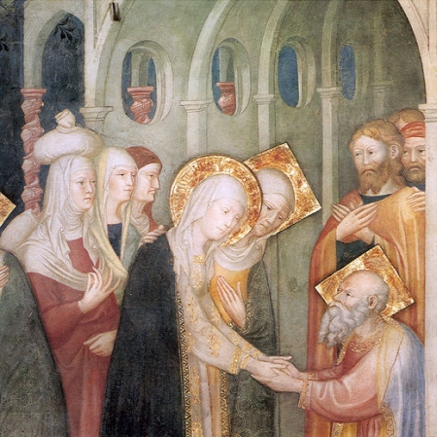
What did Mary do next?
At that time Mary got ready and hurried to a town in the hill country of Judea, where she entered Zechariah's home and greeted Elizabeth. Luke 1:39
Mary greets Zechariah
Notes:
Shortly after Elizabeth conceived John, her cousin Mary also received a visit from an angel who told her that she too would bear a son called Jesus:
At that time Mary got ready and hurried
to a town in the hill country of Judea,
where she entered Zechariah's home
and greeted Elizabeth. Luke 1:39
This is similar to the vision of Isaiah. No hint here of the cross being the purpose
36. But when she was delivered of it, she said: 'O my Lord! Behold! I am delivered of a female child!' - and Allah knew best what she brought forth - 'and nowise is the male like the female. I have named her Mariam, and I commit her and her offspring to Thy protection from the Evil One, the rejected.'
37. So her Lord accepted her with a gracious acceptance: He made her grow in purity and beauty: to the care of Zakariya was she assigned. Every time Zakariya entered her chamber to see her, he found her supplied with sustenance. He said: 'O Mariam! Whence (comes) this to you?' She replied: 'from Allah; surely Allah provides sustenance to whom He pleases without measure'. "

Slide 48
Zechariah’s family
‘The Holy Spirit will come upon you, and the power of the
Most High will overshadow you; therefore the child to be born
will be holy; he will be called Son of God. Luke 1:35
Elizabeth
Joseph
Zechariah
Mary
Sarah
Leah
Abraham
Jacob
Hagar
Rachel
Archangel
John Baptist
Jesus
Mary stayed with Elizabeth for about three months
and then returned home. Luke 1:56
Notes:
Elizabeth in position to restore position of Sarah and Leah – feelings towards younger woman. 2 women competing for the love of the same man. Jealous. Zechariah had to try to keep both happy – restore Abraham and Jacob. Mary to restore mistake of Hagar.
Joseph could have dumped Mary but didn’t. good man. Some say shouldn’t have gone on to have sexual relations with Mary. Did have other children. How to experience sibling love if no bros, sis. James, brother of Jesus, became head of church in Jerusalem after death of Jesus. Other relatives killed 70.113 AD
In Judaism, though premarital sex is strongly disapproved of, there is no requirement for a female to be a virgin at her marriage, and a child born to an unmarried female is not regarded as illegitimate (mamzer) or subject to any social or religious disabilities. Jewish law contains rules related to protecting female virgins and dealing with consensual and non-consensual pre-marital sex.
Now Zacharias was the priest on duty in the temple when Mary had a mystical experience in which she agreed to be a ‘slave girl of the Lord.’ Though an elderly man, Zacharias was not impotent, for he had just made his wife Elizabeth pregnant in spite of the fact that she was past the normal time of childbearing. When the angel Gabriel announced to Mary that she would give birth to the Messiah, she replied, ‘How can this thing be, seeing that I know not a man?’ The angel then told her that the Holy Spirit would come upon her and the power of the Most High would overshadow her (Lk. 1:35). As soon as the young girl heard that she had been chosen to give birth to the Son of God, she ‘went with haste and entered the house of Zacharias’ (Lk. 1:39). By giving herself [sexually] to the aged priest, Mary would prove that she was truly a hand-maiden of the Lord. Such an act of total surrender, far from being considered immoral in the ancient world, revealed the highest degree of spiritual dedication. By uniting with the priest, Mary ‘found favor with God’ (Lk 1:30). Dr. Weatherhead concludes: If one rejects the virgin-birth hypothesis, a [sexual] union of the priest Zacharias and the utterly devout young girl Mary in something like the traditional holy marriage rites provides a solution which meets such evidence as we possess in the scriptures." (Unification Theology, p.197)
Mary's situation paralleled Eve's in the Garden of Eden before her blessing. Mary and Joseph were engaged but not yet married; Adam and Eve were also in an engagement period as they were growing up. An angel brought Eve to the fallen act, but an angel brought Mary to the fulfillment of the heavenly dispensation. Mary was also in a position to deceive her husband and her father. Do you think Mary could discuss with her father or Joseph about how she had conceived her baby? She was risking her life because in those times, an adulterous woman was to be stoned to death.
Mary was the third woman to be chosen by God in this way. Through the previous victories of Rebecca and Tamar all satanic conditions had been cleared from Jesus' lineage, and even though Mary conceived Jesus outside marriage, Satan could not accuse her. Even inside his mother's womb Jesus was already the only begotten son of God, and after his birth everything he did was with the authority of the son of God. 18.4.1977

Slide 49
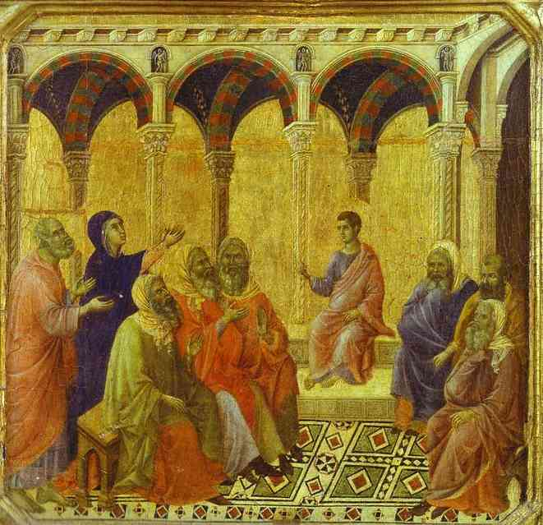
Did Jesus’ parents support him?
After three days they found him in the temple, sitting among the teachers, listening to their questions; and all who heard him were amazed at his understanding and his answers.
Luke 2:46-47
Notes:
⁴¹ Every year Jesus’ parents went to Jerusalem for the Festival of the Passover. ⁴² When he was twelve years old, they went up to the festival, according to the custom. ⁴³ After the festival was over, while his parents were returning home, the boy Jesus stayed behind in Jerusalem, but they were unaware of it. ⁴⁴ Thinking he was in their company, they traveled on for a day. Then they began looking for him among their relatives and friends. ⁴⁵ When they did not find him, they went back to Jerusalem to look for him.
As the messiah Jesus wanted to prepare for his mission by studying with religious scholars and leaders to learn and also to get to know them.

Slide 50
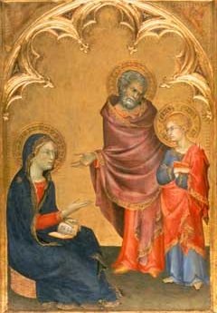
And he said to them, “How is it that you sought me? Did you not know that I must be in my Father’s house?” And they did not understand the saying which he spoke to them. Luke 2:50
Jesus
  Touched by suffering of the Jewish people
  How to solve the situation of his people?
  How to bring peace and justice?
Notes:
You can see in this painting by Simone Martini the tension between Jesus and his parents. Jesus is clearly angry with them for not realising where he would be and also for taking him away. They should have supported him to stay there.
Other verses that show that Jesus’ family didn’t support him:
“And Jesus said [to his mother], ‘Woman, what have you to do with me?’” John 2:4.
“His mother and his brothers stood outside, asking to speak to him. But he replied to the man that told him, ‘Who is my mother, and who are my brothers? . . . For whoever does the will of my Father in heaven is my brother, and sister, and mother.’” Matthew 12:46-50.
“For even his brothers did not believe in him.” John 7:5.
“And when his friends heard it they went out to seize him, for they said, ‘He is beside himself.’” Mark 3:2

Slide 51
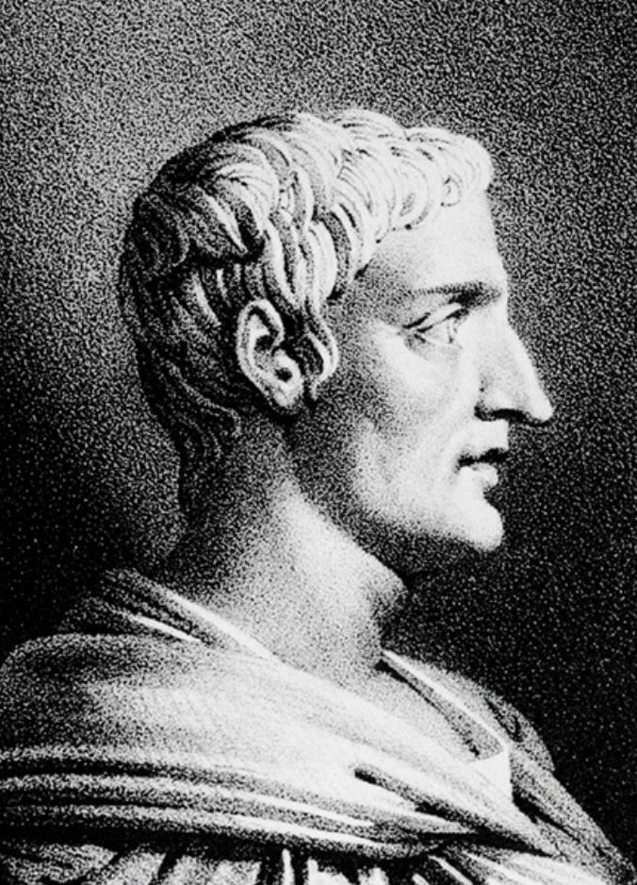
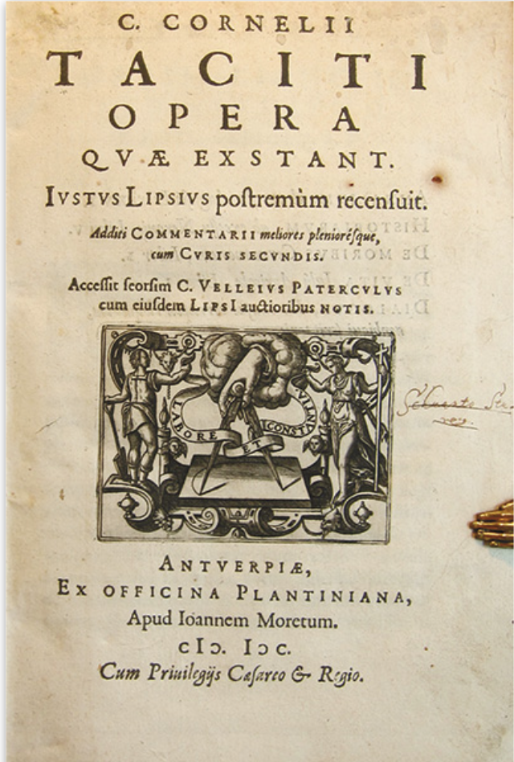
Did Jesus really exist?
Tacitus (55/56–118)
One of the best Roman historians
Experience of dealing with Christians
Notes:
Tacitus, like classical authors in general, does not reveal the source(s) he used. But this should not detract from our confidence in Tacitus’s assertions. Scholars generally disagree about what his sources were. Tacitus was certainly among Rome’s best historians—arguably the best of all—at the top of his game as a historian and never given to careless writing.
Earlier in his career, when Tacitus was Proconsul of Asia,⁷ he likely supervised trials, questioned people accused of being Christians and judged and punished those whom he found guilty, as his friend Pliny the Younger had done when he too was a provincial governor. Thus Tacitus stood a very good chance of becoming aware of information that he characteristically would have wanted to verify before accepting it as true.⁸

Slide 52
Excerpt from the Annals
Neither human effort nor the emperor’s generosity nor the placating of the gods ended the scandalous belief that the fire had been ordered [by Nero]. Therefore, to put down the rumour, Nero substituted as culprits and punished in the most unusual ways those hated for their shameful acts … whom the crowd called “Chrestians.” The founder of this name, Christ [Christus in Latin], had been executed in the reign of Tiberius by the procurator Pontius Pilate … Suppressed for a time, the deadly superstition erupted again not only in Judea, the origin of this evil, but also in the city [Rome], where all things horrible and shameful from everywhere come together and become popular.
Notes:
Tacitus’s last major work, titled Annals, written c. 116–117 C.E., includes a biography of Nero. In 64 C.E., during a fire in Rome, Nero was suspected of secretly ordering the burning of a part of town where he wanted to carry out a building project, so he tried to shift the blame to Christians. This was the occasion for Tacitus to mention Christians, whom he despised. This is what he wrote—the following excerpt is translated from Latin by Robert Van Voorst:
Tacitus’s terse statement about “Christus” clearly corroborates the New Testament on certain historical details of Jesus’ death. Tacitus presents four pieces of accurate knowledge about Jesus: (1) Christus, used by Tacitus to refer to Jesus, was one distinctive way by which some referred to him, even though Tacitus mistakenly took it for a personal name rather than an epithet or title; (2) this Christus was associated with the beginning of the movement of Christians, whose name originated from his; (3) he was executed by the Roman governor of Judea; and (4) the time of his death was during Pontius Pilate’s governorship of Judea, during the reign of Tiberius. (Many New Testament scholars date Jesus’ death to c. 29 C.E.; Pilate governed Judea in 26–36 C.E., while Tiberius was emperor 14–37 C.E.6)

Slide 53
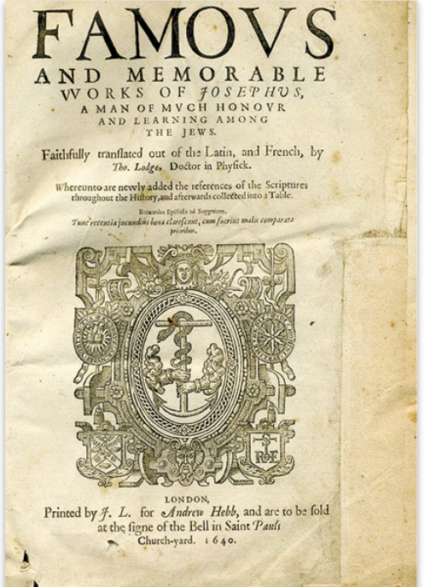
More non-Christian evidence
Josephus (37-100)
Jewish priest
Army commander
Wrote history of the Jews
  Jewish War
  Jewish Antiquities
Notes:
Titus Flavius Josephus was a first-century Romano-Jewish historian who was born in Jerusalem—then part of Roman Judea—to a father of priestly descent and a mother who claimed royal ancestry.
He initially fought against the Romans during the First Jewish–Roman War as head of Jewish forces in Galilee, until surrendering in 67 CE to Roman forces led by Vespasian after the six-week siege of Jotapata. Josephus claimed the Jewish Messianic prophecies that initiated the First Roman-Jewish War made reference to Vespasian becoming Emperor of Rome. In response Vespasian decided to keep Josephus as a slave and presumably interpreter. After Vespasian became Emperor in 69 CE, he granted Josephus his freedom, at which time Josephus assumed the emperor's family name of Flavius.[7]
Flavius Josephus fully defected to the Roman side and was granted Roman citizenship. He became an advisor and friend of Vespasian's son Titus, serving as his translator when Titus led the Siege of Jerusalem in 70 CE. Since the siege proved ineffective at stopping the Jewish revolt, the city's destruction and the looting and destruction of Herod's Temple (Second Temple) soon followed.
Josephus recorded Jewish history, with special emphasis on the first century CE and the First Jewish–Roman War (66–70 CE),[8] including the Siege of Masada. His most important works were The Jewish War (c. 75) and Antiquities of the Jews (c. 94).[9] The Jewish War recounts the Jewish revolt against Roman occupation. Antiquities of the Jews recounts the history of the world from a Jewish perspective for an ostensibly Greek and Roman audience. These works provide valuable insight into first century Judaism and the background of Early Christianity,[9] although not specifically mentioned by Josephus. Josephus' works are the chief source next to the Bible for the history and antiquity of ancient Palestine.[10]
The other strong evidence that speaks directly about Jesus as a real person comes from Josephus, a Jewish priest who grew up as an aristocrat in first-century Palestine and ended up living in Rome, supported by the patronage of three successive emperors. In the early days of the first Jewish Revolt against Rome (66–70 C.E.), Josephus was a commander in Galilee but soon surrendered and became a prisoner of war. He then prophesied that his conqueror, the Roman commander Vespasian, would become emperor, and when this actually happened, Vespasian freed him. “From then on Josephus lived in Rome under the protection of the Flavians and there composed his historical and apologetic writings” (Gerd Theissen and Annette Merz).9 He even took the name Flavius, after the family name of his patron, the emperor Vespasian, and set it before his birth name, becoming, in true Roman style, Flavius Josephus. Most Jews viewed him as a despicable traitor. It was by command of Vespasian’s son Titus that a Roman army in 70 C.E. destroyed Jerusalem and burned the Temple, stealing its contents as spoils of war, which are partly portrayed in the imagery of their gloating triumph on the Arch of Titus in Rome. After Titus succeeded his father as emperor, Josephus accepted the son’s imperial patronage, as he did of Titus’s brother and successor, Domitian.

Slide 54
Excerpt from Jewish Antiquities
Being therefore this kind of person [i.e., a heartless Sadducee], Ananus, thinking that he had a favourable opportunity because Festus had died and Albinus was still on his way, called a meeting of judges and brought into it the brother of Jesus-who-is-called-Messiah … James by name, and some others. He made the accusation that they had transgressed the law, and he handed them over to be stoned.
Notes:
James is otherwise a barely noticed, minor figure in Josephus’s lengthy tome. The sole reason for referring to James at all was that his death resulted in Ananus losing his position as high priest. James (Jacob) was a common Jewish name at this time. Many men named James are mentioned in Josephus’s works, so Josephus needed to specify which one he meant. The common custom of simply giving the father’s name (James, son of Joseph) would not work here, because James’s father’s name was also very common. Therefore Josephus identified this James by reference to his famous brother Jesus. But James’s brother Jesus (Yehoshua) also had a very common name. Josephus mentions at least 12 other men named Jesus.¹⁴ Therefore Josephus specified which Jesus he was referring to by adding the phrase “who is called Messiah,” or, since he was writing in Greek, Christos.¹⁵ This phrase was necessary to identify clearly first Jesus and, via Jesus, James, the subject of the discussion. This extraneous reference to Jesus would have made no sense if Jesus had not been a real person.
Few scholars have ever doubted the authenticity of this short account. On the contrary, the huge majority accepts it as genuine.¹⁶ The phrase intended to specify which Jesus, translated “who is called Christ,” signifies either that he was mentioned earlier in the book or that readers knew him well enough to grasp the reference to him in identifying James. The latter is unlikely. First-century Romans generally had little or no idea who Christus was. It is much more likely that he was mentioned earlier in Jewish Antiquities. Also, the fact that the term “Messiah”/“Christ” is not defined here suggests that an earlier passage in Jewish Antiquities has already mentioned something of its significance.¹⁷ This phrase is also appropriate for a Jewish historian like Josephus because the reference to Jesus is a noncommittal, neutral statement about what some people called Jesus and not a confession of faith that actually asserts that he was Christ.
mention of Jesus to specify which James was being executed by the high priest Ananus in 62 C.E. affirms the existence of the historical Jesus. Photo: Josephus,Famovs and Memorable Works of Josephvs, trans. by Thomas Lodge (London: J. L. for Andrew Hebb, 1640).
Few scholars have ever doubted the authenticity of this short account. On the contrary, the huge majority accepts it as genuine.¹⁶ The phrase intended to specify which Jesus, translated “who is called Christ,” signifies either that he was mentioned earlier in the book or that readers knew him well enough to grasp the reference to him in identifying James. The latter is unlikely. First-century Romans generally had little or no idea who Christus was. It is much more likely that he was mentioned earlier in Jewish Antiquities. Also, the fact that the term “Messiah”/“Christ” is not defined here suggests that an earlier passage in Jewish Antiquities has already mentioned something of its significance.¹⁷ This phrase is also appropriate for a Jewish historian like Josephus because the reference to Jesus is a noncommittal, neutral statement about what some people called Jesus and not a confession of faith that actually asserts that he was Christ.
This phrase—“who is called Christ”—is very unlikely to have been added by a Christian for two reasons. First, in the New Testament and in the early Church Fathers of the first two centuries C.E., Christians consistently refer to James as “the brother of the Lord” or “of the Savior” and similar terms, not “the brother of Jesus,” presumably because the name Jesus was very common and did not necessarily refer to their Lord. Second, Josephus’s description in Jewish Antiquities of how and when James was executed disagrees with Christian tradition, likewise implying a non-Christian author.¹⁸
This short identification of James by the title that some people used in order to specify his brother gains credibility as an affirmation of Jesus’ existence because the passage is not about Jesus. Rather, his name appears in a functional phrase that is called for by the sense of the passage. It can only be useful for the identification of James if it is a reference to a real person, namely, “Jesus who is called Christ.”
This clear reference to Jesus is sometimes overlooked in debates about Josephus’s other, longer reference to Jesus (to be treated next). Quite a few people are aware of the questions and doubts regarding the longer mention of Jesus, but often this other clear, simple reference and its strength as evidence for Jesus’ existence does not receive due attention.

Slide 55
Excerpt from The Testimonium Flavianum (edited)
Around this time there lived Jesus, a wise man, if indeed one ought to call him a man. For he was one who did surprising deeds, and a teacher of such people as accept the truth gladly. He won over many Jews and many of the Greeks. He was the Messiah. When Pilate, upon hearing him accused by men of the highest standing among us, had condemned him to be crucified, those who in the first place came to love him did not give up their affection for him, for on the third day, he appeared to them restored to life. The prophets of God had prophesied this and countless other marvellous things about him. And the tribe of Christians, so called after him, have still to this day not died out.
Bold portions acknowledged to be Christian additions
Notes:
Original with Christians additions:
Around this time there lived Jesus, a wise man, if indeed one ought to call him a man.²¹ For he was one who did surprising deeds, and a teacher of such people as accept the truth gladly. He won over many Jews and many of the Greeks. He was the Messiah. When Pilate, upon hearing him accused by men of the highest standing among us, had condemned him to be crucified, those who in the first place came to love him did not give up their affection for him, for on the third day, he appeared to them restored to life. The prophets of God had prophesied this and countless other marvelous things about him. And the tribe of Christians, so called after him, have still to this day not died out.²²

Slide 56
Excerpt from The Testimonium Flavianum (original)
Around this time there lived Jesus, a wise man. For he was one who did surprising deeds, and a teacher of such people as accept the truth gladly. He won over many Jews and many of the Greeks. When Pilate, upon hearing him accused by men of the highest standing among us, had condemned him to be crucified, those who in the first place came to love him did not give up their affection for him. And the tribe of Christians, so called after him, have still to this day not died out.
No writers in the ancient world, Roman, Greek or Jewish doubted the existence of Jesus

Slide 57
Conclusion . . .
He existed as a man
His name was Jesus
He was called Christos in Greek
He had a brother called James (Jacob)
He won over both Jews and Greeks
He was executed by crucifixion
He was executed by Pontius Pilate
https://www.biblicalarchaeology.org/daily/people-cultures-in-the-bible/jesus-historical-jesus/did-jesus-exist/#note22
Notes:
He existed as a man. The historian Josephus grew up in a priestly family in first-century Palestine and wrote only decades after Jesus’ death. Jesus’ known associates, such as Jesus’ brother James, were his contemporaries. The historical and cultural context was second nature to Josephus. “If any Jewish writer were ever in a position to know about the non-existence of Jesus, it would have been Josephus. His implicit affirmation of the existence of Jesus has been, and still is, the most significant obstacle for those who argue that the extra-Biblical evidence is not probative on this point,” Robert Van Voorst observes.³² And Tacitus was careful enough not to report real executions of nonexistent people.
2. His personal name was Jesus, as Josephus informs us.
3. He was called Christos in Greek, which is a translation of the Hebrew word Messiah, both of which mean “anointed” or “(the) anointed one,” as Josephus states and Tacitus implies, unaware, by reporting, as Romans thought, that his name was Christus.
4. He had a brother named James (Jacob), as Josephus reports.
5. He won over both Jews and “Greeks” (i.e., Gentiles of Hellenistic culture), according to Josephus, although it is anachronistic to say that they were “many” at the end of his life. Large growth in the number of Jesus’ actual followers came only after his death.
6. Jewish leaders of the day expressed unfavorable opinions about him, at least according to some versions of the Testimonium Flavianum.
7. Pilate rendered the decision that he should be executed, as both Tacitus and Josephus state.
8. His execution was specifically by crucifixion, according to Josephus.
9. He was executed during Pontius Pilate’s governorship over Judea (26–36 C.E.), as Josephus implies and Tacitus states, adding that it was during Tiberius’s reign.

Slide 58
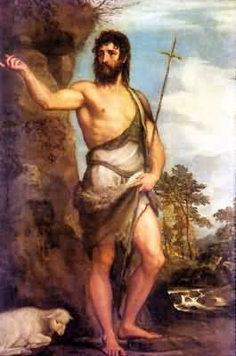
The forerunner
In those days came John the Baptist, preaching in the wilderness of Judea, “Repent for the kingdom of heaven is at hand.”
Matthew 3:1-2
Notes:
Titian 1542
If Zechariah had been the High Priest he would not have been burning incense on the Day of Atonement and Jerusalem would have been flooded with people. Like New Orleans at the peak of Mardi Gras absent the decadence. Instead we're told that only his immediate relatives were gathered outside.
Outside the Holy of Holies, in the Holy Place, there was a table of incense which was tended daily by a rotation of priests. It was the hope of every priest for his name to come up in this rotation so that he might honor God and family by performing this sacred task. The incense was never to go out and a priest entering the Holy Place to tend it was a daily event, perhaps occurring a few times each day. For any priest selected it was a great honor and naturally his relatives would be gathered outside in support.
So, if Zechariah had been burning incense, he would have been doing so in the Holy Place and not in the Holy of Holies. The revelation he received occurred while he was performing his duty as a priest and, therefore, was received in the Holy Place (not beyond the curtain in the Holy of Holies). The scriptures only reveal that he had been in the temple burning incense. I believe that Caiaphas had been the High Priest around the time of Jesus' birth. Later his son, also named Caiaphas, assumed the position and was in office during the crucifixion.....

Slide 59
Did John really exist?
Herod had killed this good man, who had commanded the Jews to exercise virtue, righteousness towards one another and piety towards God. For only thus, in John's opinion, would the baptism he administered be acceptable to God, namely, if they used it to obtain not pardon for some sins but rather the cleansing of their bodies, inasmuch as it was taken for granted that their souls had already been purified by justice. [18.117]
Josephus, Jewish Antiquities
Notes:
[18.116] Now some of the Jews thought that the destruction of Herod's army came from God as a just punishment of what Herod had done against John, who was called the Baptist.
[18.117] For Herod had killed this good man, who had commanded the Jews to exercise virtue, righteousness towards one another and piety towards God. For only thus, in John's opinion, would the baptism he administered be acceptable to God, namely, if they used it to obtain not pardon for some sins but rather the cleansing of their bodies, inasmuch as it was taken for granted that their souls had already been purified by justice.
[18.118] Now many people came in crowds to him, for they were greatly moved by his words. Herod, who feared that the great influence John had over the masses might put them into his power and enable him to raise a rebellion (for they seemed ready to do anything he should advise), thought it best to put him to death. In this way, he might prevent any mischief John might cause, and not bring himself into difficulties by sparing a man who might make him repent of it when it would be too late.
[18.119] Accordingly John was sent as a prisoner, out of Herod's suspicious temper, to Machaerus, the castle I already mentioned, and was put to death. Now the Jews thought that the destruction of his army was sent as a punishment upon Herod, and a mark of God's displeasure with him.

Slide 60
John was highly respected
As the people were in expectation, and all men questioned in their hearts concerning John, whether perhaps he were the Christ, John answered them all, “I baptise you with water; but he who is mightier than I is coming, the thong of whose sandals I am not worthy to untie; he will baptise you with the Holy Spirit and with fire.”
Luke 3:15-15
Notes:
John created some a powerful impression by his ascetic lifestyle and message that he wonder the respect of even the religious leaders who even thought he might be the Messiah himself.

Slide 61
John denies being the Elijah
And this is the testimony of John, when the Jews sent priests and Levites from Jerusalem to ask him, “Who are you?” He confessed, he did not deny, but confessed, “I am not the Christ.” And they asked him, “What then? Are you Elijah?” He said, “I am not.” John 1:19-21
Notes:
For some reason John denied the mission that had been revealed to his father. This was to have serious consequences for Jesus
Maybe didn’t want mission. Too hard. Difficult relations with father? Over expectations?

Slide 62
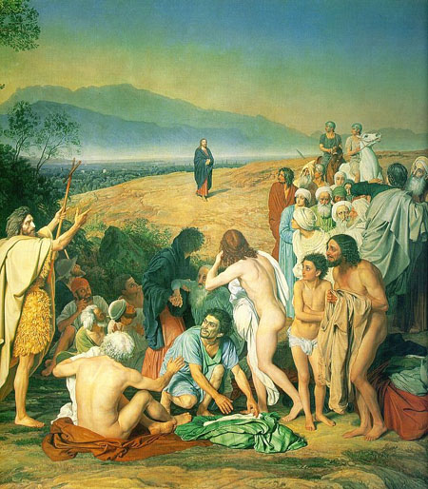
John testifies to Jesus
“Behold the lamb of God that takes away the sins of the world. John 1: 29
“And I have seen and borne witness that this is the Son of God.” John 1: 34
Notes:
John baptises Jesus and declared “behold the lamb of God that takes away the sins of the world” John 1:29
Picture by Ivanov

Slide 63
Why didn’t John follow Jesus?
Own concept of the messiah
  “He who comes after me the thong of whose sandal I am not worthy to untie.” John 1:27
Couldn’t recognise Jesus was the messiah
  “I myself did not know him.” John 1:33
Knew about Jesus’ family background
Didn’t imagine sharing Jesus’ future
  “He must increase but I must decrease.” John 3:30
Didn’t act on the inspiration and it faded
Notes:
Did 1ohn have difficult relationship with father? If father told him he was John was deny?

Slide 64
Jesus is tempted by Satan
First temptation
The tempter came to him and said, “If you are the Son of God, tell these stones to become bread.”
Jesus answered, “It is written: ‘Man does not live on bread alone, but on every word that comes from the mouth of God.’” Matthew 4:3-4
Notes:
1st temptation – overcame the temptation of the flesh – turning stone into bread – c.f. Adam and Eve who gave into physical desire – established mind – body unity. Dt 8:3 Man shall not live by bread alone
2nd temptation – overcame temptation to think he could violate the law (of gravity) (fall off the temple) with impunity – without suffering the consequences. Adam and Eve thought they could break God’s commandment, Fall, and not die. You shall not test the lord your God Dt. 6:16
“You shall not tempt the Lord your God.” Dt 6:16
3rd temptation – overcame the temptation to gain power at the compromising integrity. Means – ends. You shall worship the lord your God and him only will you serve. Dt 6:13
Temptation
Satan approached when Jesus alone, isolated
Son of god can do as he pleases. At baptism Jesus definded as pleasing God
Jesus responds with exact quote of the divine word

Slide 65
Restored first blessing
  Mind - Body unity
When the woman saw that the fruit of the tree was good for food and pleasing to the eye, and also desirable for gaining wisdom, she took some and ate it. Genesis 3:6

Slide 66
Jesus is tempted by Satan
Second temptation
Then the devil took him to the holy city and had him stand on the highest point of the temple. “If you are the Son of God,” he said, “throw yourself down. For it is written:
‘He will command his angels concerning you,
and they will lift you up in their hands,
so that you will not strike your foot against a stone.’”
Jesus answered him, “It is also written: ‘Do not put the Lord your God to the test.’” Matthew 4:5-7
Notes:
1st temptation – overcame the temptation of the flesh – turning stone into bread – c.f. Adam and Eve who gave into physical desire – established mind – body unity. Dt 8:3 Man shall not live by bread alone
2nd temptation – overcame temptation to think he could violate the law (of gravity) (fall off the temple) with impunity – without suffering the consequences. Adam and Eve thought they could break God’s commandment, Fall, and not die. You shall not test the lord your God Dt. 6:16
“You shall not tempt the Lord your God.” Dt 6:16
3rd temptation – overcame the temptation to gain power at the compromising integrity. Means – ends. You shall worship the lord your God and him only will you serve. Dt 6:13
Temptation
Satan approached when Jesus alone, isolated
Son of god can do as he pleases. At baptism Jesus definded as pleasing God
Jesus responds with exact quote of the divine word

Slide 67
Restored second blessing
  Keeping the moral law
  The woman said to the serpent, ‘We may eat of the fruit of the trees in the garden; but God said, “You shall not eat of the fruit of the tree that is in the middle of the garden, nor shall you touch it, or you shall die.”’ But the serpent said to the woman, ‘You will not die;
  Genesis 3:2-4

Slide 68
Jesus is tempted by Satan
Third Temptation
Again, the devil took him to a very high mountain and showed him all the kingdoms of the world and their splendour. “All this I will give you,” he said, “if you will bow down and worship me.”
Jesus said to him, “Away from me, Satan! For it is written: ‘Worship the Lord your God, and serve him only.’” Matthew 4:8-10
Restored Third Blessing
  Wealth and ownership

Slide 69
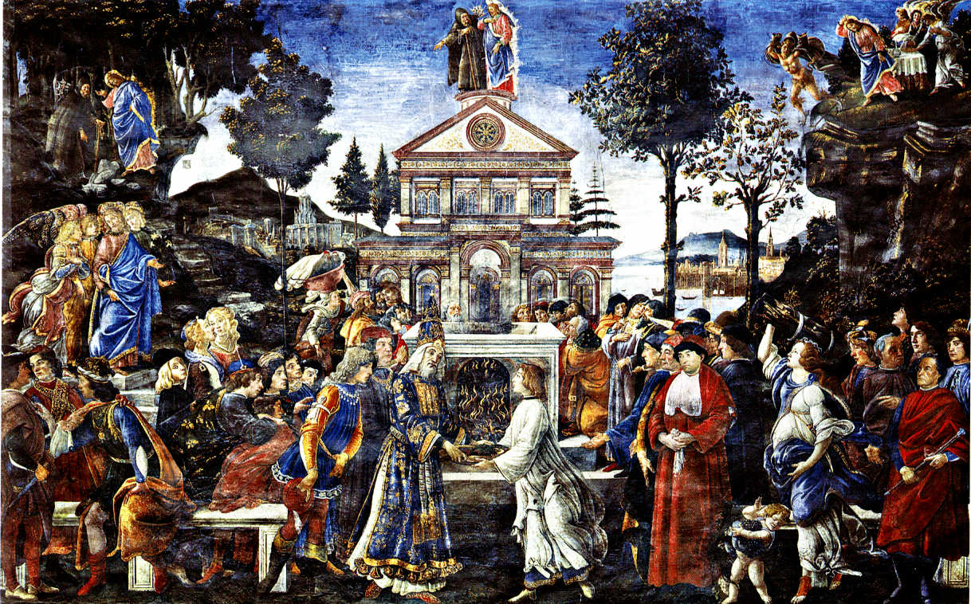
Jesus restored the three blessings
And when the devil had ended every temptation,
he departed from him until an opportune time. Luke 4:13
Notes:
1st temptation – overcame the temptation of the flesh – turning stone into bread – c.f. Adam and Eve who gave into physical desire – established mind – body unity. Dt 8:3 Man shall not live by bread alone
2nd temptation – overcame temptation to think he could violate the law (of gravity) (fall off the temple) with impunity – without suffering the consequences. Adam and Eve thought they could break God’s commandment, Fall, and not die. You shall not test the lord your God Dt. 6:16
“You shall not tempt the Lord your God.” Dt 6:16
3rd temptation – overcame the temptation to gain power at the compromising integrity. Means – ends. You shall worship the lord your God and him only will you serve. Dt 6:13
Temptation
Satan approached when Jesus alone, isolated
Son of god can do as he pleases. At baptism Jesus definded as pleasing God
Jesus responds with exact quote of the divine word

Slide 70
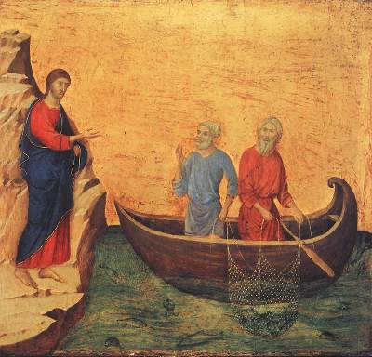
Jesus starts his ministry
Then Jesus, filled with the power of the Spirit, returned to Galilee, and a report about him spread through all the surrounding country. He began to teach in their synagogues and was praised by everyone. Luke 4:14
Jesus calling his disciples
Notes:
Preaching the kingdom was the good news. Theologians and Bible scholars agree that the imminent kingdom was the chief message of Jesus. So many kingdom verses

Slide 71
The good news
Repent for the Kingdom of heaven is at hand”
‘The kingdom of God is in the midst of you.
‘The kingdom of heaven may be compared to someone who sowed good seed in his field;
‘The kingdom of God like is like a grain of mustard seed
‘The kingdom of heaven is like yeast
‘It is easier for a camel to go through the eye of a needle than for a rich person to enter the kingdom of God.
Notes:
Kingdom of God is a political vision harkening back to Mosaic covenant and period of the Judges

Slide 72
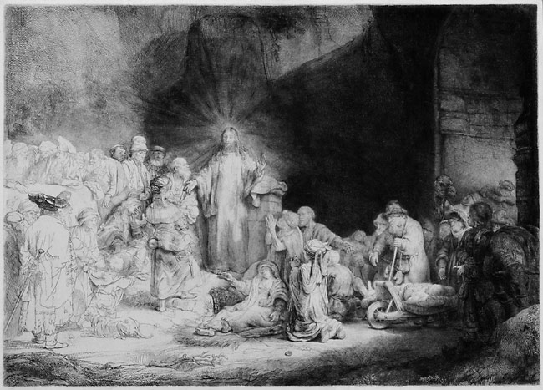
Galilean Spring
And he went about all Galilee teaching in their synagogues and preaching the gospel of the kingdom and healing every disease and every infirmity among the people.
Matthew 4:23
Notes:
Meanwhile, Jesus burst onto the scene and galvanised the people. Rembrandt’s 100 Guilder Print. Gospel of the kingdom

Slide 73
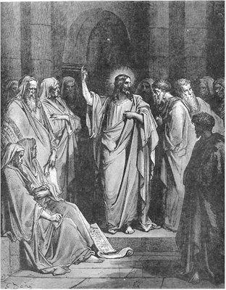
The people accept Jesus
And great crowds followed him from Galilee and the Decapolis and Jerusalem and Judea and from beyond the Jordan.
Matthew 4:25
Notes:
The ordinary people were attracted to Jesus
The Decapolis (Greek: Δεκάπολις Dekápolis, Ten Cities) was a group of ten cities on the eastern frontier of the Roman Empire in the southeastern Levant in the first centuries BC and AD. They formed a group because of their language, culture, location, and political status, with each functioning as an autonomous city-state dependent on Rome.

Slide 74
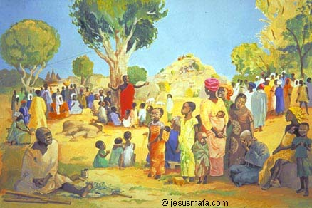
Sermon on the Mount
And when Jesus finished these sayings, the crowds were astonished at his teaching, for he taught them as one who had authority, and not as their scribes.
Matthew 7:28-29
‘The harvest is plentiful, but the
labourers are few.’ Mt. 9:37
Notes:
The constitution of the Kingdom of God. The popularity that Jesus had led to jealousy from some religious leaders

Slide 75
‘Blessed are the poor in spirit, for theirs is the kingdom of heaven.
‘Blessed are those who mourn, for they will be comforted.
‘Blessed are the meek, for they will inherit the earth.
‘Blessed are those who hunger and thirst for righteousness, for they will be filled.
‘Blessed are the merciful, for they will receive mercy.
‘Blessed are the pure in heart, for they will see God.
‘Blessed are the peacemakers, for they will be called children of God.
‘Blessed are those who are persecuted for righteousness’ sake, for theirs is the kingdom of heaven.
‘Blessed are you when people revile you and persecute you and utter all kinds of evil against you falsely on my account. Rejoice and be glad, for your reward is great in heaven, for in the same way they persecuted the prophets who were before you.

